Slide 1
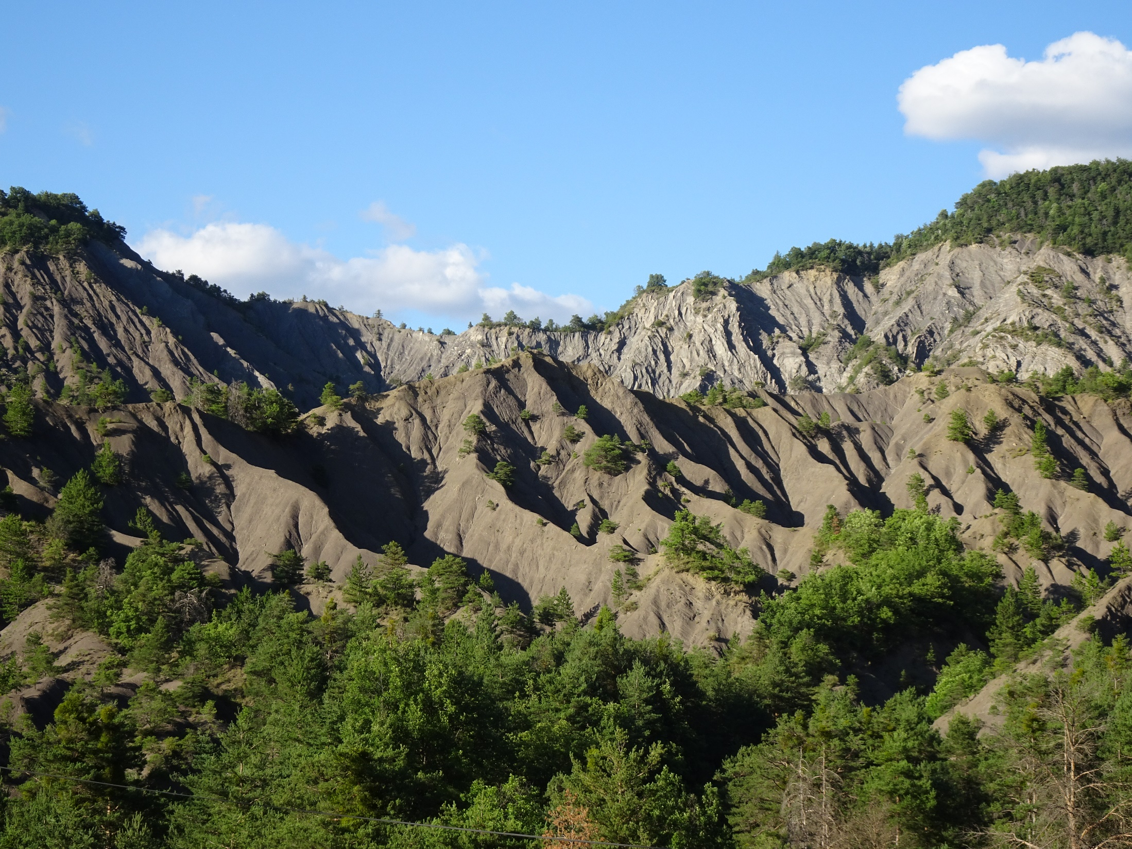

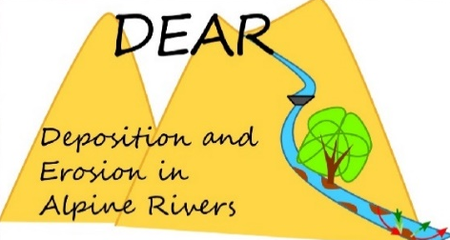
Monitoring physical weathering of marls in badlands and their effect on erosion, Draix-Bléone CZO
Coline Ariagno¹, Caroline Le Bouteiller¹, Peter van der Beek²
EGU 23/05/2022
1: INRAe - Grenoble, France
2: University of Potsdam, Germany
Notes:
And i will present you what is going on in these lovely marly badland

Slide 2
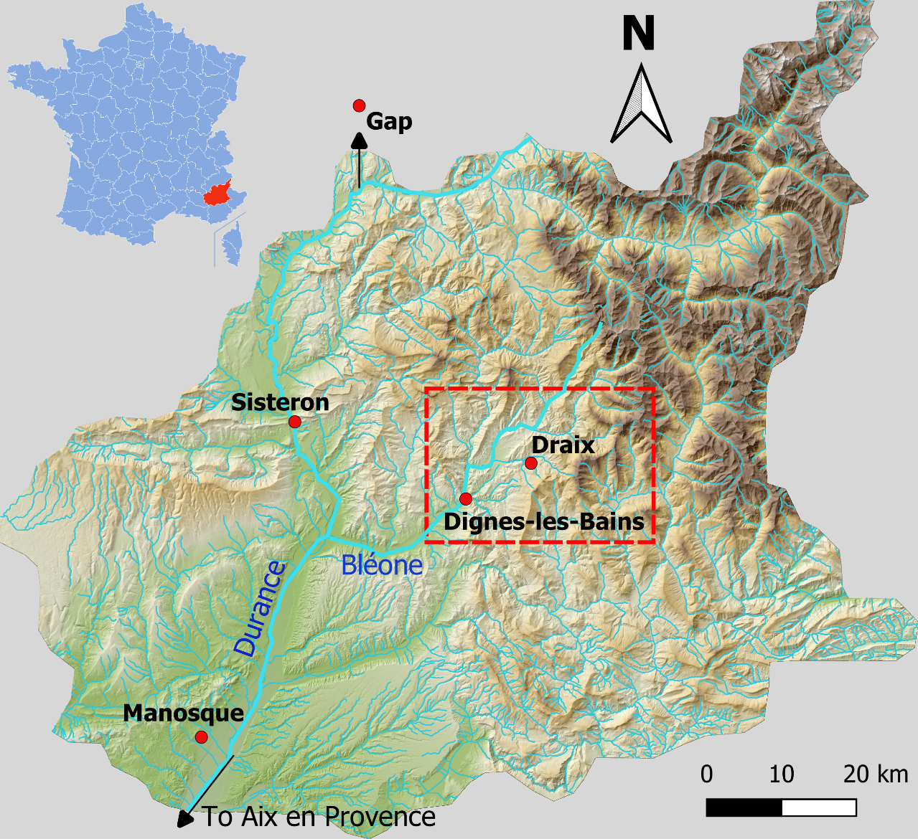
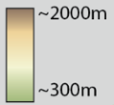
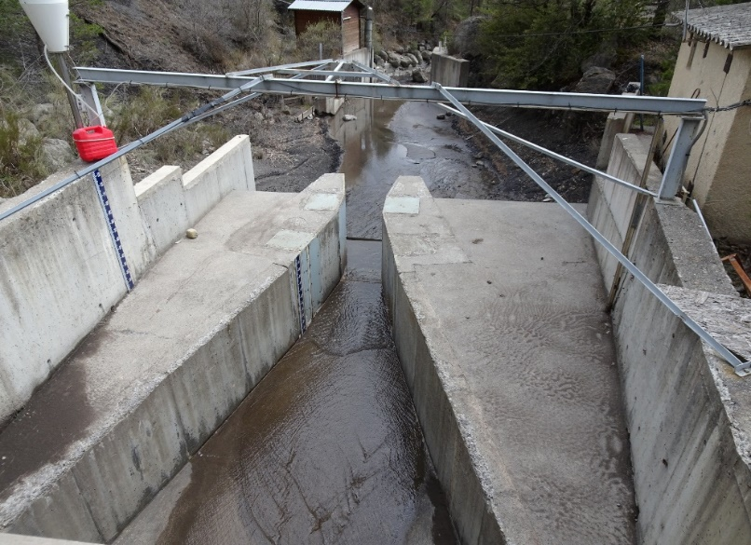
Introduction
Context
Draix-Bléone CZO, Laval catchment:
C
Draix catchments
Specific sediment yield : ~ 14000 t/km²/yr
Maximum discharge for the Laval catchment (0.86 km²): 20 m³/s
Maximum concentration: 800 g/L
Black marls: 1.5% of the Durance bassin (14200 km²) but 40% of suspended sediment load
Parshall flume, Apr 2021
D
Draix catchments, November 2019
Notes:
First my study area is situated in SF in the durance bassin where BM cover 1.5% ….
In this area the Draix-bléone CZ obs, which is a part of an observatory network, records extreme erosion data since 30yr
Black marls cover 1.5%of the duran..ce… but contribut up to 40% of
-> area that show extreme value of erosion
This observatory is chararcterize by marly badland as you can see on this picture -> with a morphology of Sharp ridge , and steep gully. And because of a porr vegetation cover and this weak lithology we can observed rapid change
Due to their limited vegetation cover and soft lithology, badlands
are sensitive areas
Vegetation cover < 40%
Zone dans le département des Alpes de haute provence, vallée de la Durance. Au cœur de la région des Terres Noirs -> observatoire de Draix-Béone, partie du réseau des observatoire d’OZCAR.
Ces bassins marneux, appellé aussi Badlands, sont une zone de forte érosion -> cf photo (comme en témoigne les reliefs très sculpés avec forte pente et , dénudés de végétation avec des réponses hydrologique très rapide. Observatoire cumul des données depuis 35ans.
Les marnes de Draix font partie d’une épaisse série marneuse du jurassique, à Draix plutôt homogène, oxfordien.
Projet basé sur l’évolution des bassins versant de Draix: marnes sont sujet à une forte érosion avec une réponse hydro très rapide.
Caractériser la variabilité saisonnière du régolithe via un suivi régulier sur le terrain pour comprendre les processus et la dynamique d’altération de ces versants.
Laval 86 ha,
Roubine 0,1 ha
Mouliin 8ha

Slide 3
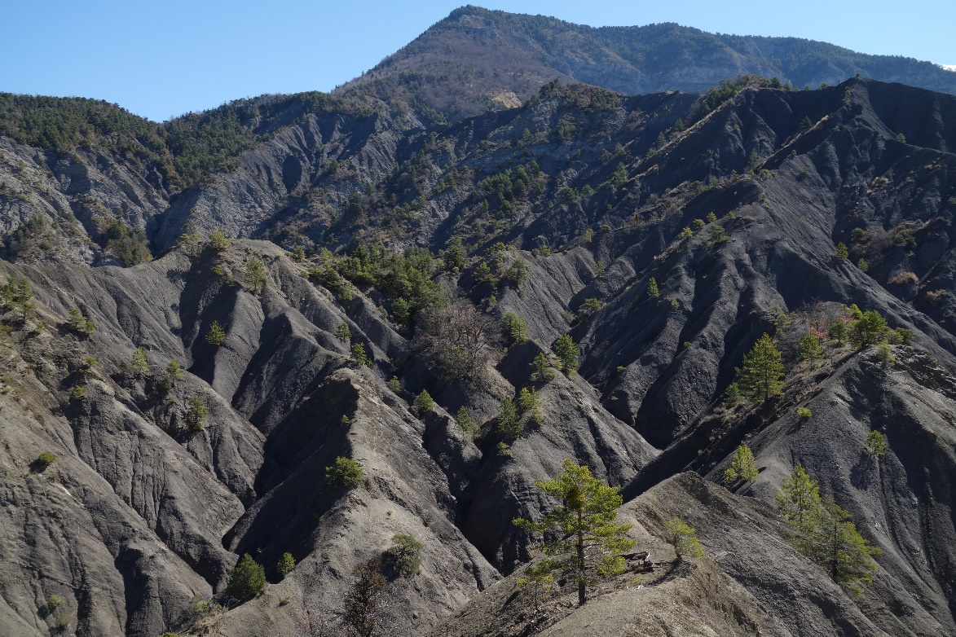
Introduction
Motivation of the study
What are the ingredients that lead to these extreme records?
Laval catchment, Apr 2022
Rapid change in morphology due to strong erosion and weathering processes…
…associated with strong inter-annual and intra-annual variability of sediments export
Notes:
Def badlands: Deeply dissacaded landscape, Soft-rock lithology, Poor vegetation cover, High drainage density

Slide 4
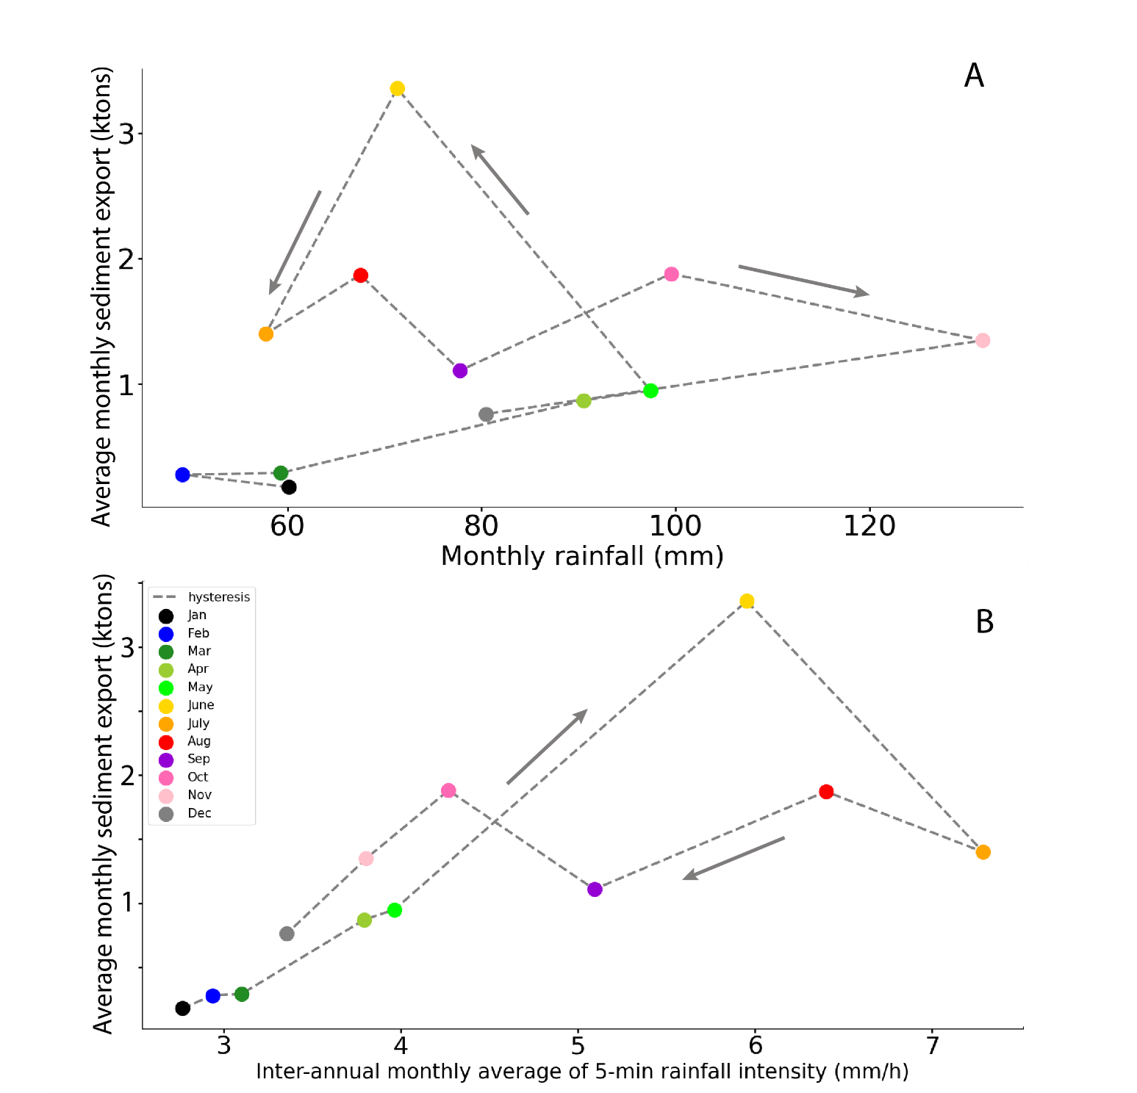
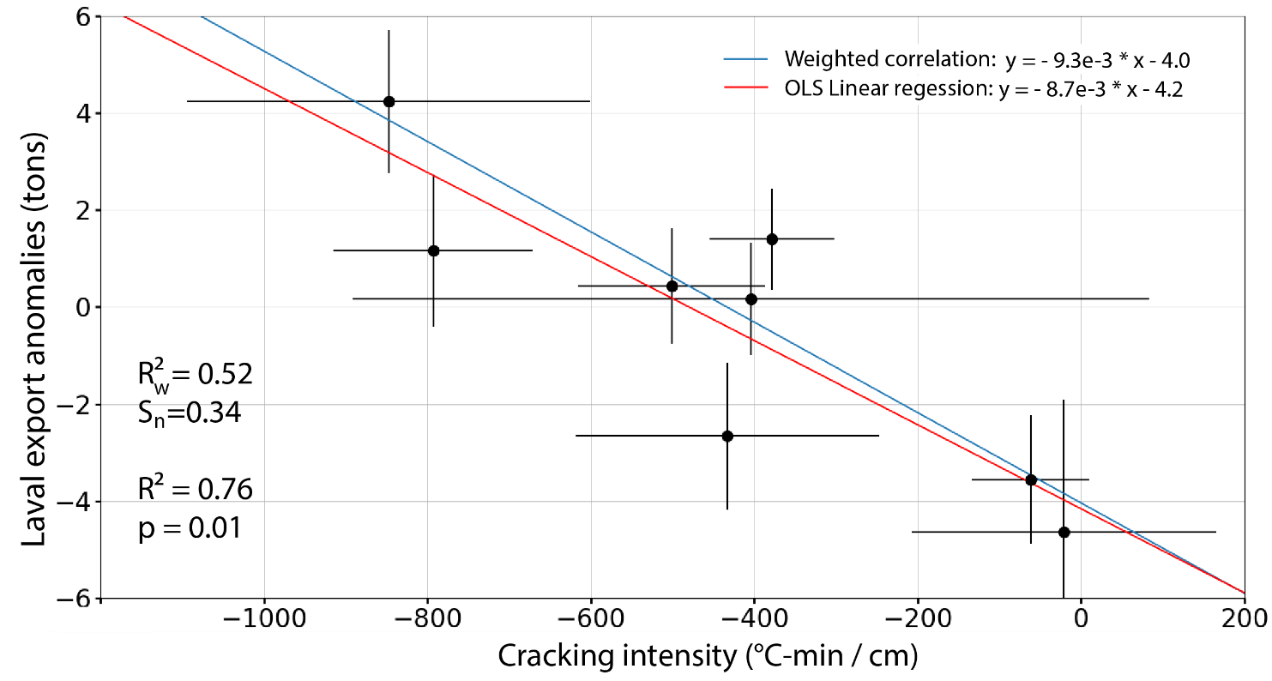
Introduction
Previous work, Draix-Bléone CZO
Ariagno et al., 2022
DOI: 10.5194/esurf-10-81-2022
Transition from transport-limited to supply-limited system
Which source processes drive this cyclicity?
Notes:
Focusing on intra-annual variability, we previously show that there is an hysteresis cycle of sed export during the year
a part of the annual sediment export can be explain by frost weathering intensity

Slide 5
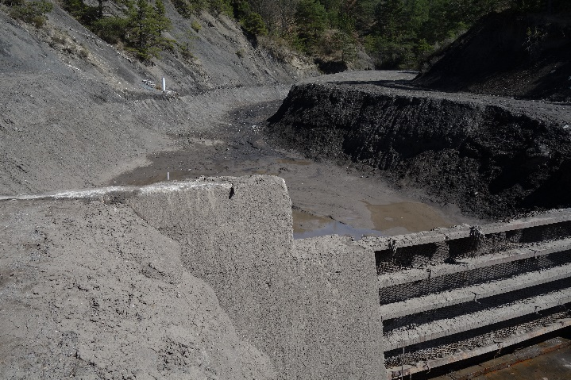
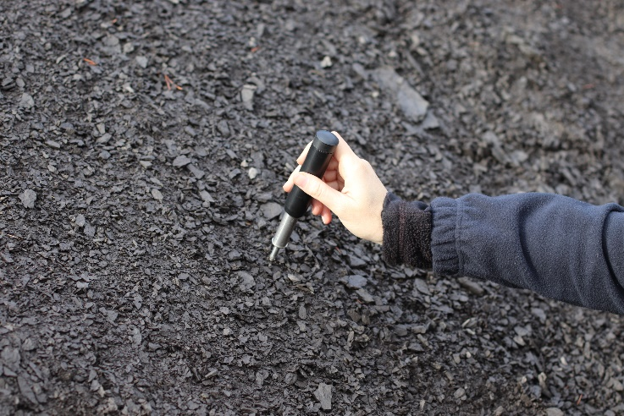

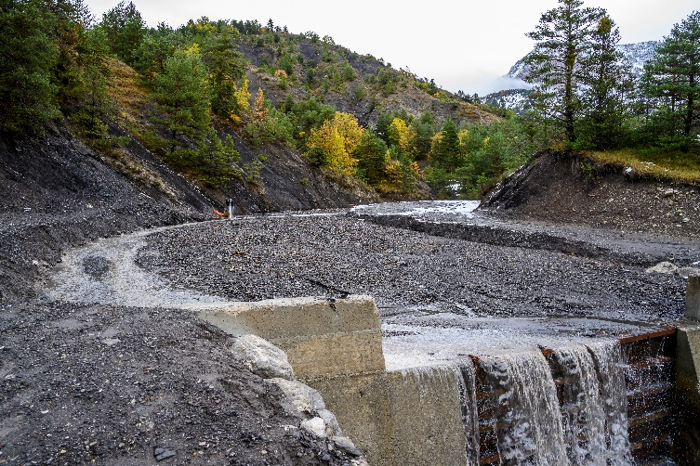
Introduction
Research questions
Can we identify a proxy for regolith weathering that is correlated with the intra-annual hysteresis cycle?
Empty deposit area
Field measurements
Full deposit area
Fig 1 : After fieldwork in marly catchments
Notes:
A l’orale: reformuler la question 2 : What is the relationship between morphology and distribution of the weathering processes
Dire à l’orale -> on se concentre que sur les question 1 et 2

Slide 6
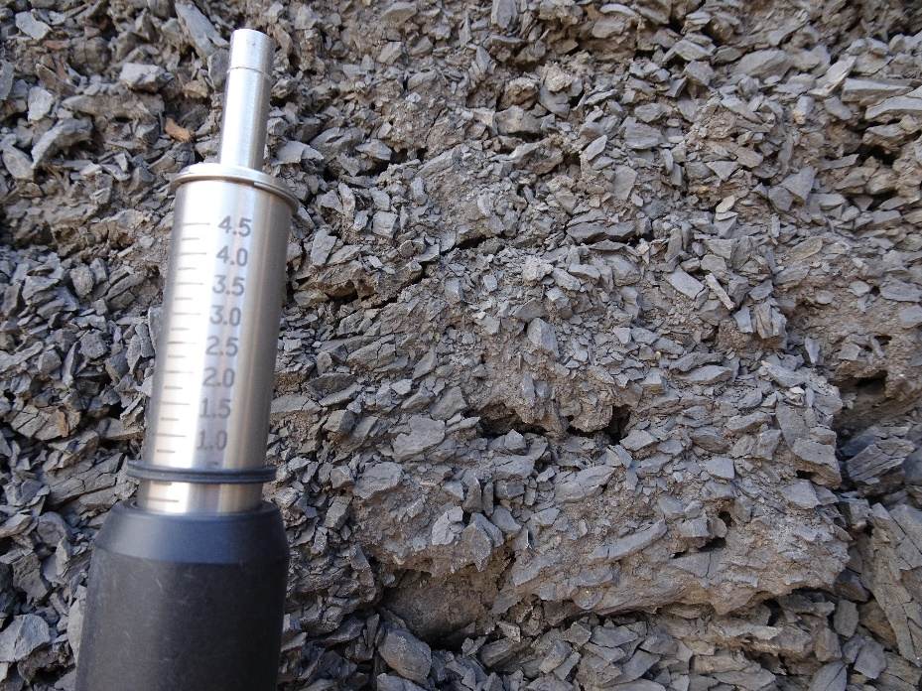
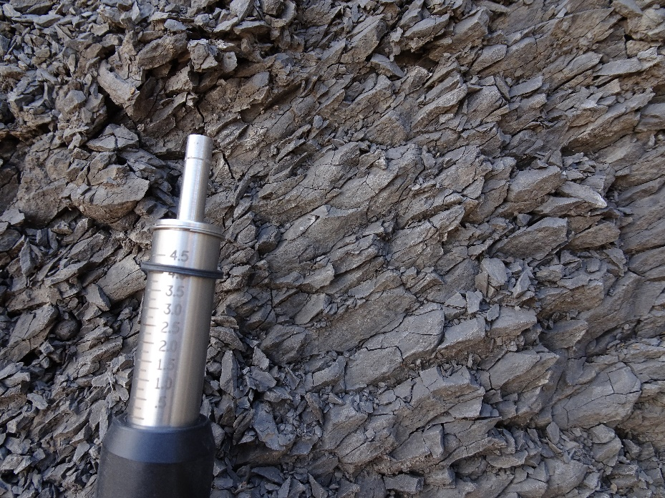
Field measurements
Resistance
August
5 cm
February
Low resistance
High resistance
10 field campaigns over 2.5 years
Notes:
To explore the regolith characteristics, we did 10 campaign over 2, 5yr to take field measurements.

Slide 7
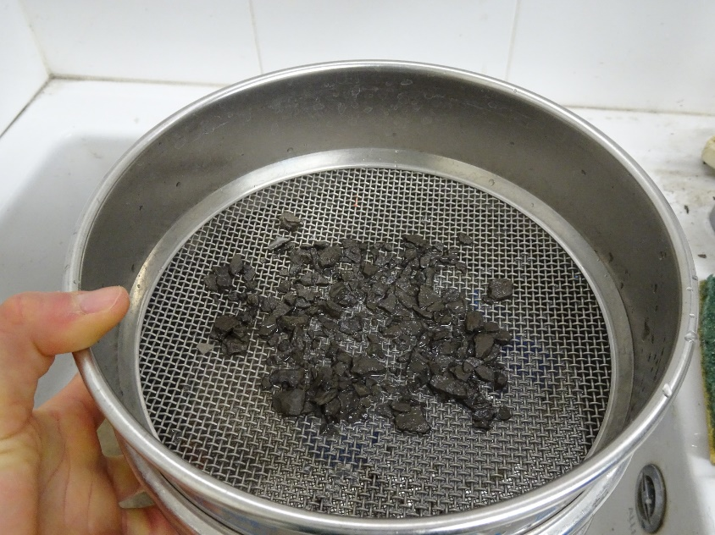
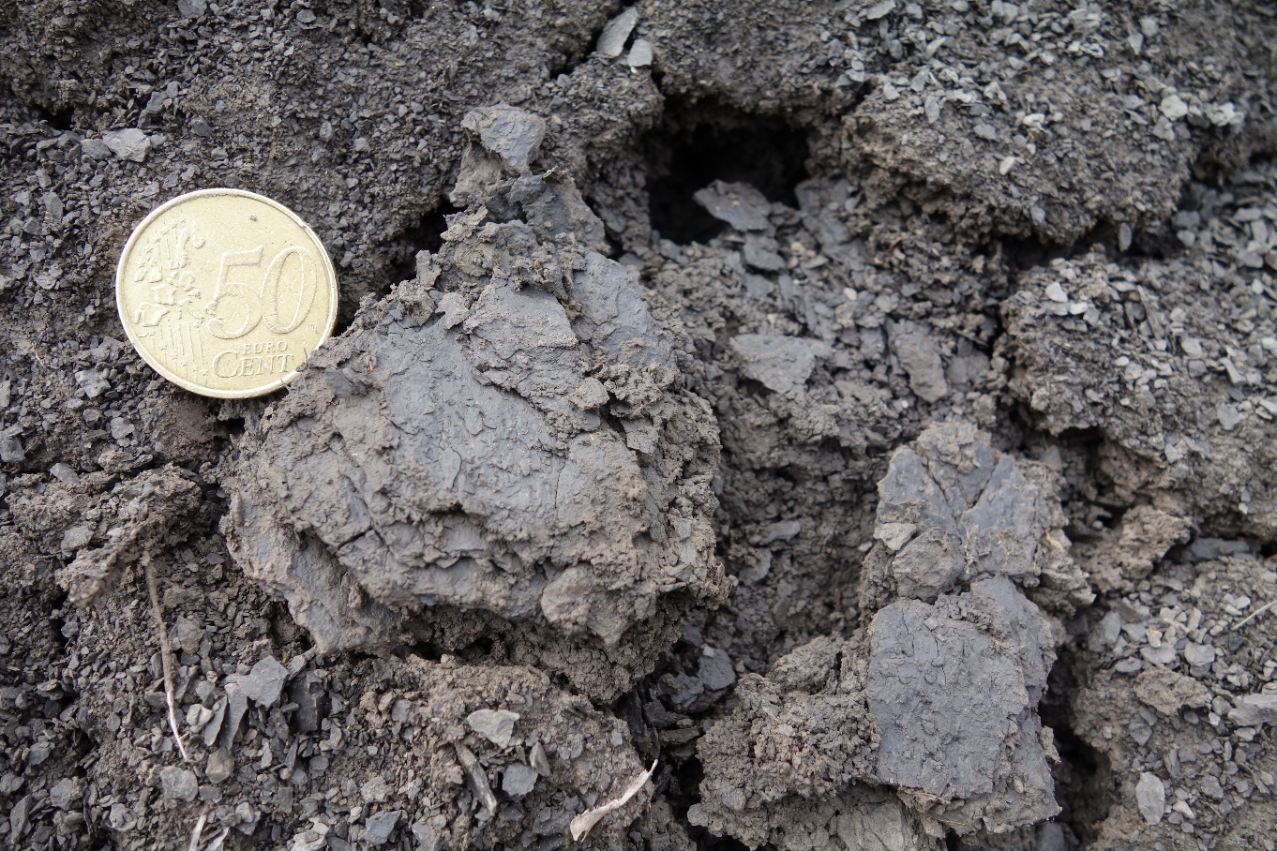
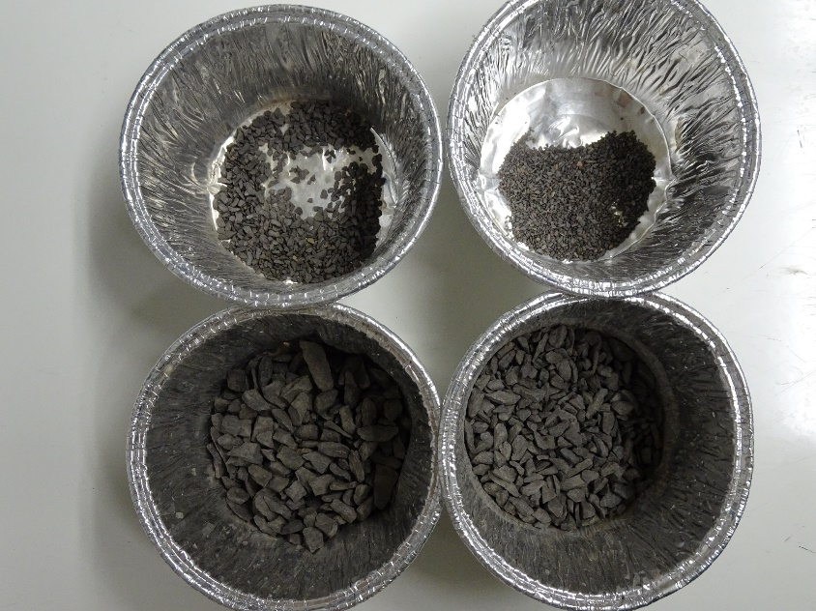
Field measurements
Grain size measurements
March 2022
Notes:
You can see on the picture that the regolith is really fragmented at the surface and more coarser underneath

Slide 8
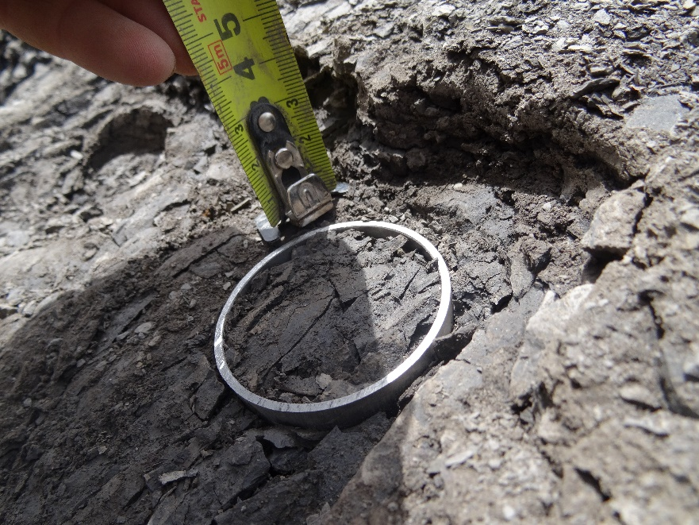
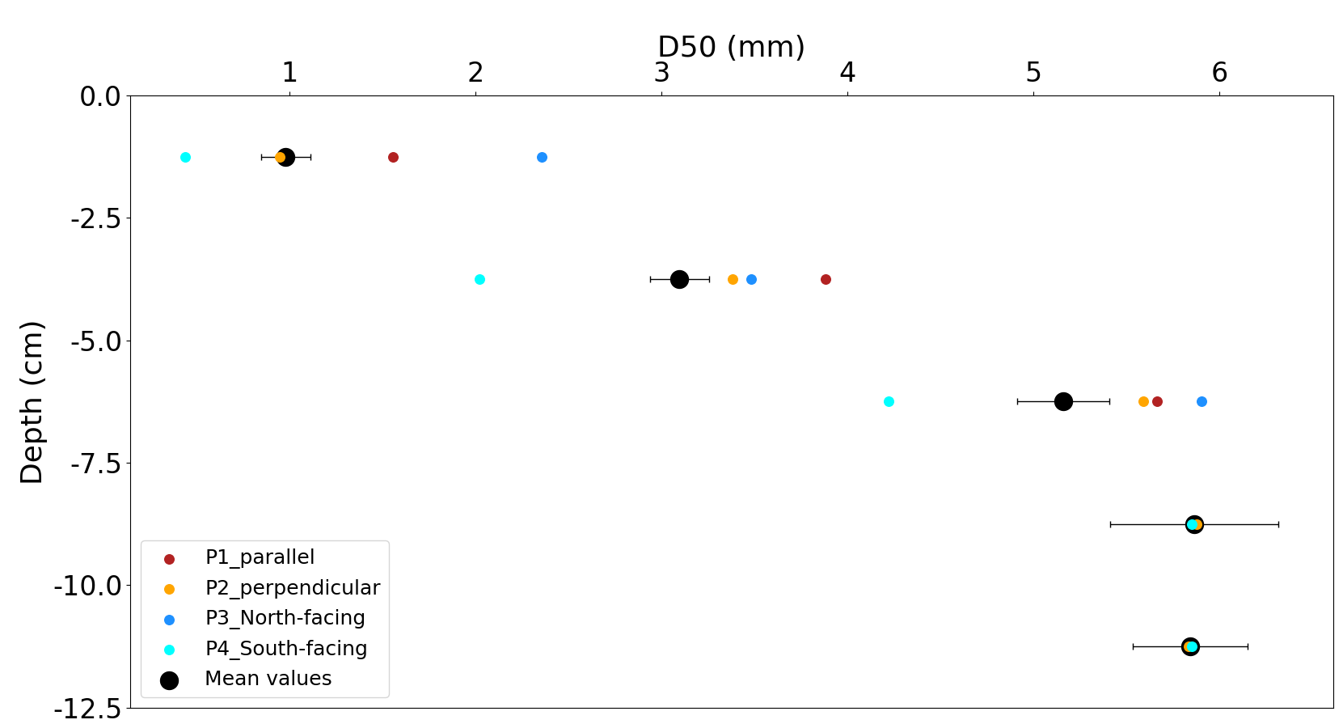
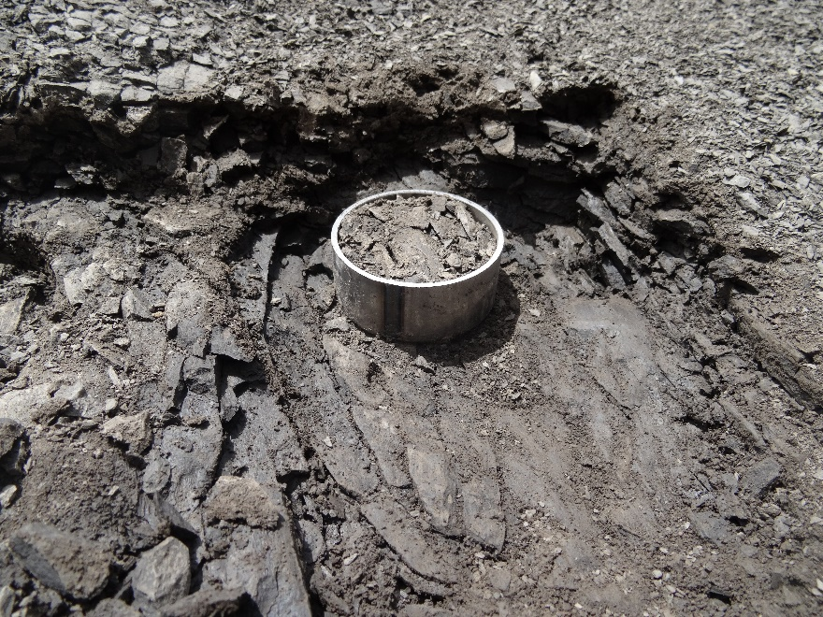
Field measurements
Vertical profile of grain-size measurements
Cylinder diameter: 5cm
Notes:
Jusqu’ou aller dans l’interprétation de la figure?
Decrease of D50 toward the surface, so the D50 illustrate a weathering state-> weathering front arounf 7cm and/or 12cm

Slide 9
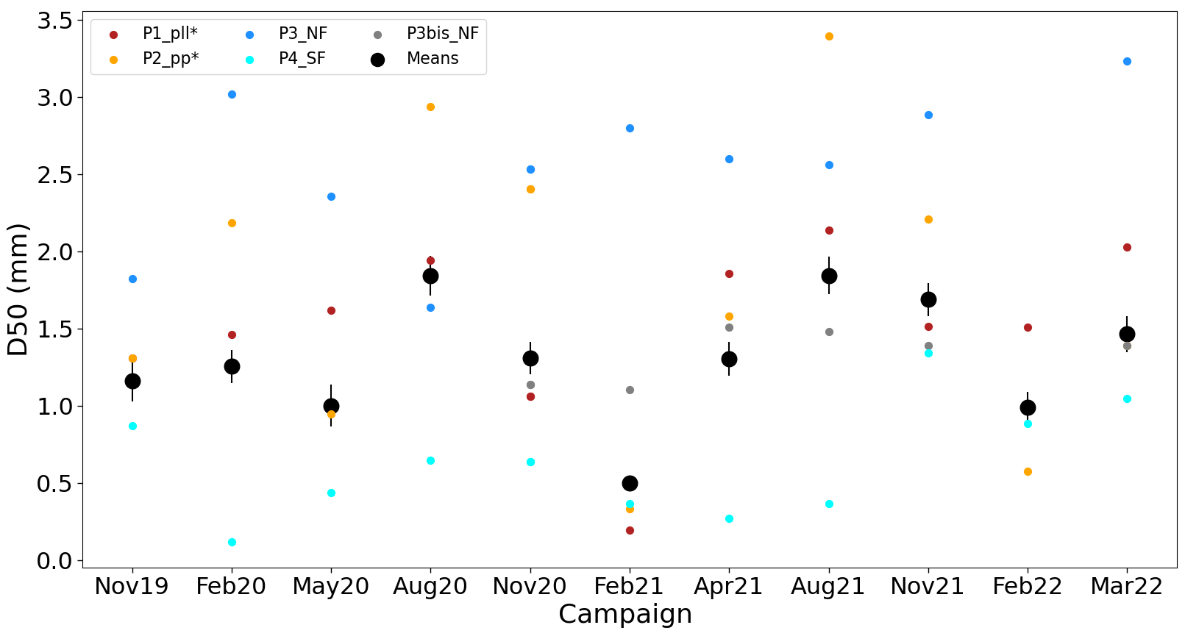
Field measurements
Grain-size measurements
pll* = surface parallel to the schistosity
pp*= surface perpendicular to the schistosity
NF = North-facing slope
SF = South-facing slope

Slide 10
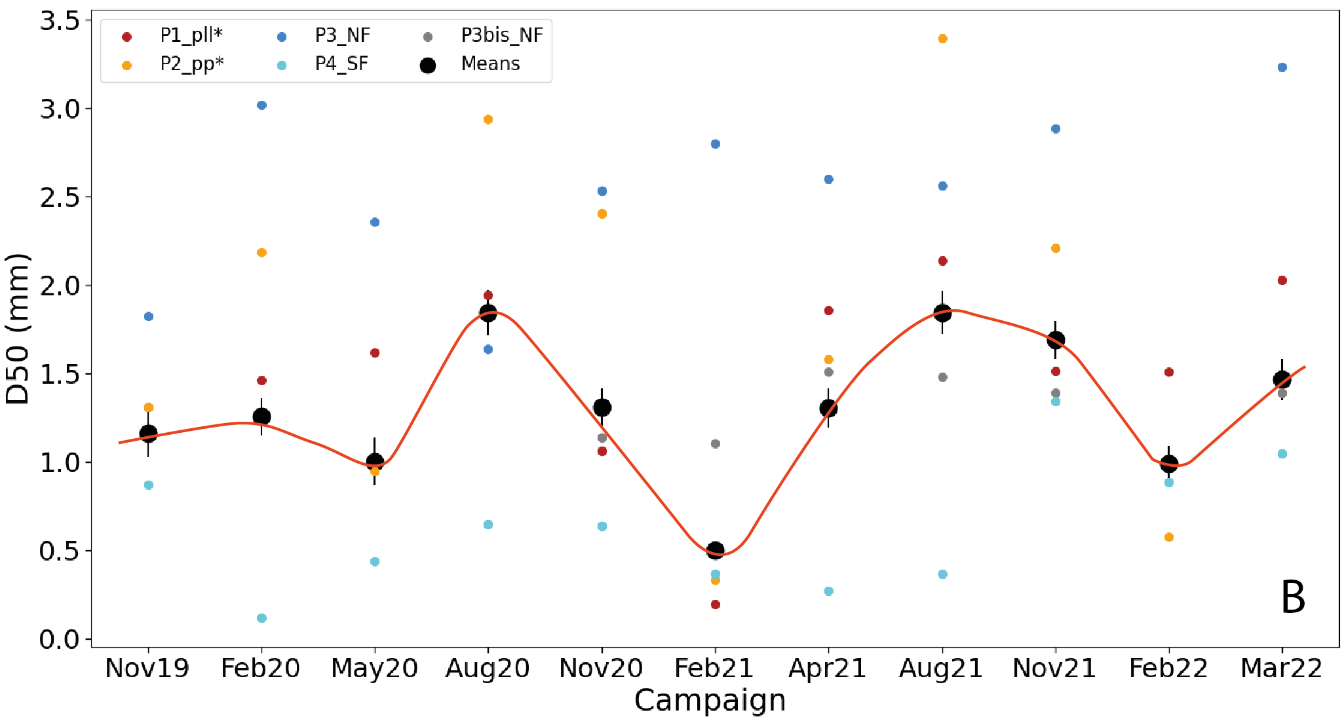
Field measurements
Grain-size measurements
pll* = surface parallel to the schistosity
pp*= surface perpendicular to the schistosity
NF = North-facing slope
SF = South-facing slope

Slide 11
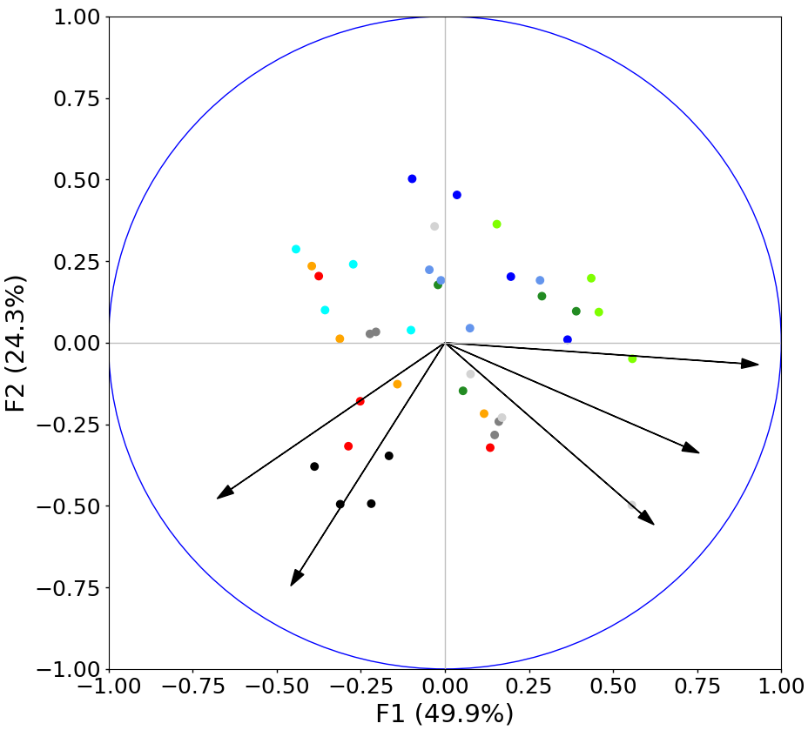
Results analysis
Principal component analysis
Strong variability associated with the resistance
Resistance depends on Grain size and water content
Resistance
Variability of the dataset is explained by seasonal weathering and high-frequency variation of the humidity
Grain size
Cumul J-10
Densite
Water content
Grain size proxy for regolith weathering
Notes:
La PCA dit qu'il y a beaucoup de variabilité liée à la resistance dans ton échantillon, mais ne dit pas que cette variabilité est liée à l'altération. Par contre, toi tu peux dire que tu voies que la resistance est assez correlée au D50 d'une part, et un peu correlée au water content d'autre part, ces deux facteurs étant eux-même plutôt orthogonaux. Et que tu peux relier le D50 à un état d'altération. Donc que la resistance est expliquée en partie par l'état d'altération (qui varie de façon saisonnière), et en partie par l'état d'humidité (qui varie à plus haute fréquence, ~journalière). Et donc la variabilité dans ton échantillon est expliquée à la fois par une dynamique saisonnière d'altération, et par une variation haute-fréquence d'humidité

Slide 12
Field measurements
Grain-size measurements
?
pll* = surface parallel to the schistosity
pp*= surface perpendicular to the schistosity
NF = North-facing slope
SF = South-facing slope

Slide 13

Field measurements
Abnormal grain-size measurements
Computation of frost-cracking indicators for both 2019/2020 and 2020/2021 winter seasons
?
Check the rainfall dataset
-> unusual strong rainfall event before the campaign
2019 / 2020
-7,5 [°C-min / cm]
-7 [°C-min / cm]
Regolith production lower for the winter 2019/2020
Nov
Feb
May
Apr
2020 / 2021
-223 [°C-min / cm]
-61 [°C-min / cm]
Notes:
Si on revient sur les données du début: comment expliquer la résistivité de Fev20? -> regarder le FCI, le cumul des pluies et les exports?

Slide 14
Conclusions
D50 is a good proxy for regolith weathering
The temporal dynamics of the regolith, as illustrated by the cyclicity in D50, is consistent with the intra-annual hysteresis of the sediment export.
Abnormal measurements can be explained by the intensity of frost-weathering during the winter period
 | Winter |  |  | Spring |  |  | Summer |  |  | Autumn
 | J | F | M | A | M | J | J | A | S | O | N | D
Rainfall
Rainfall intensity
Records from the Observatory
Sediment export
Ariagno et al, 2022
Frost-cracking
D50
Notes:
1: good proxy car il s’associe à la variabilité saisonnière du régolith

Slide 15
Back-up

Slide 16
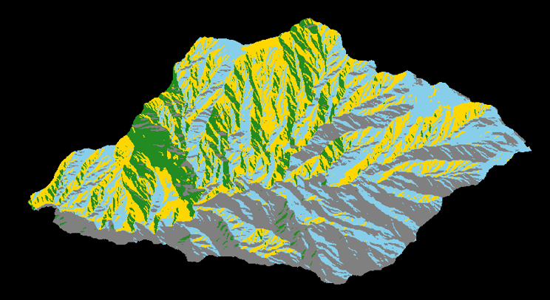
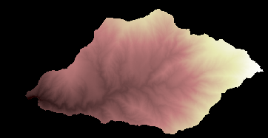
Introduction
Research questions
Can we identify a proxy for regolith weathering that is correlated with the intra-annual hysteresis cycle?
Can catchment morphology be explained by a specific distribution of weathering processes ?
Can we calibrate a landscape evolution model and predict future sediment yields according to different climate scenarios?
Field measurements
Morphology analysis
Landlab model
Notes:
Dire à l’orale -> on se concentre que sur les question 1 et 2

Slide 17
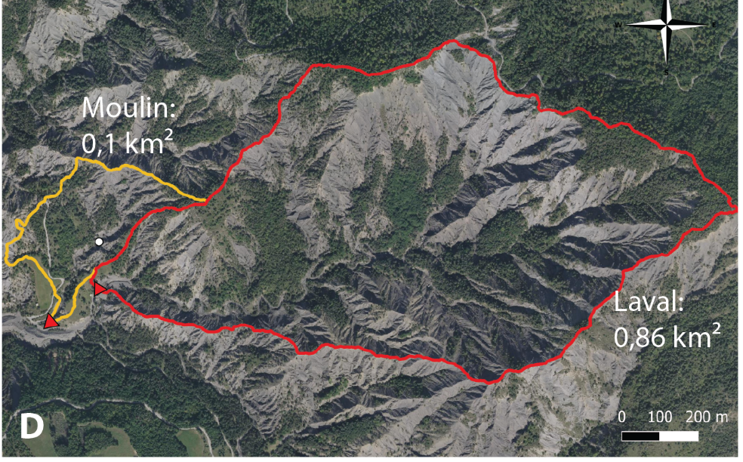
Introduction
Geographic and geologic context
Draix catchments
Outflow gauge
Temperature probes
D
Notes:
Zone dans le département des Alpes de haute provence, vallée de la Durance. Au cœur de la région des Terres Noirs -> observatoire de Draix-Béone, partie du réseau des observatoire d’OZCAR.
Ces bassins marneux, appellé aussi Badlands, sont une zone de forte érosion -> cf photo (comme en témoigne les reliefs très sculpés avec forte pente et , dénudés de végétation avec des réponses hydrologique très rapide. Observatoire cumul des données depuis 35ans.
Les marnes de Draix font partie d’une épaisse série marneuse du jurassique, à Draix plutôt homogène, oxfordien.
Projet basé sur l’évolution des bassins versant de Draix: marnes sont sujet à une forte érosion avec une réponse hydro très rapide.
Caractériser la variabilité saisonnière du régolithe via un suivi régulier sur le terrain pour comprendre les processus et la dynamique d’altération de ces versants.
Laval 86 ha,
Roubine 0,1 ha
Mouliin 8ha

Slide 18
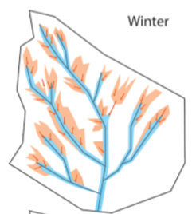
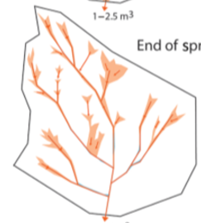
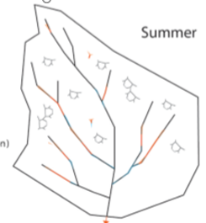
Introduction
Previous work, Draix-Bléone CZO
Late spring / Early summer
Summer
Winter
Bechet et al., 2016
DOI: 10.5194/esurf-4-781-2016
Erosion
Deposition
Conceptual sketch of Roubine catchment (modified from Bechet et al, 2016)
Ariagno et al., 2022
DOI: 10.5194/esurf-10-81-2022
Transition from transport-limited to supply-limited system
Which source processes drive this cyclicity?
Notes:
Study of topographic change over 2-year period using terrestrial laser scanner data
HRDEM avec pour objectif:
Détecter et quantifier la production de sédiment et l’évolution de la morphologie des chenaux en terme de disponibilité et de transport capacty vs rainfall et ruissellement généré.
The erosion progressively evolves from a transport-limited (at the beginning of spring) to a supply-limited (in summer) pattern

Slide 19
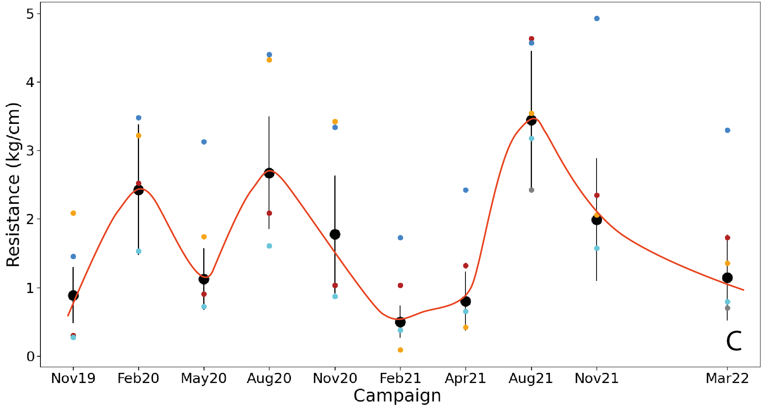
Field measurements
Resistance
February
?
August
pll* = surface parallel to the schistosity
pp*= surface perpendicular to the schistosity
NF = North-facing slope
SF = South-facing slope
5 cm

Slide 20
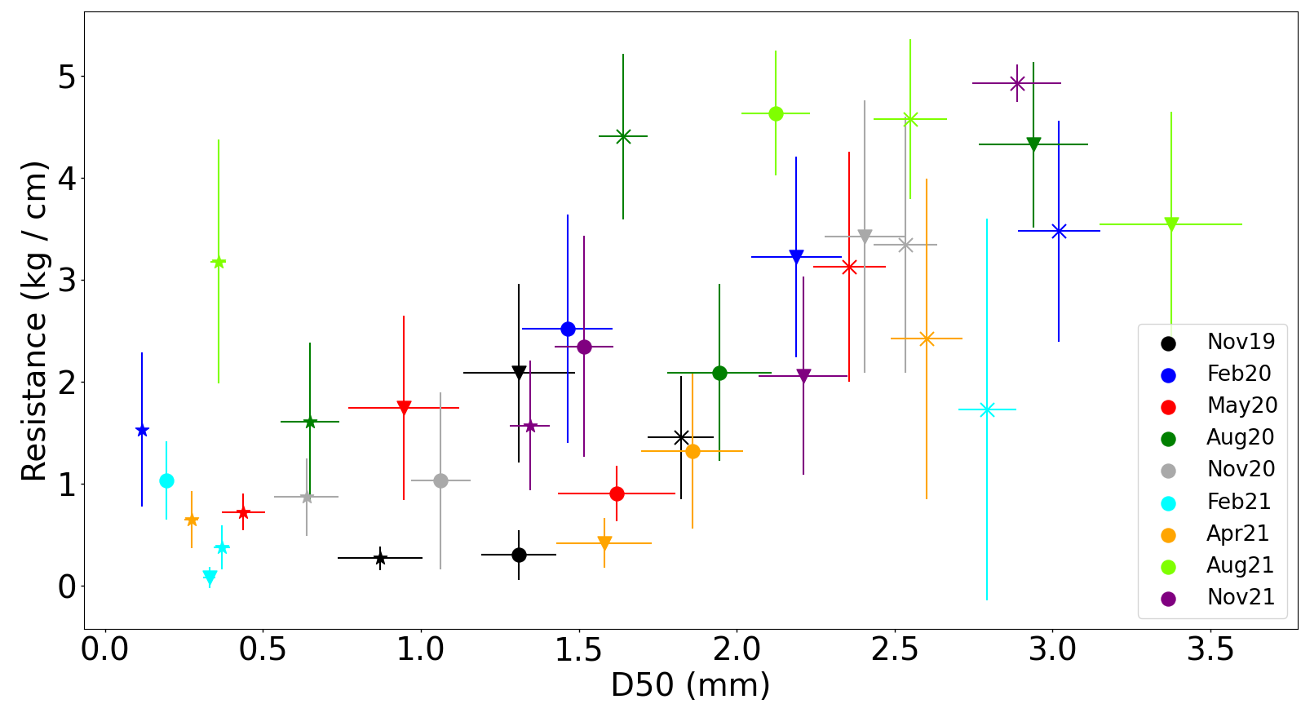
Field measurements
Correlation D50 and resistance
Pll = parallel to the schistosity
pp= perpendicular to the schistosity

Slide 21
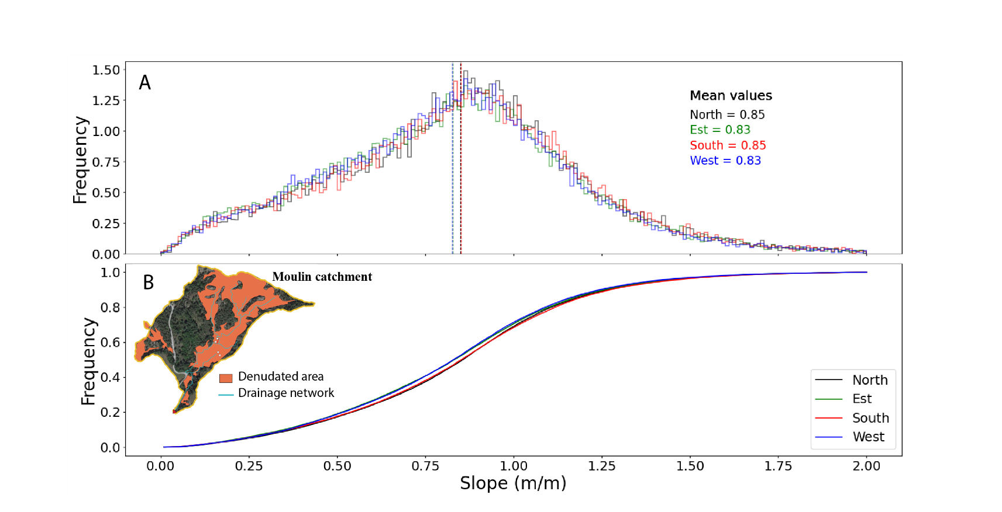
Morphology analysis
Slope versus Aspect

Slide 22

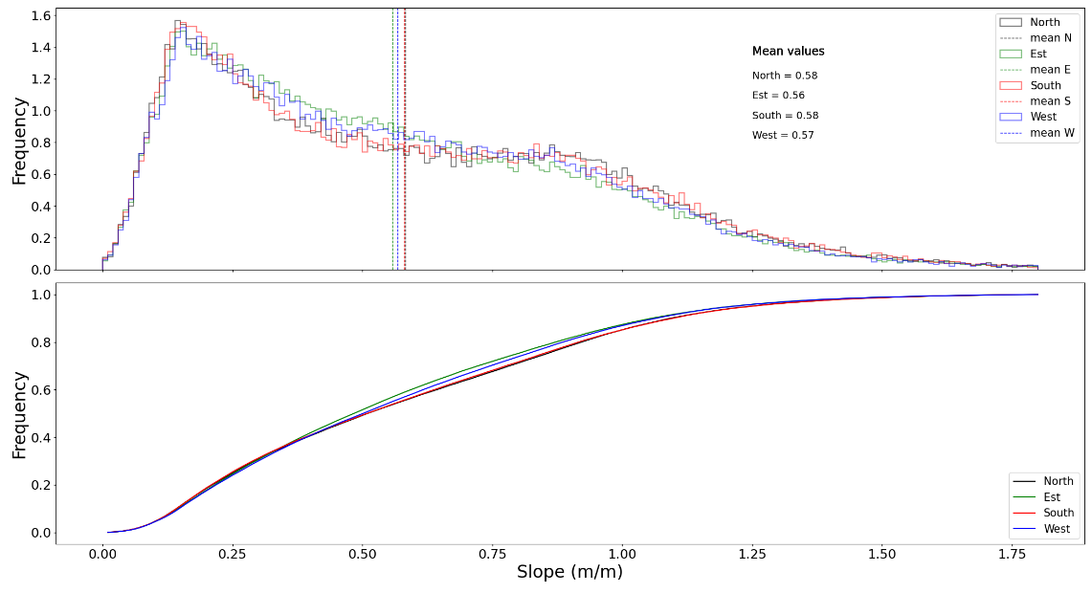
Morphology analysis
Slope versus Aspect
Notes:
For the intra-annual calibration, we are thinking about using the vertical profil of grain size measurements. We observed that the D50 increase with depth. The little cross at the surface are my seasonal D50 measurement that we can convert to a depth of soil by using the vertical trend.

Slide 23
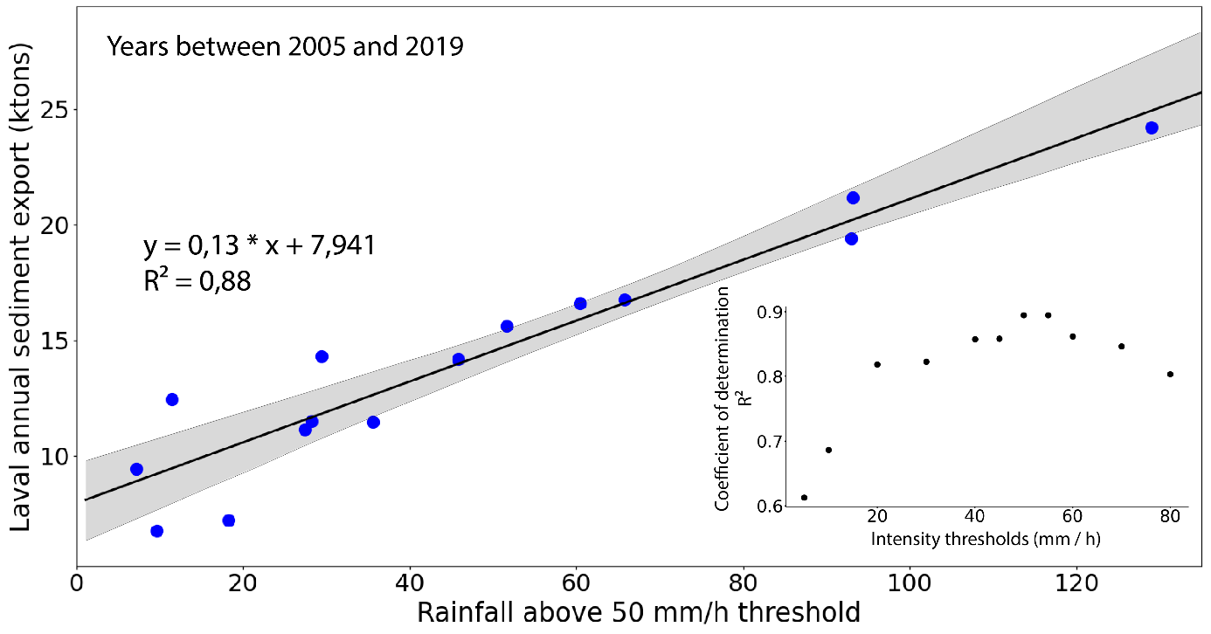
Sediment yield analysis
Precipitation and sediment export
Good correlation between total sediment export and rainfall above a rainfall intensity threshold.
Best correlation is found with a threshold around 50 mm/h
Sediment export anomaly for 1 year
Extraction of sediment export anomalies
Linear correlation between annual total sediment export from the Laval catchment and rainfall above a threshold (50 mm/h) for the years 2005 to 2019 (blue dots ). Grey shaded area shows 95% confidence interval. Most outliers occur for low cumulative rainfall above the threshold (< 40 mm).
Inset shows coefficient of determination (R²) between annual sediment export and annual rainfall above threshold for different intensity thresholds. Optimum correlations are found for threshold values between 50 and 55 mm/h.

Slide 24
Sediment yield analysis
Precipitation and sediment export
Transition between transport limited to supply-limited system
Notes:
can be associated with a significant increase in average monthly rainfall intensity
Thus, rainfall intensity appears to play a key role in triggering spring sediment export.
Été = 74% MES / 26%
Hiver= 57% MES / 43%
Pour essayer d’illustrer la variation temporelle de la production de sediment
Courbe hystérèse: la propriété d'un système dont l'évolution ne suit pas le même chemin selon qu'une cause extérieure augmente ou diminue
Total d’export annuel entre
Pour les dépôts peut pas avant 2003 car je n’ai pas le détail des MES par mois. Mais j’ai le total par an jusqu’à 1995
Monthly total sediment export (TSE; ktons) from the Laval catchment versus monthly rainfall between 2003 and 2019. A) Raw data values for each month (dots) and interannual monthly averages over the analysed period (crosses). B) Hysteresis plot using interannual monthly average values. Dashed line highlights the hysteresis cycle with two separate maxima: very high TSE and moderate rainfall in June versus very high total rainfall and moderate TSE in October/November

Slide 25
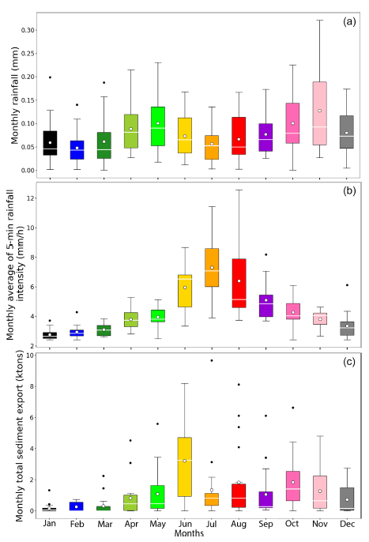
Sediment yield analysis
Precipitation and sediment export

Slide 26
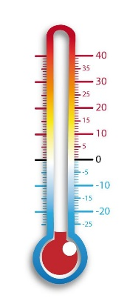

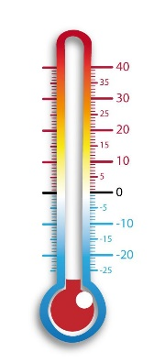
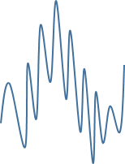


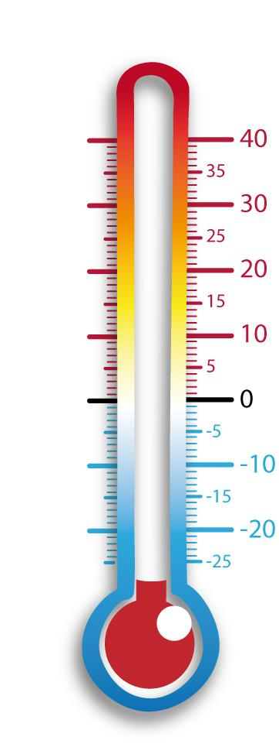
Frost weathering processes
Soil temperature indicators
1
3
Four indicators:
1 - Number of freeze-thaw cycles / yr
.
.
.
.
.
.
.
.
.
.
2
average
2 - Time spent below 0°C
3 - Mean of negative temperature
4 - Frost cracking intensity
(Hales and Roering, 2007)
- 1 cm
4
DOI:10.1029/2006JF000616
If - 1 cm in frost cracking window
Which of these indicators can best explain sediment export anomalies?
- 24 cm
Sum of gradients
=
Frost cracking intensity indicator
Period between
-3°C and -8°C
Compute gradients between -1 and -24 cm
Notes:
Mais cette anomalie d’export est peut-être liée en partie à d’autre facteurs que les températures?

Slide 27
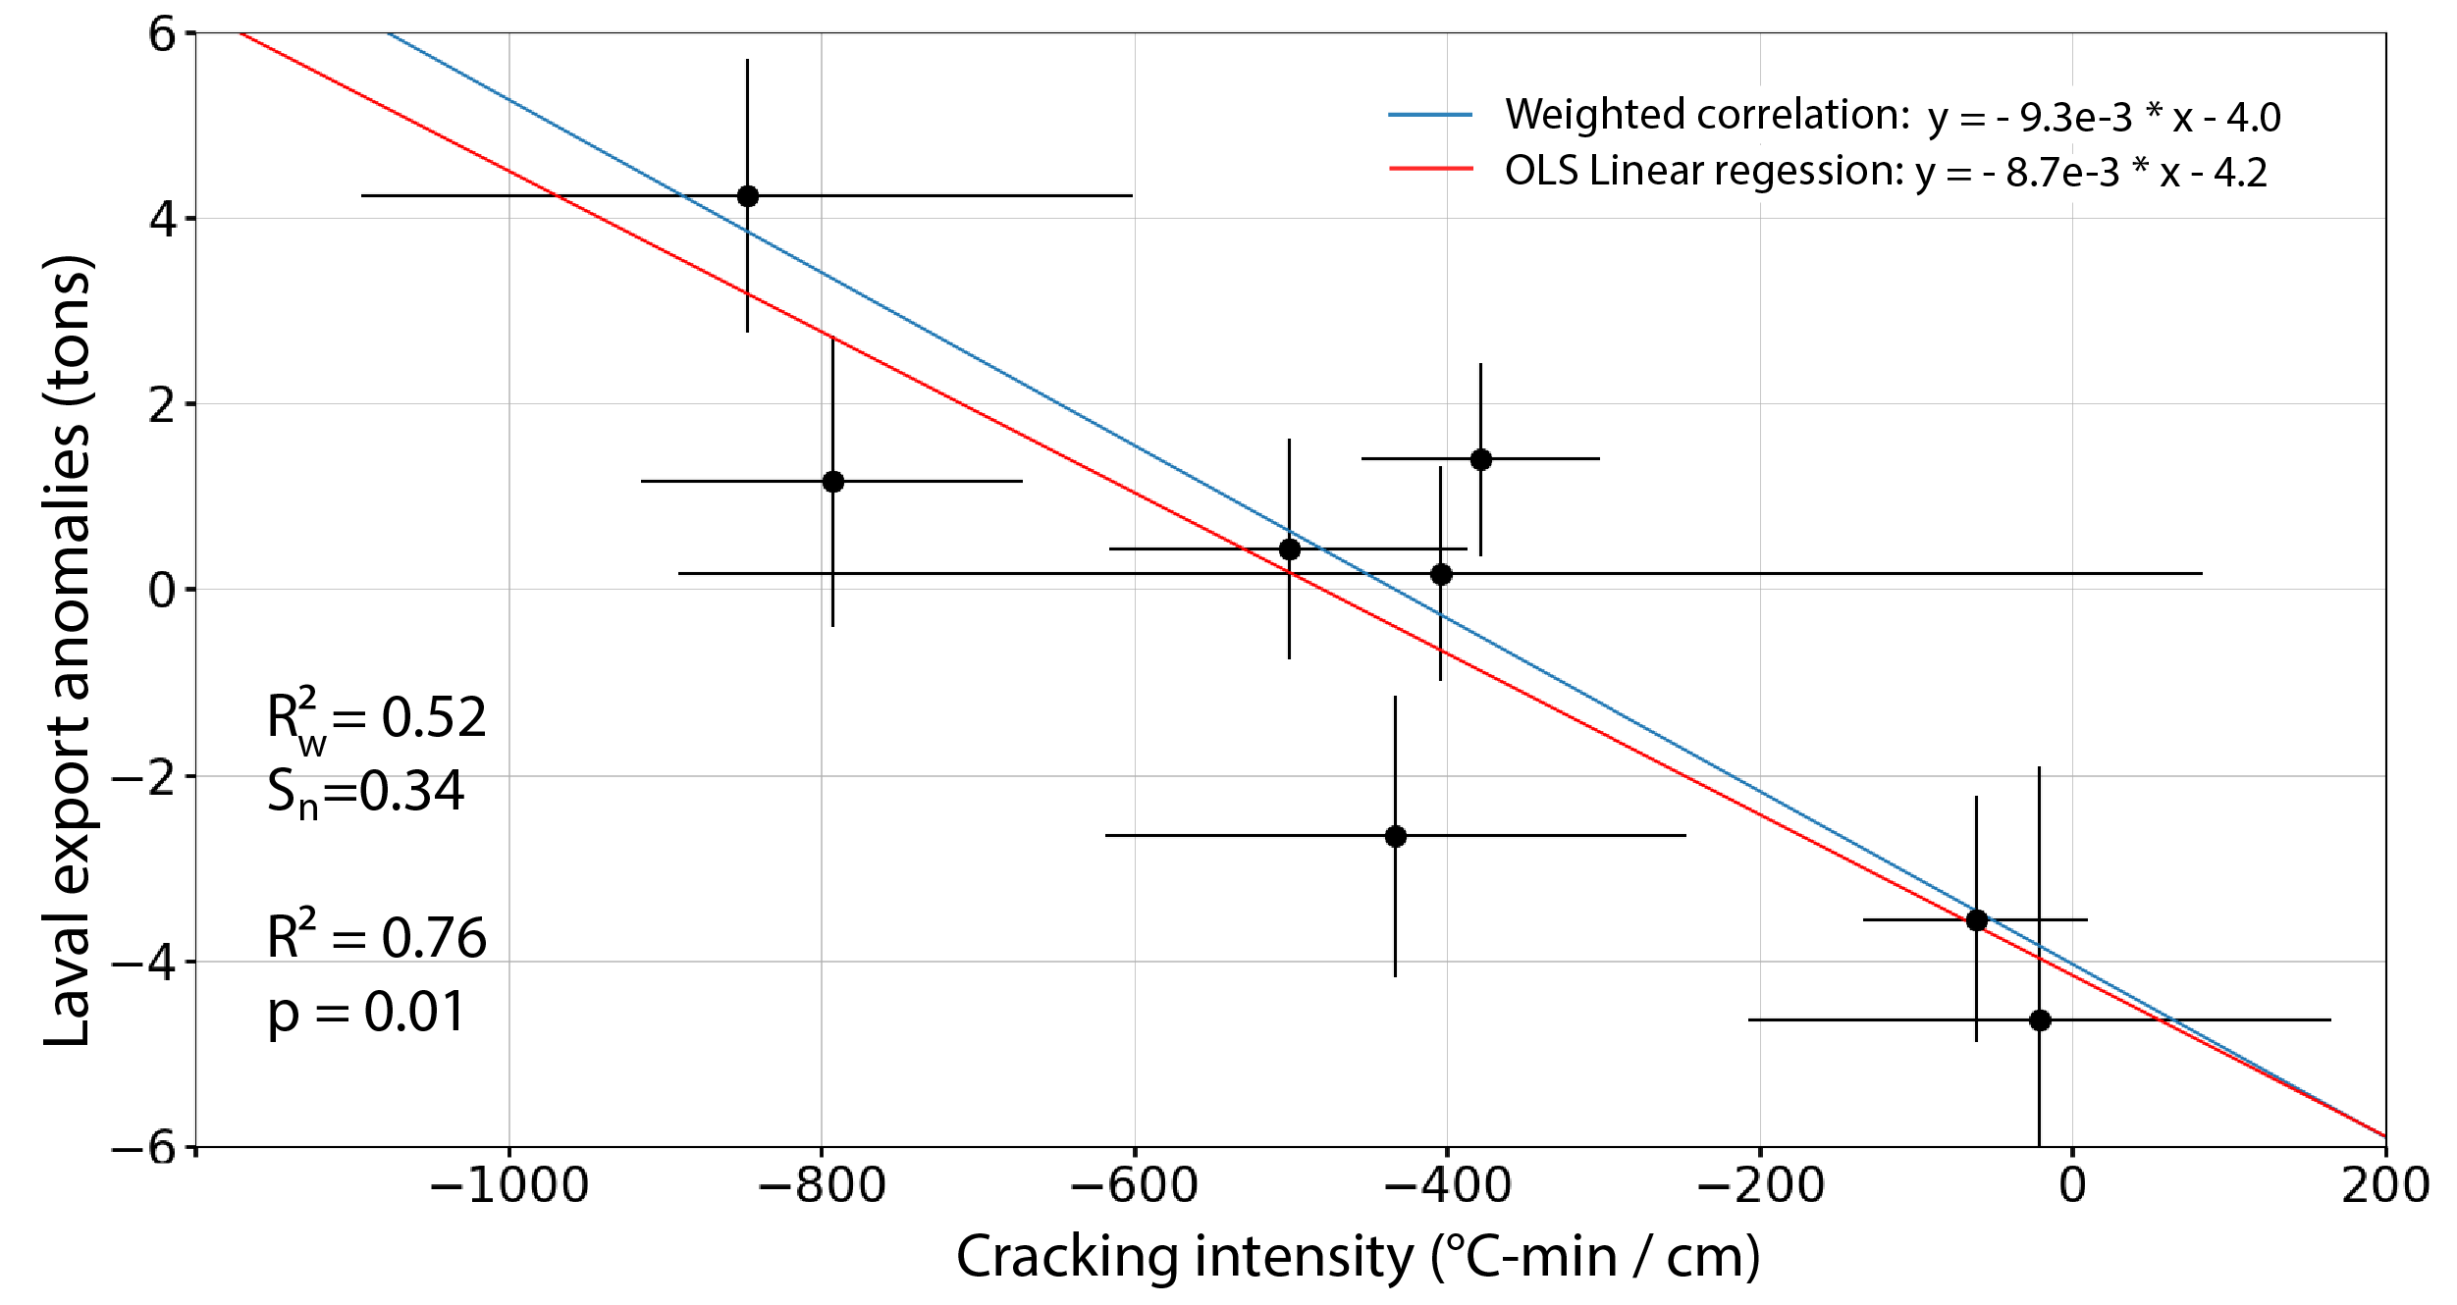
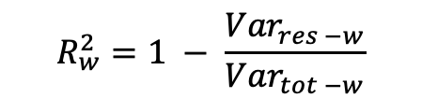

Frost weathering processes
Correlations with temperature indicators
$$R_{w}^{2}=1 − \frac{{Var}_{res −w}}{{Var}_{tot −w}}$$
With ${Var}_{res −w }$the weighted residual variance
and ${Var}_{tot −w }$the weighted total variance
S = goodness of fit normalized by the number of samples (York et al., 2004)
DOI: 10.1119/1.1632486
Modelled export anomalies controlled by frost-cracking intensity explain 76% of the variance.
Regression analysis between sediment-export anomalies and frost-cracking intensity on South-facing slope for years 2007, 2008, 2009, 2010, 2014, 2015.and 2017. Horizontal error bars refer to the difference between measurements at top and bottom of the slope; vertical error bars are ±2σ uncertainty in sediment-export anomaly. Red line shows ordinary least-squares (OLS) linear regression whereas blue line shows weighted linear regression following York et al (2004). Weighted determination coefficients R²_{w} and associated goodness of fit indicators S are indicated for each weighted regression. Standard R² and associated p-value indicate significance of the unweighted correlation.

