Slide 1





Using Precambrian carbonates for seawater isotope reconstructions: constraints from LA-ICP-MS U-Pb geochronology of a post-Sturtian cap dolomite, Brazil
Rolando E. Clavijo-Arcos¹, Matthew O. Clarkson¹, Derek Vance¹, Stefano Bernasconi², Marcel Guillong¹, Alcides N. Sial³, Marius N. Müller⁴, Nathan Looser², Yana Kirichenko¹, and Netta Shalev¹
¹Institute of Geochemistry and Petrology, Department of Earth Sciences ETH Zürich, Zürich, Switzerland (r.clavijo@erdw.ethz.ch)
²Geological Institute, Department of Earth Sciences ETH Zürich, Zürich, Switzerland
³NEG-LABISE, Department of Geology, Federal University of Pernambuco, Recife, Brazil
⁴Department of Oceanography, Federal University of Pernambuco, Recife, Brazil

Slide 2


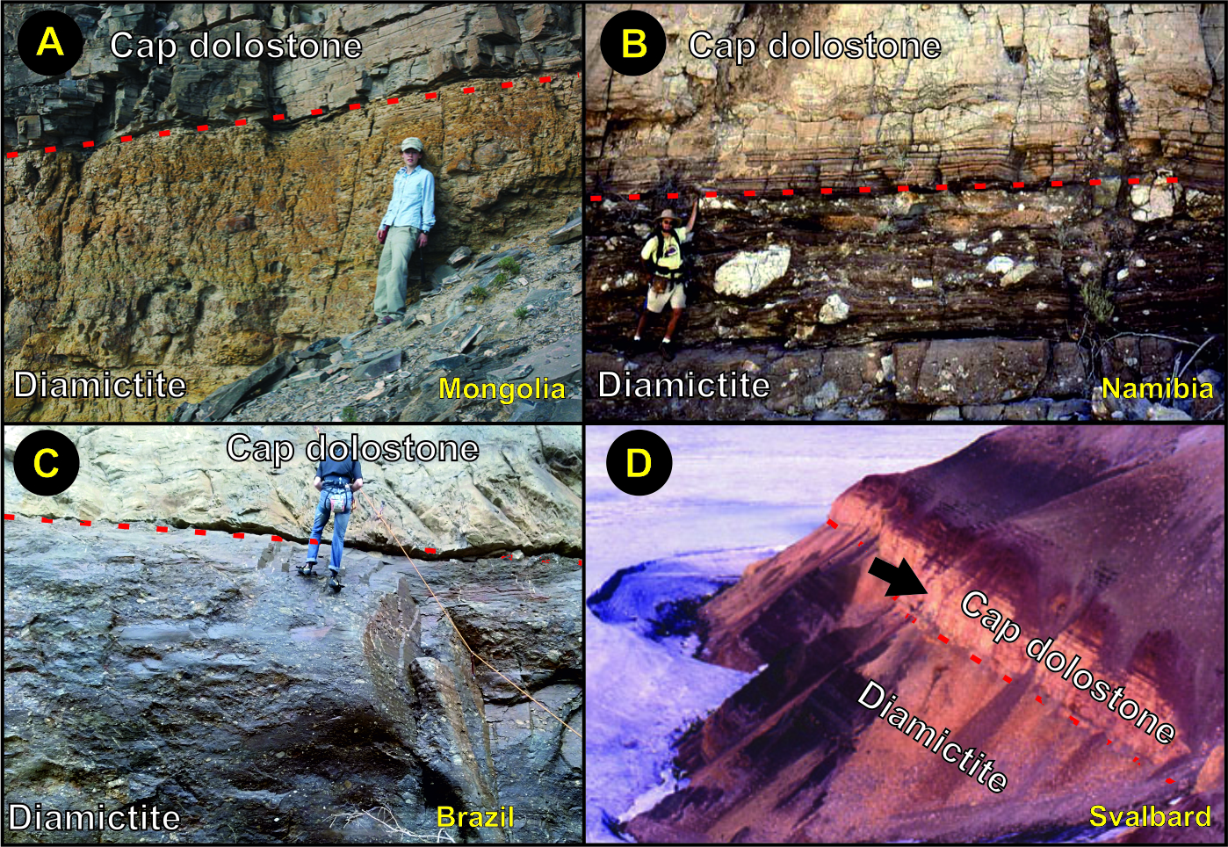
Marine carbonates are often used to reconstruct Precambrian seawater chemistry – e.g., post Snowball Earth episodes
An essential pre-requisite for this is geochronological constraints that can:
Constrain ages of sedimentation/early diagenesis;
Identify later disturbances that partially or completely reset ages and chemical records.
Here: LA-ICP-MS U-Pb carbonate geochronology on specific petrographically-identified domains.
(A) Bold et al., 2016; (B) Hoffman et al., 2017; (C) This study; (D) Hoffman, 2011
Introduction

Slide 3
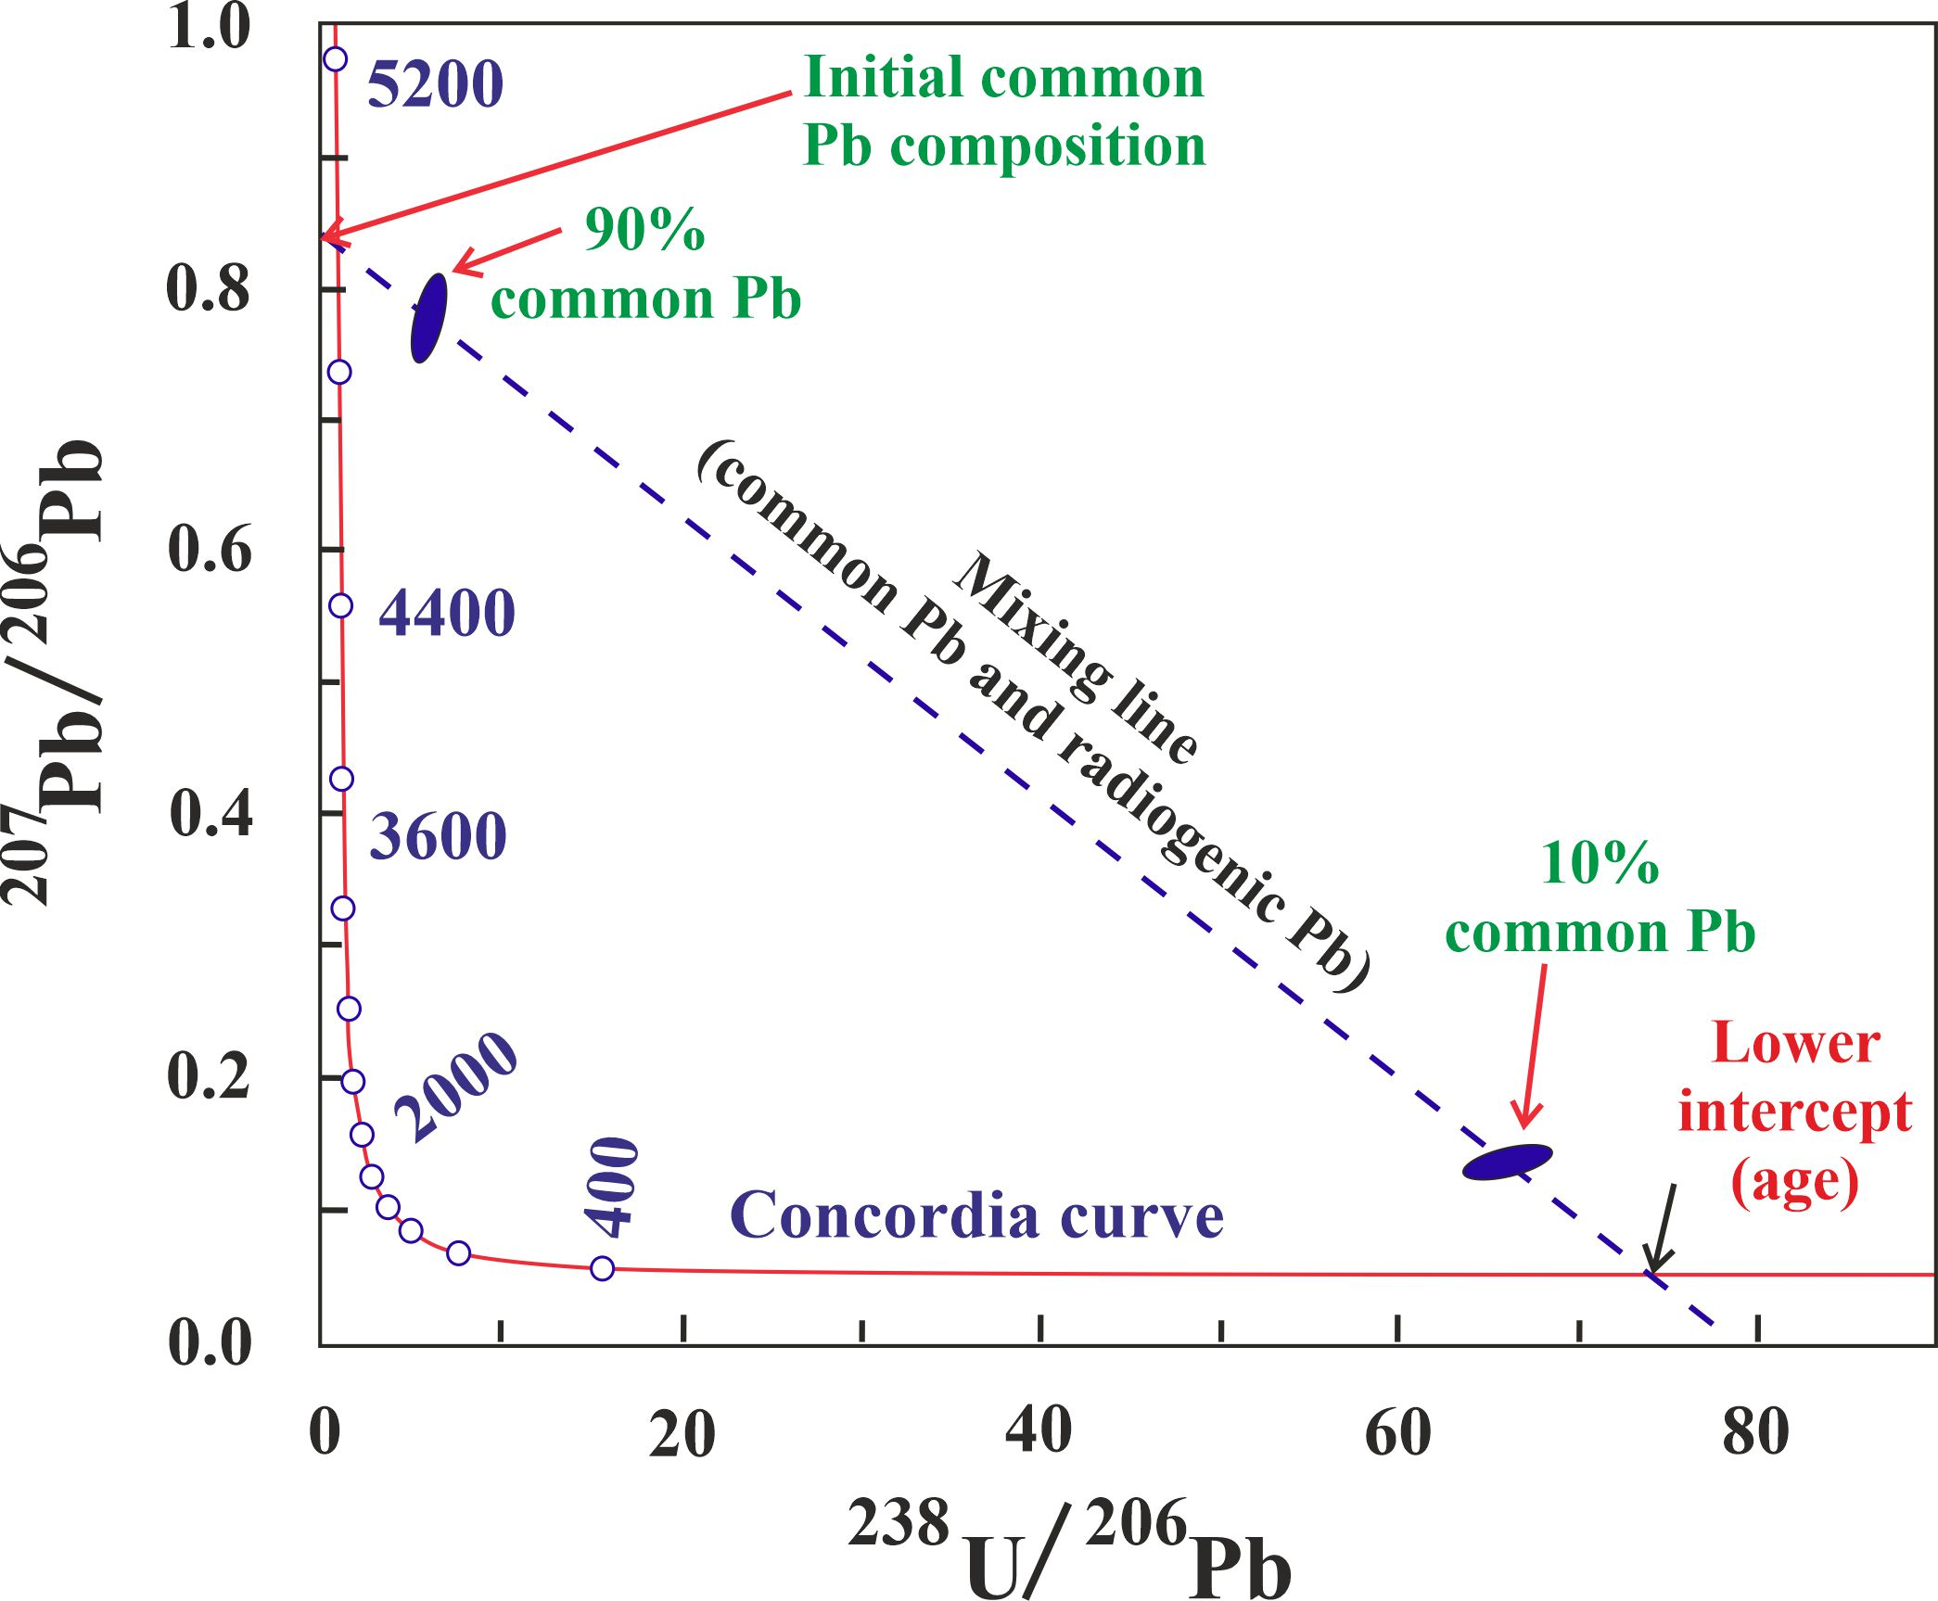
U-Pb geochronology and petrography
U isotopes | Daughter product | Relative abundance (%) | Half-lives (yrs)
²³⁸U | ²⁰⁶Pb | 99,28 | 4,46 x10⁹
²³⁵U | ²⁰⁷Pb | 0,72 | 704 x10⁶
²³⁴U | - | 0,0054 | 245 x10³
Marine carbonates incorporate soluble uranium from seawater during dolomitization!
Modified after Roberts et al. (2020)
Methods

Slide 4
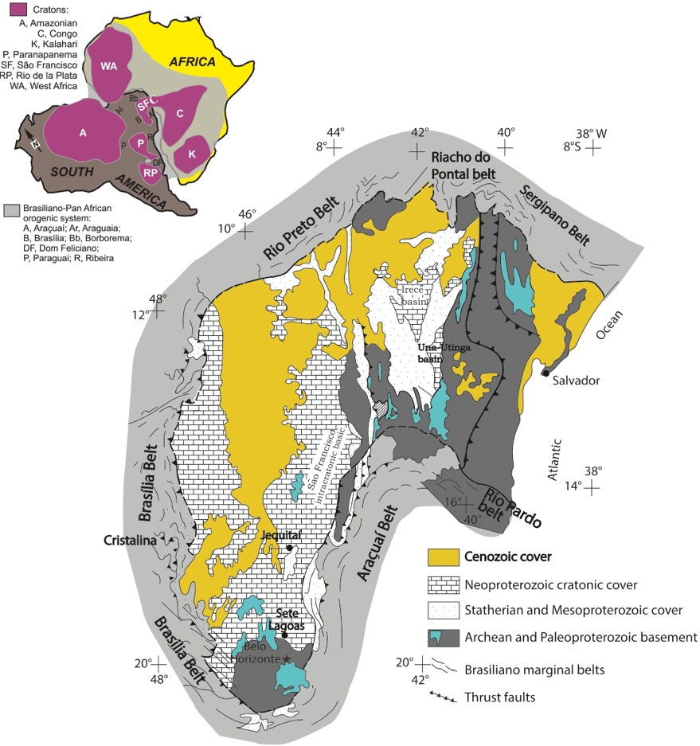
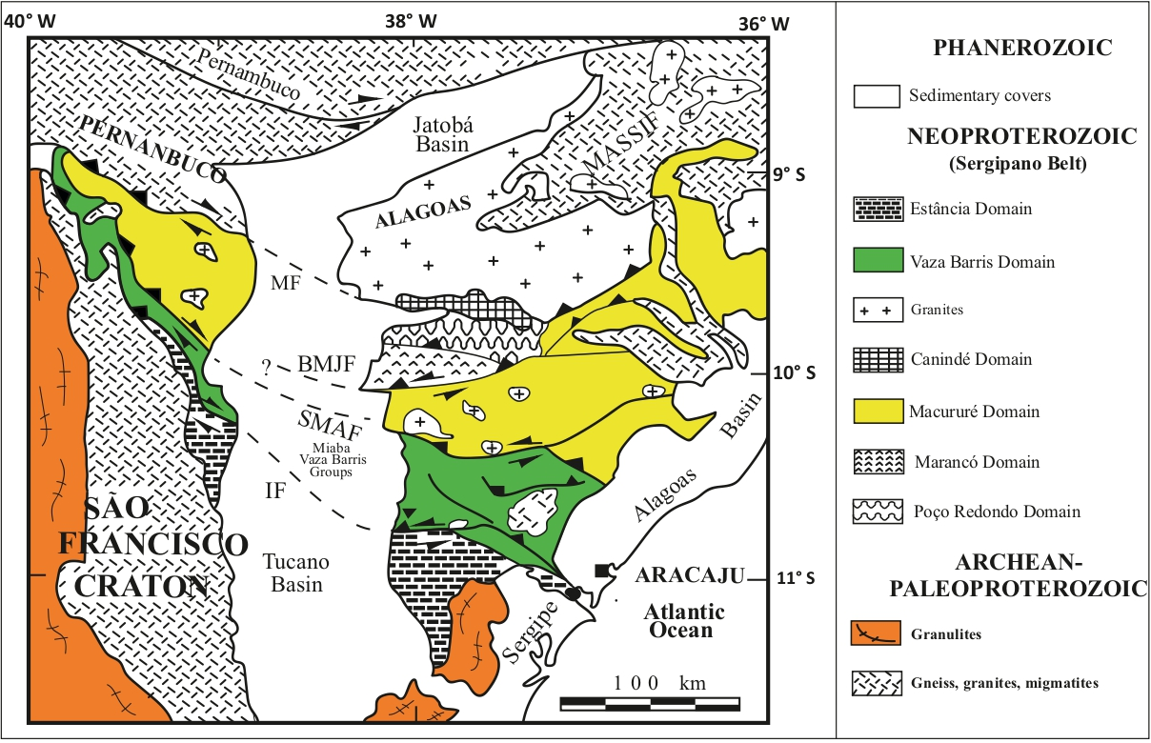
The Sergipano belt, Brazil
Modified after D’el-Rey Silva (1995)
Modified after Alkmim et al. (2006)
Research focus

Slide 5
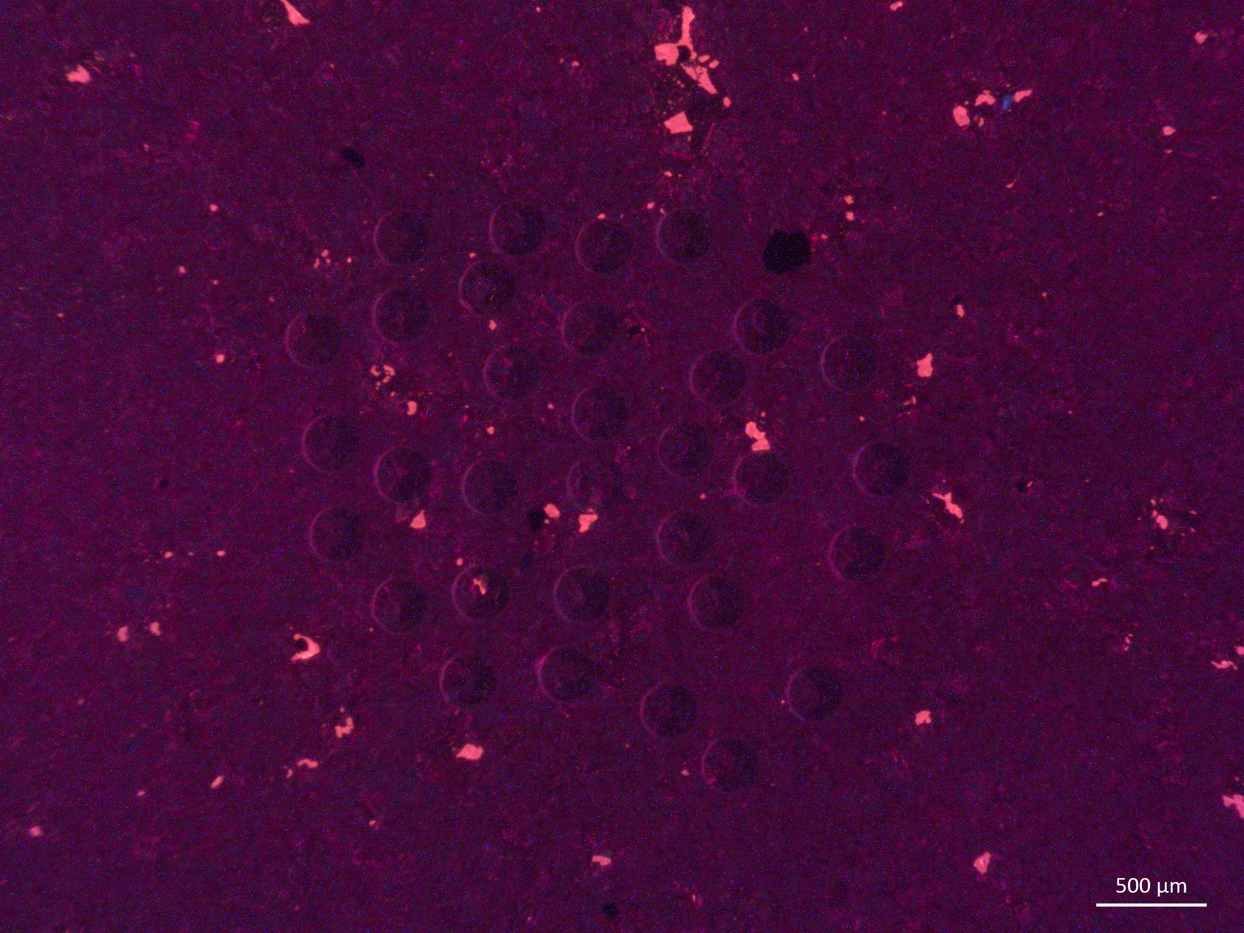
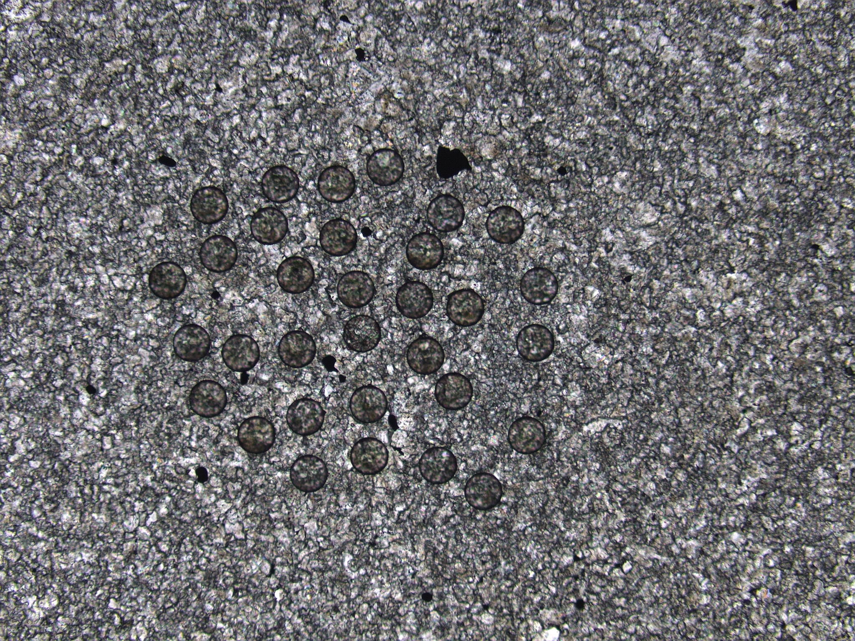

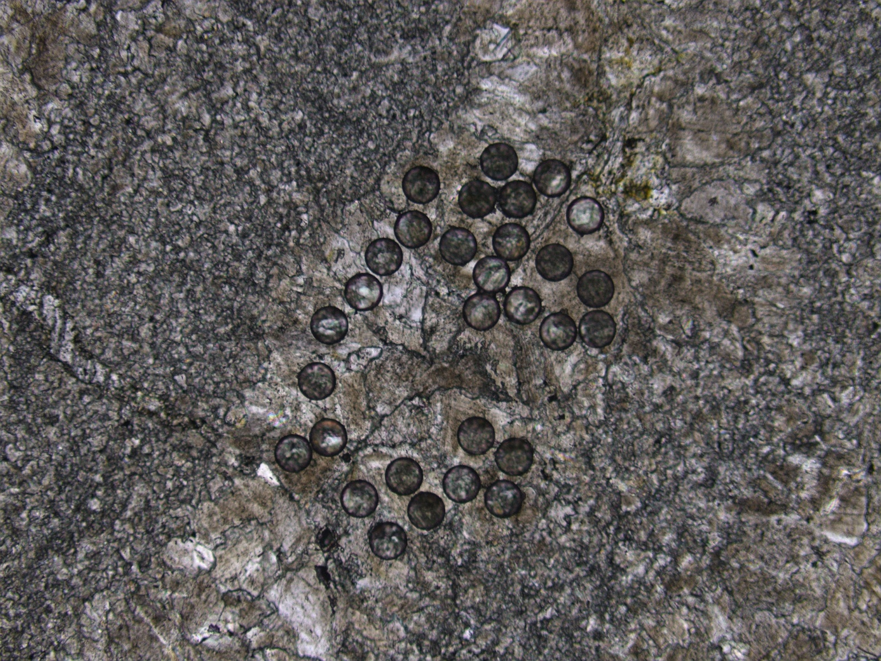
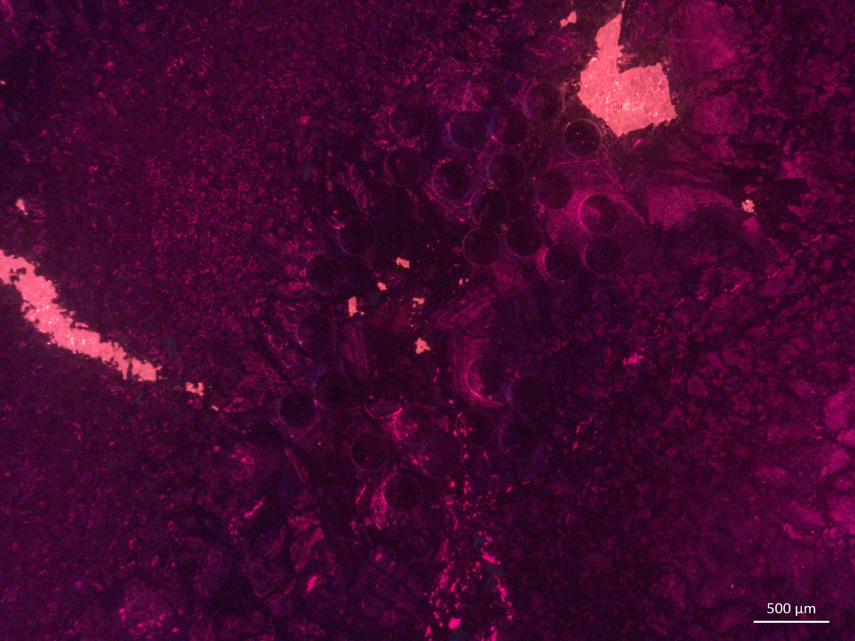

Petrographically-identified domains used for LA-ICP-MS U-Pb dating
Results

Slide 6
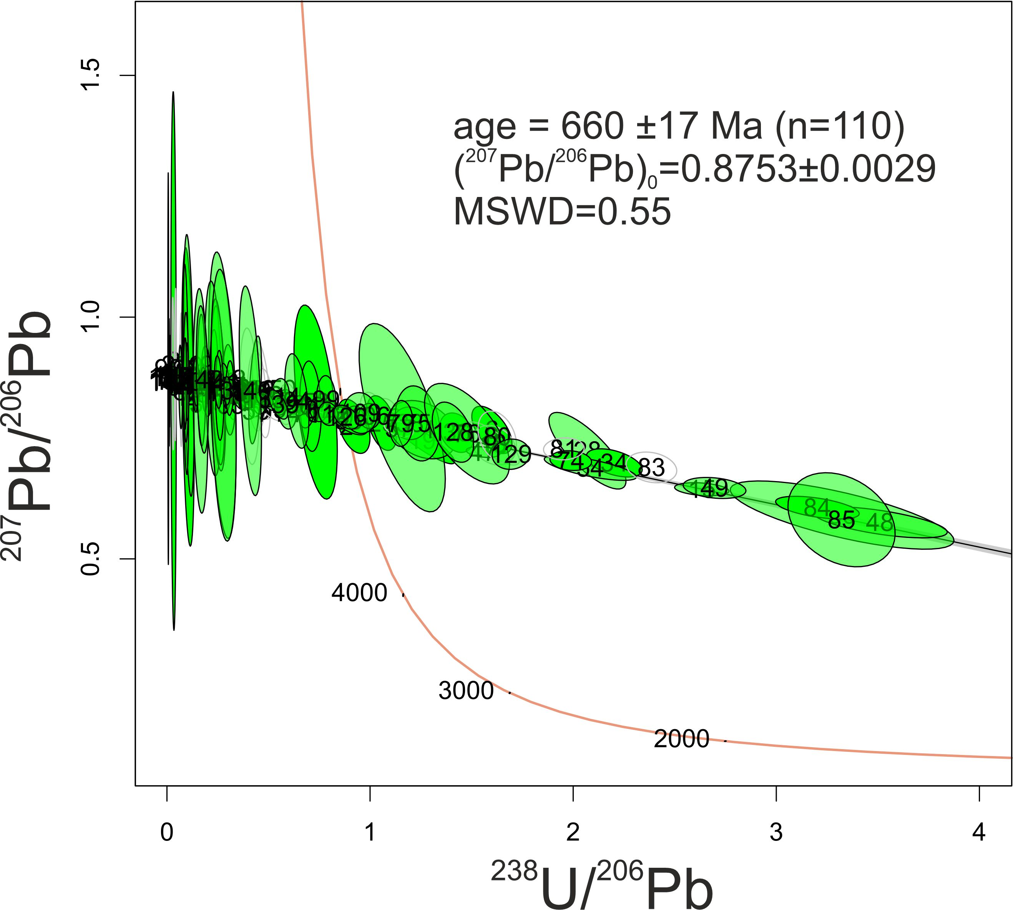
660±17 Ma
Dolomitization age upon the Sturtian deglaciation
Results

Slide 7
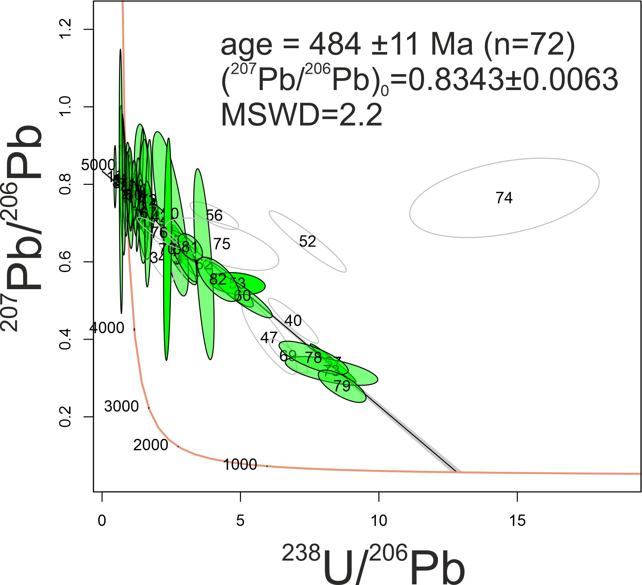
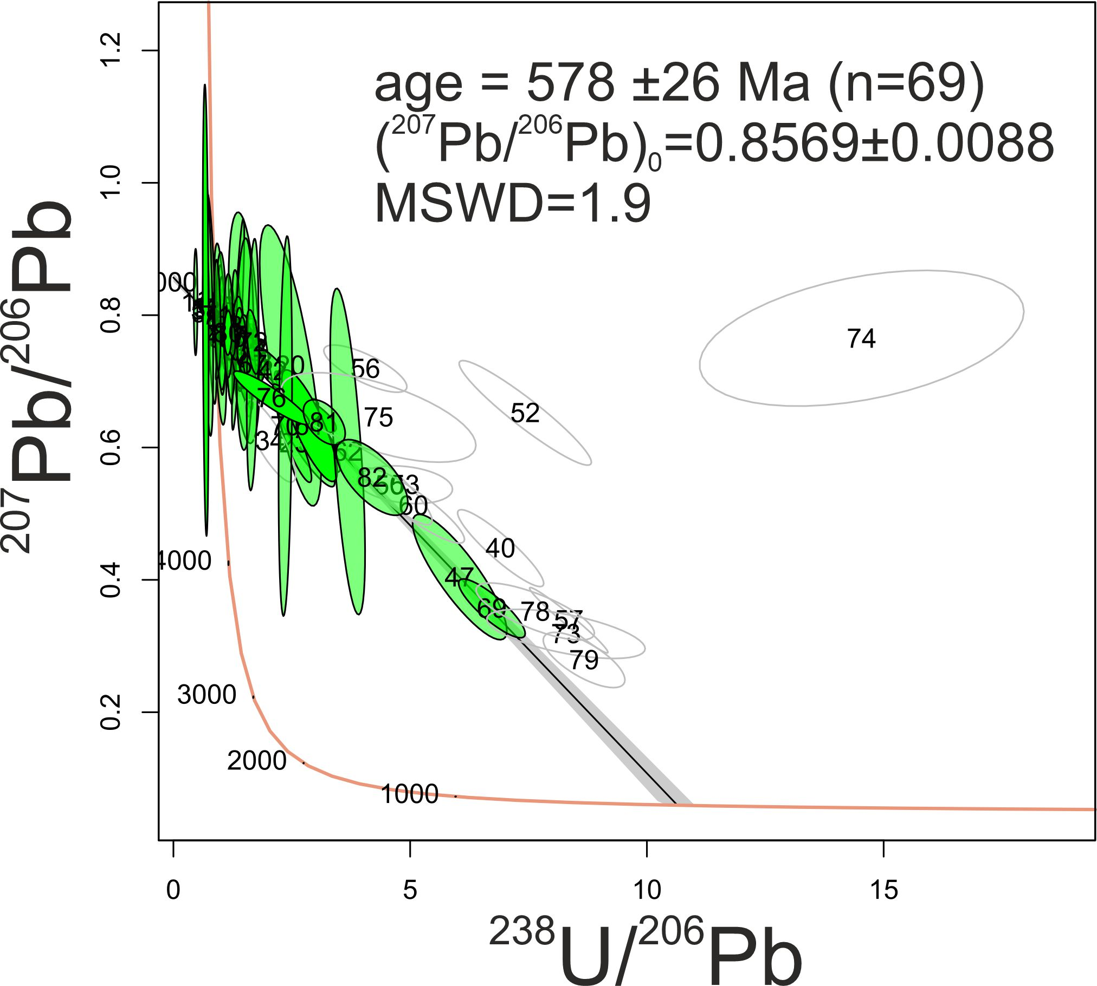
484±11 Ma
578±26 Ma
Pan-African orogenesis age
Results

Slide 8
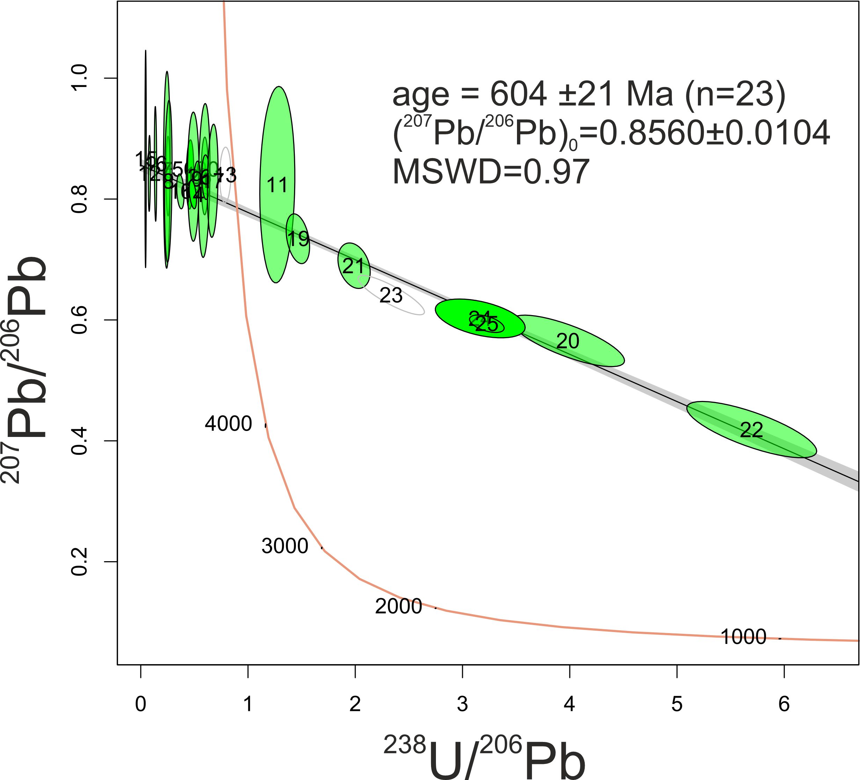
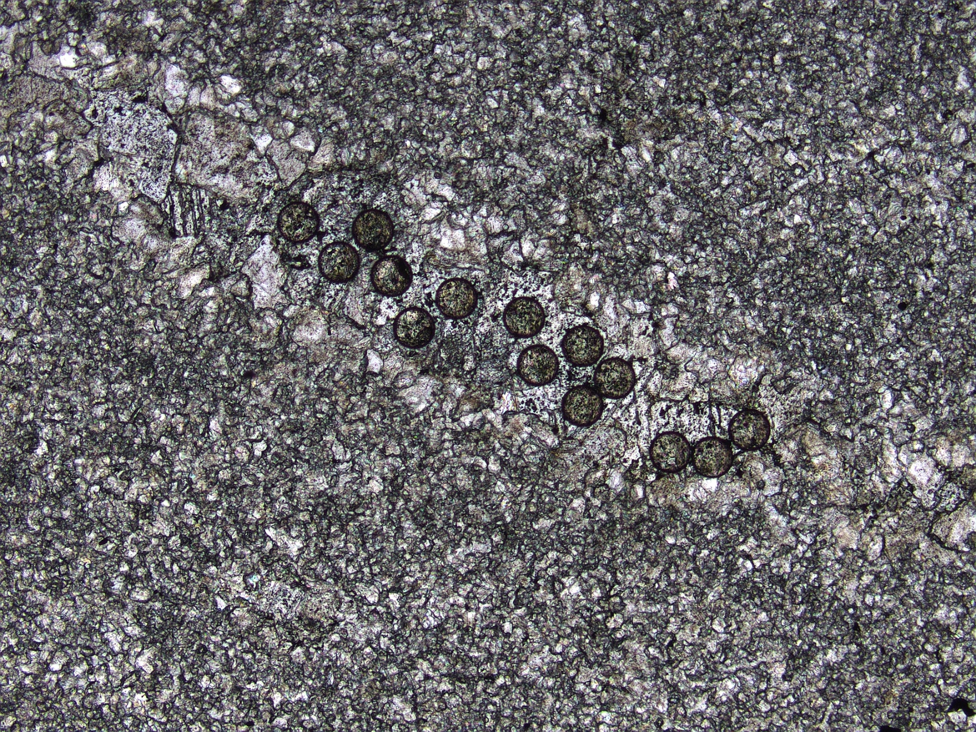
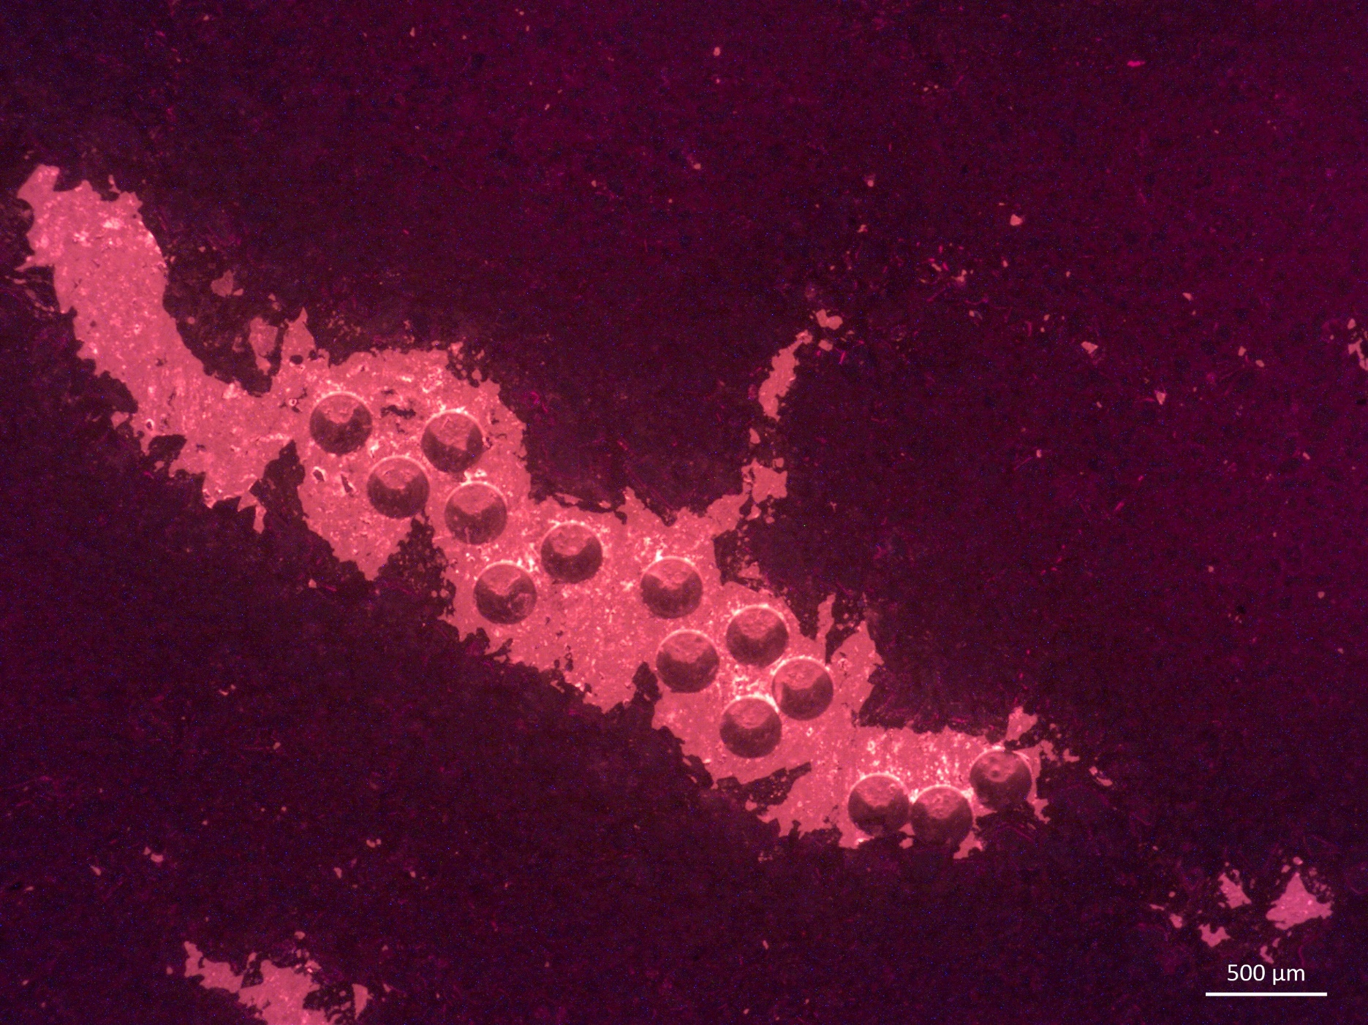

604±21 Ma
Later diagenetic event
Results

Slide 9
Preliminary conclusions
LA-ICP-MS U-Pb dating of petrographically-identified carbonate domains track local and global diagenetic and tectonic processes.
Dolomite 2 provides the best current estimate of the dolomitization event upon the Sturtian deglaciation in Western Gondwana.
Dolomite 1 provides the timing of the Pan-African metamorphic event at the northeastern margin of the São Francisco Craton.
Dolomite-vugs were filled by secondary calcite during the uplift and folding of the Neoproterozoic Sergipano carbonate platform.
Single dolomite phases from this cap dolomite may be used as global chronologic archives of tectonic and geologic events in the aftermath of the Sturtian glaciation.

