Slide 1





Institute of international rivers and eco-security, Yunnan university
Name: Qin Yuhong
Institution: Yunnan University
Email: qyh1998794@163.com
Research interests:
Soil erosion
Vegetation restoration
Carbon, nitrogen and phosphorus cycle
Date: May 23, 2021

Slide 2

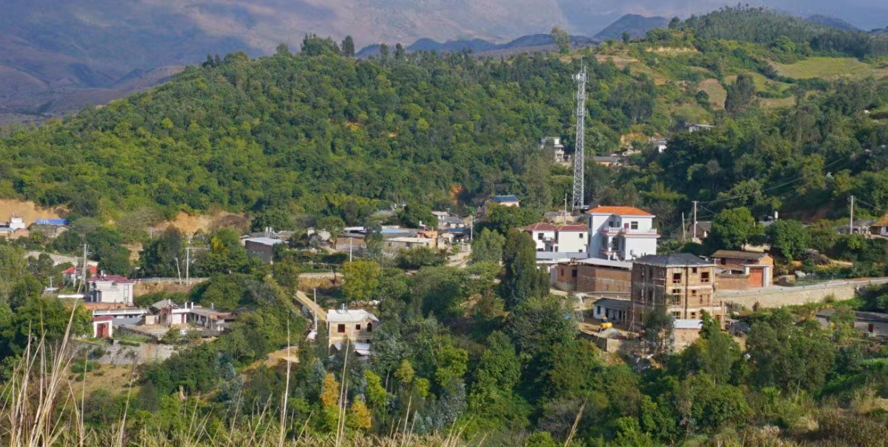
Slope drives grain yield in the Yunnan Plateau-Mountain areas
Qin Yuhong¹,Rong Li^{1,2*}, Duan Xingwu^{1,2}, Gu Zhijia³
¹ Institute of International Rivers and Eco–security, Yunnan University, Kunming, Yunnan Province, China
² Yunnan Key Laboratory of International Rivers and Trans-boundary Eco–security, Kunming,Yunnan Province, China
3 School of Geographic Sciences, Xinyang Normal University, Xinyang, Henan Province, China
high-intensity soil erosion
The plateau-mountain areas around the world are facing the risk of food insecurity
limited agriculture land
increasing population pressure
about 40% of mountain human populations being vulnerable to food shortage (Lal 2009).

Slide 3


Slope drives grain yield in the Yunnan Plateau-Mountain areas
extremes of climatic events
topography
soil erosion
lead to the gradual instability in crop production
Terefore, improving grain yield in a sustainable way is still vital for sustainable livelihood and food security demands in mountainous regions.
However, little consideration is given in relationships between climatic, topographical factors and grain yields in the Plateau-mountain region.

Slide 4
Slope drives grain yield in the Yunnan Plateau-Mountain areas
County-level data
119 counties in Yunnan province over the past 28 years (1985–2012)
Actual grain yield(AGY)
Environmental factors
Climate data
Topography data
Soil data
To explore the controls on grain yield
and how they affect grain yields.
Notes:
In this study, we collected county-level data on the actual grain yield and environmental factors of the 119 counties in Yunnan province over the past 28 years (1985–2012) to explore the controls on grain yield and how they affect grain yields.

Slide 5
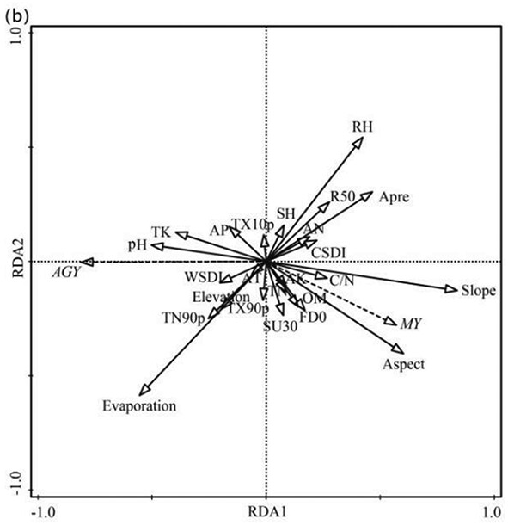
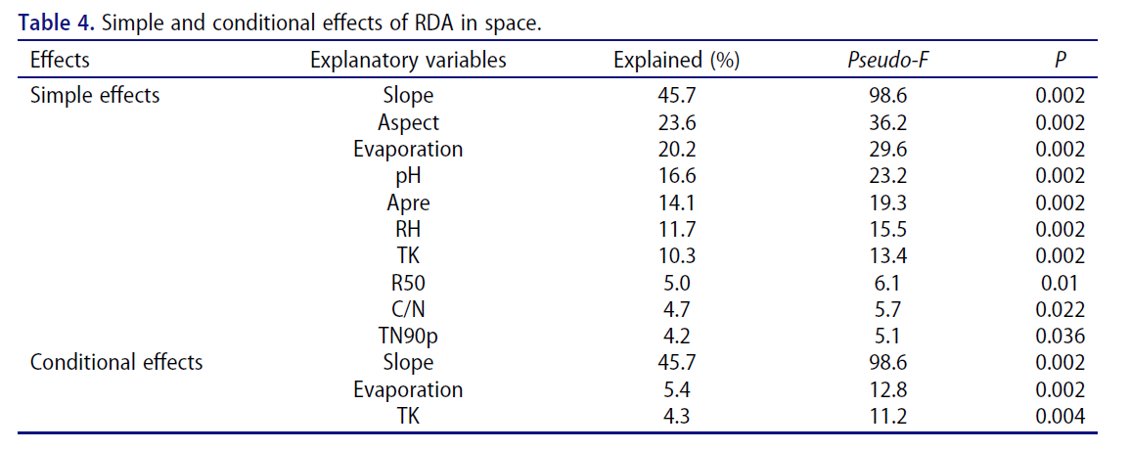
Slope drives grain yield in the Yunnan Plateau-Mountain areas
Redundancy analysis revealed that AGY positively correlated with evaporation, TN90p, TK, and pH whereas negative correlations with Apre, RH, R50, C/N, slope, and aspect.
RDA biplot of AGY in space constrained by 27 environmental variables
Three environmental variables, including slope, TK, evaporation, explained 55.5% of the total variation in space.
Apre-daily average air temperature ; RH-daily relative air humidity ;
R50-Number of days above 50 mm ; TN90P-warm nights-percentage of days when TN＞90th percentile

Slide 6
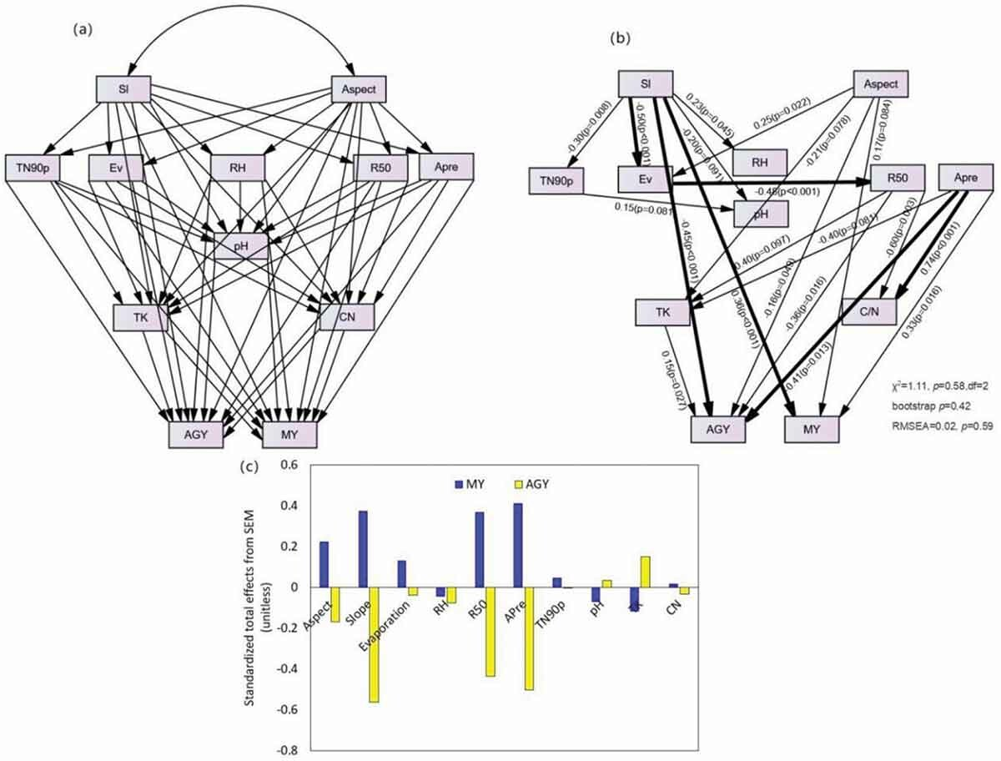
Slope drives grain yield in the Yunnan Plateau-Mountain areas
Structural equation model
Slope had a direct negative effect on AGY
Notes:
We also found that TK showed a significantly positive effect on AGY, indicating that counties with higher TK content in soils could produce higher actual grain yield. And R50 and aspect also had an indirect effect on AGY through influencing TK.

Slide 7
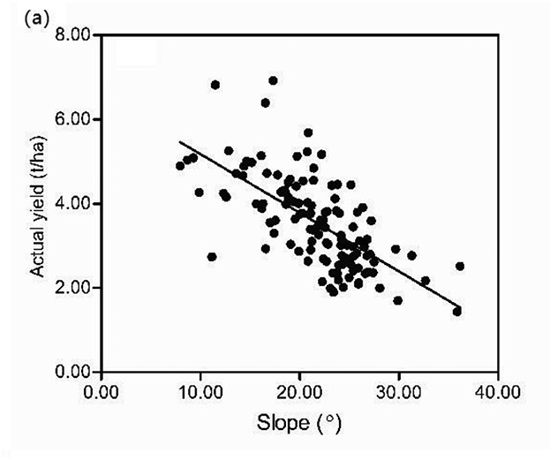
Slope drives grain yield in the Yunnan Plateau-Mountain areas
Regression analysis also showed that slope gradient could explain 26.29% of the spatial distribution variability of AGY.

Slide 8
Slope drives grain yield in the Yunnan Plateau-Mountain areas
Structural equation model
TK showed a significantly positive effect on AGY, indicating that counties with higher TK content in soils could produce higher actual grain yield.
R50 and aspect also had an indirect effect on AGY through influencing TK.
Notes:
We also found that TK showed a significantly positive effect on AGY, indicating that counties with higher TK content in soils could produce higher actual grain yield. And R50 and aspect also had an indirect effect on AGY through influencing TK.

Slide 9
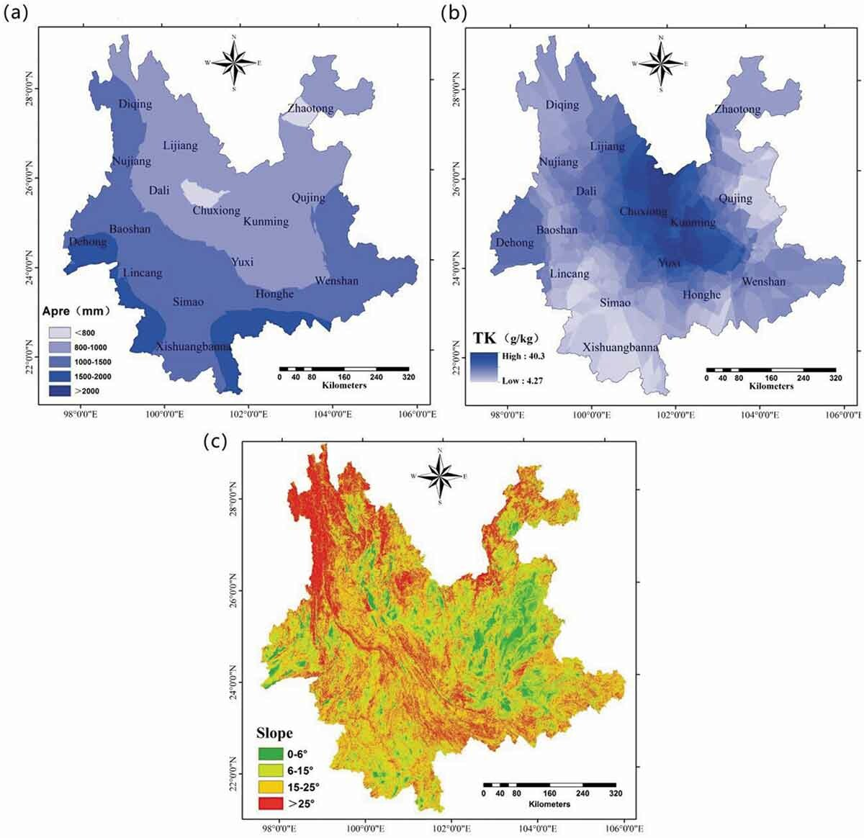
Slope drives grain yield in the Yunnan Plateau-Mountain areas
Thus, the application of K fertilizer in northwestern, northeastern, and southeastern Yunnan province where soil TK was relatively low may be the key to increase grain yield.
Spatially, our findings revealed AGY was strongly influenced by slope.
Spatial distribution of TK
Spatial distribution of slope

