Slide 1
K Arnbjerg-Nielsen, ED Thomassen, SL Thorndahl, CB Andersen, IB Gregersen, HJD Sørup
Comparing extreme precipitation between data from rain gauges, weather radar and high-resolution climate models

Slide 2
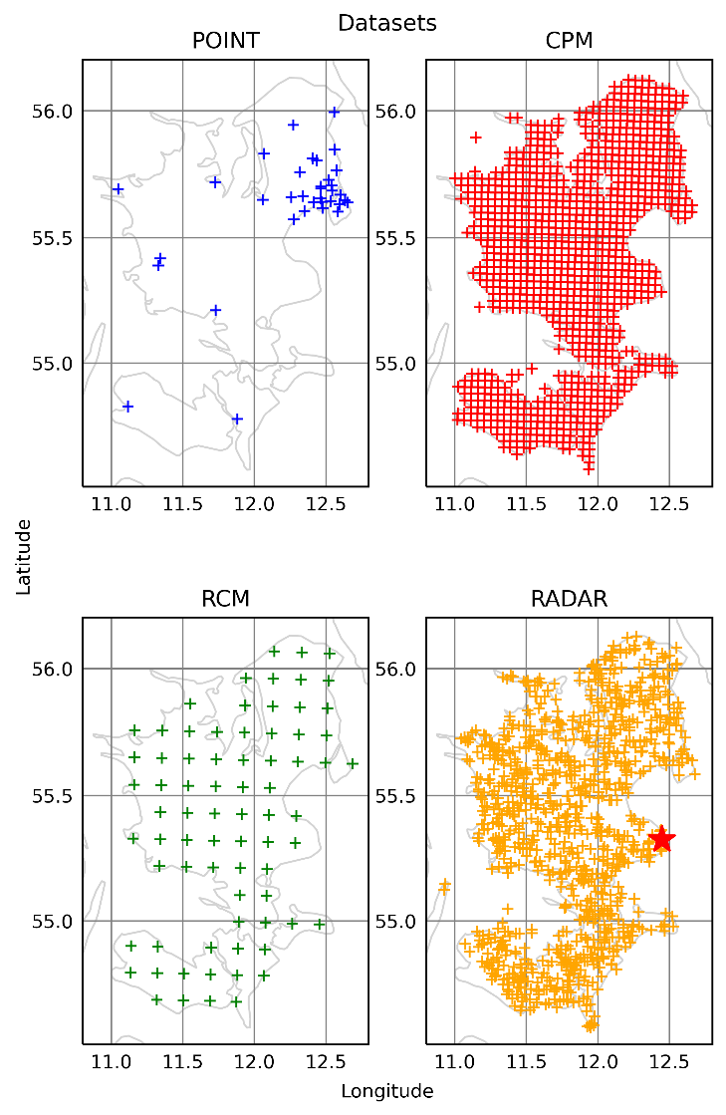
Introduction
Aim: Compare metrics of extreme precipitation
point measurements
radar data
Climate model data (CPM & RCM, re-analysis)
Data: Exact same spatio-temporal domain
120*175 km
14 years

Slide 3
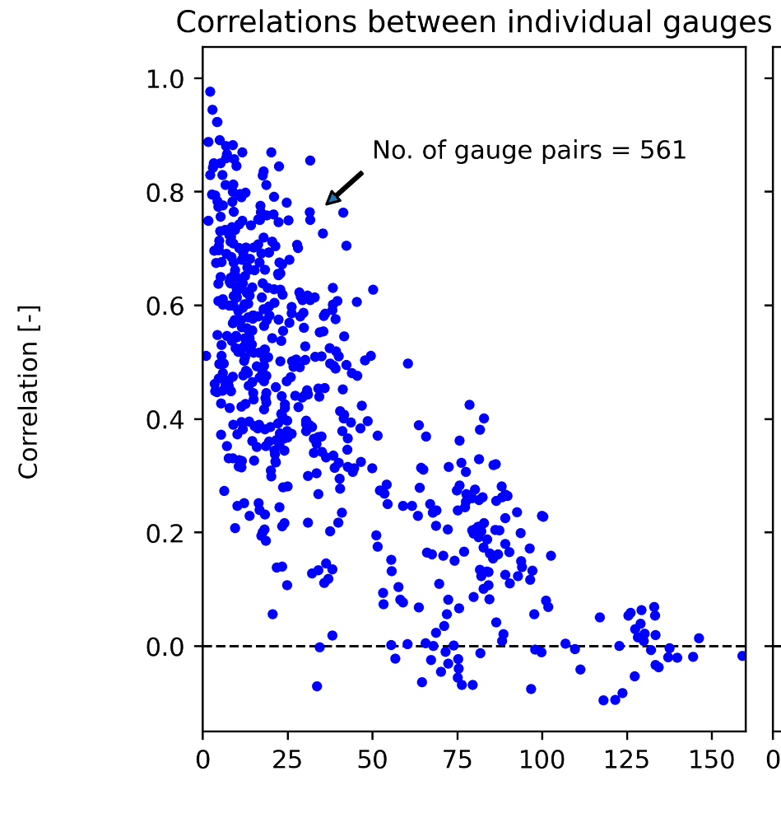
Metrics to be checked
(Annual mean precipitation)
Seasonal distribution
Intensity-duration-frequency curves
Unconditional spatial correlation

Slide 4
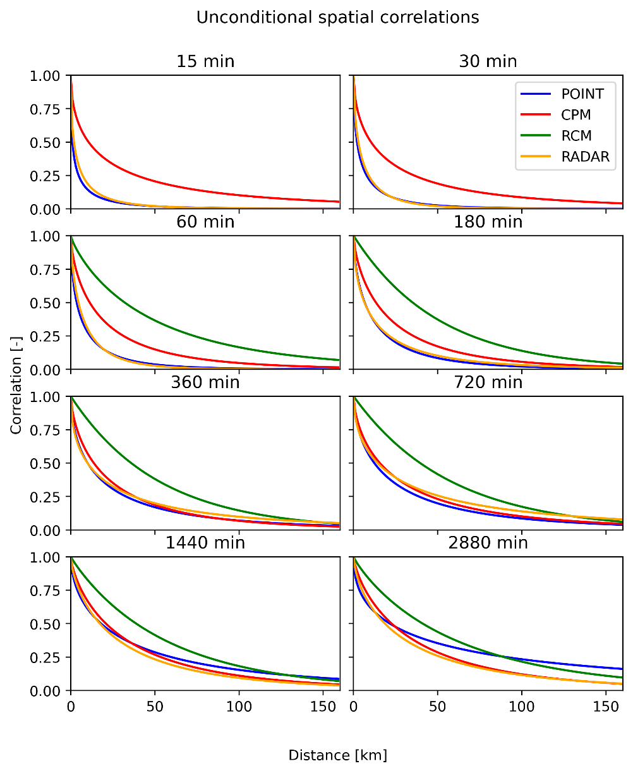
Findings
IDF + seasonal distribution ☺
Spatial correlation
For all practical purposes point and radar obs close to radar are identical ☺
Convection-permitting NWM improve spatial correlation ☺
More info https://doi.org/10.1016/j.jhydrol.2022.127915 (Journal of Hydrology, Accepted 03 May 2022)

