Slide 1


Forecasting high resolution variations in deep geothermal wells based on low resolution measurements and virtual sensors
Annette Dietmaier
Thomas Baumann
Vienna, May 25, 2022
Notes:
Acknowledge Sponsors

Slide 2
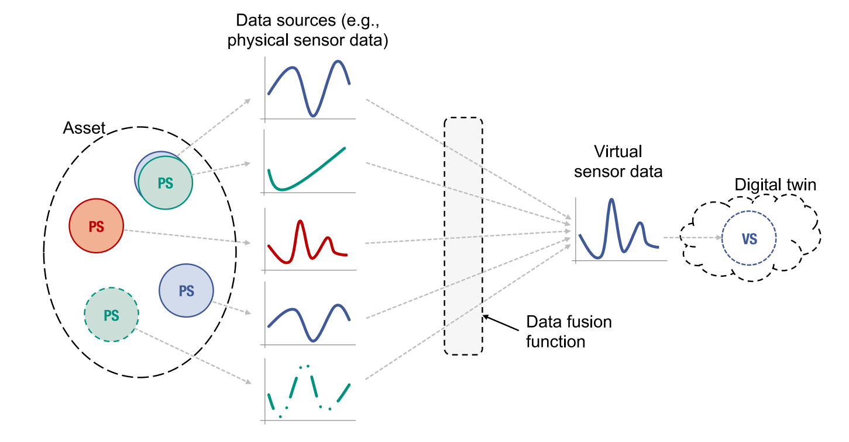
Virtual Sensors
A software that provides indirect measurements of a process variable or an abstract condition based on data gathered by physical (or other virtual) sensors (Martin et al. 2021)
Martin et al. 2021
PS: Physical Sensor, VS: Virtual Sensor

Slide 3
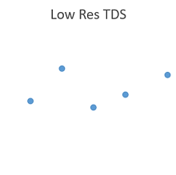
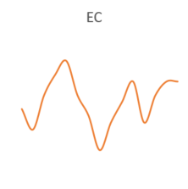
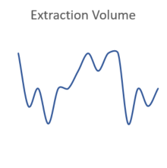
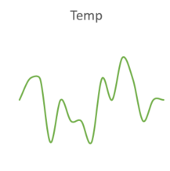
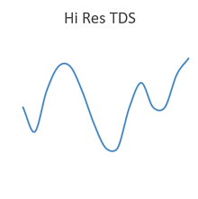
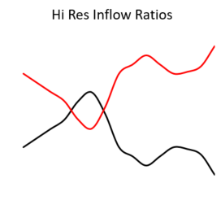
Virtual Sensors in Geothermal
Goal: hydrochemical parameters which indicate
matrix attributes along flow paths and thus flow pathways
Dynamic combination of heterogenous sensors (fusion function)
Reservoir
T1
EC1
TDS1
V1
Well head
T
V
EC
T2
TDS2
V2
EC2
Notes:
1 und 2: Zustrombereiche
Wichtig: Zustromanteile durch Korrelationen

Slide 4
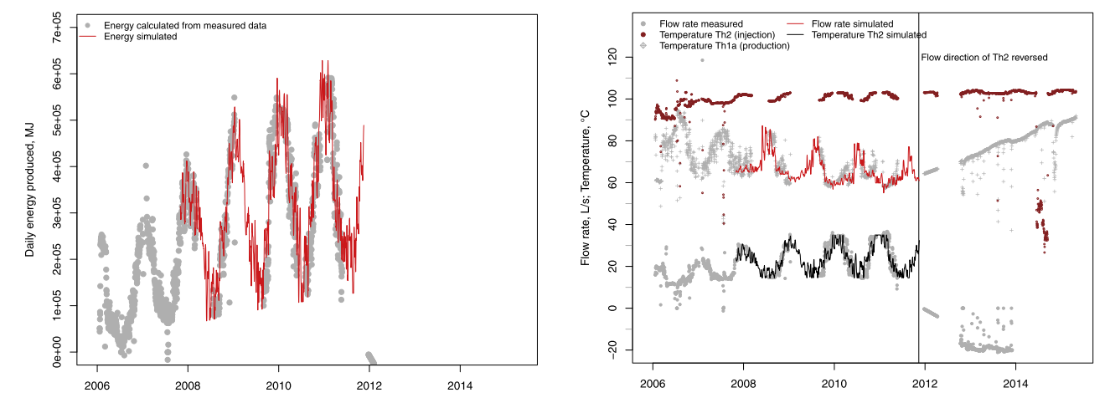
Previous Work
Filling up missing data for injection temperatures and mass fluxes using climate data and connected households
Baumann et al. 2017
Notes:
Left: Measured and substituted produced geothermal energy
Right: measured and substituted flow rates and injection temperatures

Slide 5
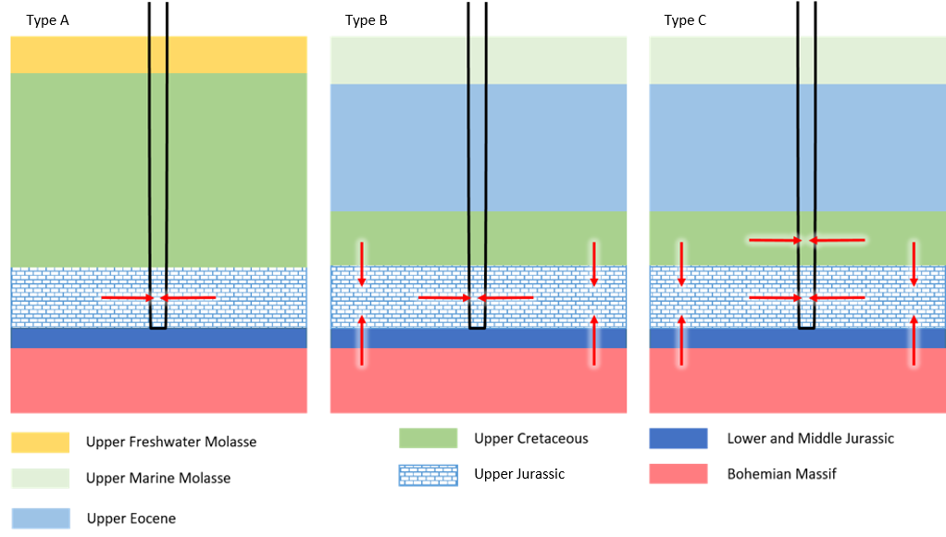
Applicability to different aquifer settings
Local flowpaths influence a groundwater‘s hydrochemical signature.
Little to no effect
Notes:
- Typ A: da passiert nichts
- Typ C: obsolet, da nicht mehr zulassungsfähig
- Typ B: wichtig, erklären warum

Slide 6
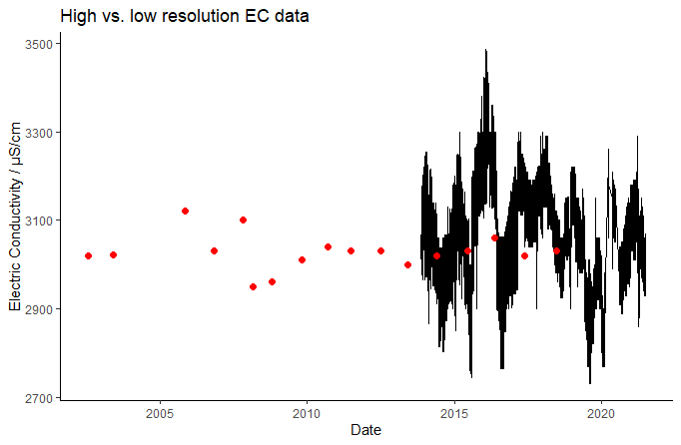
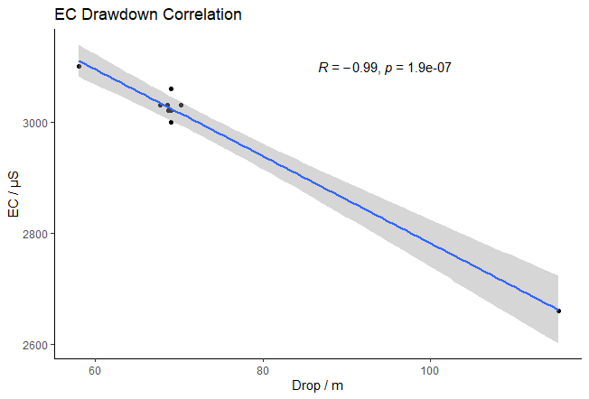
Indicators for Processes in the Reservoir
Variability of online data exceeds offline data
Hydrochemistry changes with pumping rate and drawdown
=> Assessment based on offline data misleading
Notes:
1: because samples were taken deliberately at the same pumping rates
2: different parts of the aquifer are contributing
Korrelation zw. Lastzuustand und EC
Anhand von EC, wie viel von welchem Zustromteil
Je mehr Absenkung desto mehr Aktivierung

Slide 7
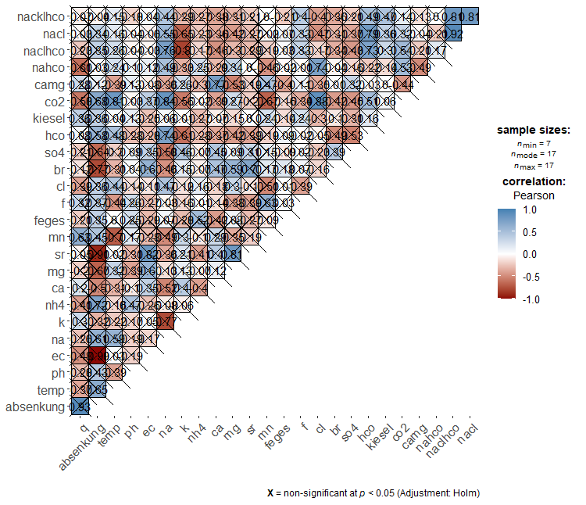
Conclusion
Virtual sensors can be applied to geothermal wells, if
there is a proper a priori characterization of the reservoir
the hydrochemical characteristics in the different parts of the reservoir are known
Of if
the samples are taken more frequently at different production scenarios
and learning algorithms in combination with mixing models are applied.
However, despite heightened awareness of the operators, the willingness to invest into hydrochemical reservoir characterization remains limited.
Notes:
This results in interesting correlations, which are not statistically significant yet, and means that we need to keep intensifying sampling at all wells.
Willingness: Analysenhäufigkeit kann reduziert werden, spart Geld

Slide 8
1 Sensor visualization: Pedometer
2 Competitive Sensing:
Multiple microphones to improve audio quality in cars
Virtual sensors
4 Dynamic Cooperative Sensing:
flexible adaptations to systemic changes
3 Static Cooperative Sensing:
several independent sensors

