Slide 1
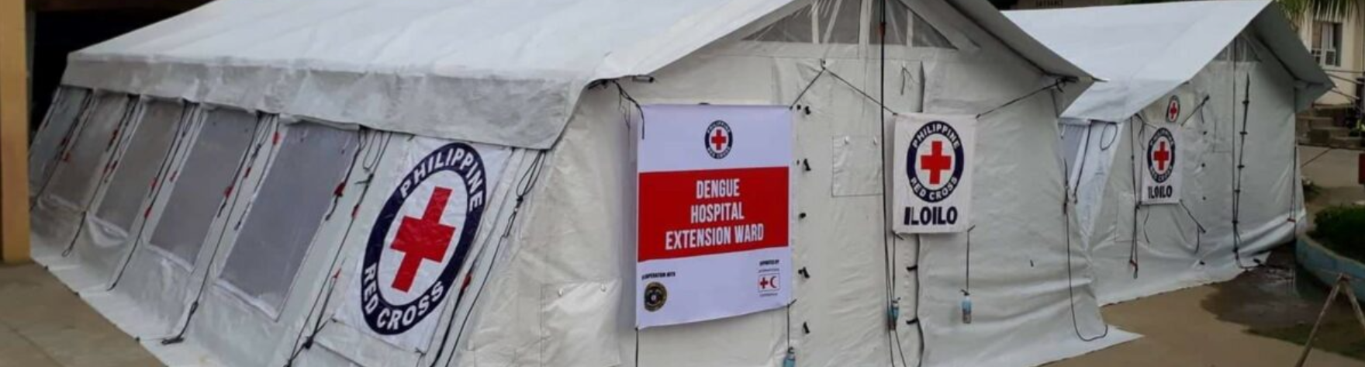


Assessing and Forecasting Dengue Risk with Hydrological Data
Jacopo Margutti, Marc van den Homberg, Fleur Hierink, and Nicolas Ray
EGU 2022

Slide 2



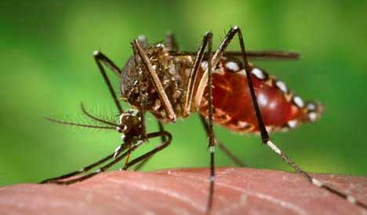
Context and our objectives
Half of the world's population at risk of dengue (WHO)
Deaths due to this vector-borne disease have increased by 65.5% from 2007 to 2017
Increased global push for epidemics early warning early action
Our Objectives:
Assess and map epidemic risk
Forecast epidemic outbreaks using hydrological data
Case study for the Philippines

Slide 3




Methodology for assessing dengue risk and forecast outbreaks
Is scalable to other countries
Does NOT rely on accurate clinical, virological, entomological data as often not available (costly, prerogative of health authorities), but on openly available data (Demographic and Health Surveys, etc)
Provides actionable information, on a local scale (not country-wide aggregates), so that it can inform local humanitarian action

Slide 4


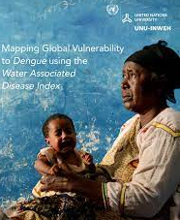






How to define epidemic risk?
Water Associated Disease Index approach:
Weighted average of exposure and susceptibility, which quantify the risk of being exposed to pathogen and risk of experiencing health outcomes
Risk = +
Exposure
Susceptibility
Vector abundance
Population density
….
Age groups
….
Access to healthcare
Access to sanitation facilities
Vector control
….

Slide 5
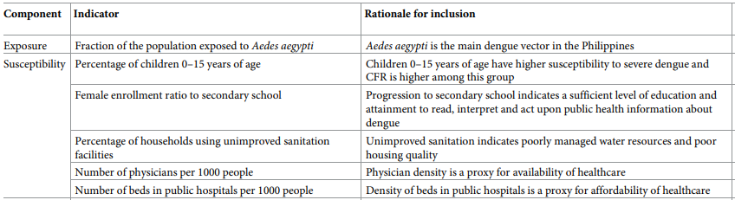
Constructing the risk index

Slide 6
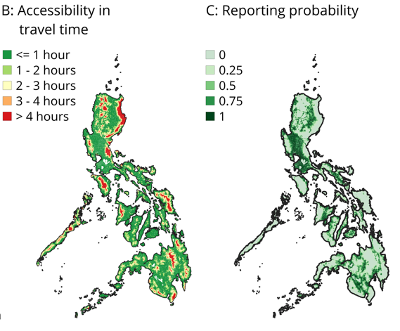
Validating the risk index
Against corrected dengue incidence & case-fatality rate
Correct for under-reporting, based on geographical accessibility to healthcare

Slide 7
Validating the risk index
Results show significant correlation between risk index and dengue incidence
Pearson’s r 0.69
p-value 0.002
Notes:
Hierink, F., Margutti, J., van den Homberg, M., & Ray, N. (2022). Constructing and validating a transferable epidemic risk index in data scarce environments using open data: A case study for dengue in the Philippines. PLoS neglected tropical diseases, 16(2), e0009262.

Slide 8
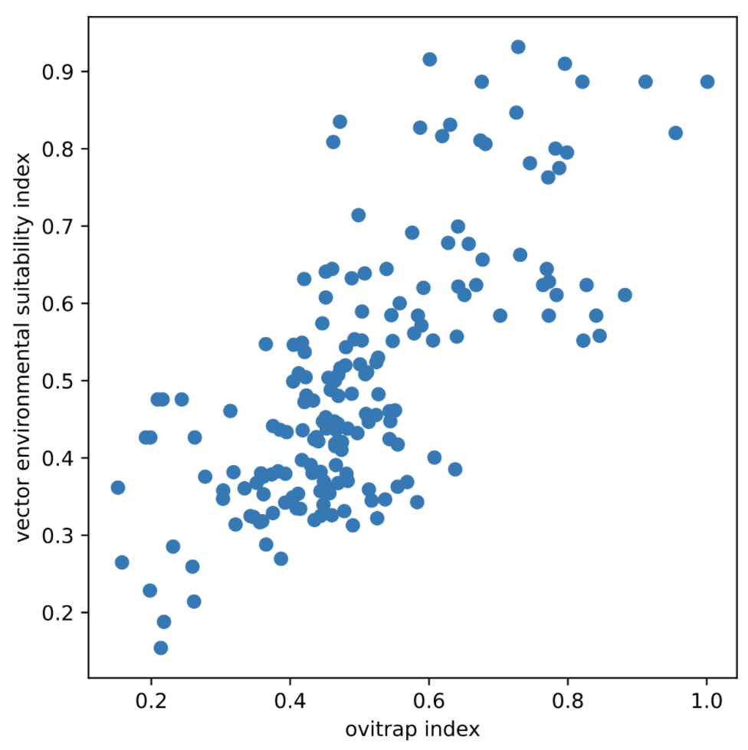
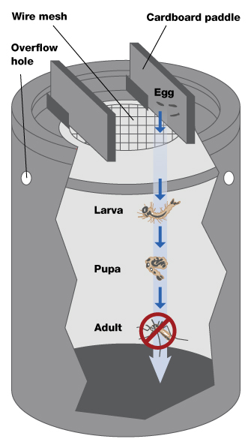
Forecast epidemic outbreaks using meteorological predictors
Model to predict
Abundance of mosquitoes
Translate into number of potential dengue cases, assuming a fixed time lag w.r.t. vector outbreaks (30-90 days from literature)
Model xgboost (1):
Predictors: rainfall, temperature (Google Earth Engine)
Target: vector environmental suitability index ∈ [0,1]
Validation: ovi trap measurements by Philippines’ Department of Veterinary Services
Results show good performance on nowcasting mosquitoes at province level (20-fold CV MAE 0.10-0.12, R2 0.38-0.83)
Notes:
DVS department of veterinary services
vector environmen-
tal suitability index v, which broadly defines how favourable a location is for the species with respect to environmental variables (covariates).

Slide 9


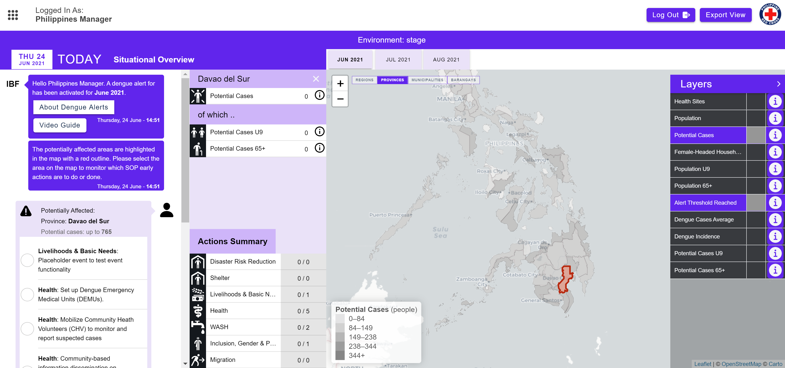
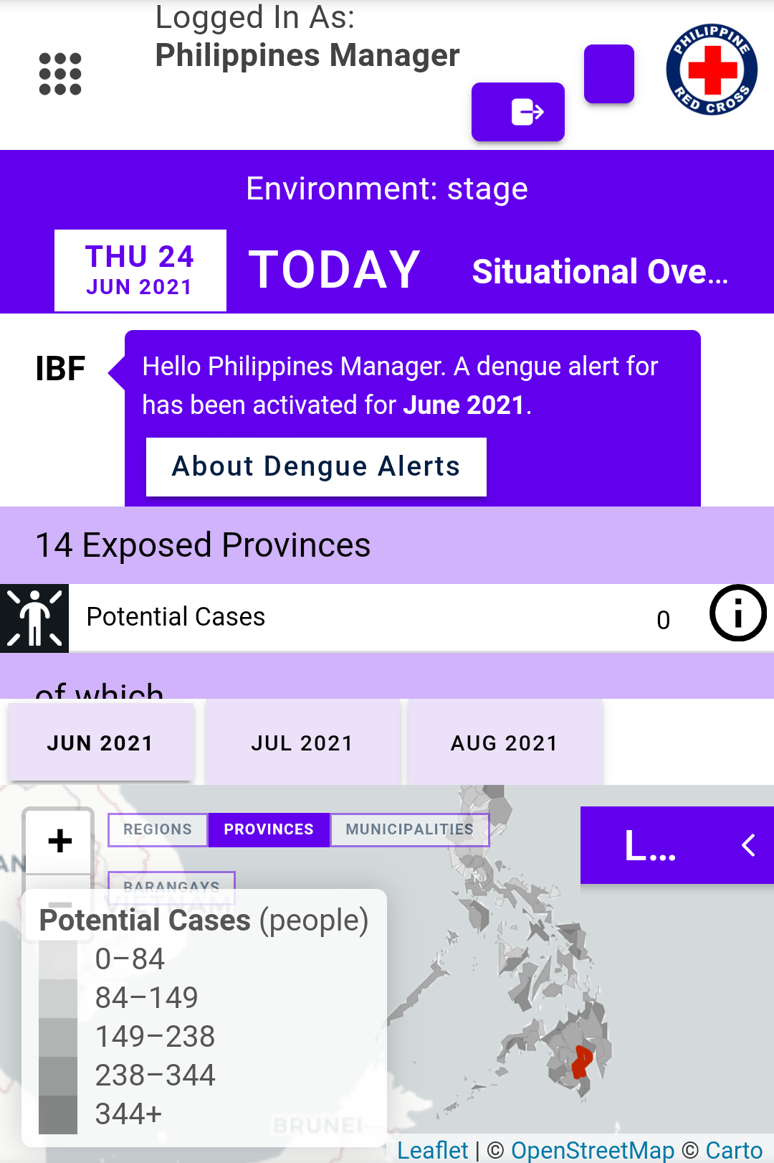




From warnings to action
DENGUE RISK INDEX
IMPACT-BASED FORECASTING PORTAL
DENGUE FORECAST

Slide 10
Dengue impact-based forecasting portal

Slide 11
To conclude
Dengue epidemic risk index
Strong indicator of sub-national dengue disease patterns
Suitable for disease risk assessments in absence of timely and complete epidemiological data.
Forecast model for outbreaks
Link between climatic indicators and epidemic outbreaks is possible (for vector-borne diseases)
Enabled by increased access to global, high-quality meteorological data
Notes:
Outputs

Slide 12
Lessons learned
Not only models but tangible outputs
Interactive dashboard
Early Action Protocol
Closely link research to human-centred design: what are users/decision makers supposed to do?
  Mandate & roles
  Capacity, literacy
  Existing processes & tools
Challenges
  Complex coordination between many actors
  Properly conveying the meaning of uncertainties
  Inability to act can be due to politics rather than lack of information

Slide 13
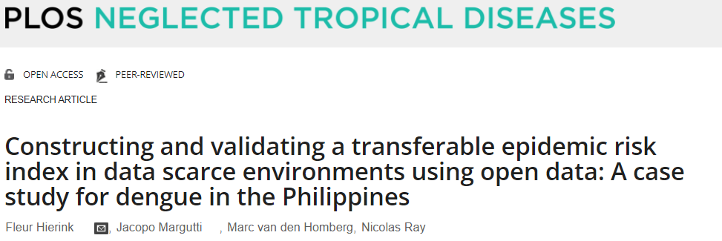
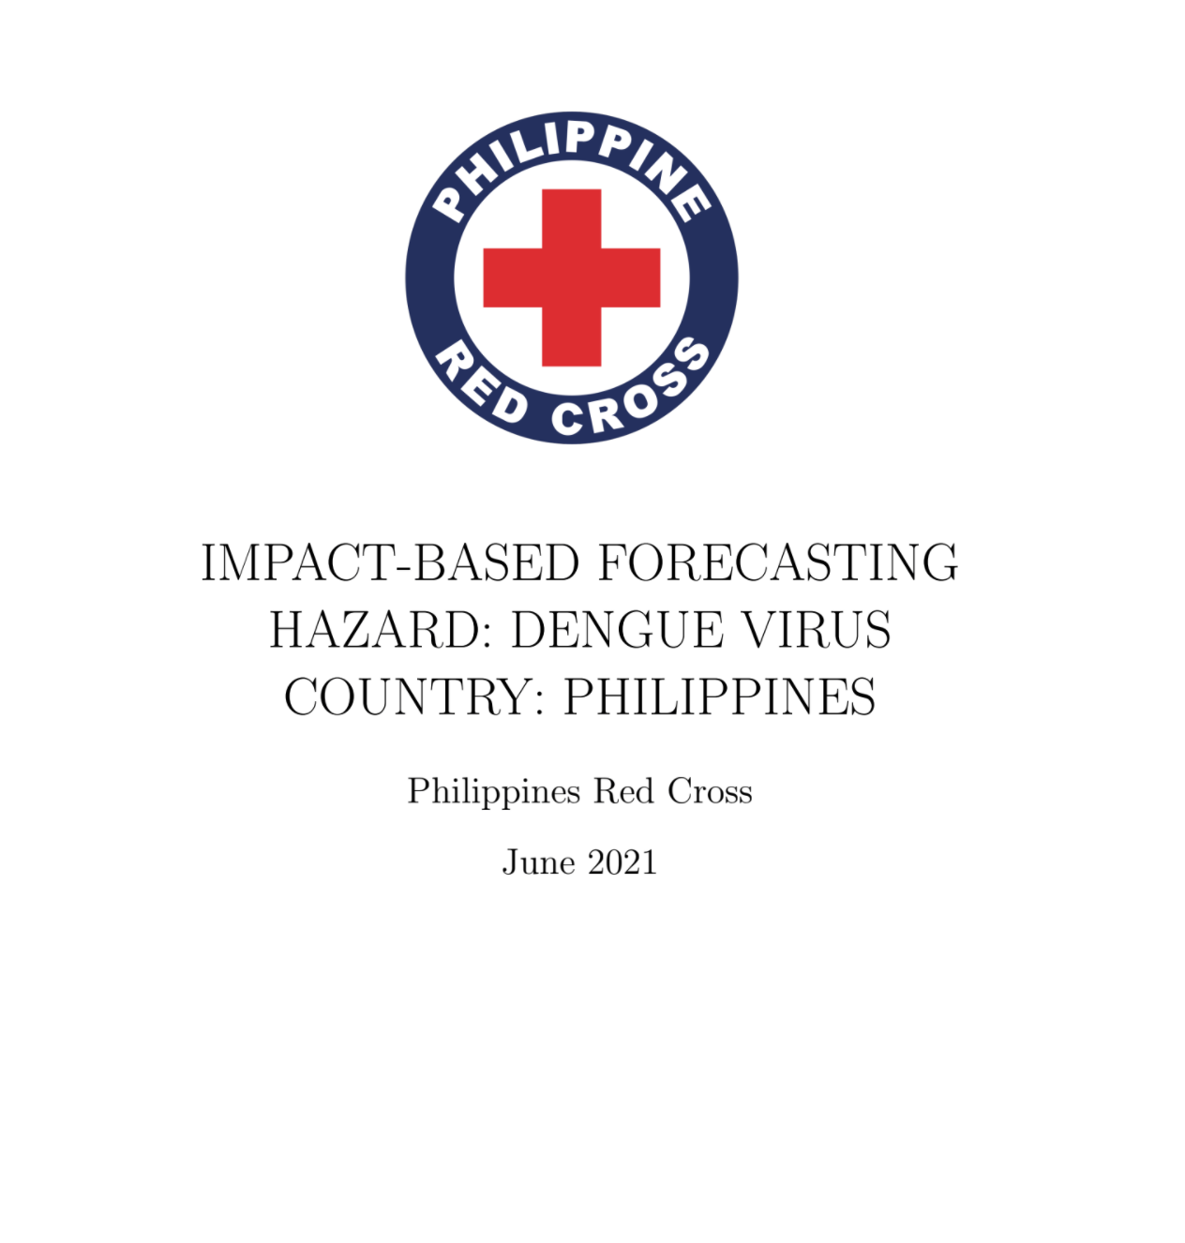
Resources
  Resources
  Paper: Hierink et al., 2021 https://doi.org/10.1101/2021.02.23.432447
  Technical Note: link
  Code of dengue model
  https://github.com/rodekruis/IBF-dengue-model
  Code of IBF portal
  https://github.com/rodekruis/IBF-system
  Contact information
  mvandenhomberg@redcross.nl
  jmargutti@redcross.nl

Slide 14


