Slide 1

Overturning and water mass transformation in CMIP6 models L C Jackson, Met Office, UK T Petit, Reading, UK

Slide 2
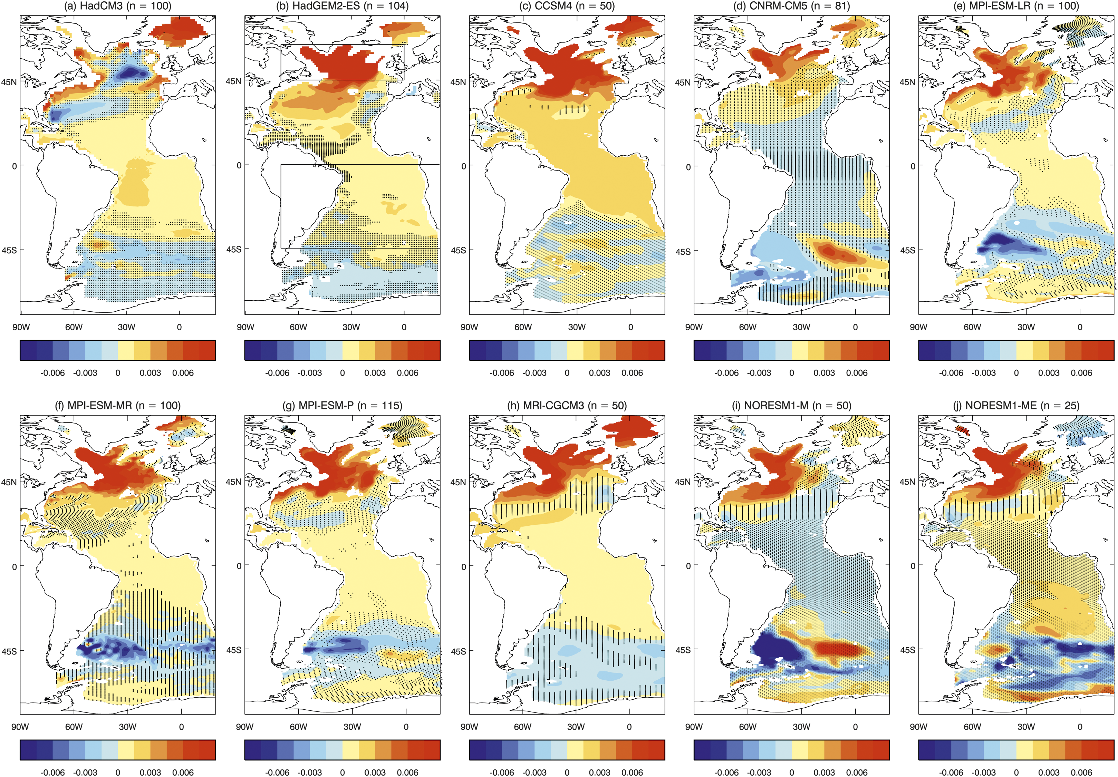
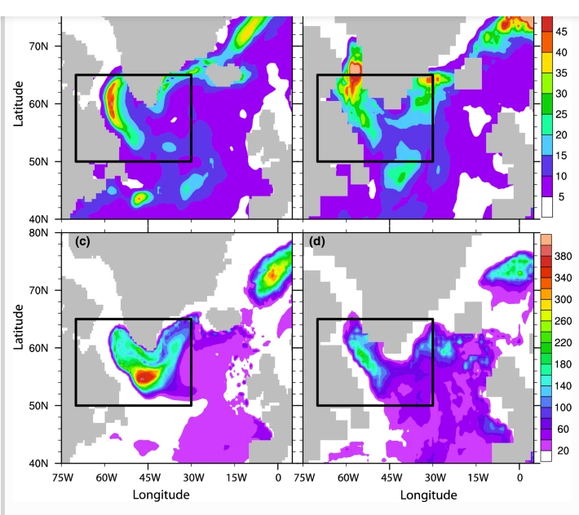
Many studies have shown relationships between AMOC and Labrador Sea/West SPG densities and mixed layer depths (proxy for convection). Thought to be because NAO phase causes anomalous heat loss/gain changing densities and convection.

Slide 3
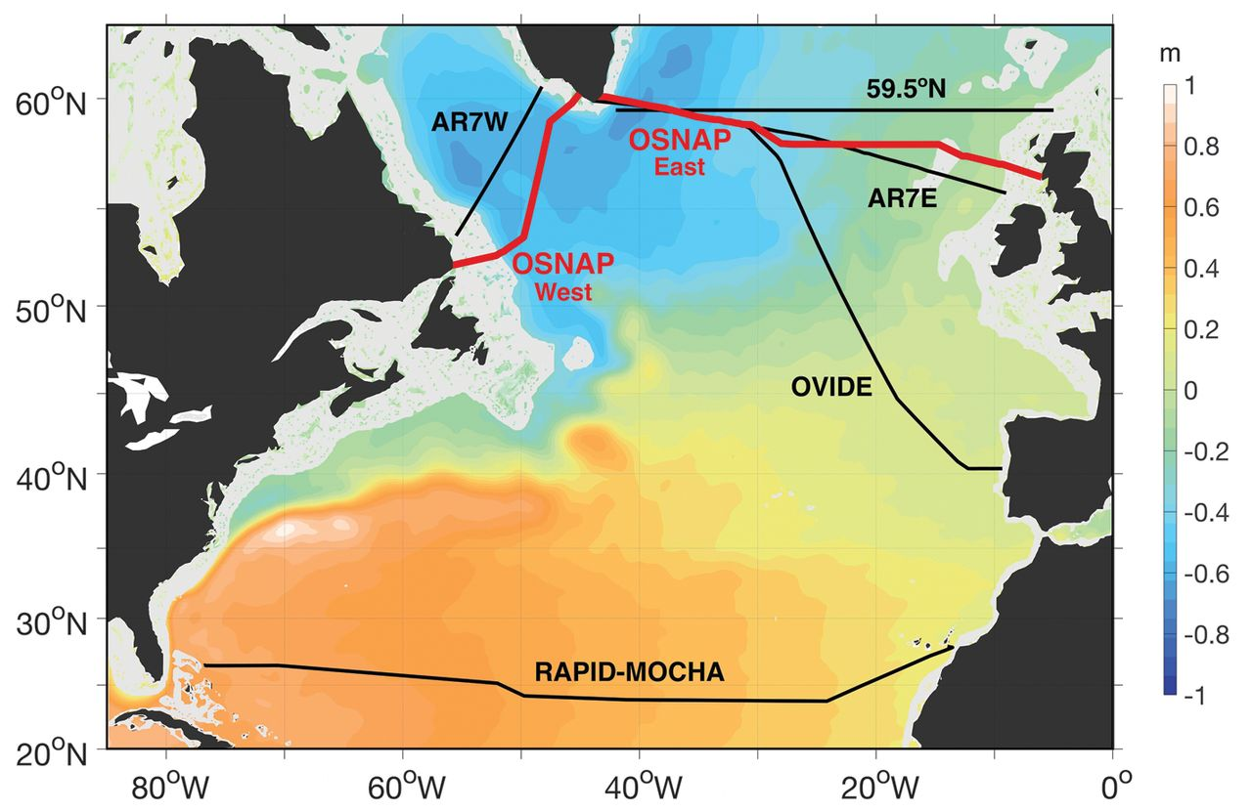
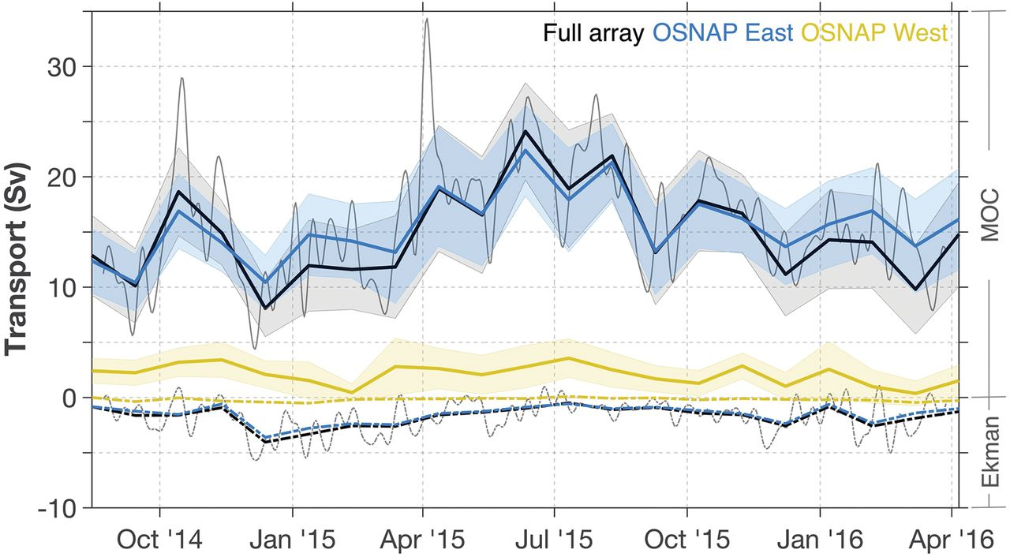
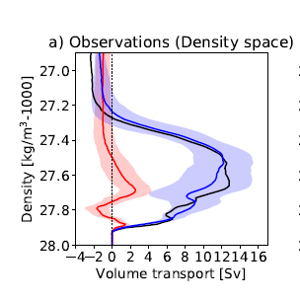
Recent observations from OSNAP show overturning in density space much larger across the east section than west section, implying more density transformation north of OSNAPE
Lozier et al, 2019. BAMS

Slide 4
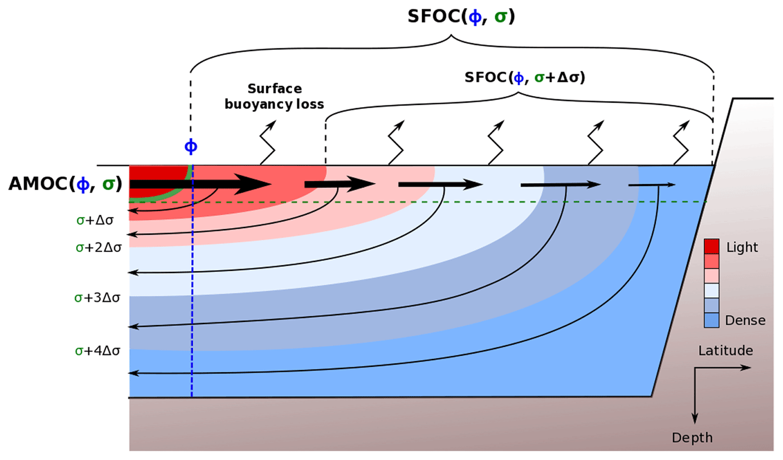
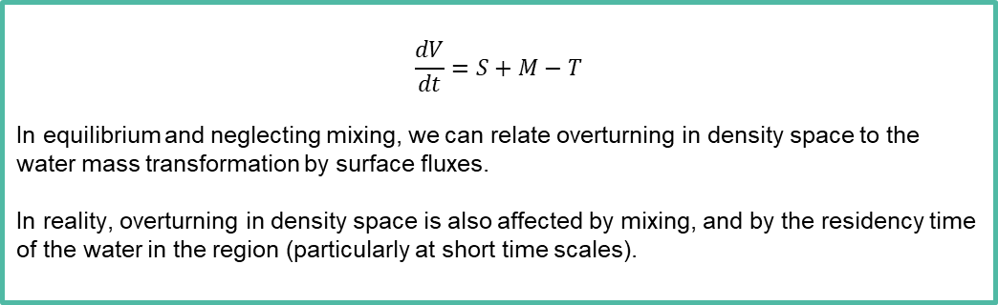
Surface transformation S
Transport T
Volume V
Mixing M
Desbruyeres et al, Ocean Science, 2019
$$\frac{dV}{dt}=S+M−T$$
In equilibrium and neglecting mixing, we can relate overturning in density space to the water mass transformation by surface fluxes.
In reality, overturning in density space is also affected by mixing, and by the residency time of the water in the region (particularly at short time scales).
Background

Slide 5
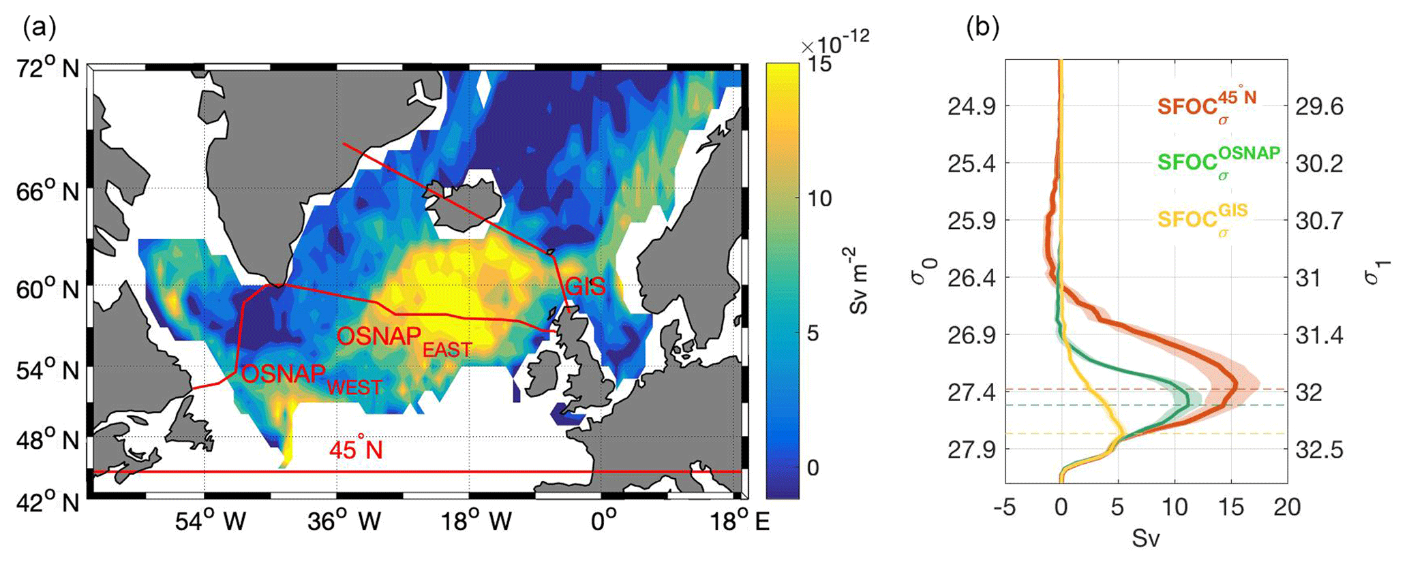
Can construct overturning from surface fluxes only (not including mixing). Results from surface fluxes from atmos reanalyses: most transformation between OSNAP east and Sills.
Desbruyeres et al, 2019. Ocean Science

Slide 6
Models and methods

Slide 7
Concentrate on models HadGEM3-GC3-1LL and MM
Both CMIP6 models using NEMO ocean model and UM atmosphere
Ocean resolution of 1º and 1/4º
Calculate overturning across OSNAP section and others. Also calculate implied overturning from surface-forced WMT (SFWMT)
Also use 6 other CMIP6 models
Use only implied overturning from SFWMT
Look at mean state and variability of decadal means.

Slide 8
Model mean overturning and WMT

Slide 9
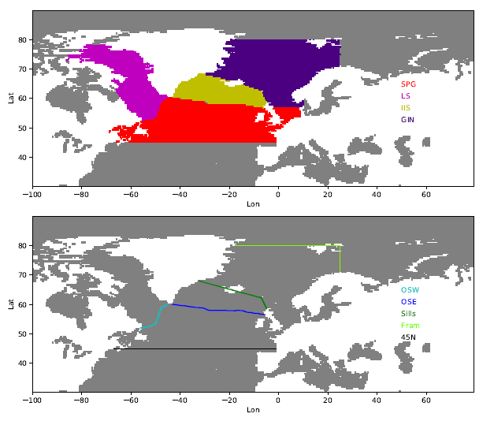
Calculate overturning across sections: 45N, OSNAPW, OSNAPE, the Sills and Fram Strait
Convergences used to calculate contribution of regions to overturning at 45N

Slide 10
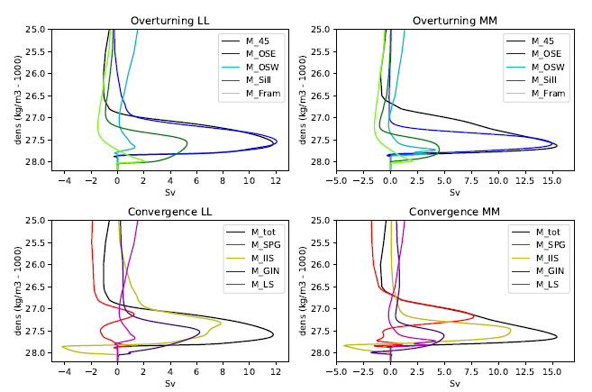
Mean state.
Overturning agrees well in both with OSNAP: OSNAPE dominates OSNAPW.
Convergence shows most of the overturning comes from the Iceland and Irminger seas (yellow).
Dense water flowing over the Sills (green) does not make it to OSNAPE (blue). Convergence shows dipole (yellow) suggesting mixing to lower densities in the IIS

Slide 11
So AMOC mean strength in both models is dominated by the AMOC over the Irminger and Iceland Seas (IIS).
Q1. Is the overturning dominated by the transformation by surface fluxes (rather than mixing)?
Q2. Can the overturning estimated from the surface flux transformation be used as an indicator of the actual AMOC? In which case comparisons with observations and with CMIP6 models become easier.

Slide 12
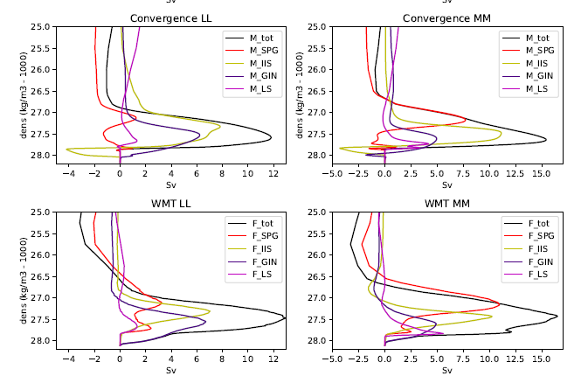
Actual overturning
Implied overturning
Good qualitative agreement between actual and implied overturning convergences.
Although mixing in overflows is not captured in IIS, the maximum is captured. This suggests mixing shifts the density location of the deep branch but doesn’t affect the total transport.

Slide 13
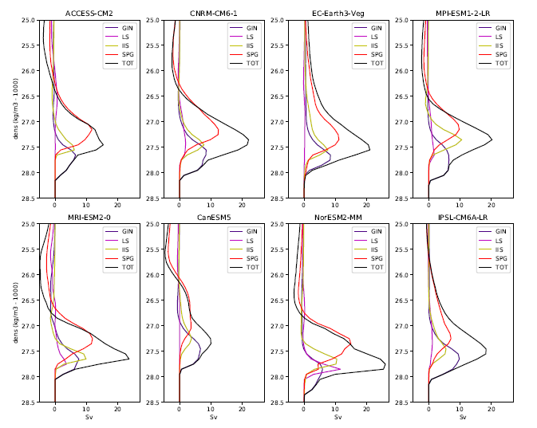
Implied overturning from CMIP6 models
IIS large contribution near the overturning peak in all models (though not always dominant)
LS has large range – from zero to 10 Sv

Slide 14
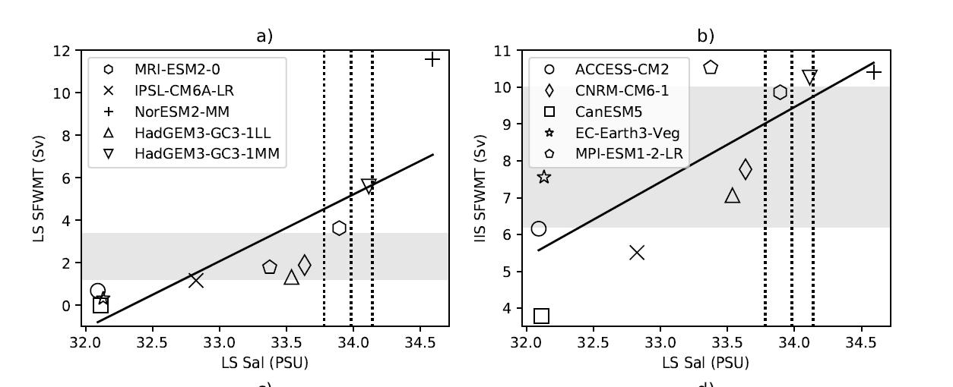
See strong relationship of both LS and IS overturning with LS surface salinity (and temperature). Fresher models have less overturning.
Obs estimates (vertical lines and grey bars) show some models have too much overturning in the LS but some have too little.

Slide 15
Decadal variability of overturning and WMT

Slide 16
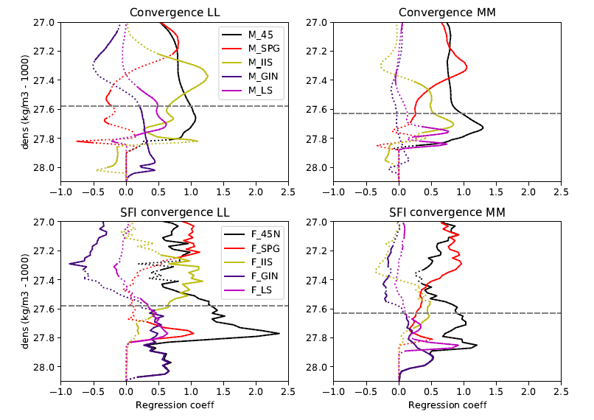
Regressions of convergence profiles with AMOC timeseries at 45N (dotted not significant)
At density where AMOC at 45N is maximum (grey dashed line), the strongest relationship is with overturning in IIS, but also contributions from others.
At lighter densities correlations with SPG and at denser densities with LS and GIN.

Slide 17
Implied overturning generally good indicator of actual variability
However SFWMT implies strong variability in GIN WMT is affecting AMOC at 45N, but this is not true in actual overturning.

Slide 18
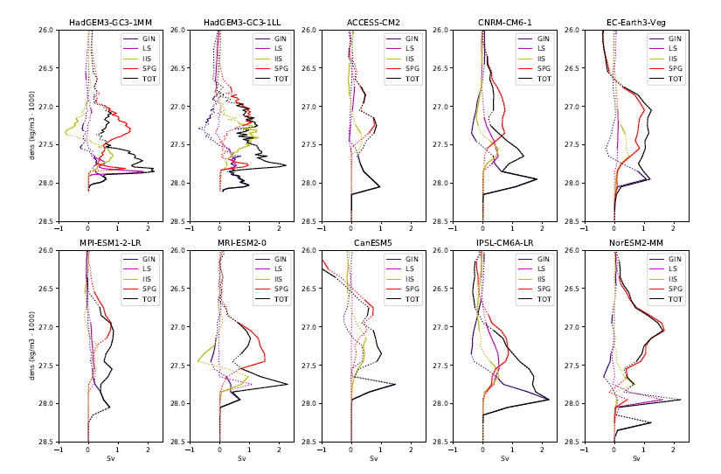
Regressions of implied overturning profiles in CMIP6 models with maximum AMOC at 26.5N
Very varied behaviour …

Slide 19
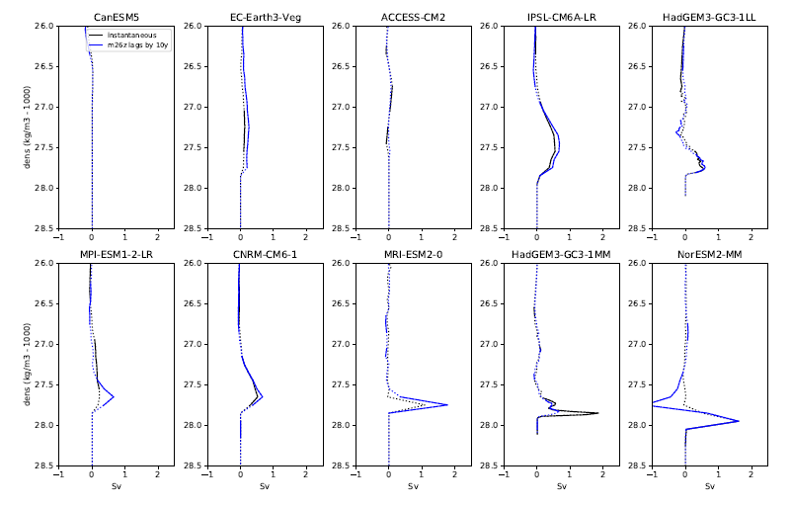
Weak mean LS overturning
… however LS overturning variability is related to mean LS strength.
Stronger mean LS overturning means stronger regressions of LS variability with AMOC variability at 26.5N, and relationships at denser levels in the LS.
Strong mean LS overturning

Slide 20
Conclusions
Models agree with observations that the mean overturning is strongest in the east (particularly in the IIS).
The mean overturning in the Labrador Sea is mostly found to be small, but has a strong relationship with salinity: fresh models have weak overturning and saline models have stronger mean overturning and stronger relationships of the Labrador Sea overturning variability with the AMOC further south.
The overturning reconstructed from surface flux driven water mass transformation is a good indicator of the actual overturning, though mixing can damp variability and shift signals to different density classes.

