Slide 1
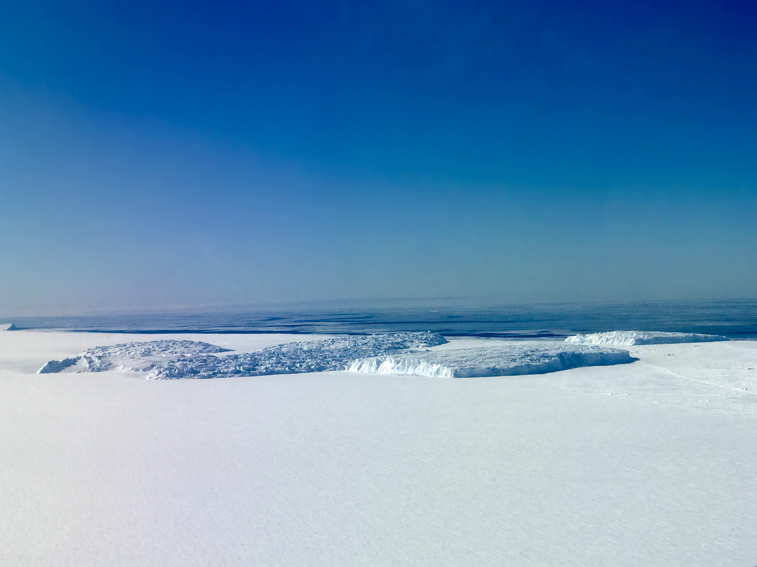



Using random forest machine learning algorithm to help investigating the relationship between subglacial sediments and ice flow in Antarctica
Authors: Renata Regina Constantino¹, Kirsty J. Tinto¹, Robin E. Bell¹,
¹Lamont-Doherty Earth Observatory, Columbia University, New York, NY, United States

Slide 2
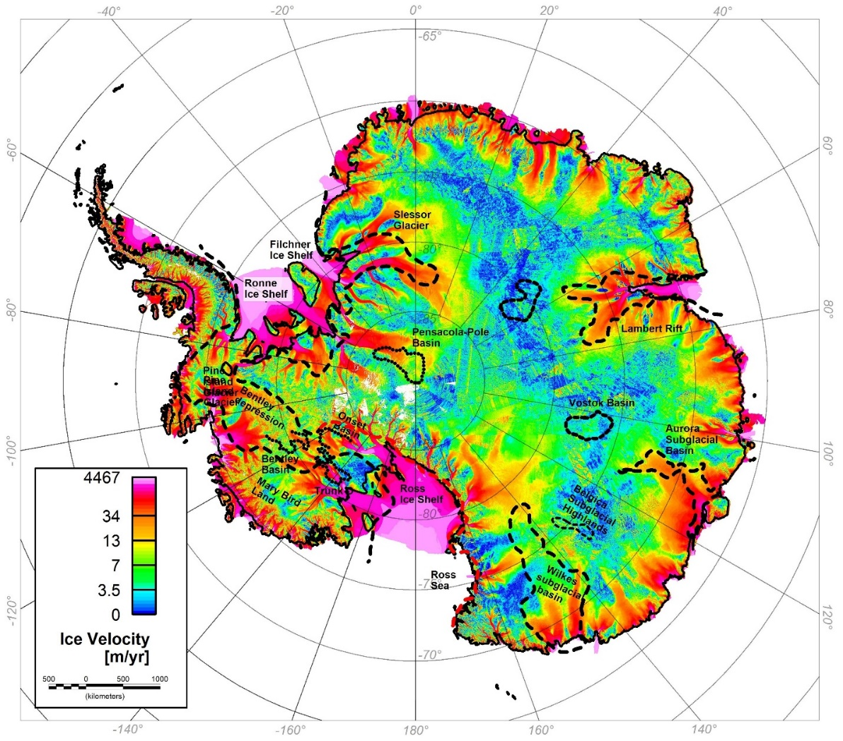
Motivation
Pan-Antarctic assessment of sedimentary basins and the onset of streaming ice flow from machine learning and aerogravity regression analyses.
Scientific hypothesis: sedimentary basins are correlated to fast ice flow behavior and to understand this correlation, we need a comprehensive identification of the sedimentary basins in Antarctica.
The main goals of this project are:
To characterize known sedimentary basins and to identify new ones using MACHINE LEARNING.
To identify new sedimentary basins by GRAVITY REGRESSION ANALYSES.
To understand the CORRELATION between sedimentary basins and ice streams, qualitatively and quantitatively.
Ice Velocity (Mouginot et al., 2017)

Slide 3
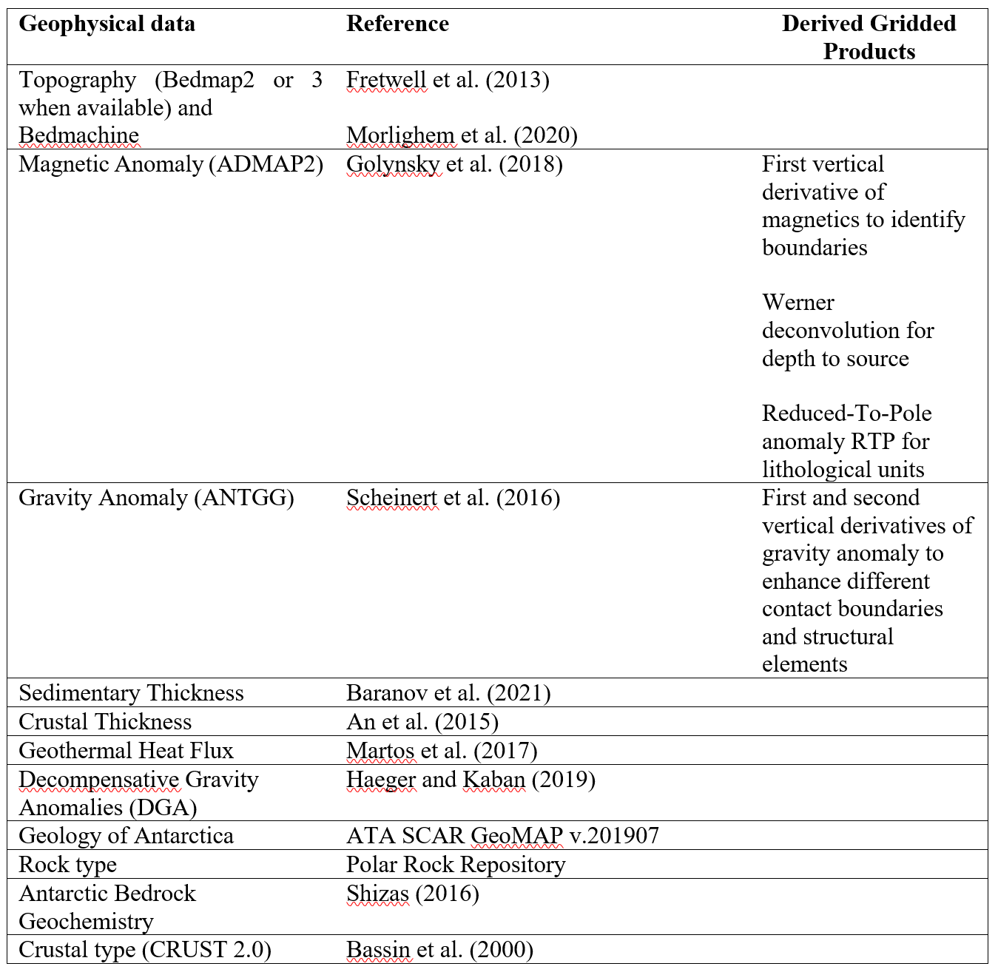
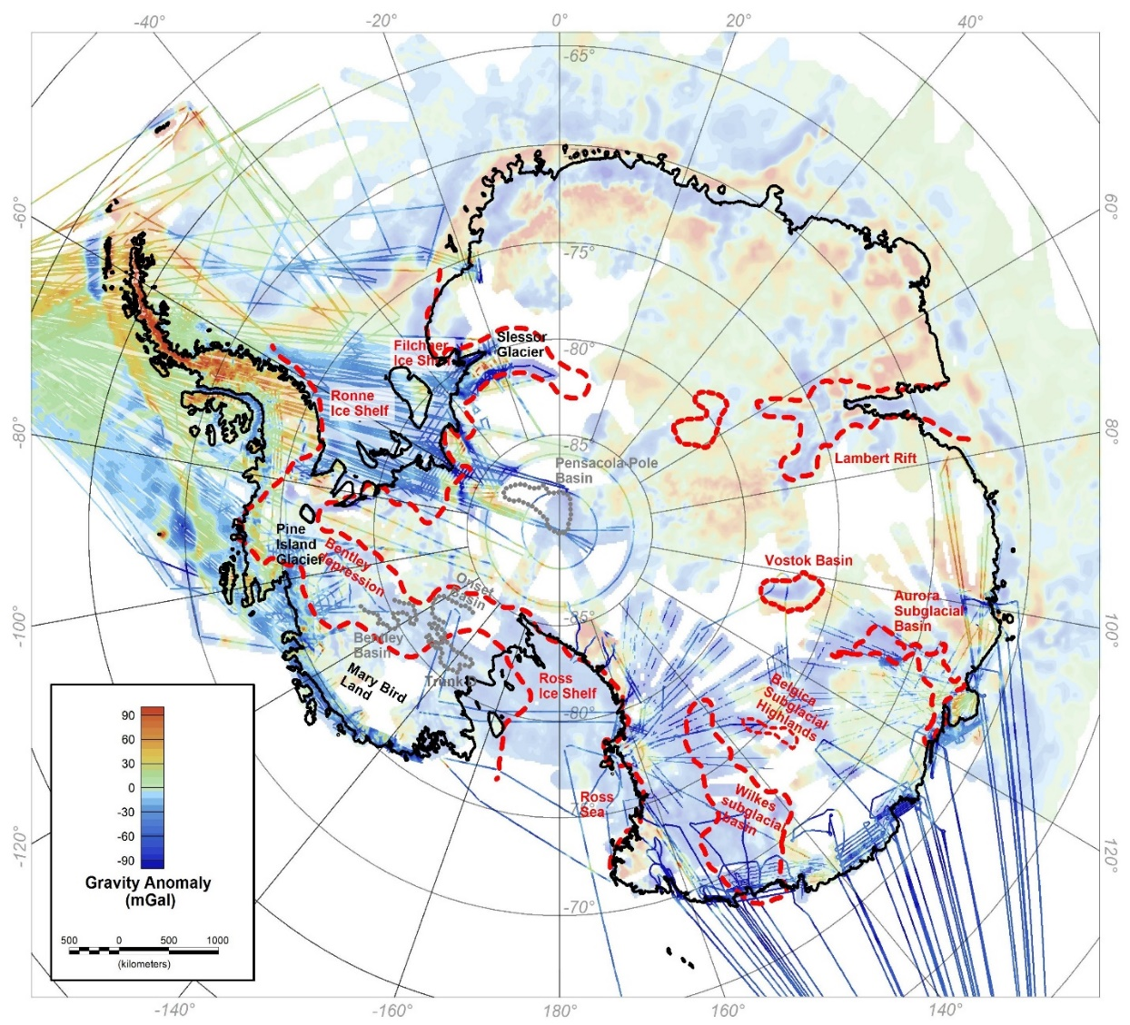
Method
Method
Uses a combination of large-scale datasets to characterize known basins and identify new sedimentary basins

Slide 4
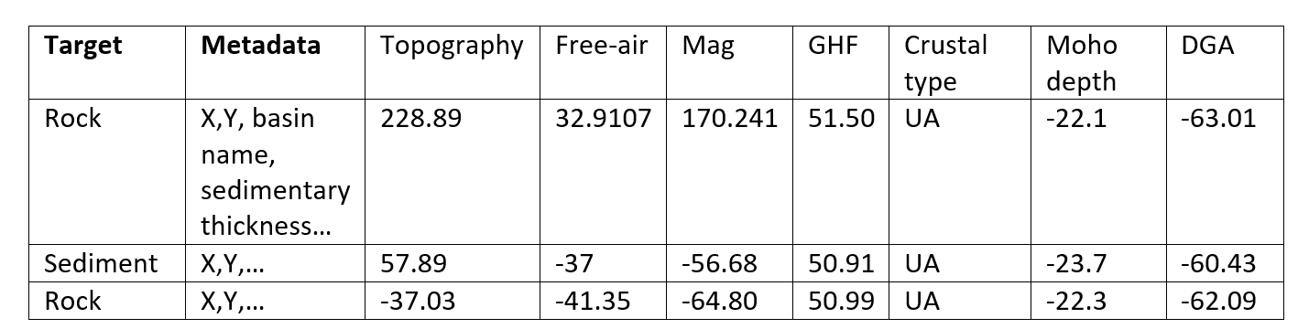
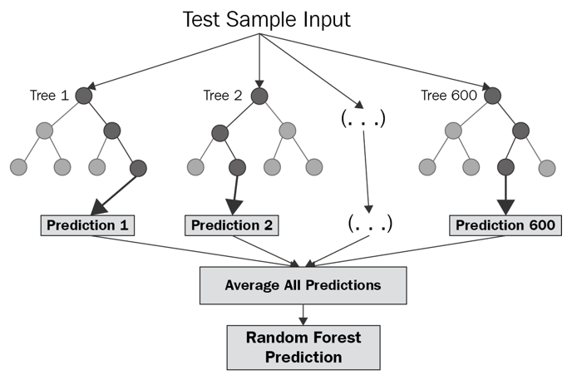
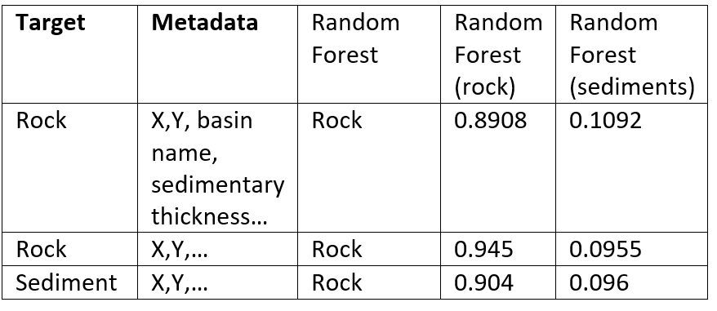
Method
Method
Random Forest is a supervised machine learning algorithm that can learn complex relationships by voting among a collection of randomized decision trees
Database that will contain instances and features.
The instance has a target, which features (target’s characteristics) are assigned to. The instance can also have metadata (information that is known but won’t be used for the prediction trees).
Instances
Metadata
Features
https://corporatefinanceinstitute.com/resources/knowledge/other/random-forest/

Slide 5
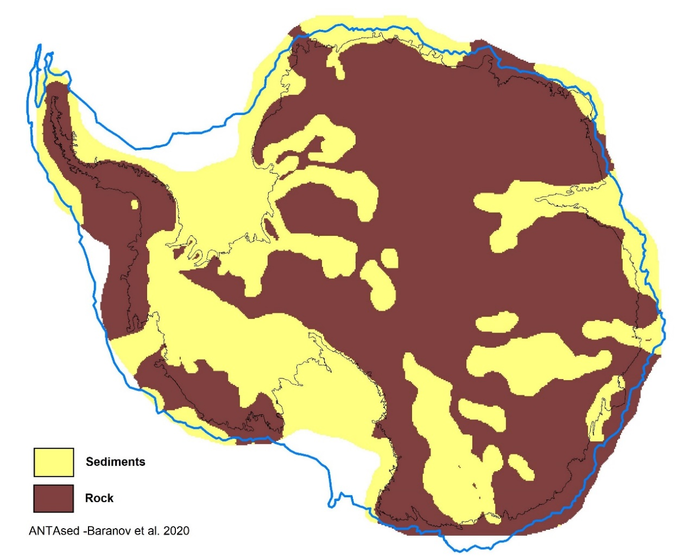
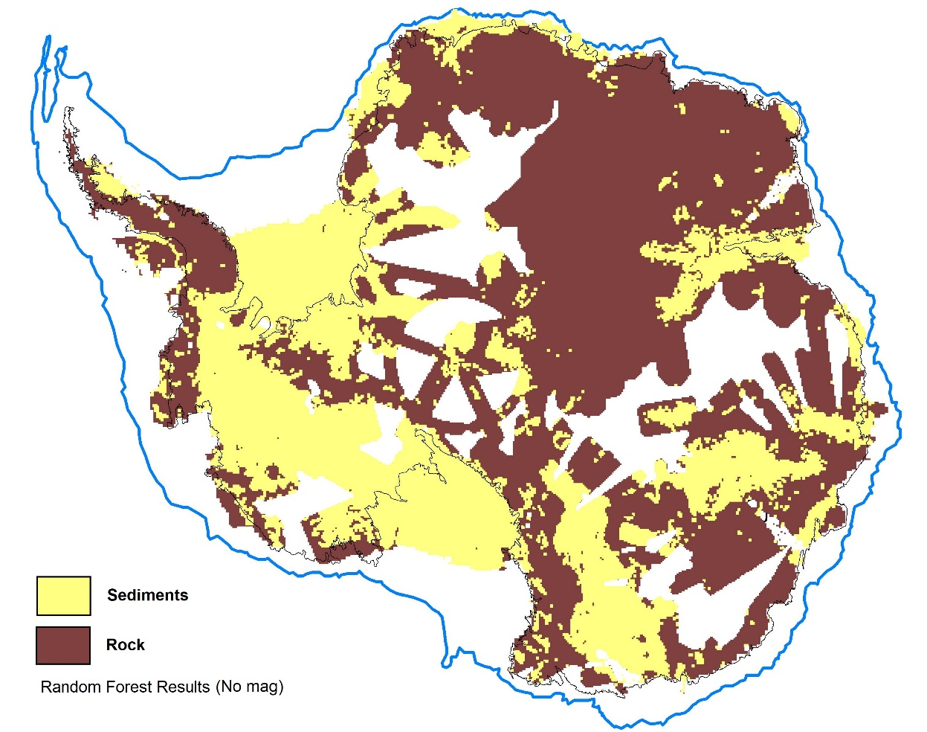
Partial Results

Slide 6
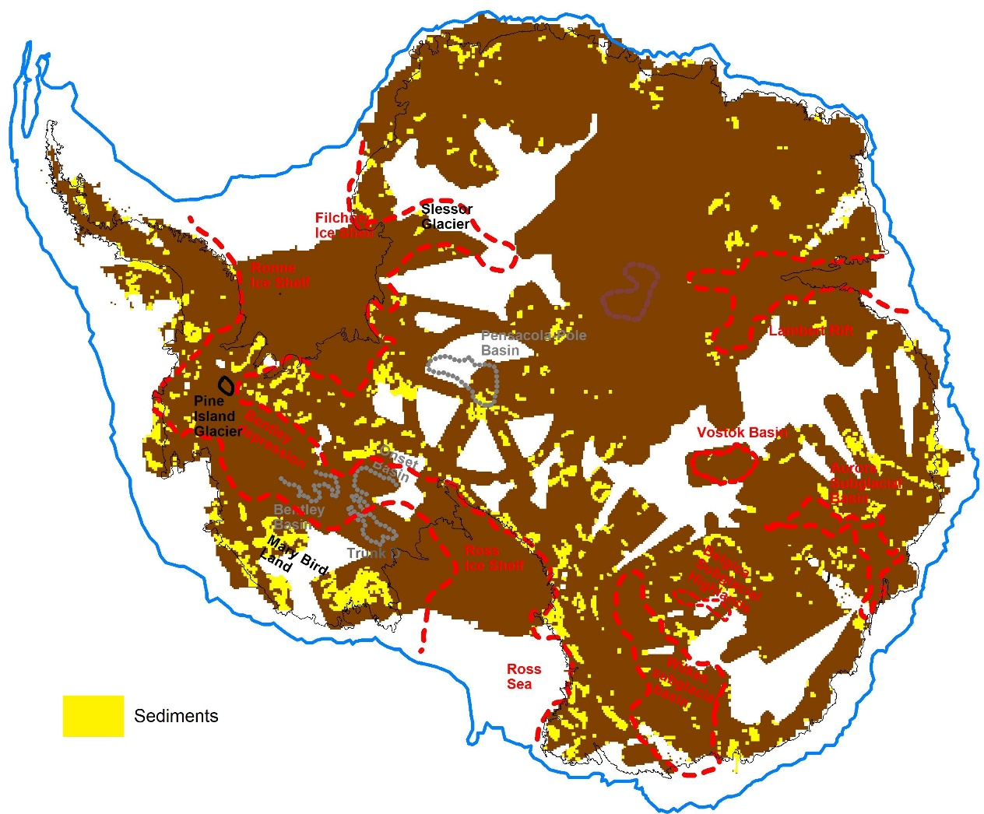

Partial Results

Slide 7
Partial Results
Foundation and
Patuxent ice streams
George VI Ice Shelf

Slide 8
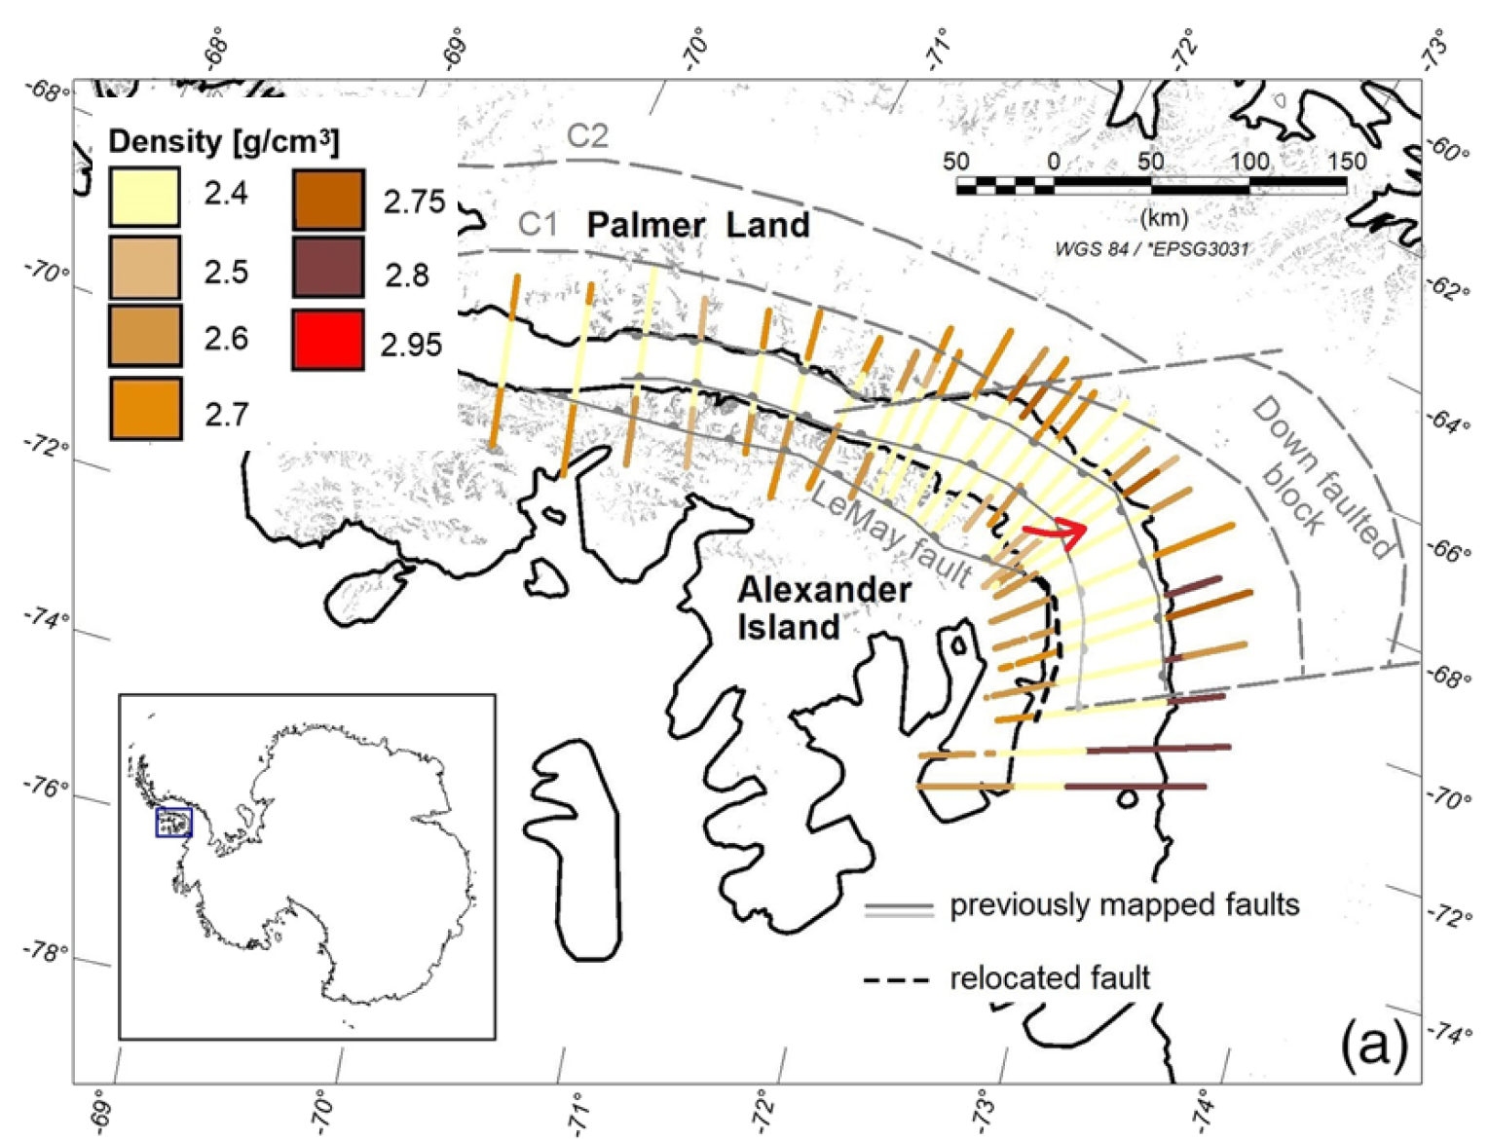
Partial Results
George VI Ice Shelf
Maslanyj (1988),
Constantino et al. 2020
Constantino et al. 2020

Slide 9
Partial Results
Foundation and
Patuxent ice streams

Slide 10
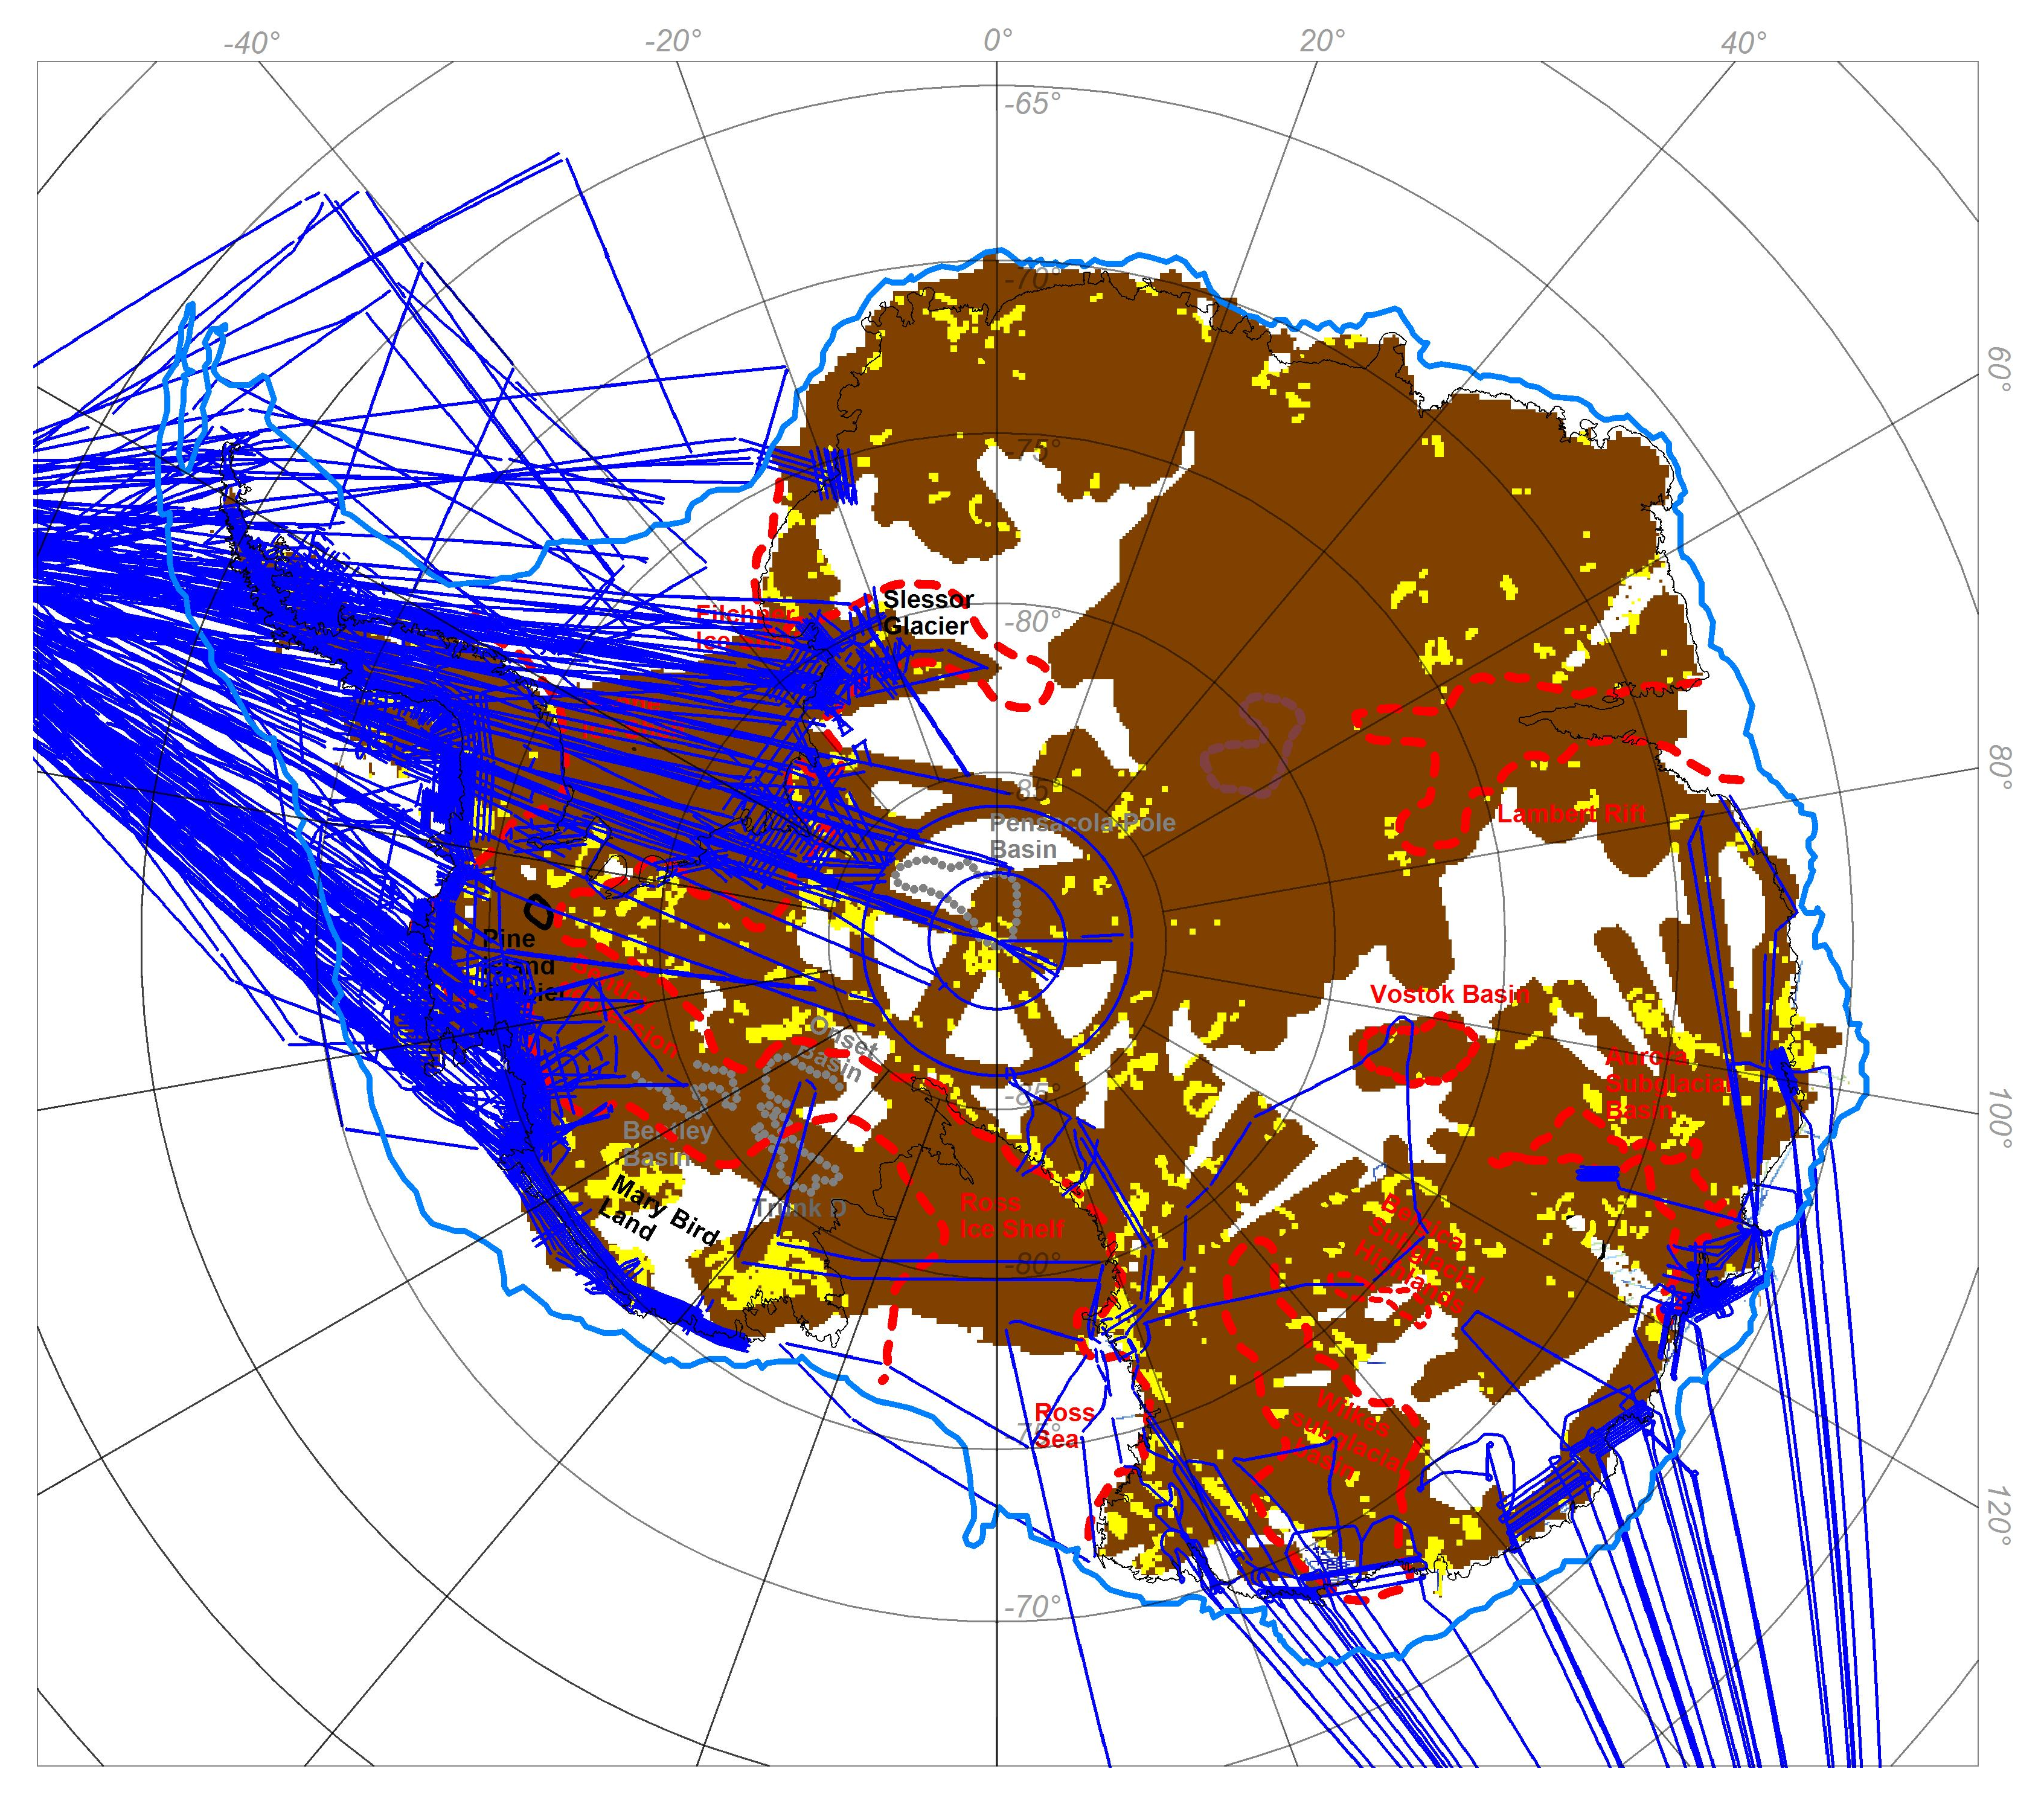
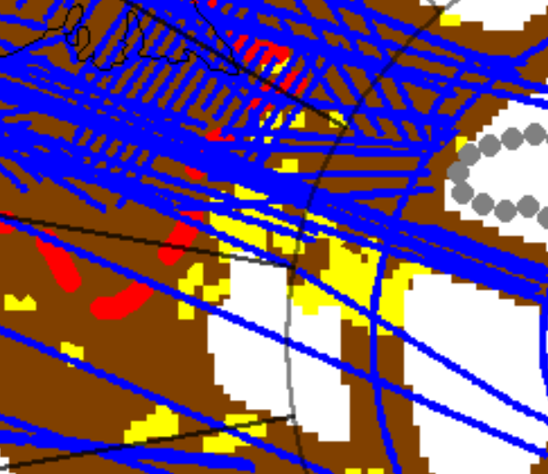
Partial Results
Foundation and
Patuxent ice streams

Slide 11
Summary
Next steps
The presence of sediments not included in the initial model, but in areas where previous studies have proposed the presence of sedimentary basins, is identified by this method
The method shows sediments in ice stream areas, which are open for new studies and possible identification of new sedimentary basins
Add data from other sedimentary basins to train the algorithm
Use rock-type from exposures as the target
Test a supervised machine learning algorithm (?)

Slide 12
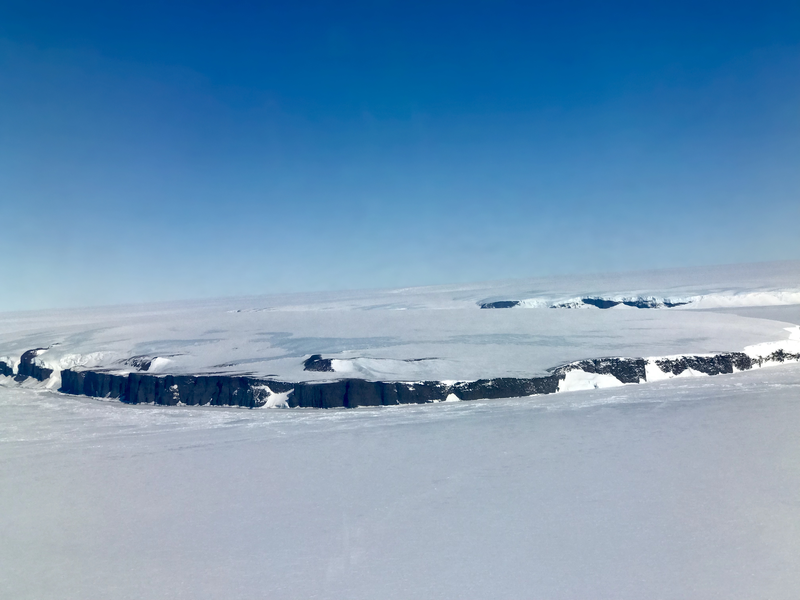
Thank you!
constantino@ldeo.columbia.edu

Slide 13
EXTRAS
Might be usefull for questions

Slide 14
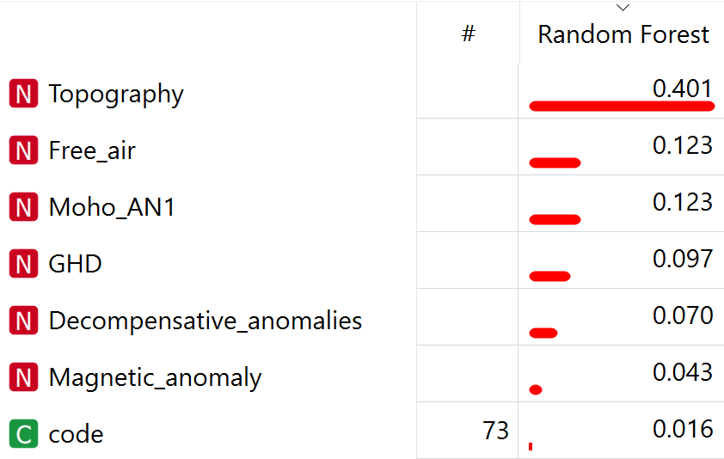
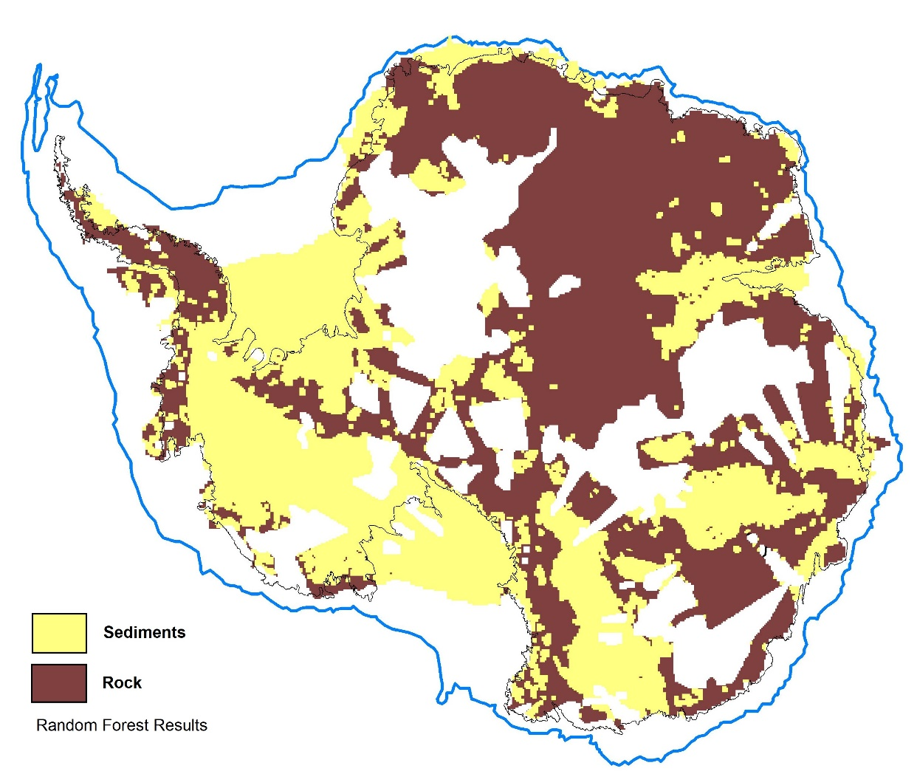
Partial Results

Slide 15
To identify new sedimentary basins by GRAVITY REGRESSION ANALYSES.
The regression between Bouguer and equivalent topography is a means to characterize crustal type, as it reflects the isostatic compensation mechanism
A homogeneous regression coefficient would correspond to a uniform isostatic compensation mechanism and absence of superficial density inhomogeneities
The presence of the basin can be identified by the deviation of the gravity signal from the average regression line.

Slide 16
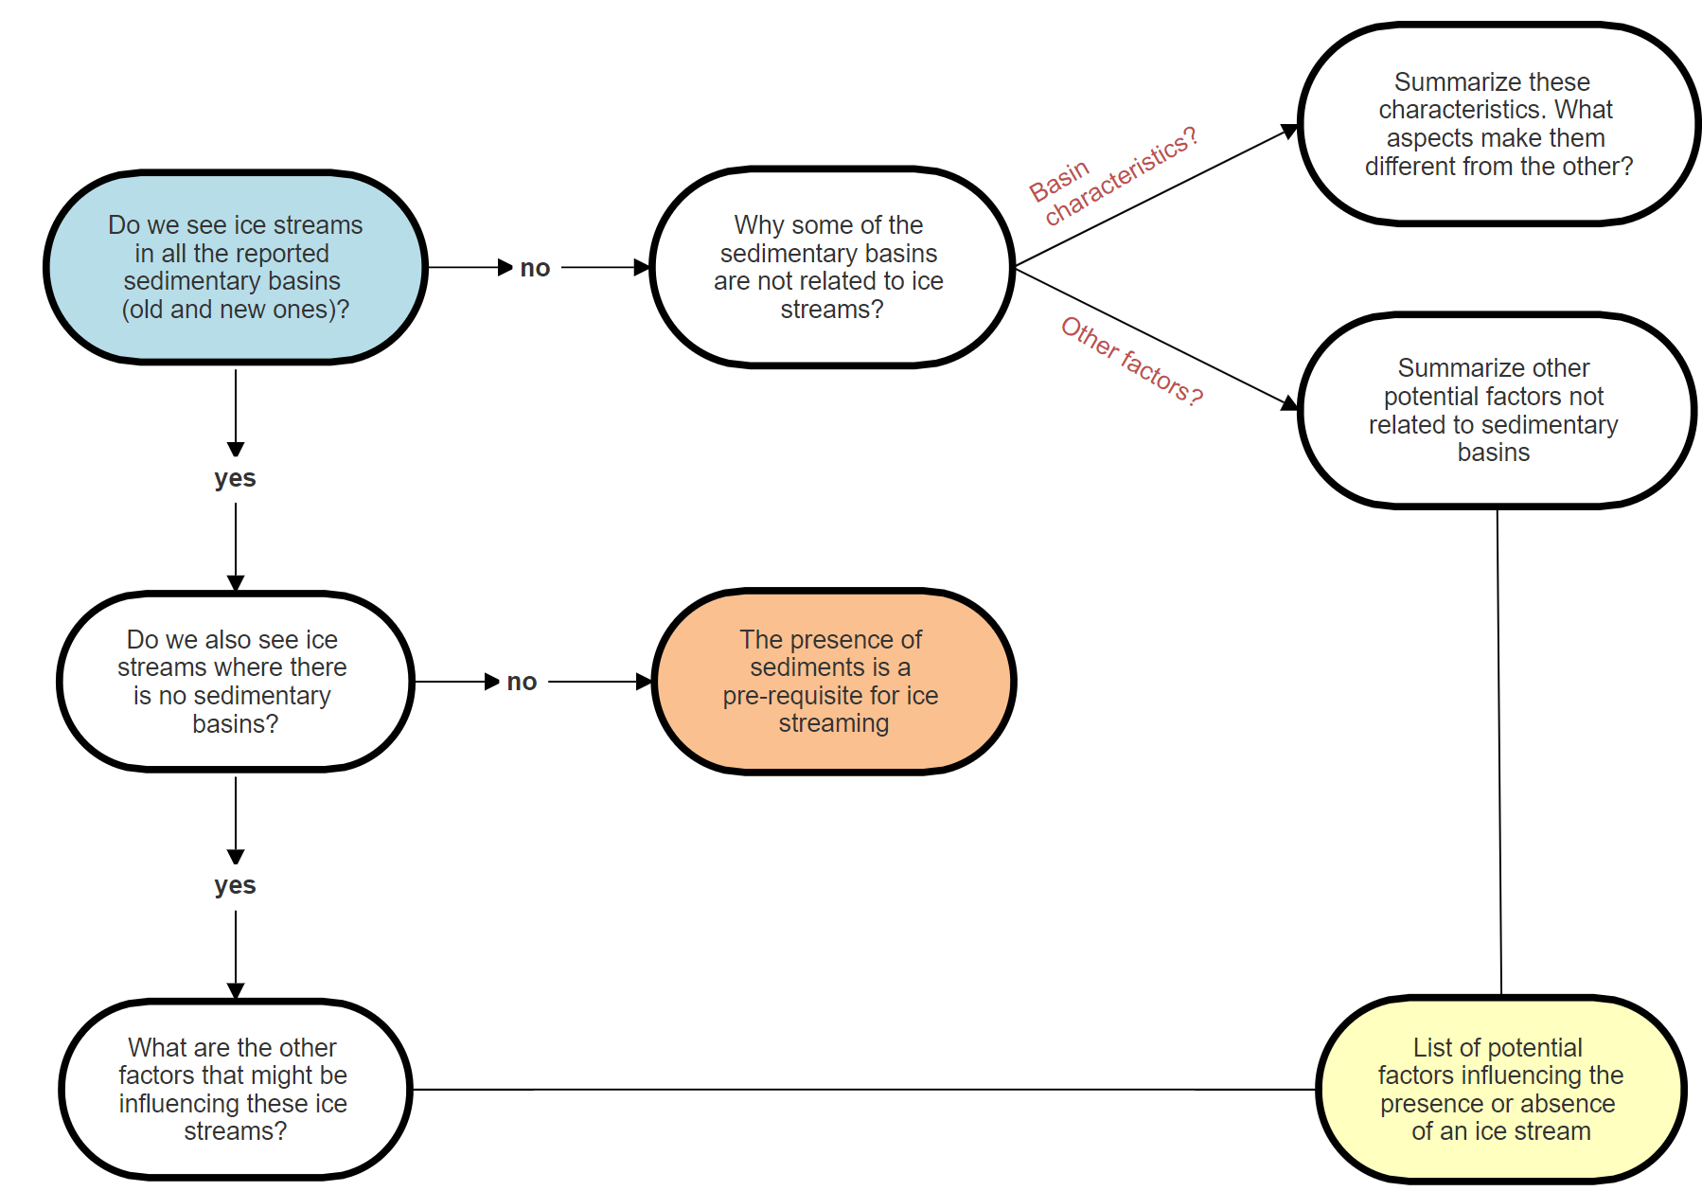
Correlation between sedimentary basins and ice streams

Slide 17
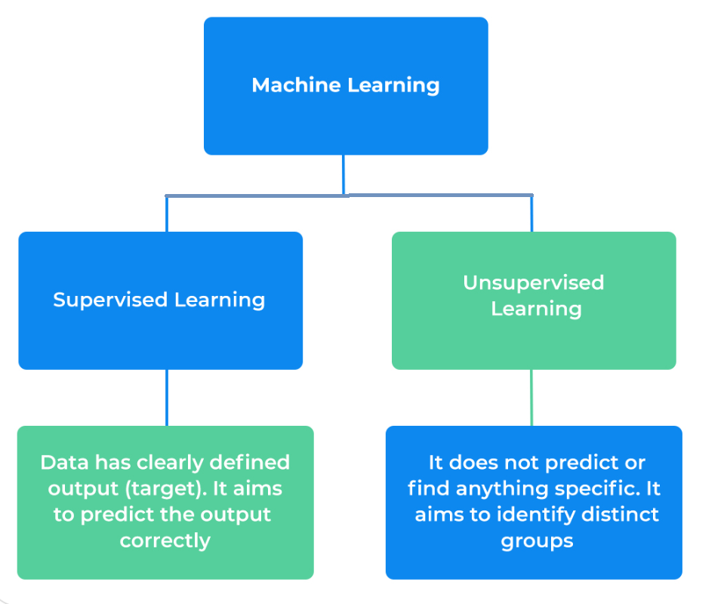
Machine learning

Slide 18
Machine learning
Supervised
Unsupervised
With supervised learning, the algorithm is given a set of particular targets to aim for. Supervised learning uses labeled data set, one that contains matched sets of observed inputs, X’s, and the associated outputs, Y’s. The algorithm is “trained,” i.e., the machine learning algorithm is applied to this data set to infer the patterns between the inputs and outputs. In other words, the algorithm works out ff in the equation:
Y=f(X)Y=f(X)
The dependent variable (Y) is the target, while the independent variables (X’s) are known as features.
The algorithm aims to produce a set of suitable labels (targets) under unsupervised learning. In other words, we have inputs (X’s) that are used for analysis with no corresponding target (Y). Unsupervised learning seeks to model the underlying structure or distribution in the data to learn more about the data since it is not given labeled training data. It is, therefore, useful for exploring new data sets that are large and complex.

