Slide 1
Multi-temporal sediment-yield estimates
in a steep headwater catchment using
UAV and sensor measurements.
Challenges and results from the Rebaixader
debris-flow monitoring site (Pyrenees)
Marcel Hürlimann,
Roger Ruiz-Carulla, Jose Moya, Ona Torra,
Felipe Buill, M. Amparo Núñez-Andrés
Dept. of Civil and Environmental Engineering.
UPC BarcelonaTECH

Slide 2
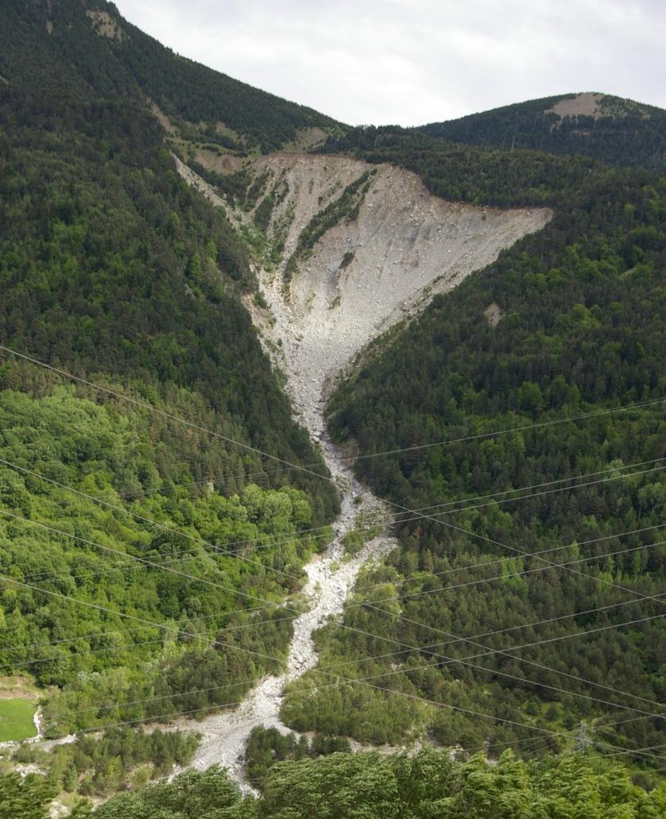
The Rebaixader monitoring site for torrential flows
Characteristics:
Area: 0.5 km²
Steep and harsh terrain (dz = 500m)
Initiation: open scarp (glacial till)
High torrential activity:
2-3 events per year
  ~1 debris flows
  ~1-2 debris floods
initiation
UAV
monitoring
channel
instrumental
monitoring
UAV monitoring since 2016
  Yearly photogrammetric survey
  → DoD analysis
Instrumental monitoring since 2009
  flow characteristics (geophones, radar…)
  → Volume estimates of each flow event
fan

Slide 3
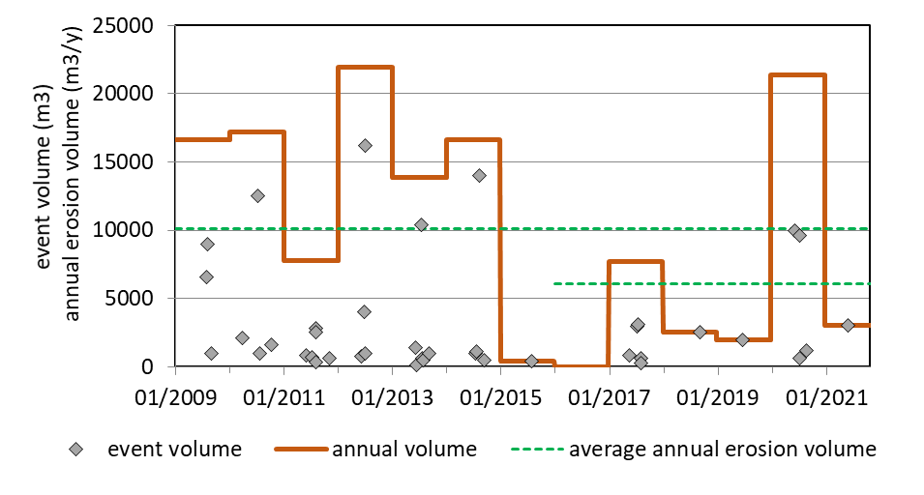
Instrumental monitoring
Continuous instrumental monitoring (2009 – 2021)
7 UAV surveys (2016 – 2021)
→ six debris-flow seasons (mostly summer)
UAV surveys

Slide 4
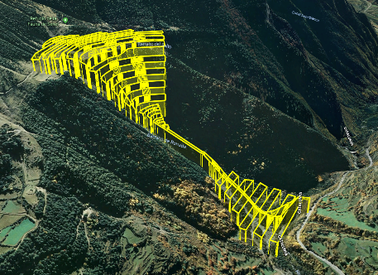
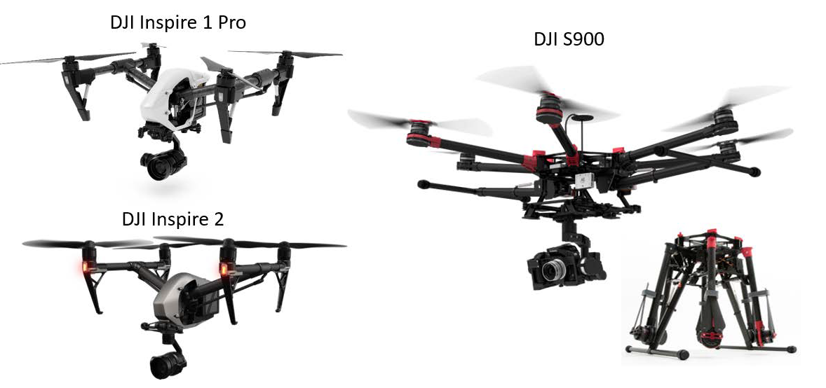
UAV monitoring
UAV details:
  DJI Inspire 1Pro & 2, DJI S900
  Approx. ~1400 photos → ~200 Millions points
  DEMs of 10 cm pixel-size
UAV problems
  Steep-harsh terrain: only very few GCPs (~20 points)
  Photogrammetric Processing → alignment uncertainty
UAV models
UAV flight plan
Notes:
DJI Inspire 1 Pro, camera X5 (16 Mp, micro 4/3 sensor)
-DJI S900 , camera SONY-NEX5 (14 Mp, APS-C sensor)
-DJi Inspire 2, camera (20.8, Mp micro 4/3 sensor)

Slide 5
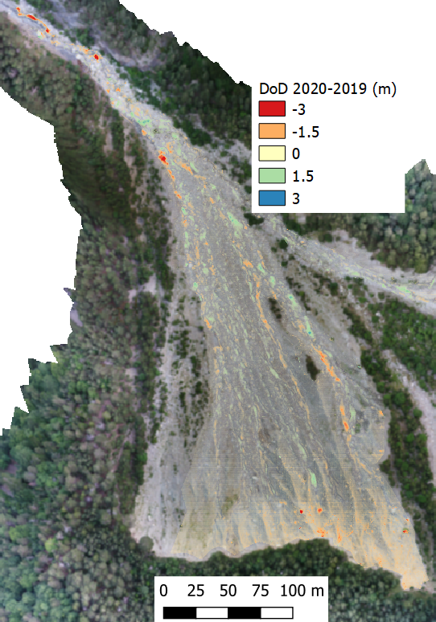
UAV monitoring
Preliminary results
DoD 2020-2019
Scarp and channel area
No landslide-initiation
Continuous entrainment
Transport of large boulders

Slide 6
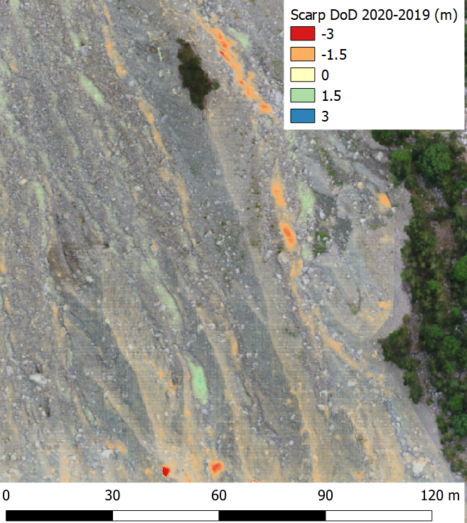
UAV monitoring
Preliminary results of scarp area
Entrainment in gullies
Erosion of large boulders
DoD - UAV

Slide 7
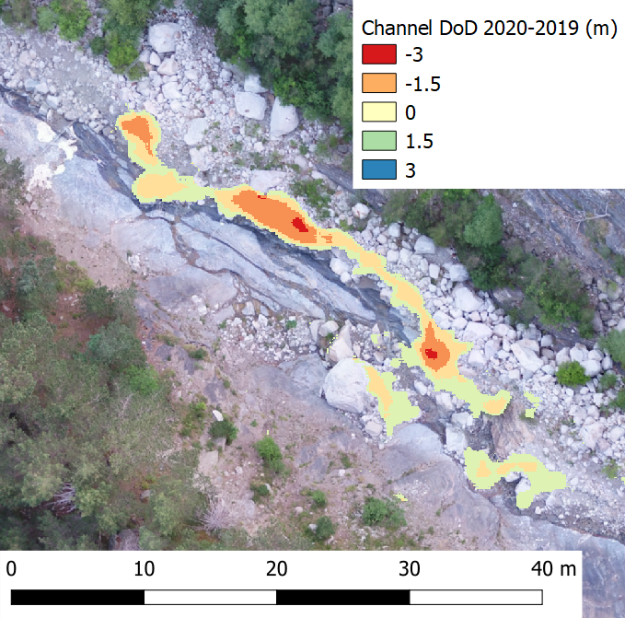
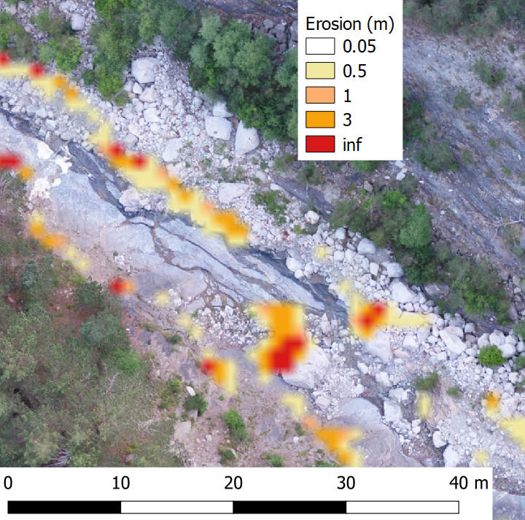
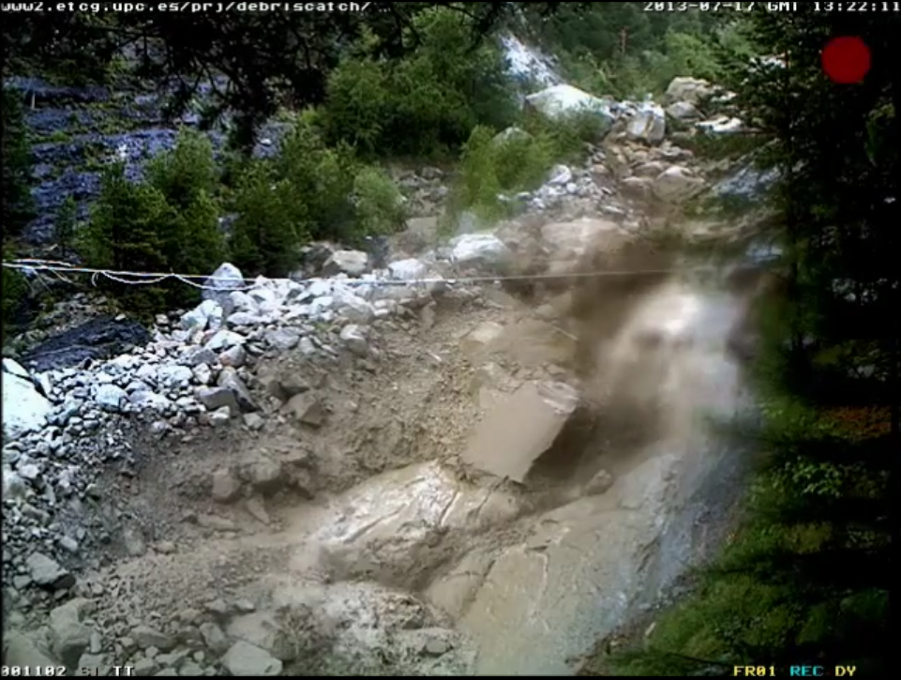
UAV monitoring
Preliminary results of channel area
Comparison with erosion modelling by numerical code FLATModel
DoD - UAV
Erosion modelling
bank erosion

Slide 8
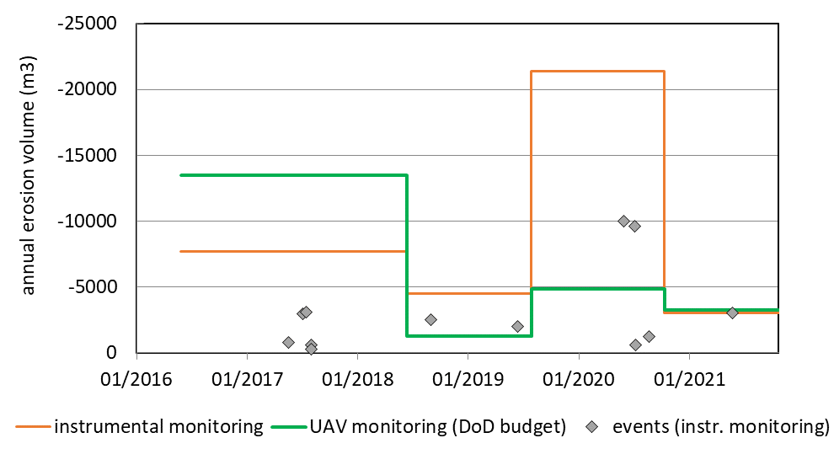
Comparsion of erosion volume (instrumental vs. UAV)
Multiple problems (especially alignment, but also snow cover…)
Exact comparison is complex task!
Adding virtual ground control points is essential
Adding of virtual GCPs

Slide 9
Concluding remarks
UAV data gathering and treatment is very challenging at Rebaixader
  Large difference in elevation
  Only few GCP
Morphological features provide information on erosion processes
Future tasks
  Add more GCPs (virtual ones) in/around area of interest
  Multi-temporal alignment
Notes:
or example DJI Phantom 4 RTK, or DJI M300 RTK

Slide 10

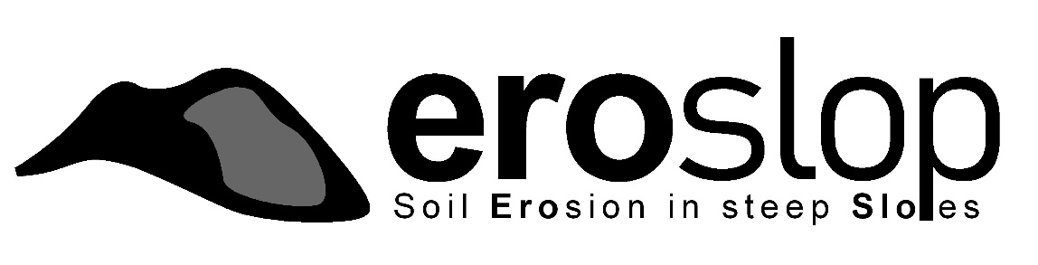
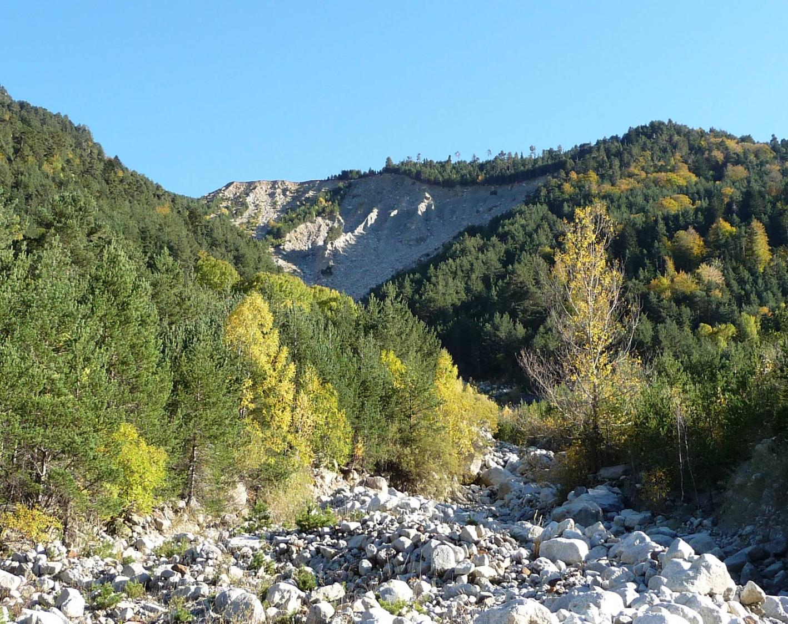
eroslop.upc.edu
marcel.hurlimann@upc.edu

Slide 11
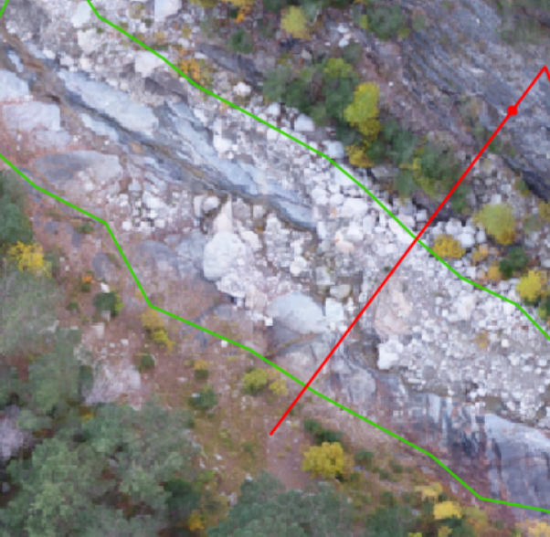
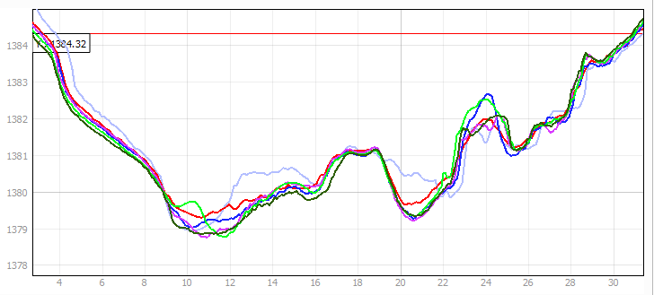
Additional material: UAV monitoring
Topographic changes in channel area (transversal cross section)
GCP

