Slide 1


Firma convenzione Politecnico di Milano e Veneranda Fabbrica del Duomo di Milano
Andrea Manzoni, Monica Riva, Giovanni Michele Porta, Alberto Guadagnini
Dipartimento di Ingegneria Civile e Ambientale
Data-driven reconstruction of the main traits of the large-scale Po River basin subsurface system
Aula Magna – Rettorato
Mercoledì 27 maggio 2015
Notes:
Hi everyone!!! My name is Andrea Manzoni, I’m a Ph.D. candidate at the department of civil and environmental engineering, Politecnico di Milano, I am part of the MiPore research group and today I’ll present the Data driven reconstruction of the subsurface system of the Po River basin.

Slide 2
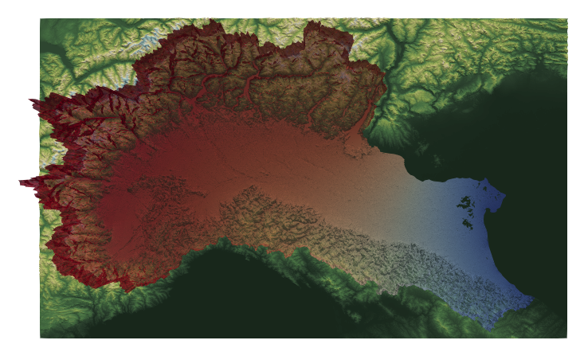
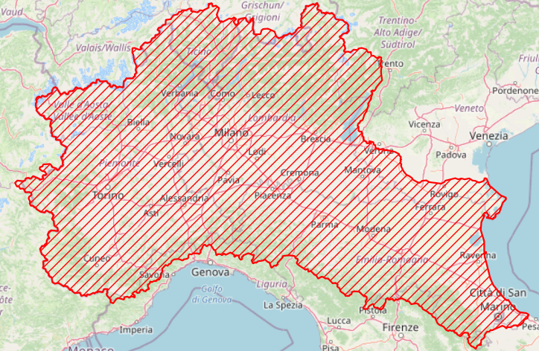
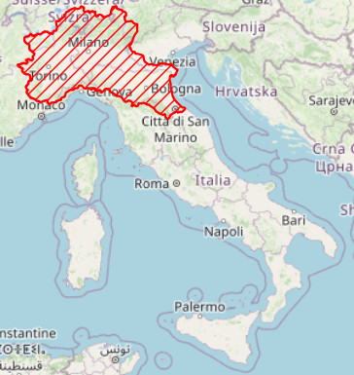
Introduction
The Po River is markedly investigated, with a watershed spanning about 72,000 𝒌𝒎2.
The Po basin comprises most of the agricultural and industrial activity of the Country and contains most of the available groundwater related data [Meffe and Bustamante, 2014].
Notes:
Well... Let start introducing our case study, as mentioned, it coincides with the Po River basin. The Po is the longest Italian river, and its catchment area includes most of the regions of northern Italy and the Ticino area of Switzerland. The entire area covers seventy-two thousand square kilometers and includes countryside, urban, and mountains environments. So, we are talking a bout a large-scale aquifer system.

Slide 3
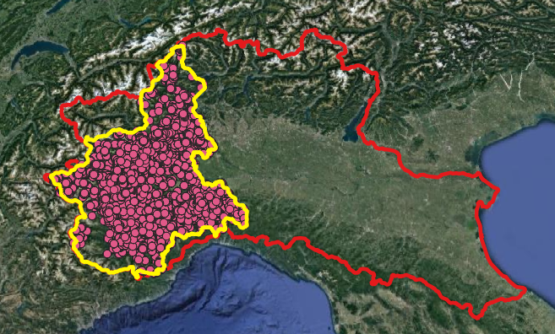
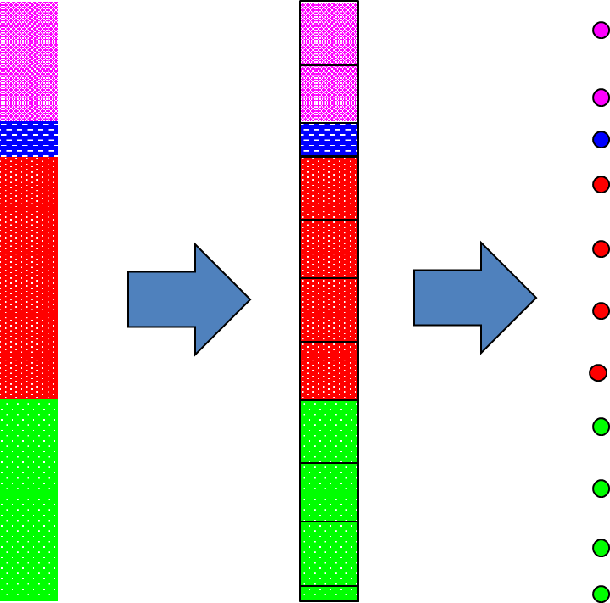
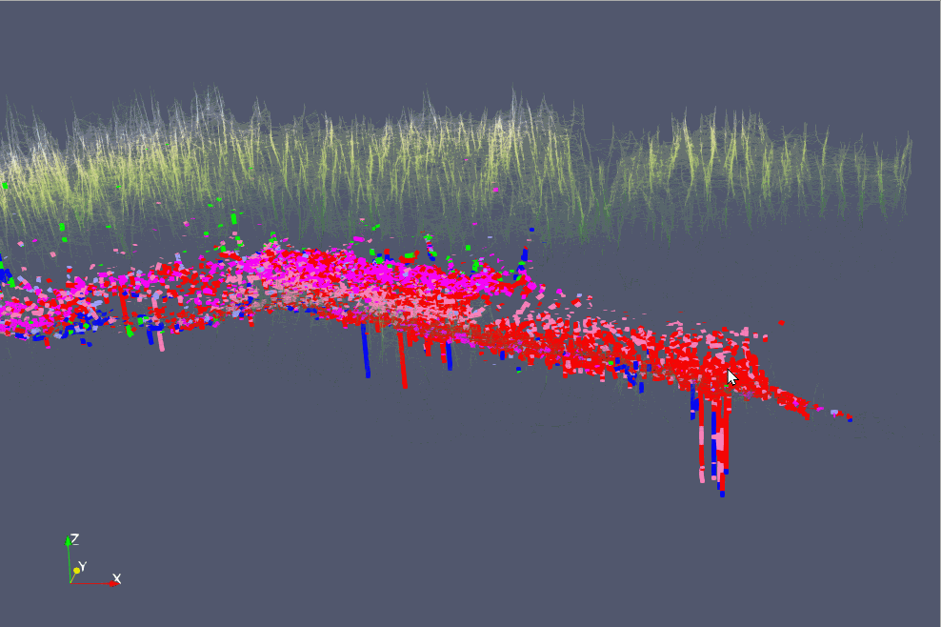
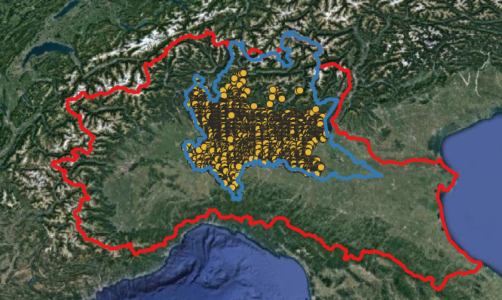
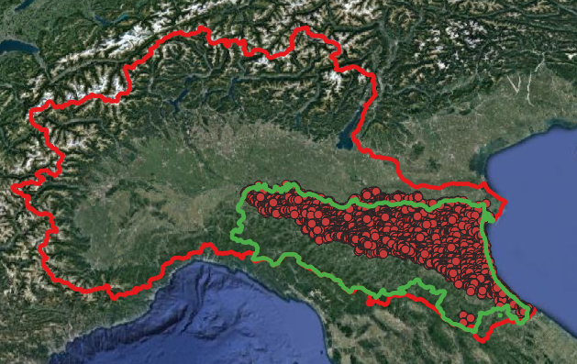
Input data preparation: Data selection & Data categorization
Each lithostratigraphic layer with a depth greater than 1 m is discretized into layers of 1 m
3D georeferenced lithostratigraphic data
Notes:
The area is historically characterized by industrial and agricultural activities, which has led to a large amount of available data associated with boreholes and their stratigraphic information. We collected data from the available databases of the Italian regions included in the area. We merged these datasets with the national dataset. We collected information from more than forty thousand boreholes. We started from the available lithostratigraphic information by dividing it into 6 categories. Gravel, sand, silt, clay, permeable and impermeable rock. The collected data were then stored in a georeferenced 3D dataset, as shown on the left.

Slide 4
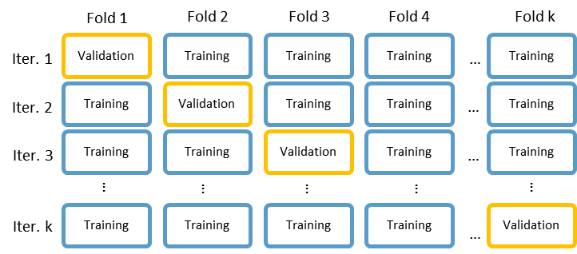
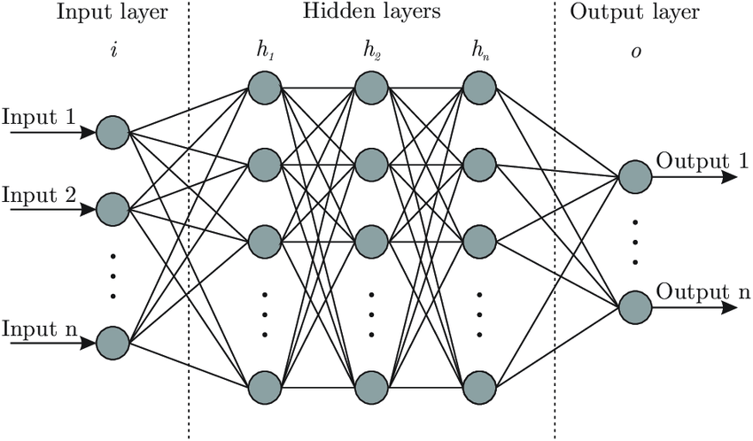
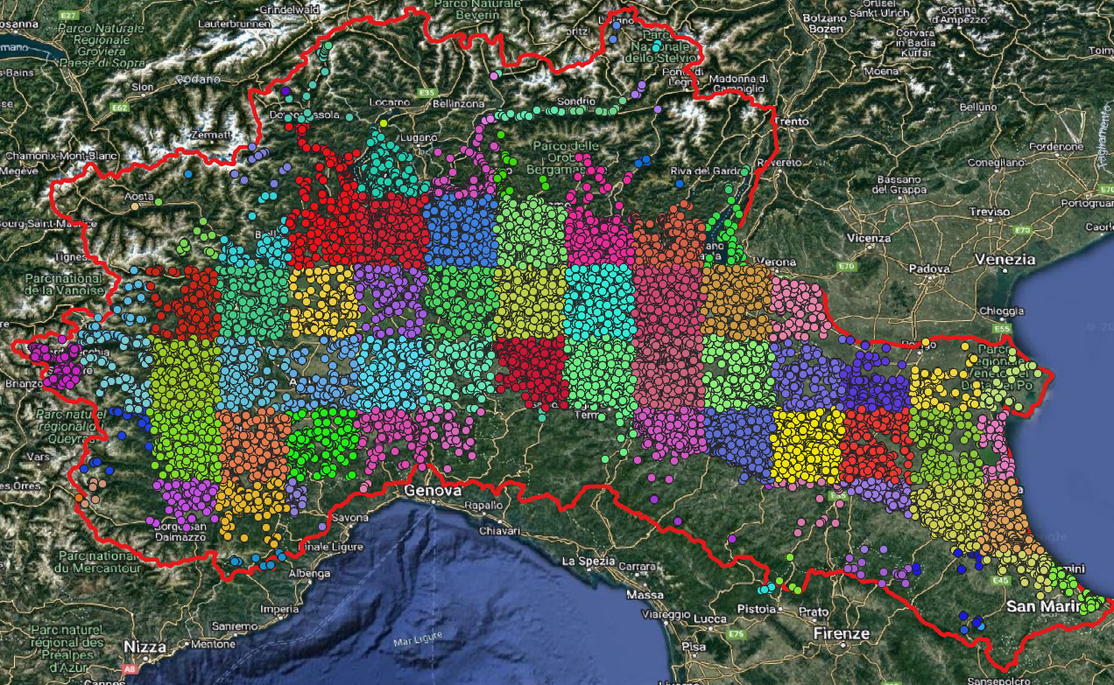
Cross validation & hyperparameter selection
Stratified cross-validation
Hyper parameter selection
N° hidden nodes
N° hidden layers
Notes:
The collected data are then used to train a categorical neural network. A K-fold stratified cross-validation strategy was used to train the network and select the hyperparameter.

Slide 5
Cross validation & hyperparameter selection
Stratified cross-validation
Hyper parameter selection
N° hidden nodes
N° hidden layers
Notes:
The k-fold cross-validation consists of dividing the available dataset into a number of subsets of data equal to the preselected fold number equal to k. 1 of these folds (or subdataset) is used for validation, and the remaining data are used in the neural network training process. On the slide (top left) the entire dataset is within the red box, while in blue you can see the folds used for training and in yellow the validation.

Slide 6
Cross validation & hyperparameter selection
Stratified cross-validation
Hyper parameter selection
N° hidden nodes
N° hidden layers
Notes:
In the second iteration we keep the same folds as in the previous step, but change the fold used for validation. We repeat this training and validation procedure for k times. In this way we are able to use the whole dataset only once for the validation process.

Slide 7
Cross validation & hyperparameter selection
Stratified cross-validation
Hyper parameter selection
N° hidden nodes
N° hidden layers
Notes:
How to select the subdivision of the folds? We divided the study area into subdomains, as can be seen in the bottom left image, and these subdomains, also called strata, are divided into a number of folds equal to k. The folds of the strata are combined with the folds of the other strata to obtain the k-folds for the whole dataset. Stratified cross-validation allowed the different domain areas associated with a small amount of data to be more fairly represented in the validation process in each iteration.

Slide 8
Cross validation & hyperparameter selection
Stratified cross-validation
Hyper parameter selection
N° hidden nodes
N° hidden layers
Notes:
we employed stratified cross validation to select the hyperparameter of the categorical neural network. We already know the input nodes that are associated with the positions of a point, latitude, longitude, vertical position relative to sea level, and vertical distance from the surface. The output node is the geomaterial category. We need to select the number of hidden nodes and hidden layers. In the table, you can see the results of our analysis: at the top right of the table, we have a poorer interpretation of the data, at the bottom left of the table we found overfitting conditions.

Slide 9
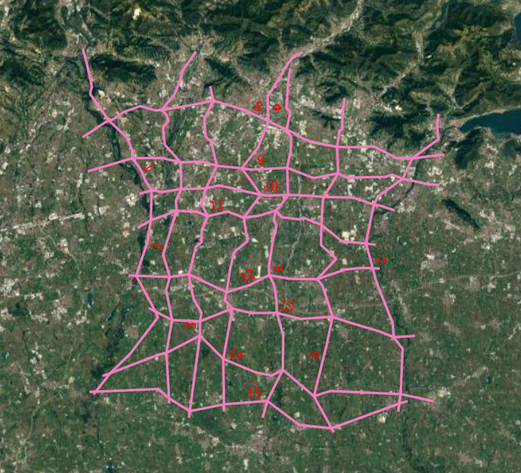
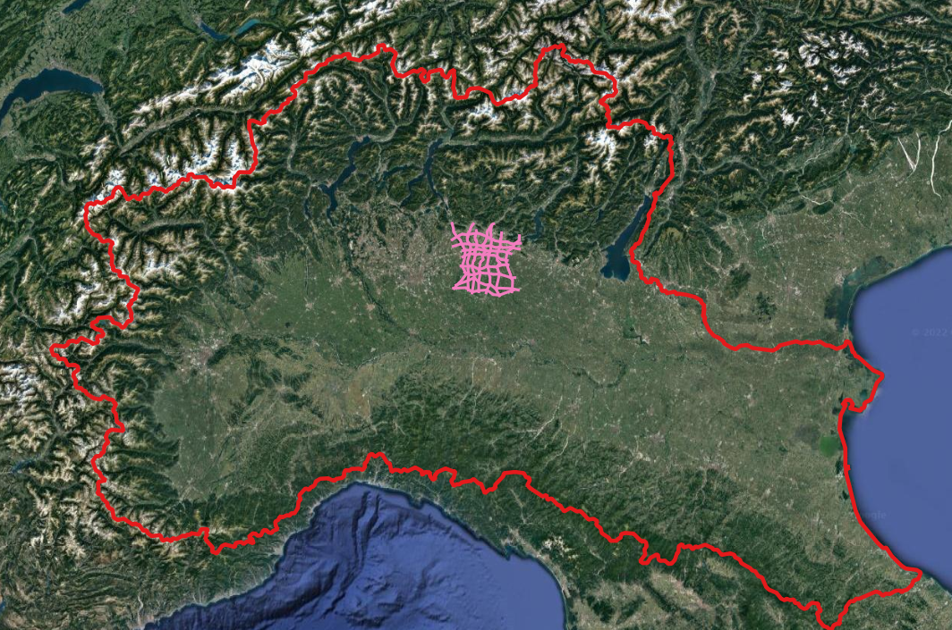
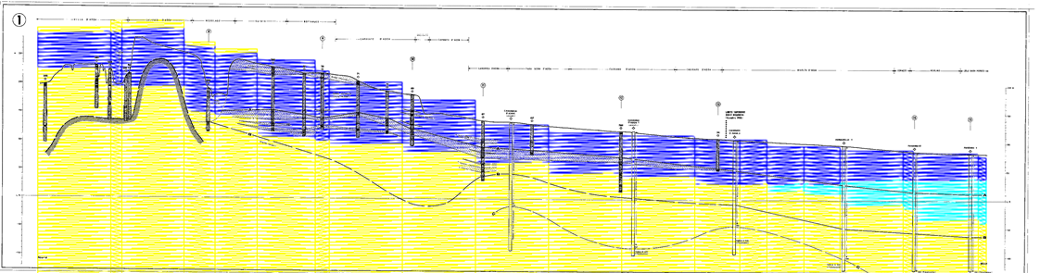
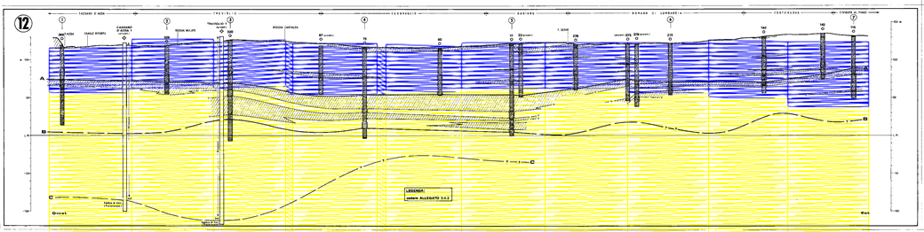
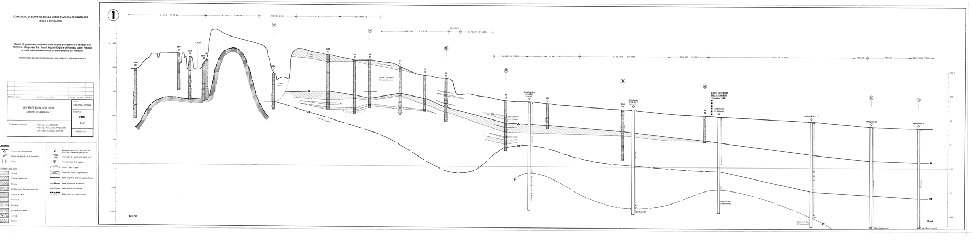
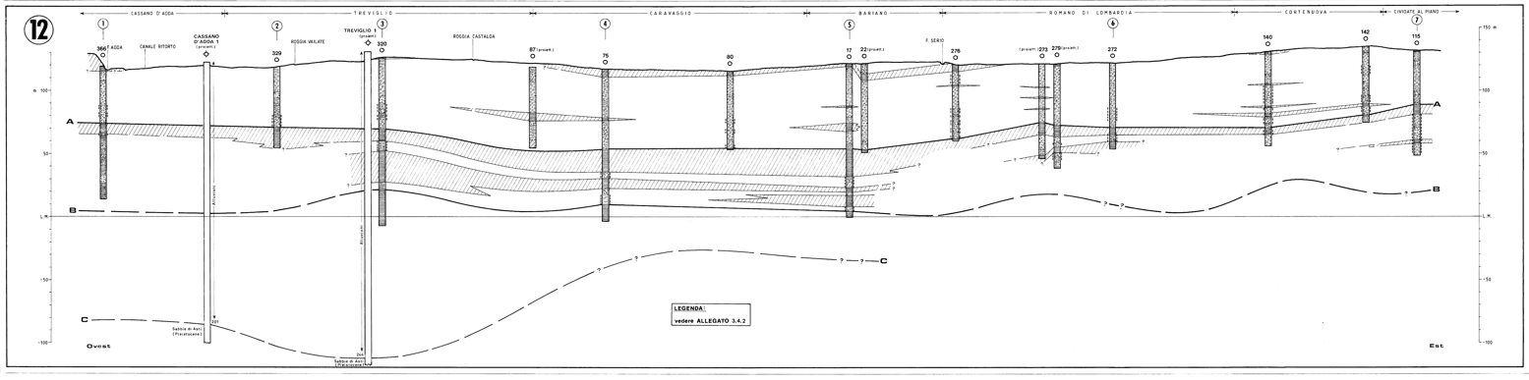
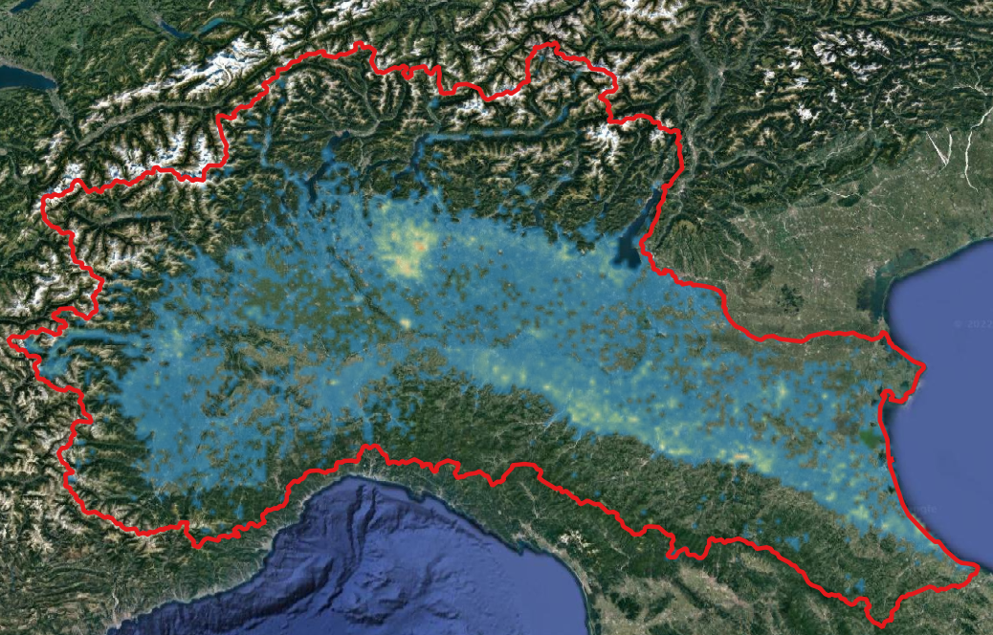
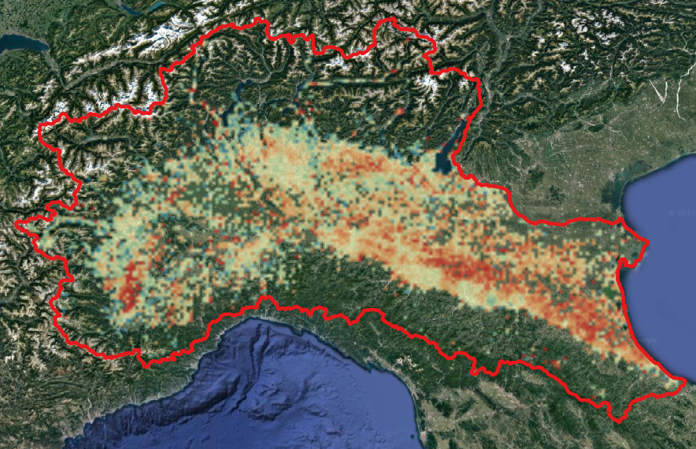
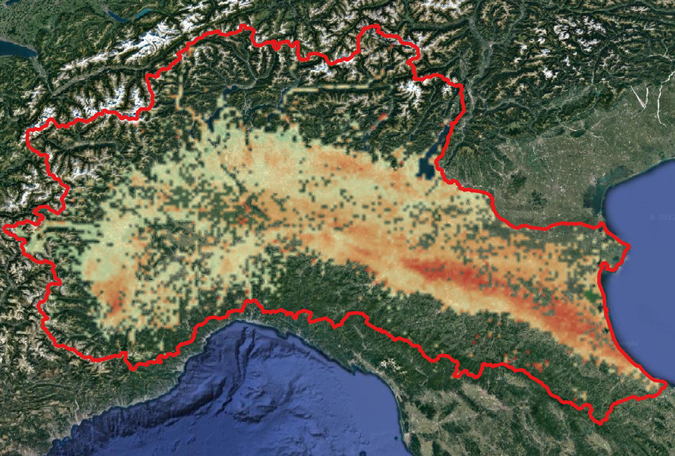
Model prediction
Qualitative comparison with available data
Spatial indexes
Notes:
The output of our model consists of a 3D structured grid of the subsurface material. Below are some qualitative comparisons with the available data and some spatial indices of the material prediction.

Slide 10
Model prediction
Qualitative comparison with available data
Spatial indexes

Slide 11
Model prediction
Qualitative comparison with available data
Notes:
We took some available geological sections from previous studies in a portion of the domain. Comparison of the results obtained with the geological section showed good prediction of unconfined aquifer layers.

Slide 12
Model prediction
Qualitative comparison with available data
Spatial indexes
Notes:
We then evaluated some spatial indices to better understand the quality of the results.

Slide 13

Model prediction
Spatial indexes
Data availability
Local accuracy
Average Softmax
0
11600
0%
100%
0%
100%
[Sample/px]
$$Accuracy = \frac{\left(number of correct prediction\right)}{\left(total number of predictions made\right)}$$
2.5km x 2.5km resolution
Notes:
we noted that large data availability is not associated with high local accuracy (comparing the first and second maps), while the SoftMax obtained with the neural network has good agreement with accuracy, indicating that the neural network is able to indicate the area in which to provide results with lower accuracy.

Slide 14
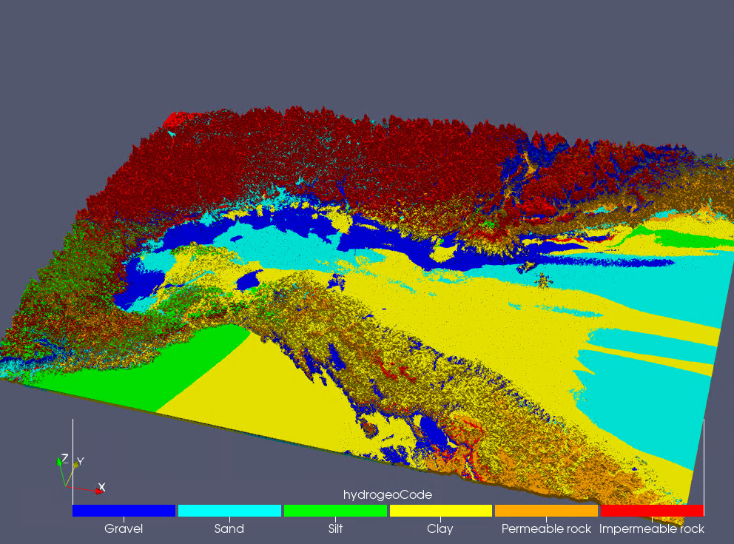
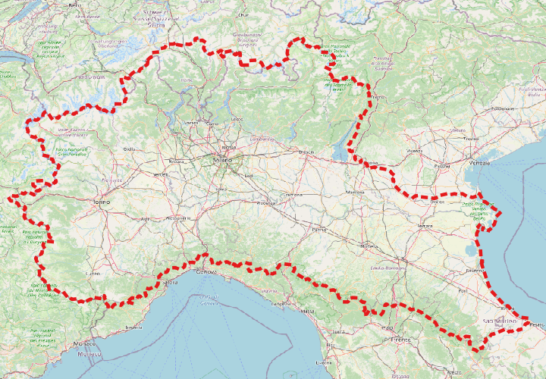
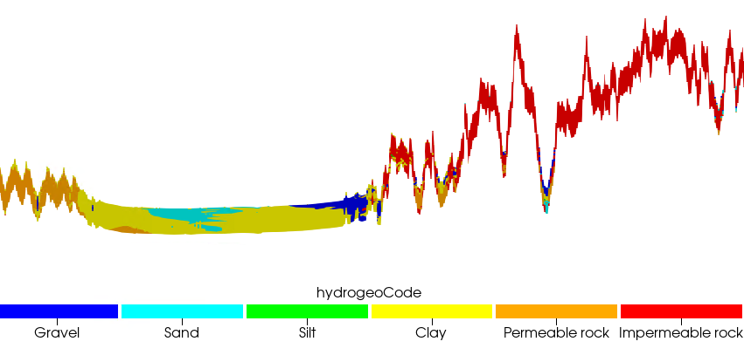
Concluding remarks & future development
Our evaluation is performed on a georeferenced 3D grid with a spatial resolution of 250×250×4 m and up to a depth of 200 m below the sea level.
A
A
Notes:
I conclude with some remarks and future development activities. Our methodology can handle large amounts of data, typically available on a large scale, to provide a prediction of subsurface structure.

Slide 15
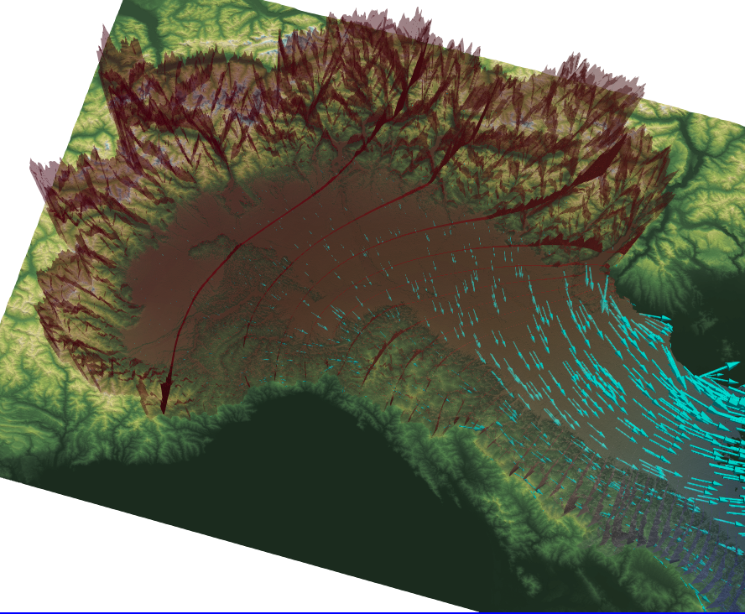
Concluding remarks & future development
Our evaluation is performed on a georeferenced 3D grid with a spatial resolution of 250×250×4 m and up to a depth of 200 m below the sea level.
A
A
Groundwater flow modelling: We are employing the obtained geomaterial distribution to define the geometry, discretize the domain, define parameters, and select boundary conditions for a large-scale groundwater flow assessment within the Po River watershed.
Notes:
We are currently using the results obtained to create the geometry of a large-scale groundwater flow model.

Slide 16
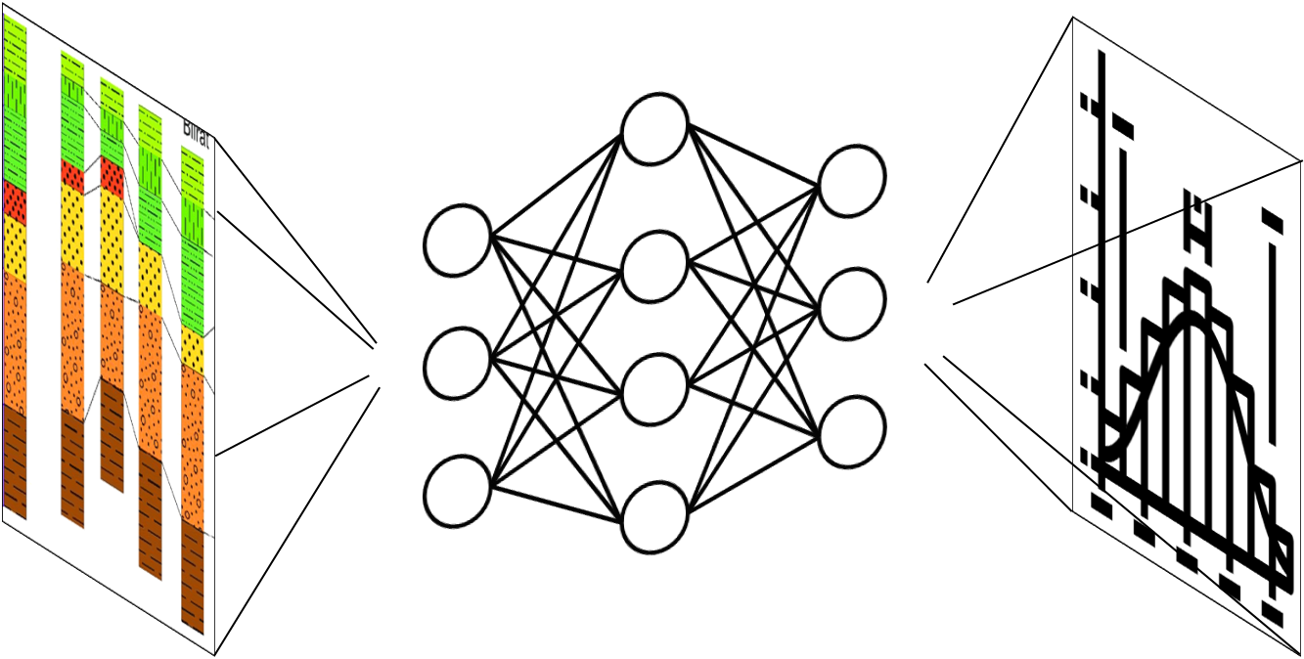
Concluding remarks & future development
Our evaluation is performed on a georeferenced 3D grid with a spatial resolution of 250×250×4 m and up to a depth of 200 m below the sea level.
A
A
Groundwater flow modelling: We are employing the obtained geomaterial distribution to define the geometry, discretize the domain, define parameters, and select boundary conditions for a large-scale groundwater flow assessment within the Po River watershed.
Uncertainty quantification: We are developing a probabilistic approach to the geomaterial spatial distribution estimation based on Artificial Neural Network techniques. The uncertainty quantification will be grounded on the probabilistic approach.
Notes:
And we are planning to move from a deterministic reconstruction to a probabilistic approach that can provide more information to the flow model.

