Slide 1



Nonlinear Multiscale Modelling of Layering in Turbulent Stratified Fluids
Paul Pružina
David Hughes, Sam Pegler
University of Leeds, UK
Development and long-term evolution of density staircases in stirred stratified turbulence – submitted to PRFluids

Slide 2




Turbulent stratification develops layers
Well-mixed layers separated by sharp interfaces
Oceans/atmosphere
Long term dynamics
Stirring rod
$ρ\left(z\right)$
$ρ\left(z\right)$
$$z$$
$$z$$
Notes:
Common geophysical phenomenon of staircase formation, where a turbulent stratified fluid develops into a system of well-mixed layers separated by sharp interfaces.
The oceans and atmosphere are both turbulent stratified fluids, and phenomenon is seen in both. Examples include thermohaline staircase in polar oceans, and PV staircases in the atmosphere. PB staircases suggested as the cause for Jupiter’s stripes. We focus on one of the simplest cases – with a single density component (e.g. salt) and turbulence provided by stirring with e.g. a rod.
Can be modelled with high power computational methods on full Navier Stokes, but to fully understand the dynamics we produce a reduced model. Major benefit we take advantage of is that it allows us to investigate the very long-time dynamics with relatively little computational power.

Slide 3
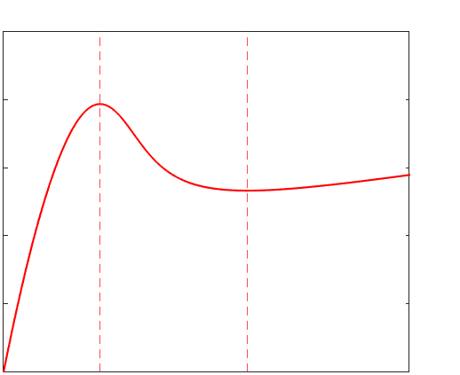

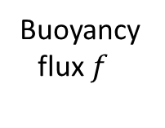

Negative diffusion leads to layering
$b_{t}=\frac{d}{dz}\left(f\left(b_{z}\right)\right)=\frac{df}{db_{z}}b_{zz}$
$\frac{df}{db_{z}}<0$ for instability – negative diffusion
[Phillips ¹, Posmentier ²]
Buoyancy flux $f$
Buoyancy gradient $b_{z}$
[Balmforth et al. ³]
Notes:
The simplest explanation for the instability that leads to layering comes from Phillips 1972, who used a 1d turbulent diffusion equation for the buoyancy b. If the buoyancy flux f is a decreasing function of the buoyancy gradient b_z then this represents an effective negative diffusion coefficient, which leads to growth of perturbations . However this simple model has nothing to arrest the instability, so leads to infinite gradients, which are not physically valid.
Balmforth et al proposed the N-shape flux-gradient relation, so that a finite range of gradients are unstable. Gradient can only grow up to a certain point, stopping infinite gradients and keeping the profile smooth. Likewise the gradient can only decrease to a certain point, so there are no regions with zero gradient.
A single equation model is still not enough, as the negative diffusion leads to instability on infinitely small scales. We fix this by coupling with a second equation.

Slide 4
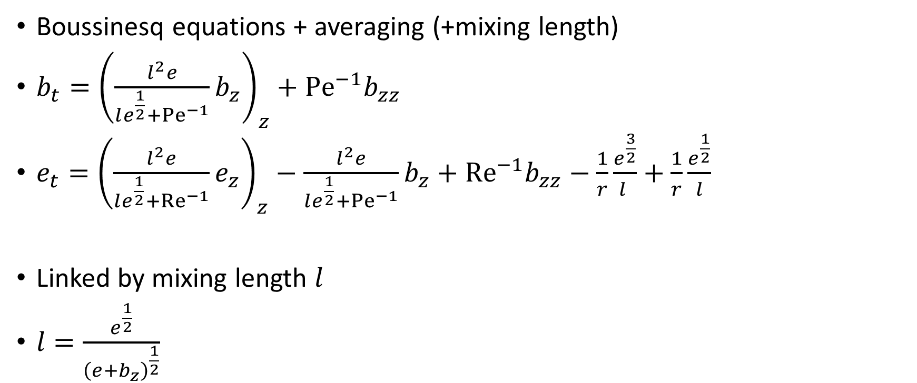

Horizontally averaged model
Boussinesq equations + averaging (+mixing length)
$b_{t}={\left(\frac{l^{2}e}{le^{\frac{1}{2}}+{Pe}^{−1}}b_{z}\right)}_{z}+{Pe}^{−1}b_{zz}$
$e_{t}={\left(\frac{l^{2}e}{le^{\frac{1}{2}}+{Re}^{−1}}e_{z}\right)}_{z}−$ $\frac{l^{2}e}{le^{\frac{1}{2}}+{Pe}^{−1}}b_{z}+{Re}^{−1}b_{zz}−\frac{1}{r}\frac{e^{\frac{3}{2}}}{l }+\frac{1}{r}\frac{e^{\frac{1}{2}}}{l}$
Linked by mixing length $l$
$l=\frac{e^{\frac{1}{2}}}{{\left(e+b_{z}\right)}^{\frac{1}{2}}}$
Turbulent flux
KE-PE Transfer
Diffusion
Dissipation
Stirring
$Pe=\frac{Ud }{κ}$ $Re=\frac{Ud}{ν}$
$r$ dissipation
Notes:
We propose a 1 dimensional model for the horinzontally averaged buoyancy and kinetic energy, in terms of turbulent fluxes with dissipation and stirring terms. Takes a similar form to that of Balmforth et al 1998.
Equations are linked by the mixing length l, which needs to capture two behaviours – the large scale layers , and the much smaller scale interfaces. Balmforth length takes the l=1 as stirring length when b_z is small, and the emergent lengthscale (e/b_z)^(1/2) when b_z is large. This is the key component providing the N-shape flux-gradient relation
Model depends on 3 dimensionless numbers: Peclet quantifies the effect of diffusion, Reynolds the effect of viscosity compared to turbulence, and r scales the amount of dissipation.

Slide 5
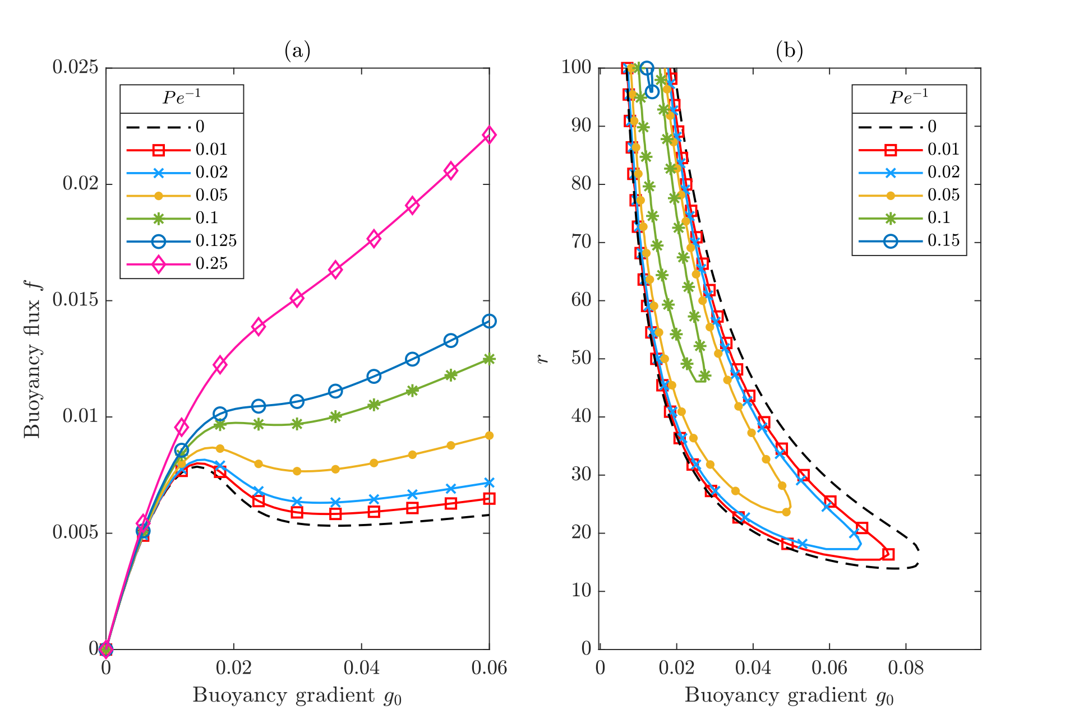





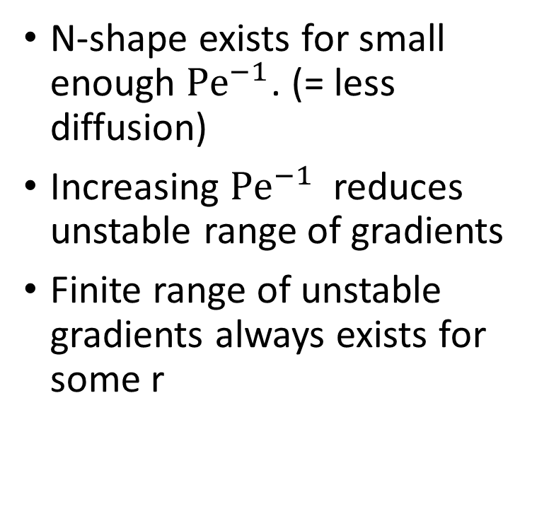

Conditions for layer development
N-shape exists for small enough ${Pe}^{−1}$. (= less diffusion)
Increasing ${Pe}^{−1}$ reduces unstable range of gradients
Finite range of unstable gradients always exists for some r
$$r∼2/g_{0}$$
Locus $\frac{df}{db_{z}}=0$
$$r∼2/{3g}_{0}$$
N-shape for ${Pe}^{−1}<0.113$
Buoyancy gradient $b_{z}^{0}$
Buoyancy gradient $b_{z}^{0}$
Notes:
As mentioned before, we expect that the model will produce layers if the flux-gradient relation is an N-shaped curve. We see here that for sufficiently small Pe^{-1} we do indeed have an N-shape, but as Pe^{-1} is increased, the profile smooths out and becomes monotonically increasing. So the more diffusion we have, the less susceptible to layering.
Right hand plot shows the locus of marginal stability in b_z-r space. For any value of Pe, there is a critical value of r above which there is a finite range of buoyancy gradients that are unstable.

Slide 6
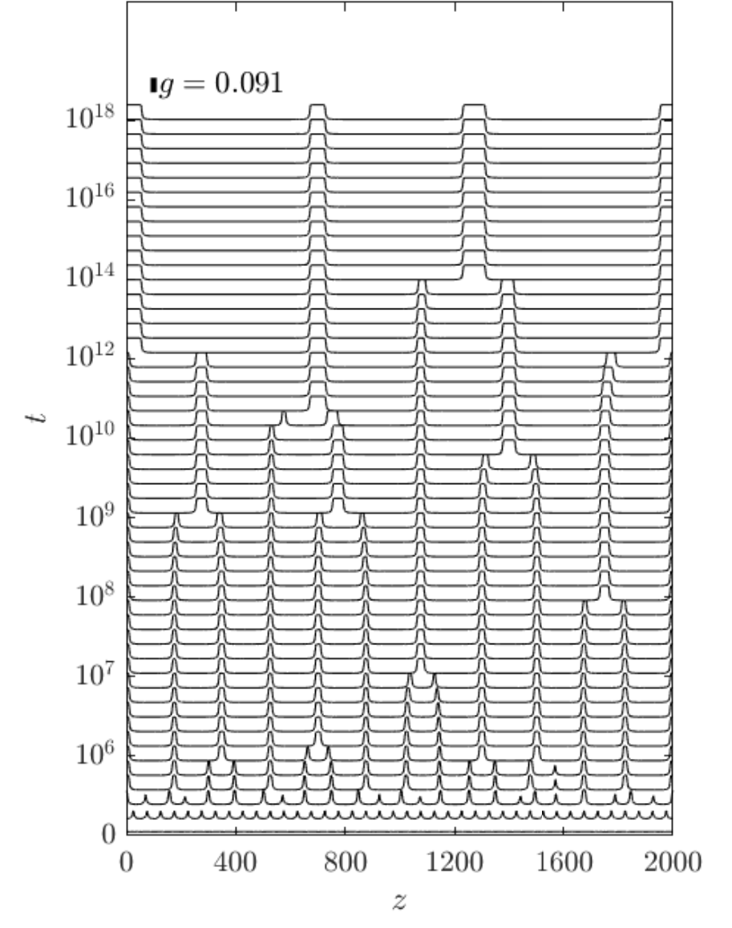
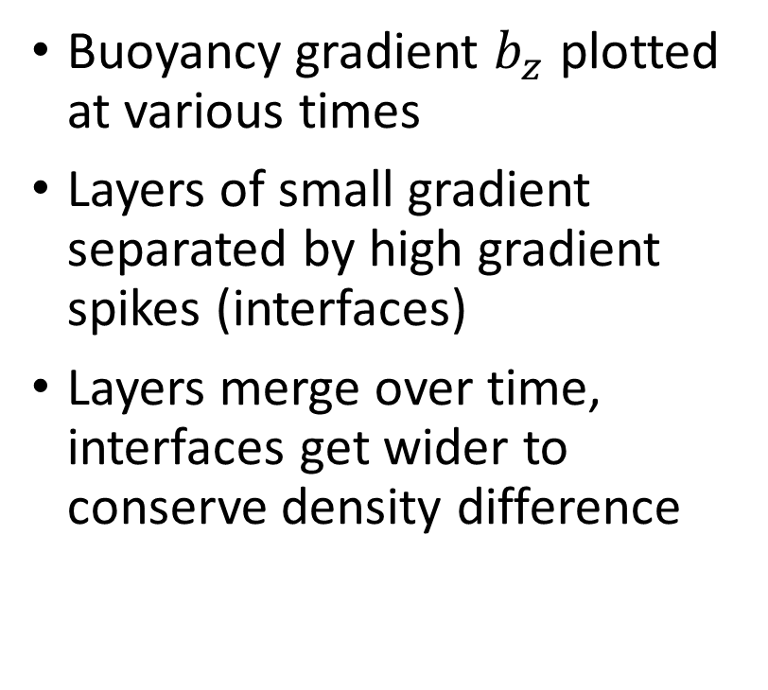
Long term evolution
Buoyancy gradient $b_{z}$ plotted at various times
Layers of small gradient separated by high gradient spikes (interfaces)
Layers merge over time, interfaces get wider to conserve density difference
Notes:
We now look at the long term evolution. The plot here shows the buoyancy gradient plotted at a series of times for a very long time range. We see clear spikes in the gradient representing interfaces between the layers. Over time, layer mergers take place, where two interfaces come together – in these, the interfaces get wider to conserve the density difference. In between mergers, the interfaces remain remarkably stable. Subsequent mergers take longer amounts of time to occur

Slide 7
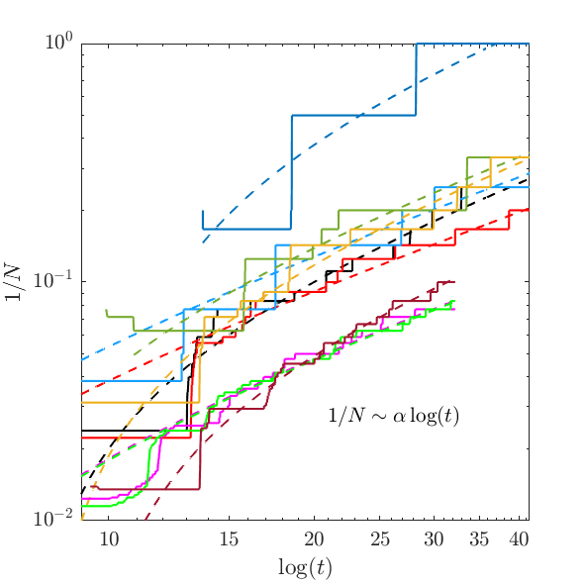
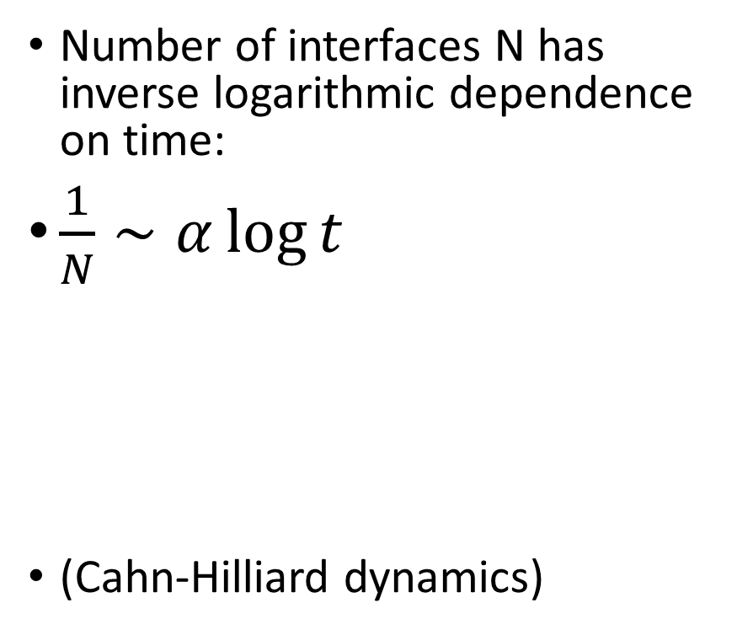
Long-term merger timescale
Number of interfaces N has inverse logarithmic dependence on time:
$\frac{1}{N}∼α\log{t }$
(Cahn-Hilliard dynamics)
Notes:
To quantify the long-term timescale for layer mergers, we plot the quantity 1/N against log(t), both on logarithmic axes. Results are from several different numerical simulations, beginning with between 6-90 initial layers. Each profile starts low (at high N) and gradually steps up as mergers happen, reducing the value of N. The dashed curves are best lit lines of the form 1/N=a log t, and show good agreement with the decay profiles from the simulations.
This 1/N~a log t behaviour is the same as in solutions to the Cahn-Hilliard equation for phase separation, which has been used as an alternative model for stratified layering. Suggests that the law is a general result about layering, rather than specific to this model.
What’s next? --- This was a model of the simplest physical case of layering – a singly straitified stirred fluid. We have recently been working on a similar model for double diffusive layering. Potential to apply the same techniques to other layered systems.

Slide 8
References
O. M. Phillips. Turbulence in a strongly stratified fluid—is it unstable? Deep Sea Res., 19:79 – 81, 1972.
E. S. Posmentier. The generation of salinity finestructure by vertical diffusion. J. Phys. Oceanogr., 7:298–300, 1977
N. J. Balmforth, S. G. Llewellyn Smith, and W. R. Young. Dynamics of interfaces and layers in a stratified turbulent fluid. J. Fluid Mech., 355:329–358, 1998.

