Slide 1



Research Presentation
on
Increased flow resistance and sediment clustering in steep coarse-bed streams?
Anshul Yadav, and Sumit Sen
Department of Hydrology, Indian Institute of Technology Roorkee, India
EGU22-270
By:-
Anshul Yadav
(19917001)

Slide 2
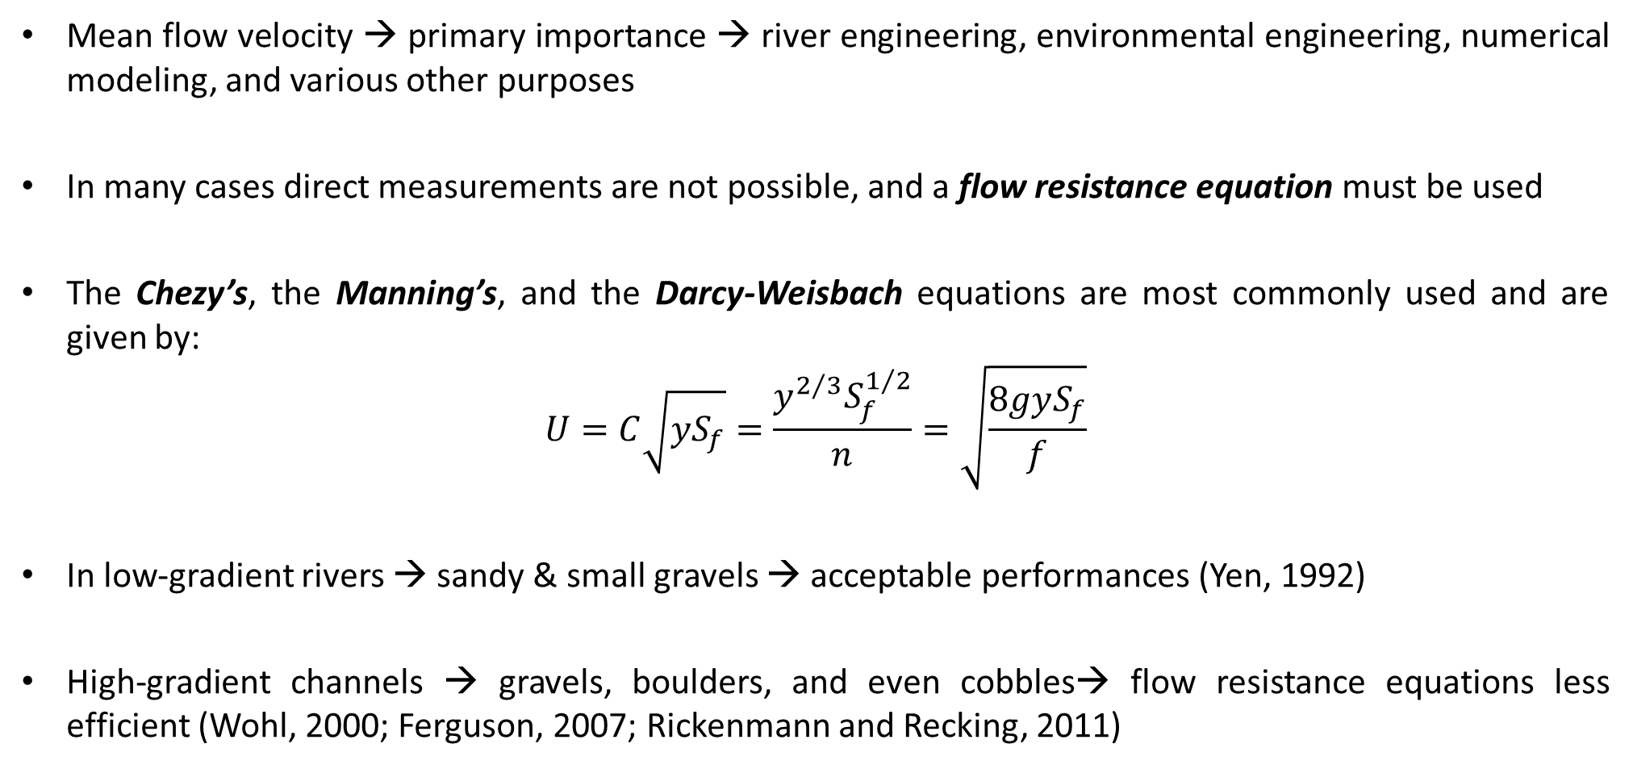
Introduction
Mean flow velocity → primary importance → river engineering, environmental engineering, numerical modeling, and various other purposes
In many cases direct measurements are not possible, and a flow resistance equation must be used
The Chezy’s, the Manning’s, and the Darcy-Weisbach equations are most commonly used and are given by:
$$U=C\sqrt{yS_{f}}=\frac{y^{2/3}S_{f}^{1/2}}{n}=\sqrt{\frac{8gyS_{f}}{f}}$$
In low‐gradient rivers → sandy & small gravels → acceptable performances (Yen, 1992)
High‐gradient channels → gravels, boulders, and even cobbles→ flow resistance equations less efficient (Wohl, 2000; Ferguson, 2007; Rickenmann and Recking, 2011)

Slide 3
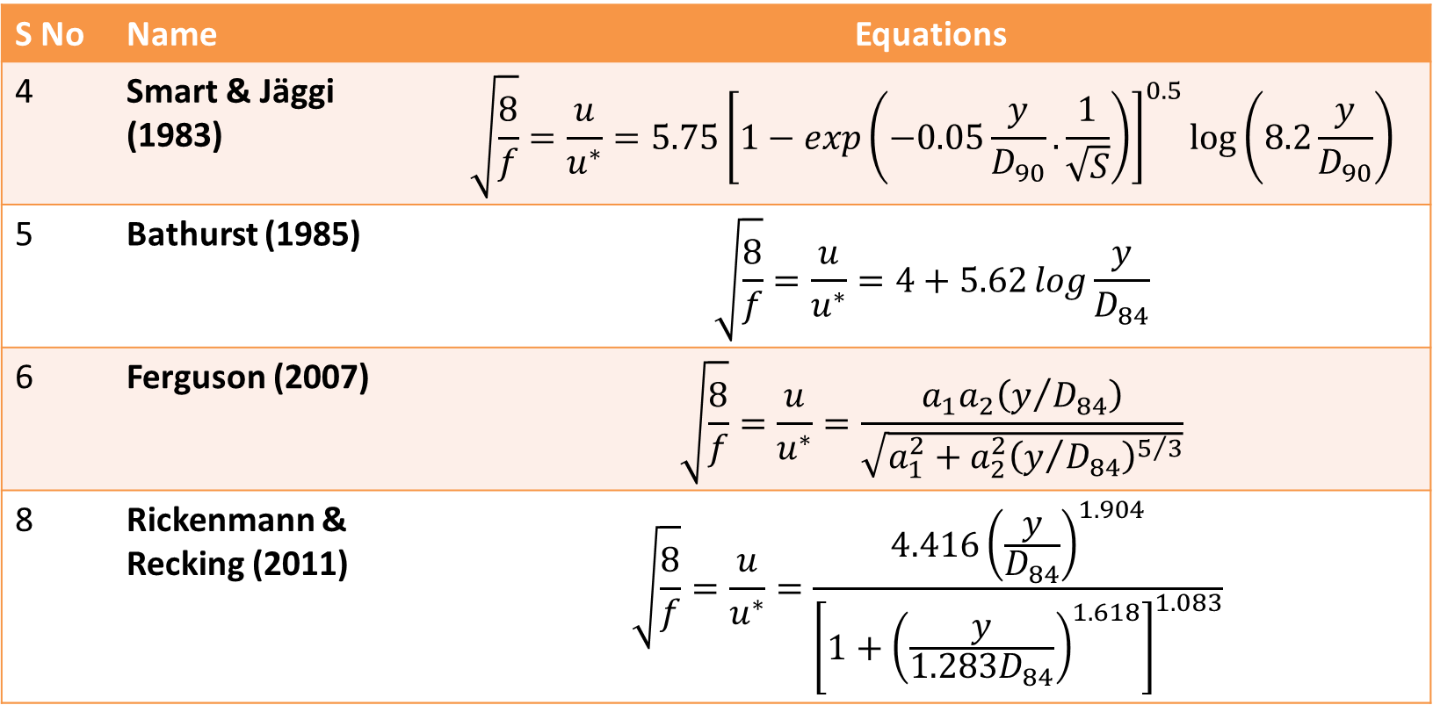

Concept of flow resistance
For $\left(\frac{y}{D_{84}}>10\right)$ the main sources → form drag on individual bed particles → viscous friction (skin friction)→ also large‐scale bed‐form characteristics.
For $\left(\frac{y}{D_{84}}\sim 1\right)$ → form drag, turbulent wakes of large roughness elements (wake vortices), free surface distortions (Ferguson, 2007; Nitsche et al., 2012; Rickenmann & Recking, 2011).
Protrusions from the channel bed forms the major source of resistance (Hodge et al., 2020; Monsalve et al., 2017)
S No | Name | Equations
4 | Smart & Jäggi (1983) | $$\sqrt{\frac{8}{f}}=\frac{u}{u^{∗}}=5.75{\left[1−exp\left(−0.05\frac{y}{D_{90}}.\frac{1}{\sqrt{S}}\right)\right]}^{0.5}\log\left(8.2\frac{y}{D_{90}}\right)$$
5 | Bathurst (1985) | $$\sqrt{\frac{8}{f}}=\frac{u}{u^{∗}}=4+5.62\log{\frac{y}{D_{84}}}$$
6 | Ferguson (2007) | $$\sqrt{\frac{8}{f}}=\frac{u}{u^{∗}}=\frac{a_{1}a_{2}\left(y/{D_{84}}\right)}{\sqrt{a_{1}^{2}+a_{2}^{2}{\left(y/{D_{84}}\right)}^{5/3}}}$$
8 | Rickenmann & Recking (2011) | $$\sqrt{\frac{8}{f}}=\frac{u}{u^{∗}}=\frac{4.416{\left(\frac{y}{D_{84}}\right)}^{1.904}}{{\left[1+{\left(\frac{y}{1.283D_{84}}\right)}^{1.618}\right]}^{1.083}}$$

Slide 4

Hypothesis
Non-uniform sediments → increased bed protrusions → increased flow resistance
Non-uniformity of sediments usually characterized by geometric standard deviation
Non-uniformity coefficients (σ_{G}):
Geometric standard deviation (σ_{g}): $\sqrt{{D_{84}}/{D_{16}}}$
Non-uniformity of bed material | Geometric standard deviation (σ_{g}) | No of observations
Very small | σ_{g} < 2.5 | 1070
Small | 2.5 ≤ σ_{g} < 5 | 816
Intermediate | 5 ≤ σ_{g} < 7.5 | 504
Large | 7.5 ≤ σ_{g} < 10 | 165
Enormous | σ_{g} ≥ 10 | 67
Trask (1933)
σ_{G} < 2.5 (well sorted)
2.5 ≤ σ_{G} < 4.5 (normally sorted)
σ_{G} > 4.5 (poorly sorted)
Folk & Ward (1957)
σ_{G} < 2 (well sorted)
2 ≤ σ_{G} < 4 (poorly sorted)
σ_{G} > 4 (very poorly sorted)
Friedman (1962)
σ_{G} < 2.8 (well sorted)
2.8 ≤ σ_{G} < 5.2 (poorly sorted)
σ_{G} > 5.2 (very poorly sorted)

Slide 5
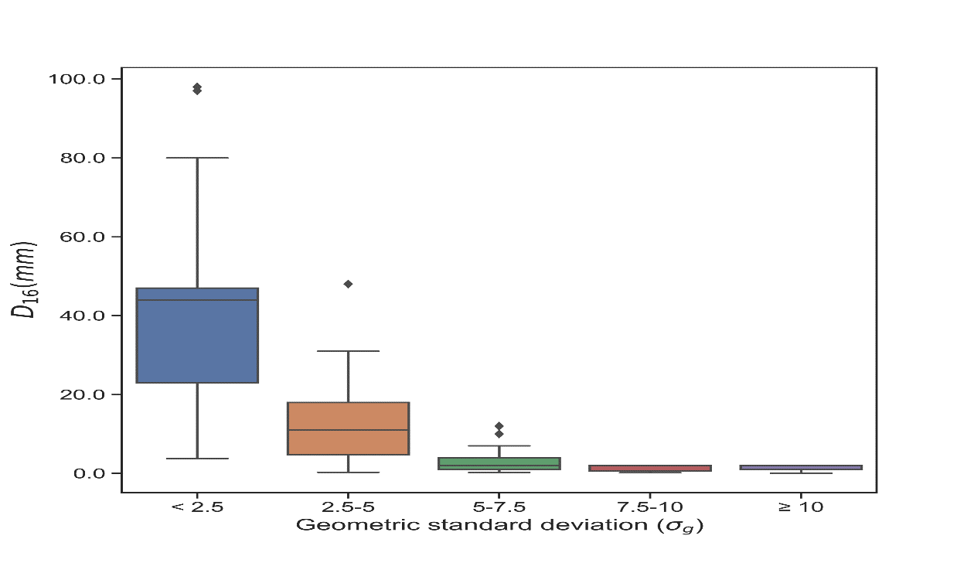
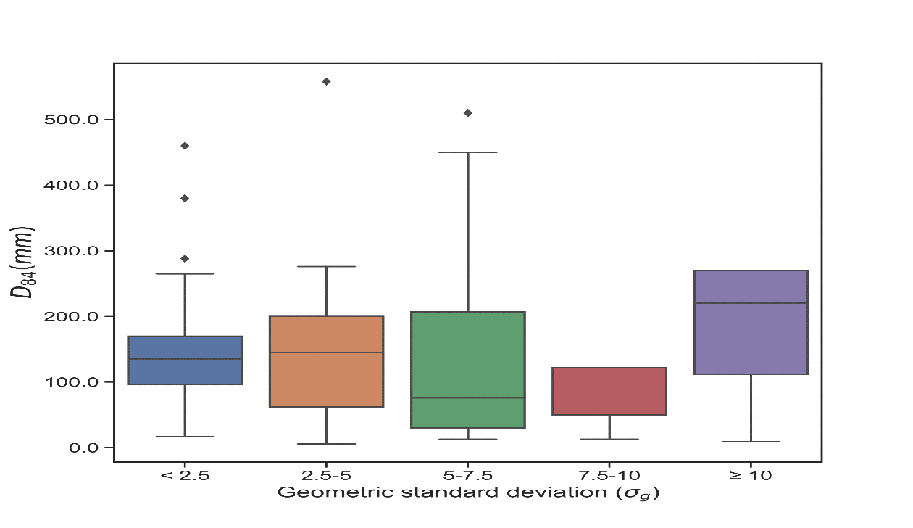
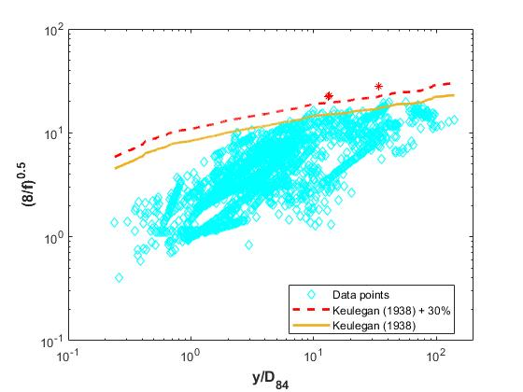
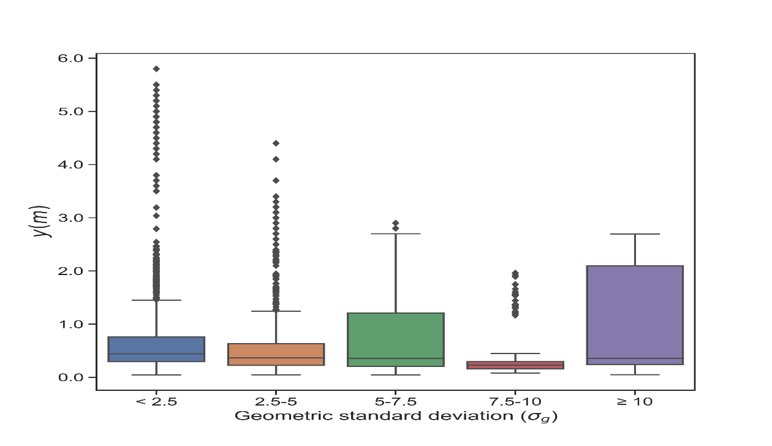
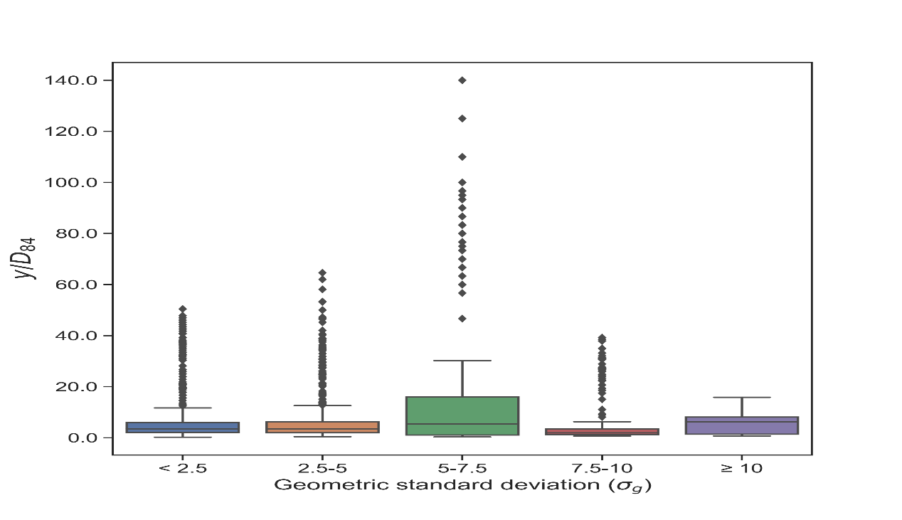
The Dataset
Literature data→ 2396 from Misset et al., 2019; and 409 from Mendicino & Colosimo, 2019
Missing variables (depth, discharge, or grain size distribution) → eliminated 180 measurements
Criteria suggested by Rickenmann and Recking (2011) to eliminate data characterised by very flat beds → 3 measurements removed
Database of 2622 measurements
Distribution range of flow and channel parameters

Slide 6
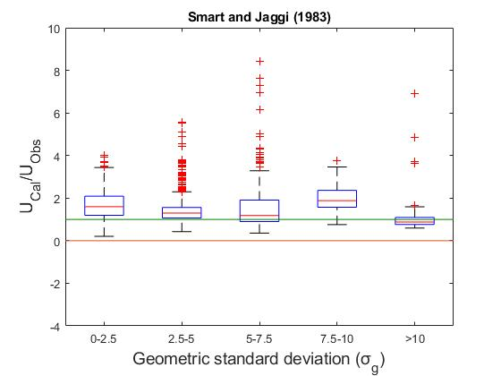
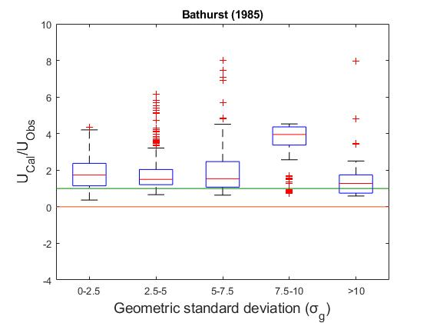
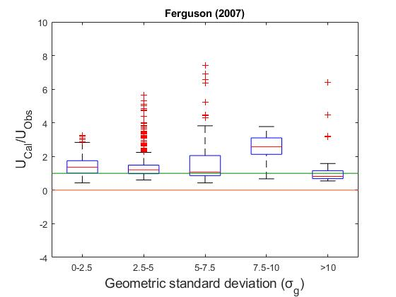
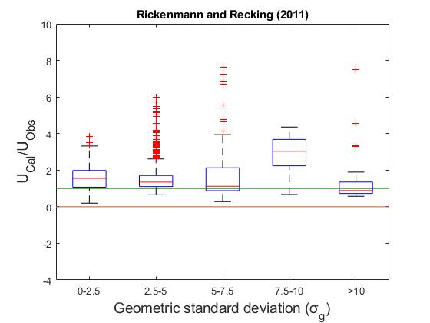
Conventional equations different $\text{σ} g$

Slide 7
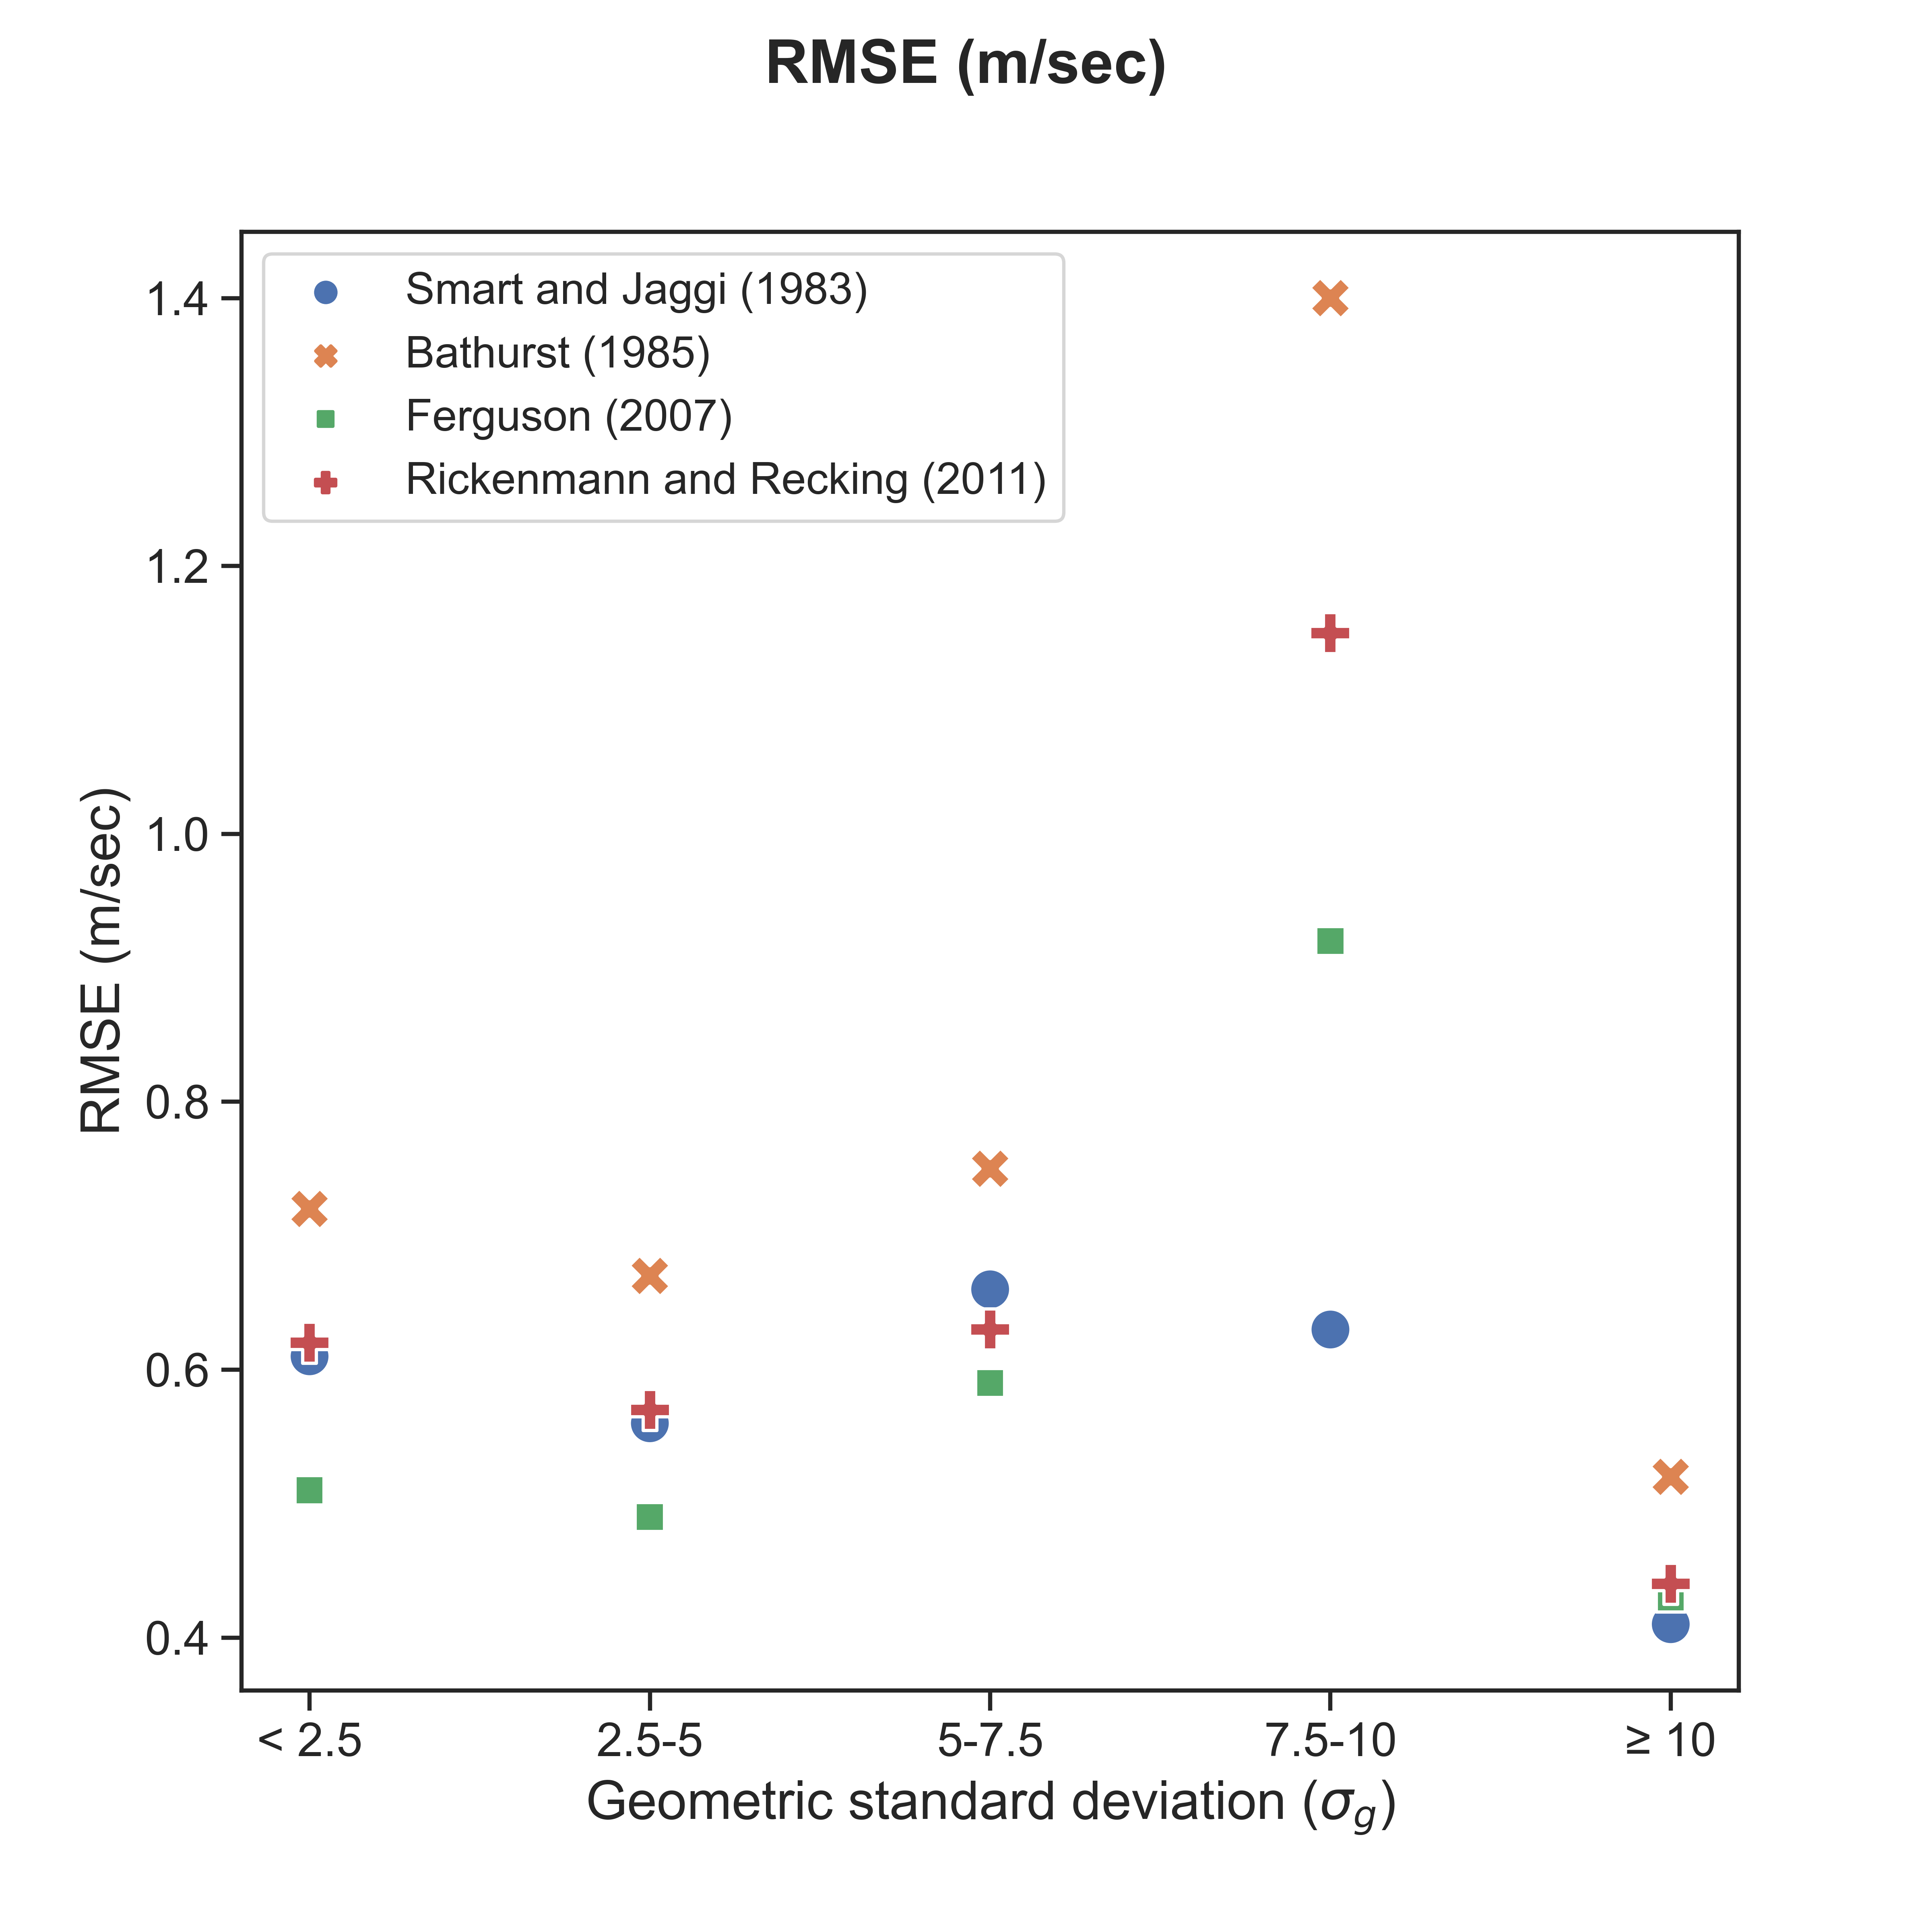
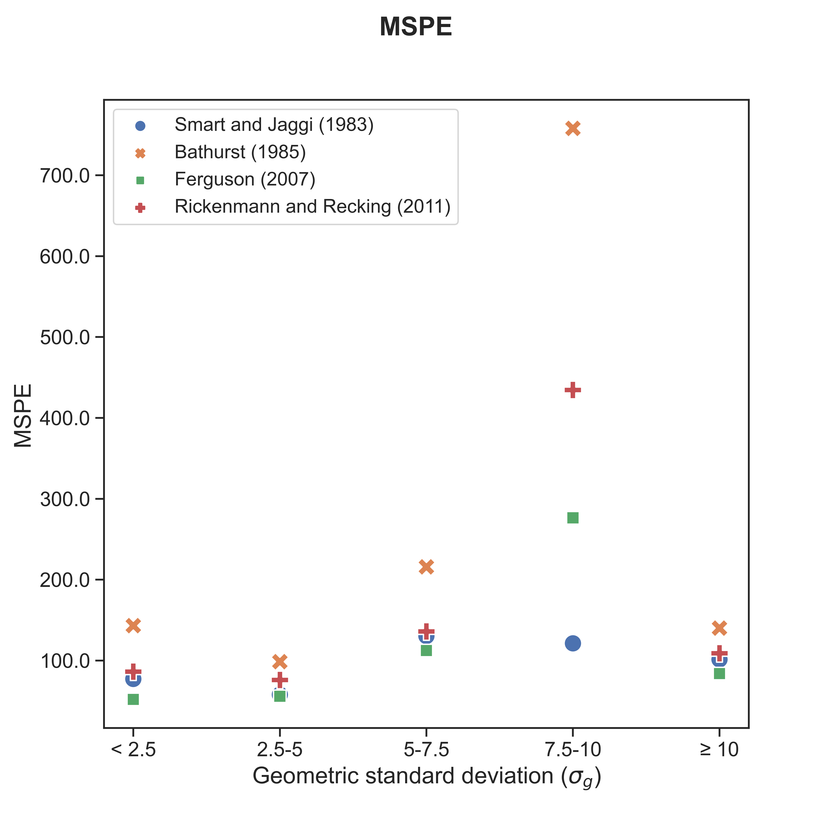
Performances in terms of statistical indices
Equation | Statistical Indices | Whole Dataset N =2622 | σ_{g} < 2.5 N=1070 | 2.5 ≤ σ_{g} < 5 N=816 | 5 ≤ σ_{g} < 7.5 N=504 | 7.5 ≤ σ_{g} < 10 N=165 | σ_{g} ≥ 10 N=67
Smart & Jäggi (1983) | RMSE | 0.60 | 0.61 | 0.56 | 0.66 | 0.63 | 0.41
 | MSPE | 84.78 | 77.23 | 57.83 | 130.32 | 121.26 | 101.35
Bathurst (1985) | RMSE | 0.77 | 0.72 | 0.67 | 0.75 | 1.40 | 0.52
 | MSPE | 181.86 | 143.13 | 98.59 | 215.82 | 757.99 | 140.08
Ferguson (2007) | RMSE | 0.55 | 0.51 | 0.49 | 0.59 | 0.92 | 0.43
 | MSPE | 79.73 | 51.89 | 55.89 | 112.45 | 276.45 | 83.96
Rickenmann and Recking (2011) | RMSE | 0.65 | 0.62 | 0.57 | 0.63 | 1.15 | 0.44
 | MSPE | 115.08 | 86.15 | 75.95 | 136.06 | 434.50 | 108.99

Slide 8
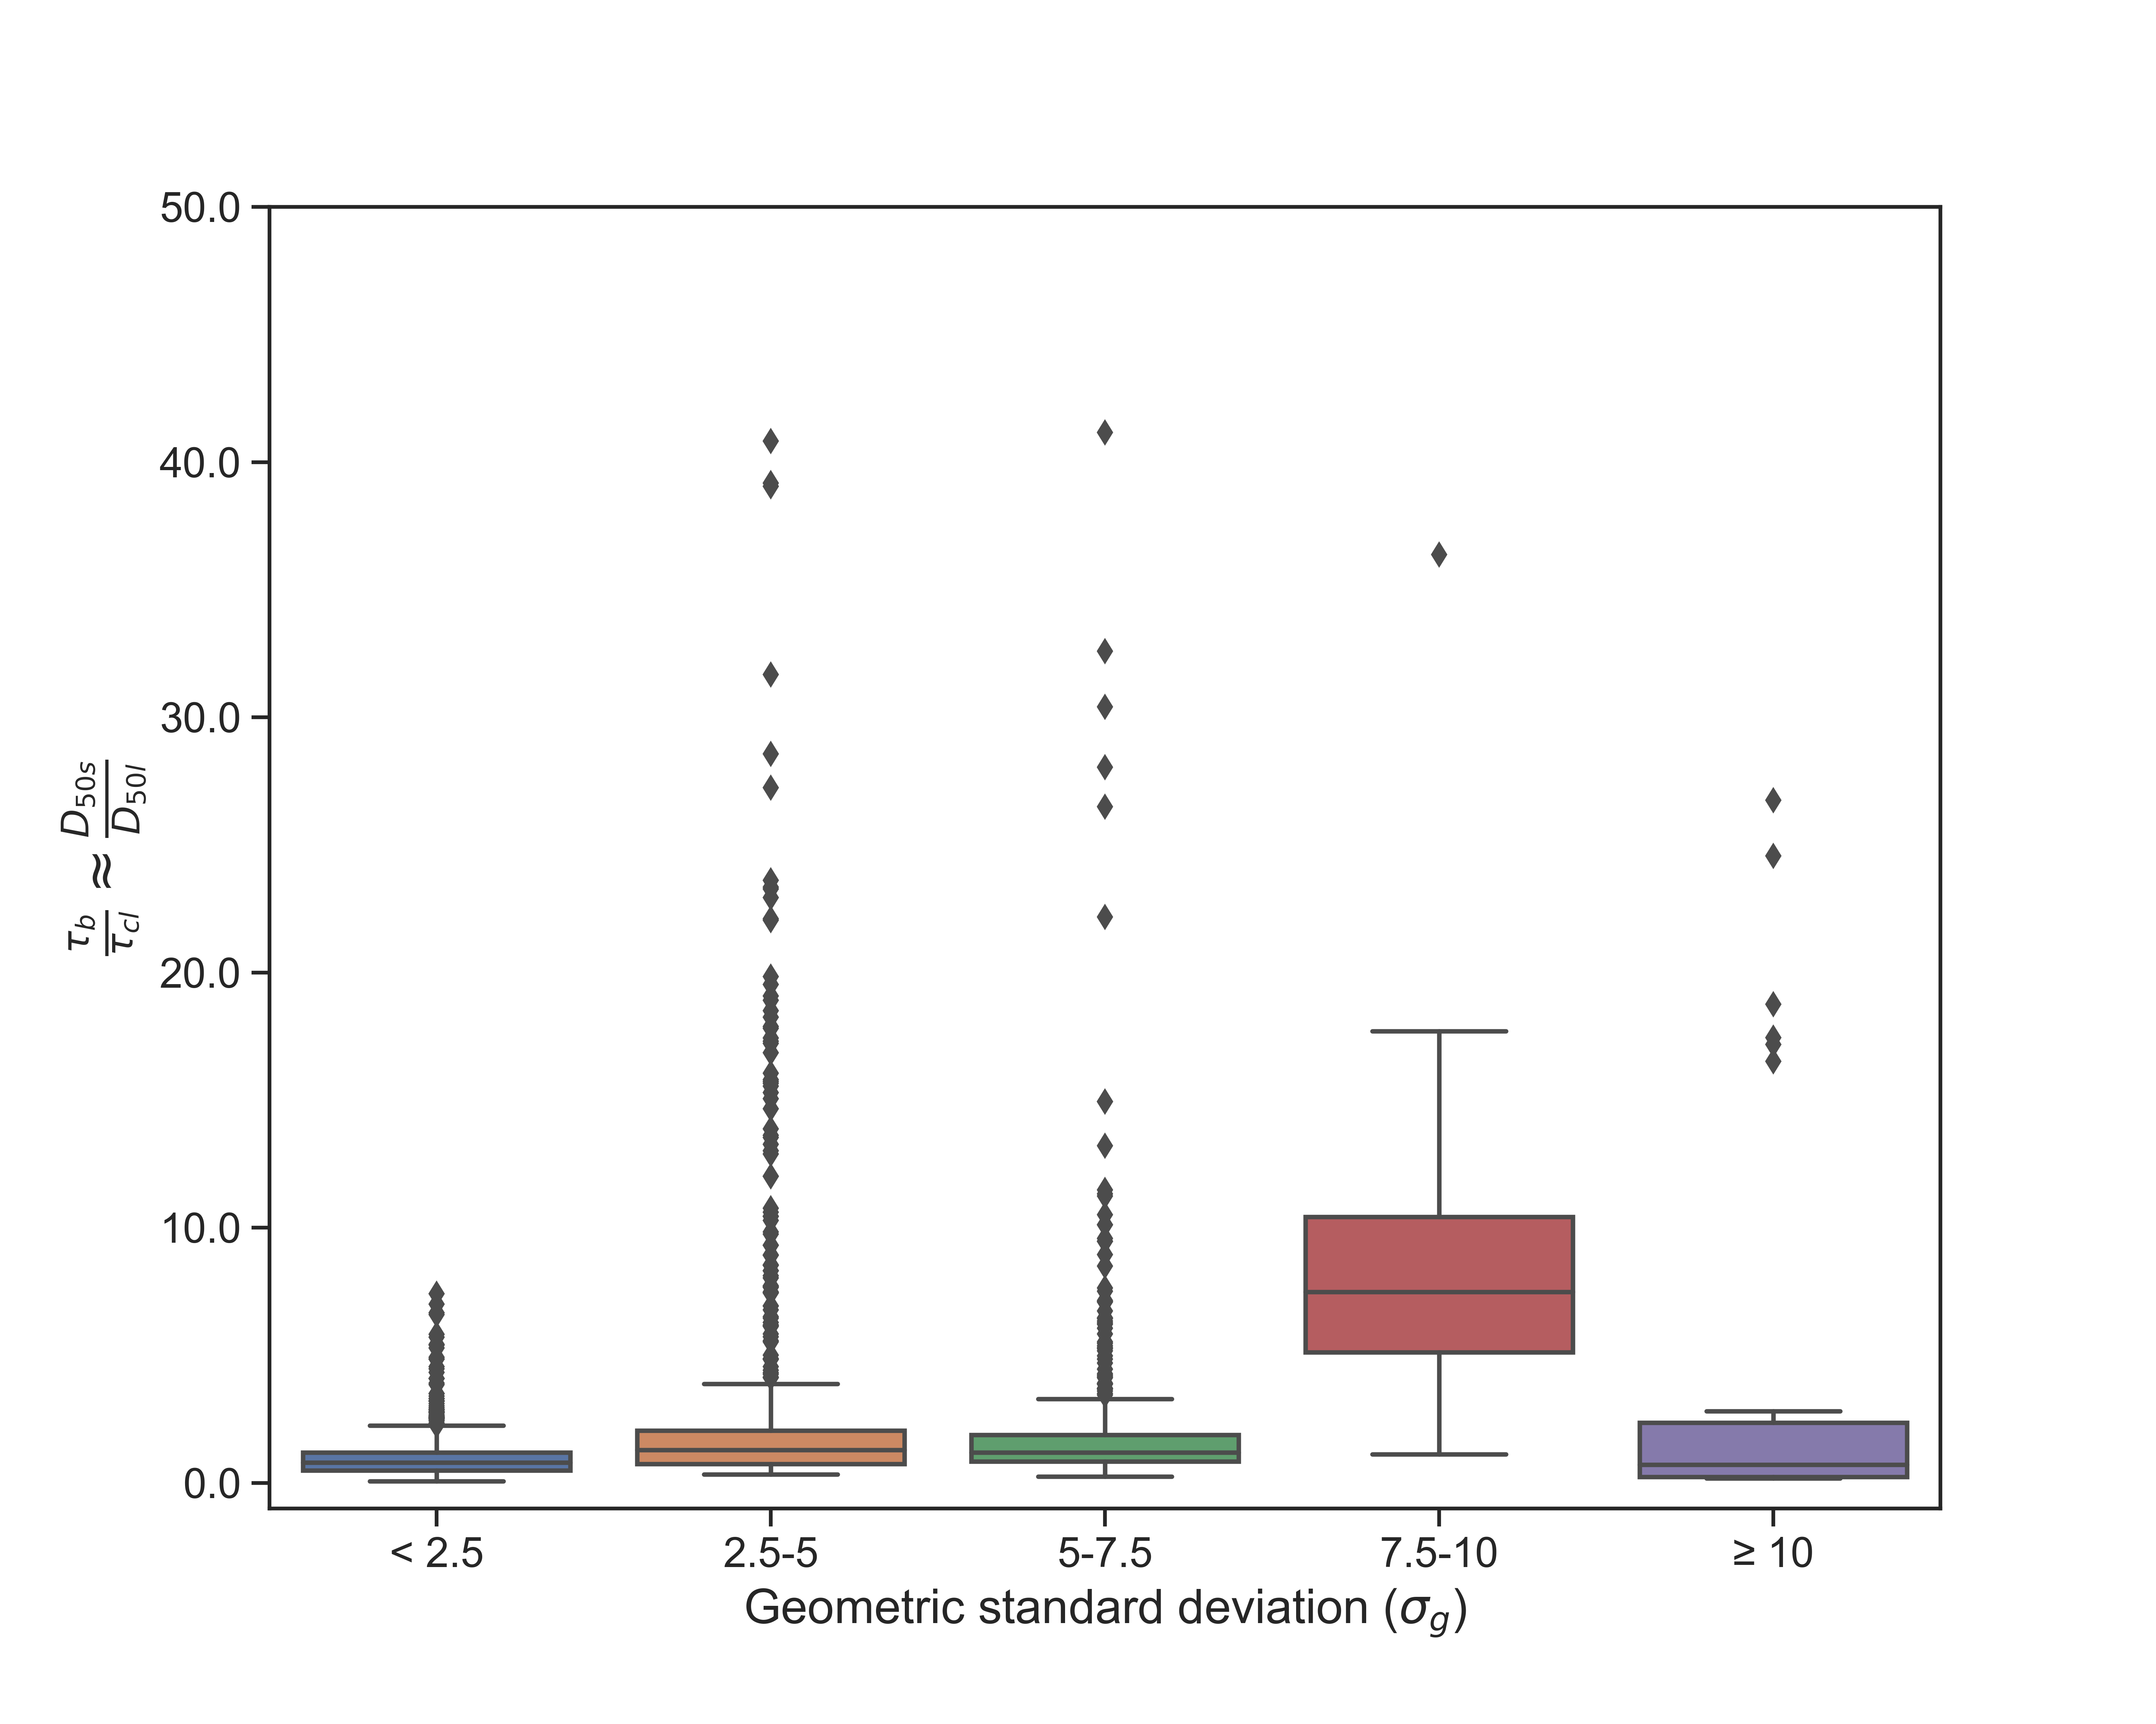

Surface coarsening using motion thresholds
Dietrich et al. (1989)
$$q^{∗}= {\left(\frac{τ_{b}−τ_{cs}}{τ_{b}−τ_{cl}}\right)}^{1.5}$$
For fully armoured bed, Church et al., (1998) simplified above relation as q* approaches 0.001:
$$\frac{D_{50s}}{D_{50l}}=\frac{τ_{b}}{τ_{cl}}$$
T_{b} (depth-slope approach), and T_{cl} by assuming τ_{cl}* as 0.045 (P. R. Wilcock & McArdell, 1993; Wong & Parker, 2006)
The back-calculated values of D_{50s}/D_{50l} were used to draw inference on bed armouring

Slide 9
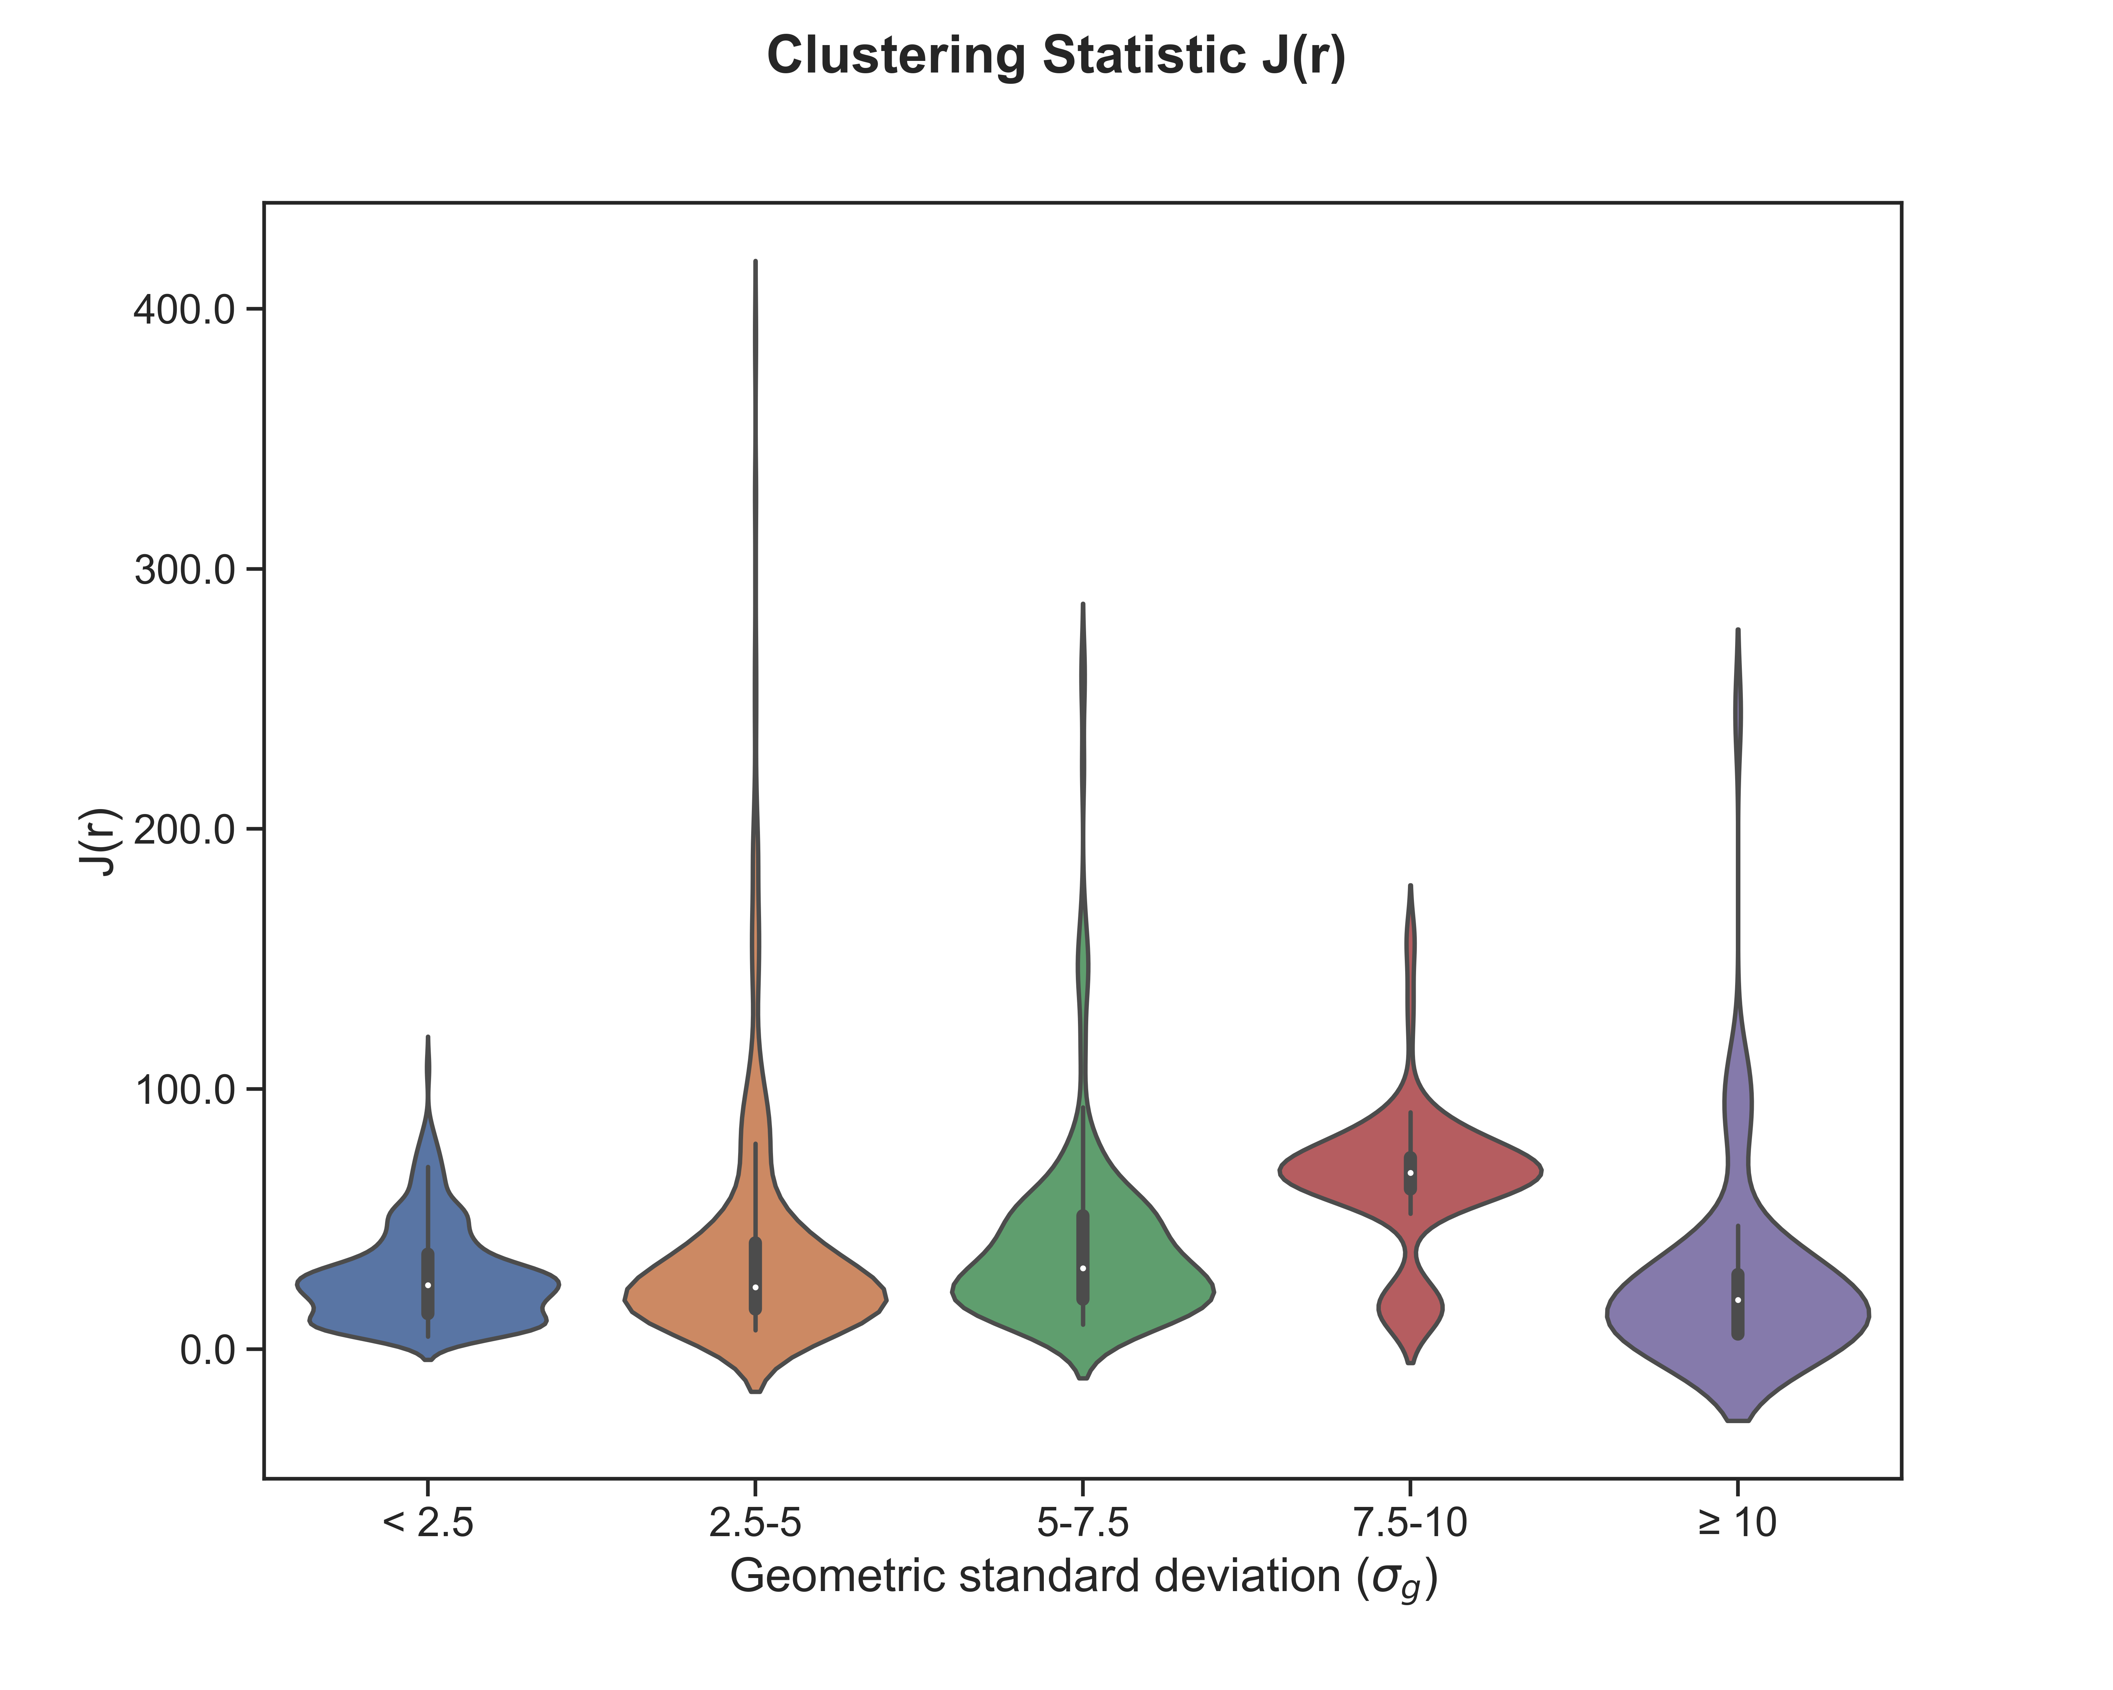
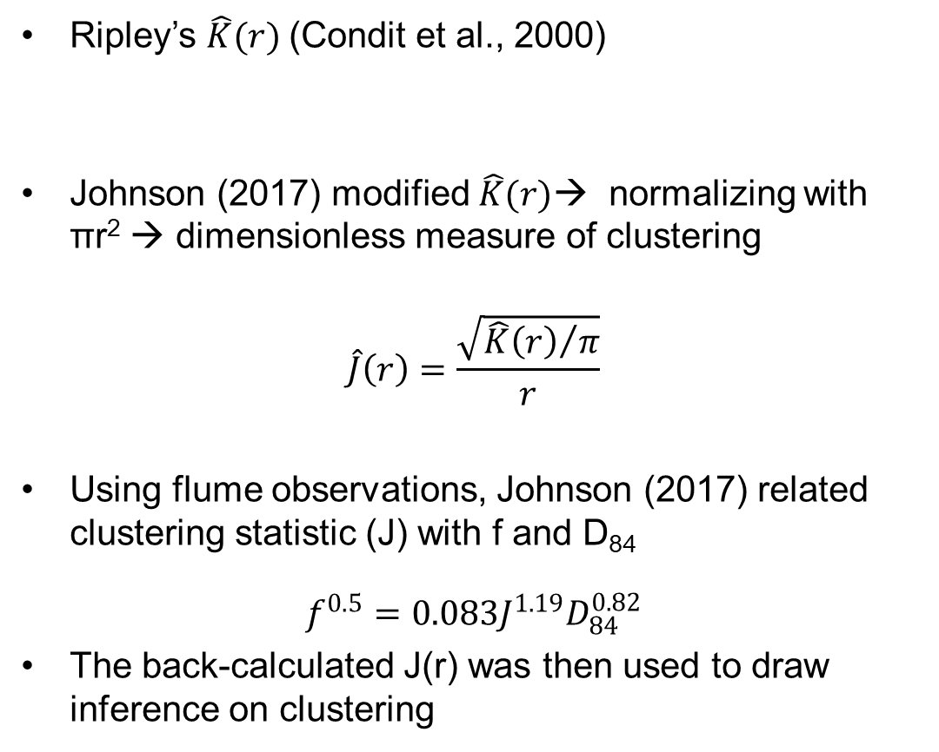
Clustering Statistics
Ripley’s $\hat{K}(r)$(Condit et al., 2000)
Johnson (2017) modified $\hat{K}(r)$→ normalizing with πr² → dimensionless measure of clustering
$$\hat{J}\left(r\right)=\frac{\sqrt{{\hat{K}\left(r\right)}/π}}{r}$$
Using flume observations, Johnson (2017) related clustering statistic (J) with f and D₈₄
$$f^{0.5}=0.083J^{1.19}D_{84}^{0.82}$$
The back-calculated J(r) was then used to draw inference on clustering

Slide 10
Conclusions
Non-uniform sediment are liable to develop armoring and sediment clusters → increased flow resistance in the rivers
The reduced resistance for σ_{g} >10 might be associated with the large sand proportion causing smoother flow conditions in between larger grains
Flume based experiments on different sediment might be useful to draw more realistic inferences on the sediment non-uniformity affects
Sediment non-uniformity is important in gravel bed rivers and should be considered to study the other fluvial processes

Slide 11
References
Recking, A., Frey, P., Paquier, A., Belleudy, P., Champagne, J.Y., 2008. Feedback between bed load transport and flow resistance in gravel and cobble bed rivers. Water Resour. Res. https://doi.org/10.1029/2007WR006219
Yen, B. C. (Ed.). (1992). Channel flow resistance: centennial of Manning's formula. Water Resources Publication.
Wohl, E. E. (2000). Mountain rivers. American Geophysical Union.
Rickenmann, D., Recking, A., 2011. Evaluation of flow resistance in gravel-bed rivers through a large field data set. Water Resour. Res. https://doi.org/10.1029/ 2010WR009793.
Ferguson, R., 2007. Flow resistance equations for gravel- and boulder-bed streams. Water Resour. Res. 43 https://doi.org/10.1029/2006WR005422.
Nitsche, M., Rickenmann, D., Kirchner, J. W., Turowski, J. M., & Badoux, A. (2012). Macroroughness and variations in reach-averaged flow resistance in steep mountain streams. Water Resources Research. https://doi.org/10.1029/2012WR012091
Mendicino, G., Colosimo, F., 2019. Analysis of Flow Resistance Equations in Gravel-Bed Rivers With Intermittent Regimes: Calabrian fiumare Data Set. Water Resour. Res. 55, 7294–7319. https://doi.org/10.1029/2019WR024819.
Misset, C., Recking, A., Navratil, O., Legout, C., Poirel, A., Cazilhac, M., Briguet, V., Esteves, M., 2019. Quantifying bed-related suspended load in gravel bed rivers through an analysis of the bedload-suspended load relationship. Earth Surf. Process. Landforms 44, 1722–1733.
Monsalve, A., Yager, E.M., Schmeeckle, M.W., 2017. Effects of bed forms and large protruding grains on near-bed flow hydraulics in low relative submergence conditions. J. Geophys. Res. Earth Surf. 122, 1845–1866.
Hodge, R. A., Voepel, H., Leyland, J., Sear, D. A., & Ahmed, S. (2020). X-ray computed tomography reveals that grain protrusion controls critical shear stress for entrainment of fluvial gravels. Geology, 48(2), 149–153.
Keulegan, G.H., 1938. Laws of turbulent flow in open channels. J. Res. Natl. Bur. Stand. (1934). https://doi.org/10.6028/jres.021.039.
Strickler, A., 1923. Beitr¨age zur Frage der Geschwindigkeitsformel und der Rauhigkeitszahlen für Str¨ome. Kan¨ale und geschlossene Leitungen.
Hey, R.D., 1979. FLOW RESISTANCE IN GRAVEL-BED RIVERS. ASCE J Hydraul Div. https://doi.org/10.2208/prohe1975.25.21.
Monsalve, A., Yager, E.M., Schmeeckle, M.W., 2017. Effects of bed forms and large protruding grains on near‐bed flow hydraulics in low relative submergence conditions. J. Geophys. Res. Earth Surf. 122, 1845–1866.
Smart, G.M., Jäggi, M., 1983. Sedimenttransport in steilen Gerinnen: sediment transport on steep slopes.
Bathurst, J.C., 1985. Flow resistance estimation in mountain rivers. J. Hydraul. Eng. https://doi.org/10.1061/(ASCE)0733-9429(1985)111:4(625).
Trask, P. D. (1933). Origin and environment of source sediments.
Folk, R. L., & Ward, W. C. (1957). Brazos River bar [Texas]; a study in the significance of grain size parameters. Journal of Sedimentary Research, 27(1), 3–26.
Friedman, G. M. (1962). On sorting, sorting coefficients, and the lognormality of the grain-size distribution of sandstones. The Journal of Geology, 70(6), 737–753.
Johnson, Joel P L. (2017). Clustering statistics, roughness feedbacks, and randomness in experimental step‐pool morphodynamics. Geophysical Research Letters, 44(8), 3653–3662.
Condit, R., Ashton, P. S., Baker, P., Bunyavejchewin, S., Gunatilleke, S., Gunatilleke, N., et al. (2000). Spatial patterns in the distribution of tropical tree species. Science, 288(5470), 1414–1418.
Church, Michael, Hassan, M. A., & Wolcott, J. F. (1998). Stabilizing self‐organized structures in gravel‐bed stream channels: Field and experimental observations. Water Resources Research, 34(11), 3169–3179.
Dietrich, W. E., Kirchner, J. W., Ikeda, H., & Iseya, F. (1989). Sediment supply and the development of the coarse surface layer in gravel-bedded rivers. Nature, 340(6230), 215–217.
Wilcock, P. R., & McArdell, B. W. (1993). Surface‐based fractional transport rates: Mobilization thresholds and partial transport of a sand‐gravel sediment. Water Resources Research, 29(4), 1297–1312.
Wong, M., & Parker, G. (2006). Reanalysis and correction of bed-load relation of Meyer-Peter and Müller using their own database. Journal of Hydraulic Engineering, 132(11), 1159–1168.

Slide 12


Thanks
EGU22-270
Your suggestions, and queries are most welcome. For more details, please contact:
Contact details: Anshul Yadav: ayadav@hy.iitr.ac.in
Sumit Sen: sumit.sen@hy.iitr.ac.in

