Slide 1


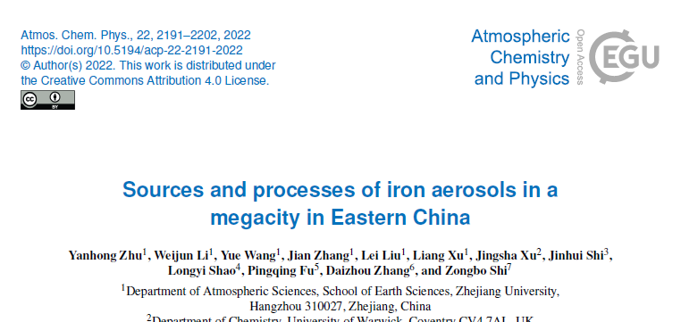

Sources and processes of iron aerosols in a upwind megacity of Northern Pacific Ocean
AS2.9 : Air-sea Chemical Fluxes: Impacts on Biogeochemistry and Climate
Weijun Li, Yanhong Zhu
School of Earth Sciences, Zhejiang University, China
Zongbo Shi
School of Geography, Earth and Environmental Sciences, University of Birmingham, UK
2022/05/23 EGU22-2714

Slide 2
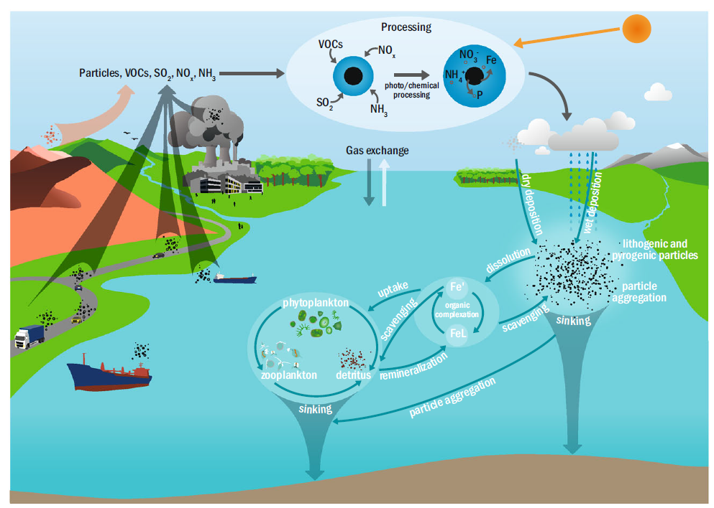
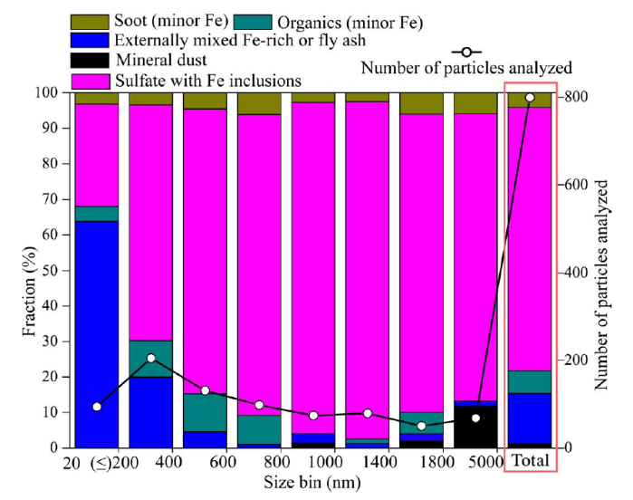
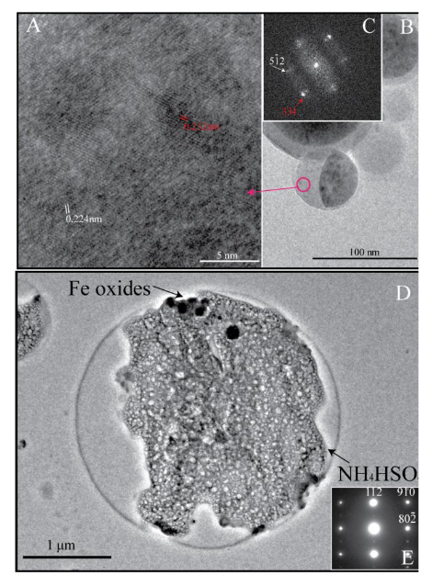
Abundant FeOx emitted from anthropogenic sources
Soluble Fe production
Li et al., SA, 2017
Ito, et al., npj, 2021
14% particles do contain FeOx
75% of Fe-bearing particles were internal mixtures of Fe-rich/fly ash and sulfate

Slide 3
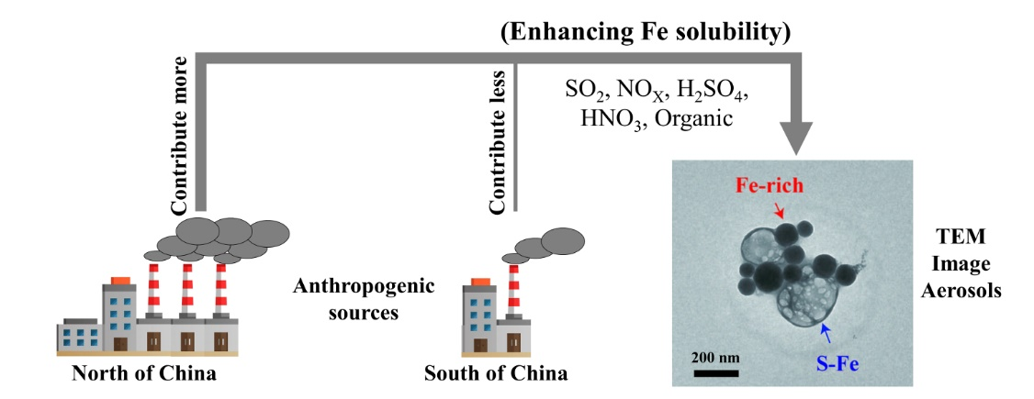
Sources of Fe?
Natural sources
Anthropogenic sources
challenge
VS
desert dust
Combustion
(biomass/oil)
soil dust
industry
What contributions between primary emission and secondary productions for total Fe and soluble Fe in the atmosphere?
Fe solubility: < 1%
Fe solubility: 0.06-81%
Global total Fe: 70-80%
Global total Fe: small
Mahowald et al., 2005; Jickells et al., 2005; Sedwick et al., 2007; Schroth et al., 2009; Oakes et al., 2012；Zhu et al., EP, 2020

Slide 4
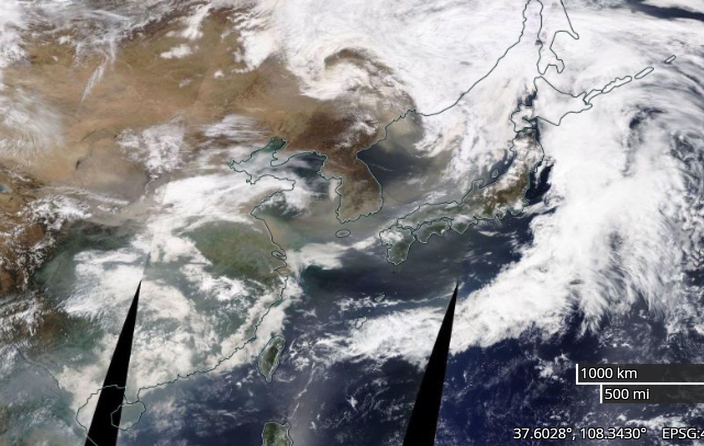
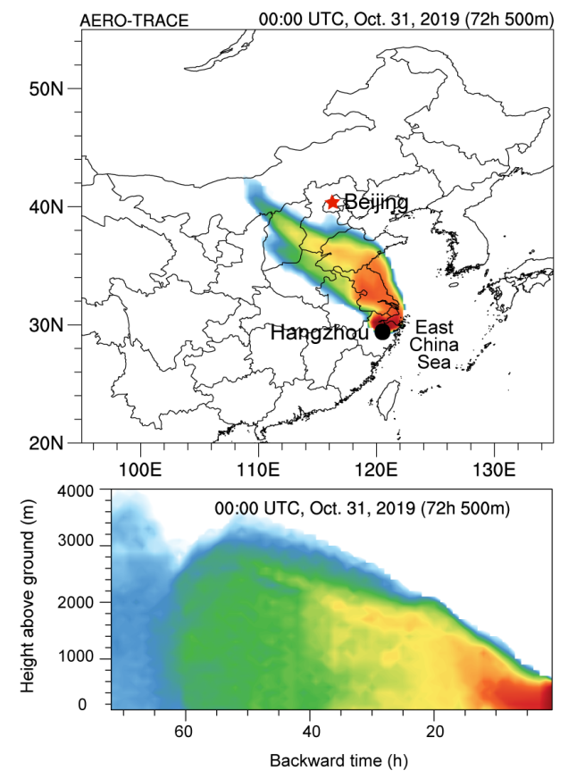
Air pollutants transport into marine air
Long range transport into North Pacific Ocean
Qingdao
Hangzhou
Zhang et al., JGR, 2021, 126 (8), e2020JD033778.

Slide 5
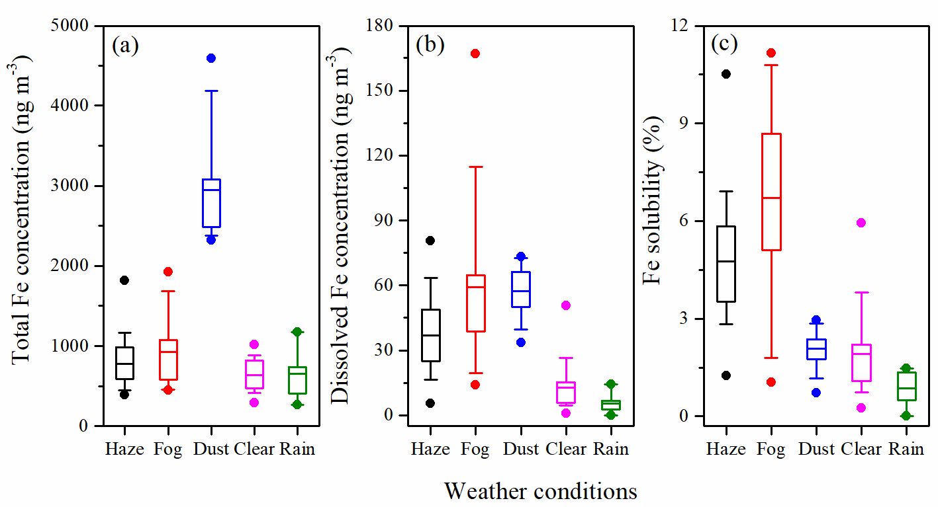
Fe concentrations under different conditions in PM2.5
Fe solubility in PM2.5: the largest in fog days (6.7 ± 3.0%), following haze days (4.8 ± 1.9%), dust days (2.1 ± 0.7%), clear days (1.9 ± 1.0%), and rain days (0.9 ± 0.5%)
Zhu et al., Atmos. Chem. Phys. 22 (4), 2191-2202.

Slide 6
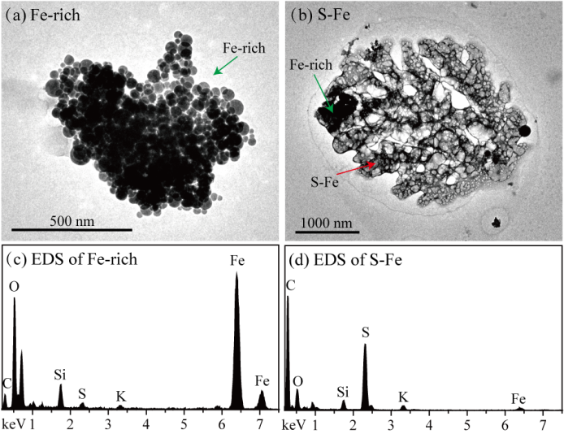
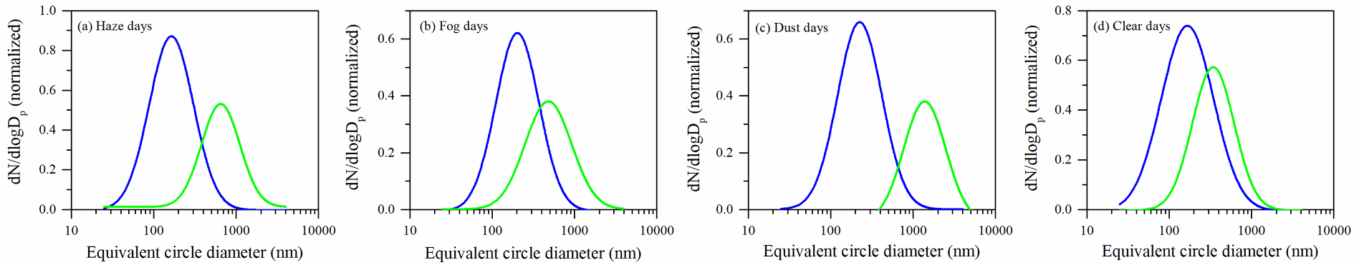
Fe-rich and S-Fe particles
There are large number of nano-FeOx particles from industrial emissions in fog and haze days
FeOx
FeOx with secondary aerosol coating
Internally mixing forms S-Fe particles

Slide 7
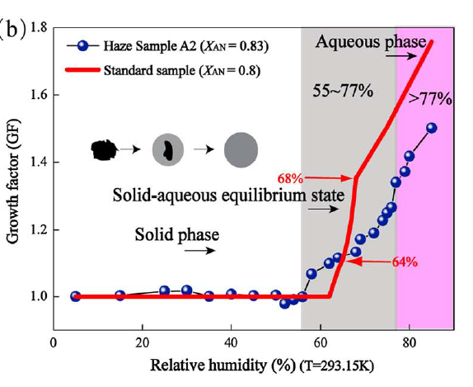
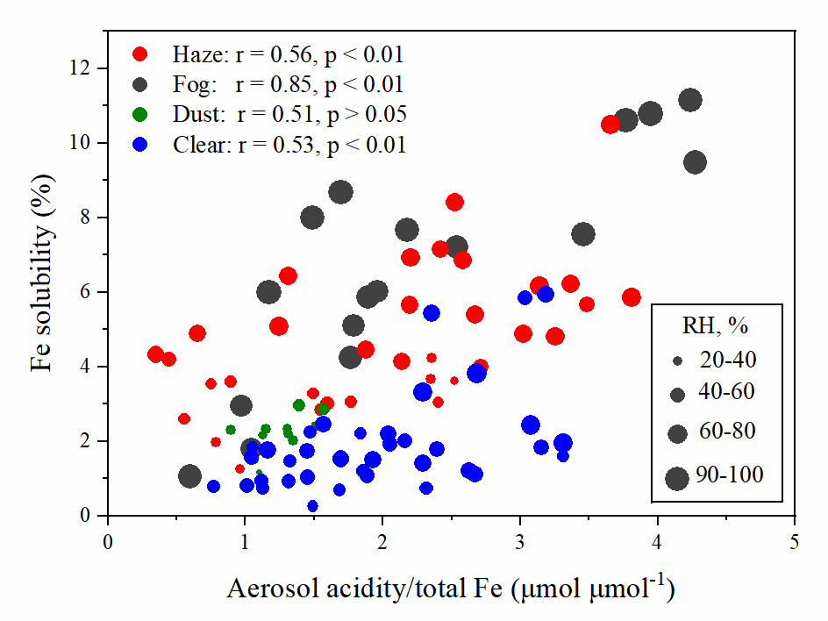
Fe solubility and aerosol acidity/total Fe under different RH
Sun et al., JGR, 2018
wet surface of aerosol particles (when RH > 60%) may facilitate the update of acidic species and thereby promote Fe dissolution and increase Fe solubility.
Zhu et al., Atmos. Chem. Phys. 22 (4), 2191-2202.

Slide 8
What sources contribute Fe in the city?

Slide 9
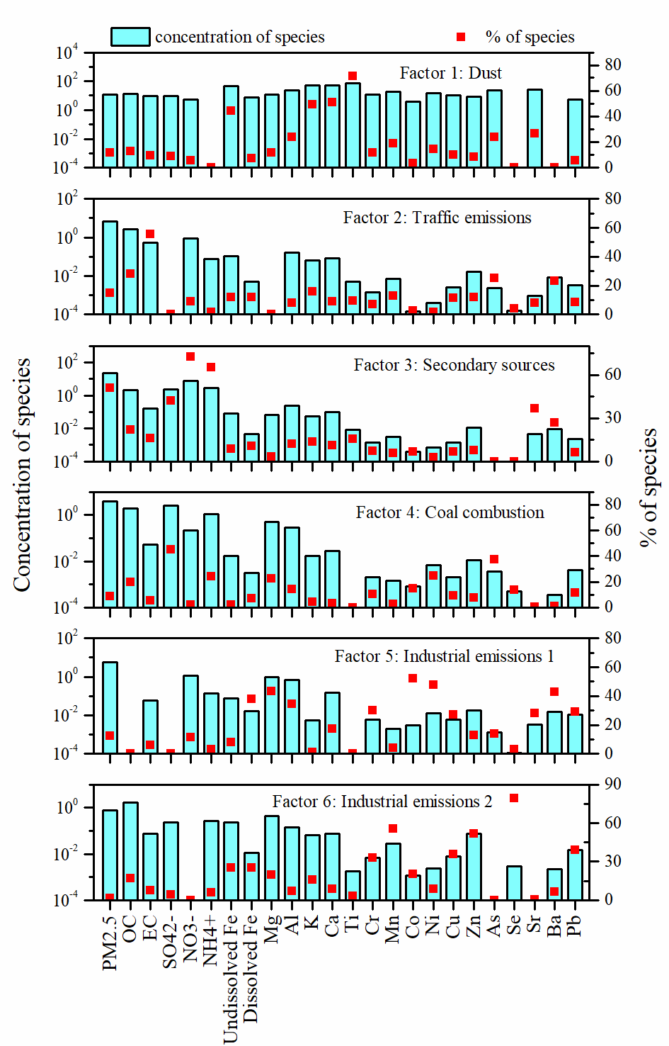
PMF model analysis
What is sournces of dissolved Fe Dust:
Traffic emission (non-exhaust traffic emissions)
Secondary sources
Coal combustion
Industrial emission-1 (heavy oil refinery processes)
Industrial emission-2 (steel industry emissions)
Zhu et al., Atmos. Chem. Phys. 22 (4), 2191-2202.

Slide 10
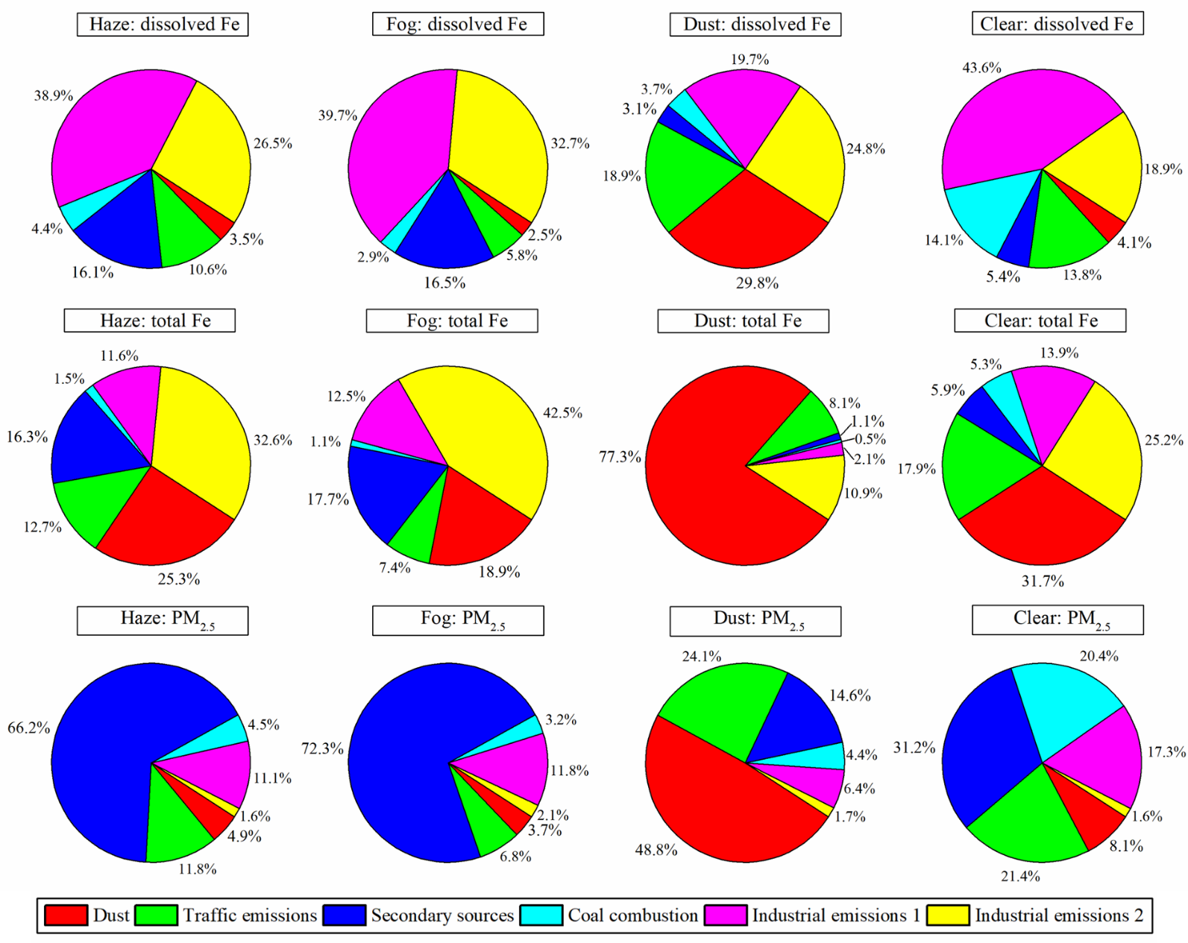
Contributions of identified sources to dissolved Fe, total Fe, and PM_{2.5}
Dissolved Fe from industrial emission?
Industrial emission

Slide 11
Conclusions
Fe solubility was the largest in fog days (6.7%), followed by haze (4.8), dust (2.1%), clear (1.9 %), and rain (0.9%) days
PMF analysis suggested that industrial emissions were the largest contributor to dissolved Fe (44.5%-72.4%) and total Fe (39.1%-55.0%, except dust days) during haze, fog, dust, and clear days.
Fe solubility showed significant positive correlations with aerosol acidity/total Fe and liquid water content
Dissolved Fe are mostly from secondary productions of the nano-FeOx sourced from industrial emissions

Slide 12
Thank you for your attention！

