Slide 1


Slide 2

When will the back-arc marginal sea grow up again?
name: Huizi Jian
advisor: Ting Yang
ID: EGU22-2715

Slide 3
content
Background and Question
Models and Results

Slide 4
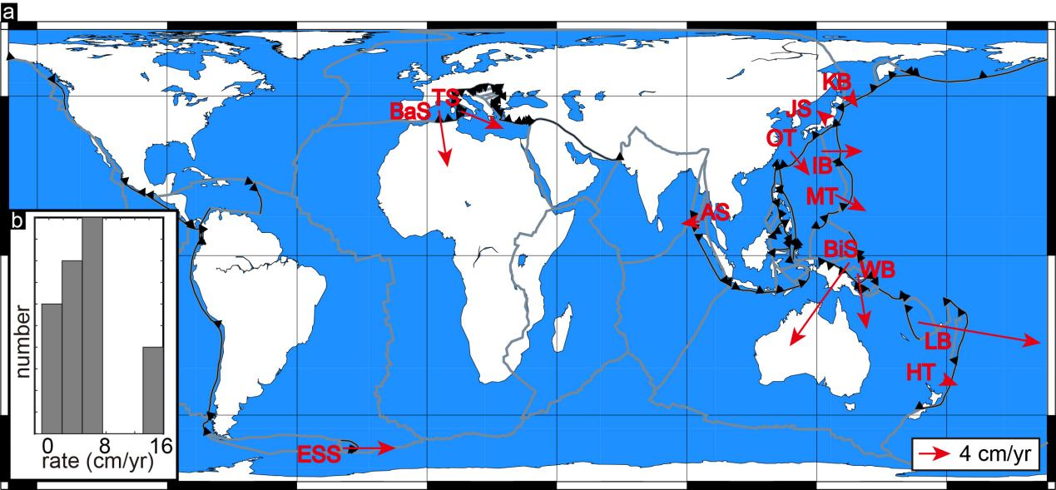
Background and Question
When will the back-arc marginal sea grow up again?
Statistics on currently active back-arc marginal sea (BMS):
80% of BMSs open at a moderate and low opening rate, even in a compression state, while 20% of BMSs rapidly open at greater than 10 cm/yr.
25% of BMSs are episodicly opening.

Slide 5
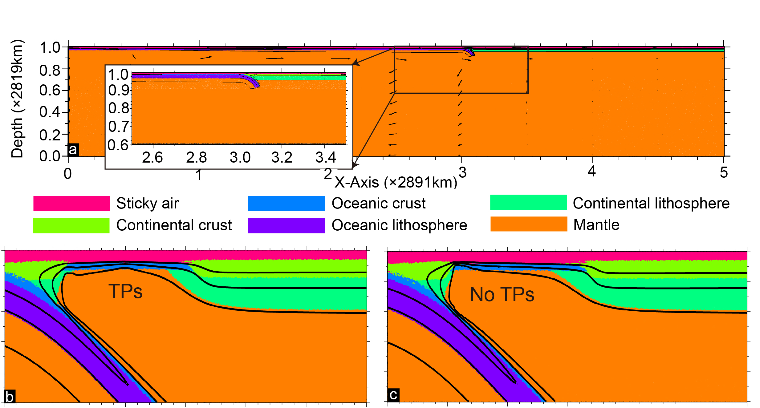
II. Models and Results
Finding the optimal age of island arc volcanoes：
Grid search method
TPs: Two temperature peaks
3 Myr is selected

Slide 6
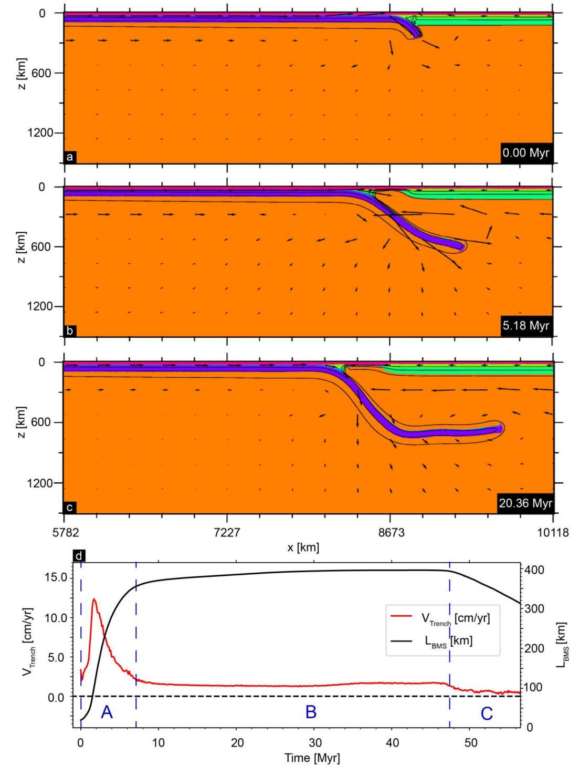
II. Models and Results
No opening again:
The BMS first opens quickly, stops opening, and finally starts to tectonic inversion of compression.

Slide 7
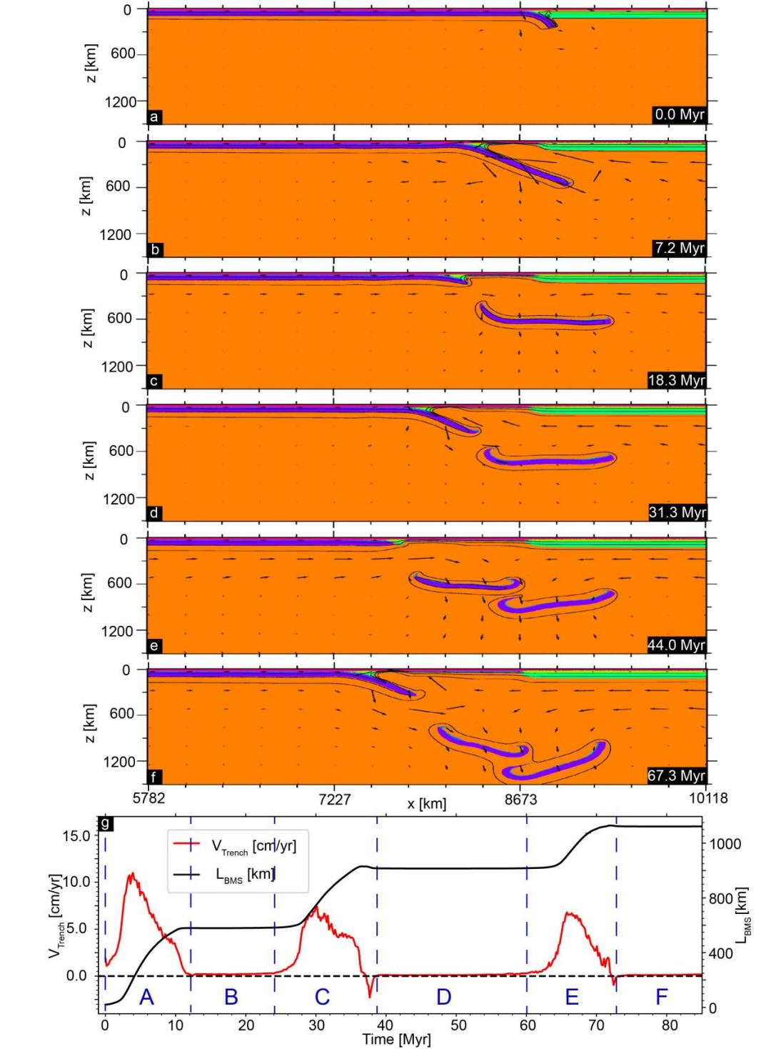
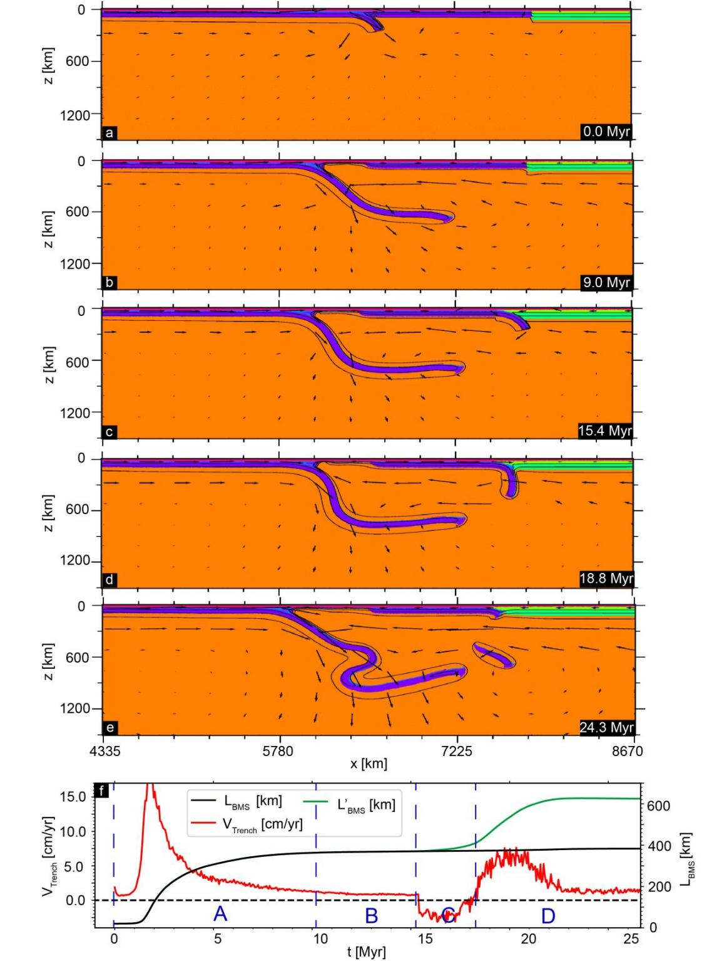
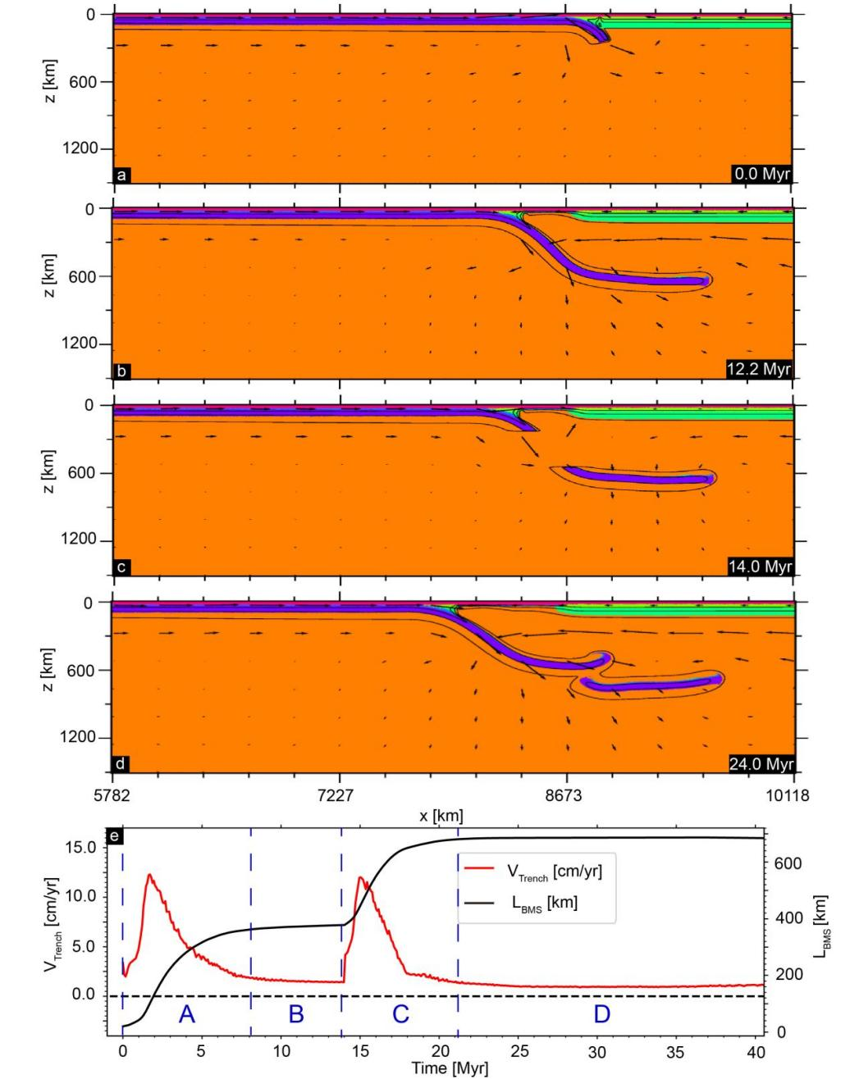
II. Models and Results
Opening again:
Episodicity in the BMS openings:

Slide 8
Conclusion:
The broken subducting slab or a double subduction system can produce BMSs episodic opening.
thanks !

