Slide 1
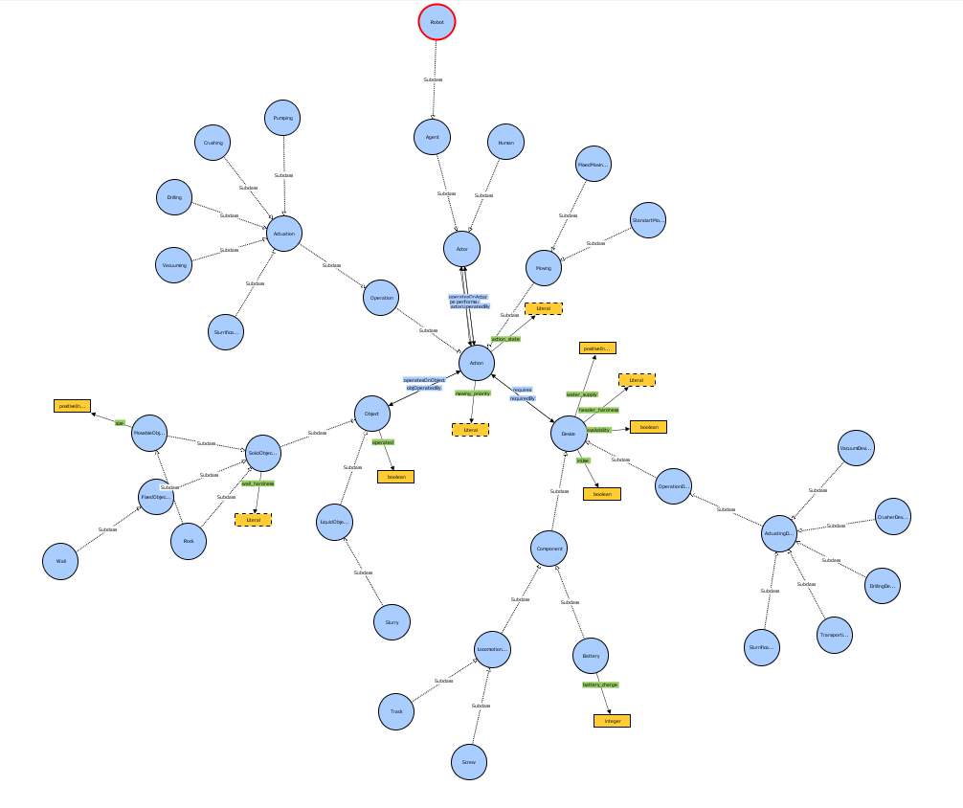
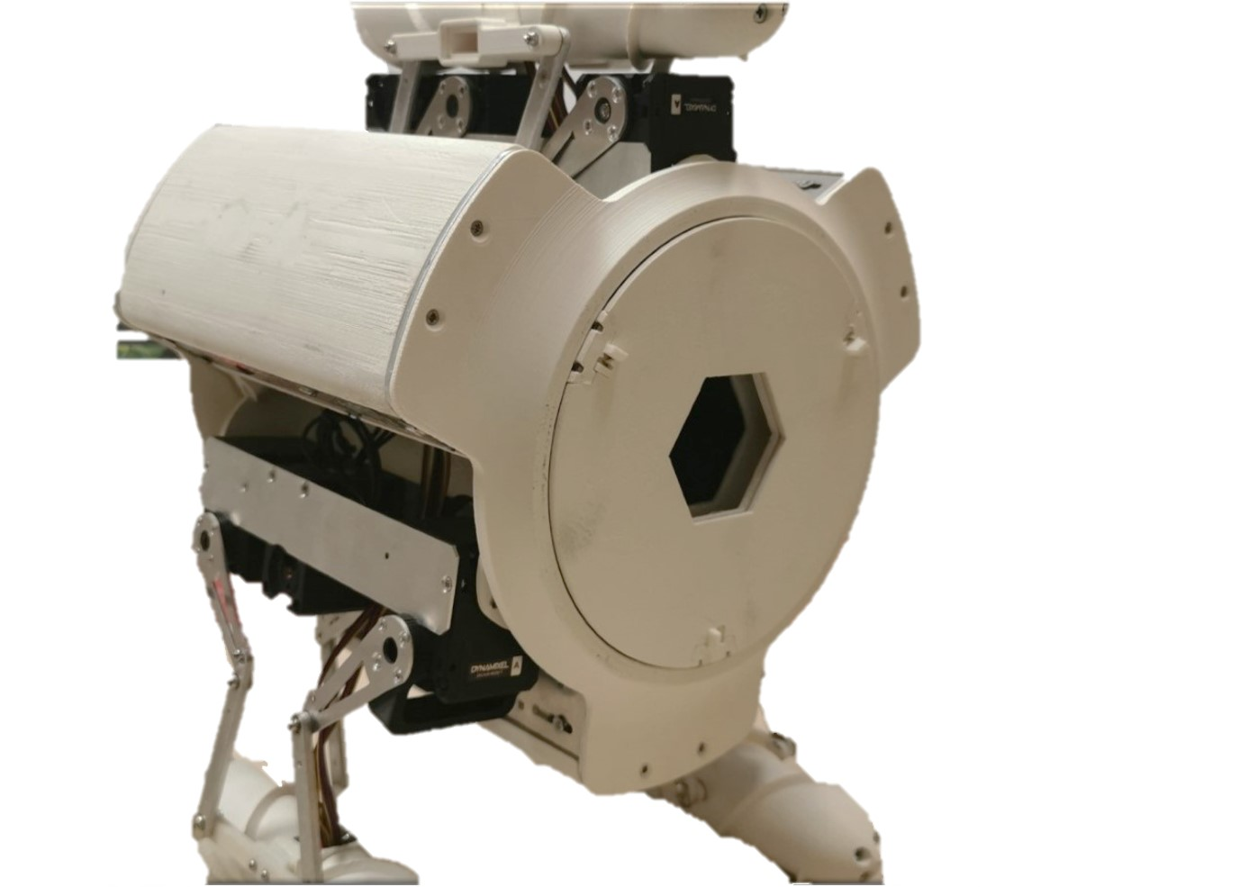



Self-awareness for robust miner robot autonomy
Esther Aguado, Ricardo Sanz, Claudio Rossi

Slide 2
Contents
Why self-awareness?
Self-adaptation concept
Reasoning in self-aware systems
Self-awareness for robust miner robot autonomy – E. Aguado, R. Sanz, C. Rossi

Slide 3
Why self – awareness?
Self-awareness for robust miner robot autonomy – E. Aguado, R. Sanz, C. Rossi

Slide 4
Robo miner crucial requirements
Self - awareness
Robustness
Resilience
Autonomy
Self-awareness for robust miner robot autonomy – E. Aguado, R. Sanz, C. Rossi

Slide 5
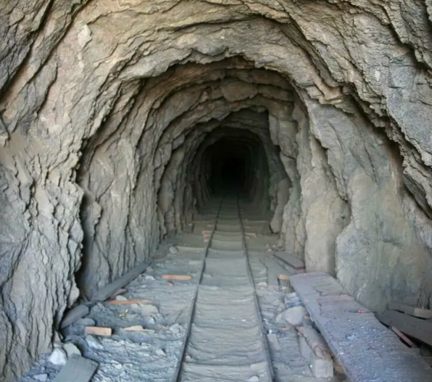
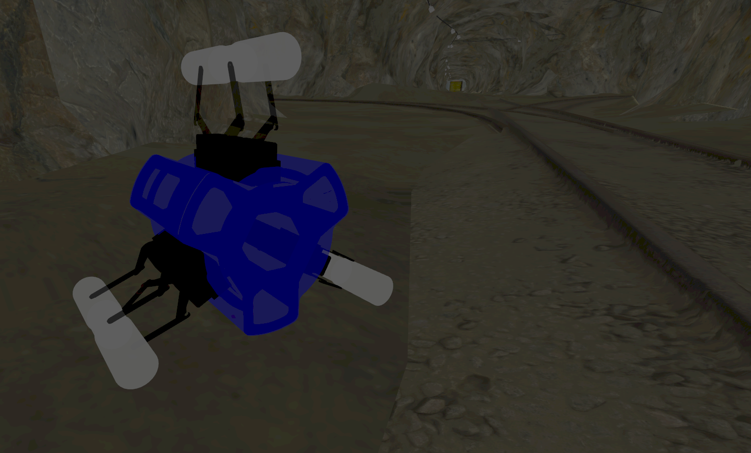
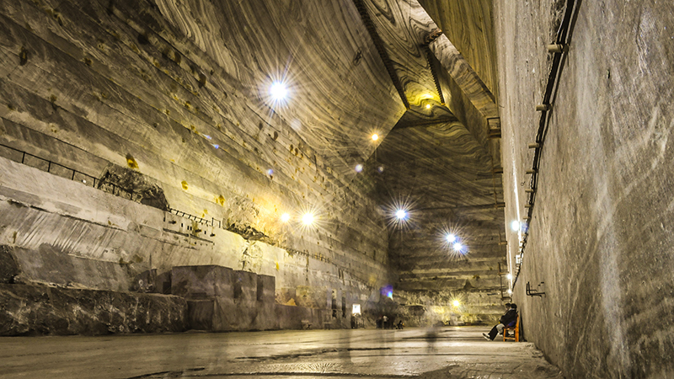
Different mine conditions

Slide 6
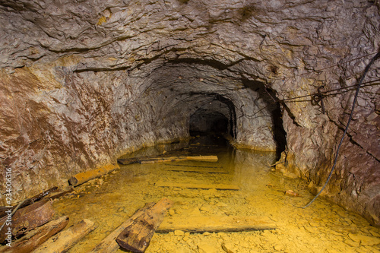
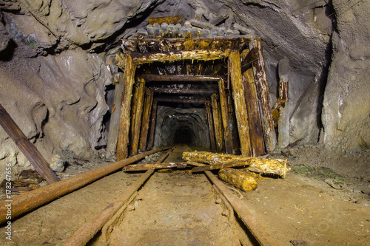
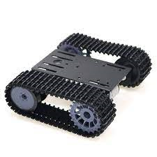
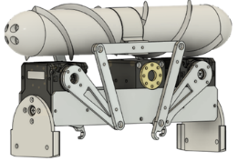
Different requirements

Slide 7
Self-adaptation concept
Self-awareness for robust miner robot autonomy – E. Aguado, R. Sanz, C. Rossi

Slide 8
Self-adaptation concept
Robot changes its own structure and/or behavior to keep working capability
BEHAVIOURAL ADAPTATION
Modify system program
  - Generate new action plan
  - Vary actions and/or order of execution
STRUCTURAL ADAPTATION
Modify the system design
  Selecting an alternative architecture from available designs
  Trade-off between performance, safety and cost
Self-awareness for robust miner robot autonomy – E. Aguado, R. Sanz, C. Rossi

Slide 9
Self-adaptation concept
The designer is relieved of the burden of 1) anticipating all possible input states and 2) selecting corresponding output actions.
Our approach uses the deep knowledge that systems engineering harnesses to solve complex problems and reuse some of that knowledge at runtime.
Self-awareness for robust miner robot autonomy – E. Aguado, R. Sanz, C. Rossi

Slide 10
Reasoning in self-aware systems
Self-awareness for robust miner robot autonomy – E. Aguado, R. Sanz, C. Rossi

Slide 11
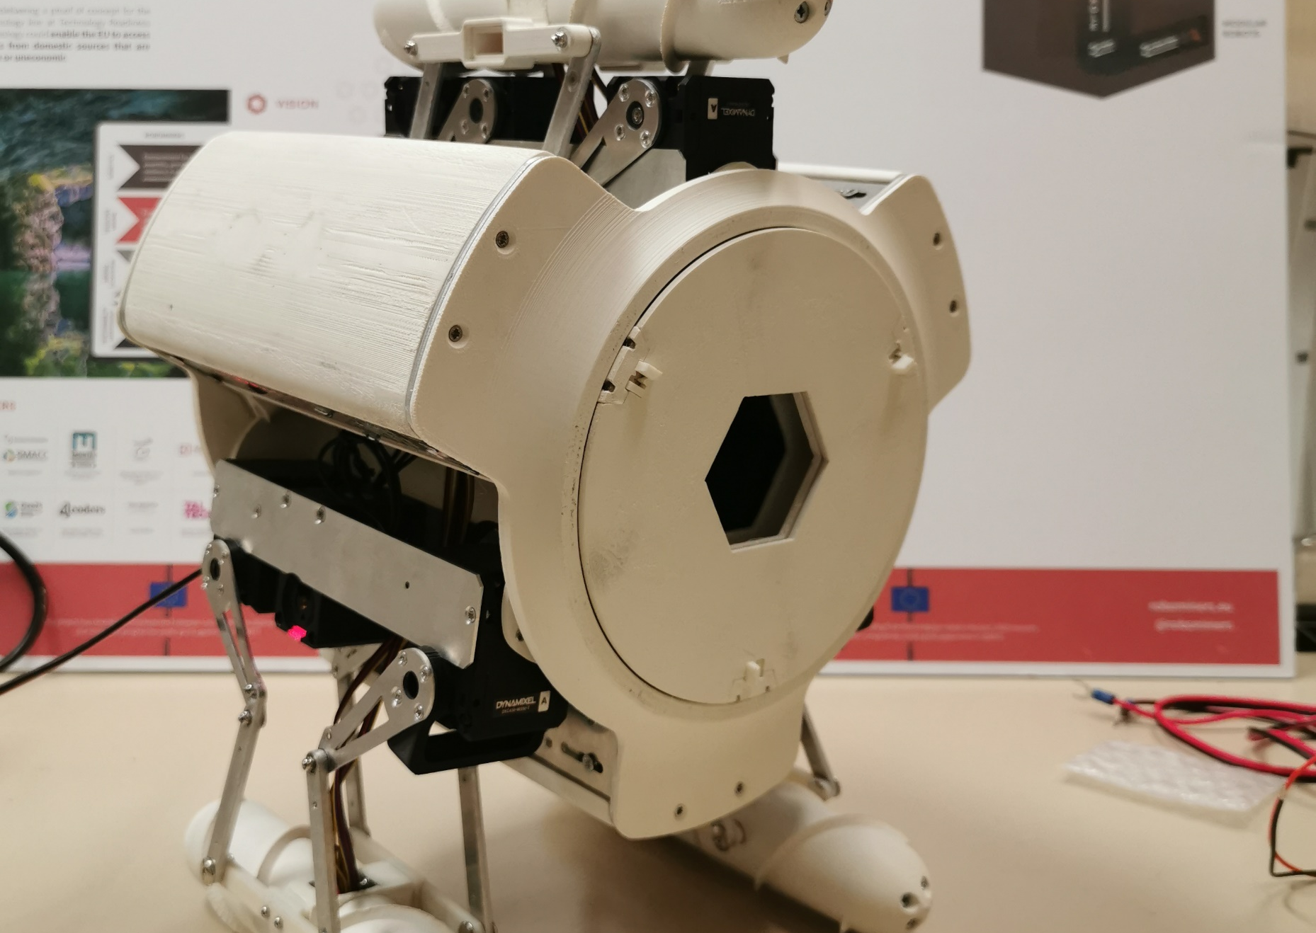
How to adapt?

Slide 12
Explicit knowledge
Self-awareness for robust miner robot autonomy – E. Aguado, R. Sanz, C. Rossi

Slide 13
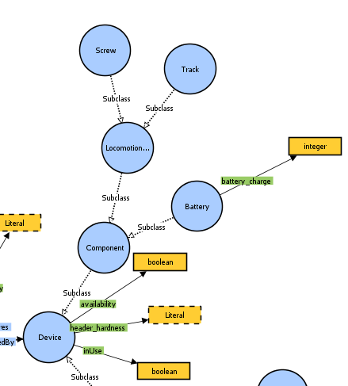
Explicit knowledge
Self-awareness for robust miner robot autonomy – E. Aguado, R. Sanz, C. Rossi

Slide 14
Metacontrol
goal
Explicit knowledge
Planning
sub goals
Monitorize,
Reflection
Adaptable behaviour
robot action
Self-awareness for robust miner robot autonomy – E. Aguado, R. Sanz, C. Rossi

Slide 15

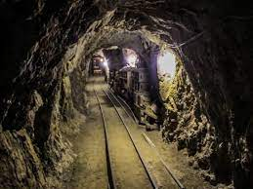
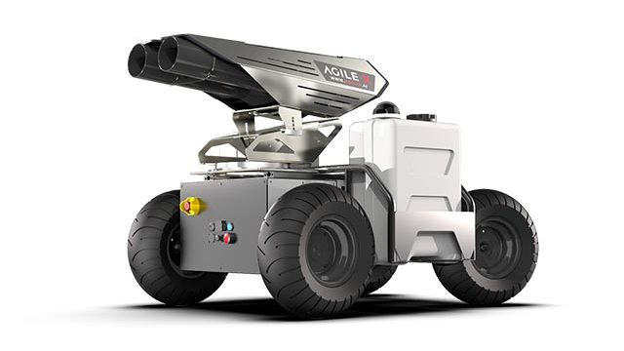

Knowledge reusability
Functional alternatives for the concrete system
Specific application
Domain knowledge
General systems
Same operation domain: : mining, robotics, geology, etc.
Component-based systems
Self-awareness for robust miner robot autonomy – E. Aguado, R. Sanz, C. Rossi

Slide 16
Thank you
Any questions?
Esther Aguado
e.aguado@upm.es

