Slide 1
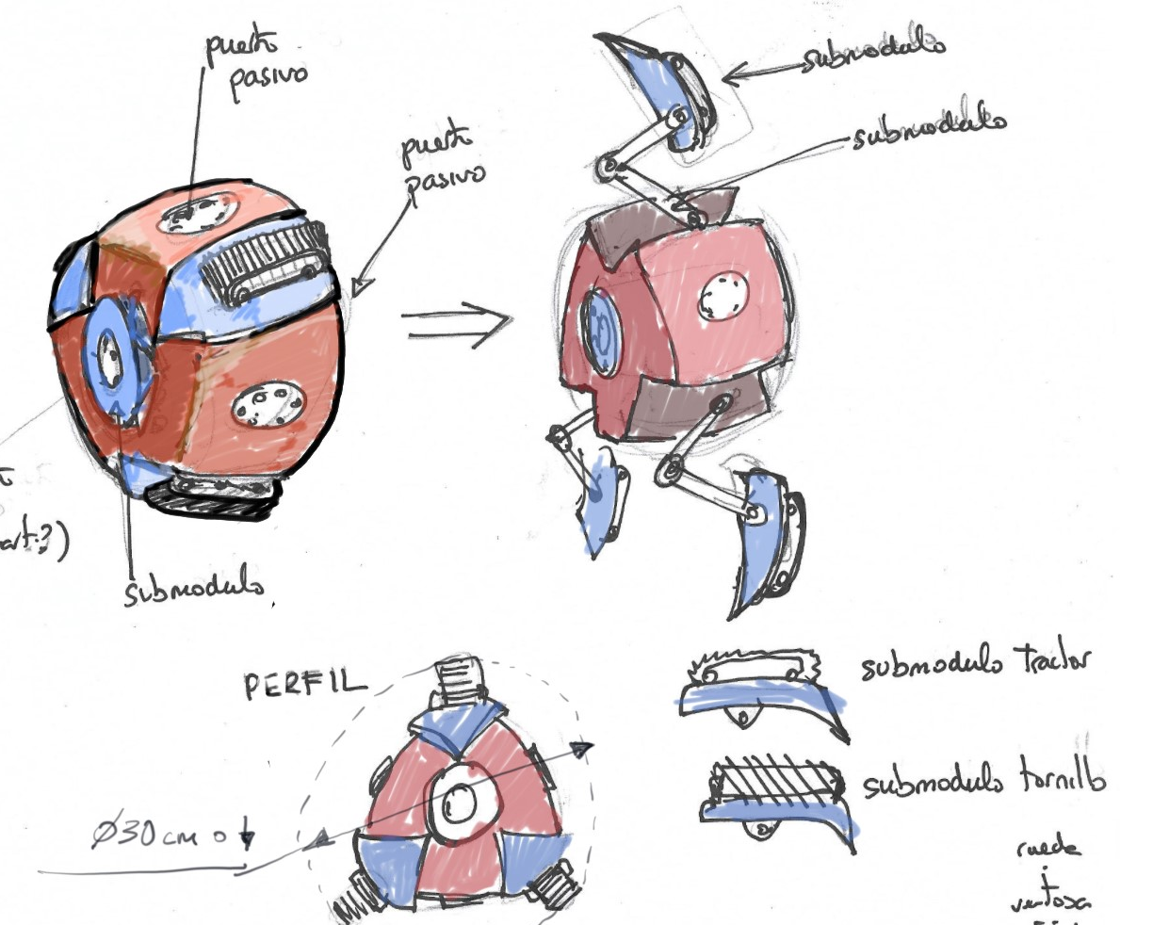





Modular collaborative resilient robots for mining operations
V. Gómez & M. Hernando,
Automation and robotics for raw material exploration and production in Europe. Vienna, 23 May 2022

Slide 2
Index
Introduction
RM2CM Coupling Mechanism
Results
Conclusions and Work In Progress
RM2 Module

Slide 3
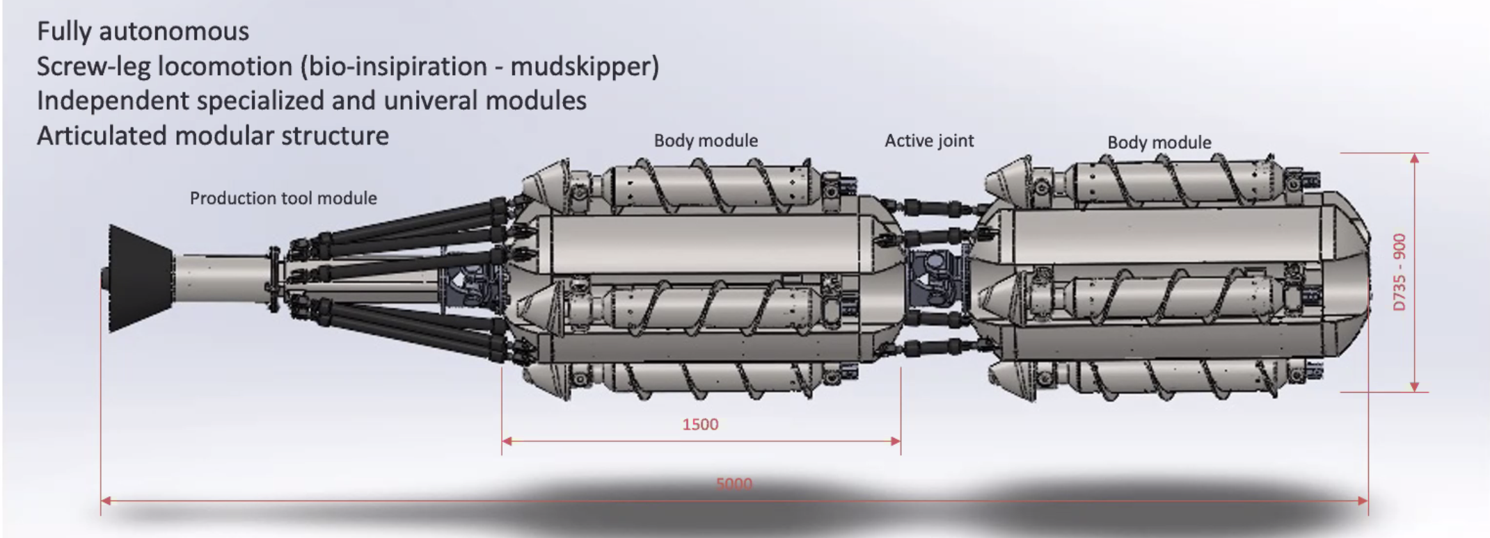
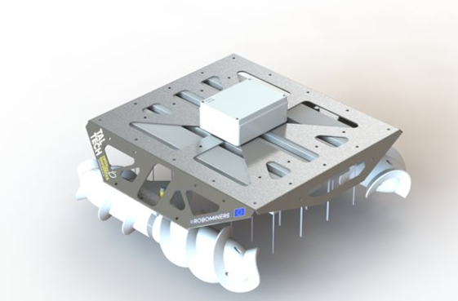
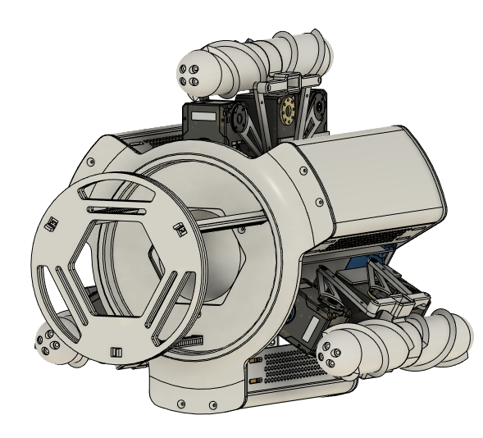
Introduction
RM1 Prototype
RM3 Prototype
RM2 Prototype

Slide 4
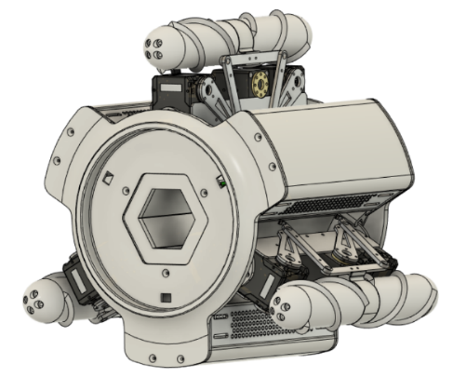
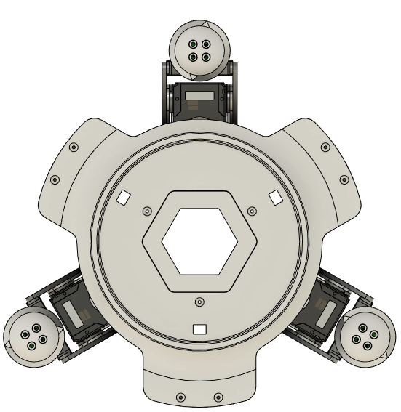
RM2 module
2
Screw Actuator
B
C
Robot Leg
1
3
A

Slide 5
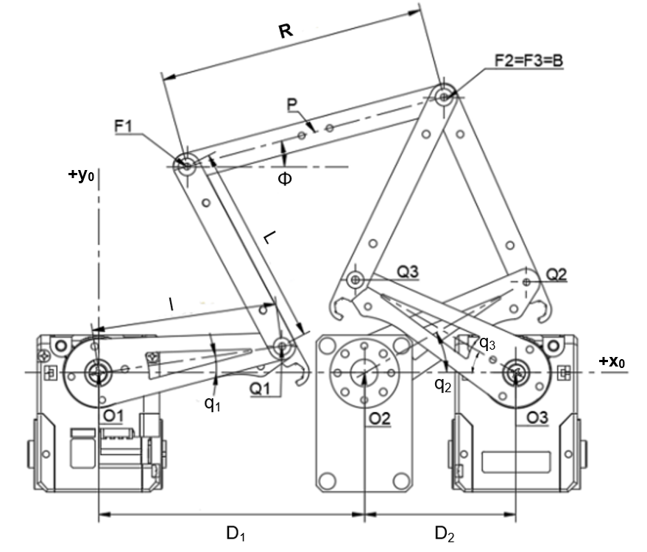
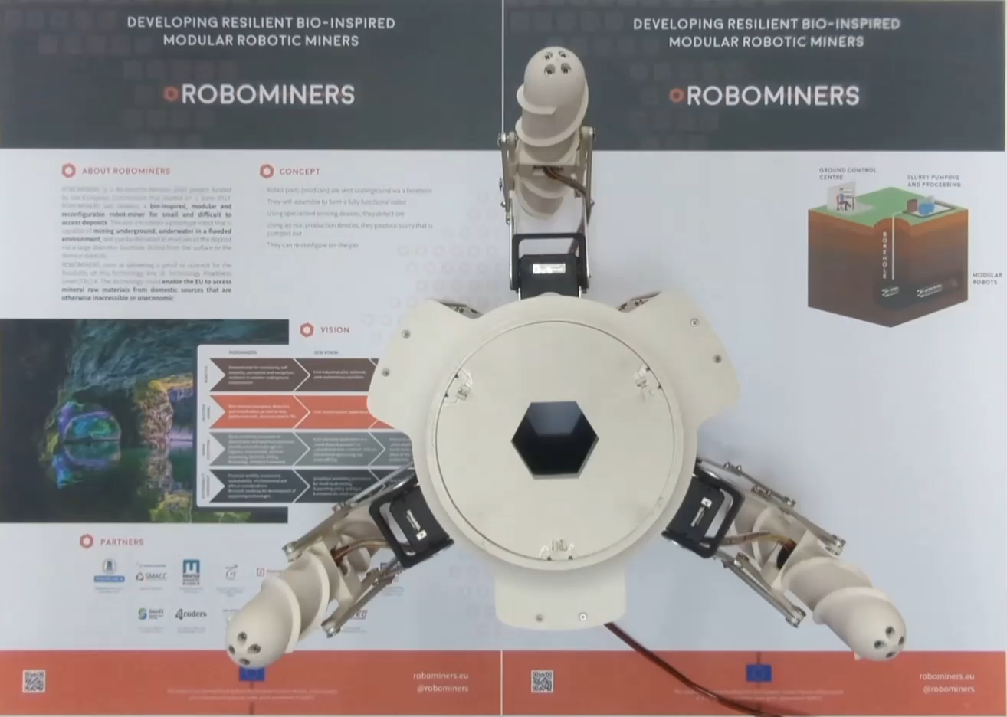
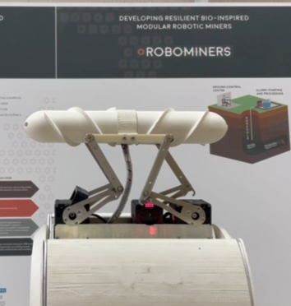
RM2 module
Leg actuation mechanism with 4 DoF:
1 Rotational DoF in the leg plane
2 Translational DoF in x and y axes
1 Rotational DoF for the end effector

Slide 6
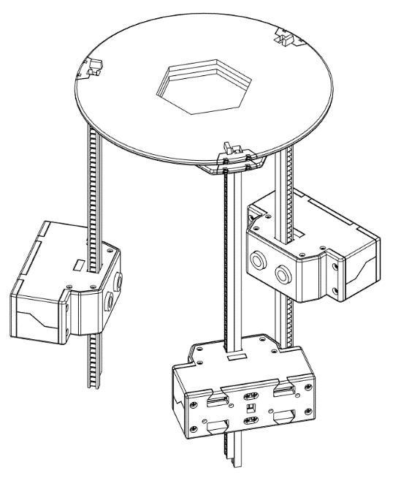
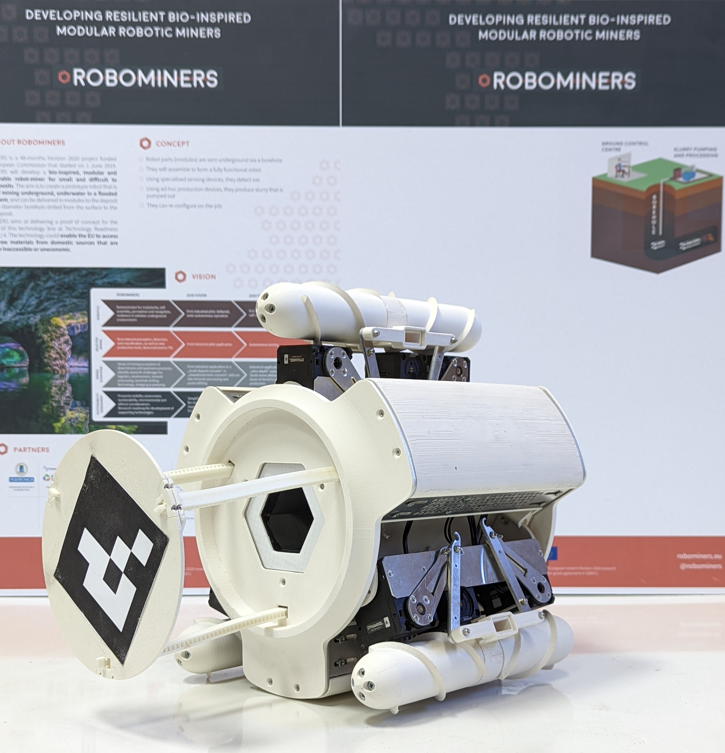
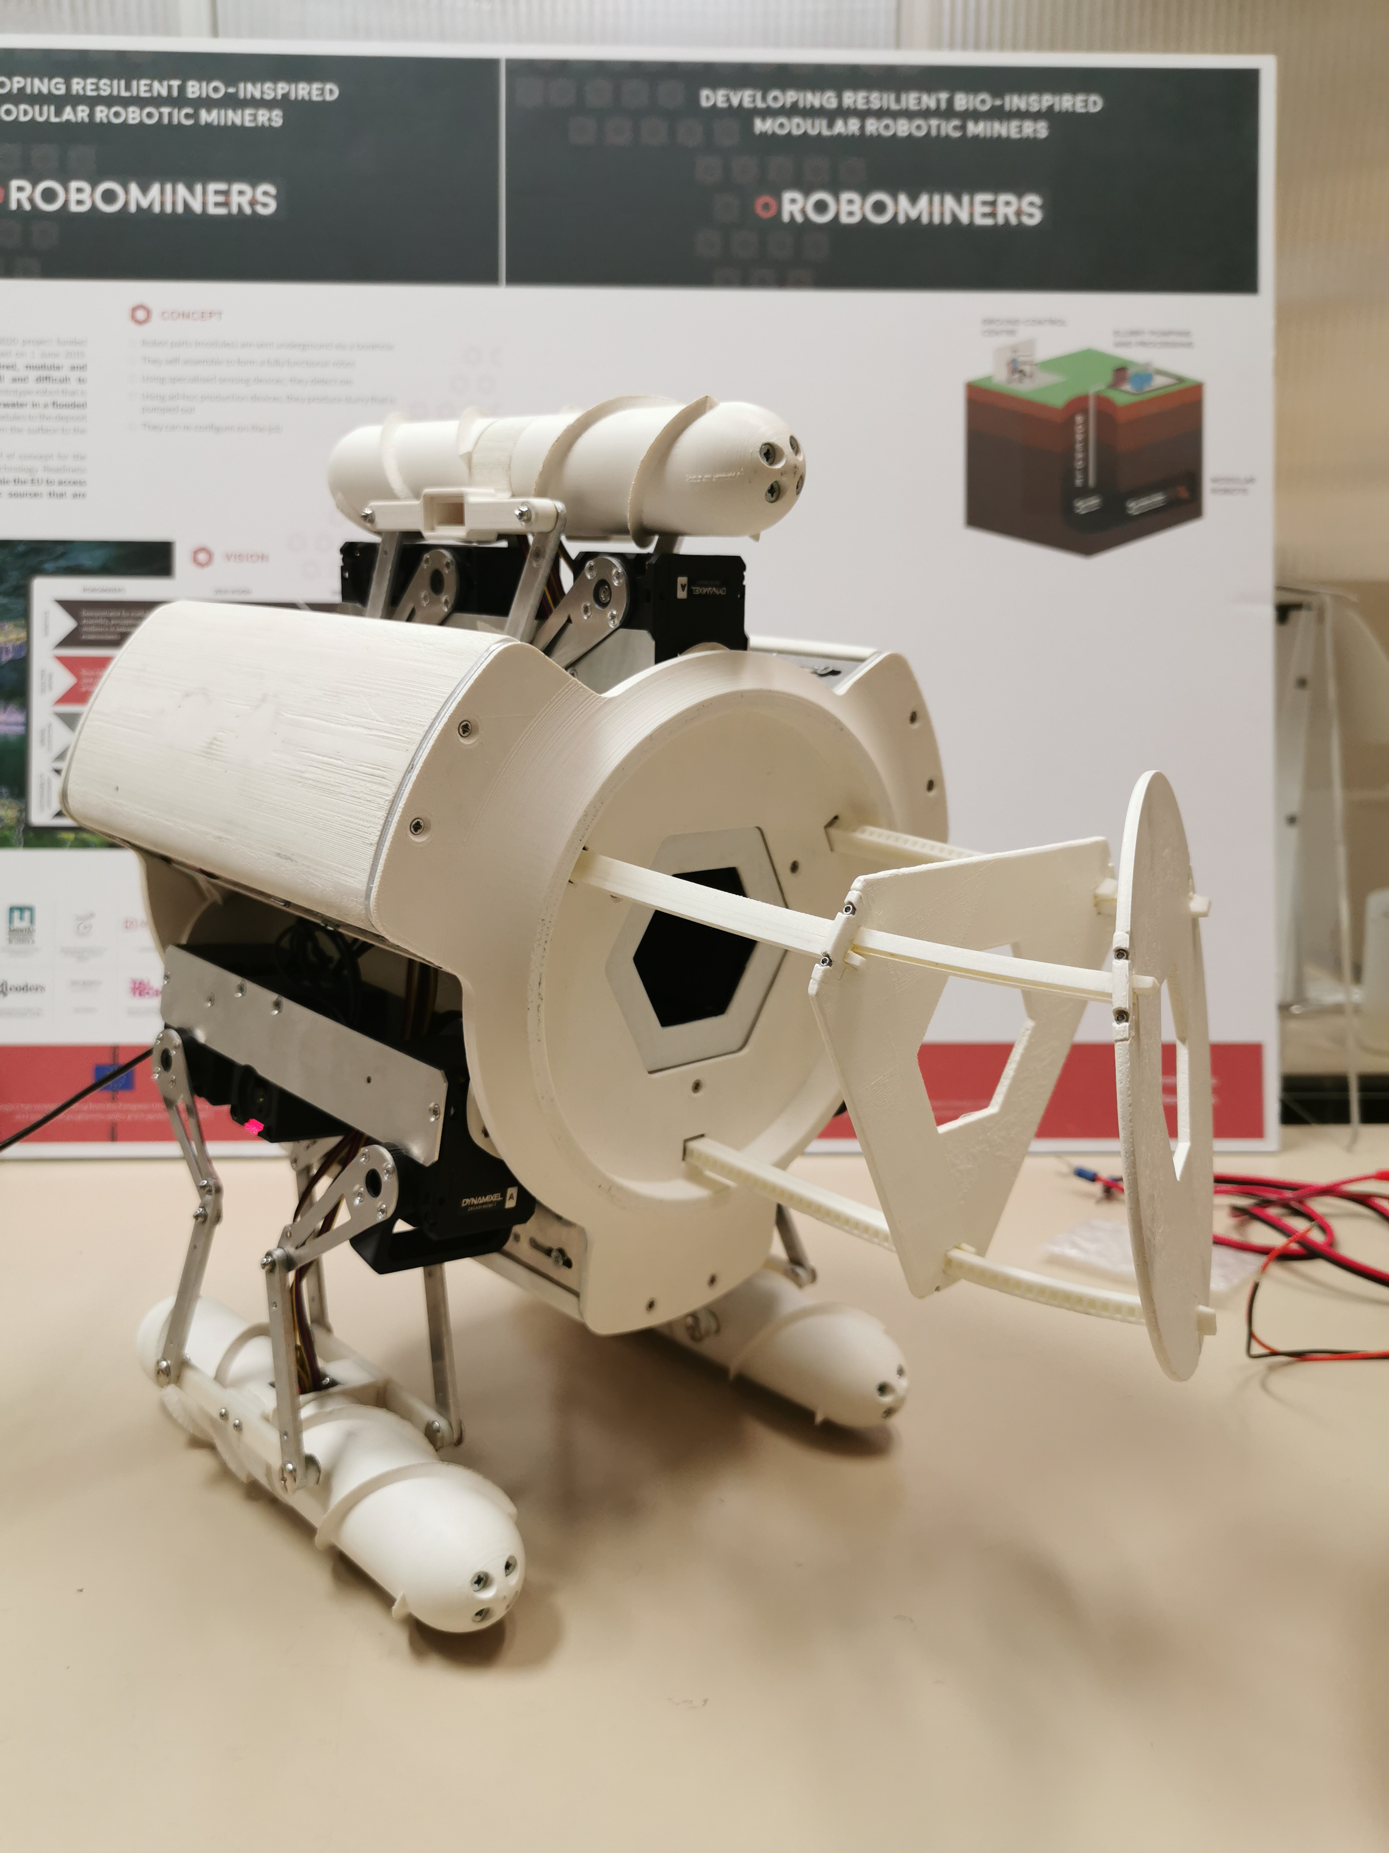
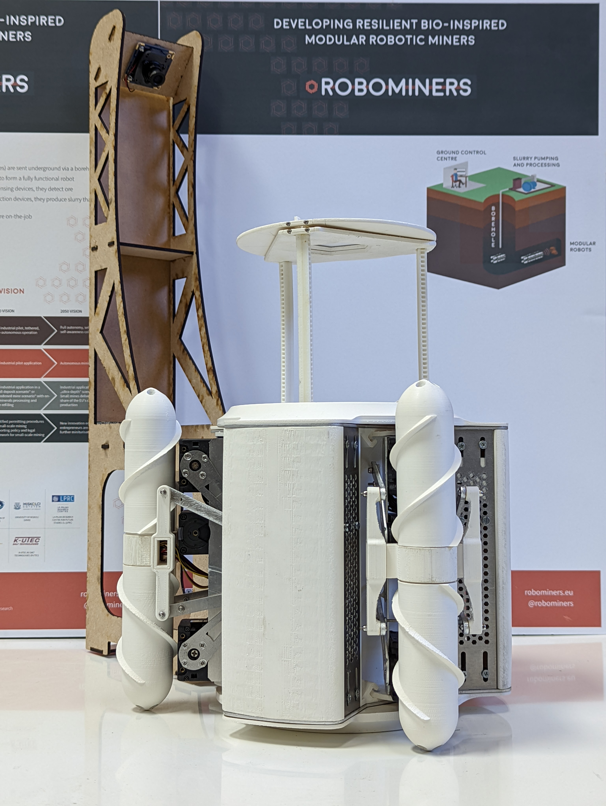
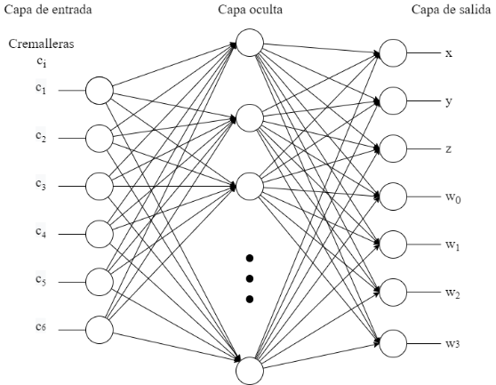
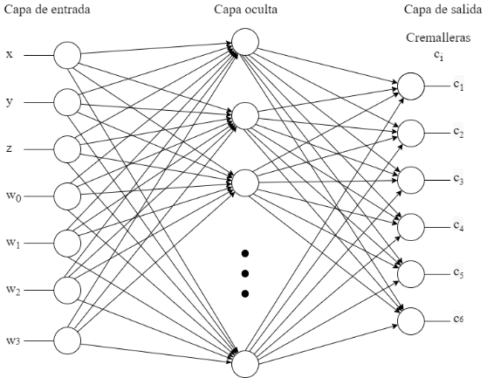
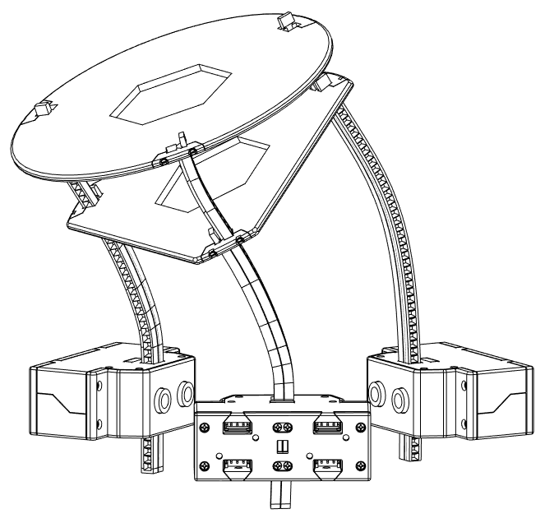
RM2CM Coupling Mechanism
Direct Kinematics
Inverse Kinematics

Slide 7
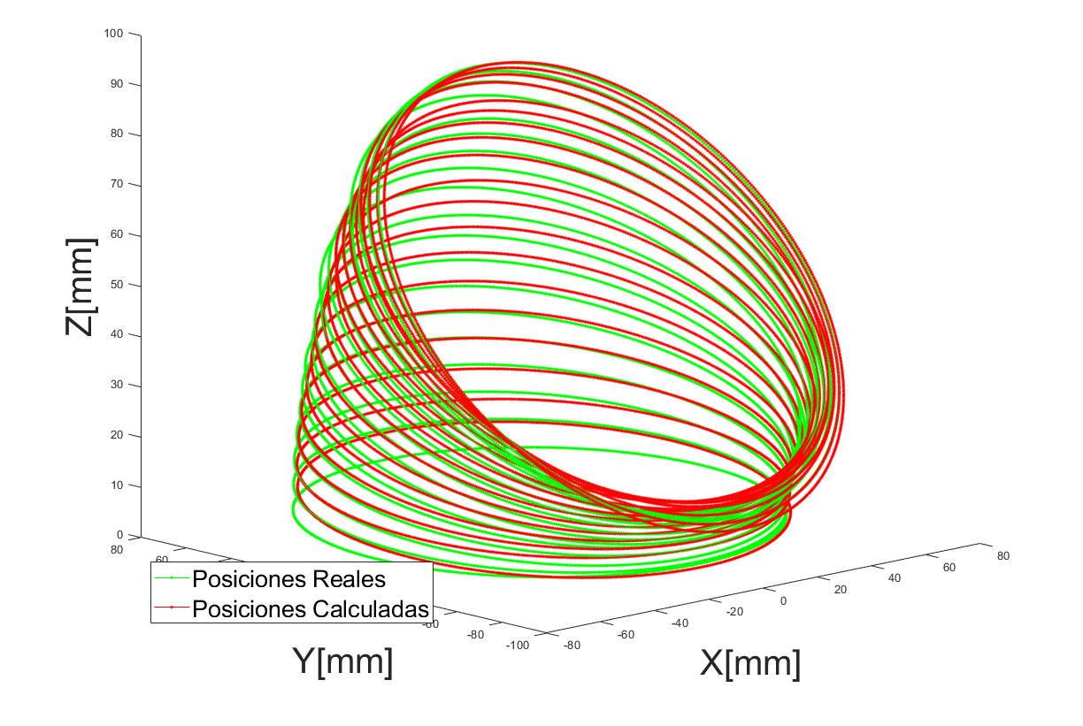
Results
Direct Kinematics
Inverse Kinematics

Slide 8
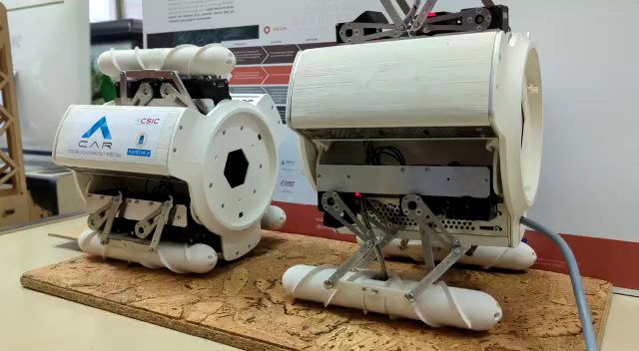
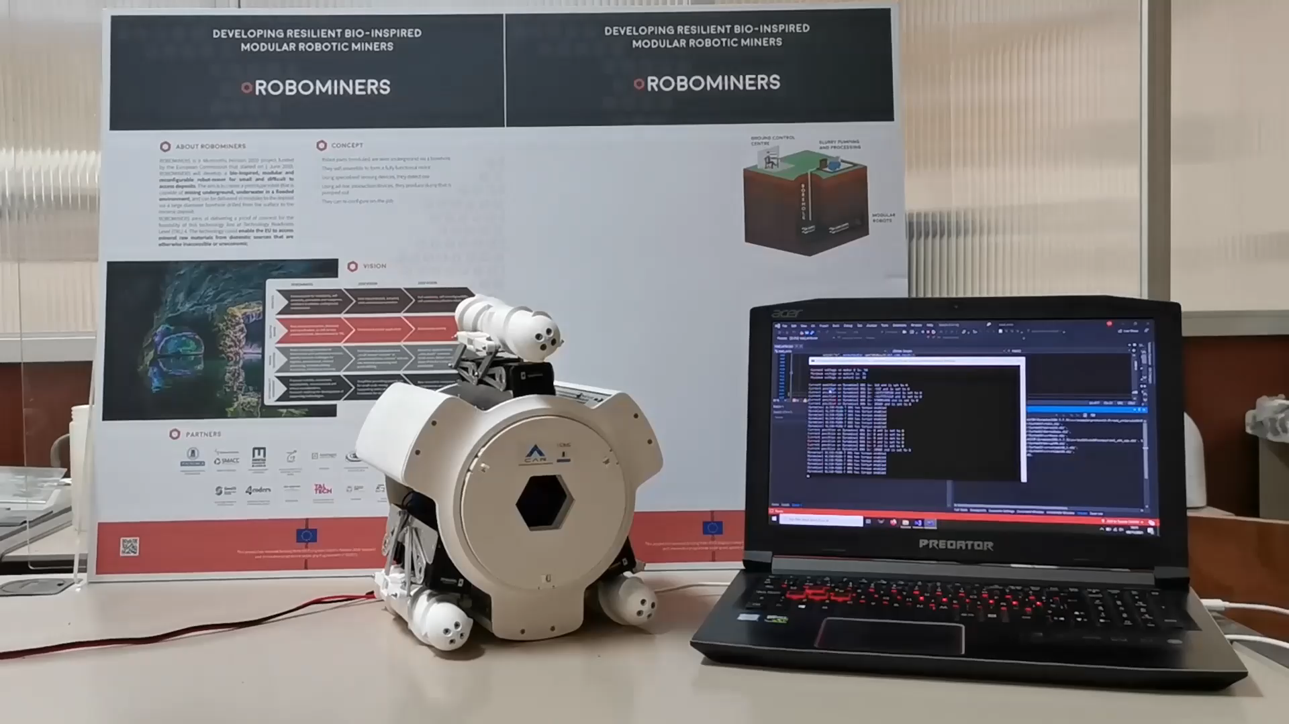
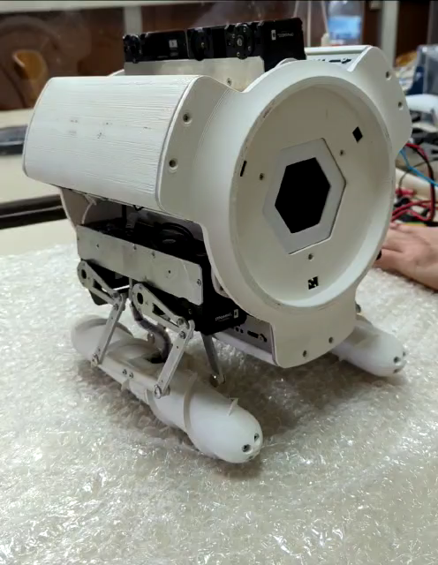
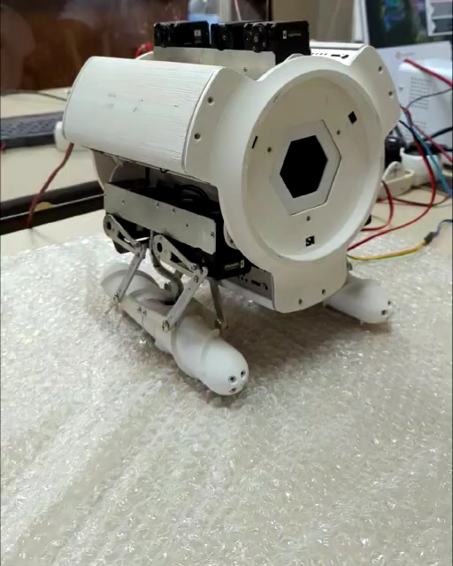
Conclusions
RM2 Maneuvers
RM2CM demo

Slide 9
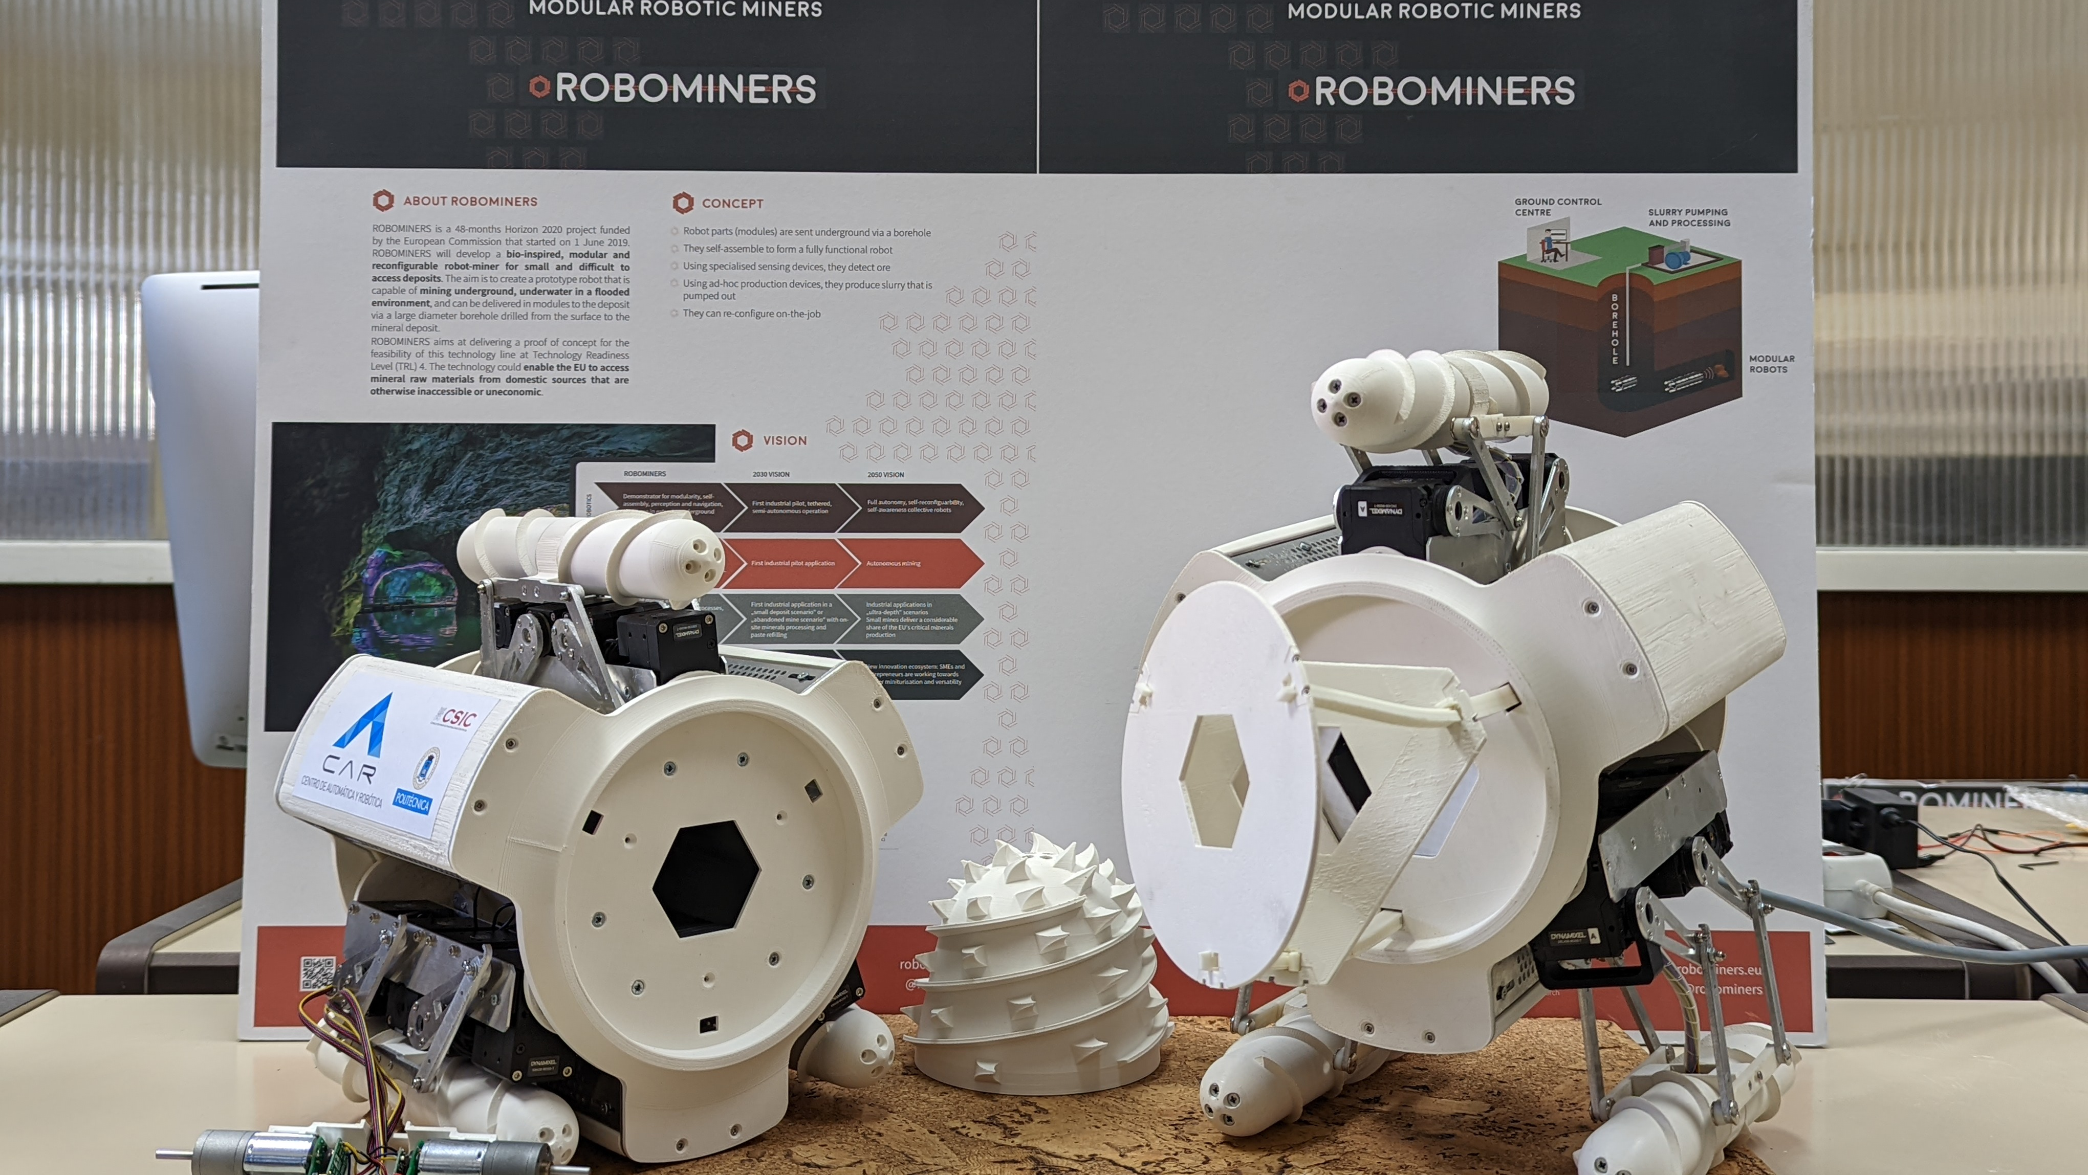
Work in Progress
Optimization of the RM2 electronic and mechanic system
Development of the coupling mechanism for the robot arm
Development of new end effector track wheels
Construction of new robotic modules

Slide 10

Thank you for your attention
Modular collaborative resilient robots for mining operations
V. Gómez & M. Hernando

