Slide 1


The difficult prediction of earthquake-induced
landslide displacements: the case of Gaggio Montano
(northern Apennines, Italy)
Gianluigi Di Paola
Department of Biological, Geological and Environmental Sciences
University of Bologna, Bologna, Italy
gianluigi.dipaola@unibo.it
Co-authors:
Giovanni Lattanzi, Rodolfo Rani, Silvia Castellaro and Matteo Berti
EGU, 2022 - Vienna, Austria & Online
23–27 May 2022

Slide 2
Aim, materials
and metodology
The aim of the work is to highlight the existing difficulties in modeling earthquake-induced displacement of a slope considering its geotechnical characteristics
Materials and
Methodology
Geomorphology
(landslide map, landslide archive and aerial photo analysis)
Data, laboratory analysis, surveys
Monitoring
Evaluation
Stratigraphy
(geological map, interpretation of existing boreholes and inclinometers)
Interpretation
Hydrogeology
(existing piezometric data,
new measurement survey)
TASK A
Geological-technical model of the slope
TASK B
Local seismic response
(Italian legislation, 2D analysis)
Geotechnical characteristics
(interpretation of existing site and laboratory tests)
validation
TASK C
Stability analysis under static and dynamic conditions
Dynamic characteristics
(existing seismic tests, new survey campaign)
TASK D
Seismo-induced displacement monitoring
(GPS-Shake monitoring,
satellite data analysis)
RESULTS
Landslide response during the earthquake event
1/7

Slide 3
Aim, materials
and metodology
The aim of the work is to highlight the existing difficulties in modeling earthquake-induced displacement of a slope considering its geotechnical characteristics
Materials and
Methodology
Geomorphology
(landslide map, landslide archive and aerial photo analysis)
Data, laboratory analysis, surveys
Monitoring
Evaluation
Stratigraphy
(geological map, interpretation of existing boreholes and inclinometers)
Interpretation
Hydrogeology
(existing piezometric data,
new measurement survey)
TASK A
Geological-technical model of the slope
TASK B
Local seismic response
(Italian legislation, 2D analysis)
Geotechnical characteristics
(interpretation of existing site and laboratory tests)
validation
TASK C
Stability analysis under static and dynamic conditions
Dynamic characteristics
(existing seismic tests, new survey campaign)
TASK D
Seismo-induced displacement monitoring
(GPS-Shake monitoring,
satellite data analysis)
RESULTS
Landslide response during the earthquake event

Slide 4
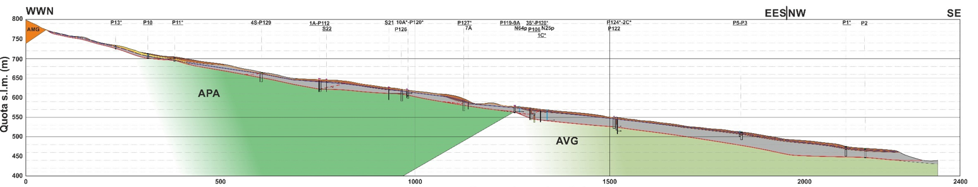
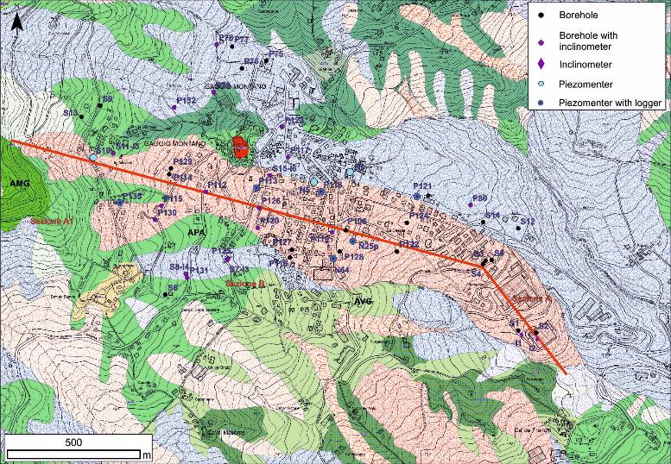
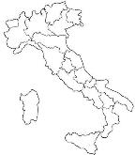
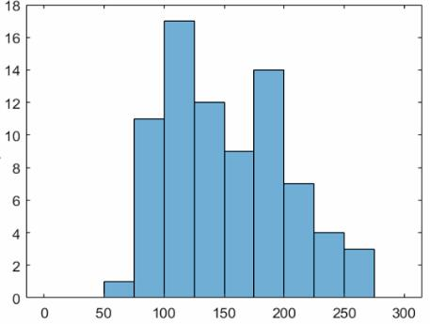
Task A: Study area and
geological-technical model
Brown clay (landslide body)
Brown clay (landslide body)
Grey clay (landslide body)
AVG: calcareous clay unit
AMG (Arerania di Monte Gabba): medium and coarse sandstones
APA (Argille a Palombini): alternation dark gray of clays and calcilutites
Grey clay (landslide body)
AVG: calcareous clay unit
APA (Argille a Palombini): alternation dark gray of clays and calcilutites
AMG (Arerania di Monte Gabba): medium and coarse sandstones
H22
Frequency histogram of undrained cohesion (cu) values obtained from CPT tests for depths greater than 2 m
Frequency
cu (kPa)
2/7

Slide 5
Aim, materials
and metodology
The aim of the work is to highlight the existing difficulties in modeling earthquake-induced displacement of a slope considering its geotechnical characteristics
Materials and
Methodology
Geomorphology
(landslide map, landslide archive and aerial photo analysis)
Data, laboratory analysis, surveys
Monitoring
Evaluation
Stratigraphy
(geological map, interpretation of existing boreholes and inclinometers)
Interpretation
Hydrogeology
(existing piezometric data,
new measurement survey)
TASK A
Geological-technical model of the slope
TASK B
Local seismic response
(Italian legislation, 2D analysis)
Geotechnical characteristics
(interpretation of existing site and laboratory tests)
validation
TASK C
Stability analysis under static and dynamic conditions
Dynamic characteristics
(existing seismic tests, new survey campaign)
TASK D
Seismo-induced displacement monitoring
(GPS-Shake monitoring,
satellite data analysis)
RESULTS
Landslide response during the earthquake event

Slide 6
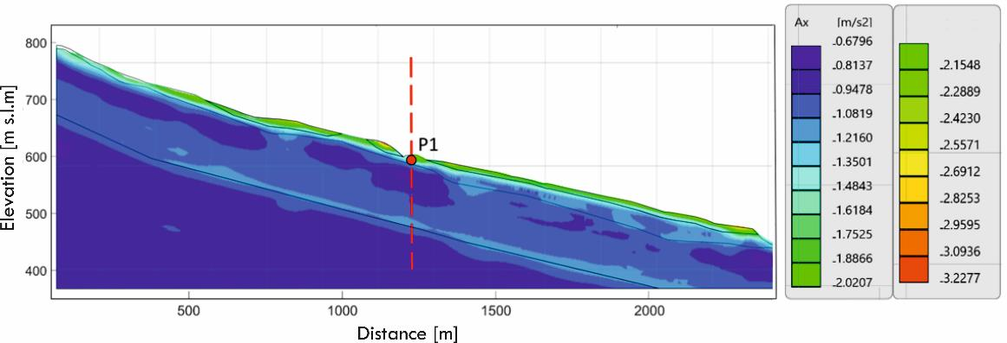
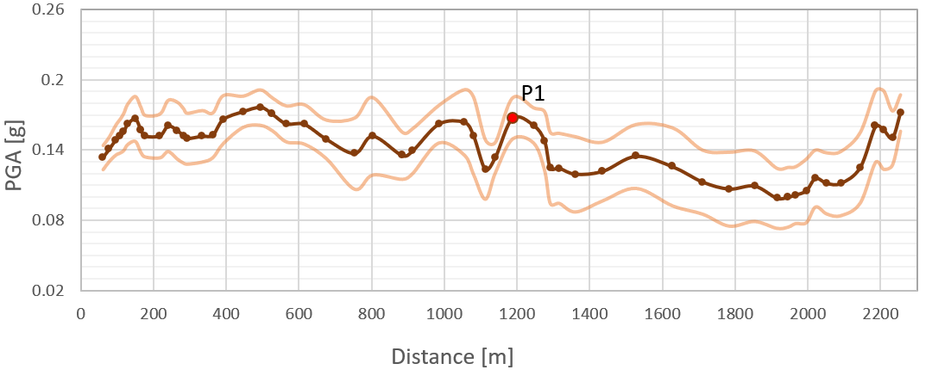
Task B:
Local seismic response
The results of RSL2d with 7 input accelerograms returns the following average horizontal acceleration values along the slope
PGA and mean spectral intensity of the 7 output accelerometers at the various control points in the middle of the landslide body. There are no margins to justify a landslide zoning
Standard Deviation
Average PGA
3/7

Slide 7
Aim, materials
and metodology
The aim of the work is to highlight the existing difficulties in modeling earthquake-induced displacement of a slope considering its geotechnical characteristics
Materials and
Methodology
Geomorphology
(landslide map, landslide archive and aerial photo analysis)
Data, laboratory analysis, surveys
Monitoring
Evaluation
Stratigraphy
(geological map, interpretation of existing boreholes and inclinometers)
Interpretation
Hydrogeology
(existing piezometric data,
new measurement survey)
TASK A
Geological-technical model of the slope
TASK B
Local seismic response
(Italian legislation, 2D analysis)
Geotechnical characteristics
(interpretation of existing site and laboratory tests)
validation
TASK C
Stability analysis under static and dynamic conditions
Dynamic characteristics
(existing seismic tests, new survey campaign)
TASK D
Seismo-induced displacement monitoring
(GPS-Shake monitoring,
satellite data analysis)
RESULTS
Landslide response during the earthquake event

Slide 8
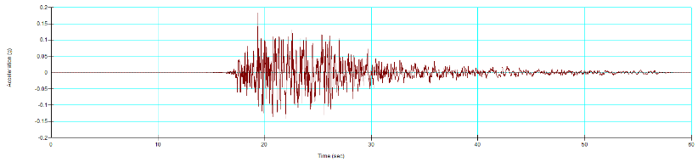
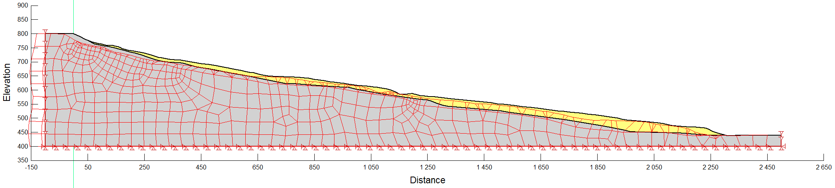
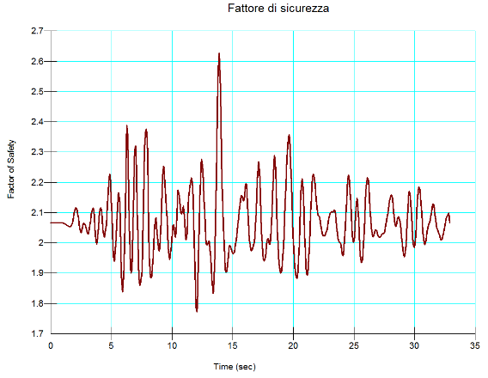
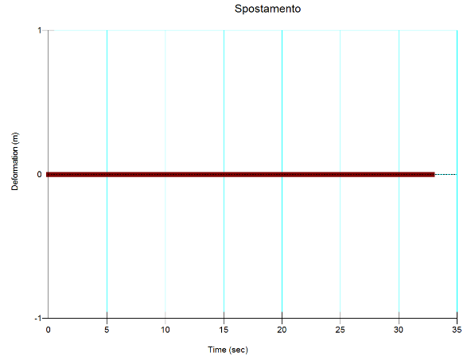
Task C: Stability analysis under
static and dynamic conditions
Calculation of displacements along the slip surface by Newmark's method (Limit Equilibrium)
cu=120 kPa
PGA=0.18 g
4/7

Slide 9
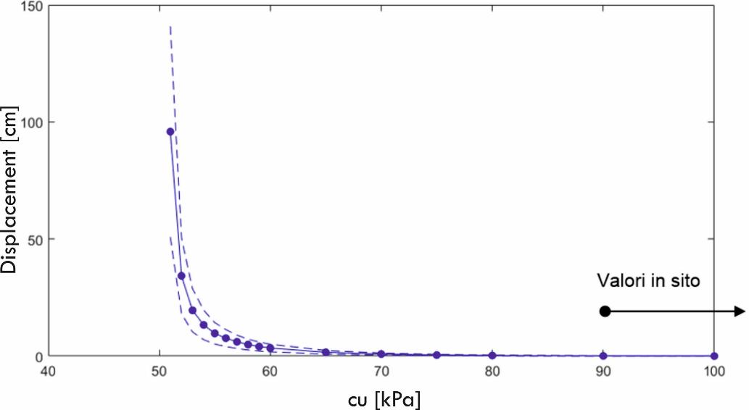
Task C: Effect of the
cu parameter
Results of stability analysis under dynamic conditions
It has been noted that different seismic inputs to the bedrock and different local seismic response analyses (1D or 2D) have little effect on the final results,
while undrained cohesion (cu) has a very strong influence, being the one that really controls the result of the analyses
5/7

Slide 10
Aim, materials
and metodology
The aim of the work is to highlight the existing difficulties in modeling earthquake-induced displacement of a slope considering its geotechnical characteristics
Materials and
Methodology
Geomorphology
(landslide map, landslide archive and aerial photo analysis)
Data, laboratory analysis, surveys
Monitoring
Evaluation
Stratigraphy
(geological map, interpretation of existing boreholes and inclinometers)
Interpretation
Hydrogeology
(existing piezometric data,
new measurement survey)
TASK A
Geological-technical model of the slope
TASK B
Local seismic response
(Italian legislation, 2D analysis)
Geotechnical characteristics
(interpretation of existing site and laboratory tests)
validation
TASK C
Stability analysis under static and dynamic conditions
Dynamic characteristics
(existing seismic tests, new survey campaign)
TASK D
Seismo-induced displacement monitoring
(GPS-Shake monitoring,
satellite data analysis)
RESULTS
Landslide response during the earthquake event

Slide 11
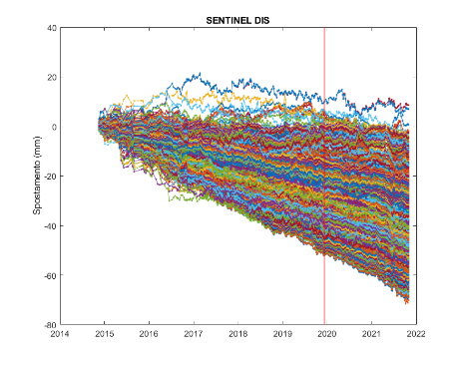
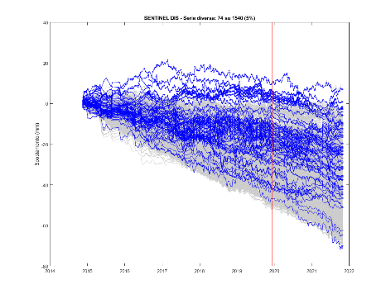
Task E: Seismo-induced
displacement monitoring
Velocity (mm/year)
Maximum velocity values are on the order of 10 mm/year and are in line with those of previous years. The fastest moving portions are located in the central portion of the landslide and at the foot. Movement is also noted in the sports field area and downstream slope, which insist at least in part on a large quiescent landslide body
2015-2021
Dataset | Most intense earthquake occurred during the monitoring period
 | Data | Magnitude | Distance (km)
SENTINEL | 09 Dec 2019 | 4.5 | 36
Displacement (mm)
Displacement (mm)
6/7

Slide 12
Main remarks
The Gaggio Montano landslide is slowly moving (mm or cm/year) and the static Factor of Safety is likely ‘‘close to 1’’
Dynamic analyses under undrained conditions indicate no displacement under earthquake (PGA=0.18 g)
In the case of quiescent/inactive landslides, earthquake-induced displacements are strongly influenced by shear strength parmeters, therefore the technical geological model must be extremely detailed
Analysis of satellite data can help to understand and validate analyses performed in contexts contradicted by slow landslides
7/7

Slide 13
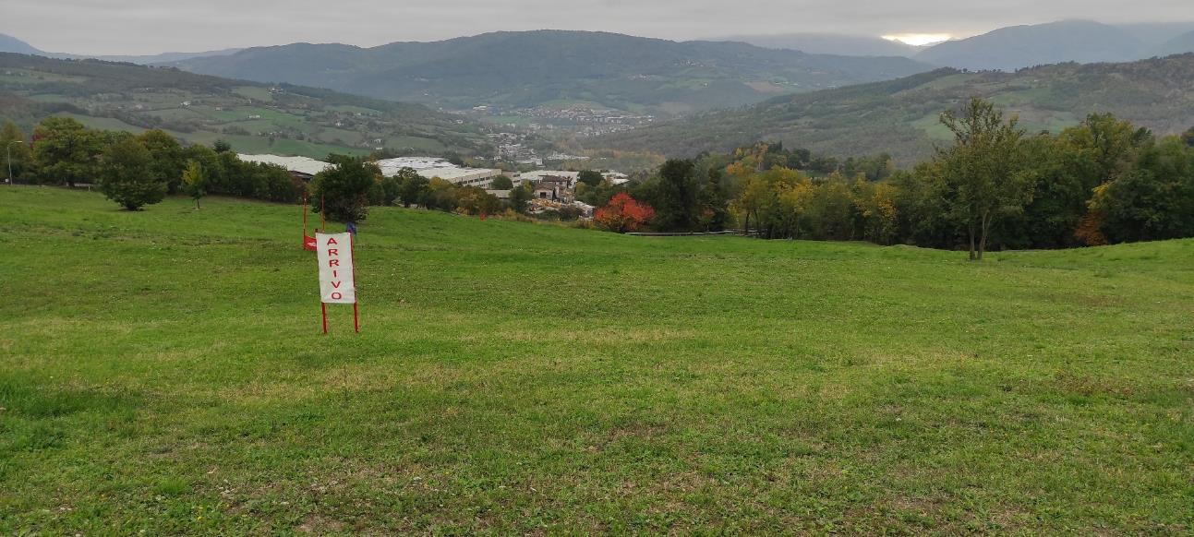
Thank you
for your attention
Gianluigi Di Paola
Department of Biological, Geological, and Environmental Sciences,
University of Bologna, Bologna, Italy
gianluigi.dipaola@unibo.it

