Slide 1
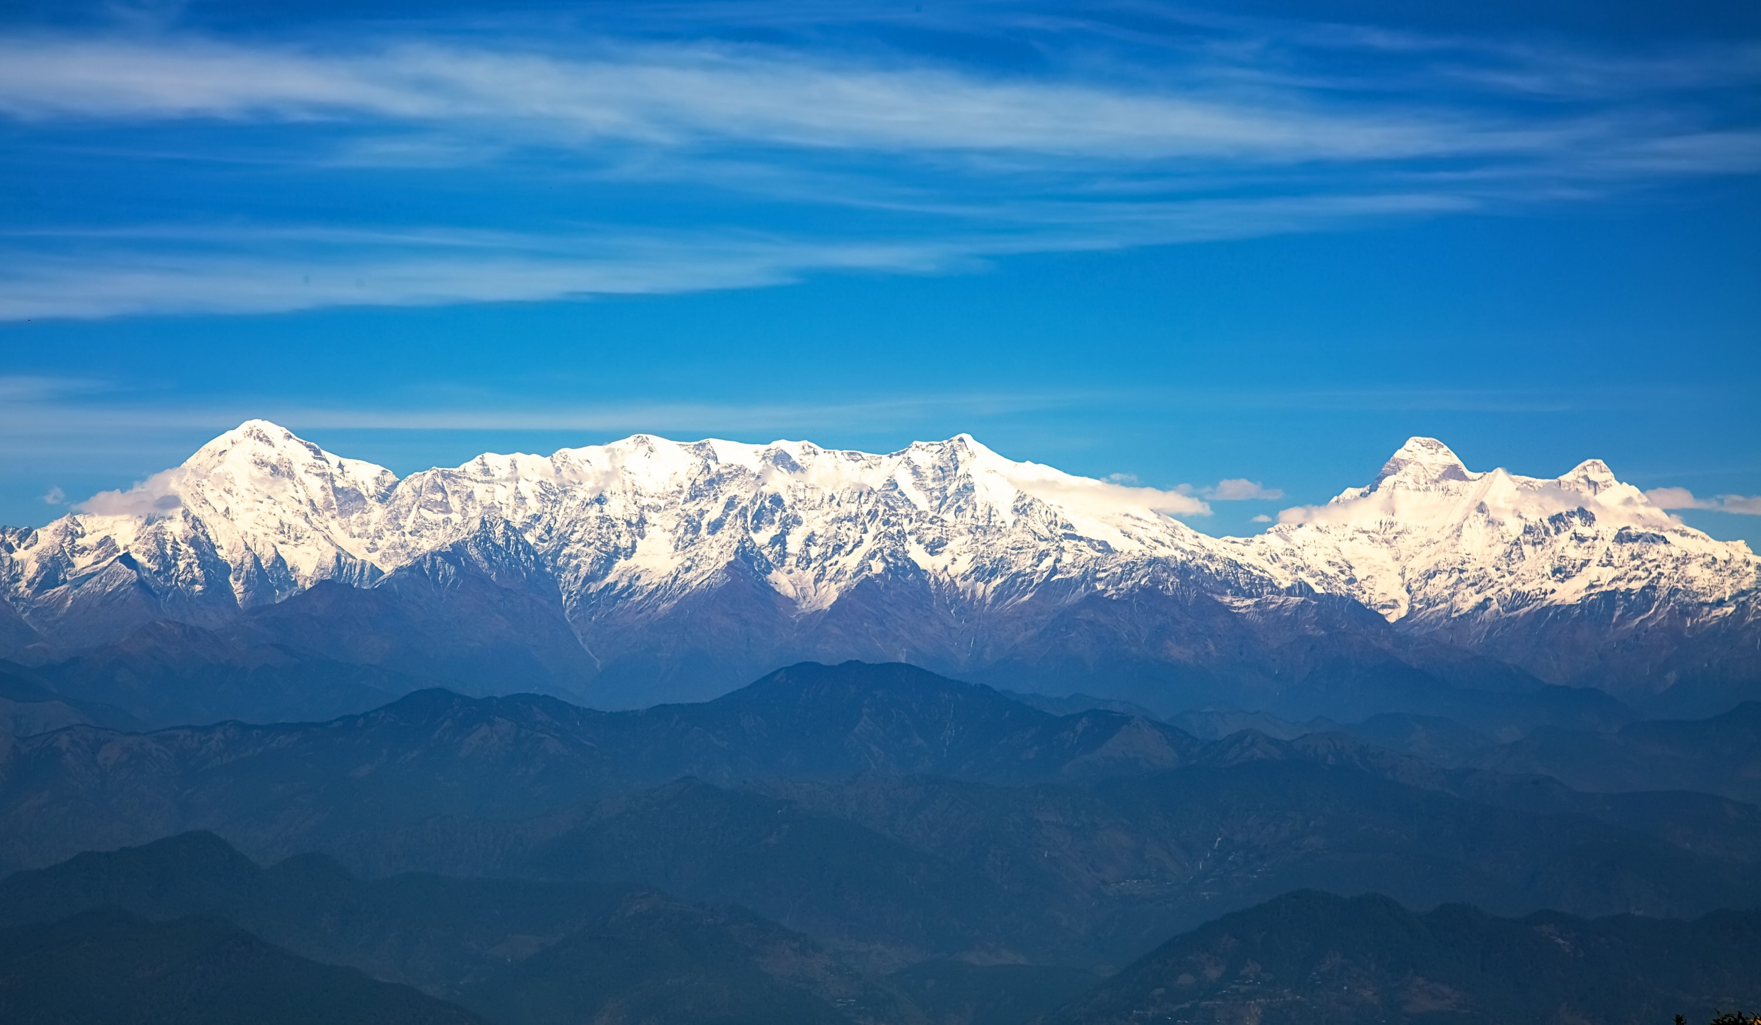







Session: HS2.1.4 (Mountain hydrology under global change: monitoring, modelling and adaptation
Assimilation of EO based data into LSM to compute the contribution of snowmelt to discharge in the High Mountainous Region
Vikrant Maurya¹, Manika Gupta¹, Naresh Chandra Pant¹, Atul Kumar Sahai²
¹University of Delhi, Department of Geology, Delhi, India (vikrant.maurya18@gmail.com)
²Indian Institute of Tropical Meteorology, Pune, India.

Slide 2
Introduction
A part of precipitation is stored in the form of snow and ice at higher elevation in the Himalayas and act as a water reservoir, which is released seasonally, contribution to the river discharge.
Water stored is affected by climate change resulting in changes in the river discharge in downstream areas.
The Himalayas and adjacent areas are important water towers that supports the water demands of the more than 1.4 billion people through large rivers such as the Ganges.
The studies about snowmelt and snow cover in the Himalayas have solely relied upon the land surface modelling using remotely sensed observations because of the inaccessible terrain and unavailability of in-situ data.
The aim of the study is to estimate the snowmelt contribution of the HMR region to the discharge of the Ganga basin by assimilating (Direct Insertion) remotely sensed snow cover into NOAH LSM.

Slide 3
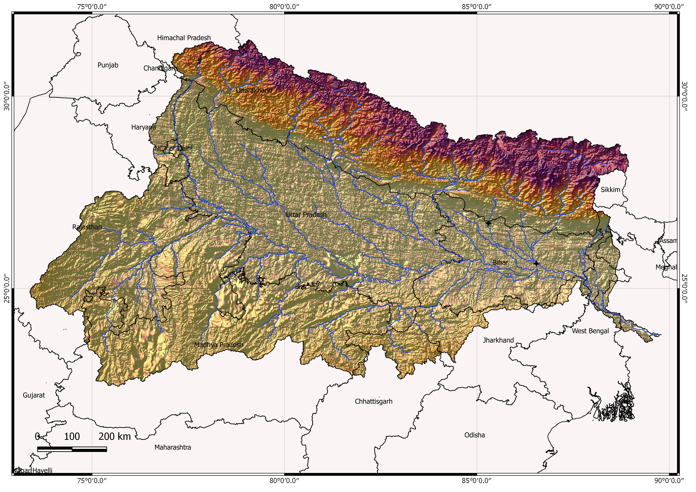
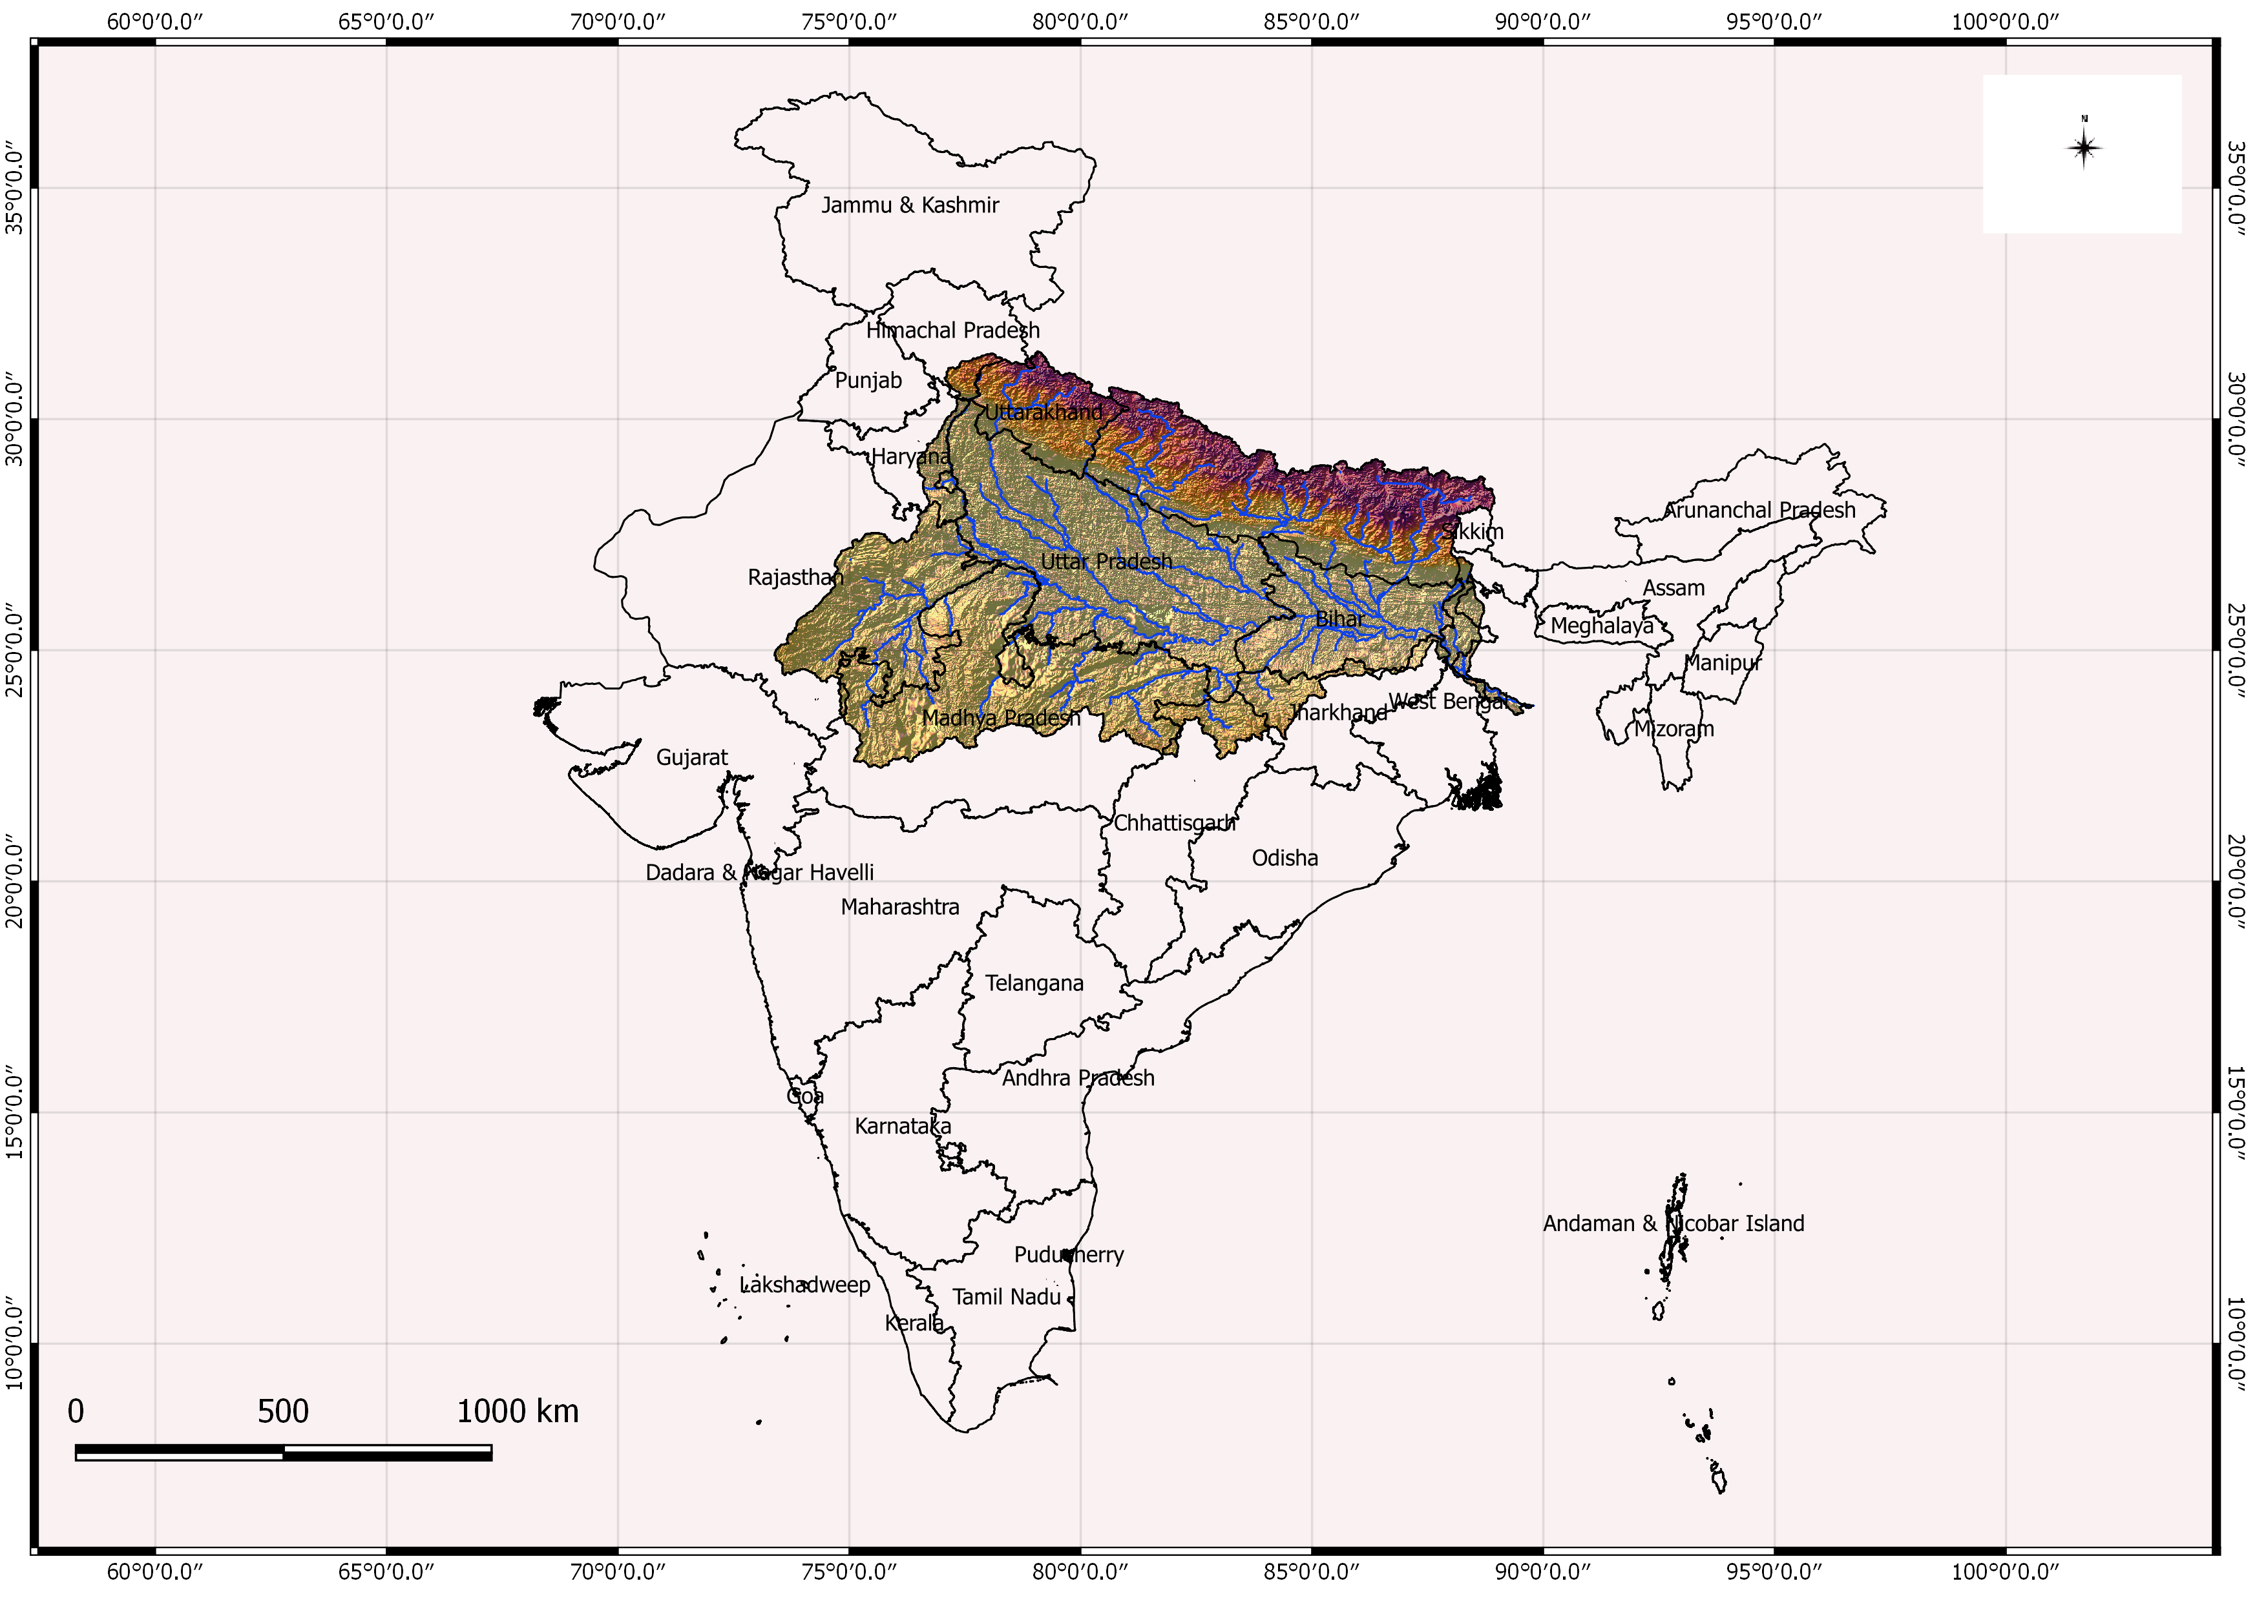
Study Area
Average population density | 520 (Census 2001)
Total Area of the Basin | 0.85 MKm²
Agricultural landcover | 0.24 MKm²
Average annual rainfall | 1000 mm

Slide 4
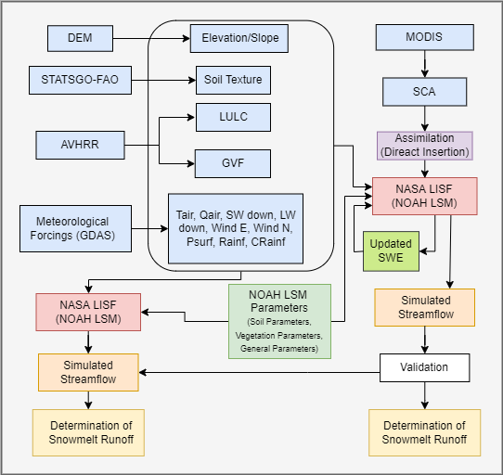
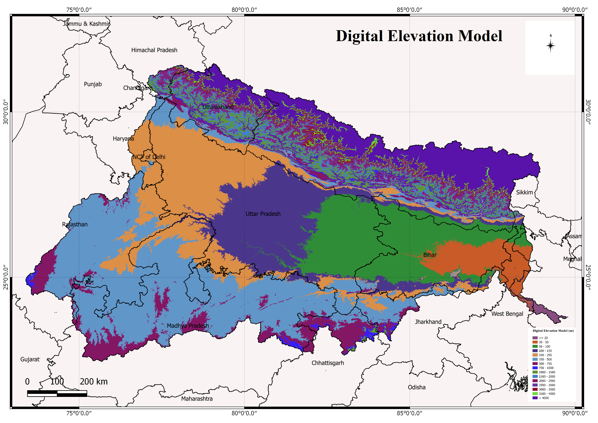
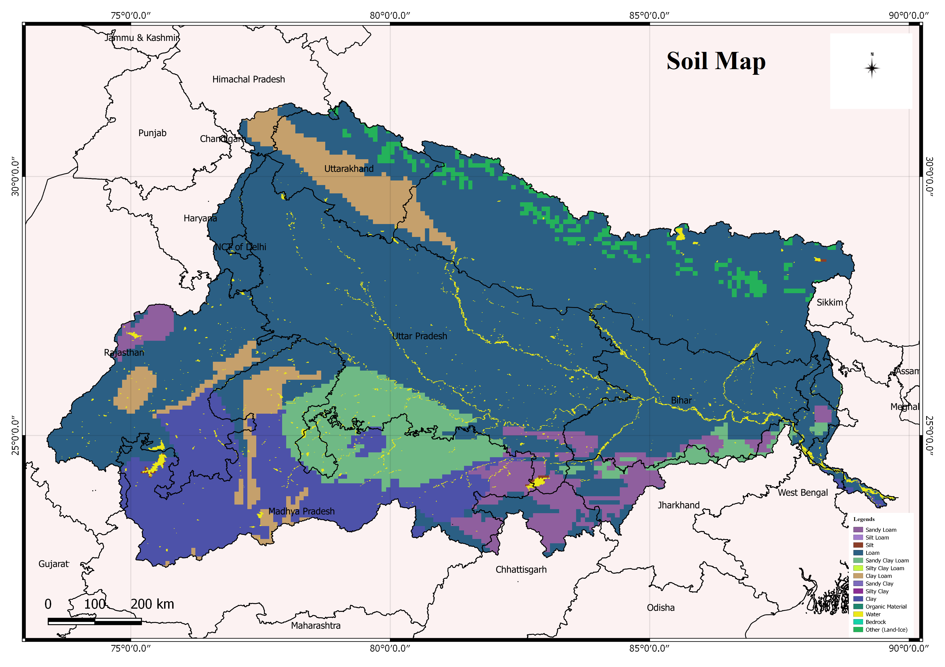
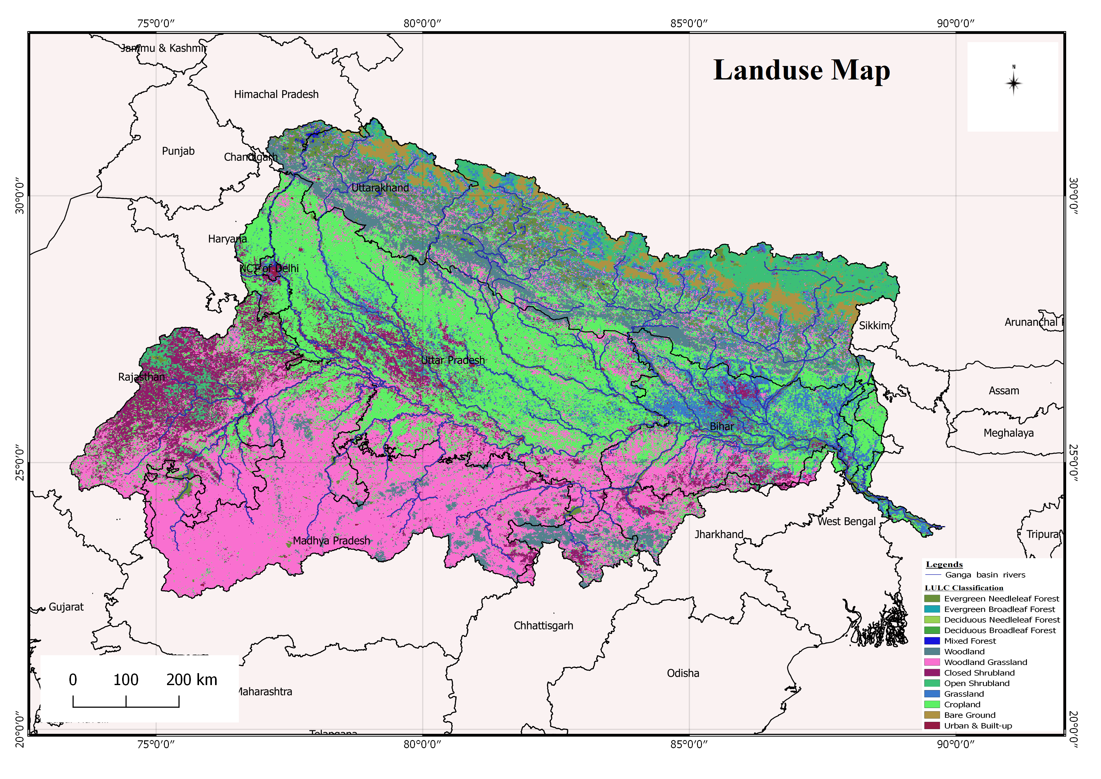
Methodology
Model simulation: 2008-2017, 0.125°

Slide 5
Results
RMSE: 0.13
RMSE: 0.04
Assimilation of remotely sensed snow cover (MODIS) has been proven to be an effective method for better estimation of the snowmelt contribution at the basin scale.

Slide 6
References
Anand, Jatin, et al. "Regional scale hydrologic modeling for prediction of water balance, analysis of trends in streamflow and variations in streamflow: The case study of the Ganga River basin." Journal of Hydrology: Regional Studies 16 (2018): 32-53.
Chen, Fei, et al. "Modeling of land surface evaporation by four schemes and comparison with FIFE observations." Journal of Geophysical Research: Atmospheres 101.D3 (1996): 7251-7268
Kumar, Sujay V., et al. "Land information system: An interoperable framework for high resolution land surface modeling." Environmental modelling & software 21.10 (2006): 1402-1415.
Naha, Shaini, Praveen K. Thakur, and S. P. Aggarwal. "Hydrological Modelling and data assimilation of Satellite Snow Cover Area using a Land Surface Model, VIC.” International Archives of the Photogrammetry, Remote Sensing & Spatial Information Sciences 41 (2016).
Peters-Lidard, Christa D., et al. "High-performance Earth system modeling with NASA/GSFC’s Land Information System." Innovations in Systems and Software Engineering 3.3 (2007): 157-165.
Siderius, C., et al. "Snowmelt contributions to discharge of the Ganges." Science of the Total Environment 468 (2013): S93-S101.
Stigter, Emmy E., et al. "Assimilation of snow cover and snow depth into a snow model to estimate snow water equivalent and snowmelt runoff in a Himalayan catchment." The Cryosphere 11.4 (2017): 1647-1664.
Zaitchik, Benjamin F., and Matthew Rodell. "Forward-looking assimilation of MODIS-derived snow-covered area into a land surface model." Journal of hydrometeorology 10.1 (2009): 130-148..

Slide 7
Thank you

