Slide 1
EGU Presentation
Assessment of brittleness and hydrocarbon potential of deep Permian shales in Krishna Godavari Basin, India
Presented By:
Shubhangi Kala
DST-Inspire Fellow (SRF)
University of Petroleum and Energy Studies
India
Date: 23-May-2022

Slide 2
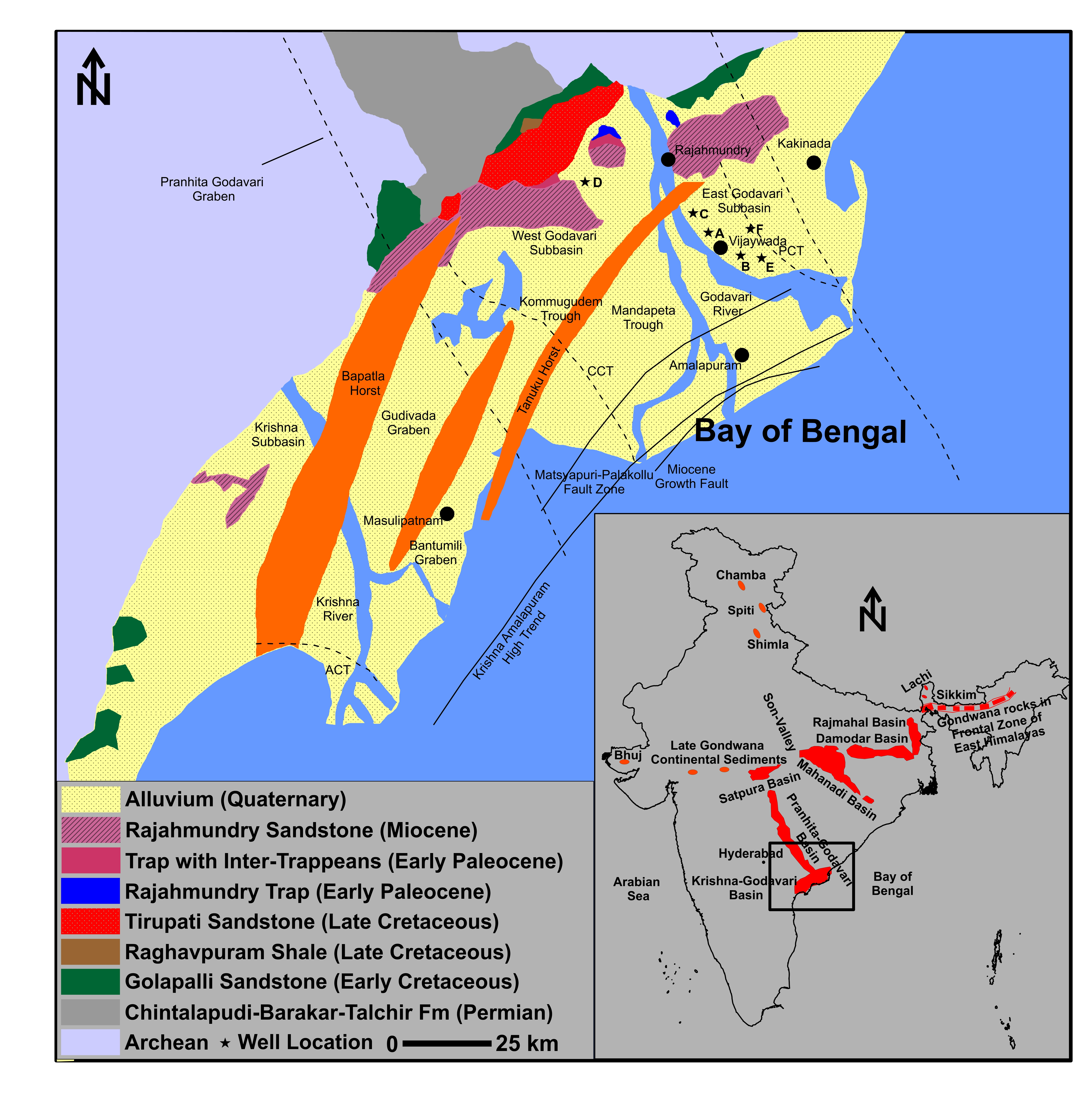
Gas shale characterization at study area?
Vitrinite reflectance >0.80 %
Inertinite abundance in Gondwana can yield natural gas
TOC: 2-8 wt% (Khan, et al. 2000)
Depth: 2800-3200 m
Depth regime is one of the shallowest amongst the sedimentary basins of India
Relatively more cost-effective shale gas development compared to any other known petroliferous basins of India
Fig. 1 Simplified Geological Map of Krishna Godavari Basin (modified after Gupta, 2006)

Slide 3
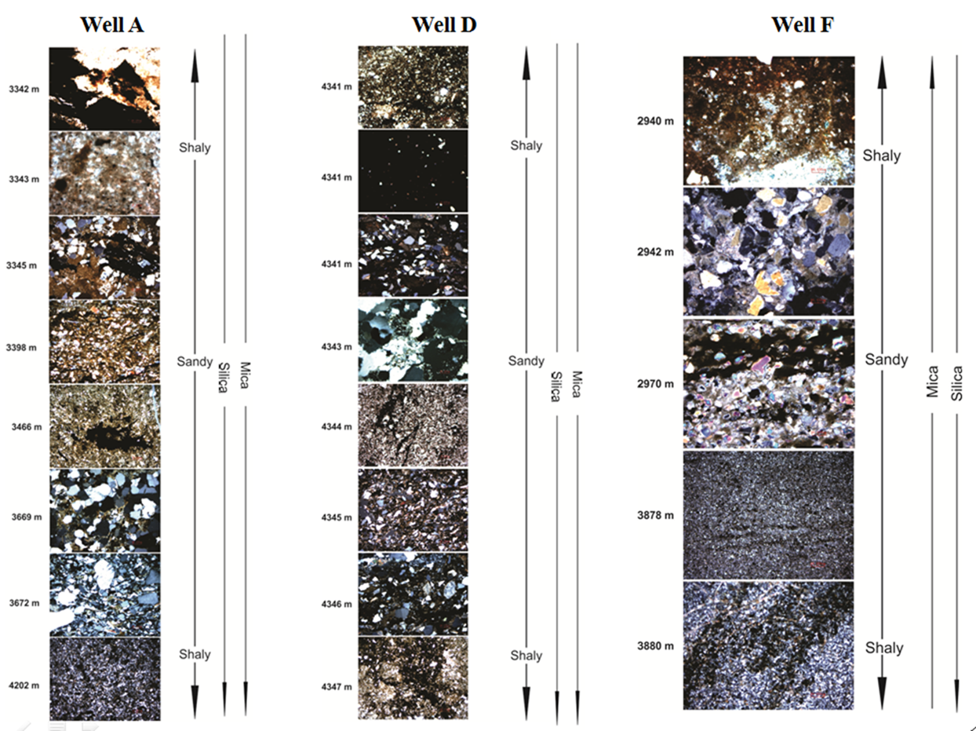
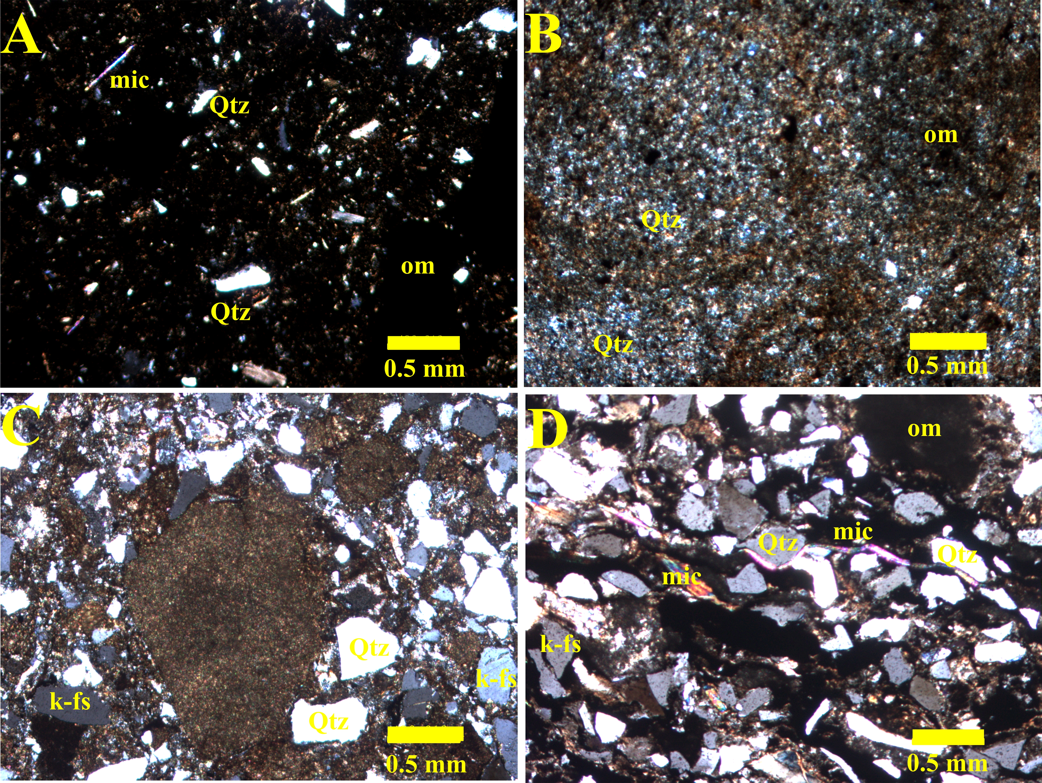
Thin Section Analysis
Silt and clay-sized quartz, feldspars and mica in the carbonaceous and argillaceous matrix.
Carbonaceous shale, carbonaceous silty shale, silty shale and fine-grained micaceous sandstone.
Detrital quartz is most dominantly noted with the presence of intergranular microquartz.
Chemical maturity index (SiO₂/ Al₂O₃) suggests deposition close to provenance without recycling during sedimentation (Bhattacharjee et al., 2018).
Nb and Th enrichment suggest the detrital source of the quartz and probable lithogeonous source terrain. (Ross & Bustin, 2000; Taylor & McLennan, 1985).
Titanium is a diagenetically stable component and a weak, albeit, positive correlation between TiO₂ and Al₂O₃ (r = 0.39) indicates Ti occurrence associated within clay lattices or detritus of constant source.
Fig. 2 Photomicrographs in CPL: a) poorly sorted quartz and mica grain floating in carbonaceous matrix, b) clay-sized microquartz in association with carbonaceous and argillaceous matrix, c) silt-sized and clay-sized quartz (subangular-subrounded), feldspars and mica with argillaceous matrix d) silt-sized quartz associated with mica grains displaying parallel lamination with carbonaceous and argillaceous matrix
Notes:
The low chemical maturity index (CMI = 2.34 - 4.35) of Kommugudem shale samples suggests an abundance of detrital minerals near provenance without substantial recycling during sedimentation (Kala, Devaraju, et al., 2021). Nb and Th enrichment observed in Kommugudem samples also supports probable detrital source of the quartz due to the insoluble nature, low sea-water/continental crust distribution and diagenetic immobility (Kala et al., 2021). The Barnett Shale Formation brittle zones majorly constitute biosiliceous allochems (a recrystallized form of clay-sized micro quartz cement). This matrix dispersed clay-sized quartz cement significantly increased the brittleness of the Barnett Formation. Clay-sized microquartz cement identified in few samples (Figure 4b-c) may bind silt-size detrital quartz and increase brittleness by also enhancing intergranular pores preservation for cement precipitation (Peng et al., 2020). Illitization of smectite clay also leads to the formation of recrystallized microquartz cement as can be confirmed by XRD semiquantitative results indicating the presence of illite and absence of smectite (Hall, 2019). The mineralogical-based brittleness index does not consider the form of minerals or the type of clay mineral associated (De et al., 2020; Hall, 2019). Thus such calculations need to be utilized carefully.
Due to the insoluble nature and diagenetic immobility, the Nb and Th enrichment identified in Kommugudem samples further supports a possible detrital source of the quartz. Clay-sized microquartz cement seen in a few samples may bind silt-sized detrital quartz and promote brittleness. The development of recrystallized microquartz cement is also caused by the illitization of smectite clay, as evidenced by XRD data revealing the presence of illite.

Slide 4
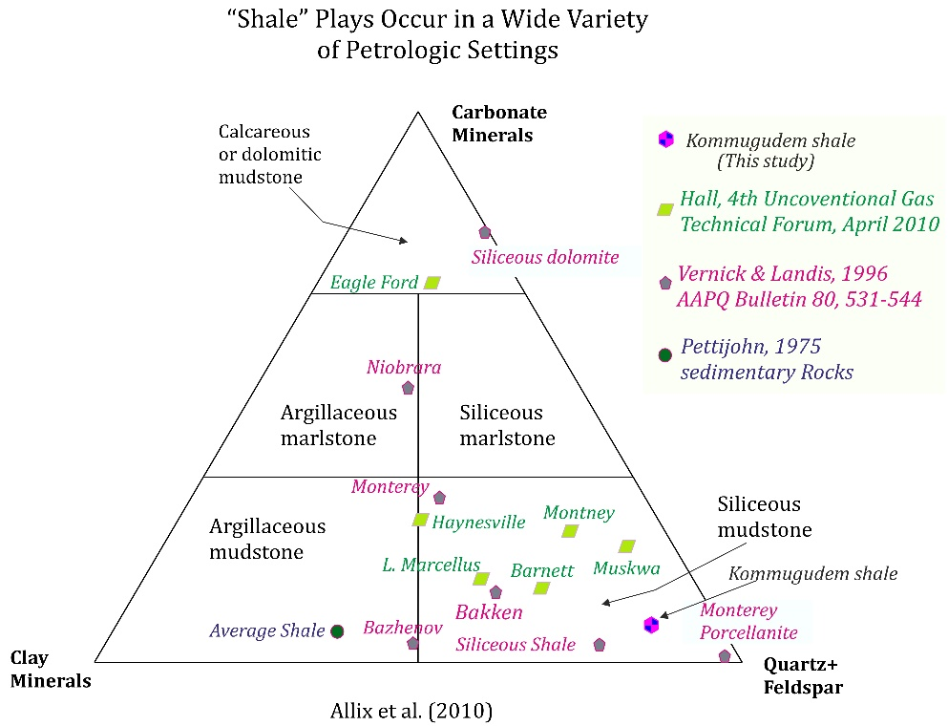
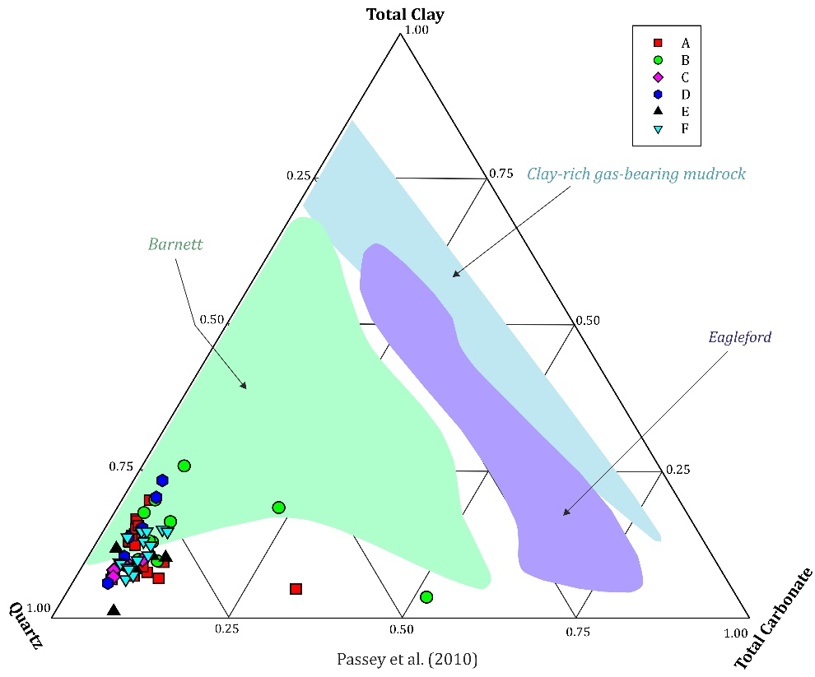
Compositional Inference-XRD
Fig. 3 (a) Ternary plot showing the range of composition from selected Kommugudem shale samples, Barnett, Eagle Ford and a clay-rich mudrock (modified from Passey, 2010)
(b)Ternary plot with classification for organic mudstones (modified after Allix et al., 2010) displaying average composition of the main shale plays from North America and Kommugudem shale
Minerals identified: Quartz, feldspars, clay (chlorite, illite and kaolinite), pyrite, siderite, muscovite.
Brittle component: Quartz (average= 73.34%), feldspar (average=11.61%), siderite (average= 3.39%) and pyrite (average= 0.49%).
Ductile component: Clays (3.63-31.94%) manifested as chlorite, illite and kaolinite with a mean of 6.54%, 3.26% and 2.16% respectively.
Compositionally analogous to the brittle zones of the Barnett shale.

Slide 5
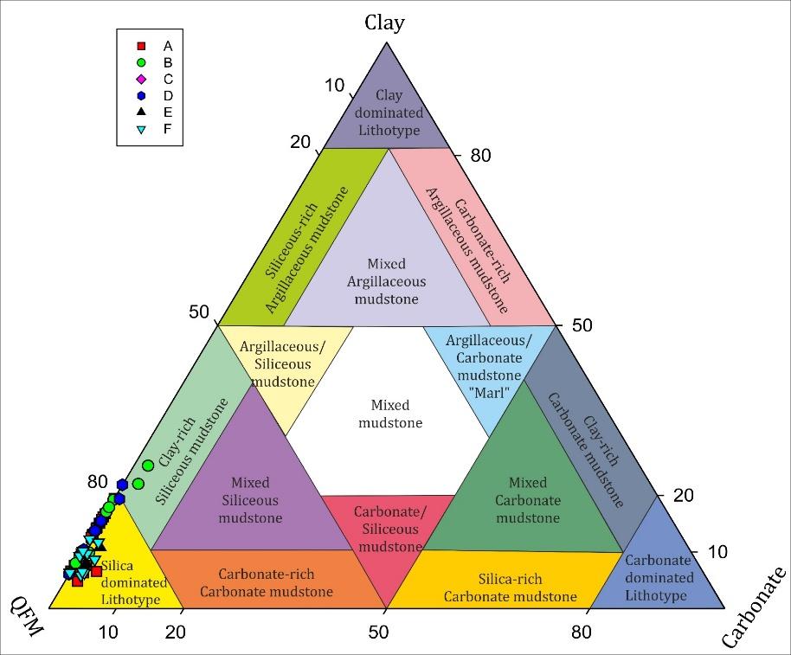

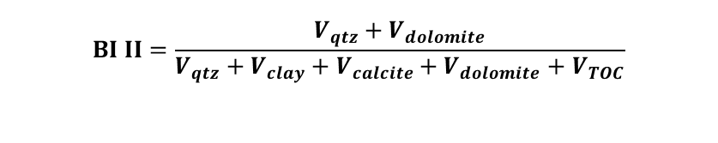

sCore: Classification for Organic Mudstones
Brittleness Index I: 84-89% (after Jarvie et al., 2007)
Brittleness Index II: 78-89% (after Wang and Gale, 2009)
Brittleness Index III: 79-90% (after Diaz et al, 2013)
$$BI I=\frac{V_{qtz}}{V_{qtz}+V_{clay}+V_{calcite}}$$
sCore Classification facies:
Silica dominated lithotype
Clay rich sillaceous mudstone
$$BI II=\frac{V_{qtz}+V_{dolomite}}{V_{qtz}+V_{clay}+V_{calcite}+V_{dolomite}+V_{TOC}}$$
$$BI III=\frac{W_{QFM}+W_{CAR}}{W_{QFM}+W_{CAR}+W_{CLAY}+TOC}$$
Fig. 4 sCore classification of Organic mudstones (after Gamero-Diaz et al, 2013)

Slide 6
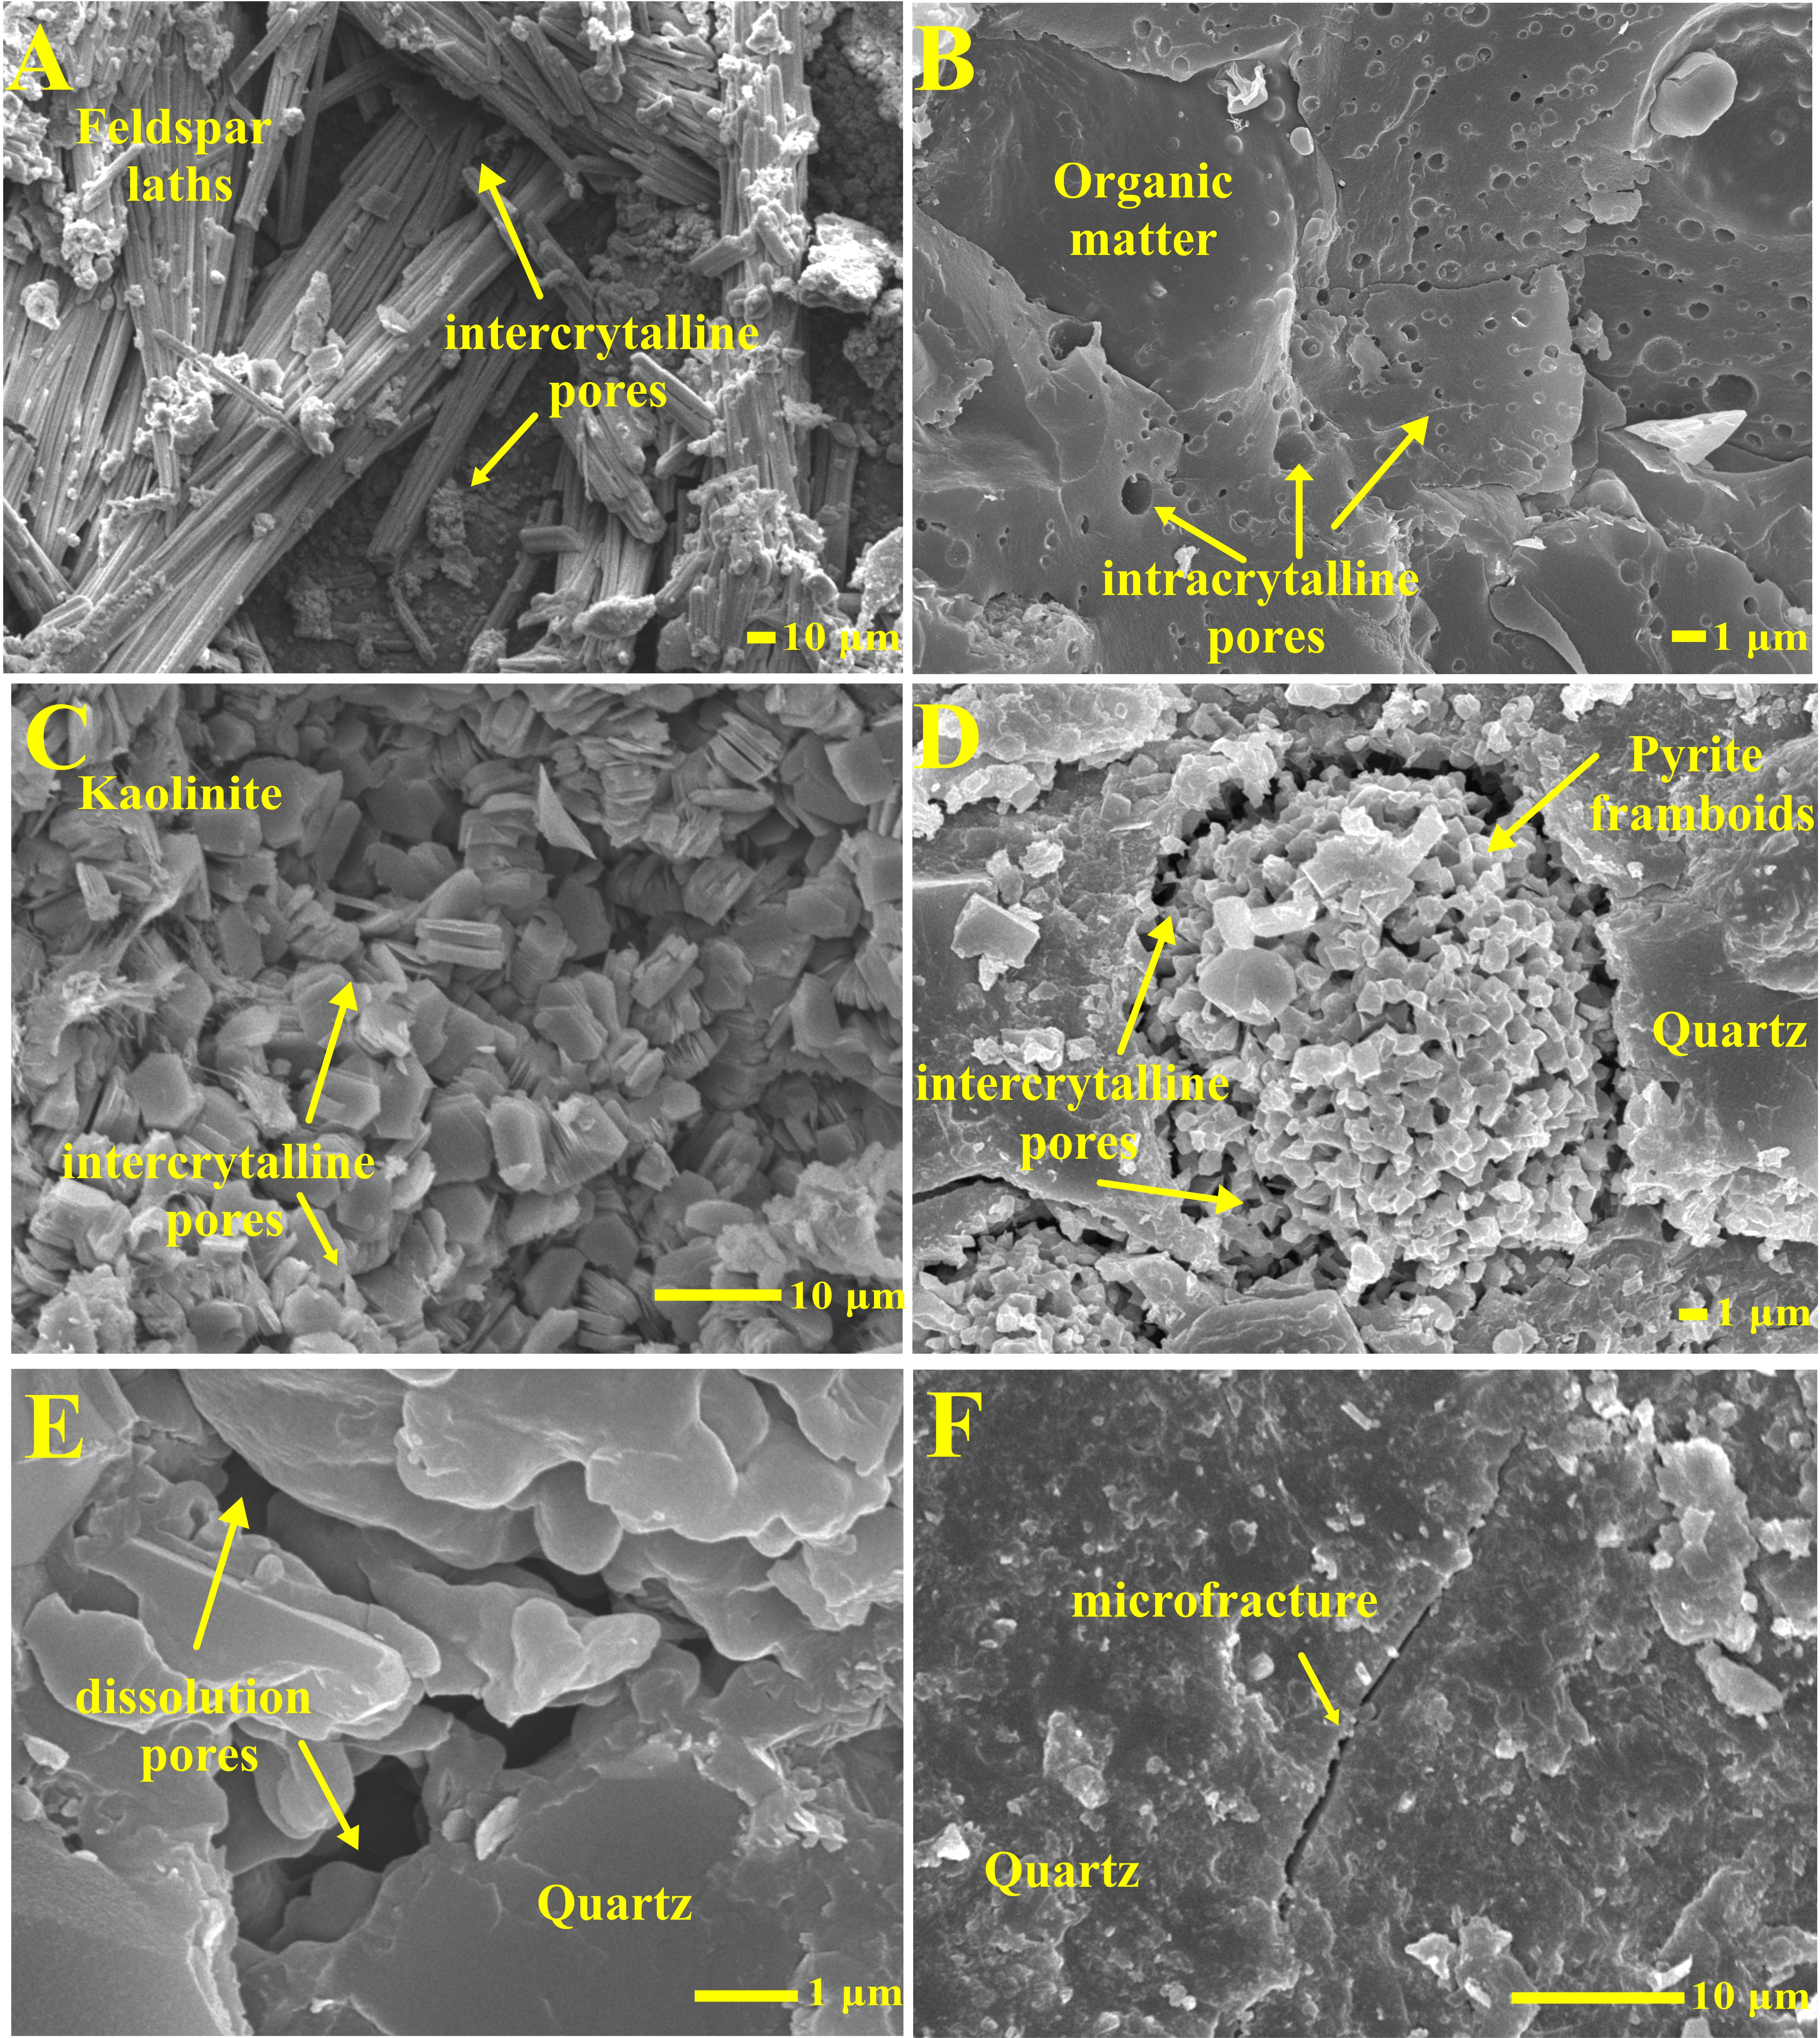
Compositional and Morphological Inference-FE-SEM
Mineral matter: Quartz, feldspar, clays (chlorite, kaolinite and illite) and pyrite.
Organic matter: Flakes, spongy network and as pore-filling materials
Pore size: Macropores to micropores
Pore morphology: Irregular, circular, elliptical, elongated and triangular) in the mineral and organic matter.
Microfractures and micropores was observed as:
(1) Intragranular pores occurring in organic matter assemblages generally in sponge-like form (Figure 12b),
(2) Intergranular and intragranular pores occurring dominantly in clay and pyrite framboids (Figure 12c-f),
(3) Dissolution pores (Figure 12g) and
(4) Microfractures (Figure 12h).
Fig. 5 SEM photomicrograph: (a) Feldspar laths in the argillaceous matrix with intergranular pores;
(b) Spongy network of organic matter with intragranular pores;
(c) Kaolinite with intergranular pores; (d) Pyrite framboids;
(e) Silica occurring as over-growth grains or recrystallized silica exhibiting dissolution pores;
(f) Natural microfracture developed in quartz grain

Slide 7
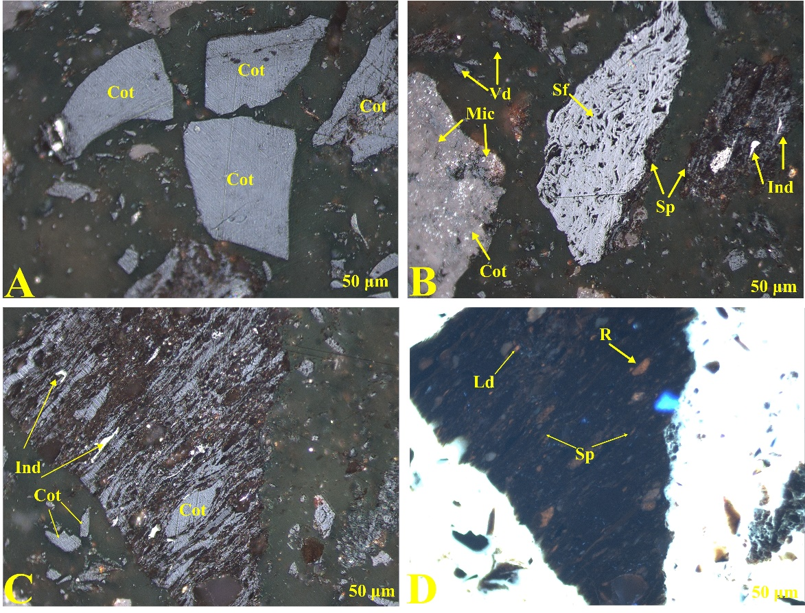
Macerals and vitrinite reflectance
The macerals identified based on ICCP classification are dominantly vitrinite with the scarce and dispersed occurrence of inertinite and liptinite
Vitrinite: woody tissues, terrestrial; type III kerogen
Inertinite: leaves and resins; higher in Gondwana; type III/IV kerogen
Vro: 0.74 to 1.64 %
Mature to postmature shale
Dry and wet gas generative window
1-1.5% indicate gas generation window
Fig. 6 Photomicrograph exhibiting a) dominant accumulation of collotellinite (Cot) b) collotellinite and vitrodetrinite (Vd) in association with semifusinite (Sf), micrinite (Mic) and inertodetrinite (Ind) and sporinite (Sp), c) collotellinite assemblage with vitrodetrinite and inertodetrinite and d) Sporinite, resinite (R) and liptodetrinite (Ld) accumulation
Notes:
Kommugudem shale shows presence of mainly vitrinite and inertinite with scarce occurrence of liptinite that have been identified on basis of ICCP classification. Collotelinite, vitrinite sub group is majorly observed in the samples occurring as layers of variable thickness. Another subgroup of vitrinite observed is Vitrodetrinite occuring as discrete small vitrinitic fragments of varying shape that become discernible when surrounded by non-vitrinitic material.
Dominance of vitrinite indicates genesis from mainly woody tissues derived from higher terrestrial land plants formed by anaerobic preservation of ligno-cellulosic material (ICCP System, 1994).
Inertinite subgroups semifusinite, micrinite and inertodetrinite are observed. Inertinite is most common maceral, especially Gondwana contain more inertinite than Mesozoic and Tertiary sequences. Depending upon its degree of chemical transformation semifusinite belongs to kerogen Type III–IV. Some Gondwana coals are rich in semifusinite, partly derived from leaves. Micrinite agglomerates of grains in varying amounts originating from resinous woods. Inertodetrinite belongs to kerogen Type IV (“dead carbon”); however, depending on its reactivity (indicated by relatively low reflectance) it may be also part of kerogen Type III.
Liptinite subgroups sporite, resinite and liptodetrinite are sparsely present in the selected samples. Sporinite and resinite are derived from spores and resinous matter of plants respectively and are rich in hydrogen (ICCP sytem, 1994). Liptodetrinite are detritus relicts of spores, pollen, cuticles, resins, waxes, cutinized and suberinized cell walls, and particularly algae, which have been mechanically disintegrated or fractionated after chemical-microbiological decomposition. Liptinite derived from non humifiable plant matter (Taylor et al., 1998), relatively hydrogen rich remains such as sporopollenin, resins, waxes and fats and comprise the macerals of the lowest reflectance at a given rank among the other macerals.
Vitrinite is a major source of natural gas of primary origin.
Cutting samples were crushed to the required size and sample pellets were made in the plastic moulds with cold setting epoxy resin. The surface of the mounted sample is first ground on the grade 100 and grade 320 waterproof silicon carbide paper, using water as lubricant, and then polished first on a billiards cloth and then on a Selvyt cloth covered rotary lap using 1.0, 0.3 and 0.05µ (micron) alumina powder successively. Vitrinite reflectance studies were carried out on Fluorescence Microscope with Image Analysis System (Automated Microscope Leica Model DM6000M with MSP 200 Photometer, DFC 500 Digital Camera).
For vitrinite reflectance measurements, the system was calibrated with glass standard of known reflectance in oil medium. Reflectance of vitrinite macerals was measured with 50X objective immersed in oil. Wherever possible, more than twenty readings were taken. The number of individual reflection measurement is dependent on the abundance of vitrinite maceral in the sample, but should be in the order of more than ten measurements per sample

Slide 8
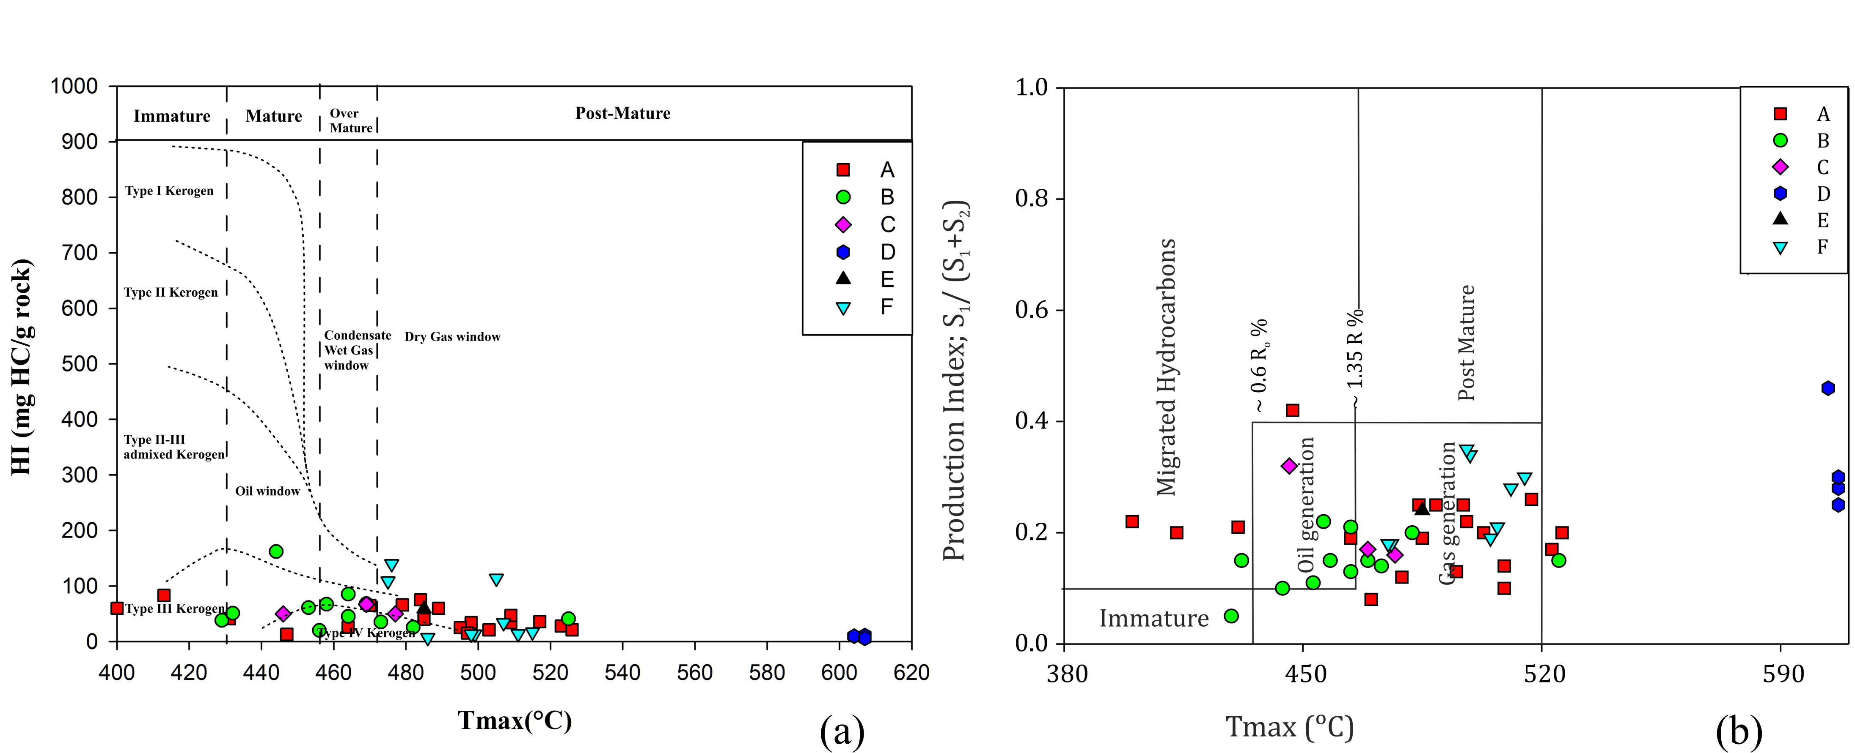
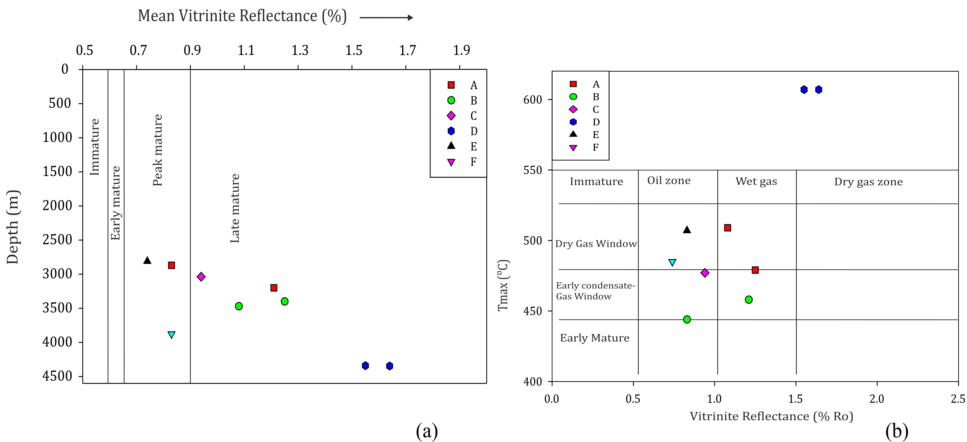
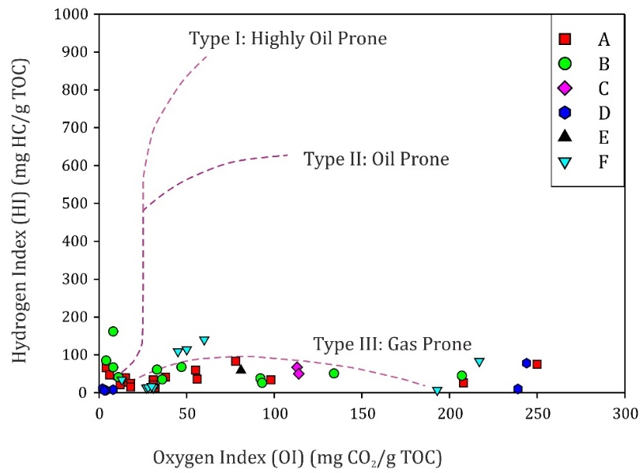
Source Rock Characterization-RockEval
Fig. 8 (a) Mean vitrinite reflectance-Depth cross plot
(b) Vitrinite reflectance-Tmax cross plot for the Kommugudem shale (after Peters and Cassa, 1994)
High TOC: 0.02-30 wt% indicates rich in Organic content (mean: 3 wt%).
Type III kerogen: HI values 50–200 mg HC/g TOC and OI values of 5–100 mg CO2/g TOC.
Low HI (<125.34 mg HC/g TOC) indicates a greater potential to generate gaseous hydrocarbon.
High Tmax further indicates mature to post mature indicating wet gas zone and dry gas zone.
The vitrinite reflectance for Kommugudem shale (0.74 to 1.64 %) suggests a postmature stage, where any residual oil or oil-prone kerogen will likely be cracked to gas.
(c)
Fig. 7 (a) Hydrogen index-Tmax cross plot exhibiting maturity range and kerogen type (after Peters, 1986)
(b) Production Index-Tmax cross plot showing maturity range (after Peters et al., 2005)
(c) HI-OI cross plot (after Peters, 1986) indicating the kerogen type for Kommugudem shale
Notes:
Rock-Eval pyrolysis analysis estimates the TOC abundance, kerogen type, maturity levels and hydrocarbon generation potential of the samples based on the source rock characteristics.
Type iii: terrestrial plants; humic kerogen
Type III kerogen corresponds to "common" terrestrial organic matter and is derived from higher land plants. This type of organic matter is rich in lignin and cellulose and, unless the plant remains are enriched in cuticles, sporomorphs, or resinite, this type of kerogen only yields gas.

Slide 9
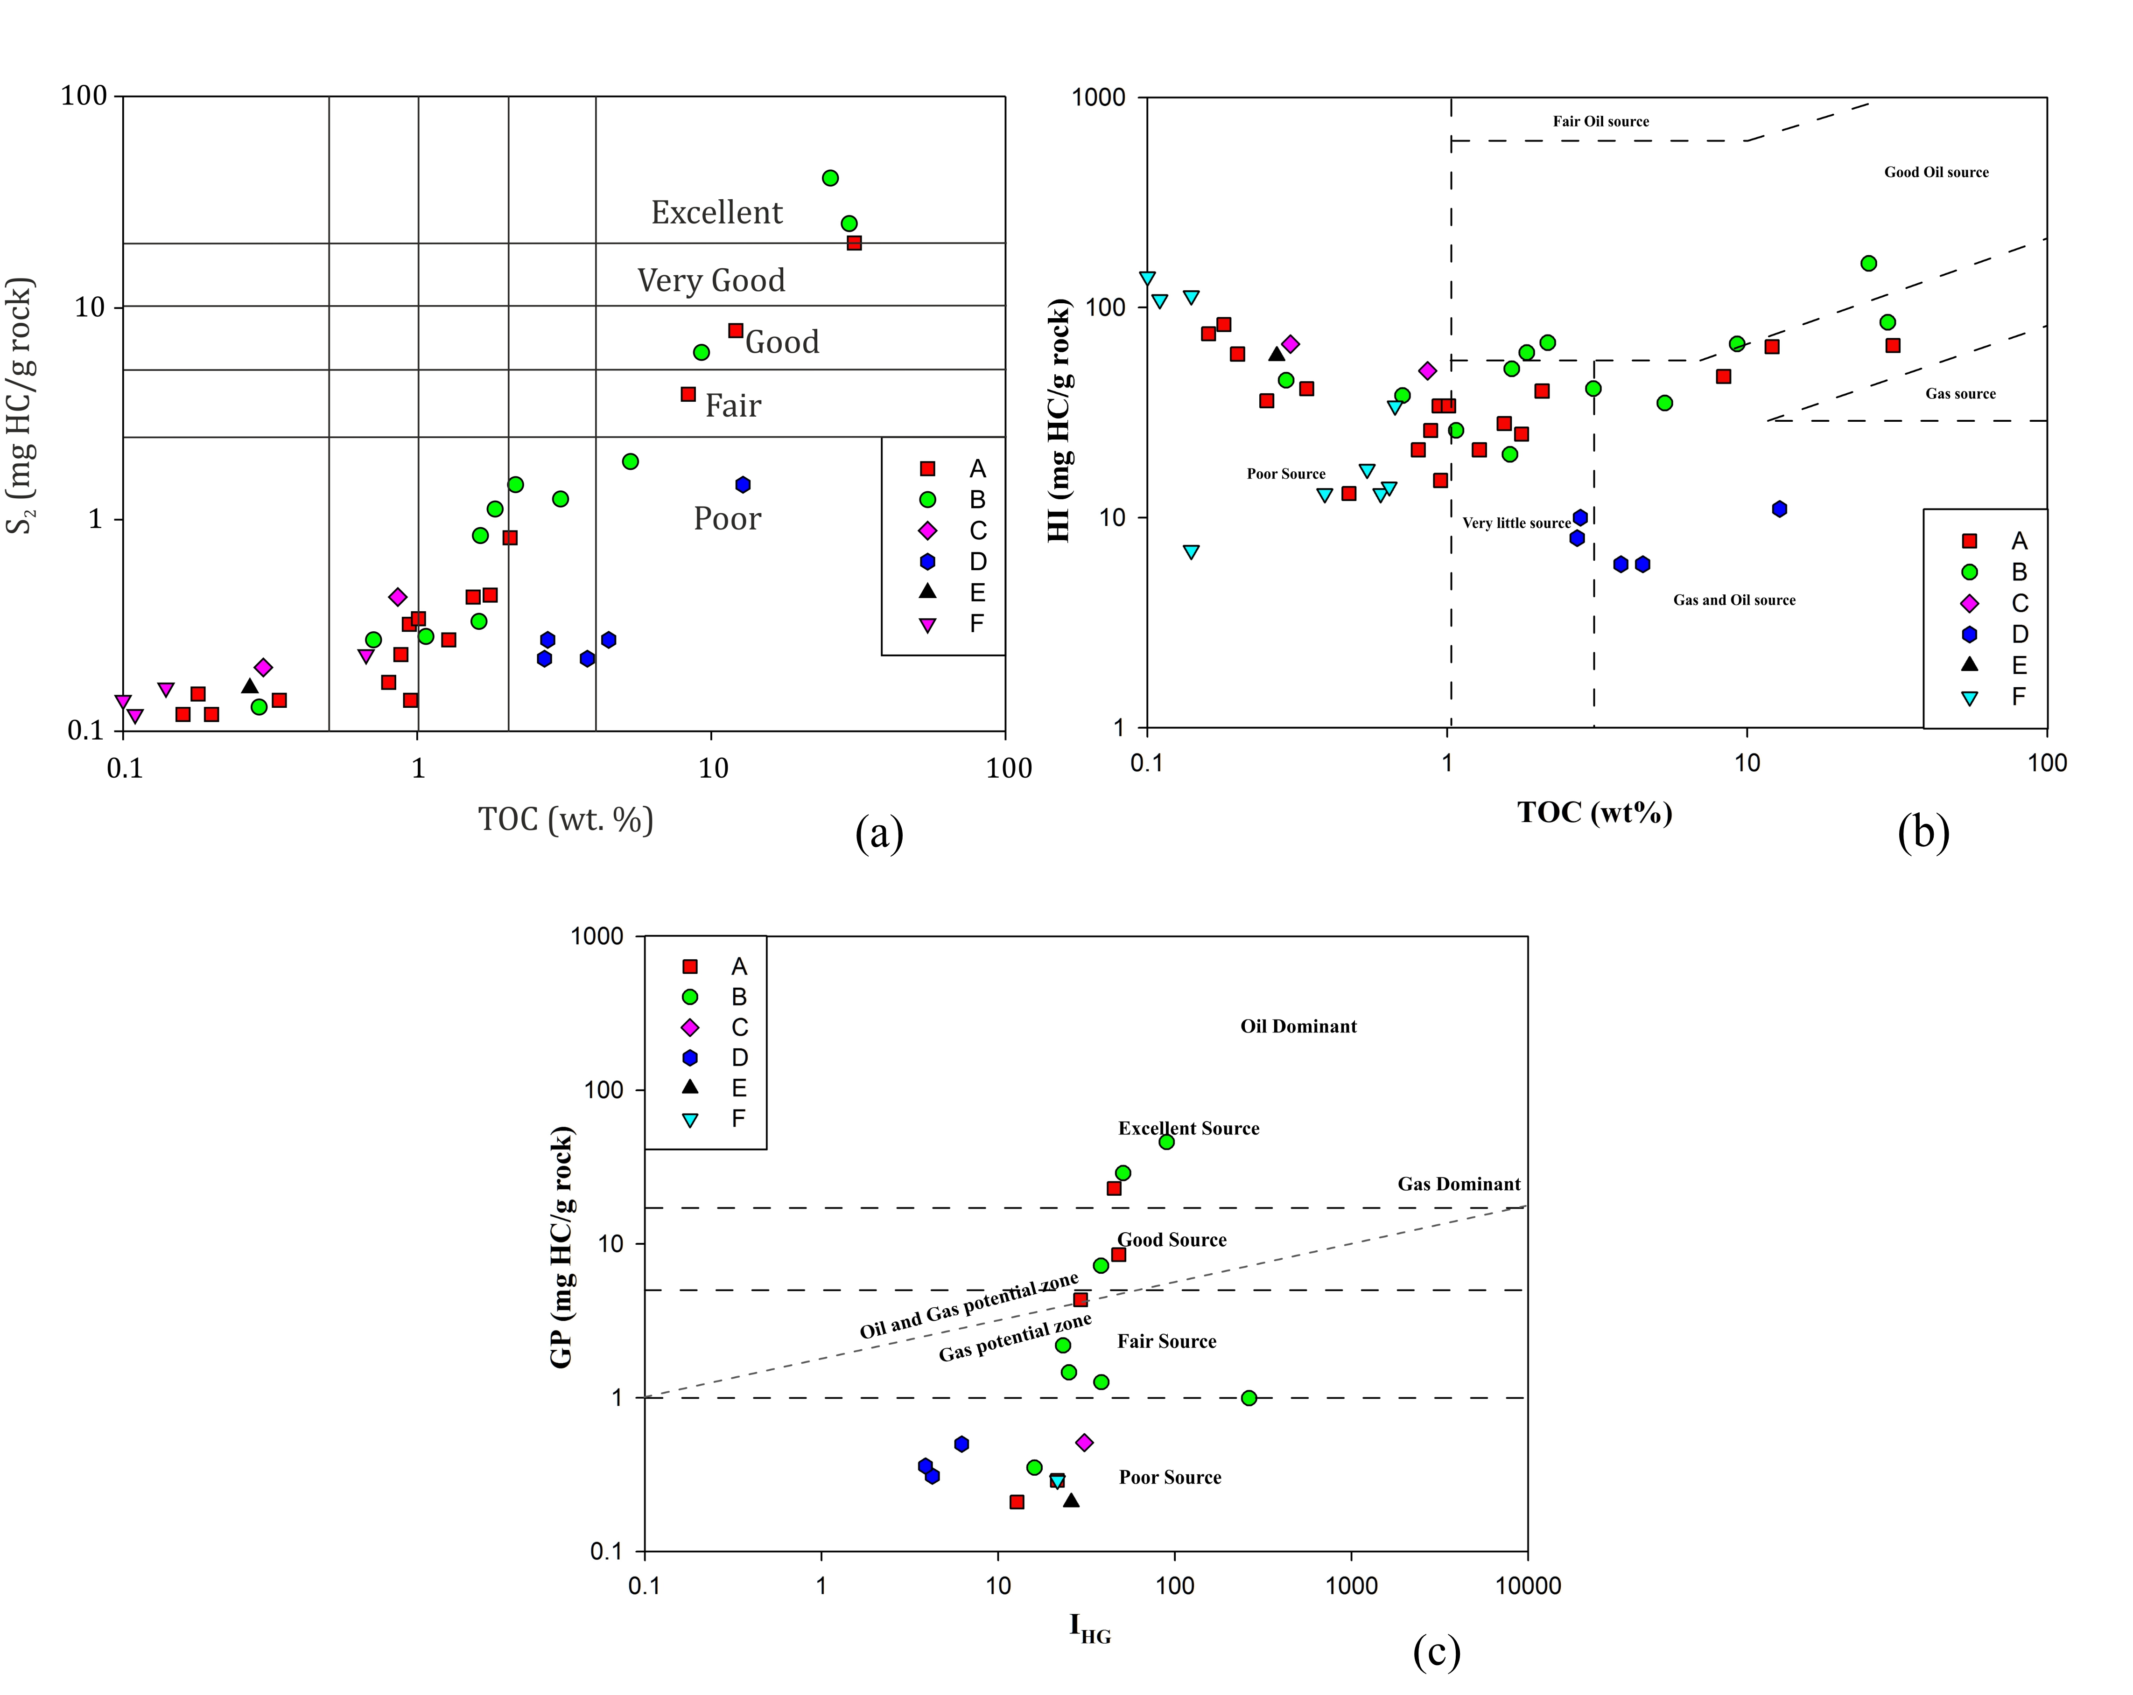
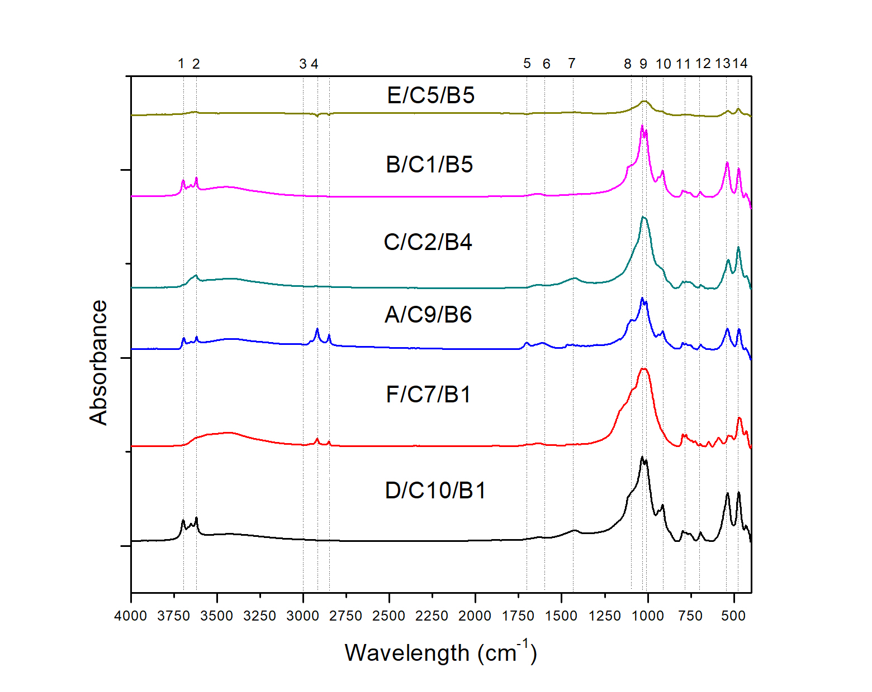
Source Rock Characterization-RockEval and FTIR
Fig. 9 (a) S2-TOC cross plot (wt %) indicating hydrocarbon potential of the Kommugudem Shale (after Hunt, 1996; Peters, 1986)
(b) HI-TOC cross plot indicating hydrocarbon potential of the Kommugudem shale
(c) Genetic potential (GP) versus Index for hydrocarbon generation (IHG) plot of the studied shale samples (modified after Misra et al., 2018)
Fig. 10 FTIR spectra of a representative sample from each well. Abbreviations: 1. Kaolinite, 2. Hydroxyl group, 3. Aromatic C-H stretching, 4. Aliphatic C–H stretching, 5. Carbonyl/Carboxyl group, 6. Aromatic C=C stretching, 7. Aliphatic CH2 and CH3 bending, 8. Quartz, 9. Feldspar + Quartz, 10. Kaolinite, 11. Quartz, 12-13. Kaolinite and 14. Quartz. IAL: Index of aliphaticity ; IHG: Index of Hydrocarbon Generation

Slide 10
Conclusion
Kommugudem formation is highly siliceous with mainly silica-dominated lithotype and clay-rich siliceous mudstone.
High mineralogical brittleness index was calculated by variable methods in Kommugudem Formation and indicated favorable conditions for hydraulic fracturing.
FE-SEM investigations demonstrated the presence of microfractures and micropores in form of inter and intragranular pore sites in mineral and organic matter that may act as storage sites for hydrocarbons.
Natural microfractures presence in Kommugudem may augment hydraulic fracturing efficiency by providing a migration pathway for hydrocarbons.
The elemental proxy investigation reveals detrital sediments undergone moderate to strong weathering along the passive tectonic continental margin.
RockEval pyrolysis analysis confirmed mainly Type III kerogen in admixture with Type II-III and Type IV with high TOC and Tmax inferring the presence of high organic matter that falls in dry gas and wet gas window.
The vitrinite reflectance studies also suggested mature to post-mature shale majorly in the gas generation window.
RockEval parametric and FTIR analysis infers excellent hydrocarbon generation potential for oil and gas sources in wells A and B while C, D, E and F have relatively lower potential and may have low gas and oil sources.

Slide 11
References
Allix, Pierre, et al. "Coaxing oil from shale." Oilfield Review22.4 (2010): 4-15.
Bhattacharjee, J., Ghosh, K. K., & Bhattacharya, B. (2018). Petrography and geochemistry of sandstone–mudstone from Barakar Formation (early Permian), Raniganj Basin, India: Implications for provenance, weathering and marine depositional conditions during Lower Gondwana sedimentation. Geological Journal. https://doi.org/10.1002/gj.2946
Gamero-Diaz, Helena, Camron K. Miller, and Richard Lewis. "sCore: a mineralogy based classification scheme for organic mudstones." SPE Annual Technical Conference and Exhibition. Society of Petroleum Engineers, 2013.
Gupta, S. K. "Basin architecture and petroleum system of Krishna Godavari Basin, east coast of India." The Leading Edge 25.7 (2006): 830-837.
Hunt, M. J. (1995). Petroleum geochemistry and geology. WH Freeman and Company, 45- 110.
Jarvie, D. M., Hill, R. J., Ruble, T. E., & Pollastro, R. M. (2007). Unconventional shale-gas systems: The Mississippian Barnett Shale of north-central Texas as one model for thermogenic shale-gas assessment. AAPG bulletin, 91(4), 475-499.
Jarvie, D. M., Brenda, L. C., Floyd, H, and John, T. B. (2001). Oil and Shale Gas from the Barnett Shale, Ft. Worth Basin, Texas; AAPG National Convention, 3-6, 2001, Denver, CO, Am. Assoc. Petrol. Geol. Bull. 85 (13).
Misra, S., Varma, A. K., Das, S. K., Mani, D., & Biswas, S. (2018). Thermal controls of lamprophyre sill on hydrocarbon generation outlook of shale beds in Raniganj basin, India. Journal of Natural Gas Science and Engineering, 56(April), 536–548. https://doi.org/10.1016/j.jngse.2018.06.028
Passey. Q. R., Creaney. S., Kulla. J. B., Moretti. F. J., Stroud. J. D., (1990). Practical Model for Organic Richness from Porosity and Resistivity Logs. AAPG Bulletin, 74, 1777- 1794
Peters, K. E., Walters, C. C., & Moldowan, J. M. (2005). Biomarkers and isotopes in the environment and human history. Cambridge University Press.
Peters, K. E., & Cassa, M. R. (1994). Applied source rock geochemistry: Chapter 5: Part II. Essential elements.
Peters, K. E. (1986). Guidelines for evaluating petroleum source rock using programmed pyrolysis. Am. Assoc. Petrol. Geol. Bull. 70(3) 318-329.
Taylor, S. R., & McLennan, S. M. (1985). The continental crust: its composition and evolution.
Wang, F. P., & Gale, J. F. (2009). Screening criteria for shale-gas systems :Gulf Coast Association of Geological Societies Transactions, v. 59, p. 779-793.

Slide 12


