Slide 1






Vienna| 23–27 May 2022
In situ radar measurements for monitoring the physiological functioning of wheat crops in the semi-arid area
N. Ouaadi, L. Villard, S. Khabba, P.L. Frison, J. Ezzahar, M. Kasbani, P. Fanise, A. Chakir, V. Le Dantec and L. Jarlan

Slide 2

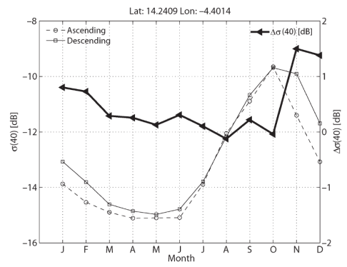
Diurnal cycle of C-band data
radar
Water content
Unstressed
Microwaves / Sensitivity to water content
Data
stressed
Diurnal cycle of sap flow → effect on backscatter and coherence?
Morning
Descending
Evening
Ascending
Theory
Steele-Dune et al., 2012
Trees
Annual crops
Diurnal cycle of the backscattering coefficient (Van Emmerik et al., 2015)
Diurnal cycle of coherence (El Idrissi et al., 2019)
Water content
Water content
Water content (%)
Few studies
Water content (%)
Scatterometer / wheat 1-2 dB at C-band (Brisco et al. 1990)
Theoretical study / corn 3.5 dB in C-band (Van Emmerik et al. 2017)
No stress
Stress
No stress
Stress
Stress
Morning
Morning
Backscattering
Evening
Backscattering
Evening
Backscattering (dB)
Backscattering (dB)
No stress
Stress
No stress
Stress
Stress
Time
Time
(Van Emmerik 2017)
(Van Emmerik 2017)

Slide 3

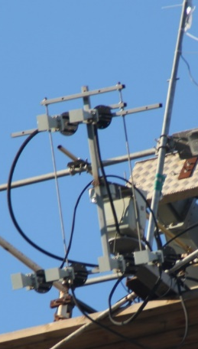
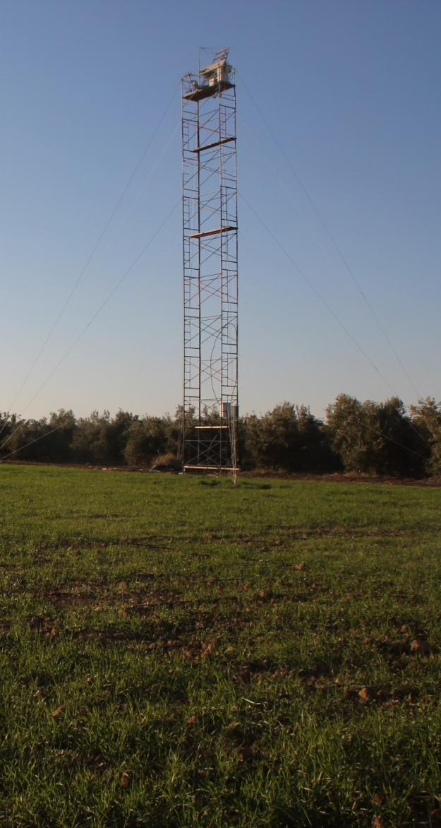


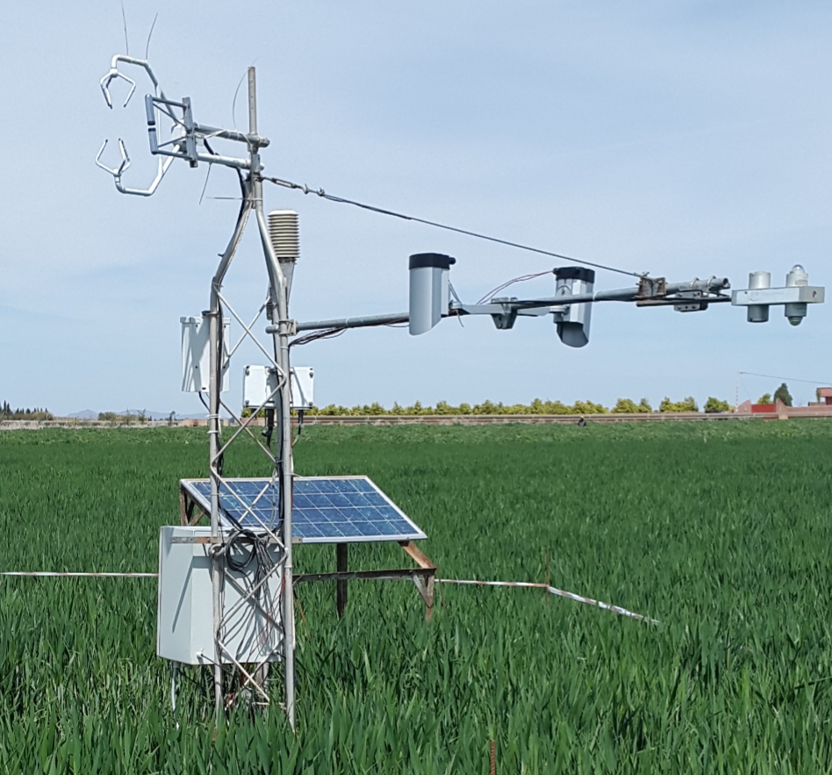
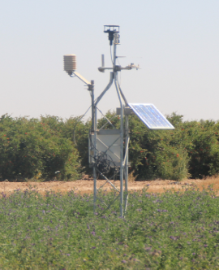

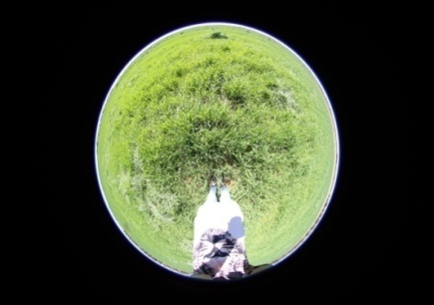
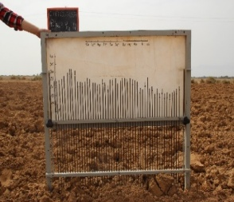
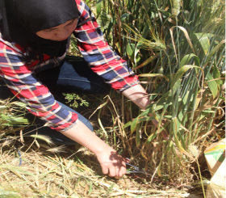
Objectives and Expérimental setup
Objective
Scientific: Investigate the diurnal cycle of backscatter and coherence in relation to the physiological functioning of the canopy
Applied: early detection of water stress for irrigation scheduling
MOCTAR experimental setup
Instruments set up on a wheat field in Central Morocco from January 2020 funded by the French spatial agency (CNES) under the MOCTAR project and IRD (LMI TREMA)
6 C-band antennas at the top of a 20m tower: backscatter and temporal coherence measurements with a time step of 15 mns
Complementary measurements
  Automatic: Eddy-correlation (convective fluxes), moisture and temperature profiles in the soil, meteorological variables every 30 mns
  Manual: roughness, above-ground biomass, height every 15 days

Slide 4
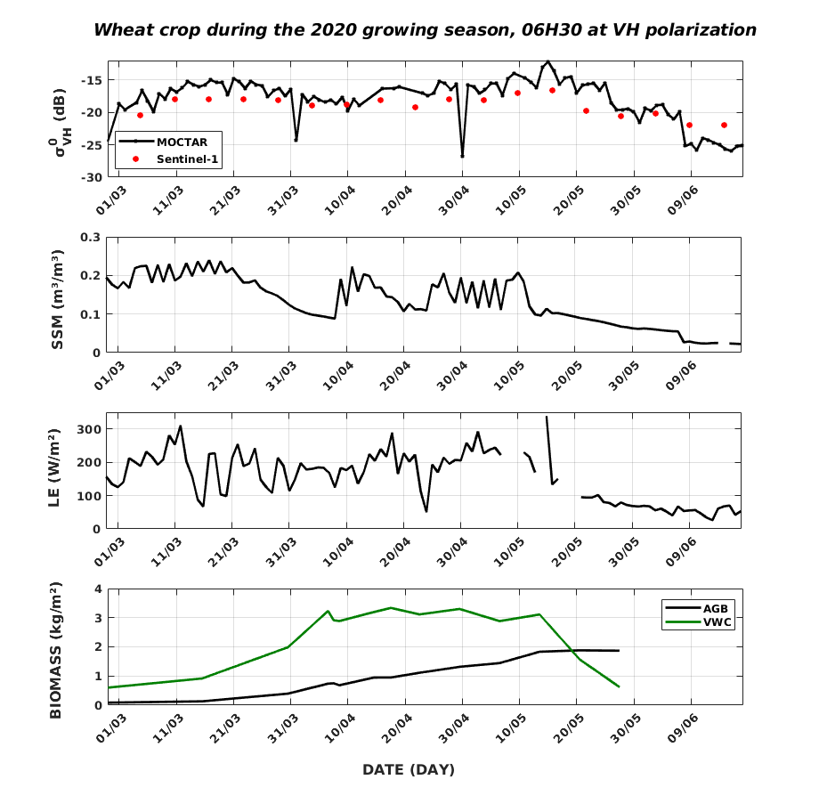
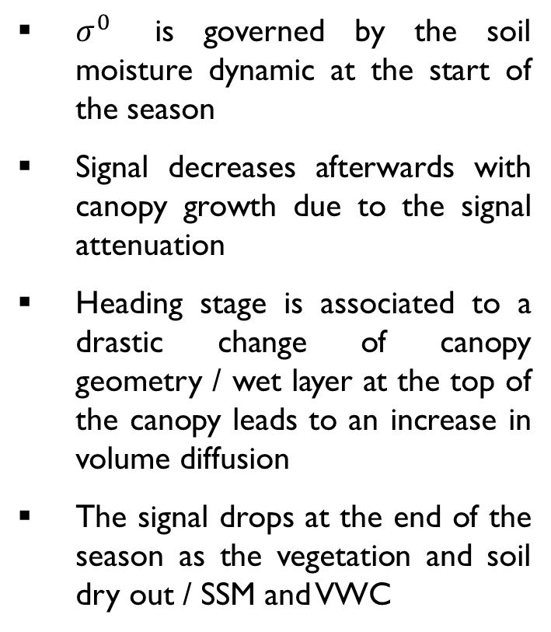
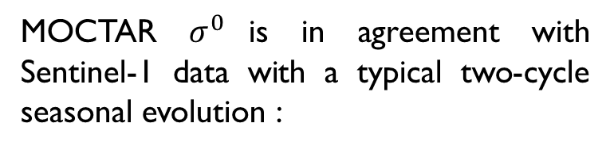
Time series analysis / 2020 agricultural season
Backscattering coefficient / VH
MOCTAR $σ^{0}$is in agreement with Sentinel-1 data with a typical two-cycle seasonal evolution :
Heading
$σ^{0}$ is governed by the soil moisture dynamic at the start of the season
Signal decreases afterwards with canopy growth due to the signal attenuation
Heading stage is associated to a drastic change of canopy geometry / wet layer at the top of the canopy leads to an increase in volume diffusion
The signal drops at the end of the season as the vegetation and soil dry out / SSM and VWC

Slide 5
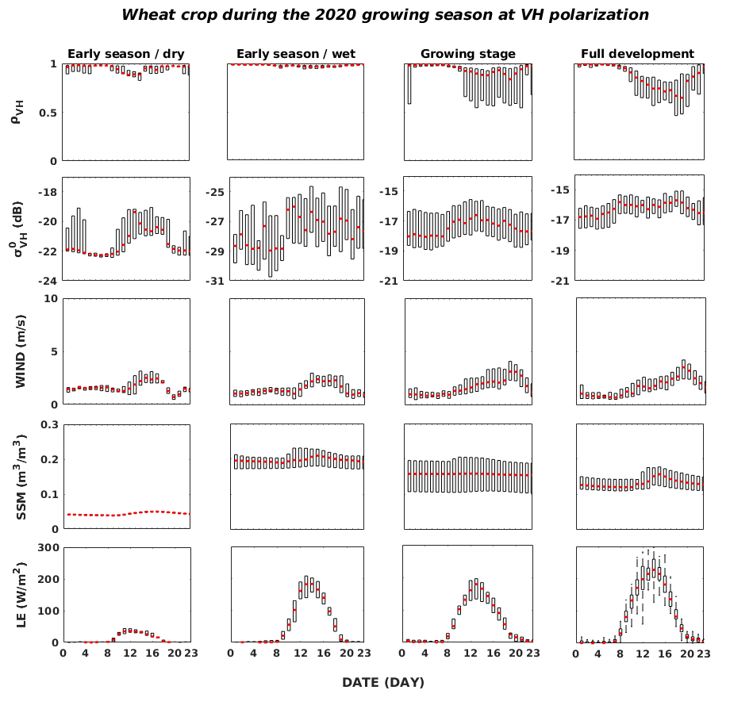
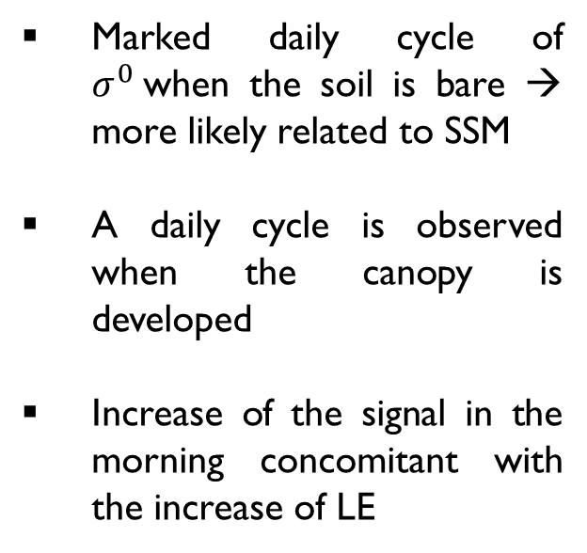
Daily cycle of backscatter and coherence
Backscattering coefficient / VH
Marked daily cycle of $σ^{0}$when the soil is bare → more likely related to SSM
A daily cycle is observed when the canopy is developed
Increase of the signal in the morning concomitant with the increase of LE

Slide 6
Daily cycle of backscatter and coherence
Coherence / VH
Diurnal cycle very low when the soil is bare and starts to increase progressively with the development of vegetation
SSM have a limited impact on ρ
Drop at dawn concomitant with evapotranspiration
Minimum values obtained in the late afternoon correspond to the higher value of wind intensity

Slide 7
Summary and conclusions
The analysis of the first observations acquired by a in situ C-band radar over wheat reveals the existence of a diurnal cycle of the interferometric coherence and of the backscattering coefficient whose amplitudes increase with the development of vegetation
The low values of ρ observed at the end of the afternoon are related to the strong winds while the drop at dawn is concomitant with the increase in evapotranspiration
For the backscattering coefficient, a good agreement is observed between the evolutions of its daily average and the evolution of evapotranspiration.
These preliminary results demonstrate the existence of important dependencies between the infra-daily C-band dynamic and the physiological functioning of wheat, which could be exploited in the future for the detection of water stress using radar data acquired at a sub-daily timescale.

Slide 8
Vienna| 23–27 May 2022
In situ radar measurements for monitoring the physiological functioning of wheat crops in the semi-arid area
N. Ouaadi, L. Villard, S. Khabba, P.L. Frison, J. Ezzahar, M. Kasbani, P. Fanise, A. Chakir, V. Le Dantec and L. Jarlan

