Slide 1

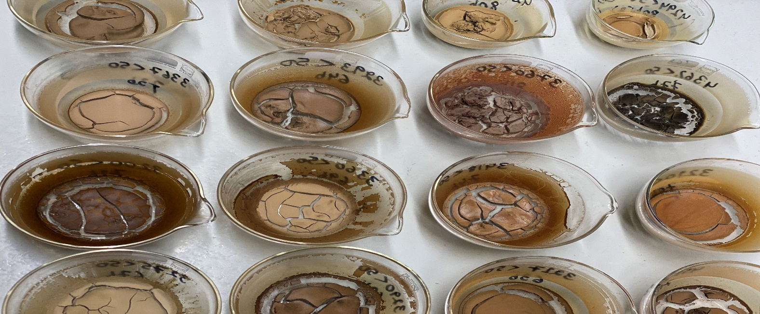



Fractionating German agricultural soils to assess if the mineral associated carbon fraction saturates
Thünen Institute of Climate Smart Agriculture
Braunschweig, Germany
Neha and Christopher Poeplau
Braunschweig
May 2020

Slide 2

Why Mineral Associated Organic Carbon (MAOC) is important?
C sequestration in agricultural soils is discussed as negative emission solution
Rate for MAOC formation is important for soil carbon sequestration
Different soils have different carbon-capture capabilities
Which soils need to be priortized?
Does the soil's ability to sequester SOC have an upper limit?
What drives the SOC storage limit in MAOC?
Cotrufo and Lavallee, 2021

Slide 3
Soil Carbon Saturation: Previous Investigation

Slide 4
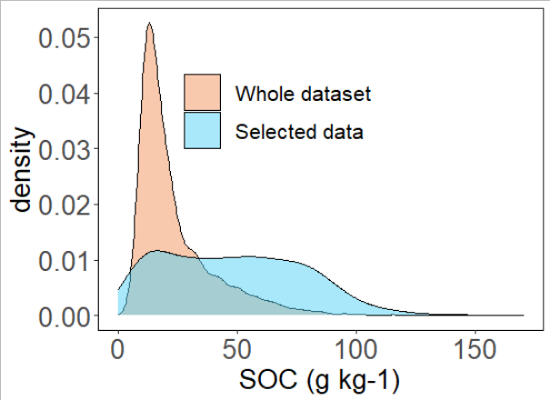
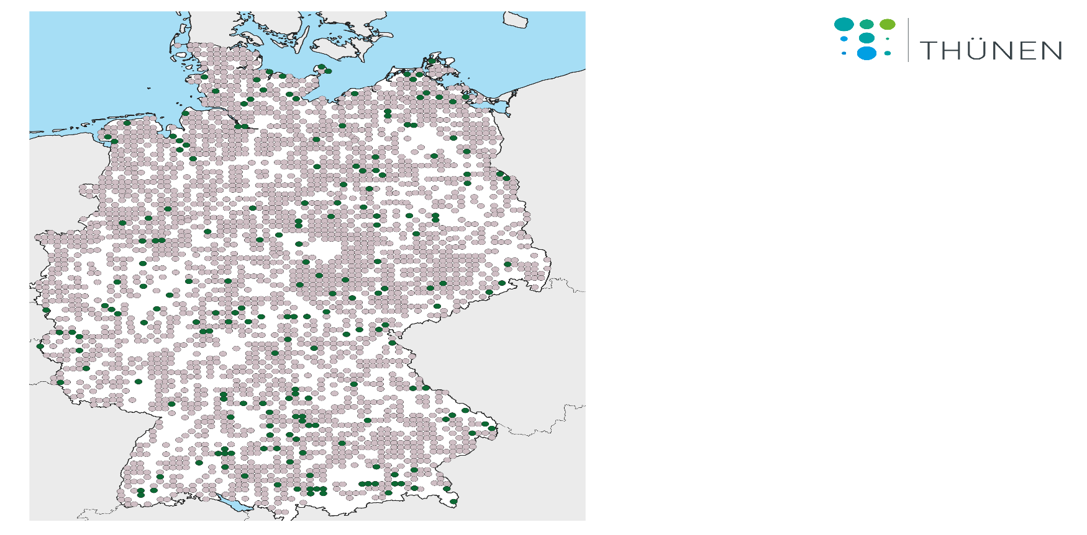

Sample selection from German Agricultural Soil Inventory (BZE-LW)
Geographical distribution of
BZE-LW tospoil samples
Systematic Random Approach
Equal number of samples were selected in each SOC content class
SOC (0.54 - 11.7 %)
Clay content (3-77 %)
Soils fractionated by size (50µm) to derive MAOC and POC
Whole dataset (n = 3104)
Selected samples (n = 190)

Slide 5
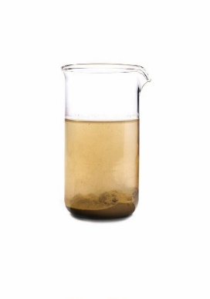
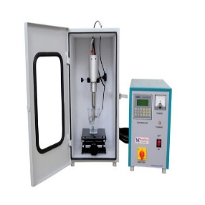
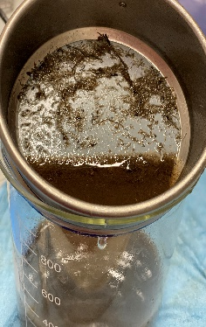
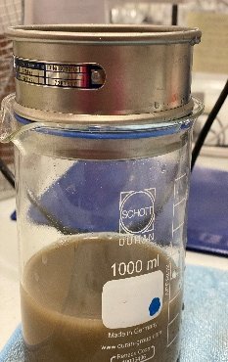


Fractionation Method
Coarse fraction
(> 50 µm)
Fine fraction + water
(< 50 µm) was centrifuged for 15 minutes at 4000 rpm
Oven-dried
at 60 °C
Bulk soil
Ultrasonic
Dispersion 100 J/ml
Wet sieving (50 µm)
Fine fraction
(< 50 µm)

Slide 6
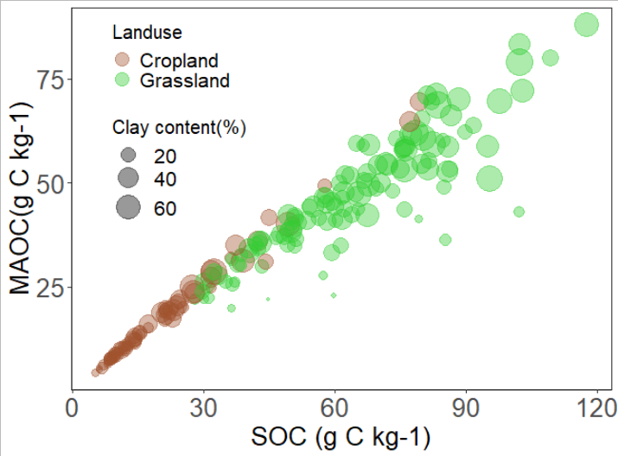
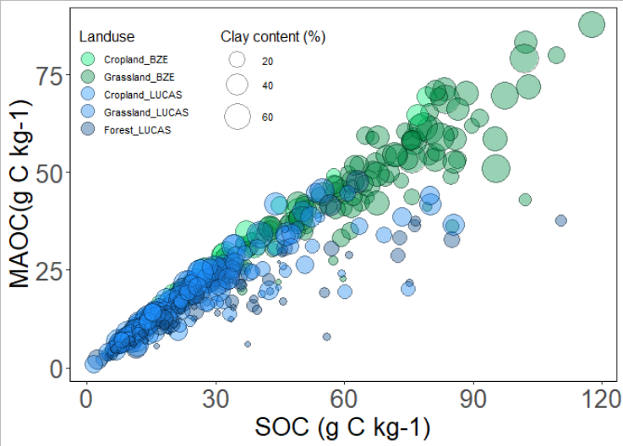
No saturation detectable
Cropland shows a straight line
Grassland scatters more than cropland
Similar behaviour observed in Cotrofu et al (2019) raw data from LUCAS
Forest and low-clay soils have relatively more POC

Slide 7
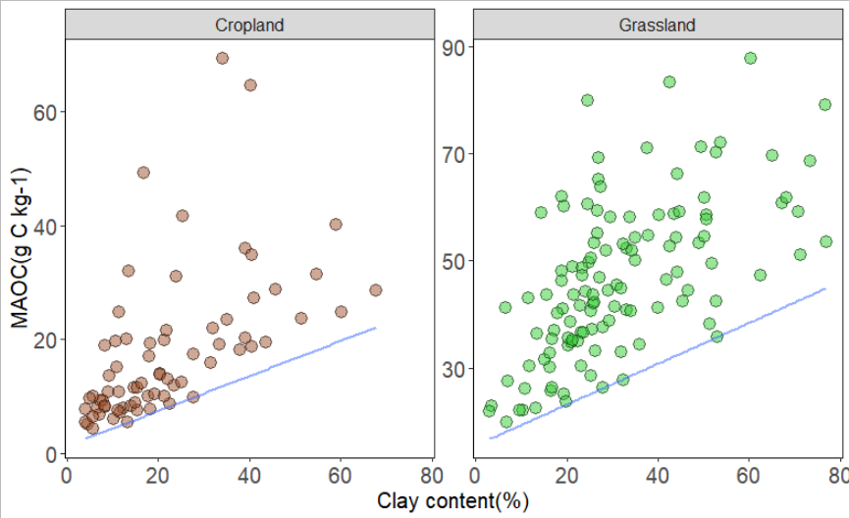
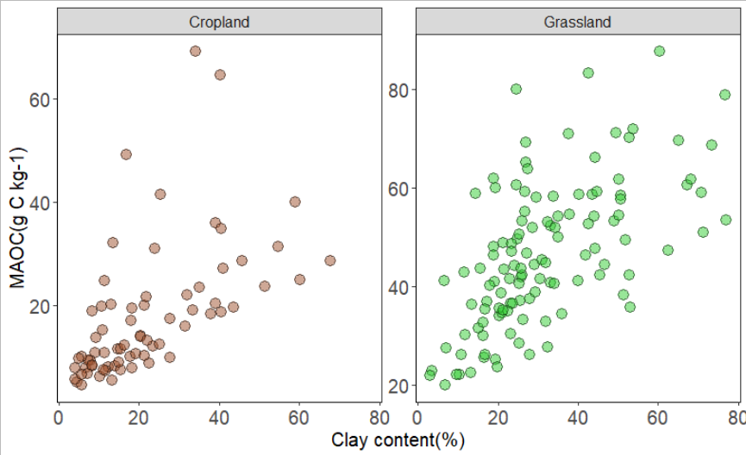
Clay content only partly explained MAOC content
Grassland sequesters more C in MAOC than cropland
Soils with lower clay contents can also store high amounts of MAOC
The lower limit is visible
There is no apparent upper limit

Slide 8
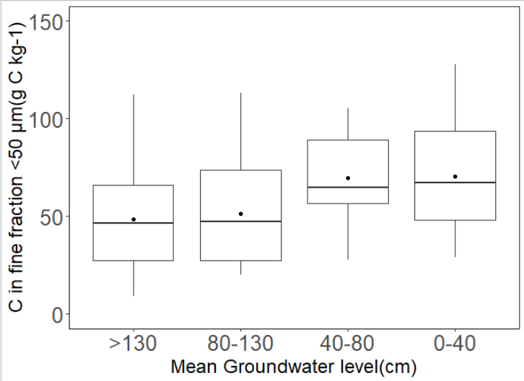
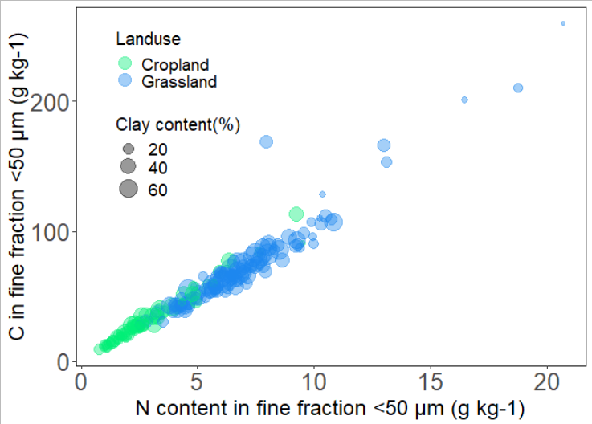
What drives C content in fine fraction?
Notes:
High groundwater level important, Gleysols had particularly high MAOC content.
In this graph,the higher C content is in 0-40cm which is low ground water level then how hi

Slide 9
Conclusion
Our results clearly deny saturation behavior in MAOC fraction using a systematic random approach
Clay content is not the only determinant of MAOC content in soils
Implication: Even soils with high carbon content might have the capacity to sequester more C
Next Step: Further stabilization factors need to be explored
“Beyond clay“, oxalate-extractable Aluminium and Iron, exchangeable calcium followed by pH was the best predictors for SOC content. (Rasmussen et al. (2018))

Slide 10
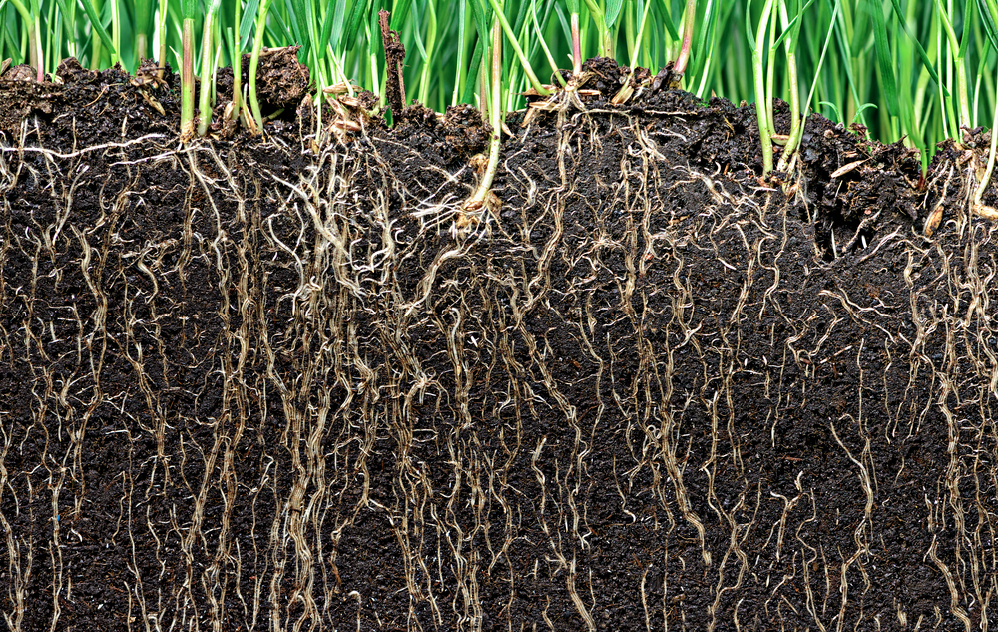
Thank you for your attention!

