Slide 1



AMOC thresholds in CMIP6 models: North Atlantic Hosing MIP Laura Jackson*, Eduardo Alastrue-de-asenjo, Katinka Bellomo, Gokhan Danabasoglu, Aixue Hu, Johann Jungclaus, Virna Meccia, Oleg Saenko, Andrew Shao, Didier Swingedouw *Met Office, UK

Slide 2
NAHosMIP
Aims: Examine AMOC thresholds in CMIP6 models in the presence of freshwater forcing.
Understand whether CMIP6 models exhibit a threshold in the AMOC (similar to that in GC2).
Understand how different feedbacks contribute to different AMOC behaviour in different models, and what the implications of this are for the real world.
Group | Model | Ocean resolution
Met Office | HadGEM3-GC2 (pre CMIP6) | 0.25
 | HadGEM3-GC3-1LL | 1 (1/3 at equator)
 | HadGEM3-GC3-1MM | 0.25
CCCma | CanESM5 | 1 (1/3 at equator)
ISAC-CNR | EC-Earth3 | 1 (1/3 at equator)
NCAR | CESM2 | 0.4 (1/4 at equator)
IPSL | IPSL-CM6A-LR | 1 (1/3 at equator)
MPI-M | MPI-ESM-LR | 1
 | MPI-ESM-HR | 0.4
Experiments
Apply 0.3 Sv of freshwater (hosing) uniformly north of 50N for 20 and 50 years (optionally also longer)
Also experiments with 0.1 Sv around Greenland (not shown).
Experiments and models

Slide 3
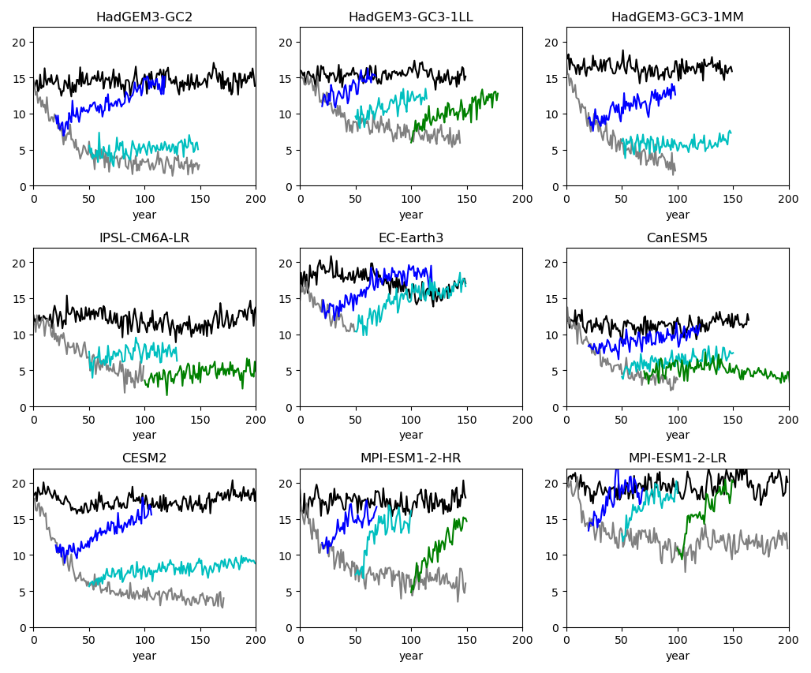
AMOC timeseries at 26.5N
Several models show a threshold where there the AMOC does not recover after hosing stops (within >100 yrs)
Key: control, hosing, stop hosing after 20 yrs, 50 yrs, 70-100 yrs.

Slide 4
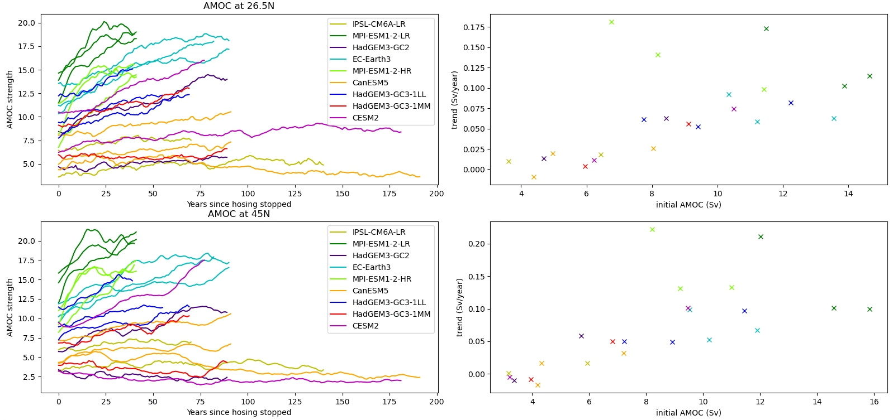
Compare AMOC response after hosing stops
In experiments where AMOC does not recover after hosing, the AMOC has the weakest absolute values initially (when hosing is stopped). There appears to be a threshold of ~7 Sv from below which the AMOC does not recover. However this is not true for AMOC weakening by GHG.
Don’t see a clear relationship with amount of AMOC weakening or percentage changes

Slide 5
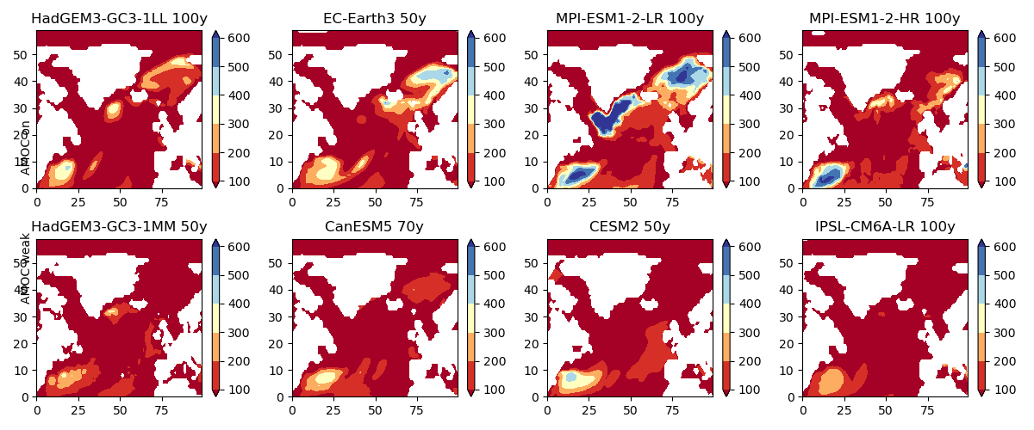
March MLD after hosing
States AMOC recovers from
States AMOC does not recover from
In experiments where AMOC does not recover after hosing (bottom panels), there is no deep March mixed layer in the subpolar N Atlantic when hosing is stopped.

Slide 6
The experiments which do not recover are those which reach a state with no deep March MLD, a very weak AMOC and less warm and salty water in the GIN seas (and possible more sea ice area).
However what is different in the different models?
Hypothesis 1: Resolution dependence X
AMOC stays in weak state in HadGEM3-GC3-1MM (1/4 degree) but also in lower resolution models (CanESM5, IPSL-CM6A-LR both 1 degree)

Slide 7
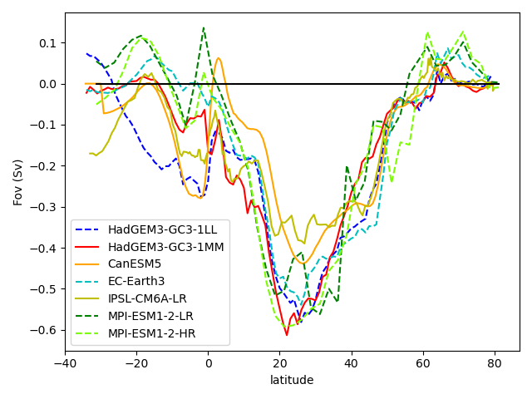
Hypothesis 2: Different values of salt advection feedback in control (Fov) X
Theory: Models with a strong salt transport by the AMOC will experience a freshening if the AMOC weakens, hence a positive feedback
No clear difference in Fov at the south boundary of the Atlantic, or at 30N between the models which have a state where the AMOC stays weak (solid) and those that do not (dashed)

Slide 8
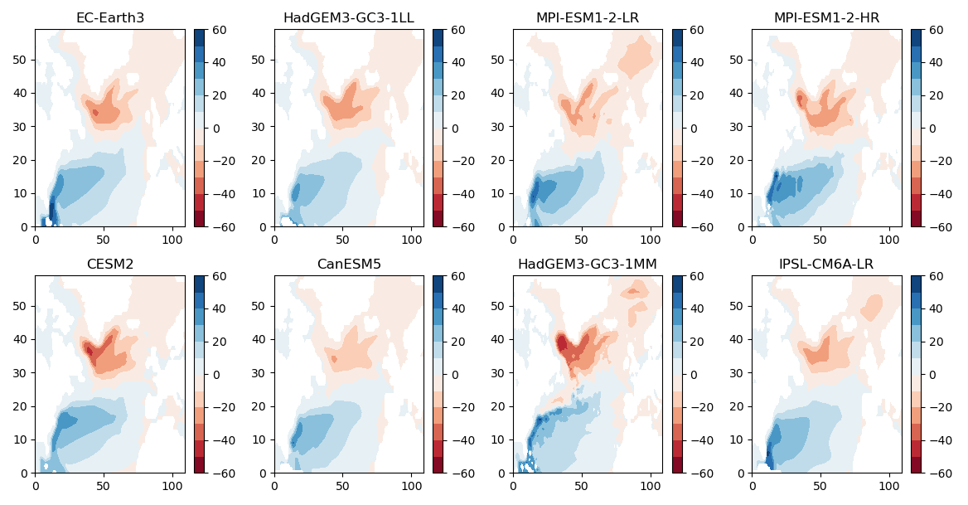
Hypothesis 3: Some models have a more ‘leaky’ subpolar gyre which exports freshwater from hosing more easily. X
No obvious difference between the gyre advection, the strength of the subpolar gyre, or the slope of the inter-gyre boundary between sets of models.
Barotropic stream function. Top panels: models where AMOC recovers. Bottom panels: models with weak state

Slide 9
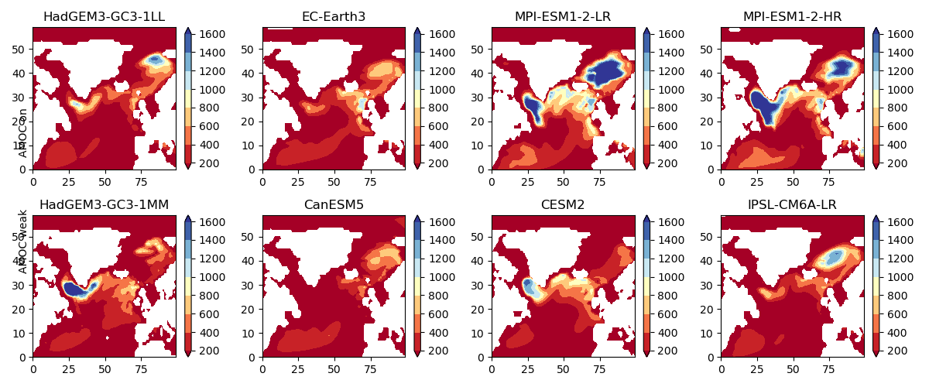
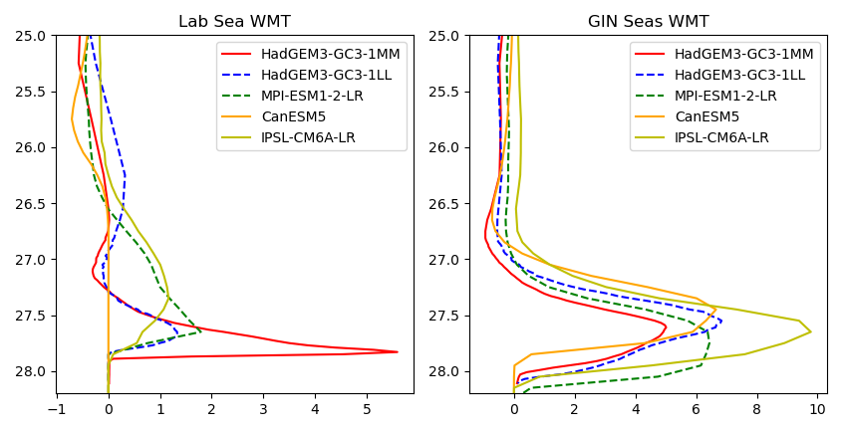
Hypothesis 4: Some models have more water mass formation in the Lab Sea/GIN seas and these regions may be affected differently by hosing. X
No clear difference in control water mass transformation or March MLD between sets of models

Slide 10
Summary
Several CMIP6 models show a threshold where the AMOC does not recover if weakened sufficiently by adding freshwater.
This threshold is related to the state reached after hosing (absolute AMOC value and the mixed layer depth).
Differences between models are not related to resolution, to the advective feedback in the control, to the strength/shape of the subpolar gyre or to preferred regions of water mass transformation.
Analysis is still ongoing.
Follow up studies looking at impacts etc.
https://www.tipes.dk/na-hosing-mip/

