Slide 1

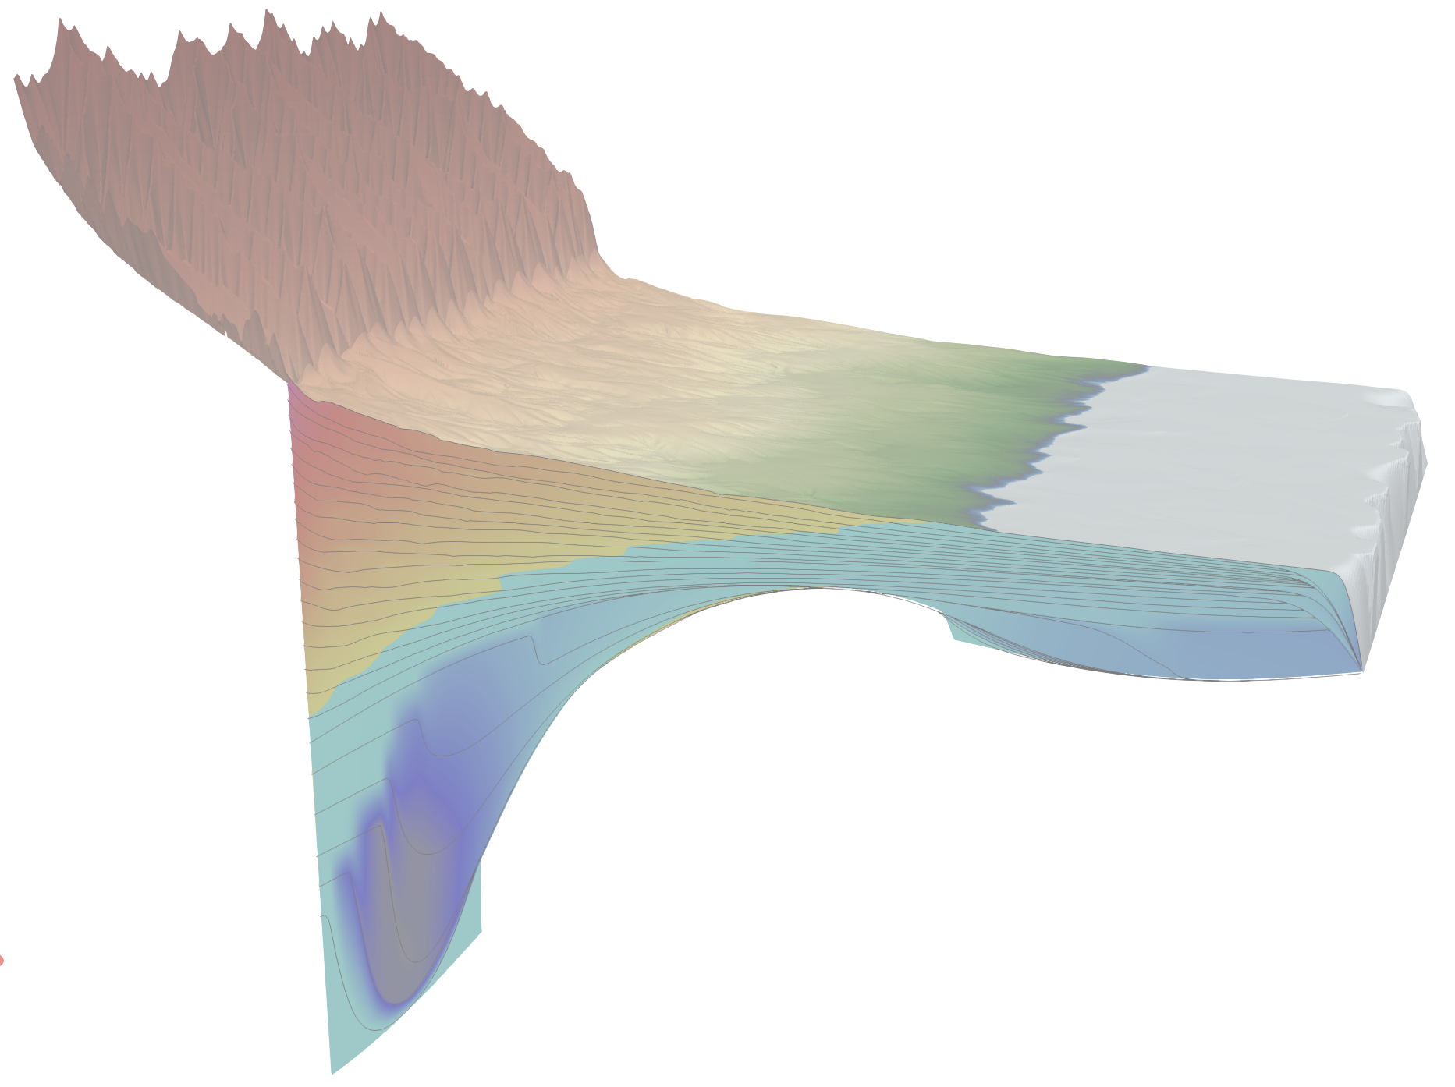


Impact of Inherited Paleo-topography on Syn-orogenic Foreland Basins
Numerical approach (FastScape)
Benjamin Gérard, Delphine Rouby, Ritske Huismans & Cécile Robin
27th of May, 2022
benjamin.gerard@get.omp.eu
Session GM10.1
EGU22-2781

Slide 2
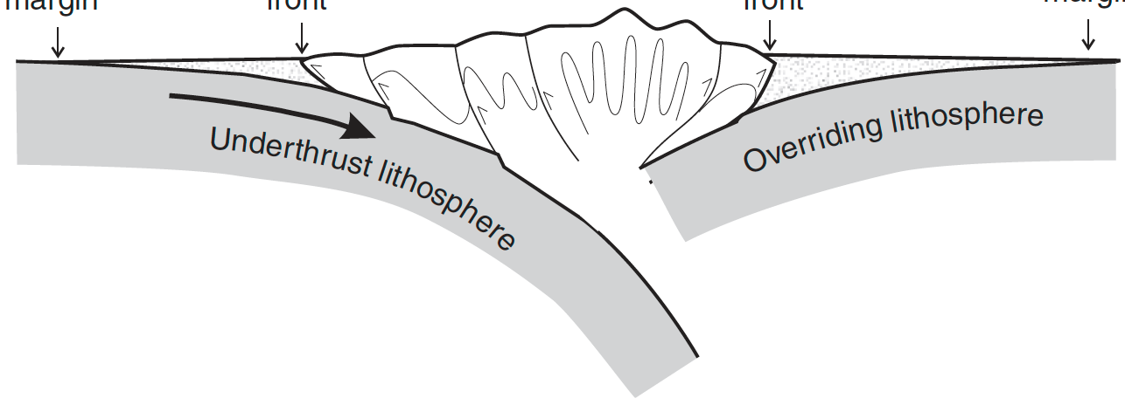
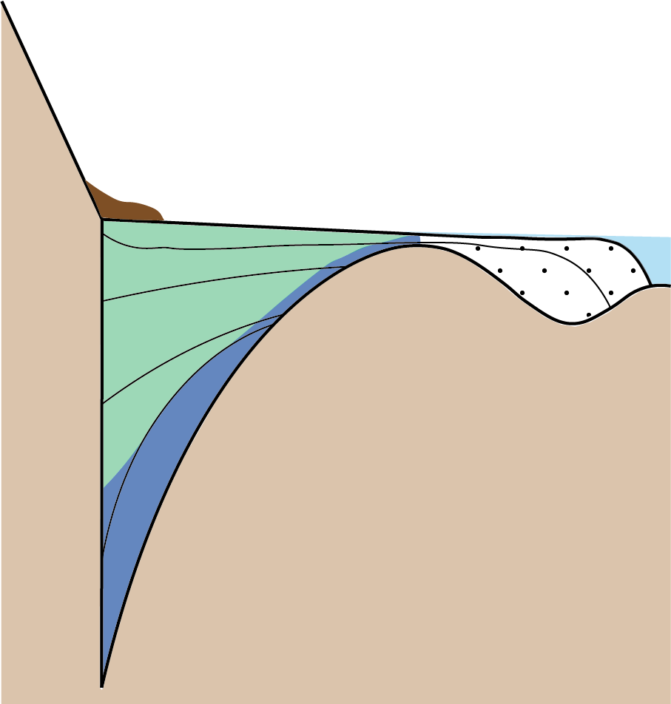

Aims / Model setup
Mountain range
Uniform uplift
Pro-foreland
Retro-foreland
Alluvial fan
Continental deposits
Naylor & Sinclair (2008)
Sediment routing system
What is the influence of initial foreland topography on foreland basin evolution?
2.5 km
Marine deposits
Braun & Willett (2013)
Sedimentary dynamic: Sediment production, Transit, Storage, Export
Quantification & prediction: Stratigraphic architecture, Volume, Timing
Flexure
700 km

Slide 3
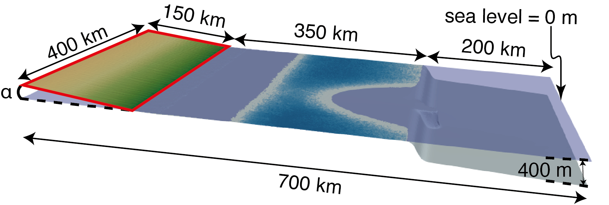
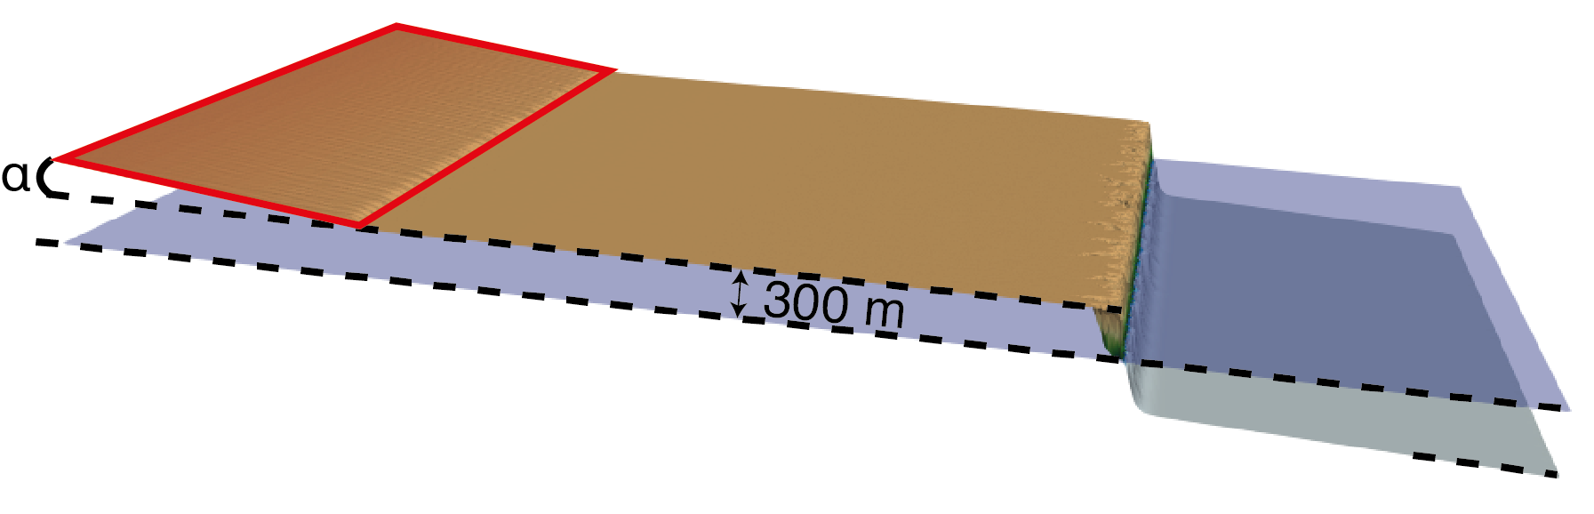
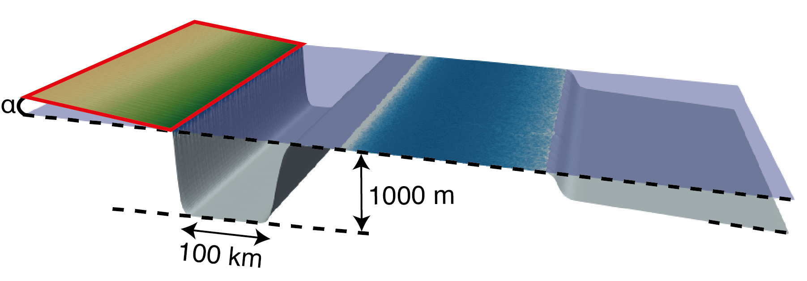
Model setup – Inherited geometries tested
Uniform uplift
Production; Export; Storage
→Sediment routing system
Case 1: Initial foreland at sea level
Flexure
Case 2: Initial elevated foreland
Case 3: Inherited bathymetry

Slide 4
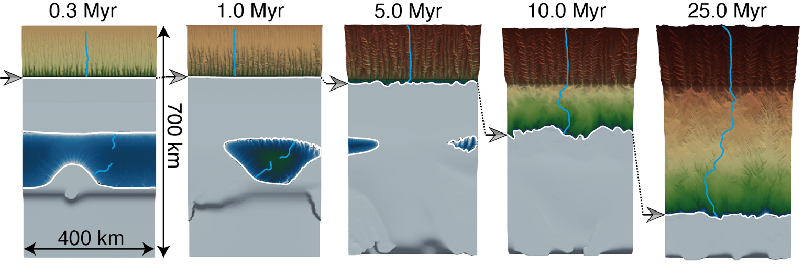
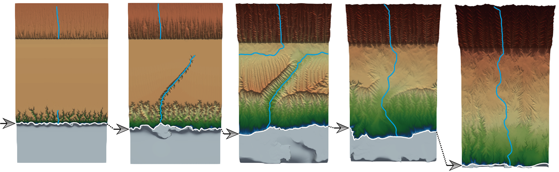
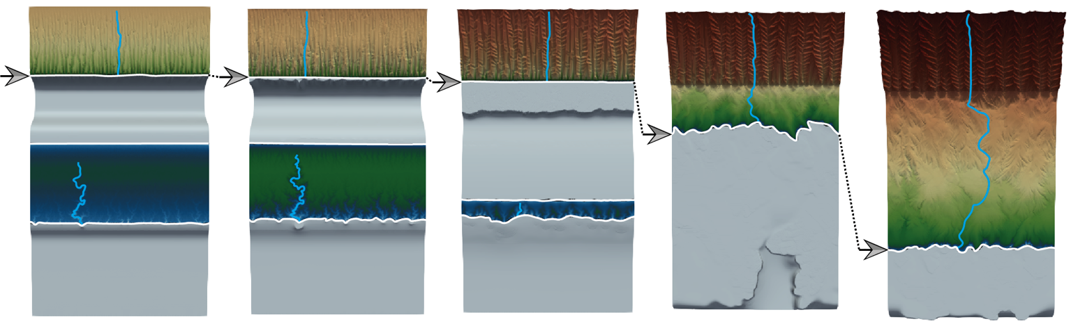
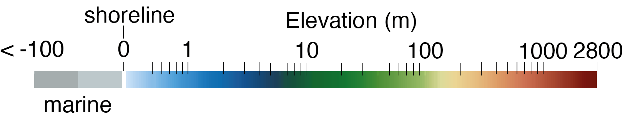
Comparing cases / Surface evolution
Case 1: Initial foreland at sea level
Storage
Export
Continentalization
Case 2: Initial elevated foreland
Storage
Export
Hydrographic network → Efficient sediment export
Case 3: Inherited bathymetry
Storage
Storage
Full storage (foreland) → Sediment export delayed
Storage
Export
Gérard et al., in prep
Continentalization

Slide 5
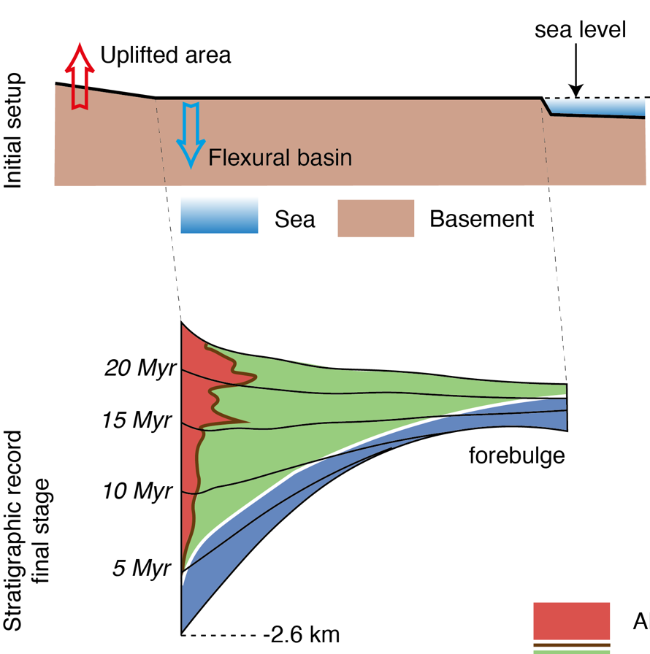
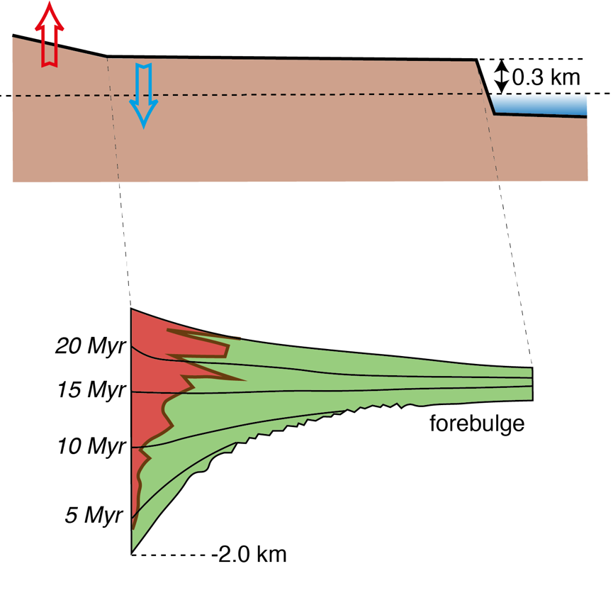
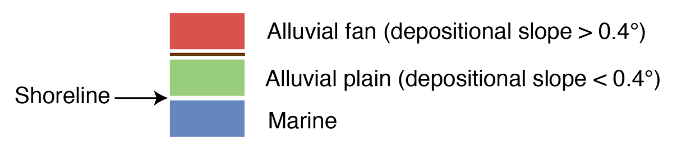
Impact of inherited elevated foreland
Case 1
Case 2
Metastable topography
Hydrographic network
Erosion
Sediments export → mass deficit
Less flexure
Less accommodation
Continental sediments only
Implication for natural cases?
No marine deposits does not reflect majority of cases…
Gérard et al., in prep

Slide 6
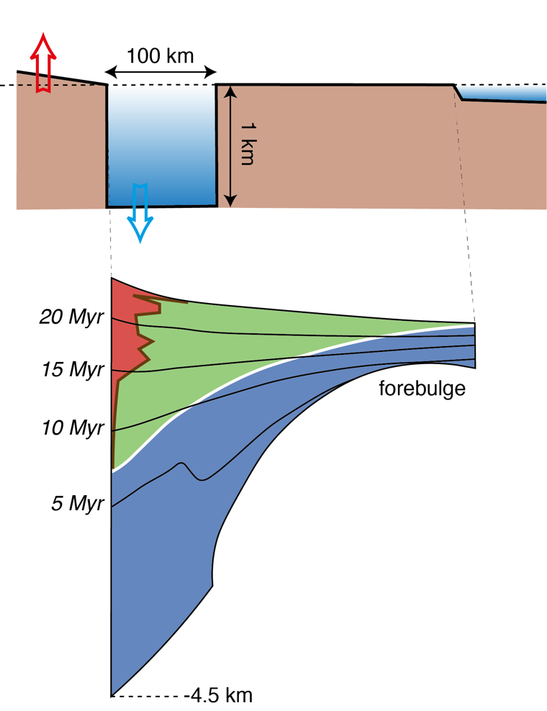
Impact of inherited bathymetry
Case 1
Case 3
Initial bathymetry
Initial space filling
Sediment export delayed → excess of mass
More flexure
More accommodation
Deep marine deposits well preserved
Implication for natural cases?
Deep marine sediments preserved (Flysch-like)
More consistent with natural cases
Inherited bathymetry required to preserve
marine deposits in the foreland basin
Gérard et al., in prep
6

Slide 7



Thank you !
To further discuss it:
In-person here
or
benjamin.gerard@get.omp.eu
ResearchGate profile
EGU abstract

Slide 8
Supplementary
benjamin.gerard@get.omp.eu

Slide 9
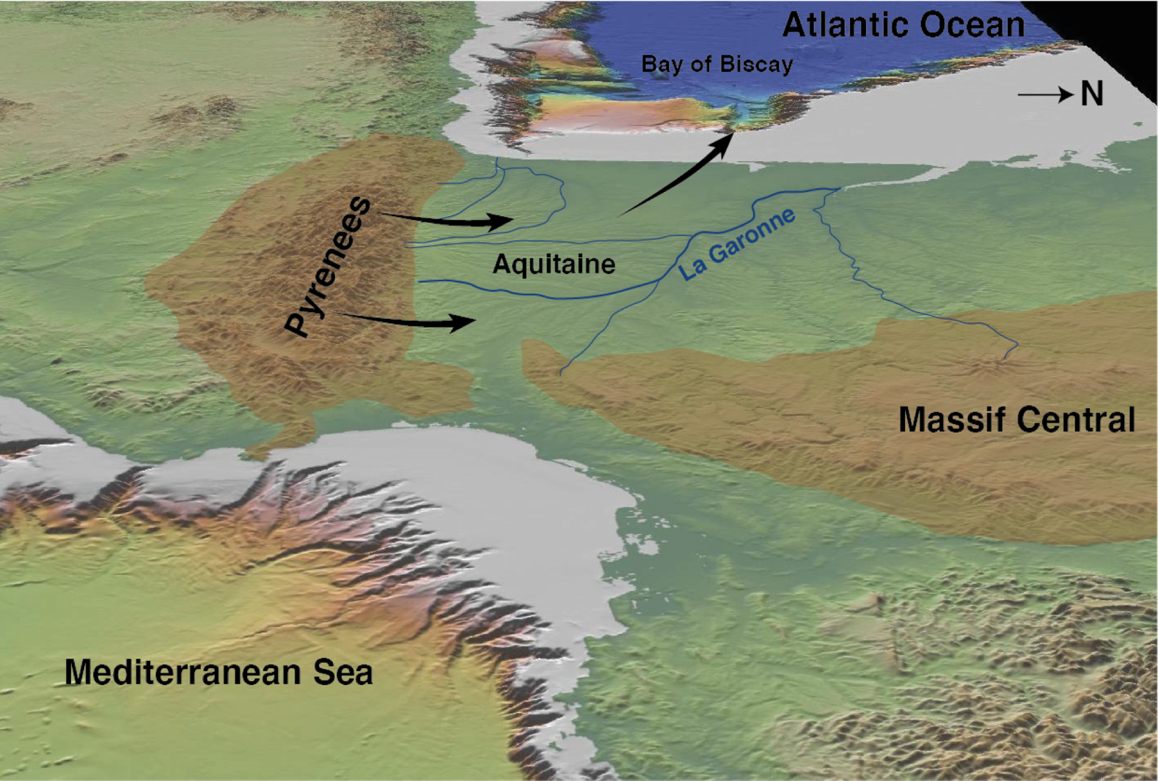
Modelling setup
Block uplift
Orogen + Foreland basin (coupled)
Sedimentary dynamic: Sediment production, Transit, Storage, Export
Quantification & prediction: Strati. architecture, Volume, Timing, Grain size
Alluvial fan
Continental deposits
Sediment routing system
2.5 km
Marine deposits
Flexure
Inspired by the Pyrenean system
700 km

Slide 10
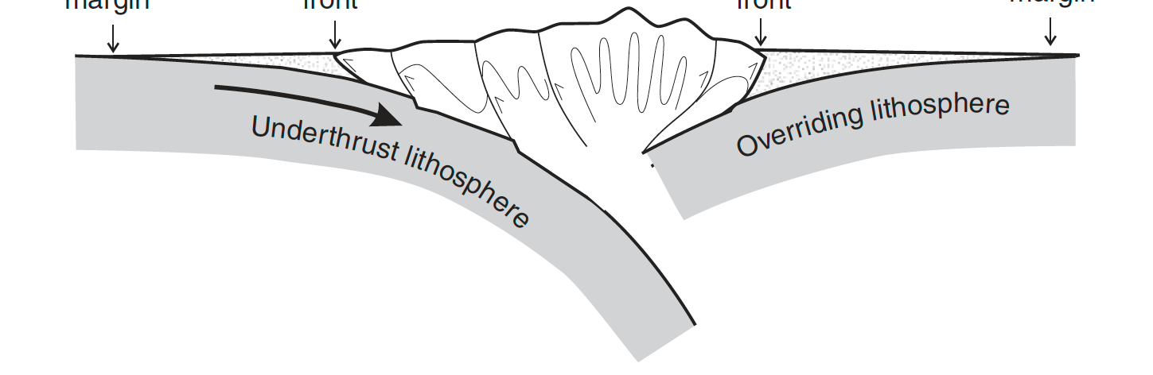
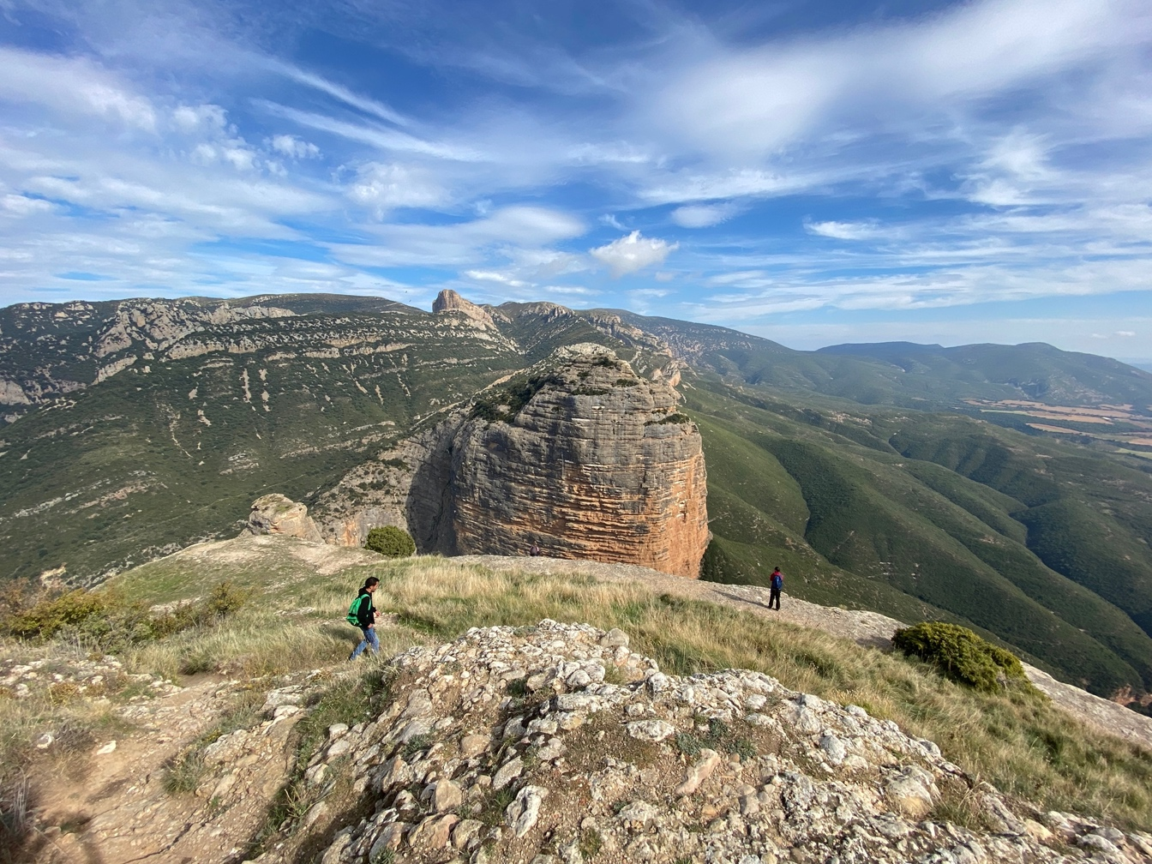
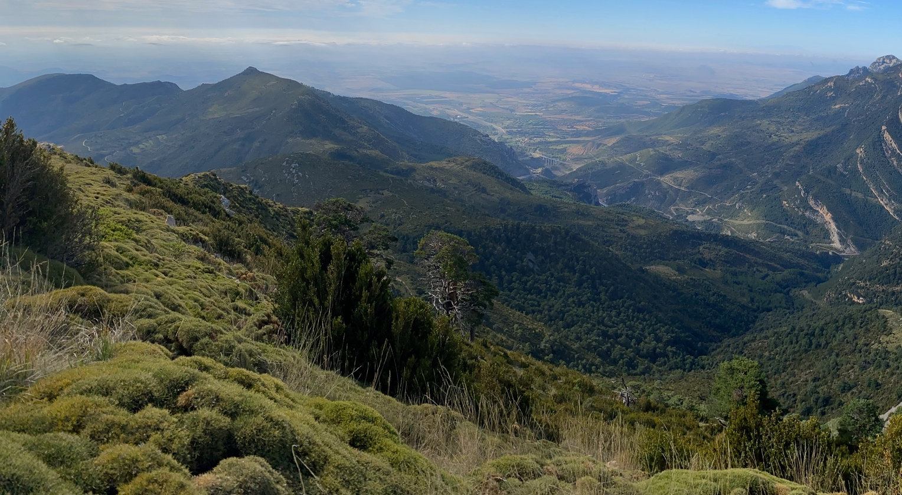
Foreland basins – Southern Pyrenean case
Southern Pyrenees pro-wedge
Pro-foreland
Mountain range
Accumulation of detrital material
e.g. Sandstones
Conglomerates
Marine and/or Continental

Slide 11
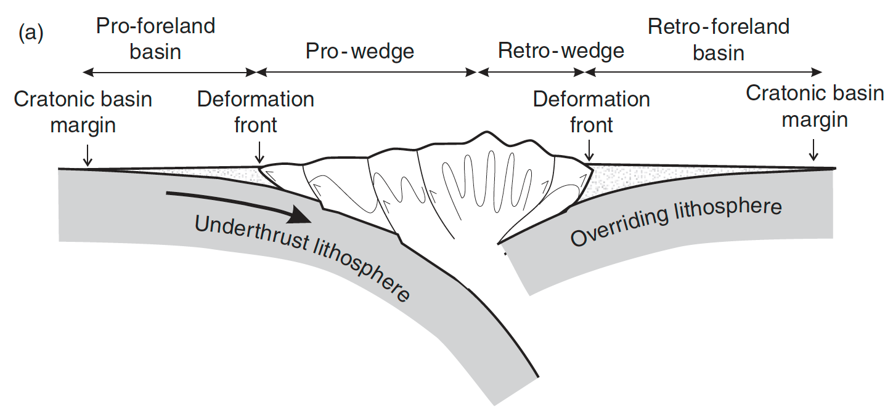
Foreland basins – Definition
Pro-foreland
Mountain range
Retro-foreland
Forebulge
Forebulge
Naylor & Sinclair, 2008
Uplift
Foreland basins:
archives of orogenic systems evolution
→ economic interests: e.g. hydrocarbons
Flexural subsidence

Slide 12
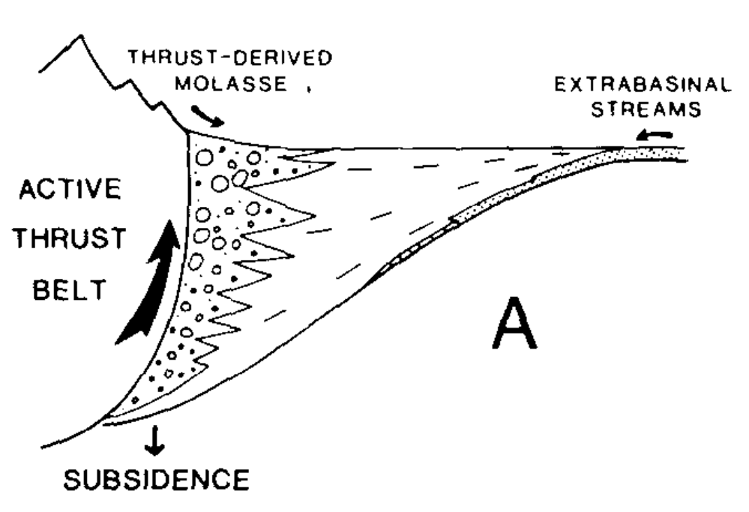
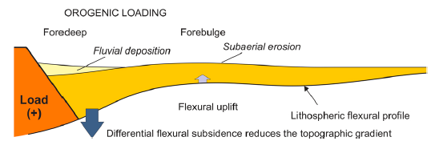
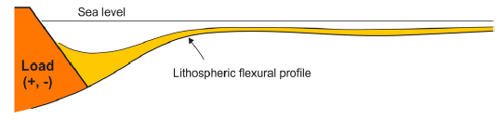
Foreland basins – Classical infilling sequence
Heller et al. (1988)
Prograding megasequence → grain coarsening
Filled – overfilled A=S or A<S
Continental → Alluvial fans
Underfilled A>S
Shallow → coastal / fluvial plains
Catuneanu (2019)
Deep marine → Flysch

Slide 13
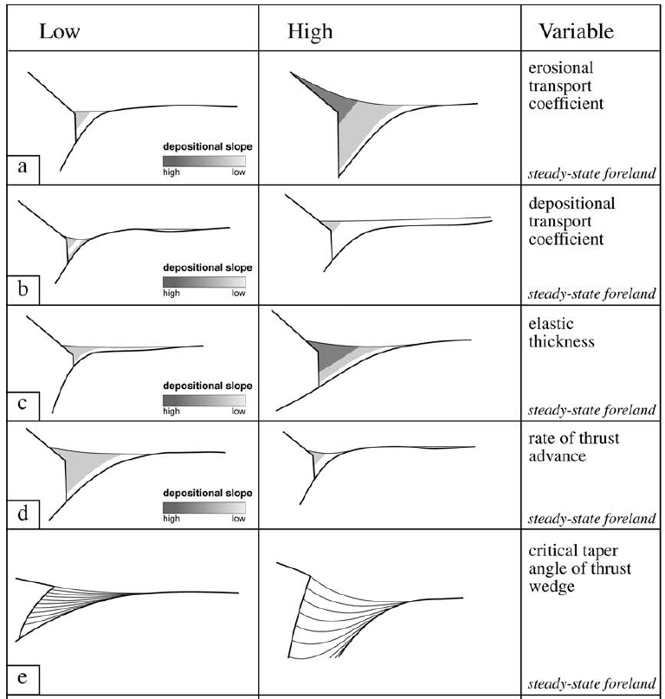
Previous studies – Numerical approach
Paola (2000)
Erosional
transport
coeff.
Depositional
transport
coeff.
Complex Source-to-Sink systems
Geometries / Architectures / Volumes
Elastic
thickness
Rate of thrust
advance
Many parameters tested but:
how initial foreland geometries can influence the basin evolution ?
Angle of thrust
wedge

Slide 14
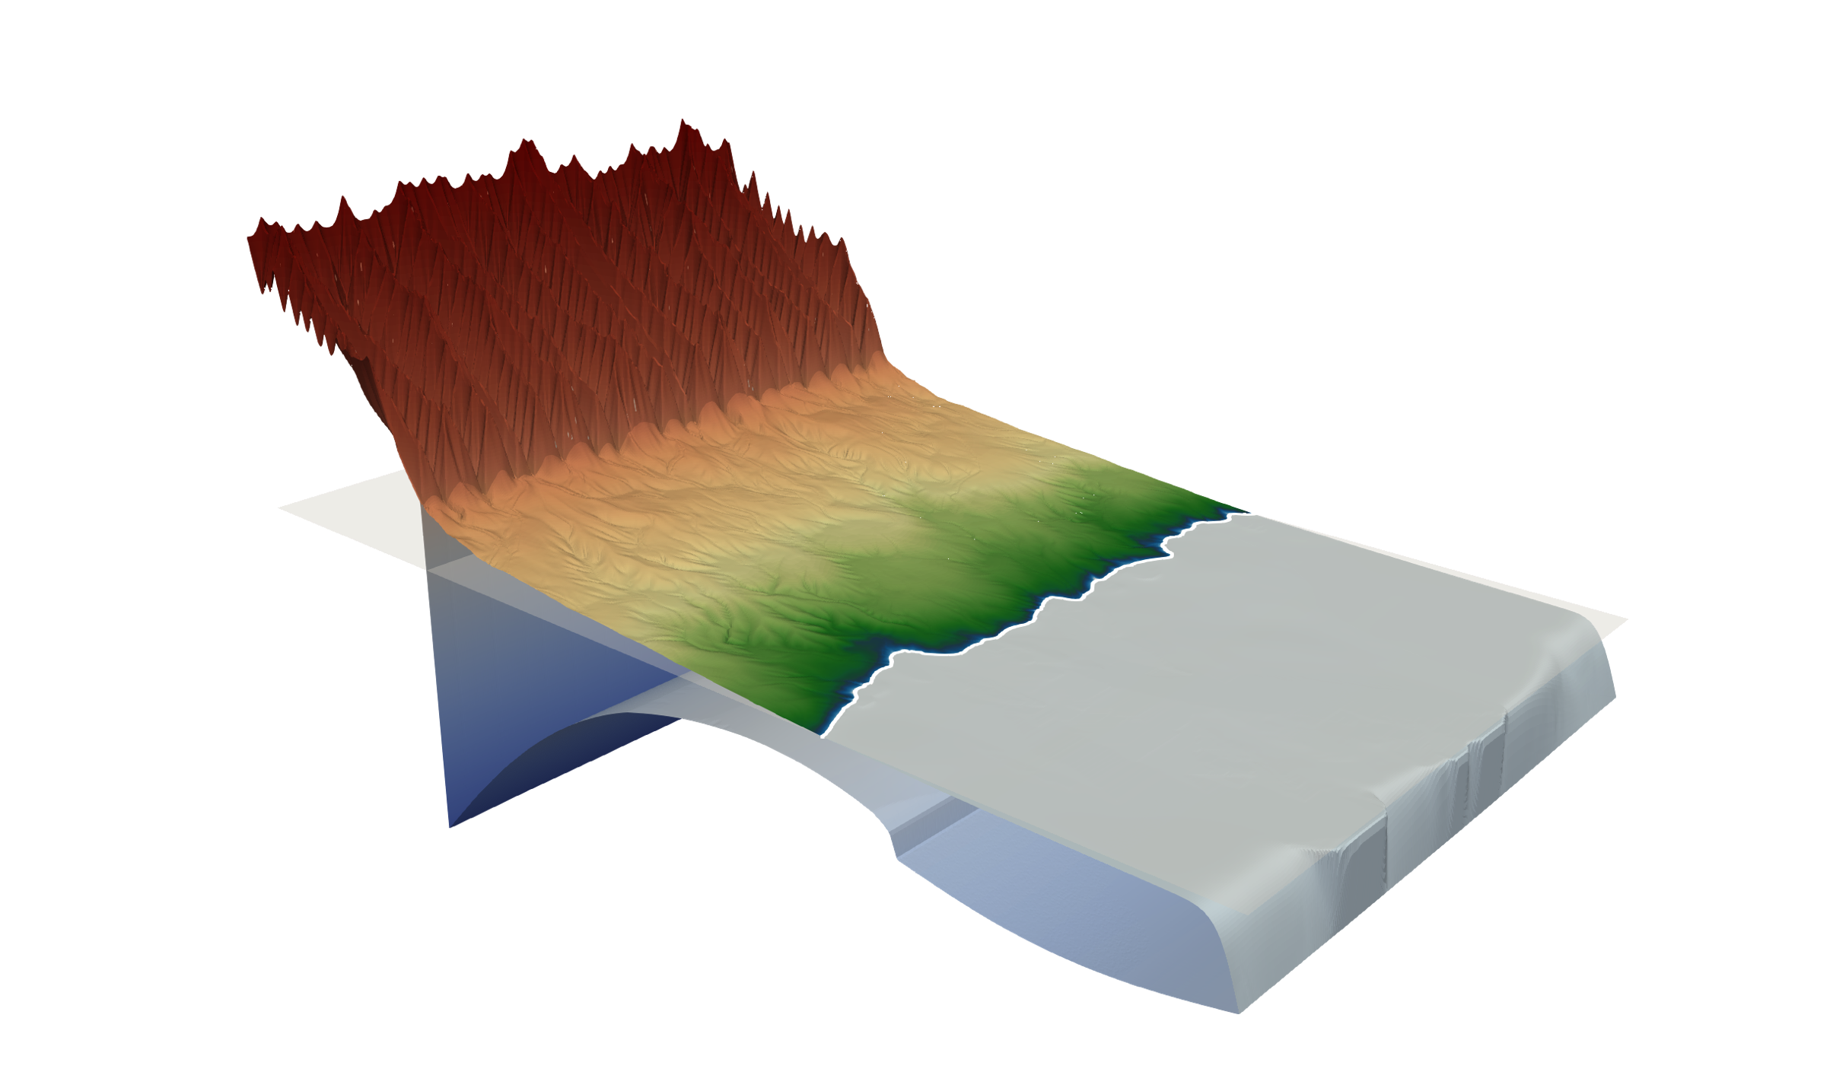
Method – FastScape (Landscape Evolution Model)
Braun & Willett (2013)
SPL
Yuan et al. (2019a & b)
Uplift
Flexure = topo. + sed. load

Slide 15
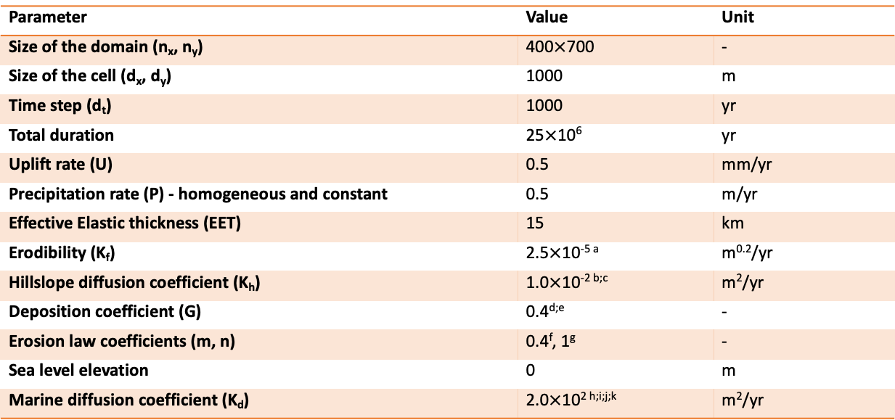
Parameters
Parameter | Value | Unit
Size of the domain (n_{x}, n_{y}) | 400$×$700 | -
Size of the cell (d_{x}, d_{y}) | 1000 | m
Time step (d_{t}) | 1000 | yr
Total duration | 25$×$10⁶ | yr
Uplift rate (U) | 0.5 | mm/yr
Precipitation rate (P) - homogeneous and constant | 0.5 | m/yr
Effective Elastic thickness (EET) | 15 | km
Erodibility (K_{f}) | 2.5$×$10^{-5 a} | m^{0.2}/yr
Hillslope diffusion coefficient (K_{h}) | 1.0$×$10^{-2 b;c} | m²/yr
Deposition coefficient (G) | 0.4^{d;e} | -
Erosion law coefficients (m, n) | 0.4^{f}, 1^{g} | -
Sea level elevation | 0 | m
Marine diffusion coefficient (K_{d}) | 2.0$×$10^{2 h;i;j;k} | m²/yr
Table 1. Common Parameters for the Different Experiments
Note. The erodibility value (K_{f}) was chosen to reach a mean mountain range elevation of ~1.7 km after 25 Myr.
Parameters from ªWhipple & Tucker (1999);
^{b}Densmore et al. (2007);
^{c}Armitage et al. (2013);
^{d}Davy & Lague (2009) ;
^{e}Guerit et al. (2019) ;
^{f}Stock & Montgomery (1999);
^{g}Braun & Willett (2013);
^{h}Jordan & Flemings (1991);
^{i}Rouby et al. (2013);
^{j}Yuan, Braun, Guerit, Simon, et al. (2019);
^{k}Simon et al. (2022).

Slide 16
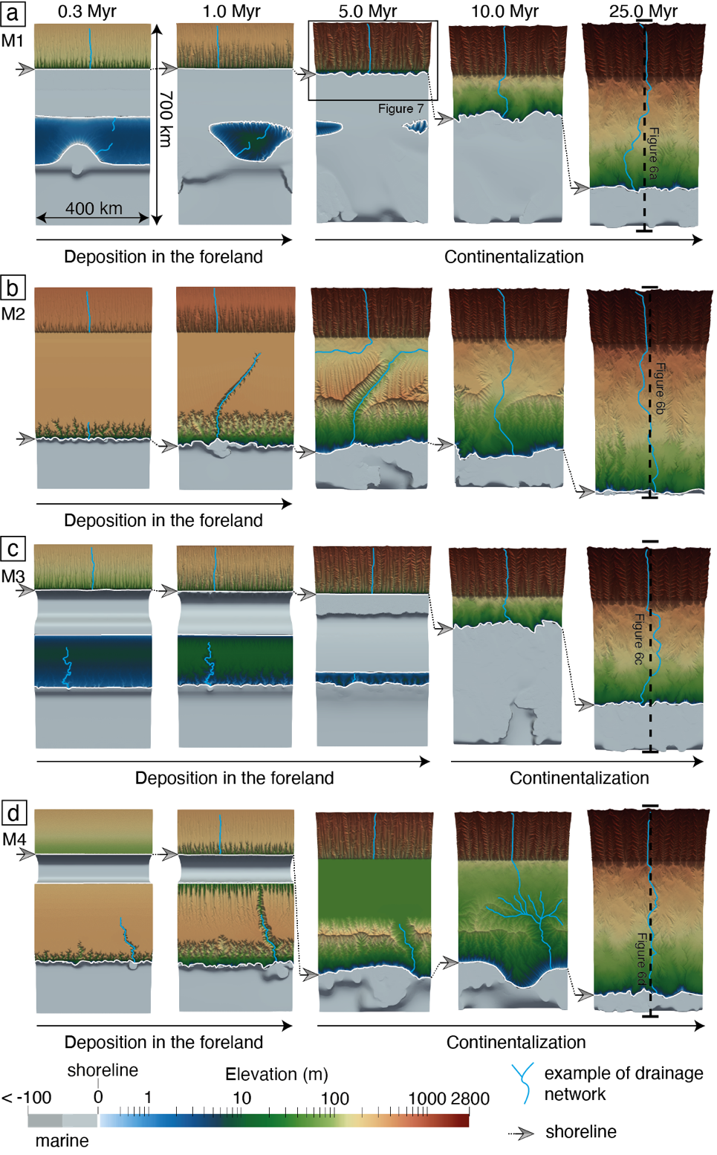
Experiments M1 to M4 – view from the top

Slide 17
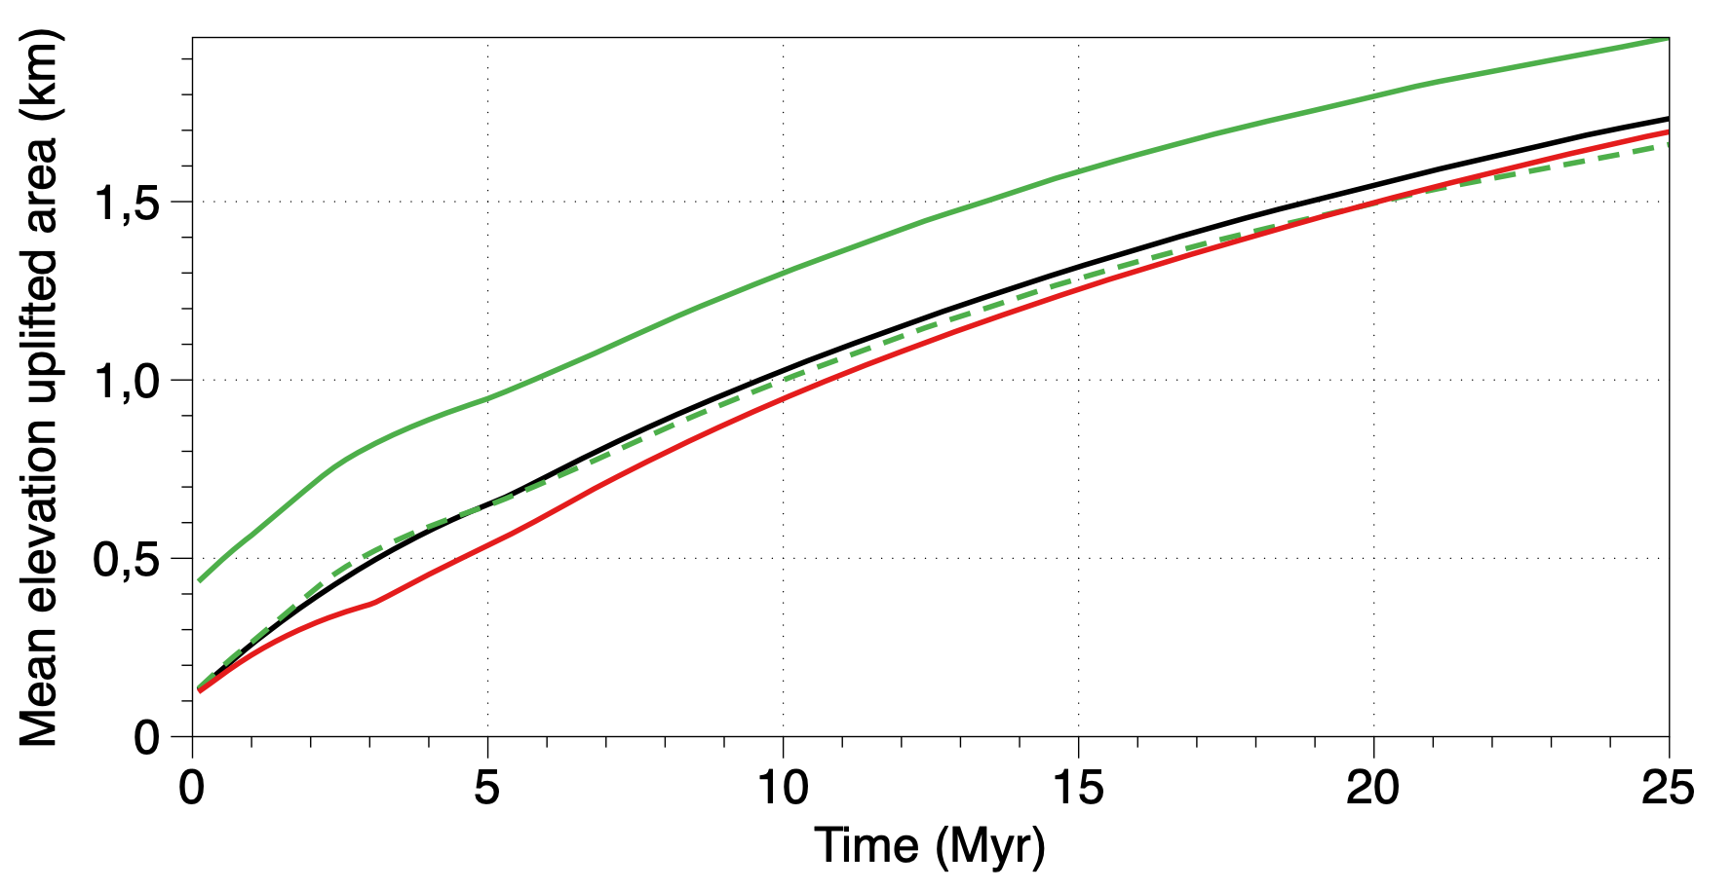
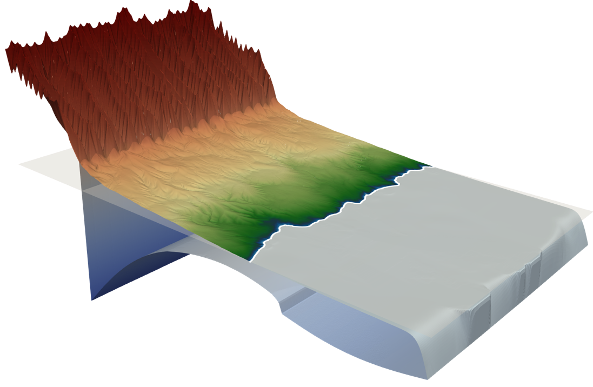
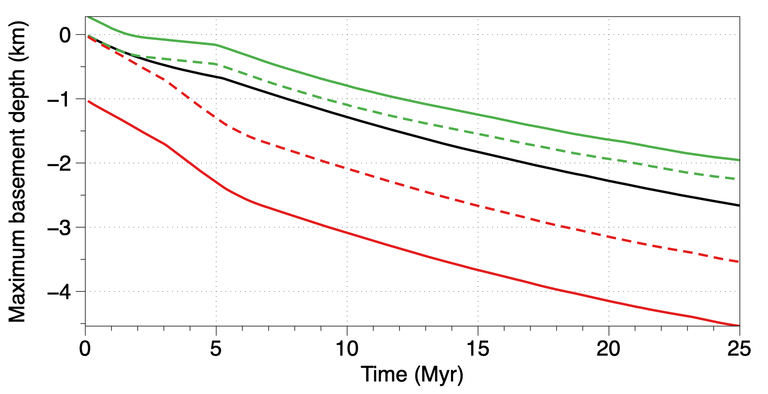

First-order interpretations
No influence of geometries on uplift dynamic
Case 1: sea level
Case 2: elevated
Case 3: bathymetry
$≠$ in basement deepening
Not explained by topo. load
Linked to the sed. load only

Slide 18
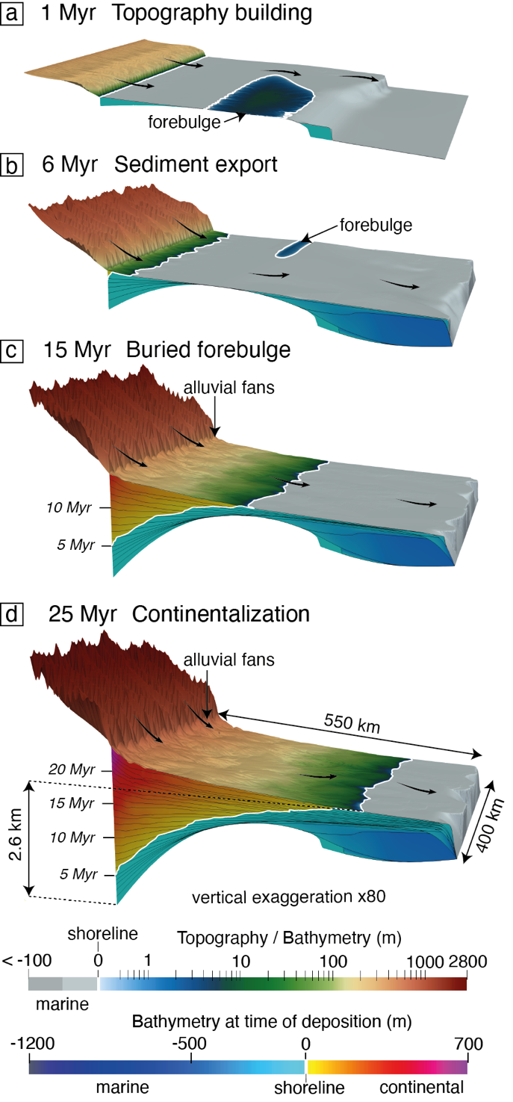
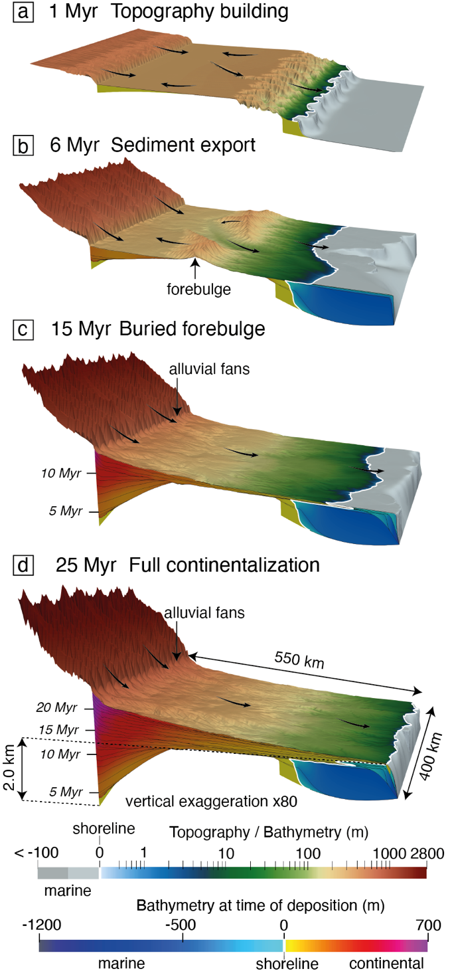
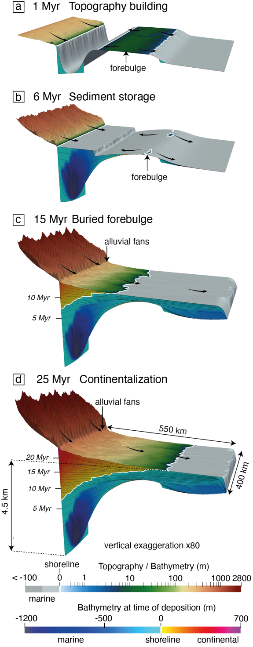
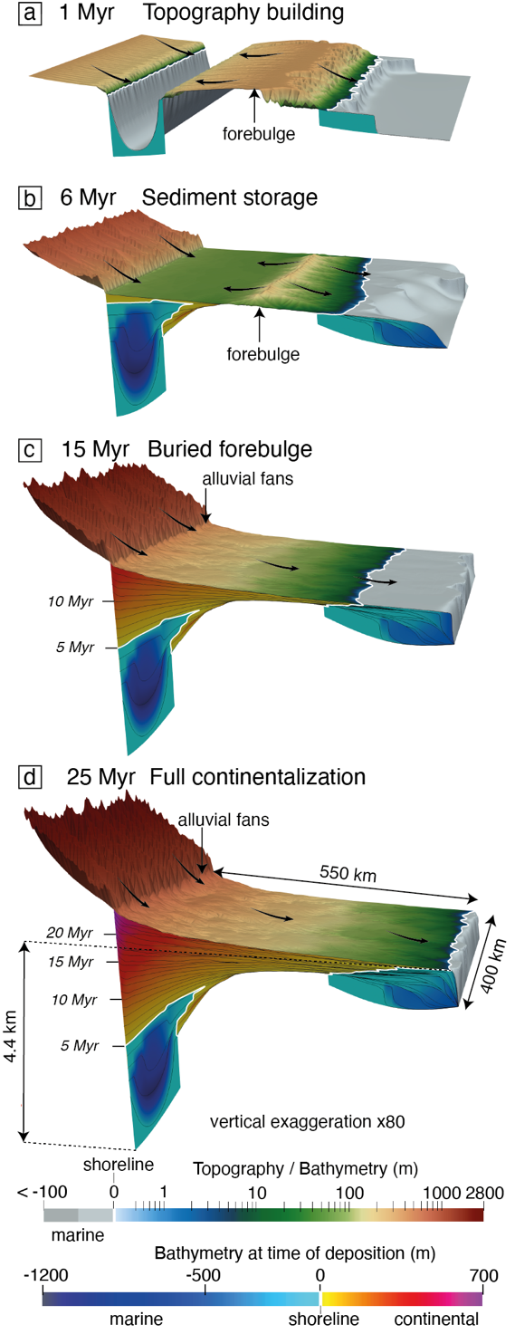
Experiments M1 to M4 – 3D views
M1
M2
M3
M4

Slide 19
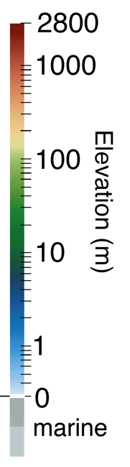
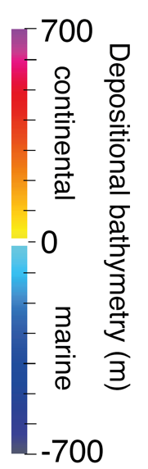
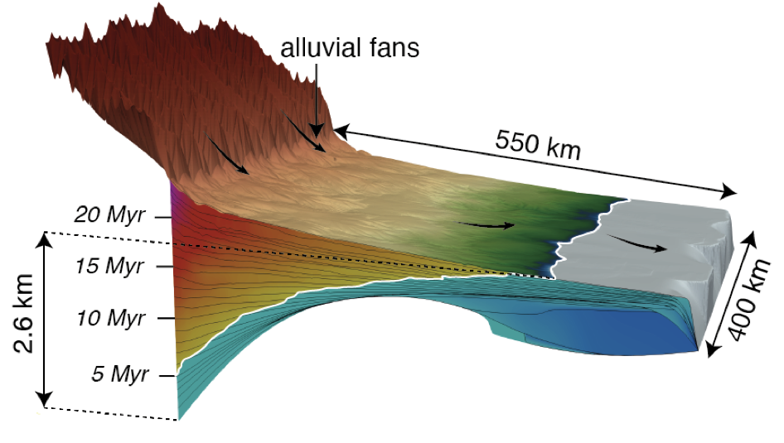
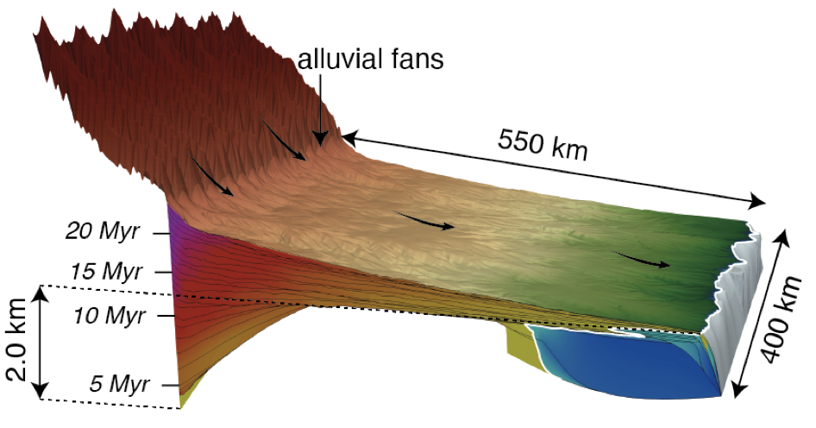
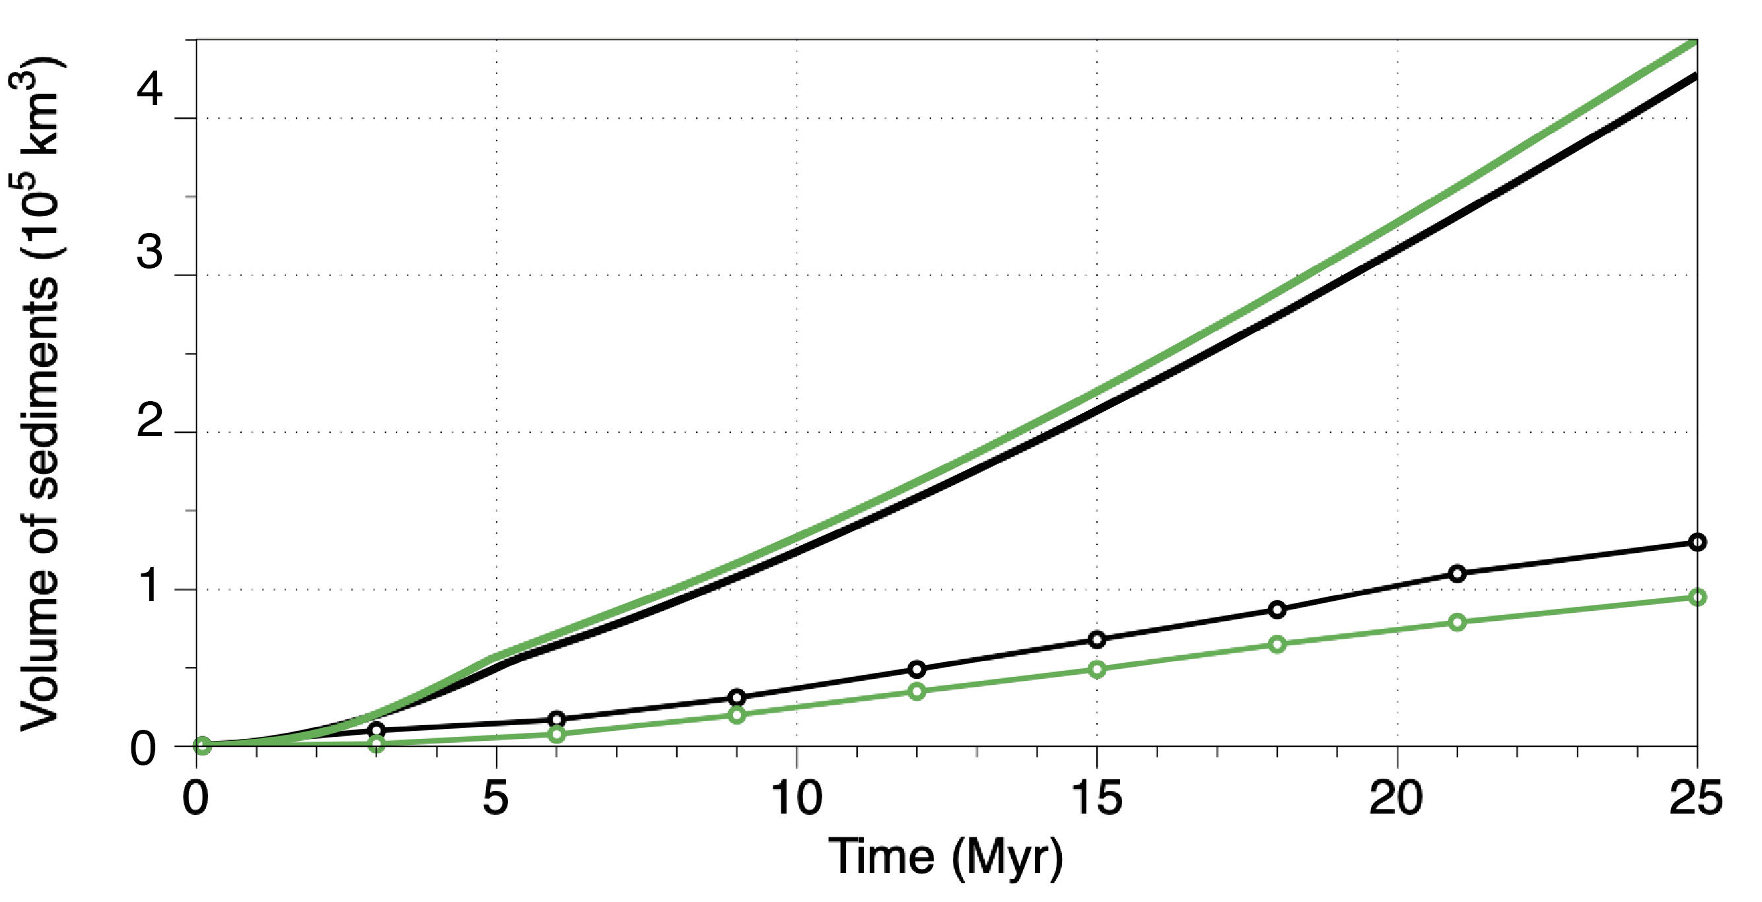
Impact of inherited elevated foreland
Case 1
Case 2
vs.
No marine deposits
Volume stored Case 1 > Case 2
Case 1
Case 2
Initial elevated foreland → thinner basin
Sed. production
Fast & efficient sed. Export
- sed. Load
- flexure
- accommodation
Stored in the foreland

Slide 20
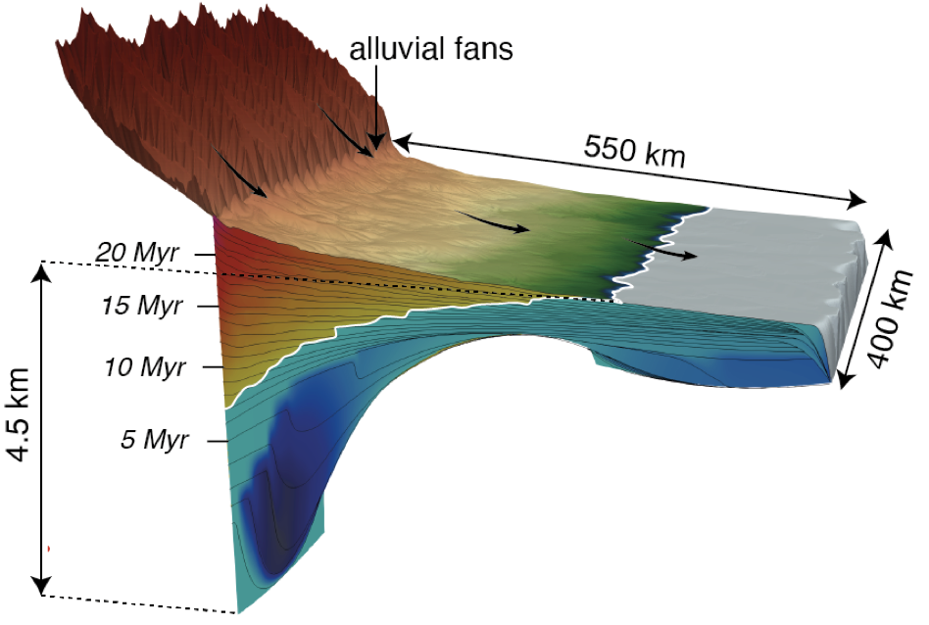
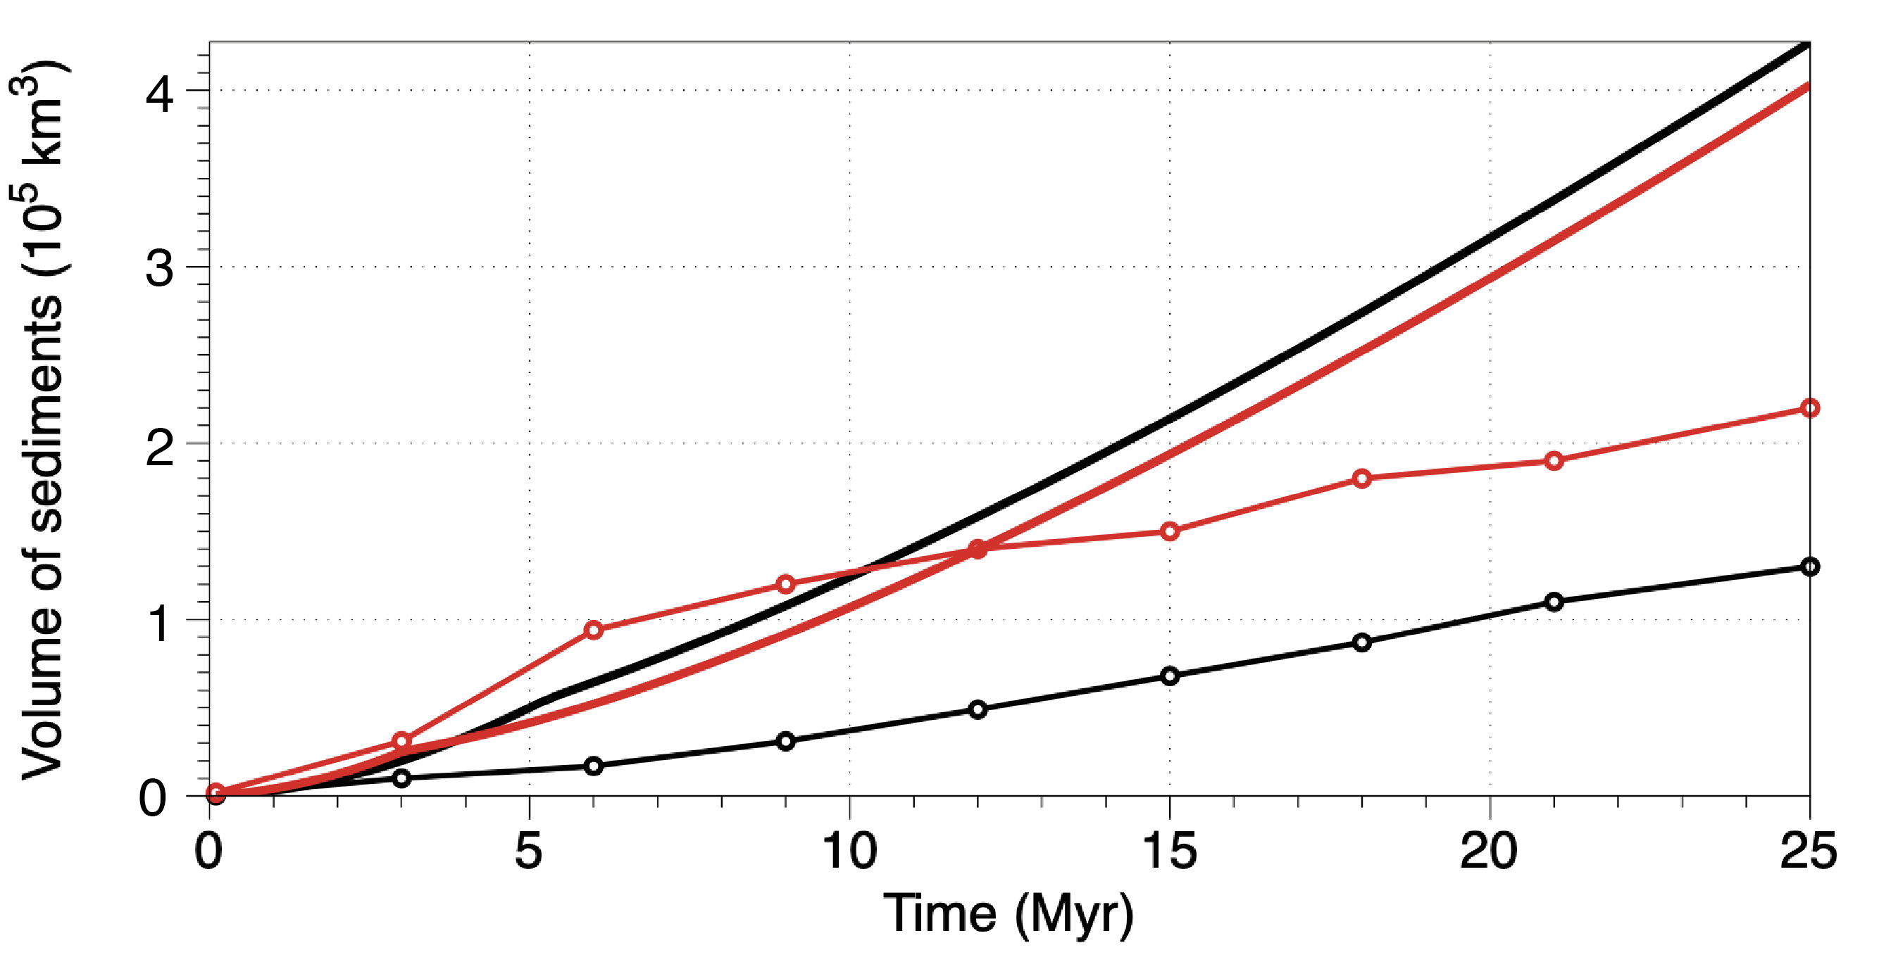
Impact of inherited bathymetry
Case 1
Case 3
vs.
Case 1
Marine facies last longer
Volume stored Case 3 > Case 1
Case 3
Sed. production
Initial bathymetry → thicker basin
Filling of the initial space
+ sed. Load
+ flexure
+ accommodation
Stored in the foreland

Slide 21
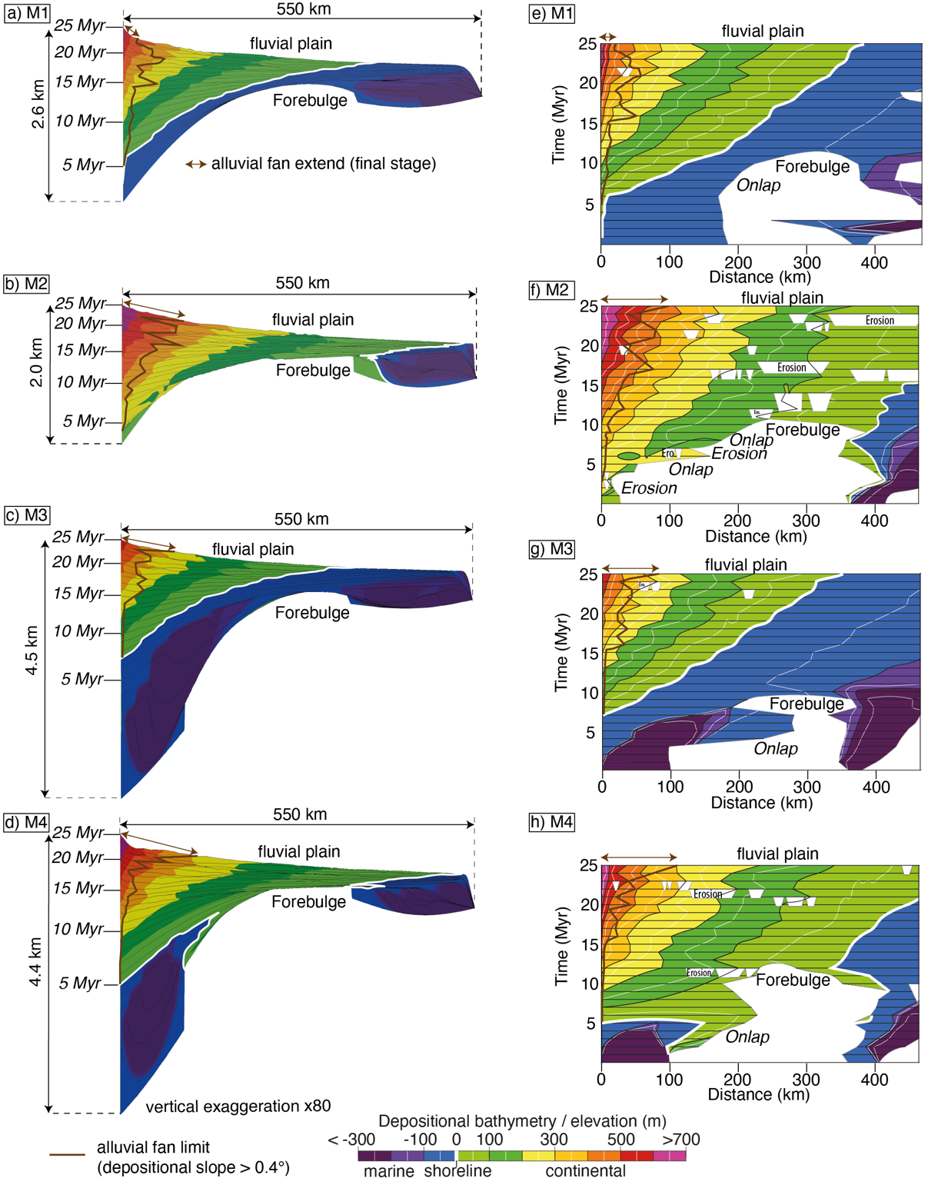
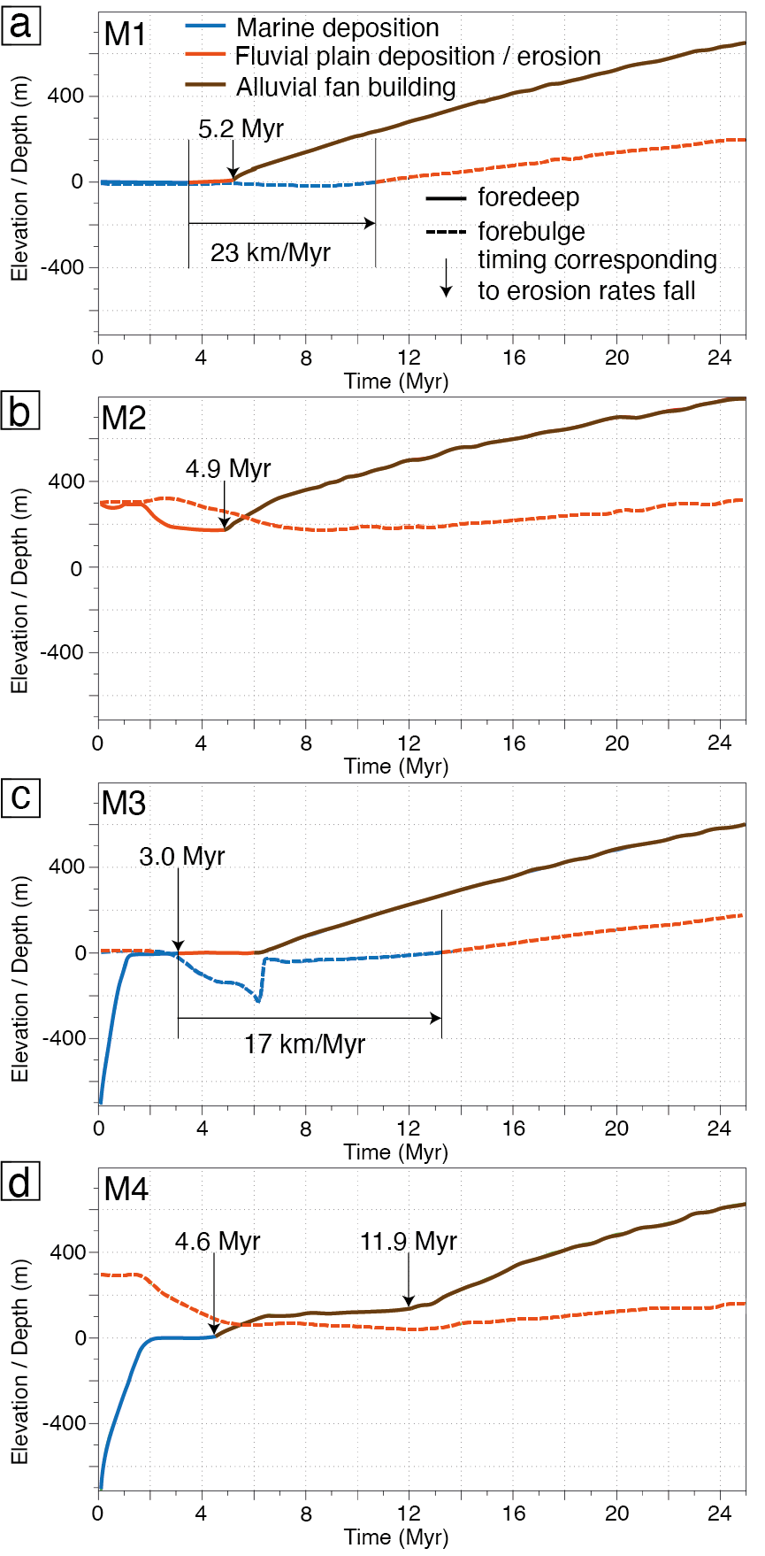
Experiments M1 to M4 – Wheelers

Slide 22
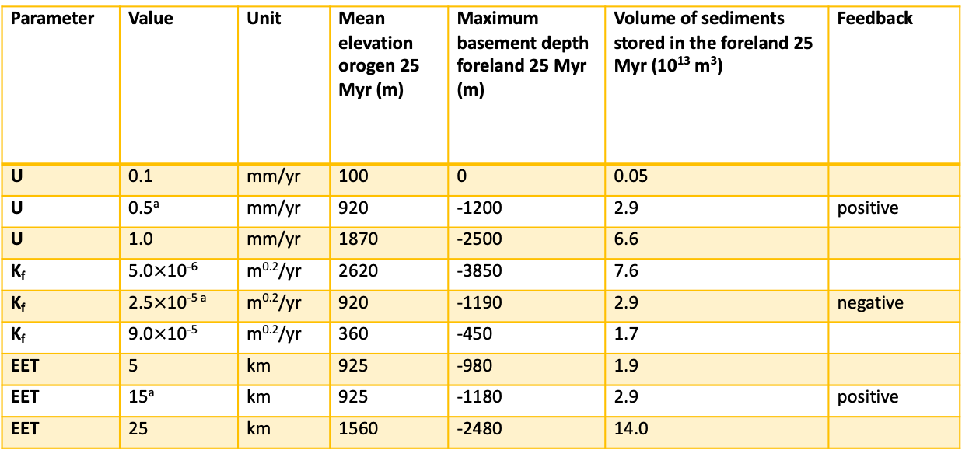
Parameters – Sensitivity analysis
Parameter | Value | Unit | Mean elevation orogen 25 Myr (m) | Maximum basement depth foreland 25 Myr (m) | Volume of sediments stored in the foreland 25 Myr (10¹³ m³) | Feedback
U | 0.1 | mm/yr | 100 | 0 | 0.05
U | 0.5ª | mm/yr | 920 | -1200 | 2.9 | positive
U | 1.0 | mm/yr | 1870 | -2500 | 6.6
K_{f} | 5.0$×$10⁻⁶ | m^{0.2}/yr | 2620 | -3850 | 7.6
K_{f} | 2.5$×$10^{-5 a} | m^{0.2}/yr | 920 | -1190 | 2.9 | negative
K_{f} | 9.0$×$10⁻⁵ | m^{0.2}/yr | 360 | -450 | 1.7
EET | 5 | km | 925 | -980 | 1.9
EET | 15ª | km | 925 | -1180 | 2.9 | positive
EET | 25 | km | 1560 | -2480 | 14.0
Table 2. Sensitivity Results for Reference Experiment (M1)
Note. U is the uplift rate, K_{f} is the erodibility and EET is the effective elastic thickness. See figures S6 to S8 for details regarding the sensitivity analysis. ªValues used in reference experiment M1.

Slide 23
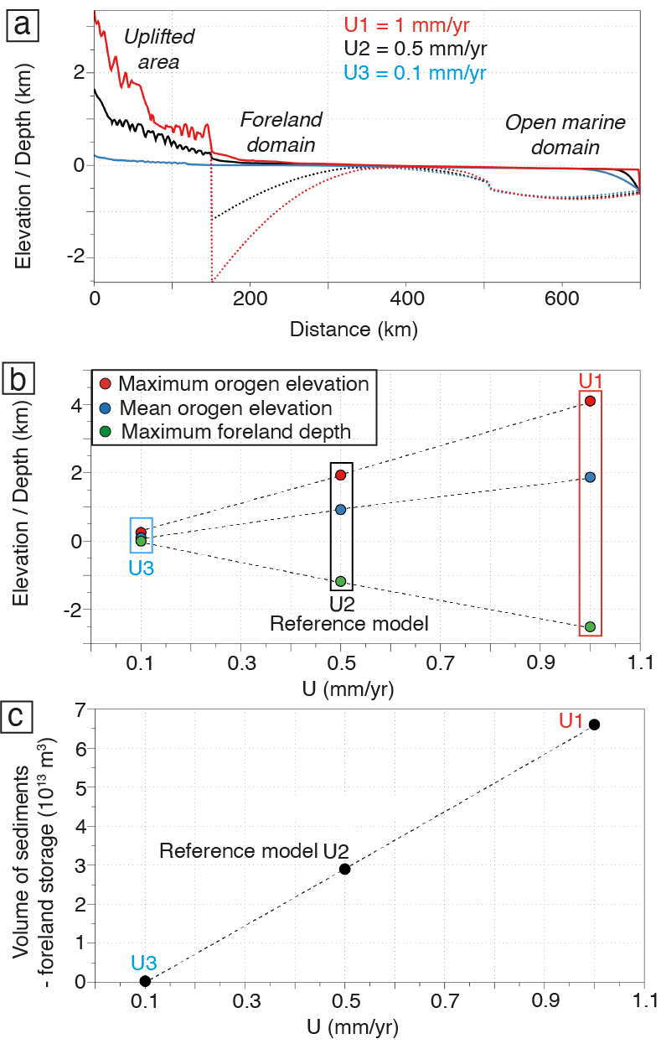
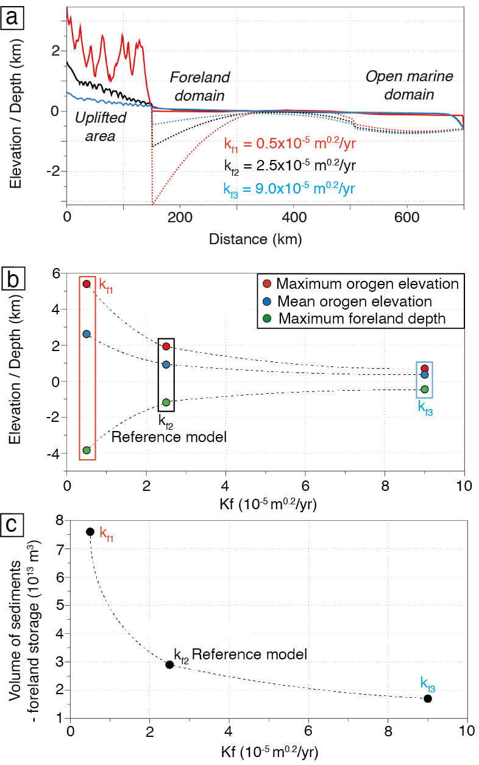
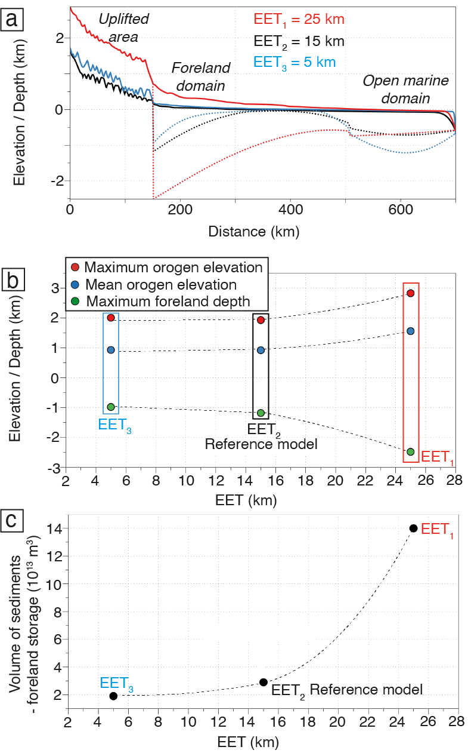
Sensitivity analysis
Uplift
Erodibility
Elastic thickness

Slide 24
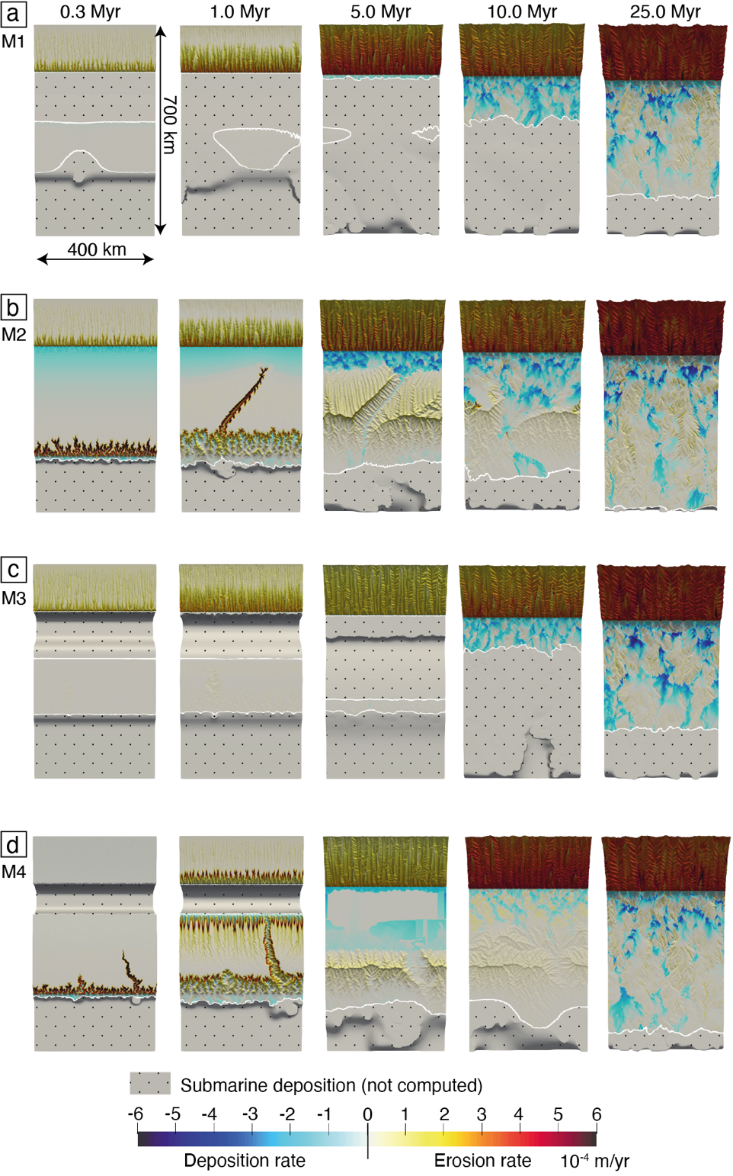
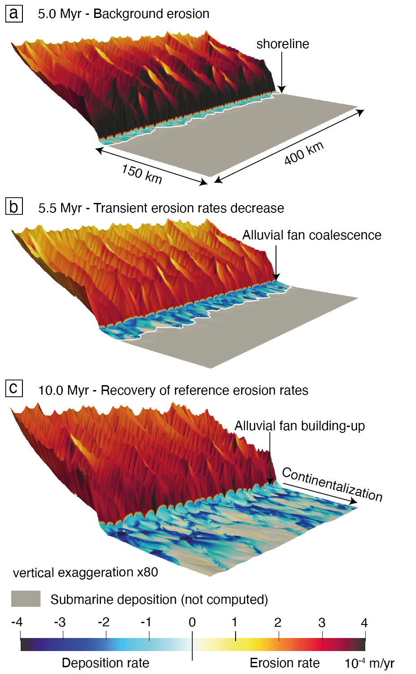
Deposition / erosion dynamics

Slide 25
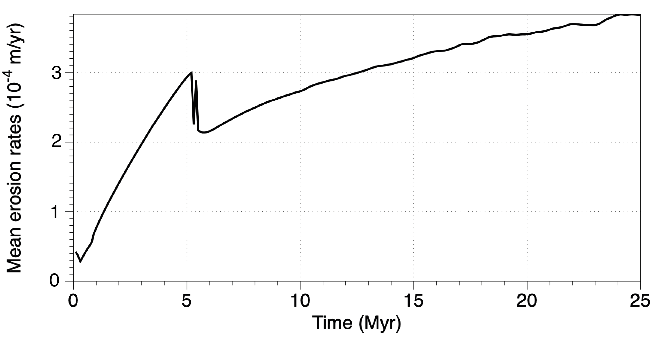

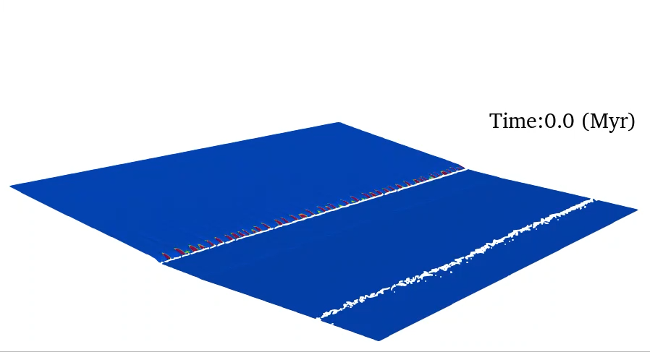

Impact of the sedimentary dynamic on the erosion pattern in the range
Erosion rate decrease (Case 1)
Alluvial fan
Common for all cases
Alluvial fan emplacement
Change in base level
Transient erosion rates decrease
Already discussed by:
Babault et al. (2005)
Carretier & Lucazeau (2005)

Slide 26



M1 – M3 / Summary

Slide 27


Comparison to natural case: Northern Pyrenees
Curry et al. (2019)
Similar mean elevation
$≠$ in surface uplift dynamic
Comparable to the Pyrenean system
Case 1: sea level
Case 2: elevated
Case 3: bathymetry

Slide 28

Comparison to natural case: Northern Pyrenees

Slide 29



Take-home message
Case 1: sea level
Case 2: elevated
Case 3: bathymetry
1) Elevated foreland → sediment export out of the foreland → --- flexure → thinner flexural basin
2) Inherited bathymetry → additional load filling the initial space → +++ flexure → thicker flexural basin
3) Inherited bathymetry required to preserve marine deposits in the foreland basin

Slide 30




Take-home message
4) Changes in depositional dynamic in the sedimentary basin impact erosion rates in the range → autogenetic behavior
5) Pyrenean retro-foreland case → difficult to preserve marine deposits without any pre-existing bathymetry → inherited rift preservation?

