Slide 1




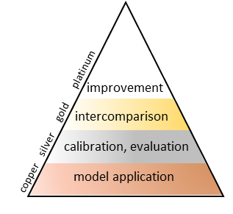
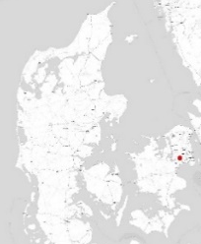
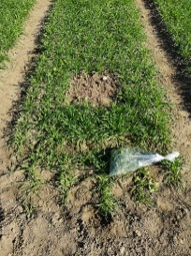

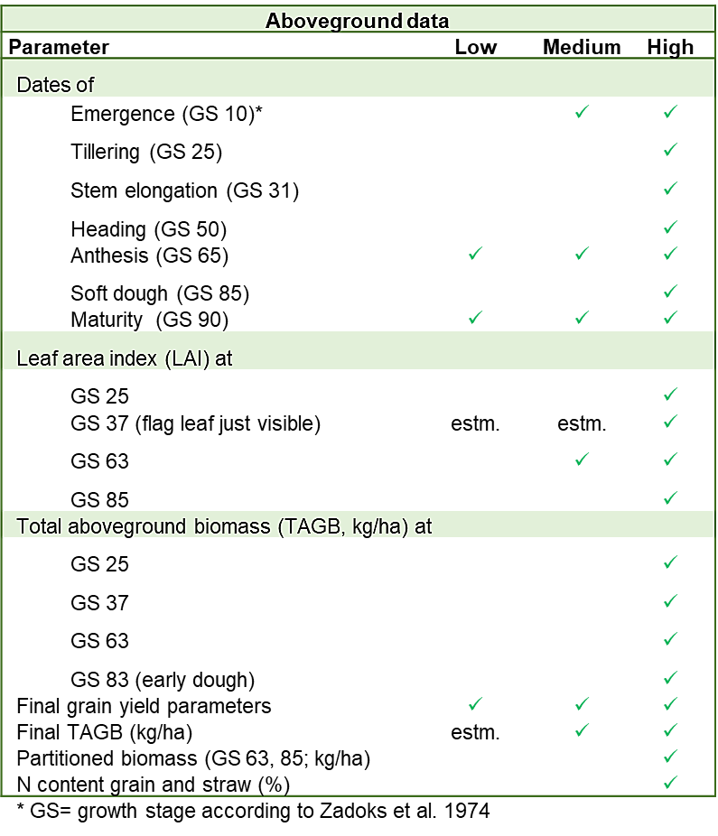
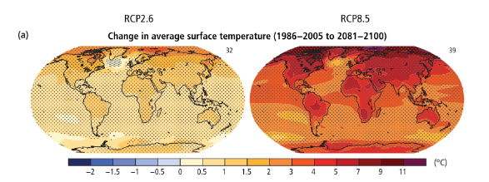
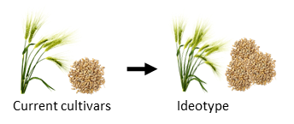
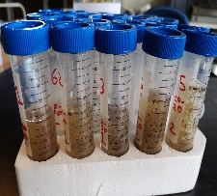
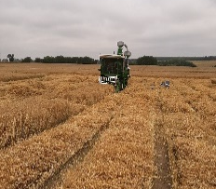
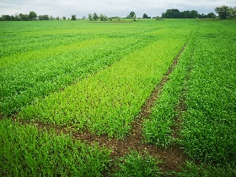

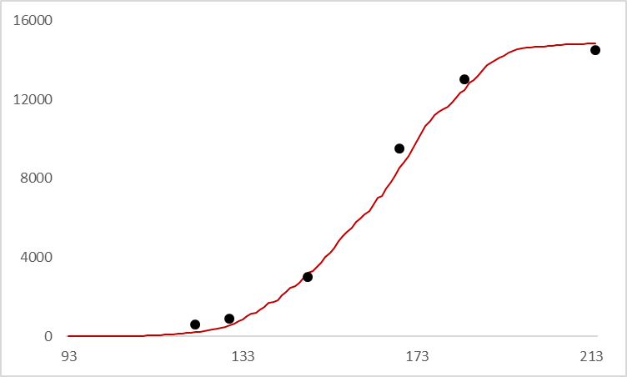
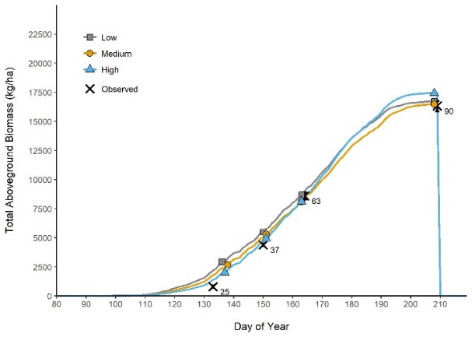
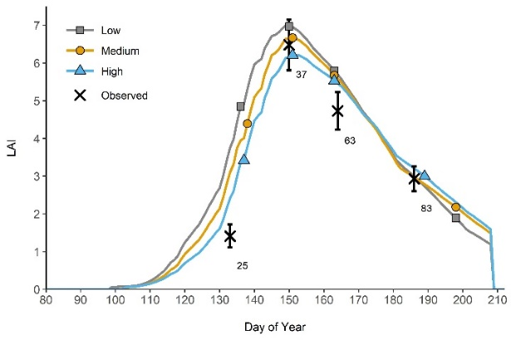
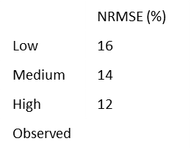
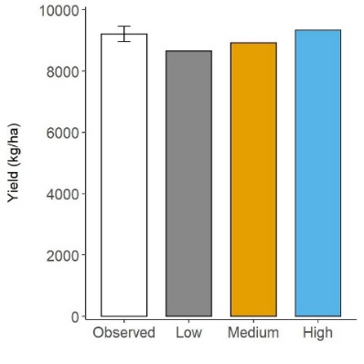
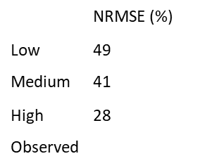


Effects of field data quality on crop model calibration
Mercy Appiah (mercy.appiah@uni-goettingen.de), Gennady Bracho-Mujica, Simon Svane, Merete Styczen,
Kurt-Christian Kersebaum, Reimund Rötter
Background
(Pachauri
et al.,2015)
East Denmark
Multiple in- season biomass harvests
Rapid climate change
Crop simulation model (CSM) -aided ideotyping
acc. Boote et al. 2016, Kersebaum et al. 2015
S.Svane
Root samples
Final harvest
S.Svane
field trials with 2-row spring barley cv. RGT Planet, in Denmark 2019
calibration of APSIM with datasets of different quality
evaluation with statistical performance indicators
© A. Sarmiento Soler
High quality field data
Iterative CSM improvement
robust CSMs (G x E x M )
Prel. Results
Leaf area index (LAI)
Biomass
Yield
Validation study in progress
NRMSE: Normalized Root Mean Squared Error (%)
Hejnsvig ‘20
Taastrup ’20
(2 sowing dates)
Ringsted ’19 & ‘20
Highlights
high quality data → highest prediction accuracy
such high quality data from model-guided field experiments suitable for model improvement is extremely rare, especially for barley production under Nordic conditions
step wise calibration of APSIM with each individual data quality level
evaluation of results with statistical performance indicators: ME (model efficiency, 0-1), MBE (mean bias error, unit of parameter), NRMSE (normalized root mean square error, %)

Slide 2

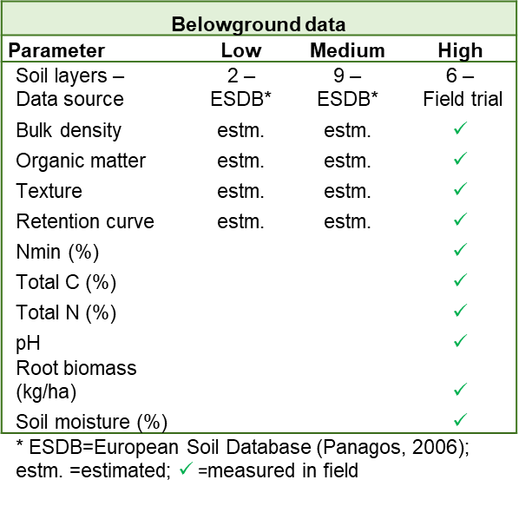
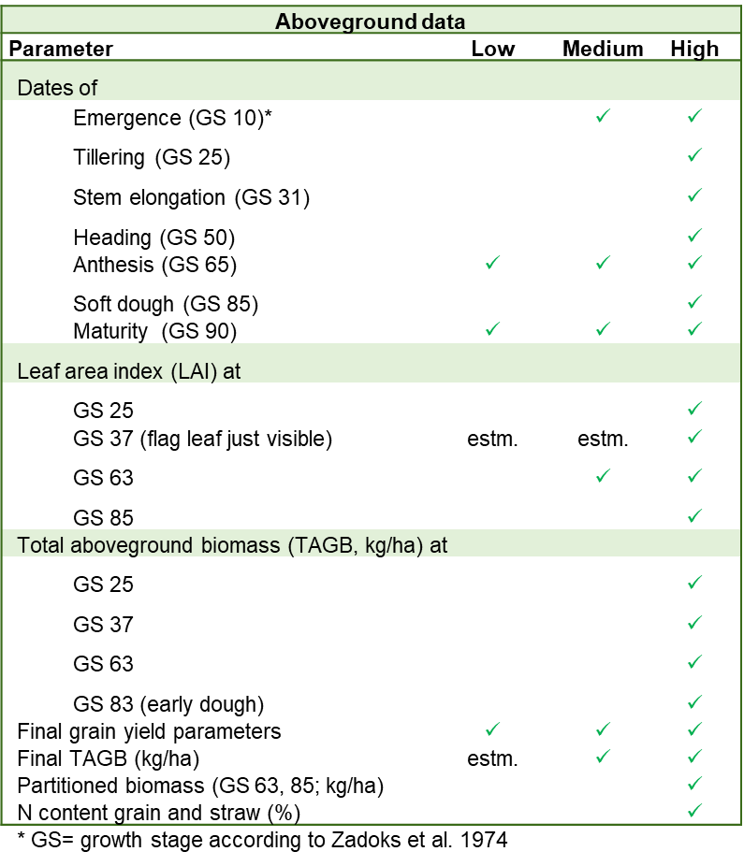
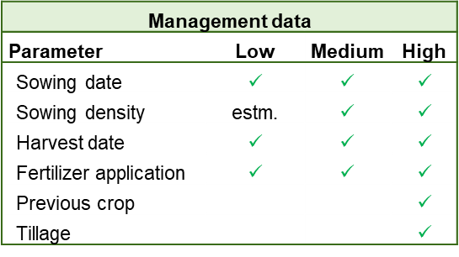
Effects of field data quality on crop model calibration
Mercy Appiah (mercy.appiah@uni-goettingen.de), Gennady Bracho-Mujica, Simon Svane, Merete Styczen,
Kurt-Christian Kersebaum, Reimund Rötter
RGT Planet (spring barley), sown on 29th March 2019
fertilizer level 160 kg N/ha
weather data from on site weather station at Taastrup, Denmark
step wise calibration of APSIM with each individual data quality level
evaluation of results with statistical performance indicators: ME (model efficiency, 0-1), MBE (mean bias error, unit of parameter), NRMSE (normalized root mean square error, %)

Slide 3

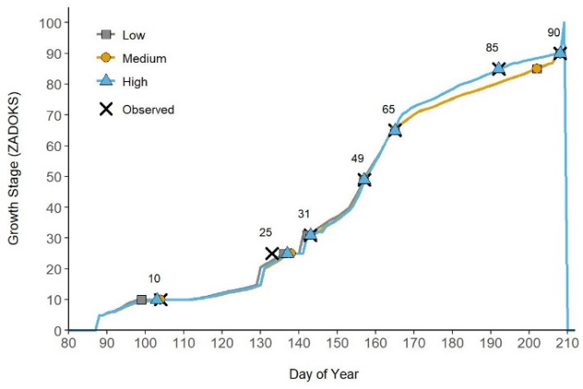
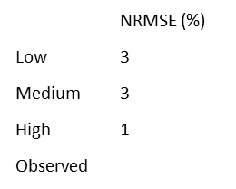
Effects of field data quality on crop model calibration
Mercy Appiah (mercy.appiah@uni-goettingen.de), Gennady Bracho-Mujica, Simon Svane, Merete Styczen,
Kurt-Christian Kersebaum, Reimund Rötter
Phenology
NRMSE: Normalized Root Mean Squared Error (%)

