Slide 1



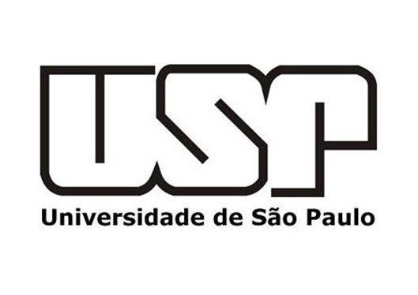



South Atlantic Convergence Zone as Rossby Wave Source During Strong El Niño
Hugo Braga and Tercio Ambrizzi
University of São Paulo, Institute of Astronomy, Geophysics and Atmospheric Sciences, Department of Atmospheric Sciences. São Paulo, Brazil.
e-mail: hugo.braga@iag.usp.br
01/09

Slide 2
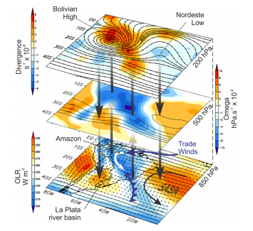
Introduction
The South Atlantic Convergence Zone (SACZ), which extends from the Amazon to the southwestern South Atlantic, is one of the major precipitation systems in South America during the spring and austral summer months, and has an important socioeconomic impact for Brazil.
It’s presence has been deﬁned as a band of cloudiness that persists for at least 4 days with a Northwest-Southeast (NW-SE) orientation, stretching from the Amazon to the Southwest of the South Atlantic (Kodama, 1992, 1993; Liebmann et al., 1999; Carvalho et al., 2002, 2004; Ambrizzi and Ferraz, 2015).
Similar convergence zones are found in the South Pacific and the Southern Indian Ocean, although the South Indian Convergence Zone (SICZ) is not as prominent as the SACZ and the South Pacific Convergence Zone (SPCZ).
Figure 1 – SACZ vertical structure by Nielsen et al. (2019).
02/09

Slide 3
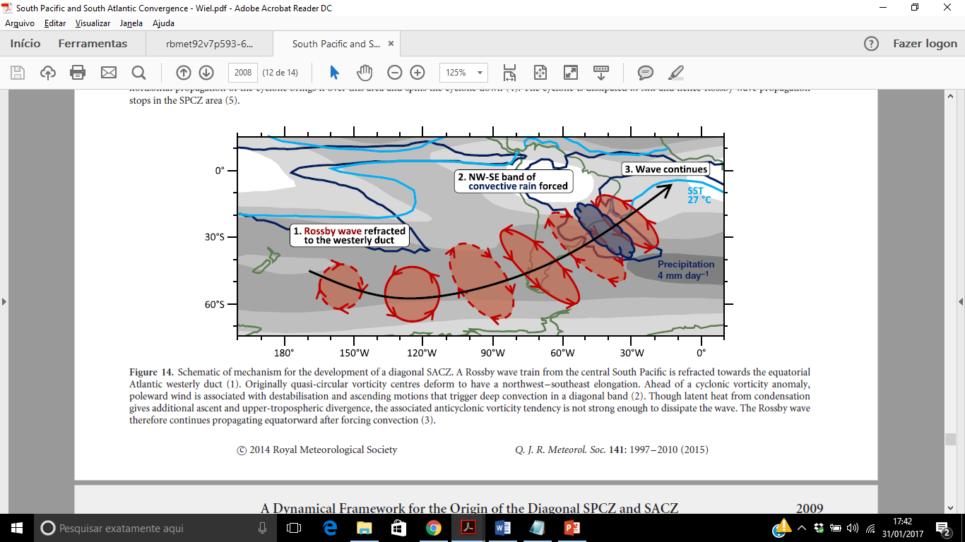
Subtropical Convergence Zones as Rossby Wave Source
Many scientific studies have commented on the intraseasonal interaction between the South Pacific Convergence Zone (SPCZ) and the SACZ via Rossby waves, Grimm and Silva Dias (1995); Figueroa et al. (1995); Liebmann et al. (1999); Carvalho et al. (2004); Cunningham and Cavalcanti (2006); Van der Wiel et al. (2015), but only Grimm and Silva Dias (1995) regarded the SACZ as a possible Rossby wave source.
Figure 2 – SPCZ - SACZ interaction by Van der Wiel et al. (2015)
03/09

Slide 4
Methodology
This study suggests the possibility of SACZ to act as a Rossby wave source using numerical simulations from a simple baroclinic model under strong El Niño basic state.
1.Model
Model results will be presented showing the stream function (ψ) response to an anomalous heat source. A primitive equation model is used (DREAM: Dynamical Research Empirical Atmosphere Model) that integrates prognostic equations for vorticity, divergence, temperature, and (log) surface pressure with a horizontal resolution of T42, 15 sigma levels, and a semi-implicit time-step of 22.5 min. A ﬁxed El Niño basic state is used from the 2015/16 austral summer, held in place by a forcing function calculated from ERA-interim reanalysis data. The empirical forcing approach used with this model was initially introduced by Hall (2000), and recent applications can be seen in Hall et al. (2019); Hall et al. (2020).
The austral summer of 2015/16 was marked by a strong El Niño event with positive SST anomalies of +2.5°C in the Central Pacific Ocean region, according to the ONI 3.4 index. The heating anomaly that forces the model experiments under the 2015/16 austral summer basic states is fixed with an average vertical peak of 2K/𝑑𝑎𝑦, equivalent to a precipitation of 8 mm/𝑑𝑎𝑦, near to the SACZ activity region (15ºS–35ºS and 60ºW–40ºW) for 20 days (1,280 time steps). This region is similar to the SACZ-coastal fraction described by Carvalho et al. (2004).
2.Stationary Rossby Wave Number (SRWs)
Stationary Rossby Waves (SRWs) indicate the regions where Rossby wave propagations are allowed and inhibited, underscoring the importance of jet streams as waveguides. In this study, SRW calculation described by Rehbein et al. (2020) was applied in the strong El Niño basic state , in order to aid the interpretation of these basic states as waveguides, a simple analyses was done in the same manner as Hoskins and Ambrizzi (1993); Ambrizzi (1994); Ambrizzi and Hoskins (1997).
04/09

Slide 5
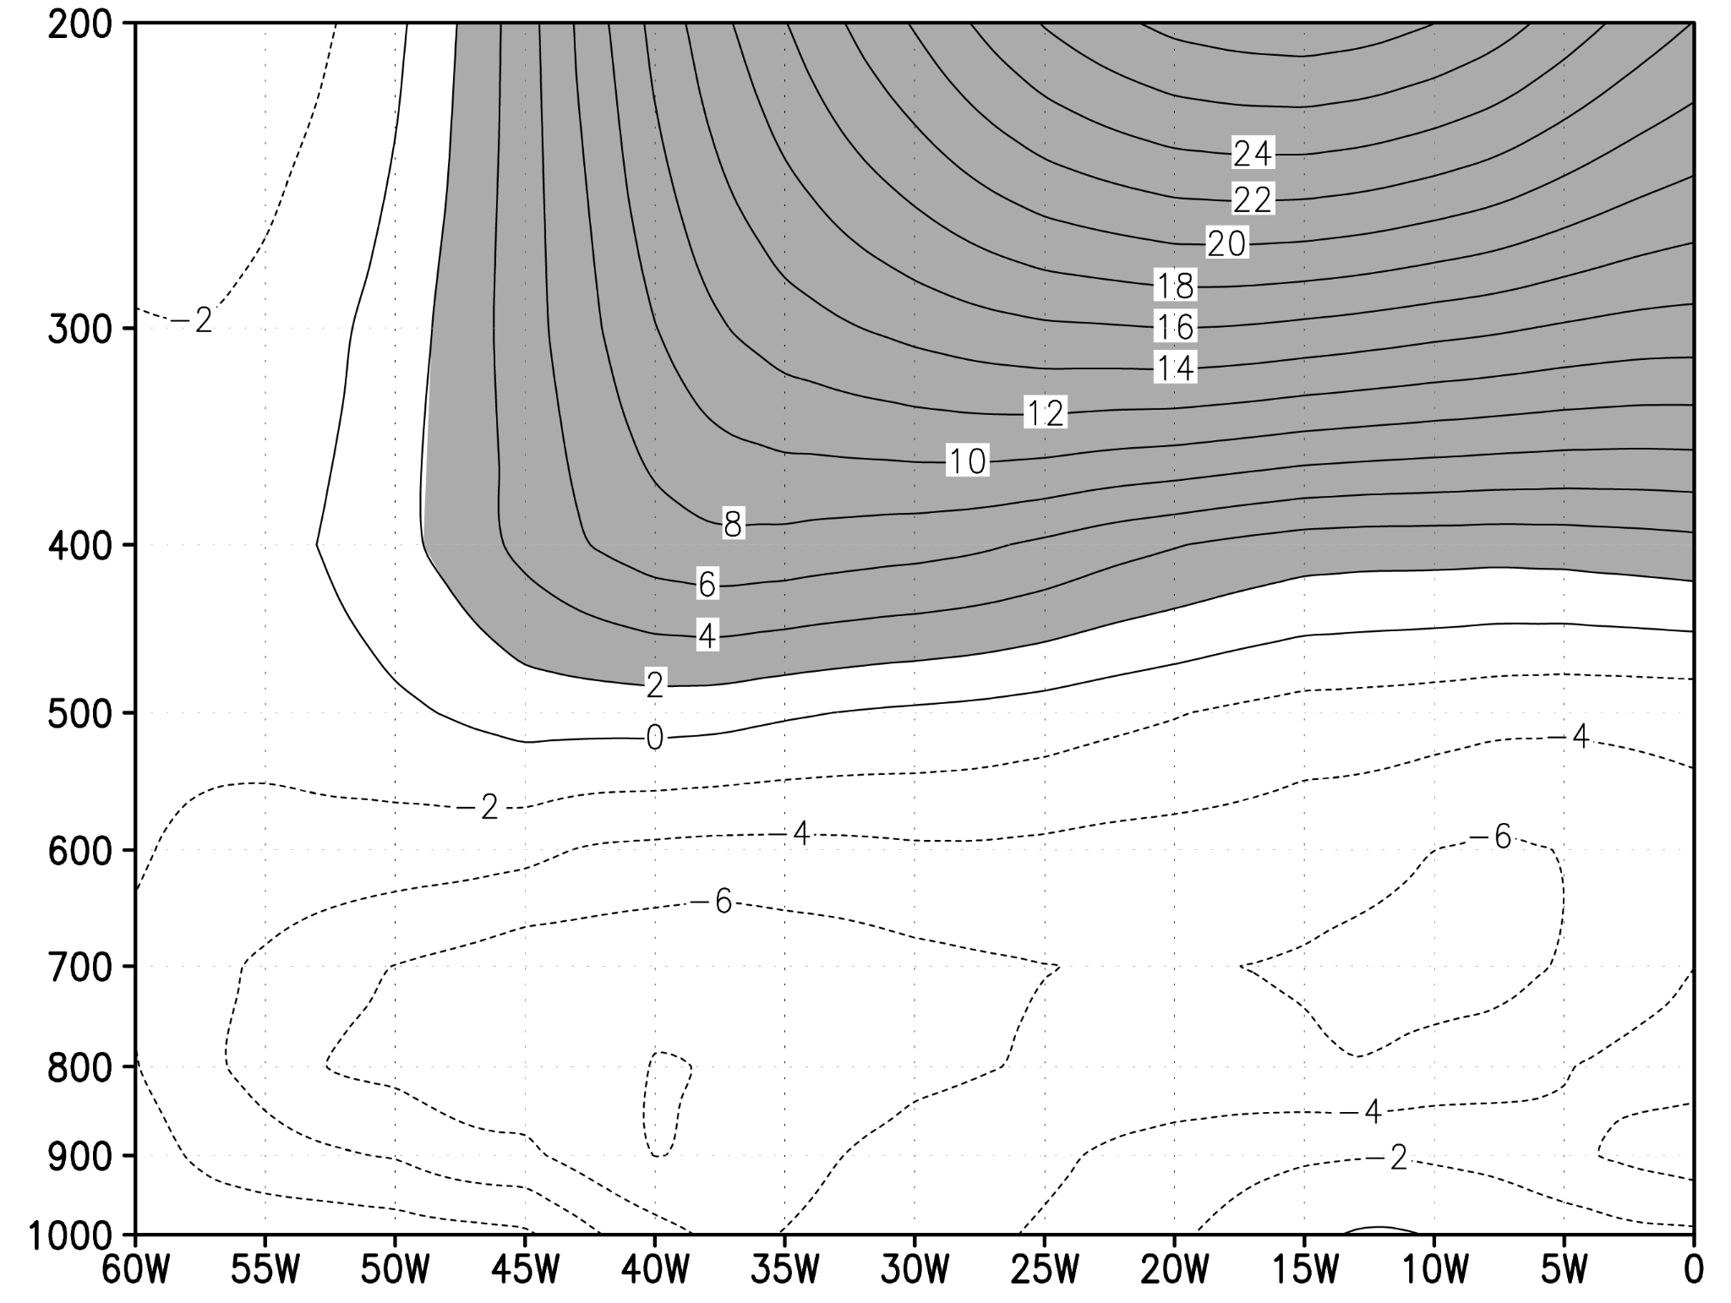
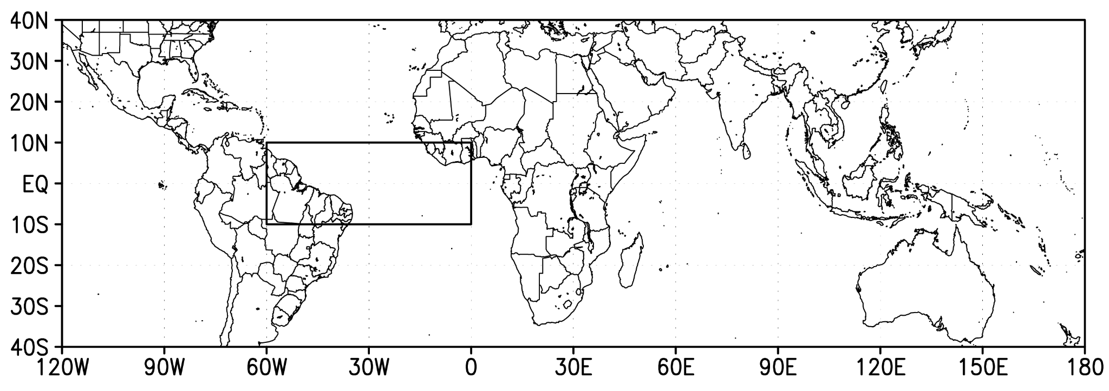
Equatorial Window Under Strong El Niño Basic State
Before analyzing the response of thermal forcing and the development of stream function (𝜓) anomalies, it is important to understand the vertical profile of zonal wind in the equatorial Atlantic Ocean domain (10ºN–10ºS and 60ºW–0ºW), given that variations at high-level tropospheric flow may or may not allow meridional propagation of Rossby waves. Webster and Holton (1982), suggested that planetary Rossby waves could cross the Equator, provided there is a heat source strong enough to trigger them and strong enough equatorial westerly flow to allow them to propagate. Tomas and Webster (1994) suggested that, depending on interannual variability, Rossby waves may propagate along different waveguides and there is a possibility of interhemispheric propagation when there is equatorial westerly flow.
As shown in Figure 3, there is a intense zonal flow over equatorial atlantic ocean, thus facilitating wave propagation in this region. According to the linear propagation of the meridional rossby waves.
Figure 3 – Vertical cross-section of zonal wind in Equatorial Atlantic Domain of Strong El Niño Basic State
05/09

Slide 6
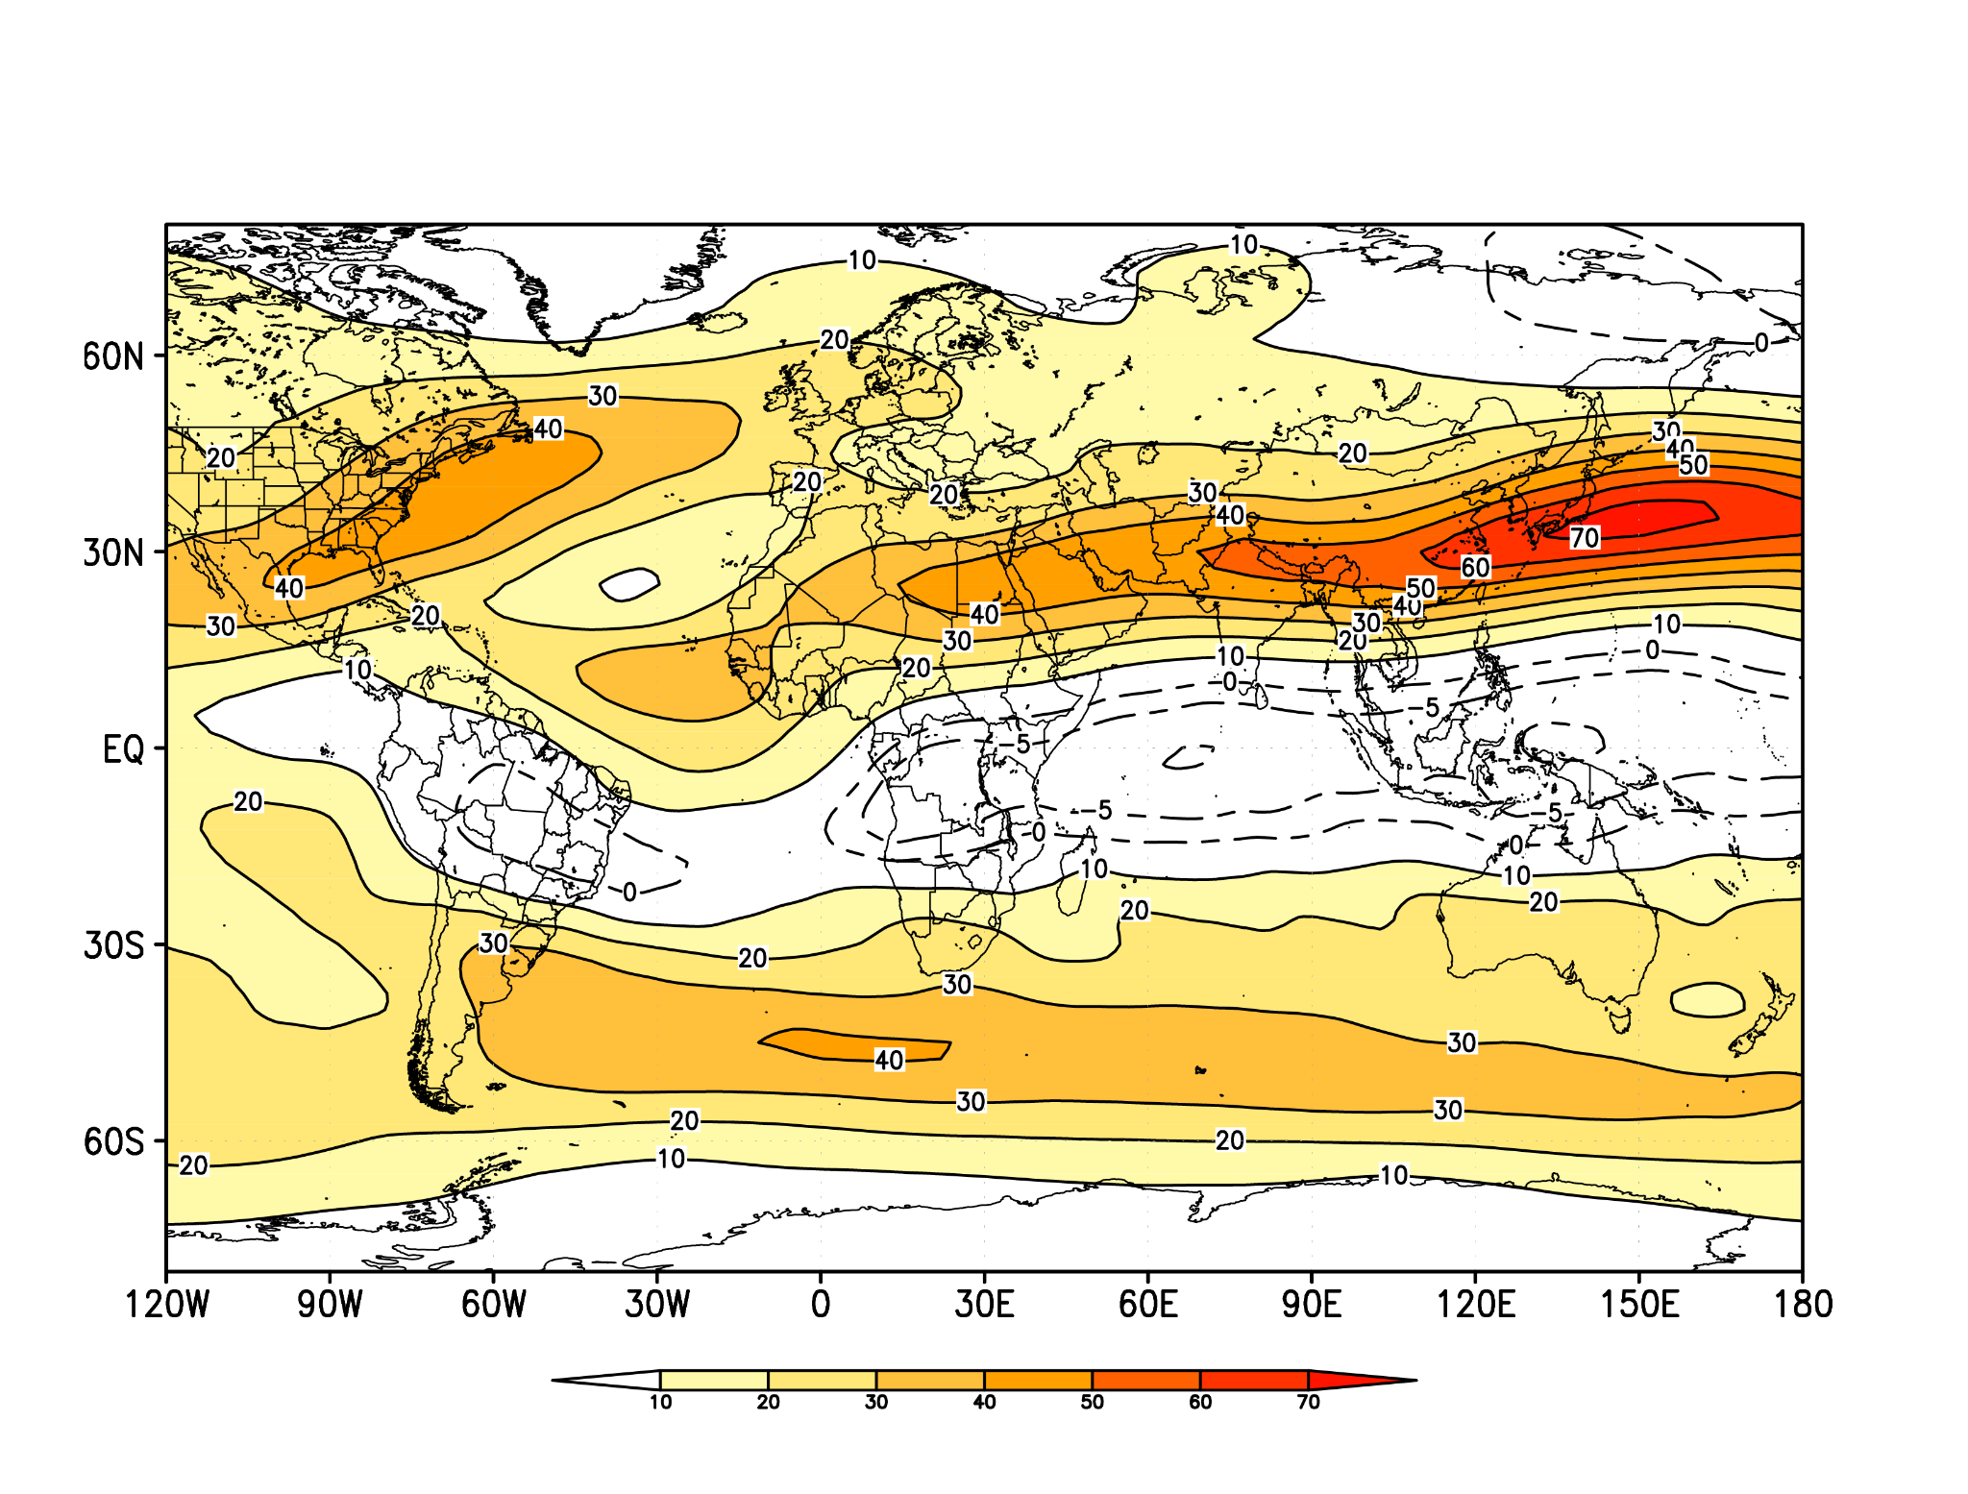
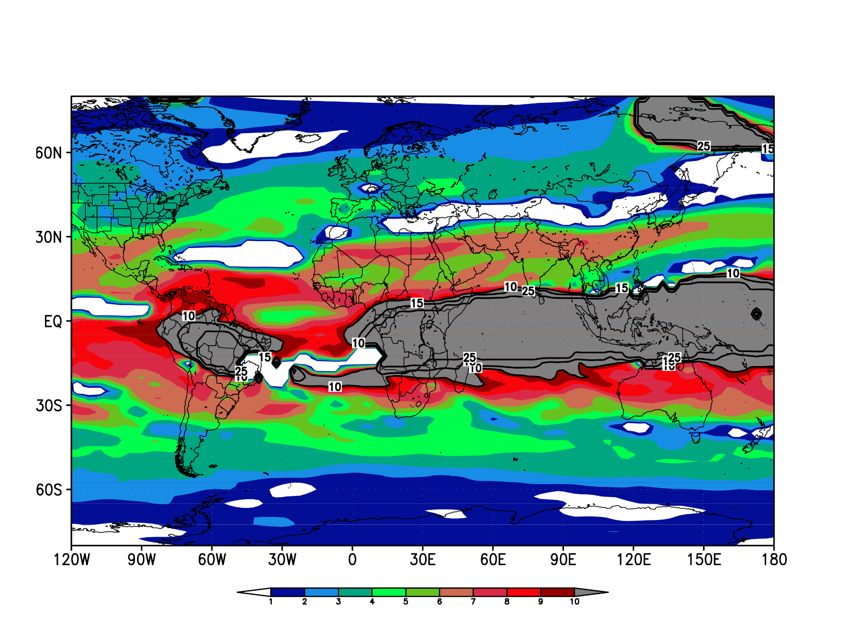
Strong El Niño Basic State
The 2015/16 basic state have an intense westerly flow in the equatorial Atlantic Ocean, where waves are more likely to cross the equatorial region at wavenumbers 6-10 (Fig 4.b) with narrow SRW contours allowing long waves to propagate in this region embedded by the subtropical westerly flow in the NH (Fig 4.a).
a)
b)
Figure 4 – Climatological Austral Summer 200-mb flow based on strong El Niño basic state over Austral Summer 2015/16. a) Westerly component of the wind (U); contour interval 10 m/s. b) Stationary wave number (𝐾𝑠), contours at zonal wave numbers 10,15, 25-30.
06/09

Slide 7
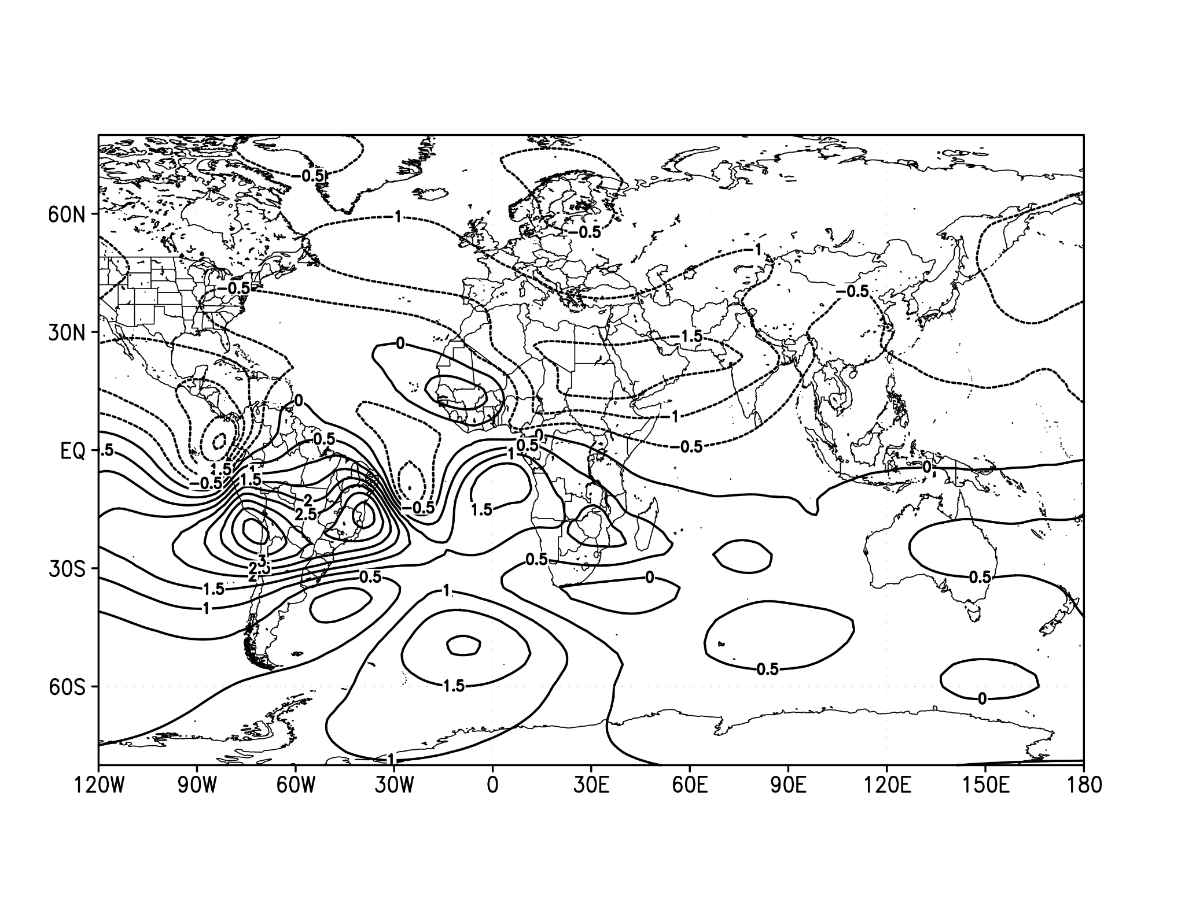
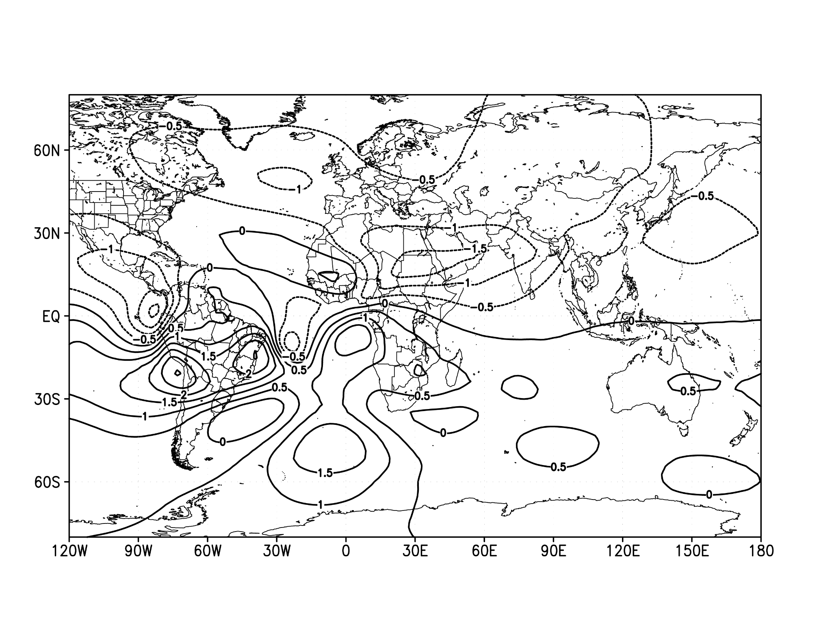
Numerical Simulation using Strong El Niño Basic State
Figure 5 shows the development of stream function anomalies (𝜓) during the strong El Niño basic state. The Rossby wave starts in the Southeastern Brazil, crosses the Atlantic Ocean and, embedded in the subtropical jet of the NH, interacts with subtropical latitudes over the African continent (Figs 5.a.b).
a)
b)
Figure 5 – Streamfunction response (𝜓 = 0,5x10^6𝑚²/s) to the source (2K/𝑑𝑎𝑦) located at SACZ region (15ºS - 35ºS and 60ºW - 40ºW) over strong el niño basic state, a) day 2, b) day 4.
07/09

Slide 8
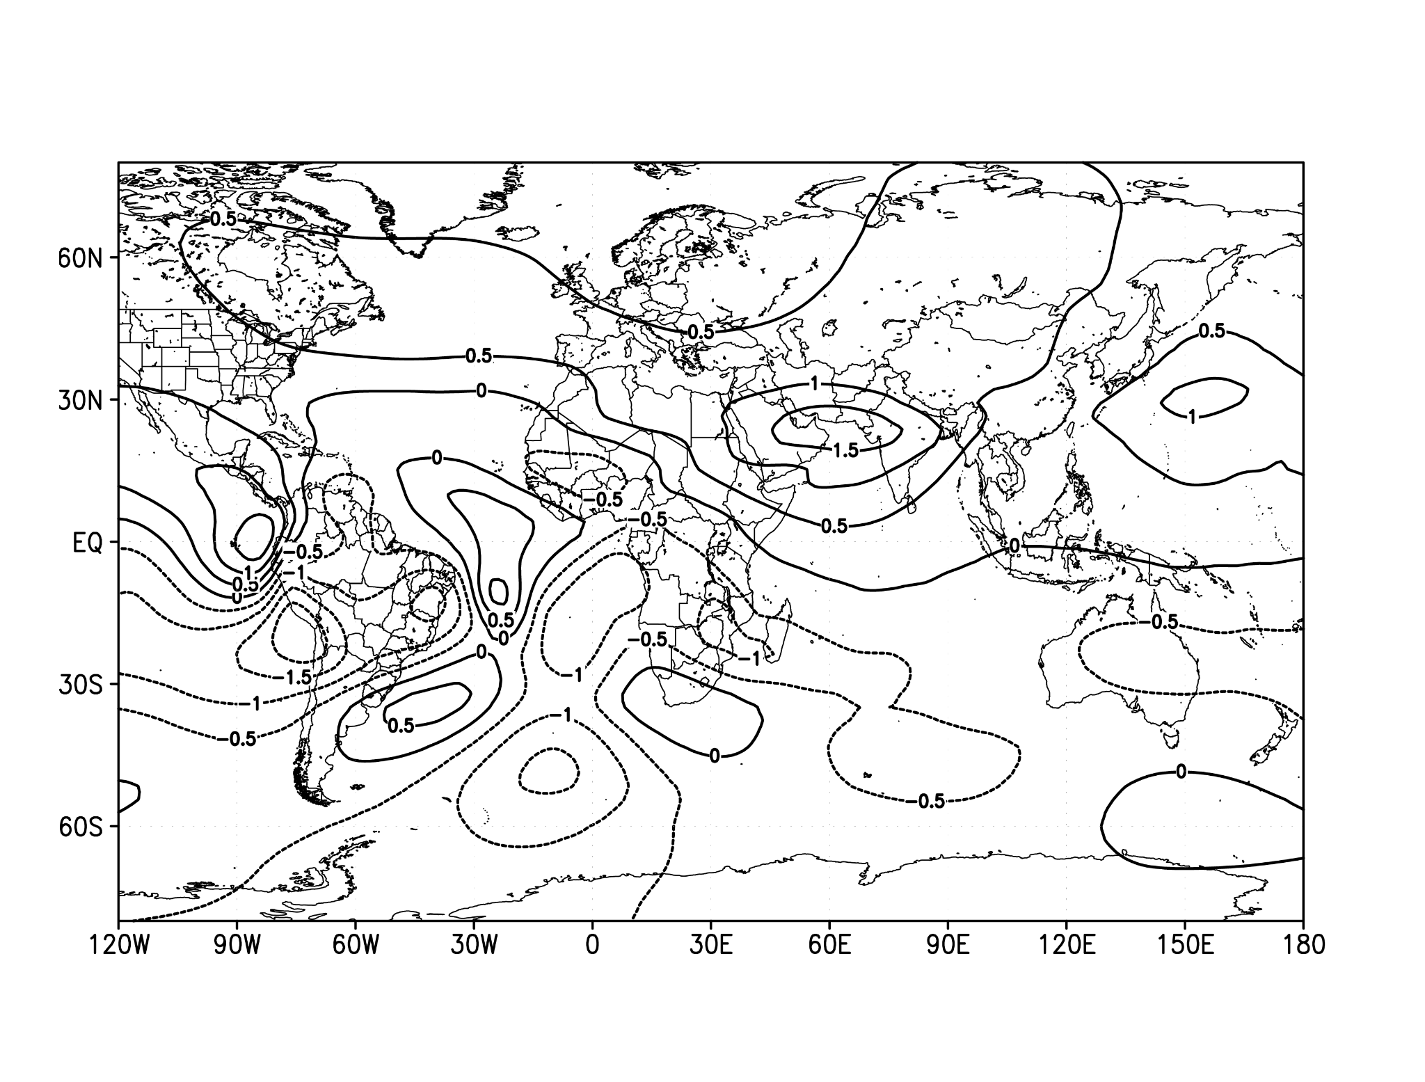
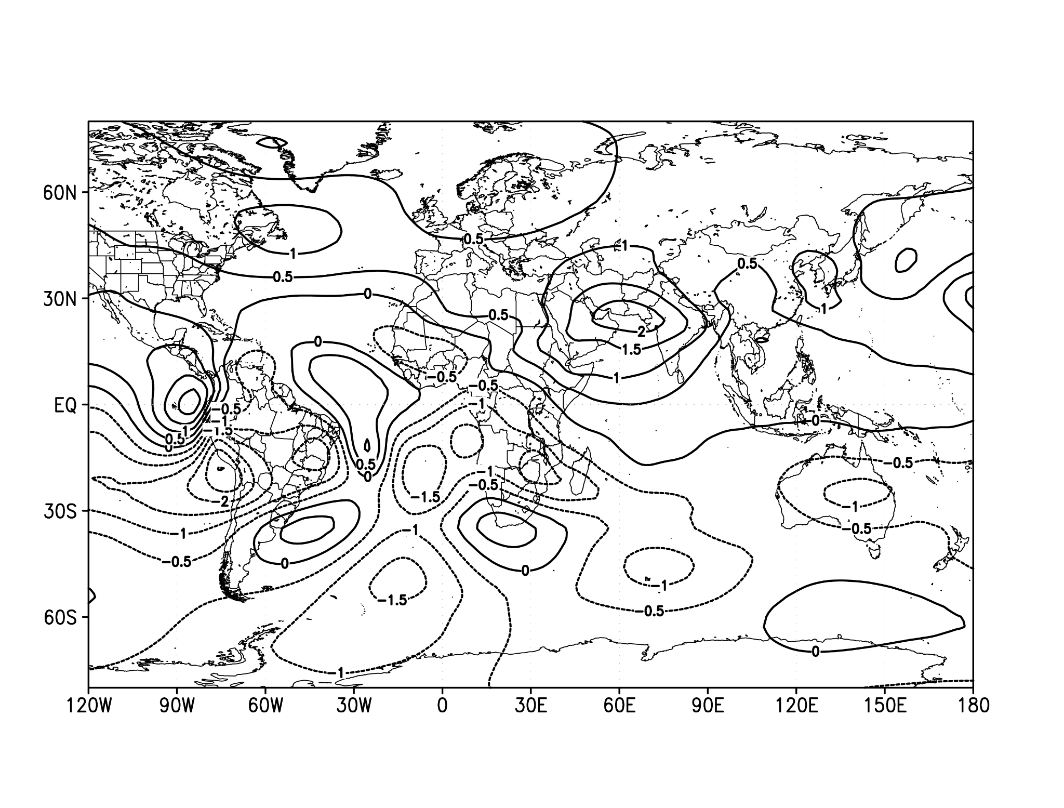
Numerical Simulation using Strong El Niño Basic State
The Rossby continues to propagate which intensifies over time while it propagates eastward over the Middle East and the Asian continent after 16 days (Fig 5.c). At 19 days (Fig 5.d), the subtropical wave is even more evident in the simulation interacting even with the North Pacific Ocean.
Also, there is a Rossby wave that propagates over the South Atlantic towards the Indian Ocean and South Pacific, represented by the stream function anomalies (𝜓) (Figs 5.a.b.c.d) being guided by the subtropical jet of the Southern Hemisphere at wavenumbers 2–6.
c)
d)
Figure 5 – Streamfunction response (𝜓 = 0,5x10^6𝑚²/s) to the source (2K/𝑑𝑎𝑦) located at SACZ region (15ºS - 35ºS and 60ºW - 40ºW) over strong el niño basic state, c) day 16, d) day 19.
08/09

Slide 9
Conclusion
According to the present analyses, SACZ may sometimes act as interhemispheric Rossby wave source, enabling a connection between South America and subtropical latitudes in North Hemisphere over 16 days, providing there is westerly flow that allows wave propagation over the equatorial Atlantic Ocean.
References
Ambrizzi, T., 1994: Rossby wave propagation on el nino and la nina non-zonal basic flows. Revista Brasileira de Meteorologia, 9, 54–65.
Ambrizzi, T., and S. Ferraz, 2015: An objective criterion for determining the south atlantic convergence zone. Frontiers in Environmental Science, 3 (5), 1–9.
Ambrizzi, T., and B. J. Hoskins, 1997: Stationary rossby-wave propagation in a baroclinic atmosphere. Quarterly Journal of the Royal Meteorological Society, 123 (540), 919–928.
Carvalho, L. M. V., C. Jones, and B. Liebmann, 2004: The south atlantic convergence zone: Intensity, form, persistence, and relationships with intraseasonal to interannual activity and
extreme rainfall. Journal of Climate, 17 (1), 88–108.
Cunningham, C., and I. Cavalcanti, 2006: Intraseasonal modes of variability affecting the south atlantic convergence zone. International Journal of Climatology, 26, 1165–1180,
Figueroa, S. N., P. Satyamurty, and P. L. D. S. Dias, 1995: Simulations of the summer circulation over the south american region with an eta coordinate model. Journal of Atmospheric Sciences, 52, 1573–1584.
Grimm, A. M., and P. L. Silva Dias, 1995: Analysis of Tropical–Extratropical Interactions with Influence Functions of a Barotropic Model. Journal of the Atmospheric Sciences, 52 (20),3538–3555.
Hall, N. M. J., 2000: A Simple GCM Based on Dry Dynamics and Constant Forcing. Journal of the Atmospheric Sciences, 57 (10), 1557–1572.
Hall, N., Leroux, S. and Ambrizzi, T. (2019) Transient contributions to the forcing of the atmospheric annual cycle. Clim Dyn,52, 6719–6733.
Hall, N. M. J., Le, H. H. and Leroux, S. (2020) The extratropical response to a developing MJO: forecast and climate simulations with the DREAM model. Clim Dyn, 55, 813–829.
Hoskins, B. J., and T. Ambrizzi, 1993: Rossby Wave Propagation on a Realistic Longitudinally Varying Flow. Journal of the Atmospheric Sciences, 50 (12), 1661–1671.
Hoskins, B. J., and A. J. Simmons, 1975: A multi-layer spectral model and the semi-implicit method. Quarterly Journal of the Royal Meteorological Society, 101 (429), 637–655.
Nielsen, D., A.Belém, E.Marton, and M.Cataldi, 2019: Dynamics-based regression models for the south atlantic convergence zone. Clim Dyn, 52, 5527–5553.
Rehbein, A., T. Ambrizzi, S. Ibarra-Espinosa, and L. M. M. Dutra, 2020: raytracing: An R package for identification and tracking the atmospheric Rossby waves.
Tomas, R. A., and P. J. Webster, 1994: Horizontal and vertical structure of cross-equatorial wave propagation. Journal of the Atmospheric Sciences, 51 (11), 1417–1430.
Van der Wiel, K., A. J. Matthews, D. P. Stevens, and M. M. Joshi, 2015: A dynamical framework for the origin of the diagonal south pacific and south atlantic convergence zones. Quarterly Journal of the Royal Meteorological Society, 141 (691), 1997–2010.
Webster, P. J., and J. R. Holton, 1982: Cross-equatorial response to middle-latitude forcing in a zonally varying basic state. Journal of the Atmospheric Sciences, 39 (4), 722–733.
09/09

