Slide 1

Analysis of the polar motion excitation function based on ITSG daily models
Aleksander Partyka¹, Jolanta Nastula¹, Justyna Śliwińska¹, Tomasz Kur¹, Małgorzata Wińska²
¹Centrum Badań Kosmicznych Polskiej Akademii Nauk, Warsaw, Poland
²Warsaw University of Technology, Faculty of Civil Engineering, Warsaw, Poland
EGU General Assembly 2022, 23–27 May 2022, Vienna

Slide 2
Introduction
The main aim of this study is to assess the usefulness of the daily gravity field models from the Gravity Recovery and Climate Experiment (GRACE) mission delivered by ITSG (The Institute of Geodesy at Graz University of Technology) – ITSG-Grace2016 and ITSG-Grace2018 – to determine the equatorial components (χ1 and χ2) of the polar motion (PM) excitation.
These models are in our area of interest due to the fact that they are the only models based on GRACE mission data that have a daily temporal resolution.
We used two reference series for comparison with χ1 and χ2 derived from ITSG-Grace models:
  the sum of HAM (Hydrological Angular Momentum) and SLAM (Sea-level Angular Momentum) series from the LSDM (Hydrological Land Surface Discharge Model)
  GAO geodetic residuals, being a differences between geodetic angular momentum (GAM) and a sum of atmospheric and oceanic angular momentum (AAM and OAM, respectively)
In order to evaluate the PM excitation series determined from ITSG-Grace models with the use of series obtained from HAM+SLAM and GAO models, correlations between the series, root mean square errors (RMSE) and amplitudes of annual and semiannual oscillations were calculated.
The analysis covers 3 periods that allow us to examine the data obtained at different stages of the GRACE mission:
  04.2002 - 06.2017 (all available ITSG-Grace data)
  04.2002 - 11.2009 (first half of available ITSG-Grace data)*
  11.2009 - 06.2017 (second half of available ITSG-Grace data)**
  the end*/start** of the period is in the middle of the month

Slide 3
Data
GRACE daily solutions – C₂₁, S₂₁ coefficients of geopotential (GSM) obtained from the following solutions:
ITSG-Grace2016 (abbreviated here as ITSG 2016) – provided by Institute of Geodesy at Graz University of Technology, Graz, Austria
ITSG-Grace2018 (abbreviated here as ITSG 2018) – provided by Institute of Geodesy at Graz University of Technology, Graz, Austria
LSDM-based series – Earth rotation excitation functions obtained from the following solutions:
HAM – provided by GeoForschungsZentrum, Potsdam, Germany
SLAM – provided by GeoForschungsZentrum, Potsdam, Germany
GAO geodetic residuals – differences between GAM and a sum of AAM, OAM obtained from the following solutions:
GAM – χ1 and χ2 coordinates of PM excitation obtained from EOP 14 C04, provided by International Earth Rotation and Reference System Service (IERS)
AAM – based on ECMWF (European Center for Medium–Range Weather Forecasts) model
OAM – based on MPIOM (Max Planck Institute Ocean Model) model

Slide 4
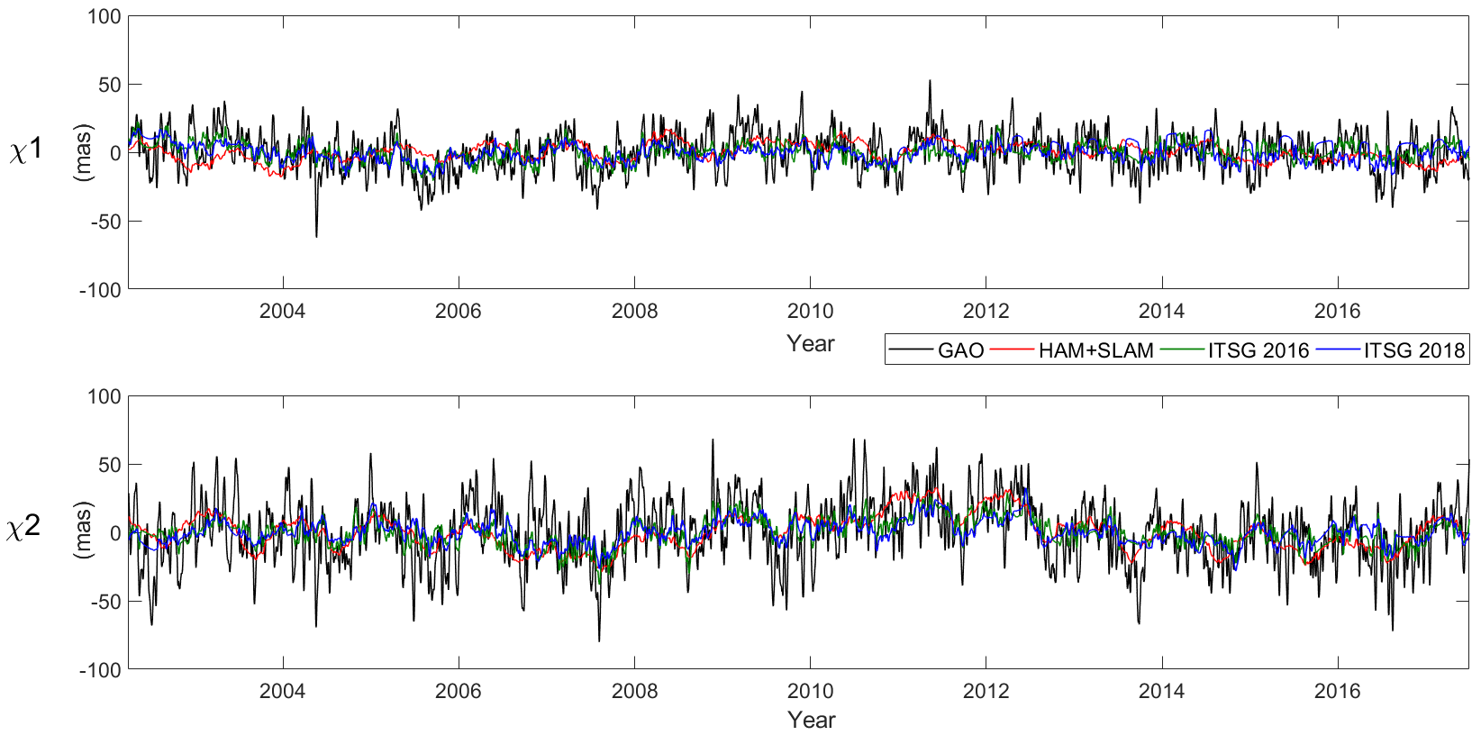
Results – Time series of χ1 and χ2
Figures showing comparison of χ1 and χ2 series obtained from ITSG-Grace 2016, ITSG-Grace2018, GAO, HAM+SLAM.
A seven-day moving average was applied to the series. A trend has been removed from the series.

Slide 5
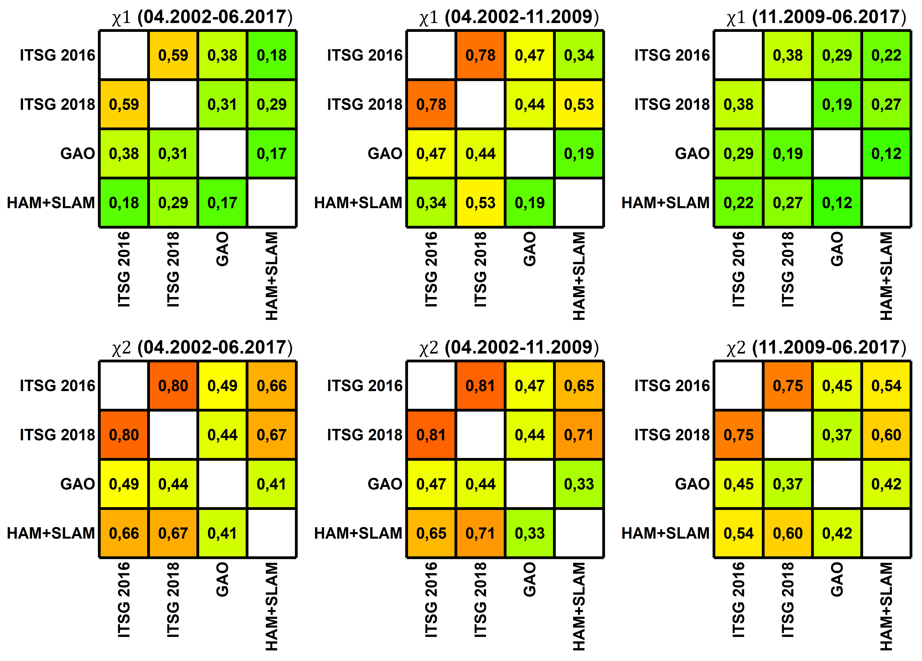
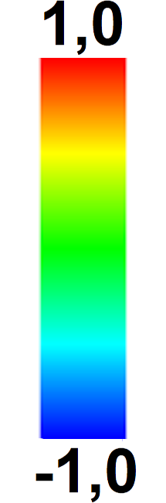
Results - Correlations
χ1 vs χ2
correlations for χ2 at a higher level than for χ1
Periods
Period 2002-2009 with correlations visibly higher than period 2009-2017 (especially in χ1).
For example ITSG 2018/GAO – 0.44 vs 0.19.
ITSG models:
Correlation between excitation function based on ITSG 2016 and ITSG 2018 models at similar levels (from 0.75 to 0.81)
The difference in χ1 over the period 2009-2017, which results into a low correlation over the entire period for χ1.
GAO vs HAM+SLAM:
GAO higher correlated with excitation function based on ITSG models in χ1 for period 2002-2017
HAM+SLAM higher correlated with excitation function based on ITSG models in χ2 over the period 2002-2017
HAM+SLAM higher correlated for excitation function based on ITSG 2018 (comparable over 2002-2017 period for χ1)

Slide 6

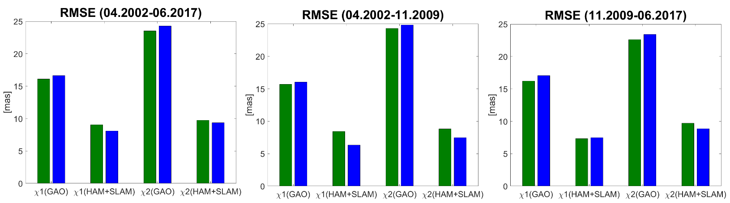
Results - RMSE
ITSG 2016 vs ITSG 2018
GAO as a reference :
ITSG 2016 with smaller RMSE in χ1 and χ2 (every tested period)
HAM+SLAM as a reference:
ITSG 2018 with smaller RMSE in χ1 and χ2 except for χ1(HAM+SLAM) in the period 11.2009-06.2017
Periods:
Period 04.2002-11.2009 with the same relationships as period 04.2002-06.2017
Period 11.2009-06.2017 with different relationship in χ1(HAM+SLAM) which interacts the change in the period 04.2002-06.2017 (whole period under study)

Slide 7
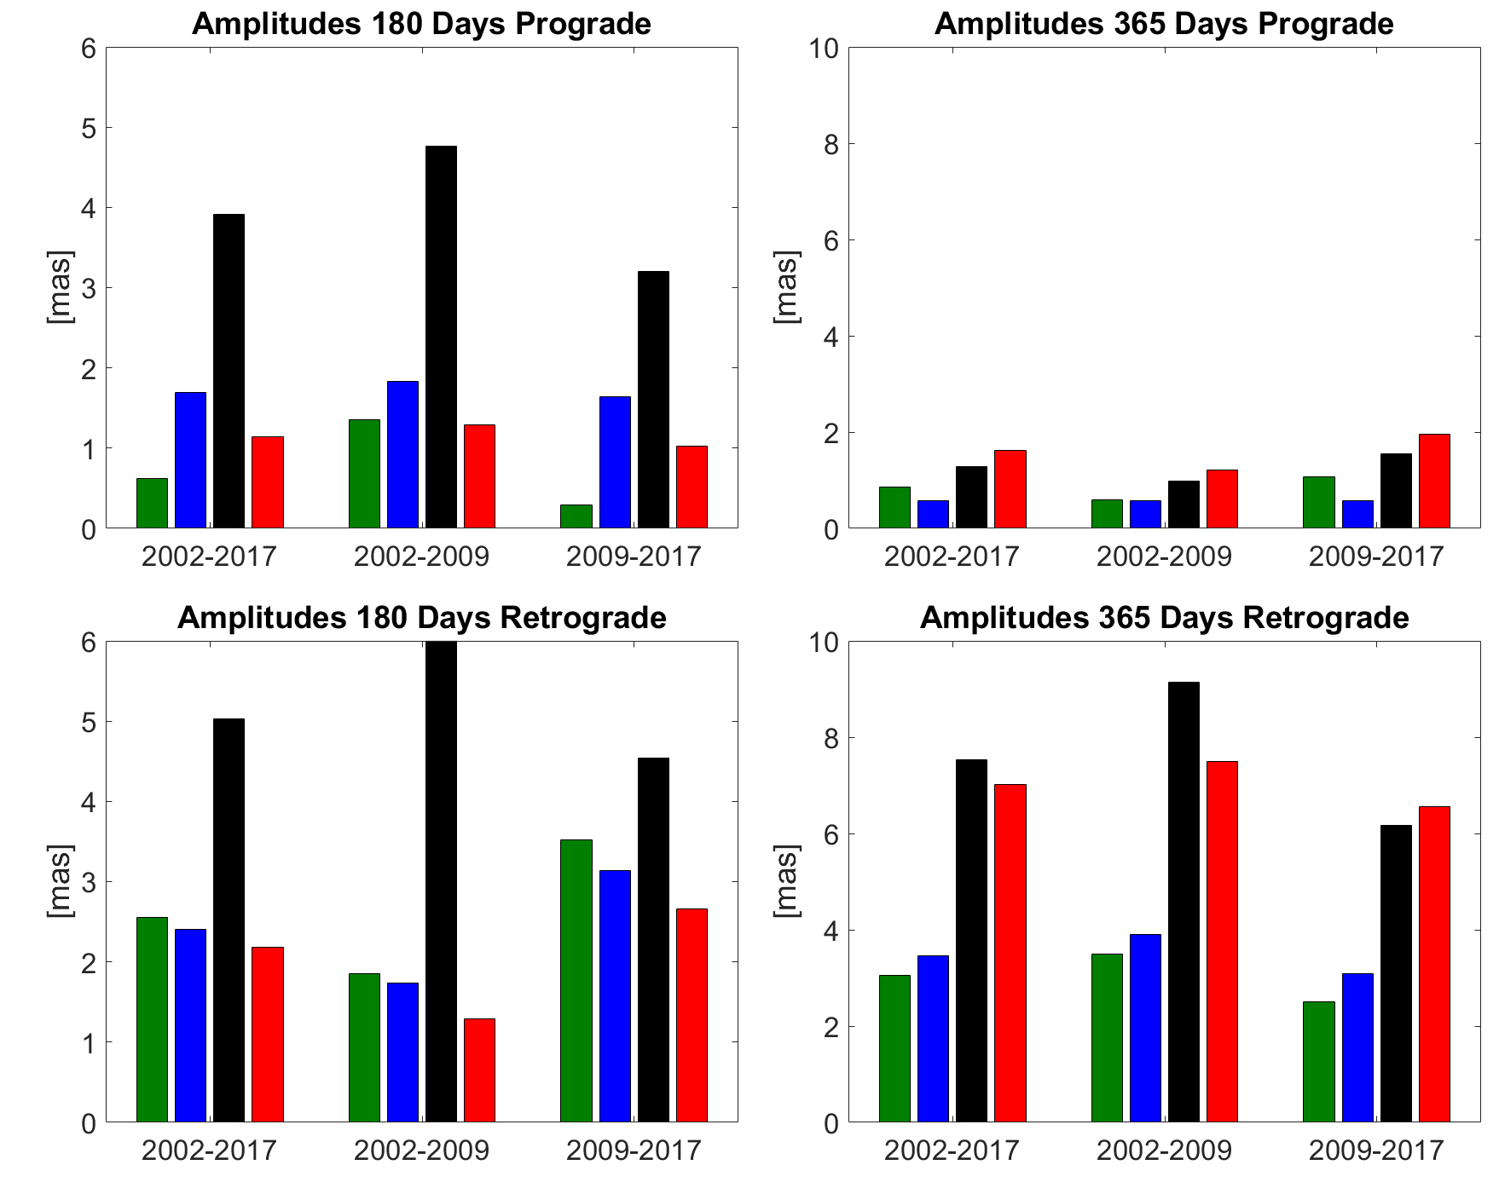
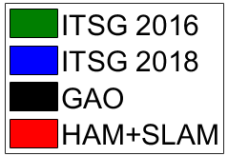
Results - Amplitudes of seasonal oscillations
180 Days Prograde
ITSG 2016 in each period with smaller amplitude than ITSG 2018. Visibly smaller amplitude of ITSG 2016 in the 2009-2017 period. GAO amplitudes higher than HAM+SLAM amplitudes.
180 Days Retrograde
ITSG 2018 in each period with smaller amplitude than ITSG 2016. Amplitude at a smaller level in the 2002-2009 period than in the 2009-2017 period.
GAO amplitudes visibly higher than HAM+SLAM amplitudes.
365 Days Prograde
ITSG 2018 with smaller amplitude than ITSG 2016 in each case (comparable in 2002-2009 period). Large differences between all of the values over the 2009-2017 period. ITSG 2018 with similar values in each period.
365 Days Retrograde
ITSG 2016 with smaller amplitude than ITSG 2018 in each case. Smallest amplitudes in the 2009-2017 period.
GAO amplitudes comparable or higher to the amplitudes of HAM+SLAM.

Slide 8
Conclusions
Generally:
Correlations between polar motion excitation from ITSG-Grace2016 and ITSG-Grace2018 are at a higher level in χ2 than in χ1.
Both ITSG-Grace series over the period 2002-2009 are higher correlated with reference series (GAO and HAM+SLAM) than in the period 2009-2017 (especially in χ1).
For χ1, series from both ITSG-Grace are higher correlated with GAO than with HAM+SLAM.
For χ2, series from both ITSG-Grace are higher correlated with HAM+SLAM than with GAO.
For the period 11.2009-06.2017 in χ1, the ITSG-Grace series are noticeably less correlated with each other and with the reference series. This impacts the disturbance of the χ1 correlation for the whole period under study (04.2002-06.2017).
On the basis of analyses of annual and semiannual amplitudes and calculated RMSE, it is found that:
ITSG-Grace2016 is more consistent with GAO than with HAM+SLAM.
ITSG-Grace2018 is more consistent with HAM+SLAM than with GAO.
GAO amplitudes are comparable or higher to the amplitudes of HAM+SLAM.

Slide 9
Thank you

