Slide 1


Session NH6.5 - May 26th, 2022
Exploiting Sentinel-1 InSAR capabilities for studying the land subsidence process in an urban area
A. Zuccarini¹, B. Bayer², S. Franceschini², S. Giacomelli¹, G. Di Paola¹, M. Berti¹
1 - Department of Biological, Geological and Environmental Sciences (BiGeA), University of Bologna
2 - Fragile s.r.l., Viale Fanin 48, 40127 Bologna, Italy;

Slide 2
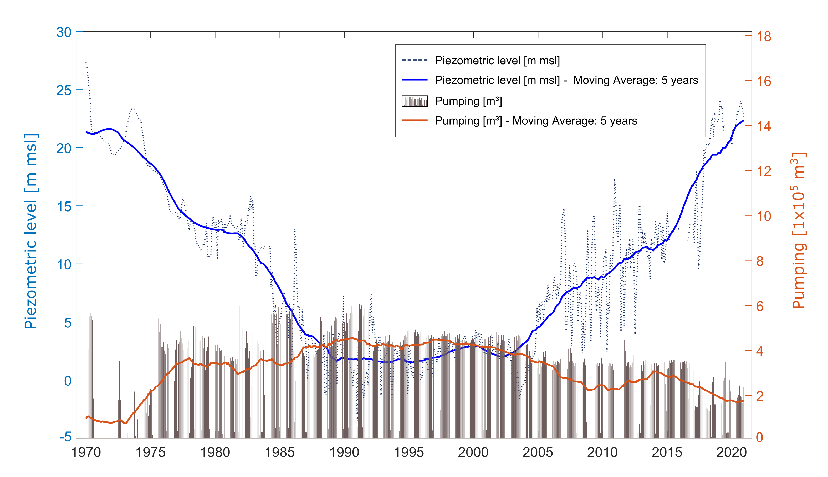
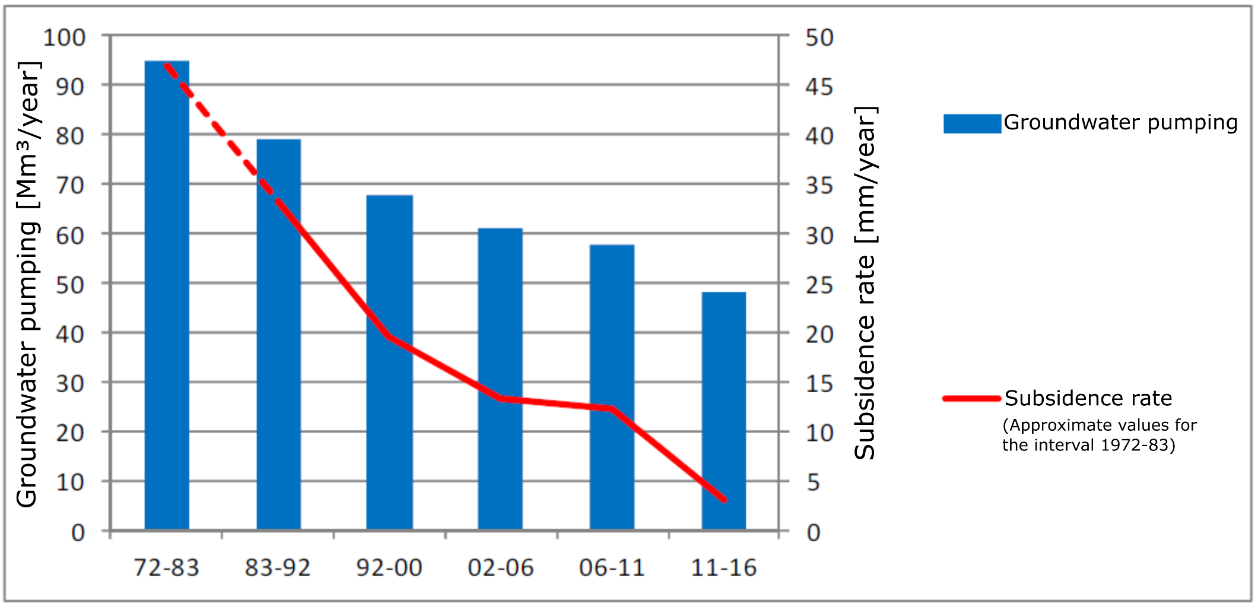
Land subsidence process in the urban area of Bologna
Since the beginning of the 1960s, the city of Bologna has experienced land subsidence due to excessive groundwater withdrawals
During the 1970s, ground displacement rate peaks of 10 cm/year were documented
Since the mid-1980s, the introduction of groundwater management regulations initiated:
  a gradual lessening of the subsidence rates
  a stop of the drawdown of the piezometric level, followed by a rise since the mid-2000s
Nowadays a few areas of the urban area seem to be stable.
a)
a) Pumping and piezometric level time series at Fossolo pumping station from 1970 to 2020 (HERA).
b) Medium-long term evolution of land subsidence and groundwater withdrawal rates (Arpae, 2018).
b)

Slide 3
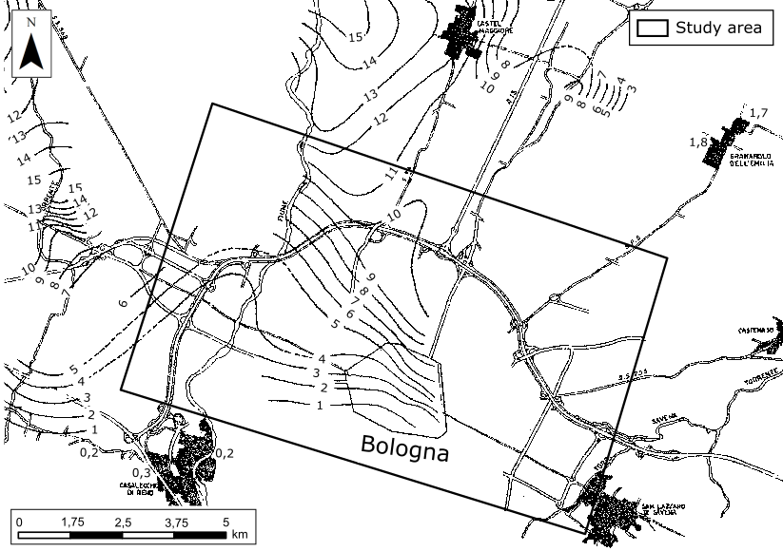
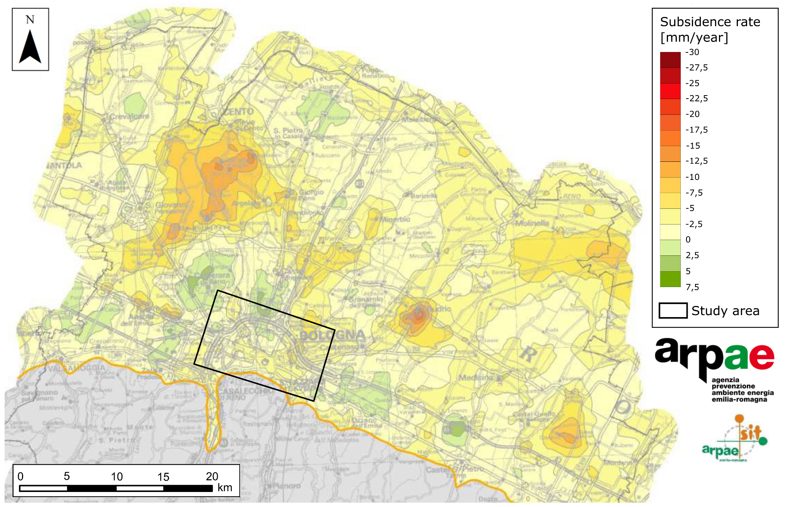
Historical subsidence monitoring
1950 – 1972: Topographic levelling
1973 – 1983: Topographic levelling
1983 – 1987: Topographic levelling
1987 – 1992: Topographic levelling
1992 – 2000: InSAR survey → ERS – PSInSAR
1999 – 2005: Topographic levelling + GNSS network
2002-2006: InSAR survey → ENVISAT – PSInSAR
2006-2011: InSAR survey → RADARSAT – SqueeSAR
2011-2016: InSAR survey → RADARSAT and COSMO-SkyMed – SqueeSAR
Subsidence peak:
≈ 10 -11 [cm/yr]
Subsidence rate map from Radarsat and Cosmo-SkyMed survey 2011 – 2016 (Arpae, 2018).
Subsidence isokinetics [cm/year] 1973-1983 (Barbarella et al.,1990).

Slide 4
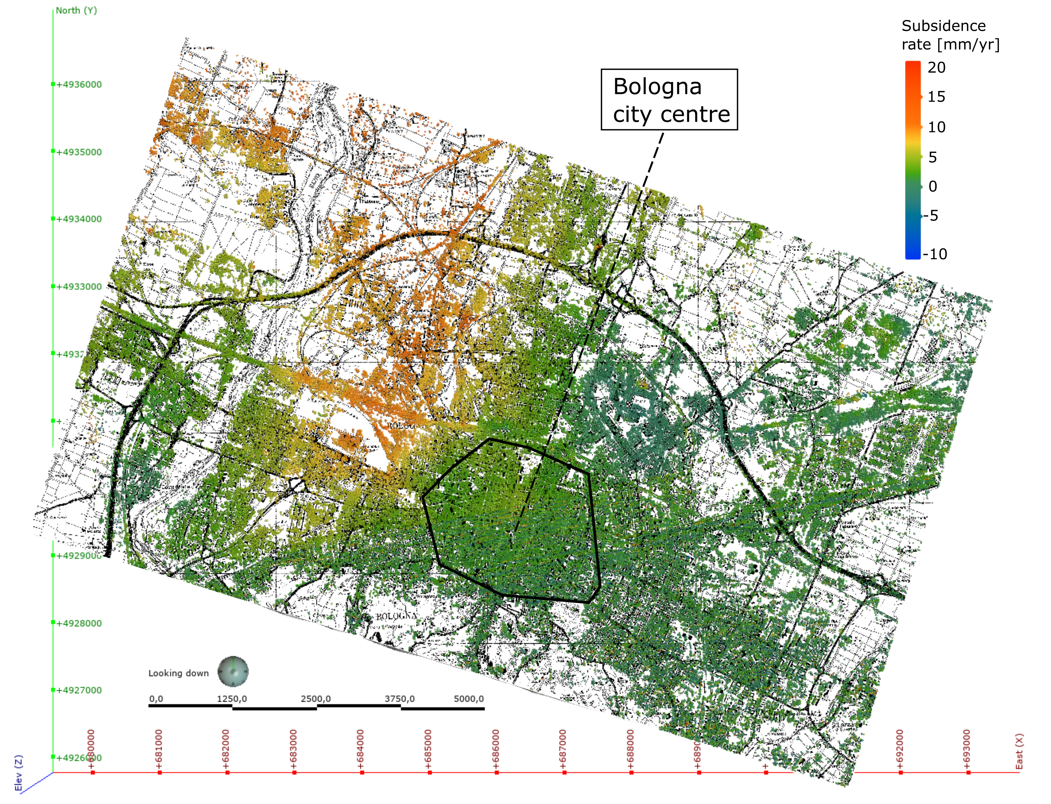
SENTINEL-1 InSAR survey
New InSAR survey performed by UniBo spin-off “Fragile” on the 2014 – 2020 Sentinel-1 ascending and descending orbits free data
Each interferogram was processed through the software GMTSAR
A Small Baseline approach was followed to resolve the displacements over time
Great attention was paid to:
  the choice of reference pixels to maximise their density in the selected area
  the definition of the considered time span (6-365 days) to consider both quicker and slower movements
The resulting displacement map has higher spatial and temporal resolution than the previous ones.
InSAR Survey | N°PS (study area) | PS density [n°PS/km²]
ERS (1992-2000) | 6321 | 718
ENVISAT (2002-2006) | 5279 | 600
RADARSAT (2006-2011) | 6720 | 764
RADARSAT+COSMO (2011-2016) | 18800 | 2136
SENTINEL-1 (2014-2020) | 145956 (asc.) | 16586 (asc.)
 | 209290 (desc.) | 23783 (desc.)

Slide 5
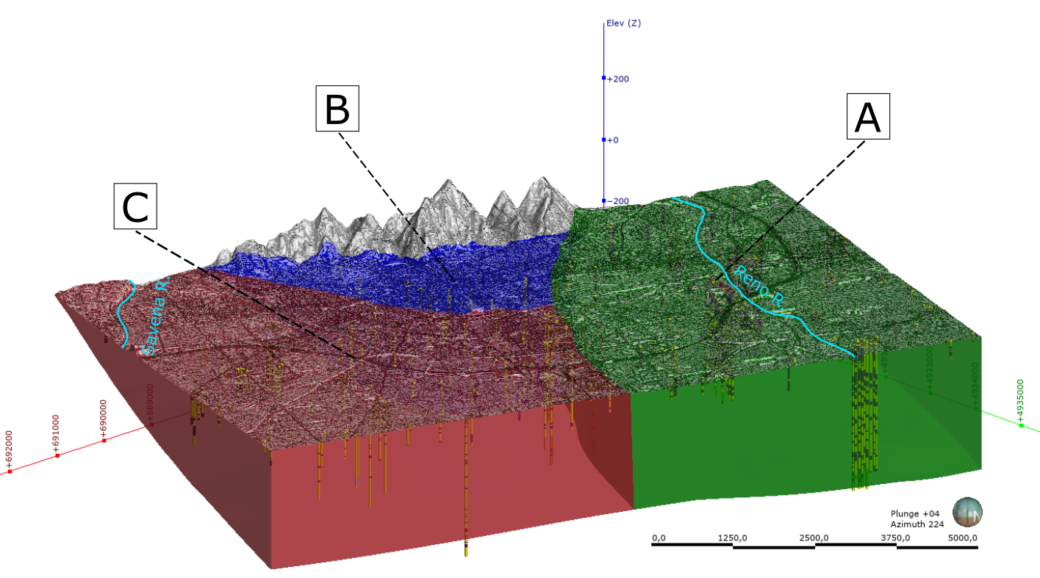
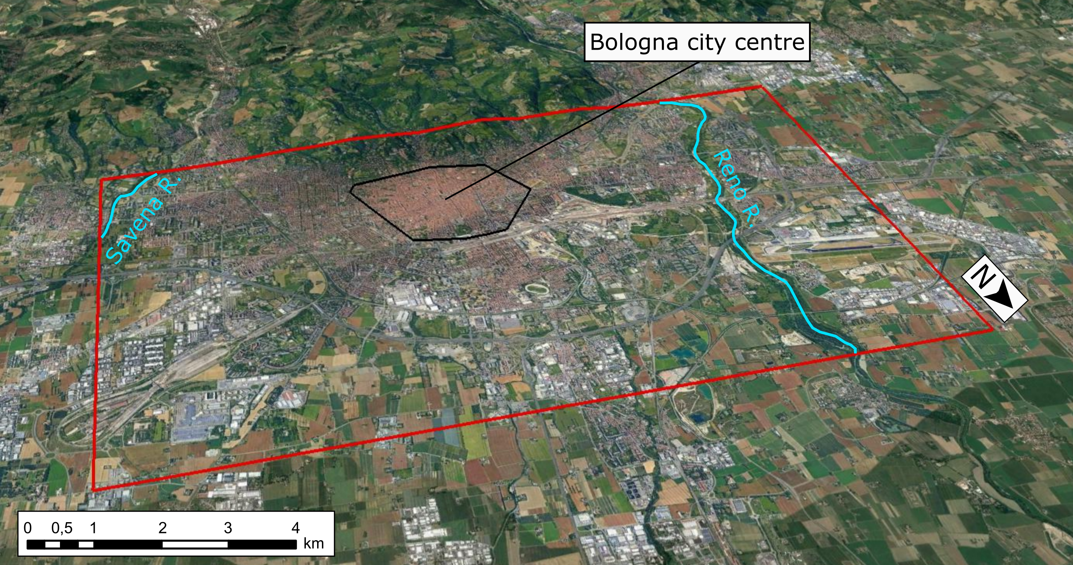
3D geological model of the Bologna urban area
Detailed stratigraphic analysis based on:
  systematic revision of the existing geognostic surveys archives
  analysis and correlations on appropriately oriented stratigraphic sections
The area of Bologna is distinguished by a more complex geological setting than the expected rather homogeneous alluvial context.
Partition of the study area into 3 sub-domains characterised by different morphological and lithostratigraphic features.
Sub-domain | Short lithological description
A | Thick and amalgamated gravelly deposits of the Reno River.
B | Rather continuous sequences of rigid and overconsolidated fine-grained deposits.
C | Thinner and more dispersed gravelly deposits of the Savena River alluvial fan.

Slide 6
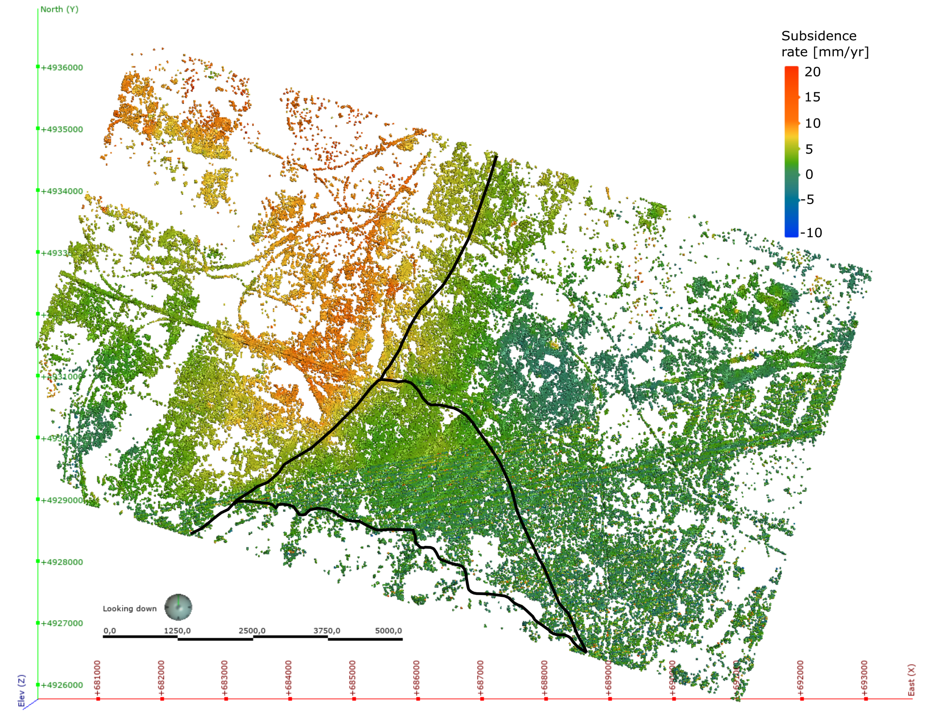
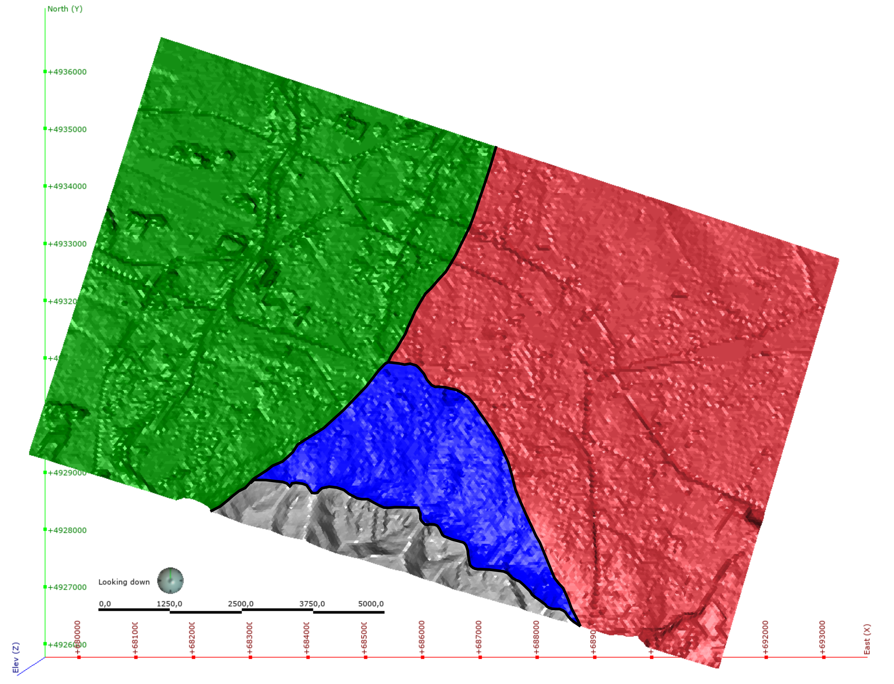
Displacement rate map and geological model
The InSAR-derived ground displacement field well agrees with the main evidences of the stratigraphic analysis, underlining the influence of the peculiar geological setting on the subsidence process evolution.
A
C
B

Slide 7
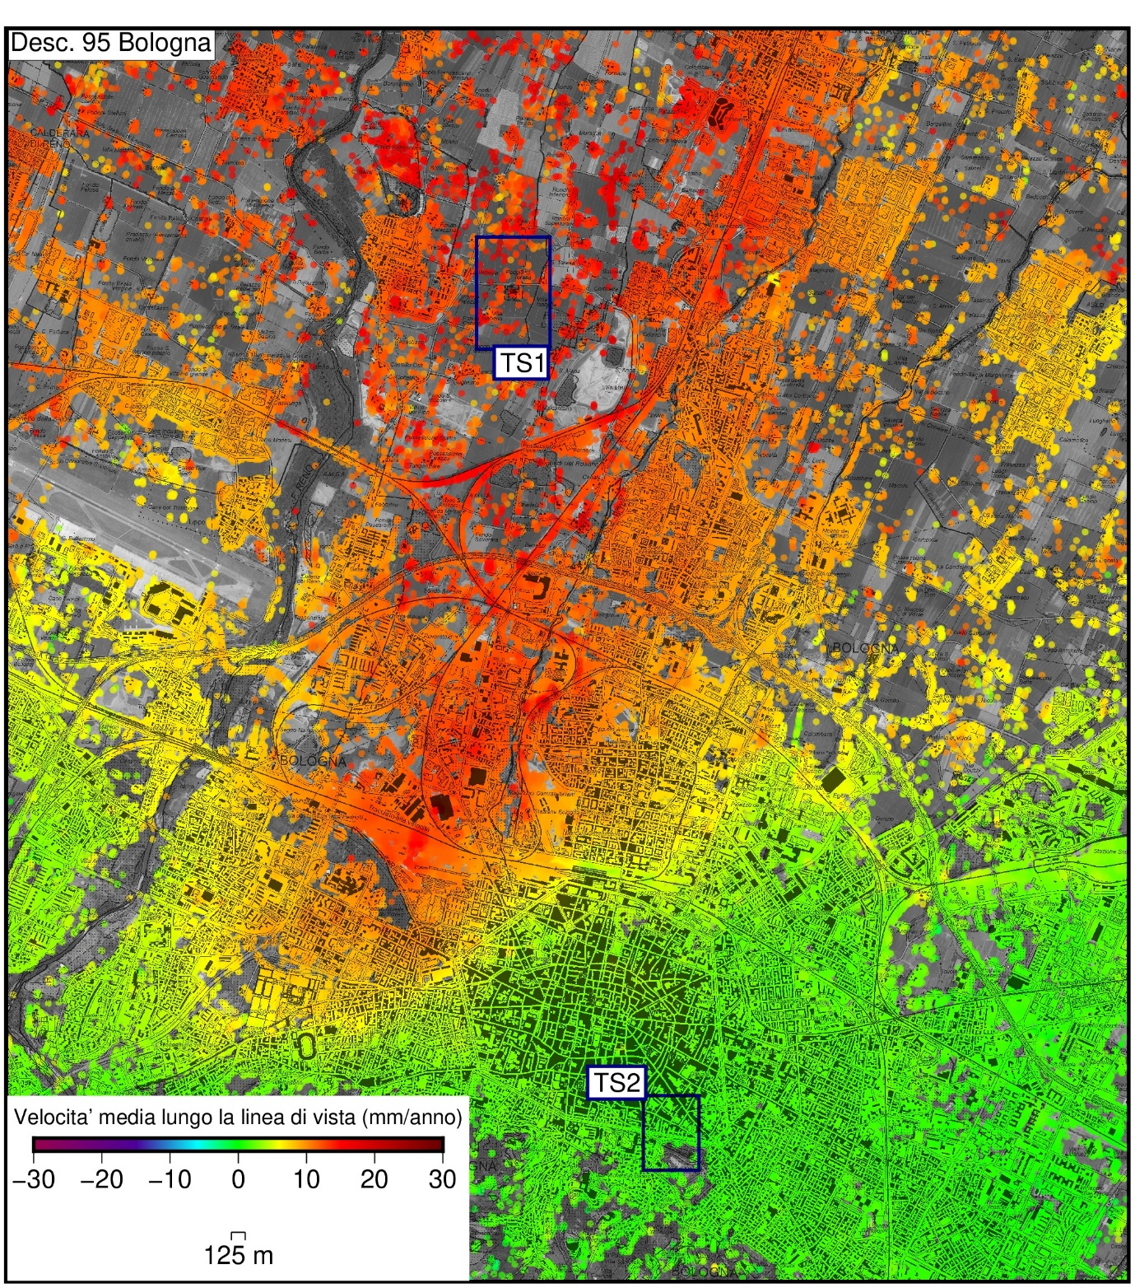
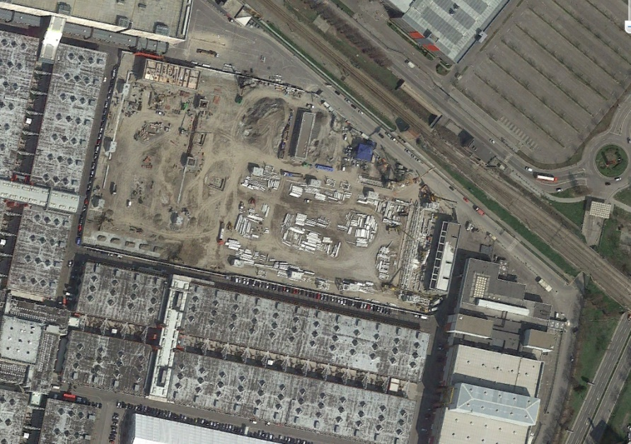
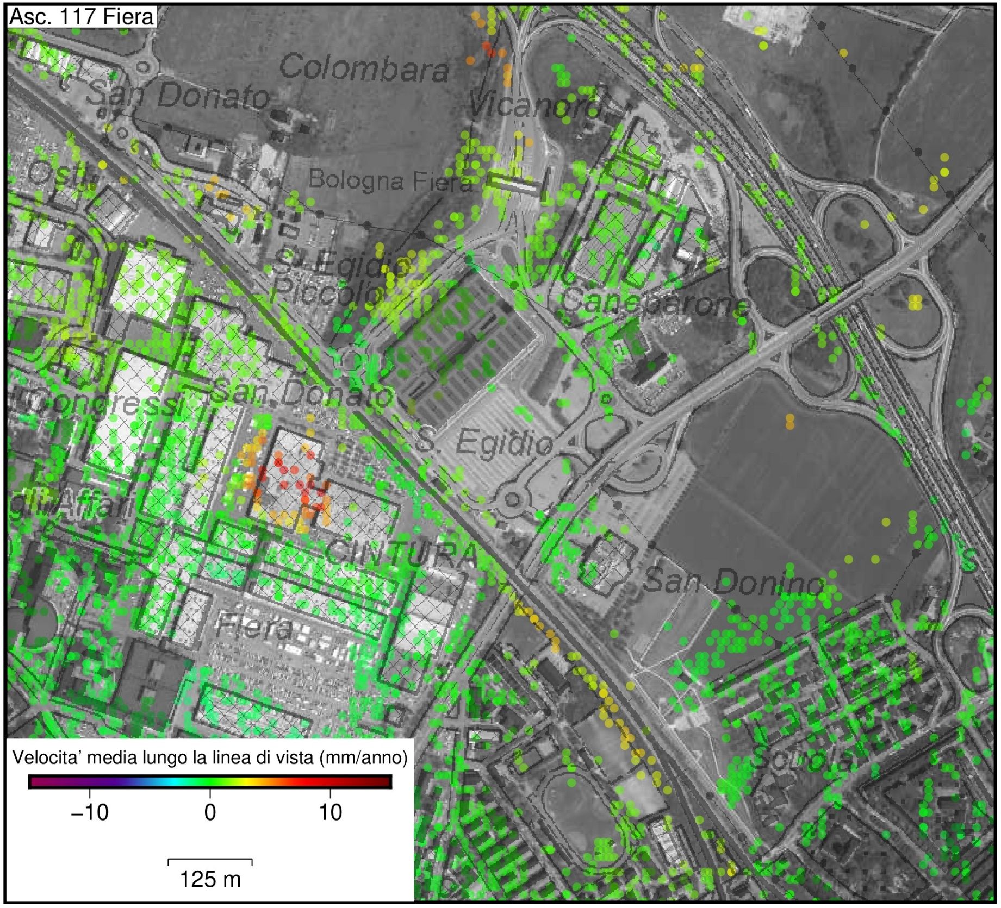
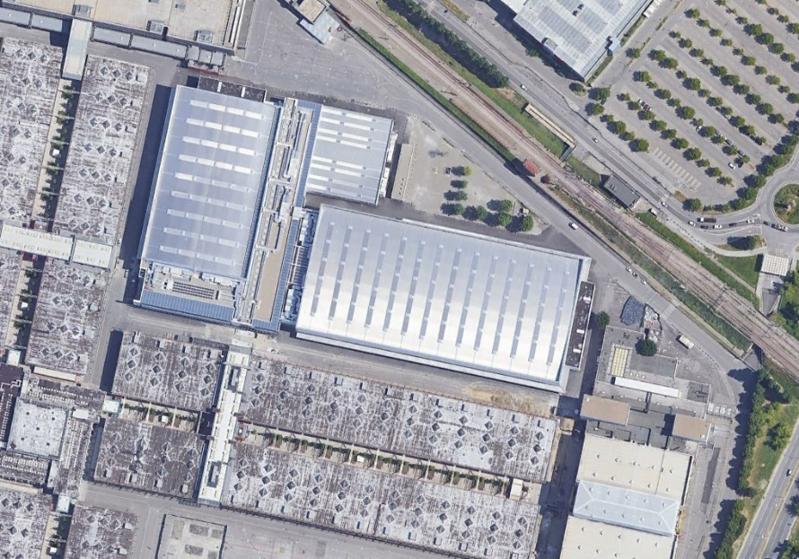
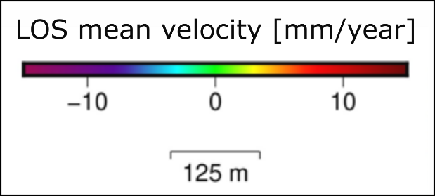
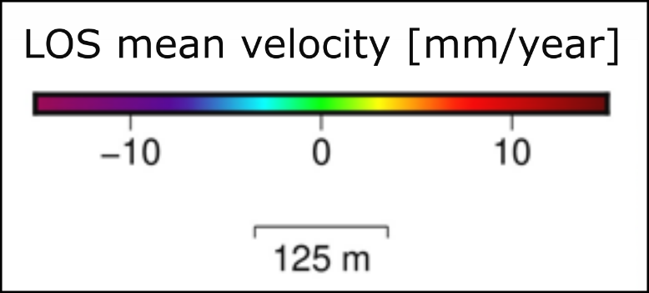
Small-scale settlements detection
The high resolution of the Sentinel-1 survey allows to isolate and analyse also small-scale settlements that could be related to localised anthropic activities.
March 2018
June 2019

Slide 8
Final considerations
The 2014-2020 Sentinel-1 survey allowed to produce more accurate ground displacement maps than previous InSAR campaigns, with an average PS density increment of about 850%, compared to the 2011-2016 Rasdarsat and Cosmo-SkyMed one
The agreement between the displacement field maps and the stratigraphic analysis main remarks highlights the influence of the peculiar geological setting of the study area on the subsidence process evolution
The high resolution of the Sentinel-1 survey allows the analysis of both sub-regional and small-scale ground displacements.
Notes:
In conclusione, le peculiari caratteristiche morfologiche e geologiche di Bologna non porterebbero a pensare alla subsidenza come uno dei geohazard principali.
I tassi di subsidenza anomali documentati non sembrano dipendere dall’assetto naturale e dal contesto geologico in cui si inserisce la città, ma sembrerebbero essere dovuti all’azione prolungata di forzanti antropiche esterne, quali l’eccessivo emungimento di acque sotterranee dagli acquiferi del Reno e del Savena.
In un contesto particolare come quello di Bologna la «recente» adozione di politiche di gestione e razionalizzazione della risorsa idrica, anche se riguardanti zone esterne alla città, si è rivelata fondamentale per la riduzione degli effetti della subsidenza anche nel centro storico.
I diversi tassi di subsidenza osservati tra il centro storico e le zone periferiche, legati alle diverse caratteristiche geologiche illustrate, dovrebbero essere trattati in modo differente in funzione della vulnerabilità del luogo/sito considerato. Infatti, anche bassi valori di subsidenza possono comunque rappresentare un fattore di rischio non trascurabile per la città dato il suo grande valore storico.

Slide 9
Thank you for your attention
(alessandro.zuccarin4@unibo.it)

