Slide 1





The Upper Tropospheric Cyclonic Vortex influence over moisture convergence and precipitation on Brazilian Northeastern
Matheus Lyra¹, Josefina Arraut¹, and Hugo Braga²
¹ Technology and Natural Resources Center, Federal University of Campina Grande, Campina Grande, Brazil – e-mail: matheuslyraa@gmail.com; josefina.arraut@gmail.com
² Department of Atmospheric Sciences, University of São Paulo, São Paulo, Brazil – e-mail: hugo.braga@iag.usp.br

Slide 2
Introduction
The Northeastern Brazil (BNE) is the second largest region in the country;
The Sertão is the driest area in Brazil (Reboita et al., 2010) with precipitation not exceeding 400 mm per year (Conti and Furlan, 2003);
The Upper Tropospheric Cyclonic Vortex (UTCV) is responsible for rainfall production in the pre-rainy season (December-February) over the region (Rao and Bonatti, 1987;
The Amazon region (AMZ) has high importance for the moisture transport to extratropical latitudes of the continent over South America (Marengo et al., 2012).
Figure 1 - Study region topographical map containing South America and adjacent oceans. The Brazilian Northeast and Amazon region are highlighted. Andes mountain range can be observed on western.

Slide 3
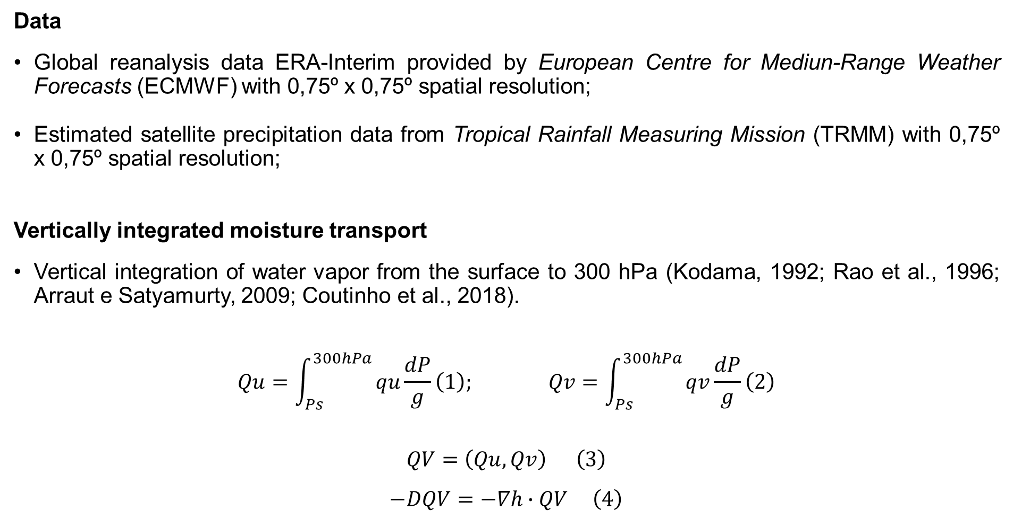
Data and methodology
3
Data
Global reanalysis data ERA-Interim provided by European Centre for Mediun-Range Weather Forecasts (ECMWF) with 0,75º x 0,75º spatial resolution;
Estimated satellite precipitation data from Tropical Rainfall Measuring Mission (TRMM) with 0,75º x 0,75º spatial resolution;
Vertically integrated moisture transport
Vertical integration of water vapor from the surface to 300 hPa (Kodama, 1992; Rao et al., 1996; Arraut e Satyamurty, 2009; Coutinho et al., 2018).
$$Qu=\int_{Ps}^{300hPa}{qu\frac{dP}{g}}\left(1\right); Qv=\int_{Ps}^{300hPa}{qv\frac{dP}{g}}\left(2\right)$$
$$QV=\left(Qu,Qv\right) \left(3\right)$$
$$−DQV=−∇h∙QV \left(4\right)$$

Slide 4
Data and methodology
4
Virtual boxes method
Average intensity calculation in an irregular area
Study areas cut out;
Definition of a threshold**;
Variable calculation;
*Values below the threshold are replaced by undefined values.
Step 1
Step 2
Figure 2 - Application of the average intensity calculation in an irregular area for a vertically integrated moisture transport field (1000-300hPa).
Step 3

Slide 5
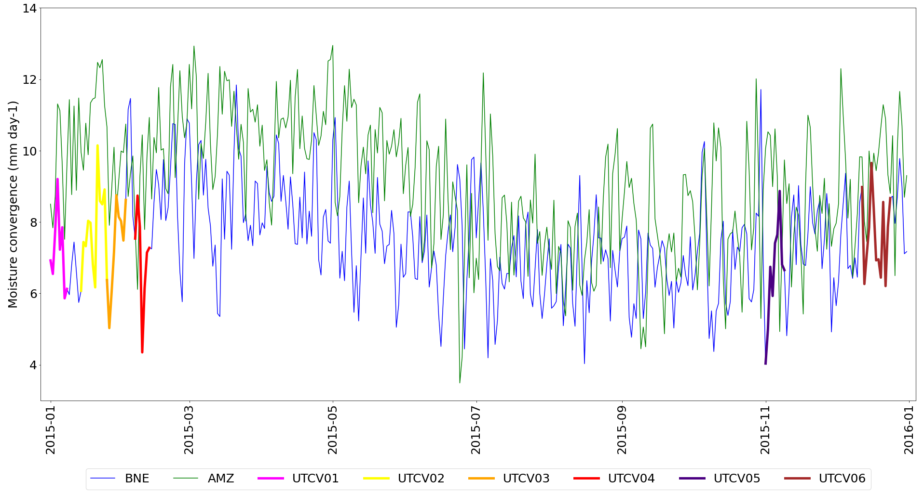
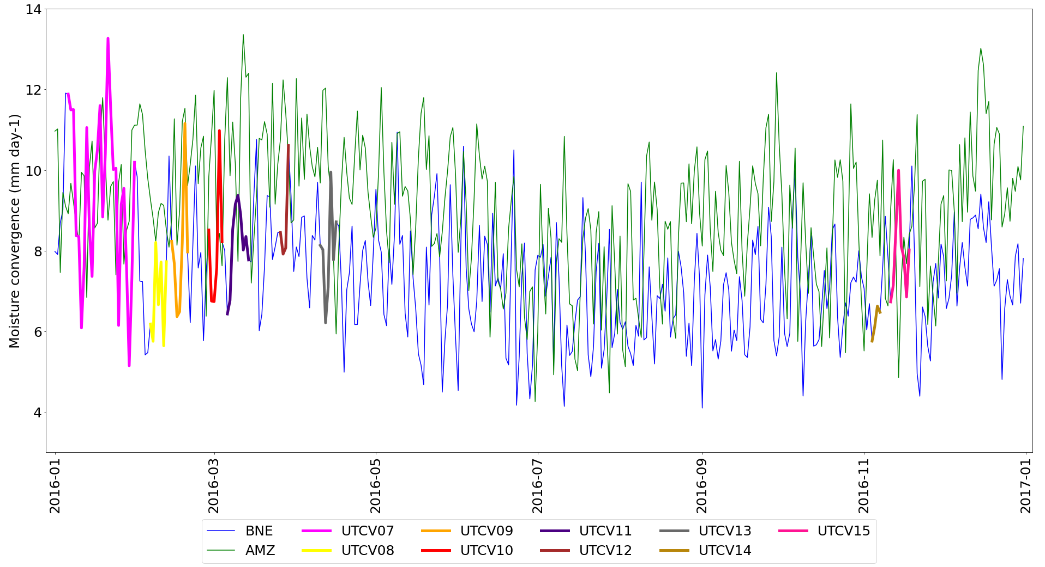
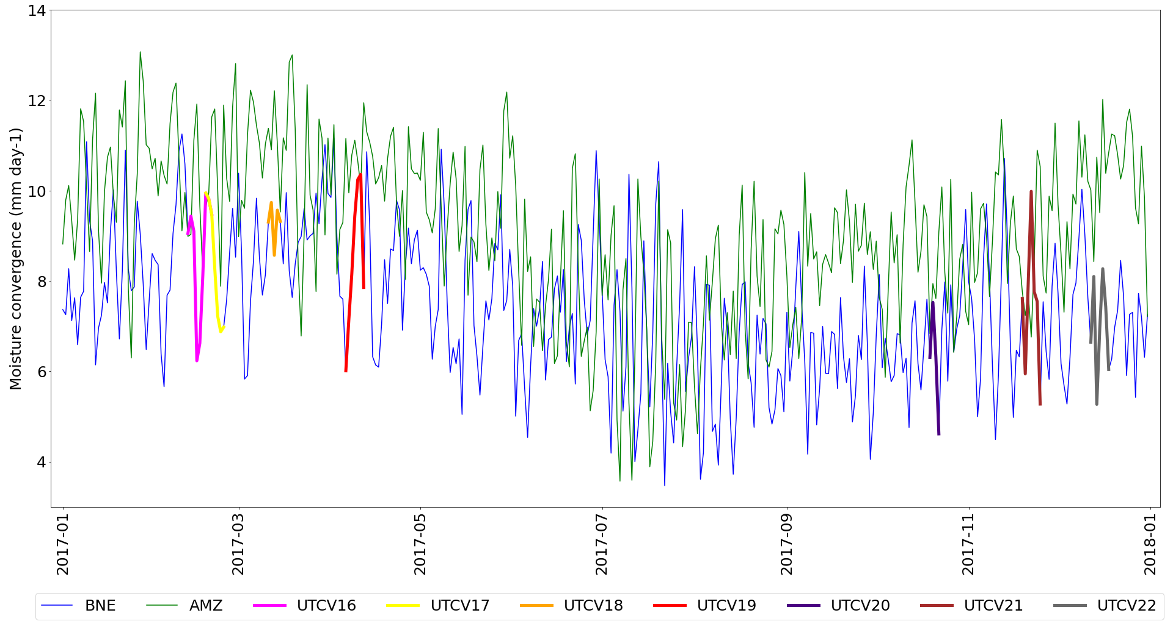
Results
5
2015
2016
2017
Figure 3 - Vertically integrated moisture transport convergence daily averages for BNE and AMZ regions. The colored lines represent the dates of UTCV occurrences during the presented period.

Slide 6
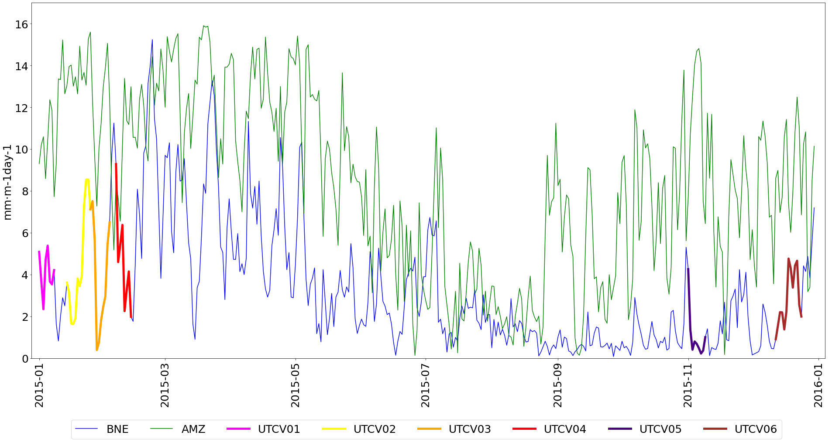
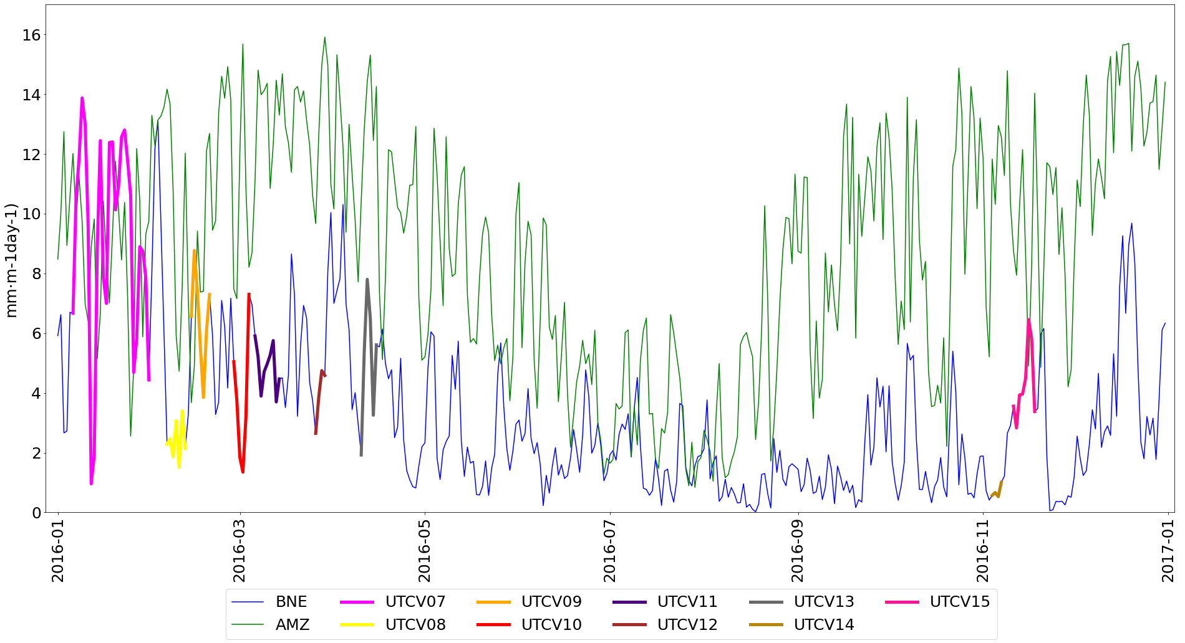
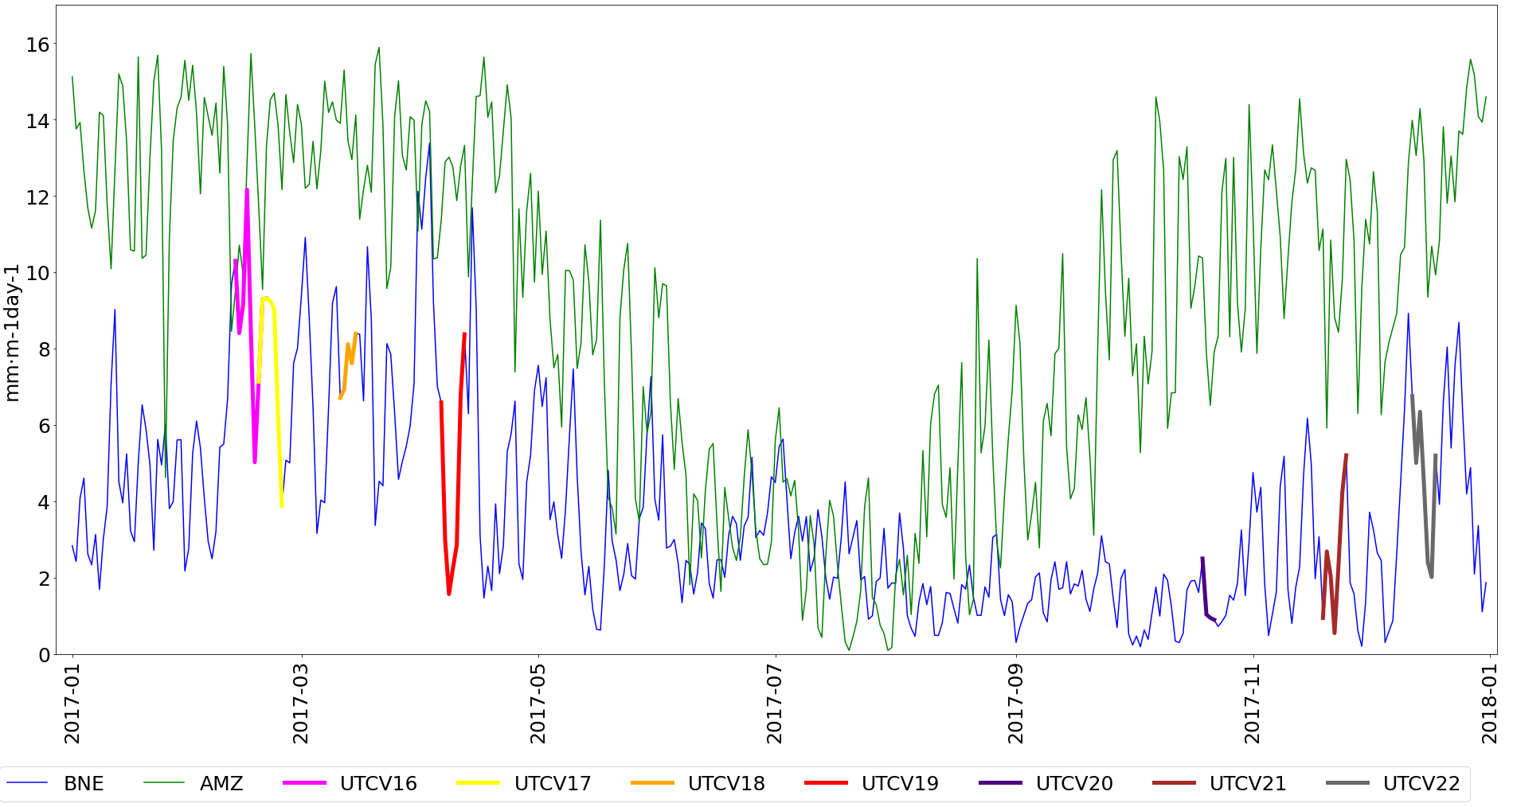
Results
6
2015
2016
2017
Figure 4 - Precipitation daily averages for BNE and AMZ regions. The colored lines represent the dates of UTCV occurrences during the presented period.

Slide 7
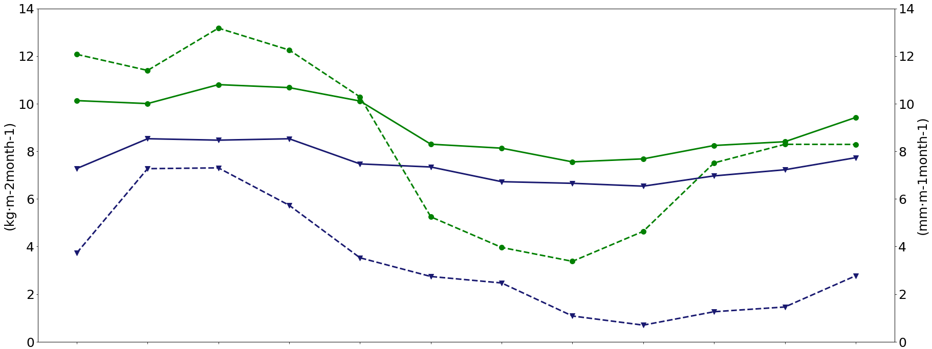
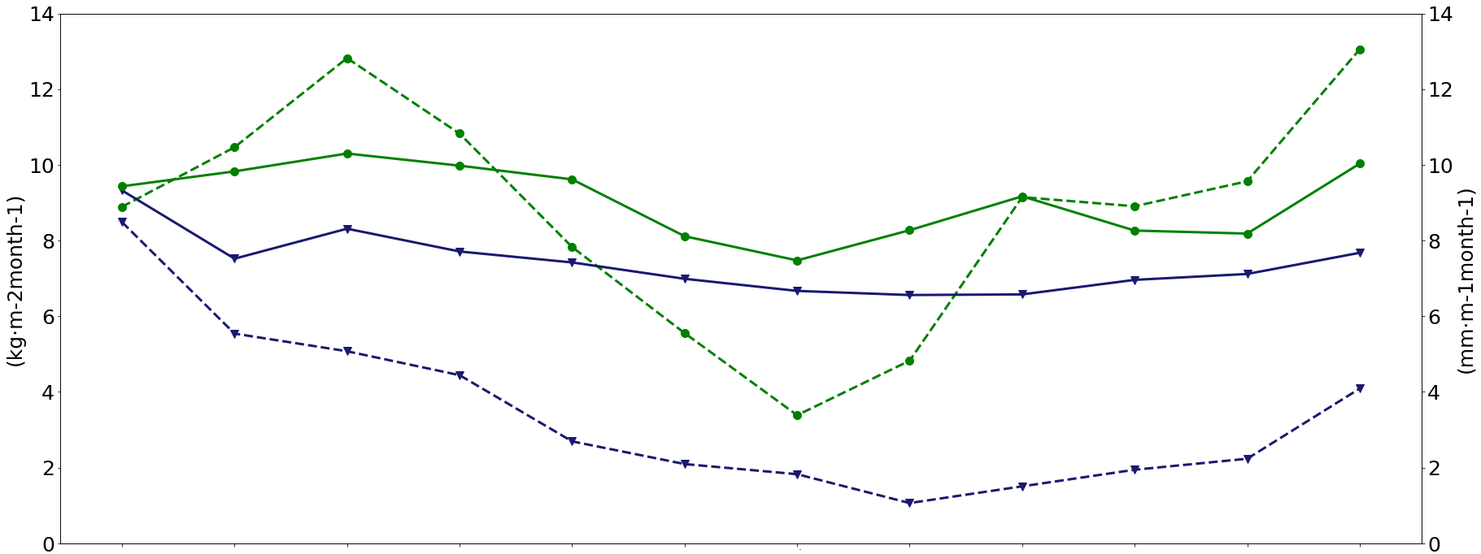

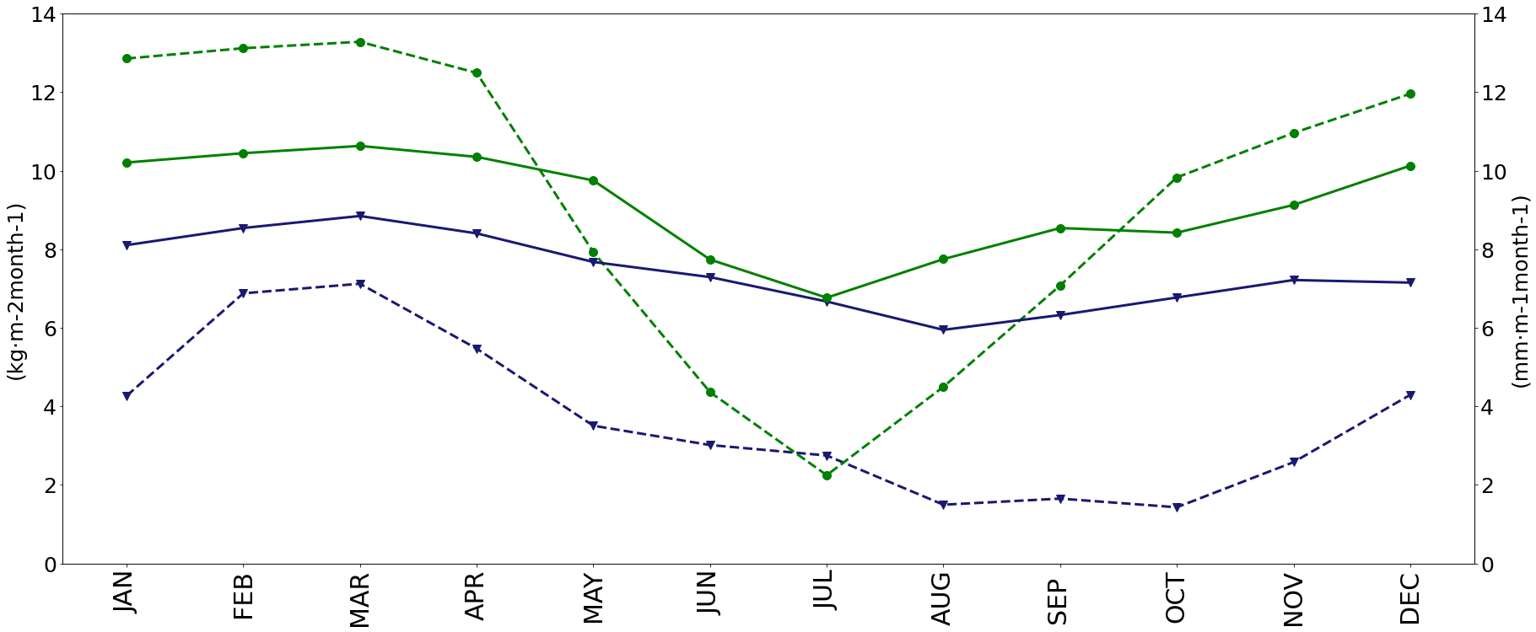
Results
7
2015
2016
Figure 5 - Convergence of vertically integrated moisture transport and precipitation monthly averages for the two analyzes regions in 2015 (a); 2016 (b); 2017 (c).
2017

Slide 8
Conclusions
8
It was possible to observe, on certain dates, higher concentrations of moisture convergence and precipitation in the BNE concerning AMZ;
This occurred during the presence of some vortexes over the BNE, mainly in 2016;
The UTCV07 periphery location (fixed on the continent) raised the moisture convergence and precipitation values in the BNE, being more intense than in the AMZ.
References
Arraut, J. M.; Satyamurty, P. Precipitation and Water Vapor Transport in the Southern Hemisphere with Emphasis on the South America Region. Journal of Applied Meteorology and Climatology. v. 48, p. 1902-1912. 2009.
Kousky, V. E., Gan, M. A. Upper troposhperic cyclonic vortices in the tropical South Altantic. Tellus, v.33, p. 538-551, 1981;
Marengo, J. A.; et. al. Development of regional future climate change scenarios in South America using the Eta CPTEC/HadCM3 climate change projections: Climatology and regional analyses for the Amazon, São Francisco and the Paraná River Basins. Climate Dynamics, v. 38, n. 9-10, p. 1829-1848, 2012.
Rao, V. B. and Bonatti, J. P. On the origin of upper tropospheric cyclonic vortices in the South Atlantic Ocean and adjoint Brazil during the summer. Meteorology and Atmospheric Physics, 37, p. 11-16, 1987.
Reboita, M. S.; Gan, M. A.; Rocha, R.P.; Ambrizzi, T. South American rainfall regimes: A bibliographic review. Revista Brasileira de Meteorologia, v. 25, n. 2, p. 185-204, 2010.

