Slide 1
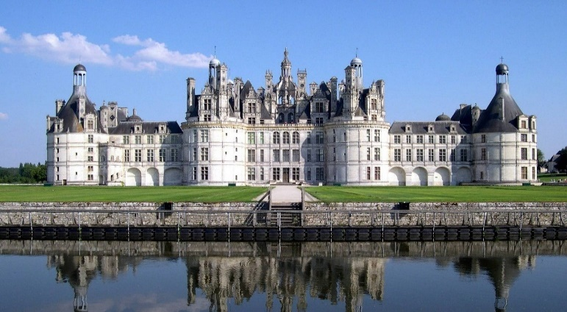
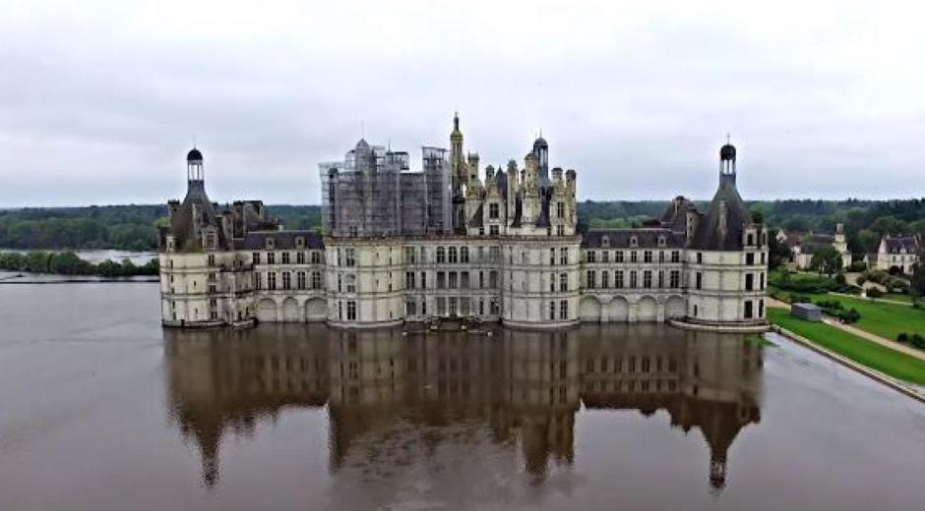
Climate Change and Cultural Heritage, EGU General Assembly, Vienna, April 2022
THE FRENCH MONUMENTAL HERITAGE
IN THE FACE OF GLOBAL CLIMATE CHANGE:
ASSESSMENT AND PERSPECTIVES OF RESEARCH
June 2016
R.-A. Lefèvre¹, P. Brimblecombe² , A. Verney-Carron¹
¹ Université Paris-Est Créteil, LISA UMR CNRS 7583
² National Sun Yat Sen University, Kaohsiung, Taiwan

Slide 2
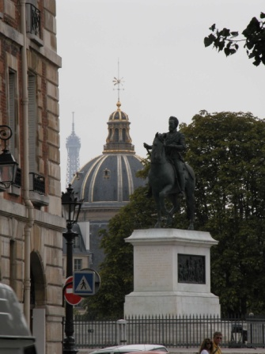
Cultural heritage and climate
Numerous materials (stones, glass, metals, wood,…)
Alteration caused by climate (T, water, wind)
Slow and extreme events
What are the impacts of climate change?
How to assess and predict these impacts?

Slide 3
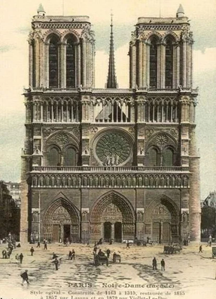
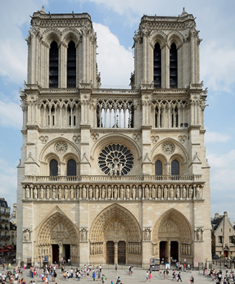
Methodology to assess and predict impacts
Dose-response functions: dose=f(rain, pH, T, RH, SO₂, NO₂, PM₁₀, O₃, HNO₃)
Climate and pollution data (PAST: dendroclimatology, historic data) / PRESENT: measurements / FUTURE: scenarios + model)
Case study of Notre-Dame
(1160-1345)
(Brimblecombe & Lefèvre, 2021)
MULTI-ASSESS; ICP-Materials program
Beginning of 20 st century
2003

Slide 4
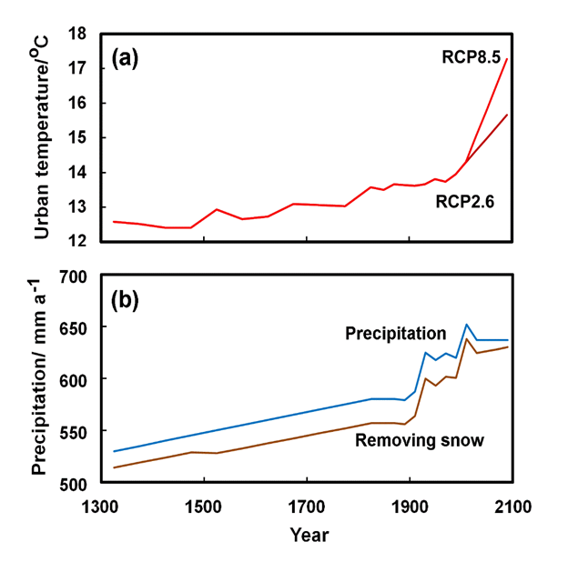
Environmental data
Data for T: tree rings + 2 RCPS (RCP2.6 = optimistic scenario / RCP8.5 = increase of emissions)
Precipitation: slightly drier in the past, no significant change in the future
Qualitative estimates, fuel use data / measurements (AQMN) / emissions from http://gains.iiasa.ac.at

Slide 5
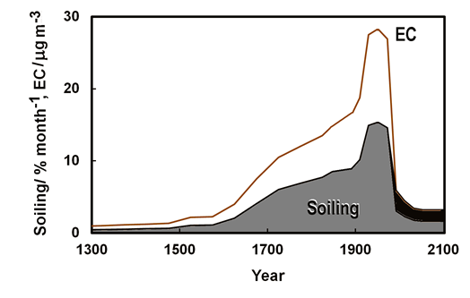
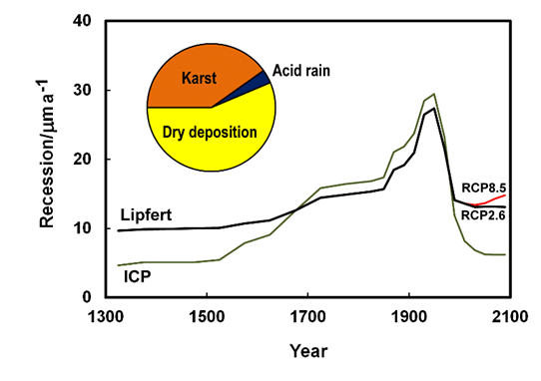
Stone façades
Brimblecombe & Grossi (2004, 2008); Kucera (2005, 2007); Sabbioni (2003)
Soiling (% / month)
Recession (µm/a)
Evolution similar to pollution + influence of CO₂ for erosion

Slide 6
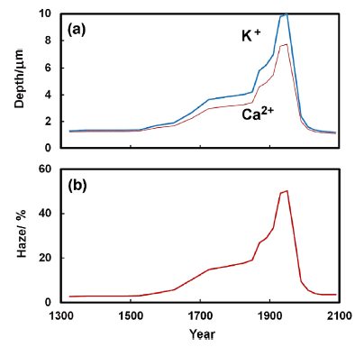

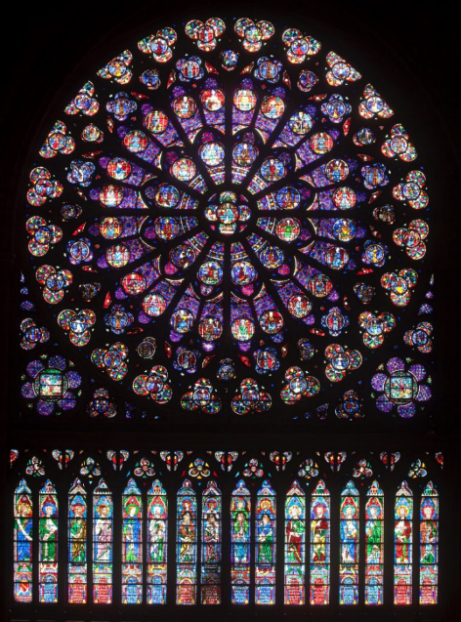
Ancient stained glass windows
Melcher & Schreiner (2007, 2010)
Chemical alteration: depth (µm)
Opacification/soiling: haze (%)
Predominant influence of pollution
Significant decrease in the 21th century

Slide 7
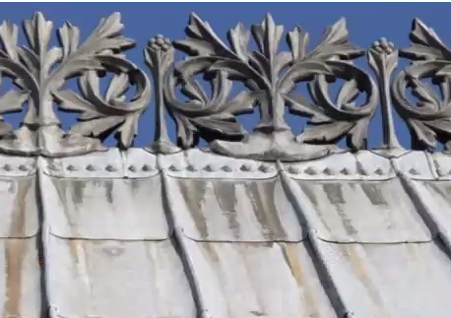
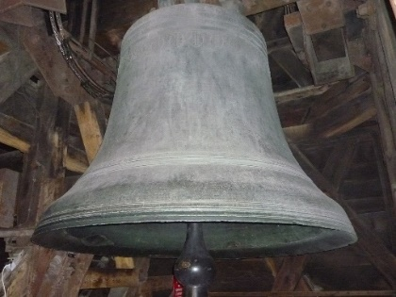
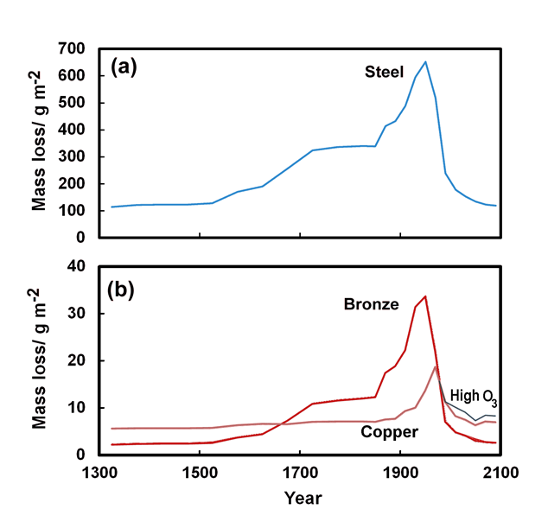
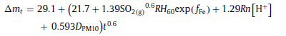
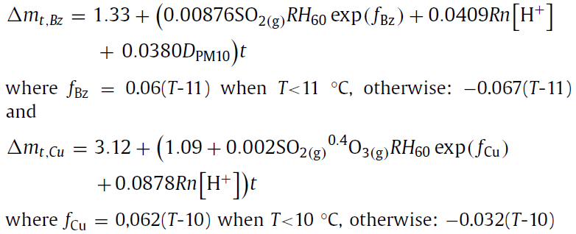
Metals
Iron
Bronze and copper
Decline of corrosion
Uncertainty of O₃ for Cu
Notes:
A value of 60 µg/m3 was considered instead of 40 for the blue curve to estimate this uncertainty on pollution models predictions.

Slide 8
Conclusions and perspectives
DRF are useful tools to anticipate climate changes and pollution effects
Pollution impact is apparent from around 1700 and increased notably after 1850. 21th century looks a little like the preindustrial period.
But uncertainties on O₃, other phenomena (biological colonization, salt weathering)
Need for higher spatial and temporal resolution

