Slide 1

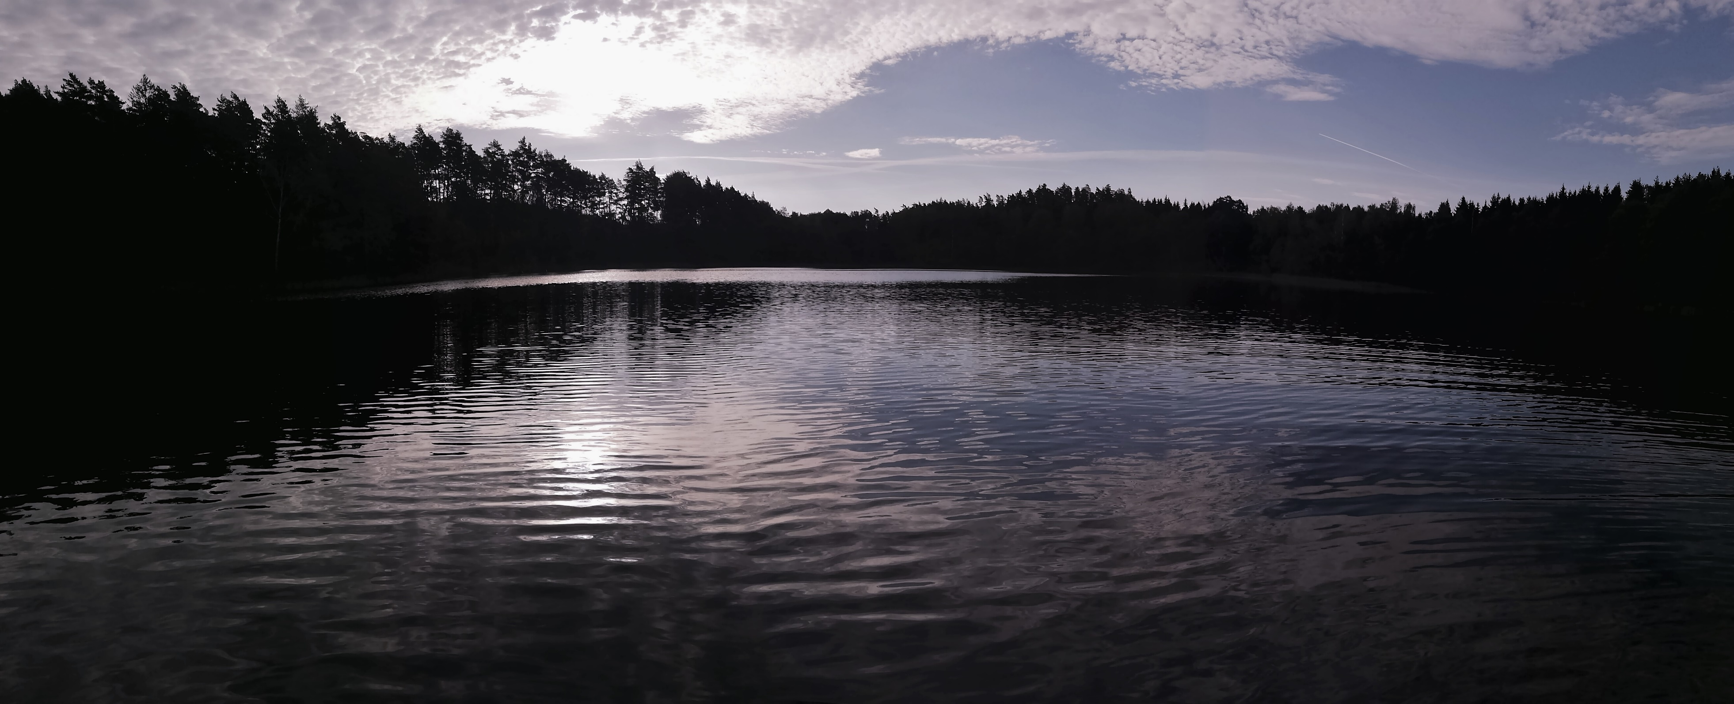




CHRYSOPHYTE CYSTS REFLECT SEASONAL METEOROLOGICAL AND LIMNOLOGICAL CONDITIONS: EVIDENCE FROM SEDIMENT TRAP STUDY IN NORTHEAST POLAND
Agnieszka Szczerba¹, Sergi Pla Rabés², Maurycy Żarczyński¹, Wojciech Tylmann¹
¹ Institute of Geography, University of Gdańsk, Gdańsk, Poland
² CREAF Centre for Ecological Research and Forestry Applications, Cerdanyola del Vallès, Spain
agnieszka.szczerba@phdstud.ug.edu.pl @SzczerbaAga
Tracking climate signals preserved in lake sediments from integrated process studies and ultra high-resolution analysis of annually laminated sediments. NCN 2015/18/E/ST10/00325

Slide 2
GOAL
GOAL & RESEARCH QUESTIONS
Determining whether changes in fluxes and taxonomy of cysts can be explained by meteorological conditions
Do chrysophyte cysts indirectly respond to meteorological variables acting through changes in mixing regime and properties of lake water?
Do chrysophyte cysts directly respond to specific meteorological variables?

Slide 3
STUDY SITE
ŁAZDUNY
Surface area: 10.6 [ha]
Trophic type: mesotrophic
Hydrologic type: outflowing
RZĘŚNIKI
Surface area: 12.0 [ha]
Trophic type: meso/eutrophic
Hydrologic type: flow-through
Localization of the study site, topography and hydrography of the catchment, and bathymetry of investigated lakes

Slide 4
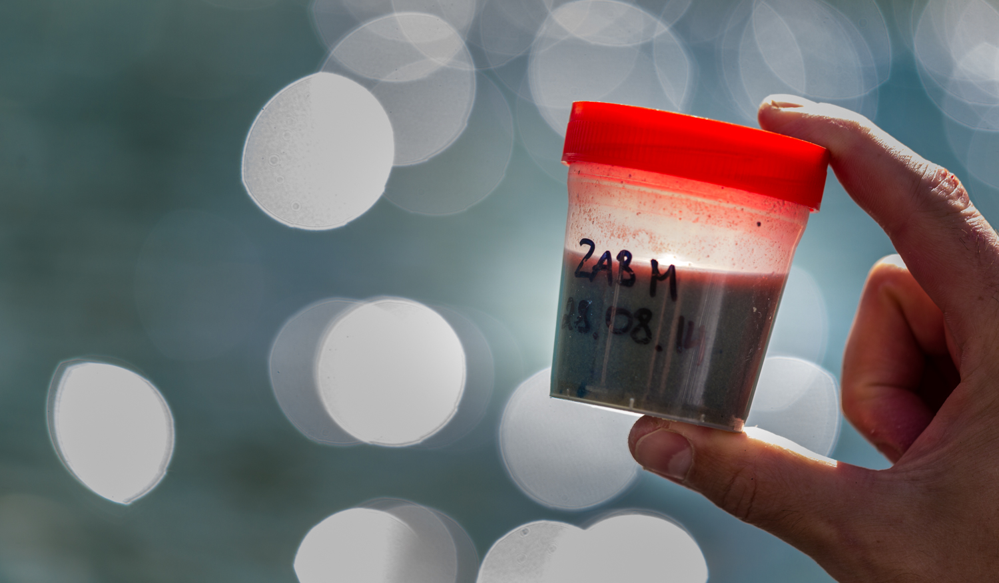
METHODS
CHRYSOPHYTE CYST ANALYSIS
LIMNOLOGICAL
MEASUREMENTS
Water temperature
Electrical conductivity
Chlorophyll-a
Oxygen concentration
pH
HYDROCHEMICAL MEASUREMENTS
Total phosphorus
Total nitrogen
METEOROLOGICAL
DATA
Air temperature
Wind speed
Precipitation
Photo: M. Zięba

Slide 5
ŁAZDUNY
RESULTS
RZĘŚNIKI
Exceptional winter was noted in 2020, when mean temperatures exceeded 5ºC – the longest whole water column mixing period. 2017-2019 development of spring mixing after the ice-out accompanied by an increase in nutrient concentrations and then followed by summer stratification.
Total fluxes are characterized by strong seasonality. Between 2017 and 2019 we recorded two major flux peaks: after ice-out and during fall. In 2020 no distinctive peaks were observed.
Depth profiles of water temperature and oxygen concentration, and total chrysophyte cyst fluxes [cysty d⁻¹ cm^2⁻¹],

Slide 6
ŁAZDUNY
RZĘŚNIKI
MIXING
STARTIFICATION
RDA biplots of cysts morphotypes and ‘collective groups’ with explanatory variables for the periods of mixing and stratification, the percent of variance in cyst data explained by limnological and hydrochemical (pink), and climate (blue) variables

Slide 7
INDICATOR TYPES
S130
Associated to spring and fall mixing in Ładuny and Rzęśniki
S159
Associated to spring and fall mixing in Ładuny and Rzęśniki
S180
Associated to spring and fall mixing in Rzęśniki
S404
Associated to fall mixing in Łazduny
Cyst types pointed out as indicative of specific lake physical structure period through multi-level pattern analysis

Slide 8
FINDINGS
The study of Lakes Łazduny and Rzęśniki revealed that chrysophyte cysts react both directly and indirectly to changes in meteorological conditions.
Cyst seasonality is strongly dependent on the physical properties of lakes, which are altered by changing meteorological conditions.
Ice cover and mixing intensity, controlling the availability of light and nutrients, are the major drivers of changes in cyst seasonality.
Both the mean and standard deviation values of air temperature proved to be vital variables for the development of individual cyst types, therefore confirming the direct impact of meteorological conditions.
Specific cyst types were indicative of different periods of lake physical structure.

Slide 9
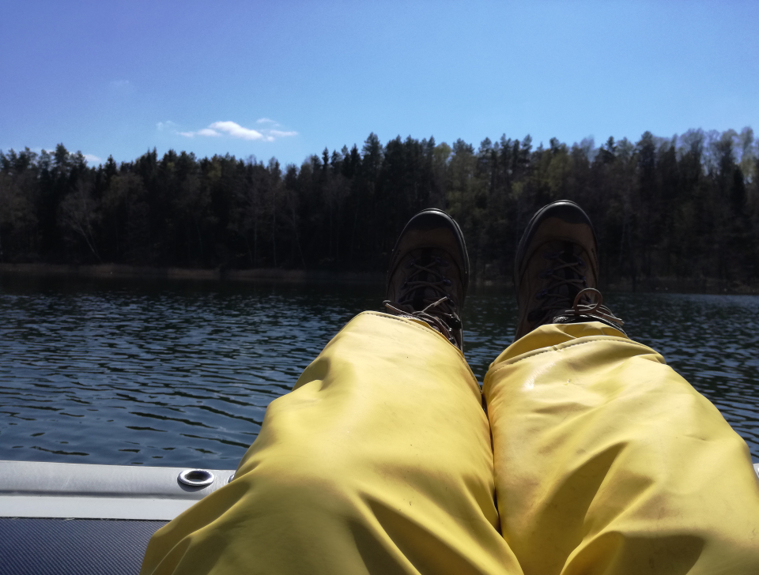
Thank you!

