Slide 1
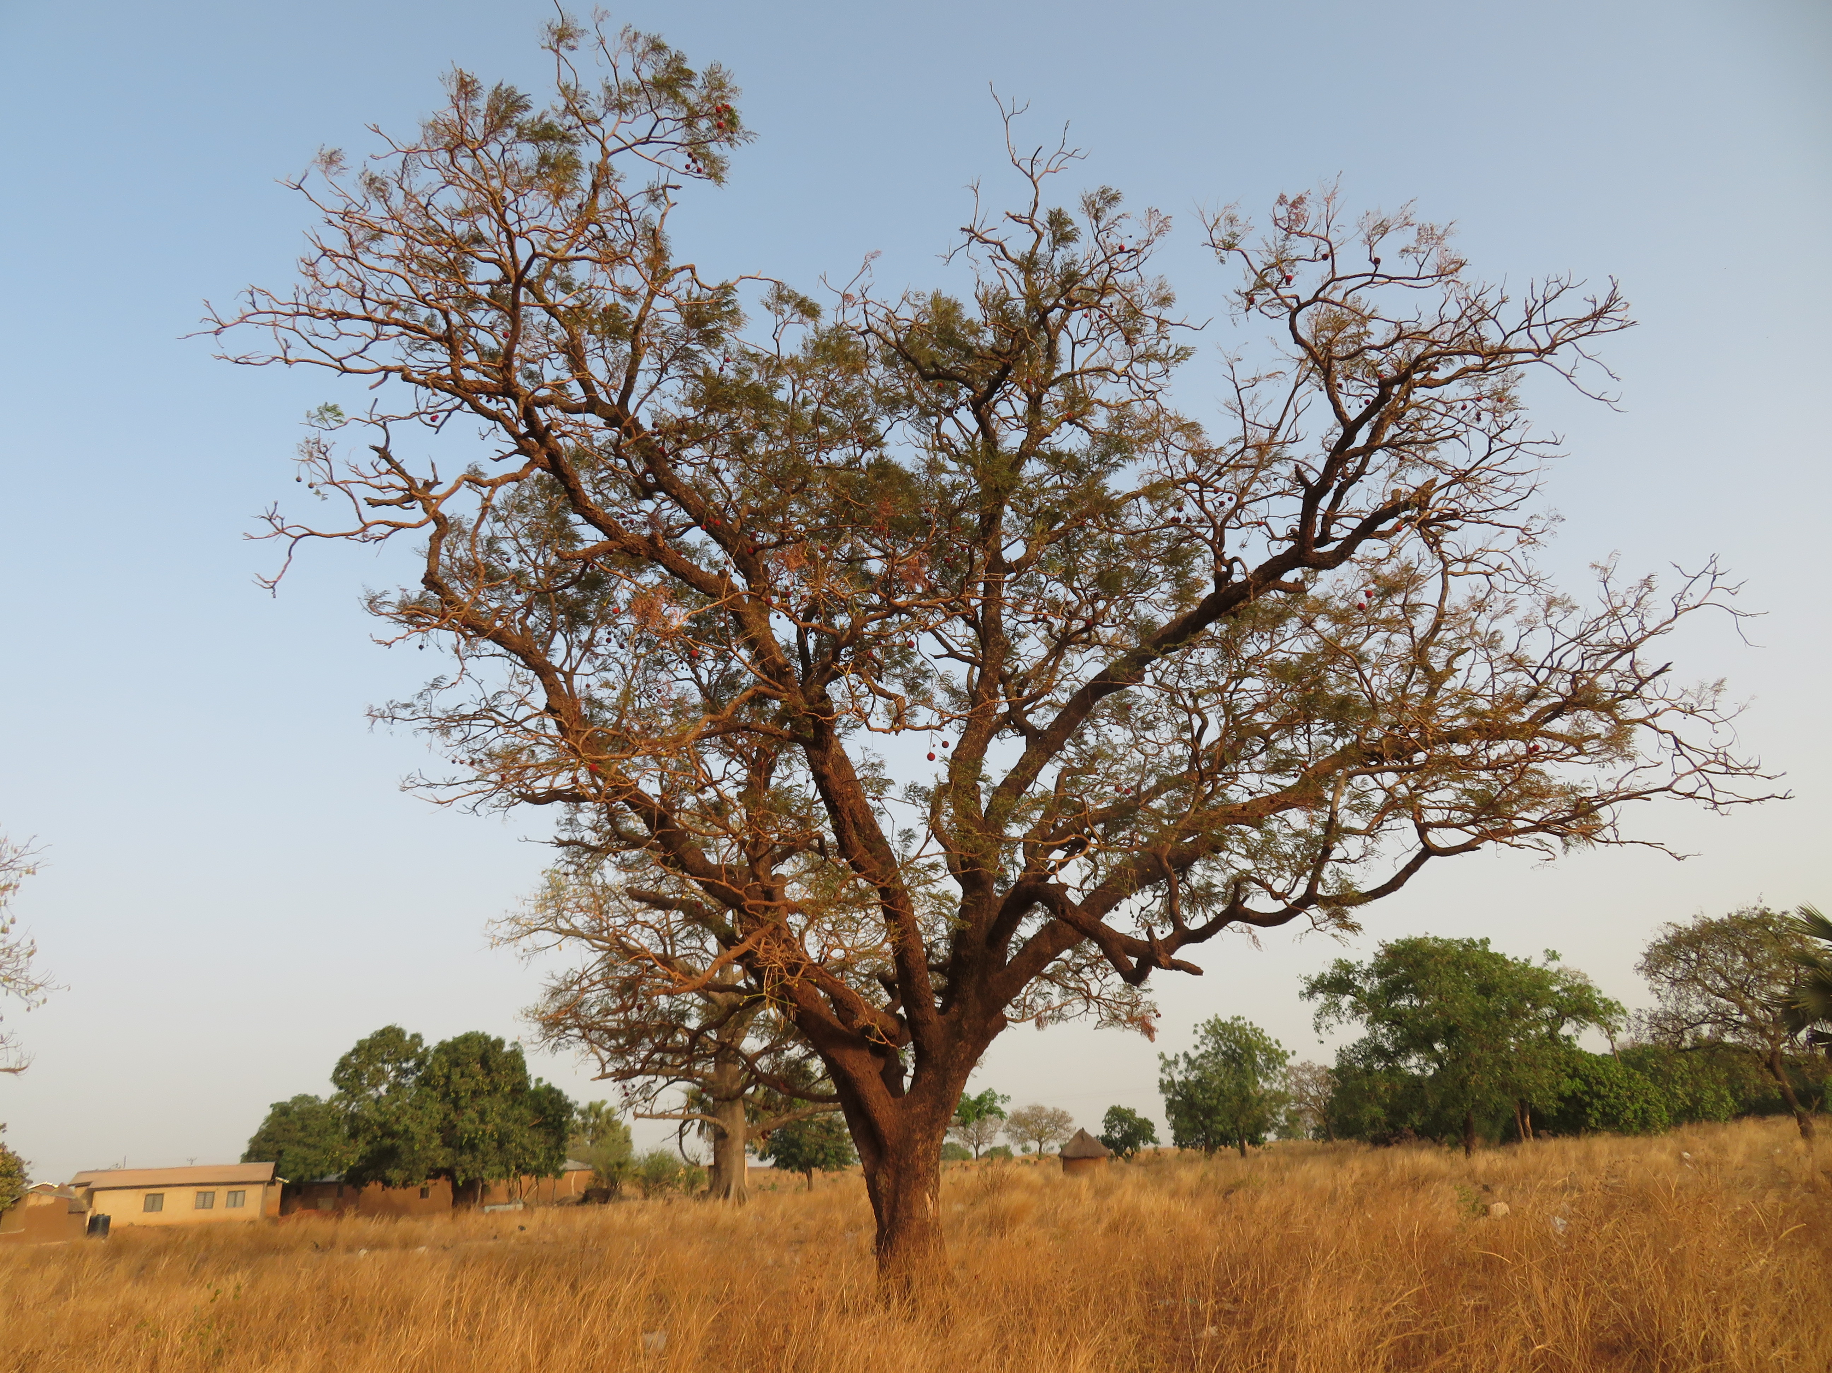


Rainfall onset no longer a starting signal for planting crops?
Sehouevi M. D. AGOUNGBOME, Nick van de Giesen, Marie-Claire ten Veldhuis
EGU General Assembly 2022, May 26th, 2022
Email: s.m.d.agoungbome@tudelft.nl

Slide 2
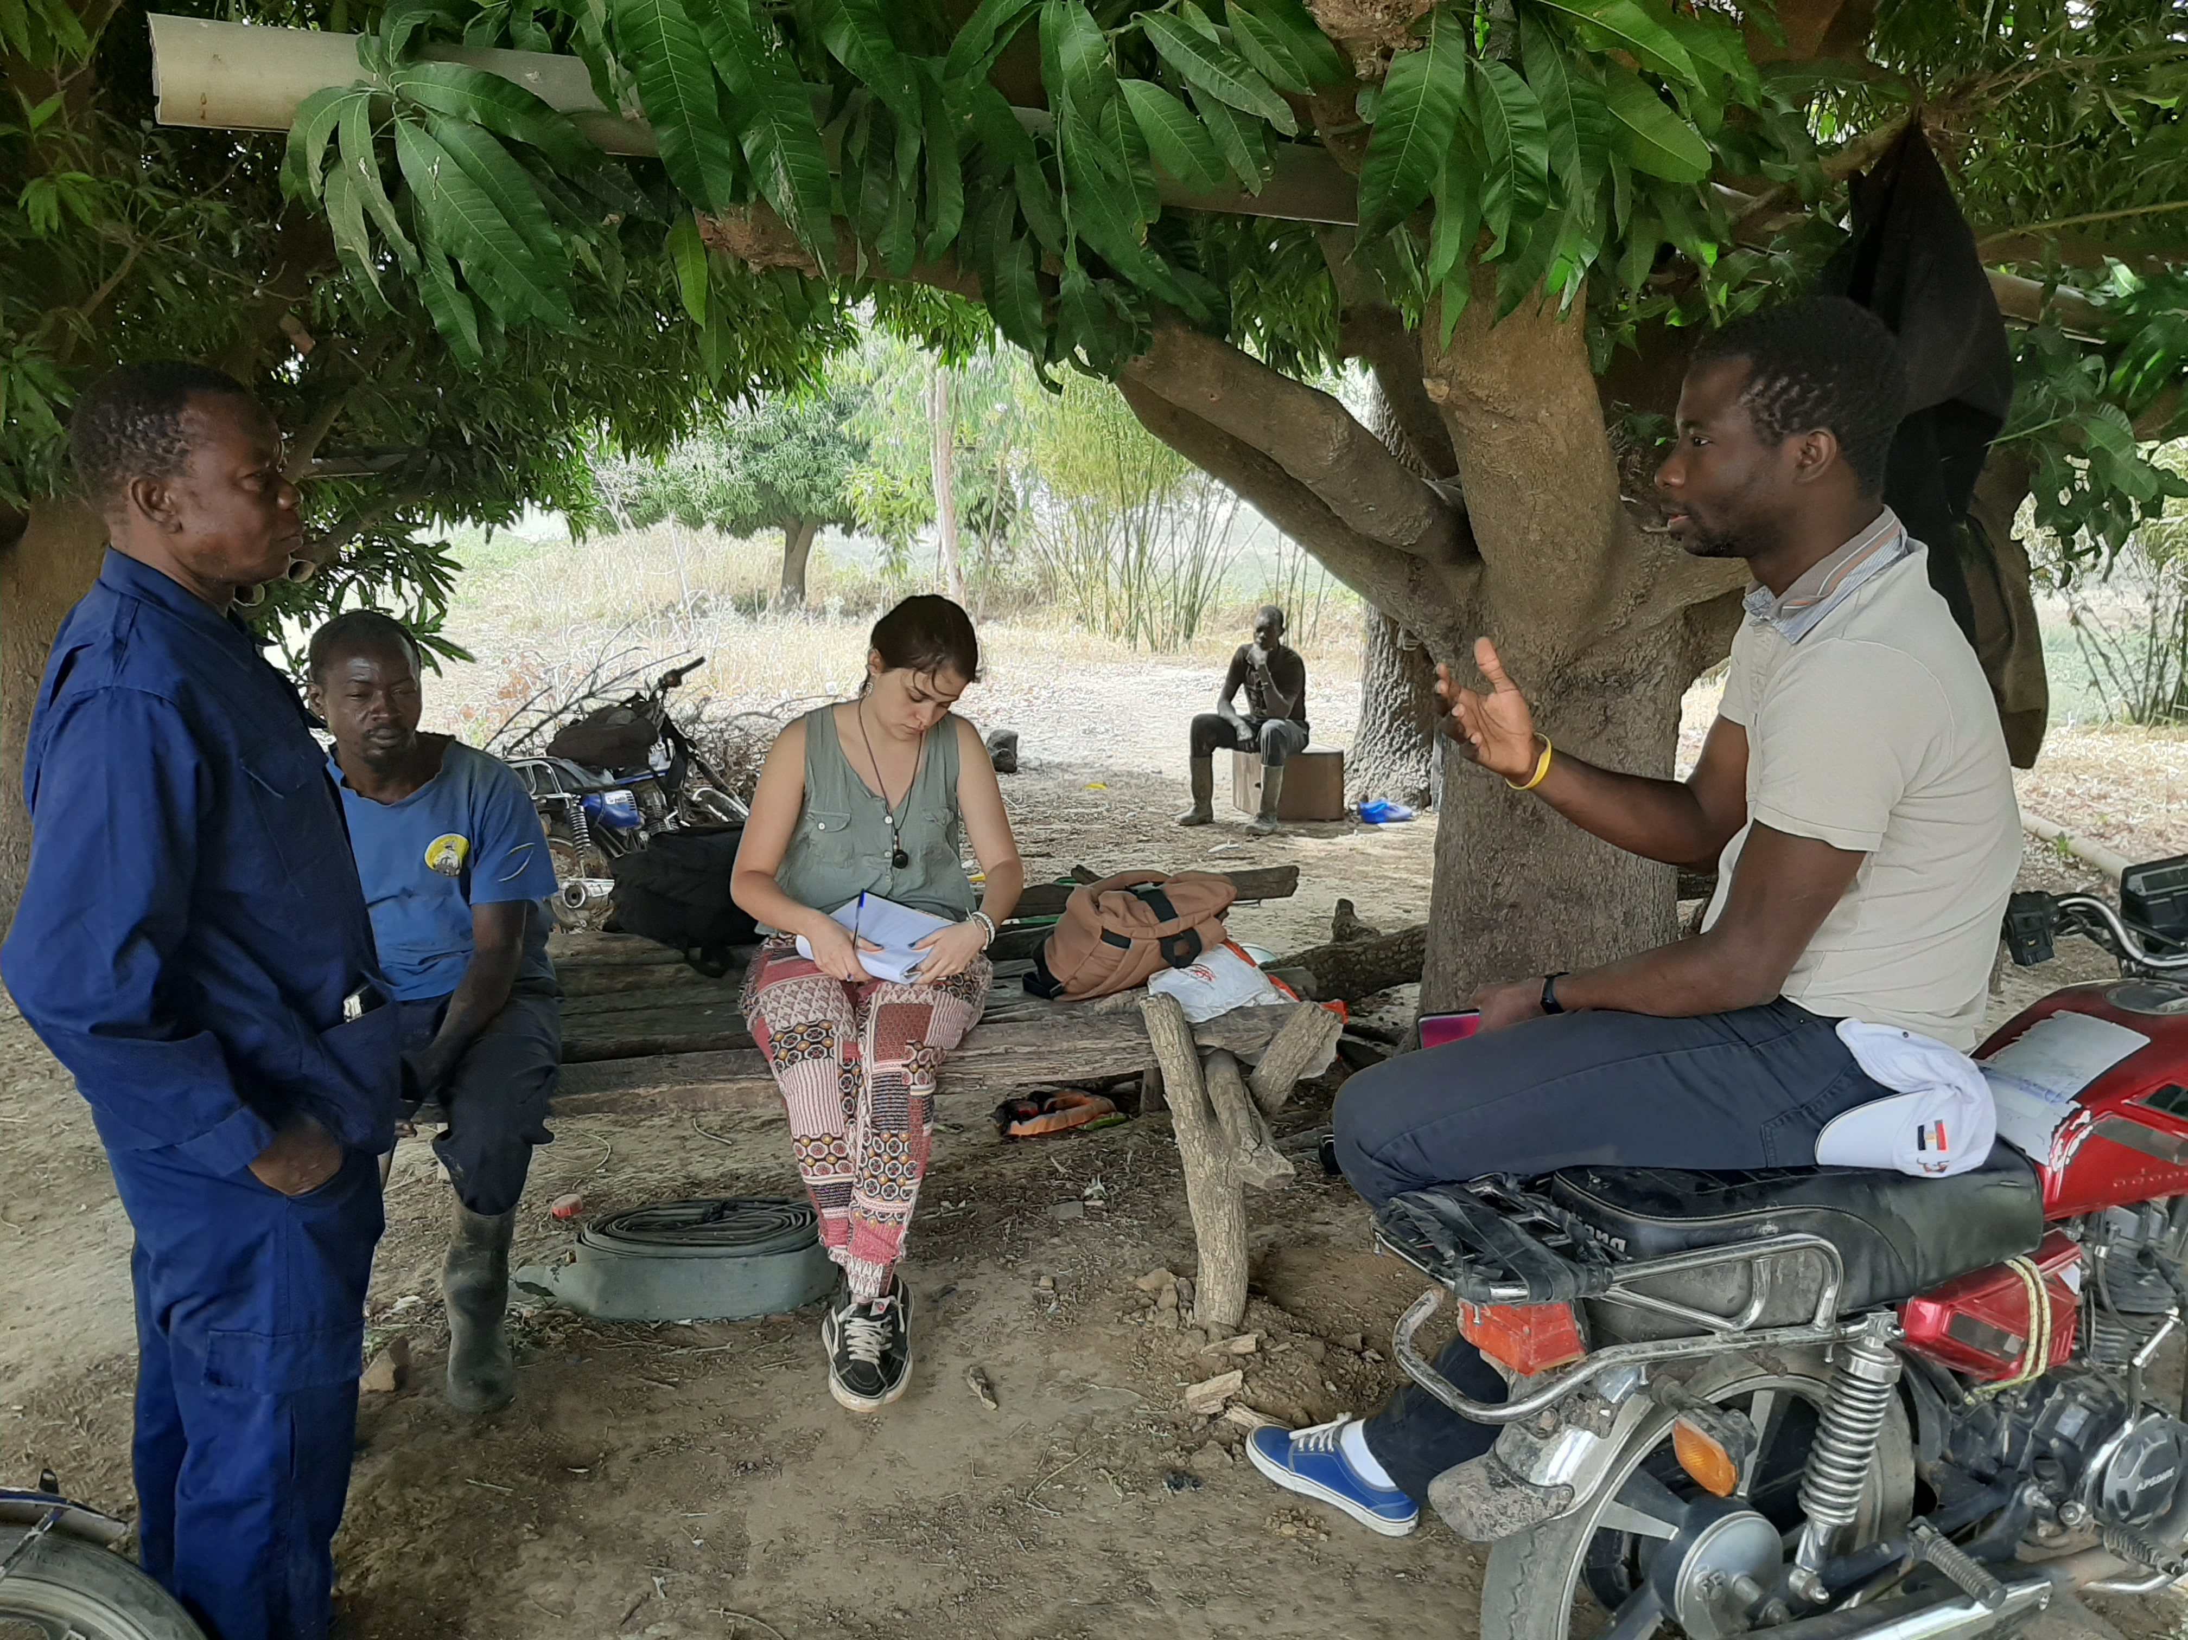
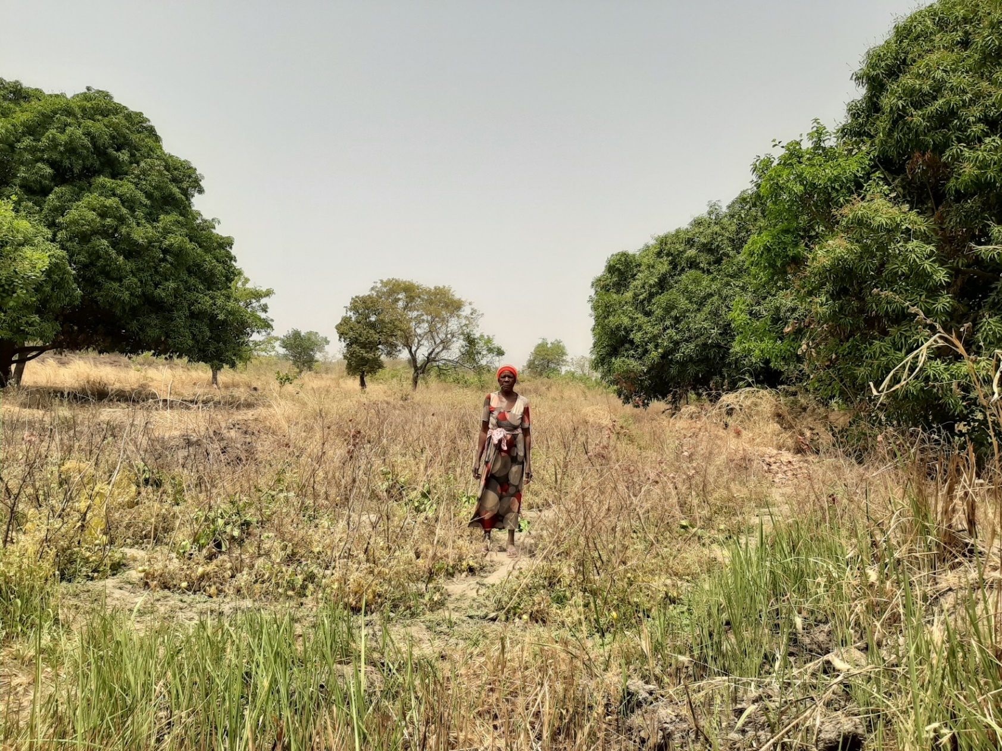
“We can’t trust the rain anymore”
90% rainfed Agriculture
“We are now afraid to apply our ancestors techniques as of when to start planting”

Slide 3
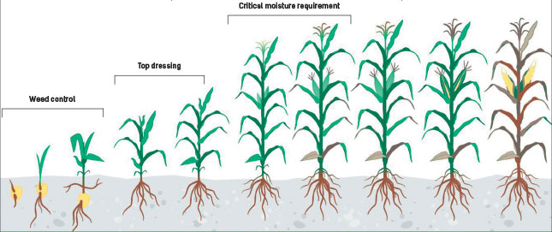
How do dry spells affect crop yield?
Crop modeling
AquaCrop
Management Practices
Climate
Data
Soil Profile
https://www.farmersweekly.co.za/crops/field-crops/maize-production-managing-critical-plant-growth-stages/
3

Slide 4
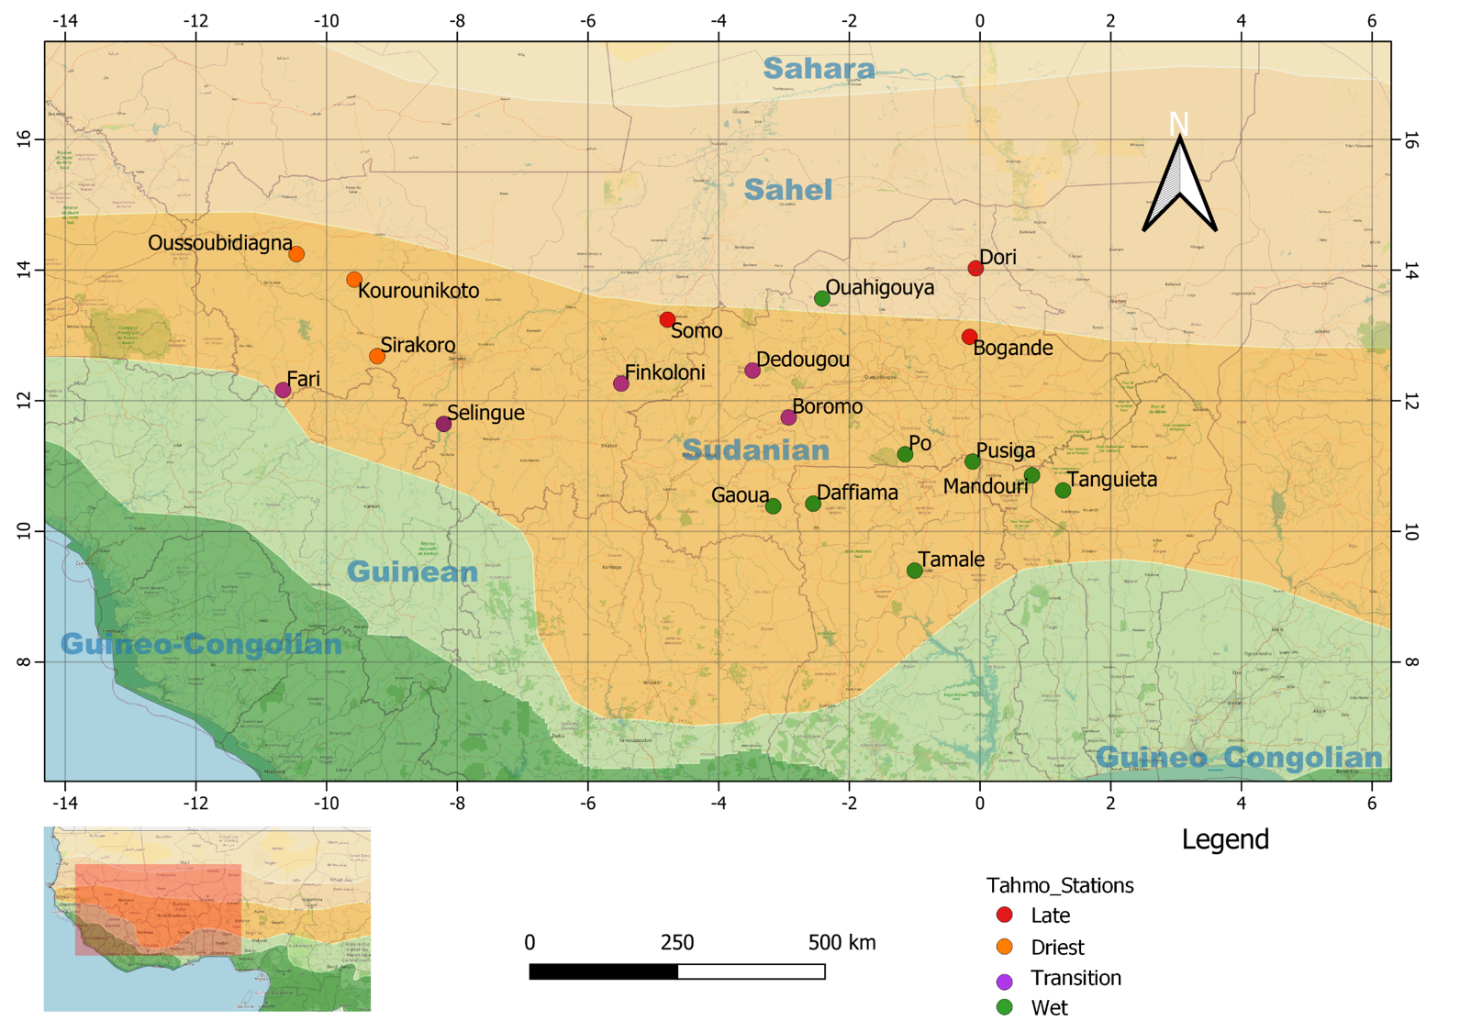

Climate data: 20 Stations across Sudanian region in West Africa
4

Slide 5
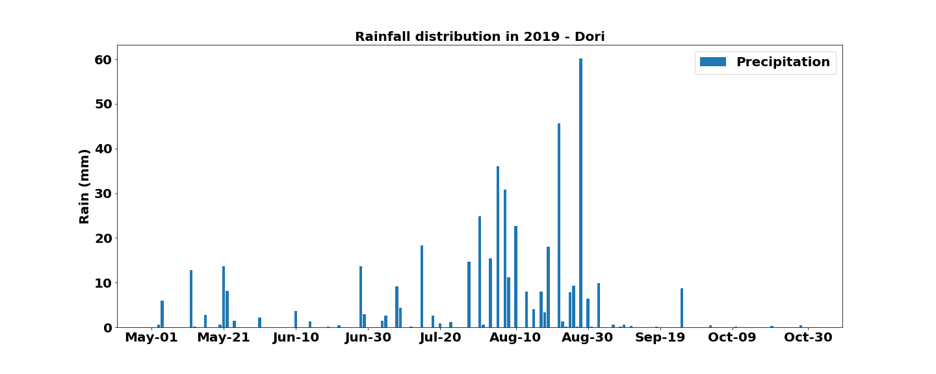
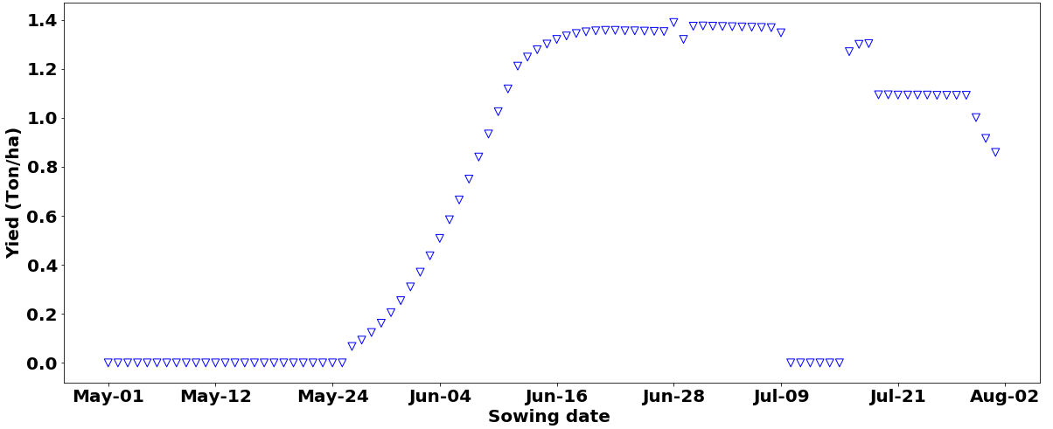
Rainfall, planting date and crop yield
Peak
Onset
Dori, Burkina Faso, 2019
Dry spells
Safe window
Current window

Slide 6
Main conclusions
It is risky for famers in West Africa to start planting after the first rains
Dry spells during growing season affects yields
Delay sowing until mid-June is safer. This late dates ensures there is enough soil water storage to overcome dry spells

Slide 7
Thank you!
Email: s.m.d.agoungbome@tudelft.nl @davidagoungbome

