Slide 1


Forecasting day-ahead 1-minute irradiance variability from NWP output
F.P.M. Kreuwel, C.C. van Heerwaarden
EGU 2022
Notes:
Tips: (How to give a dynamic scientific presentation (elsevier.com))
- Tell audience members up front why they should care and what’s in it for them. What problem will your work help solve? Is it a diagnostic test strategy that reduces false positives? A new technology that will help them to do their own work
faster, better and less expensively? Will it help them get a new job or bring new skills to their present job?
Convey your excitement. Tell a brief anecdote or describe the “aha” moment that convinced you to get involved in your field of expertise.
Storyline
Start with context. What is the state of the art, what is unique about our work?
Frame the problem
Provide highlights of what you did, tied to the audience’s expertise and/or reasons for attending your presentation. .. the what is often more important than the how.
Conclude by summing up key points and acknowledging collaborators and mentors.

Slide 2
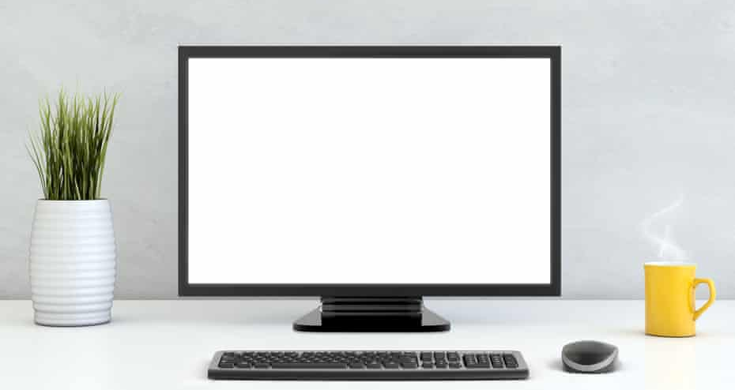
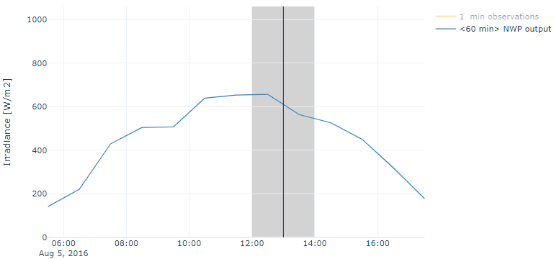
Day ahead irradiance forecast
Grid constraint
Notes:
Suppose you work at an electricity grid operator
Is there congestion forecasted?

Slide 3
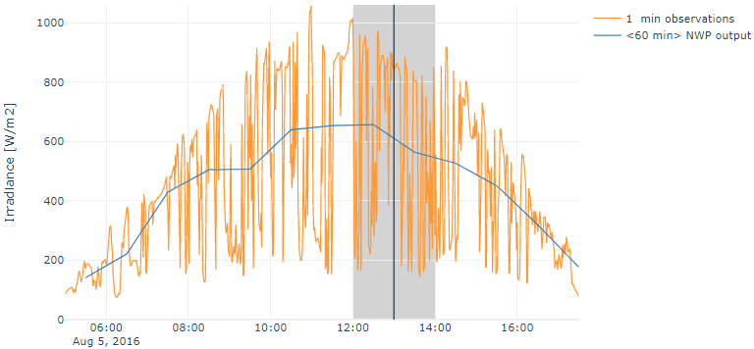
Hourly NWP output does not provide sufficient detail for grid balancing of Solar Energy
Grid constraint
This talk: Forecasting 1-min variability from 1hour NWP output at 24h lead time
Notes:
Suppose you work at an electricity grid operator
Is there congestion forecasted?

Slide 4
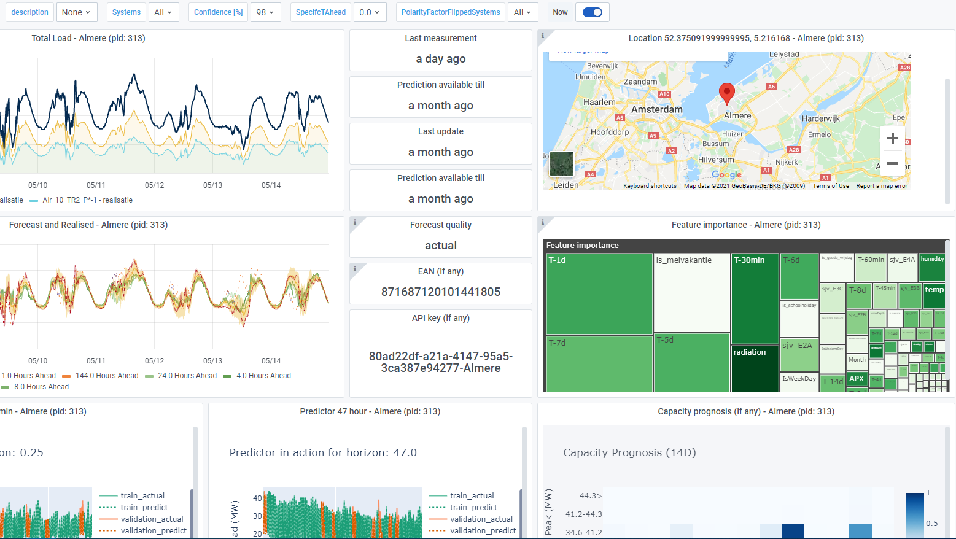
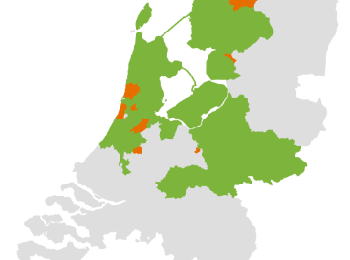
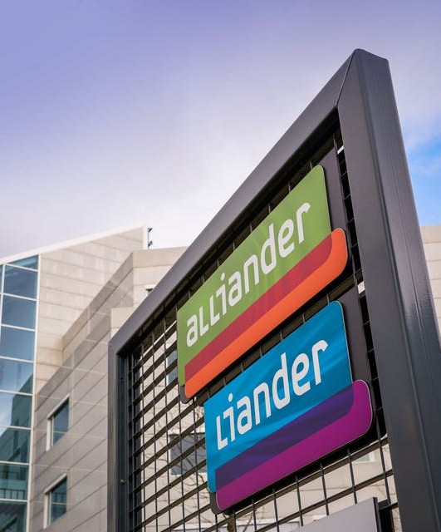
Frank Kreuwel
PhD Candidate Wageningen University – Meteorology & Air Quality
Data Scientist Grid Operator Liander – Short Term Forecasting

Slide 5


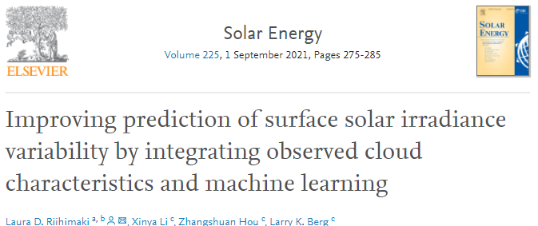
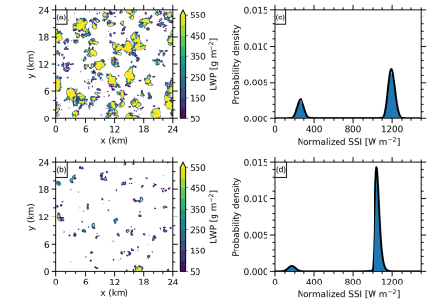
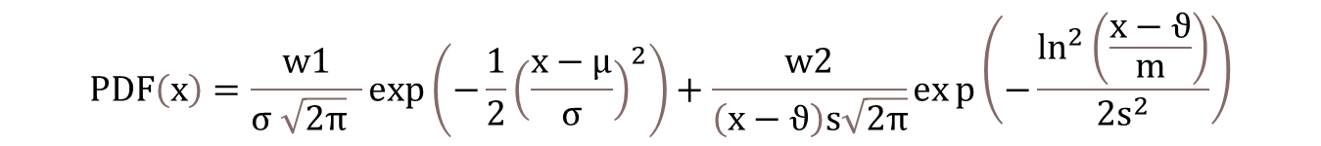
The state of the art
$$PDF\left(x\right)=\frac{w1}{σ \sqrt{2π} }\exp\left(−\frac{1}{2}{\left(\frac{x−μ}{σ}\right)}^{2}\right)+\frac{w2}{\left(x−ϑ\right)s\sqrt{2π}}exp\left(−\frac{\ln^{2}\left(\frac{x−ϑ}{m}\right)}{2s^{2}}\right)$$

Slide 6
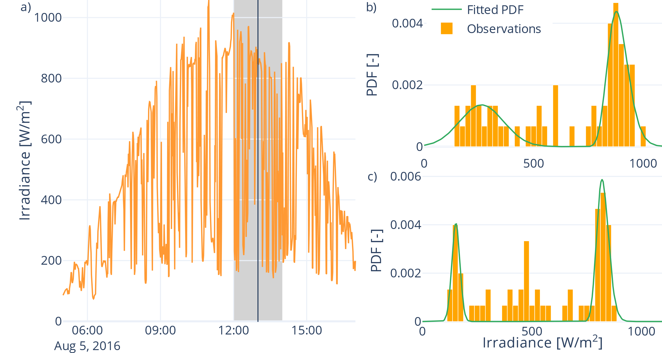
Method
NWP output (hourly mean)
10 Parameters per hour parametrize
1-minute irradiance variability
Forecast these based on NWP output using LightGBM
Data:
1 year of 1-minute GHI observations at 19 locations in NL
Harmonie Arome day-ahead NWP output ~20 predictors

Slide 7
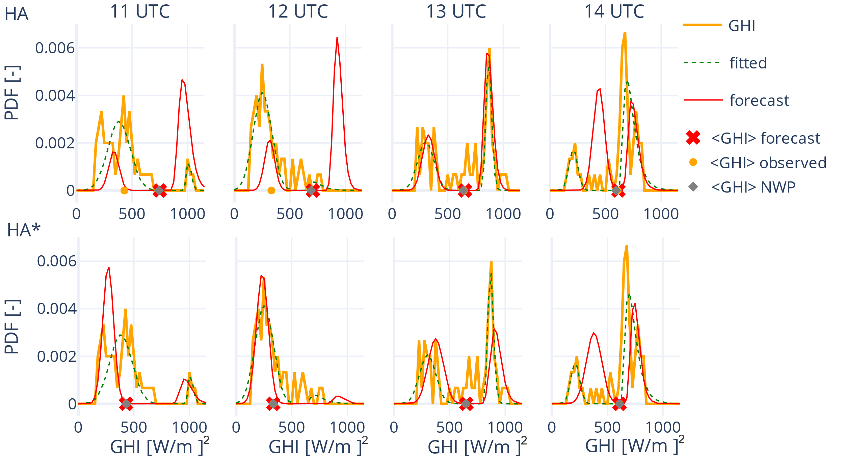
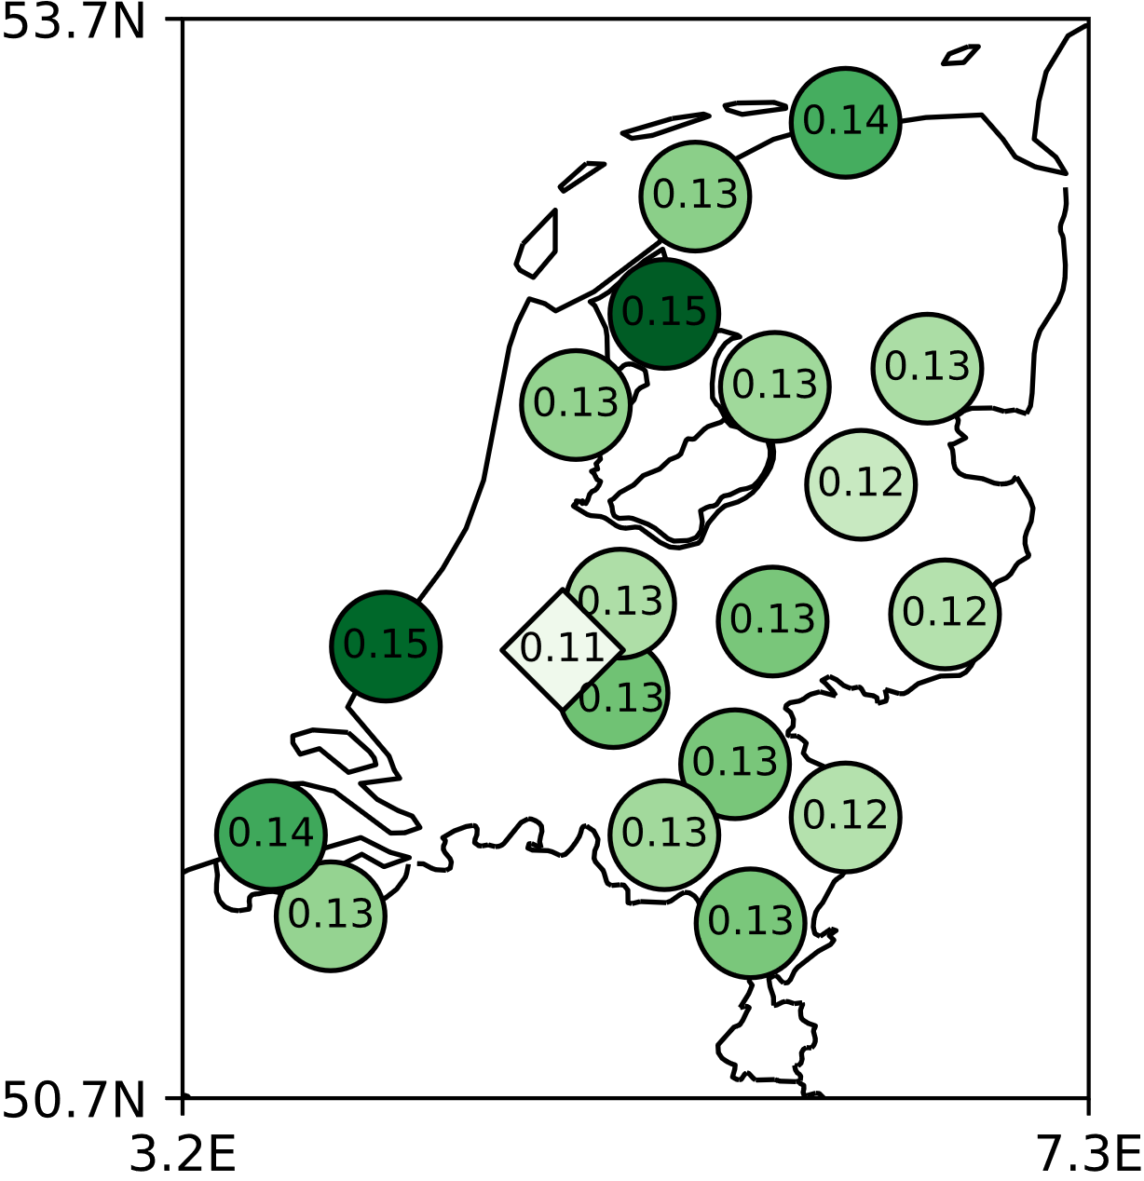
Highlights
If the NWP was incorrect,
the post-processing is incorrect
For the corrected NWP,
the post-processing is (more) correct
Even if only trained on one location,
results can be generalized

Slide 8
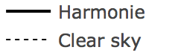
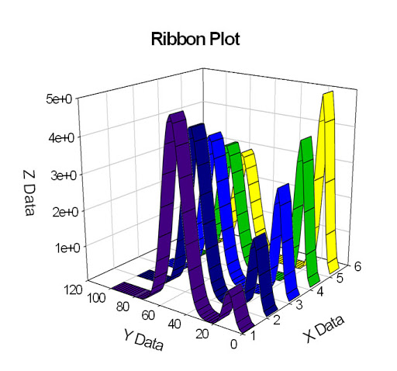
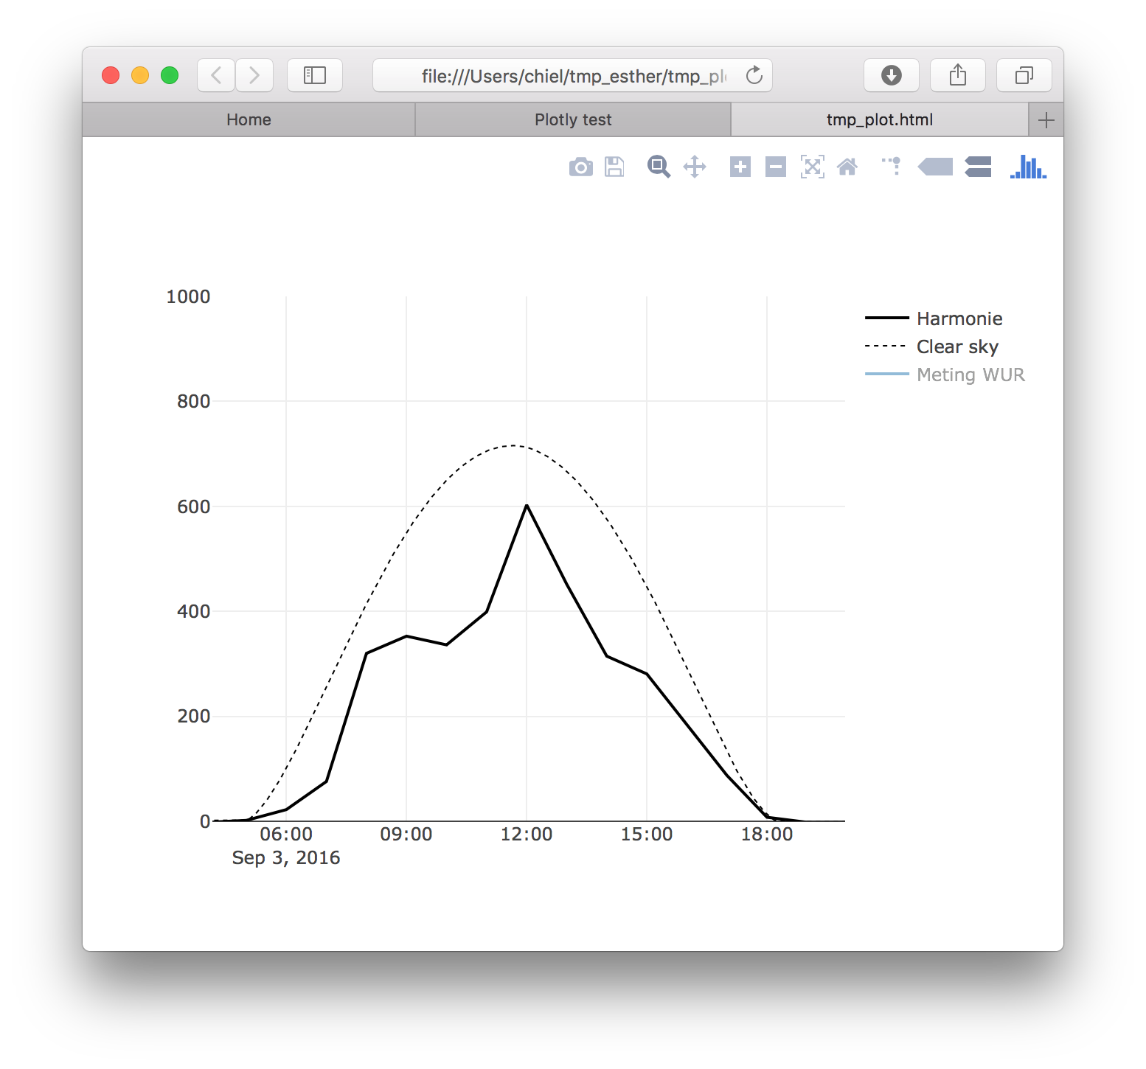
This work:
Truly forecast pdf of 1min irradiance based on operationally available, day-ahead NWP output
Probability Density [-]
This research
Irradiance [W/m²]
time [hour]
Irradiance [W/m2]
Thanks!
Kilian Bakker for providing the HARMONIE-AROME data set used in this work
Martin Janssens from WUR for thinking along on interpreting the ML model results
Jan Maarten van Doorn from Alliander for his help with sklearn
This work is part of the research programme Industrial Doctorates with project number NWA.ID.17.051, which is financed by the Dutch Research Council (NWO), Alliander N.V. and Wageningen University & Research.
Frank.Kreuwel@wur.nl

Slide 9

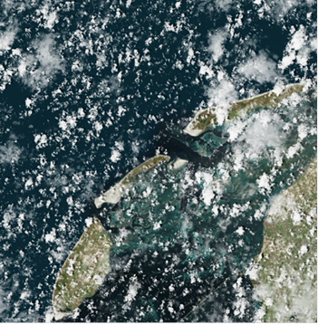
How can we tailor weather forecasts to fit the solar PV needs?
Post-processing NWP output using AI
2 years of Harmonie output -> 1 min irradiance variability forecasts

Slide 10
