Slide 1



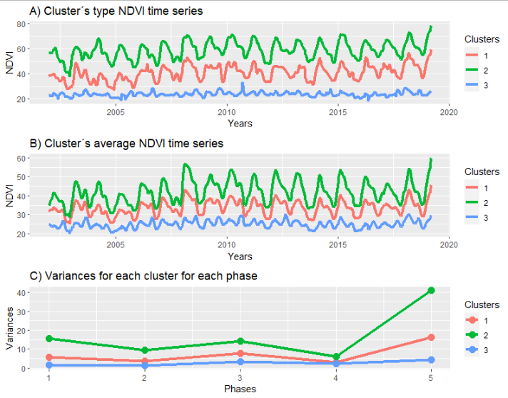
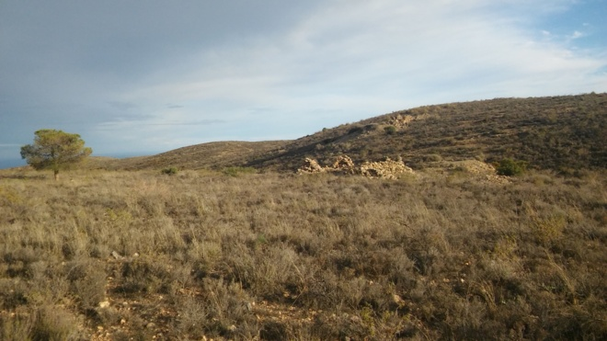
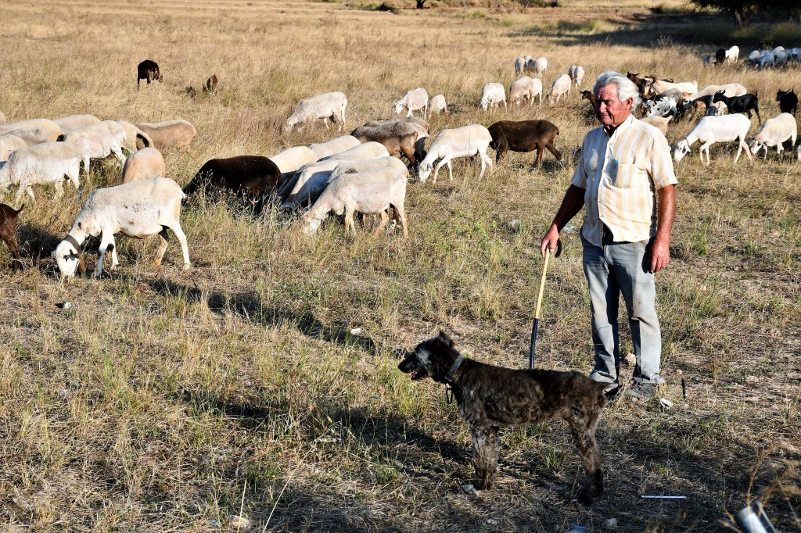
Clustering arid rangeland pixels using NDVI series and fractal analysis to classify land uses. Case in Southeastern Spain
Ernesto Sanz, Andrés Almeida-Ñauñay, Carlos G. Diaz-Ambrona, Antonio Saa-Requejo, Margarita Ruiz-Ramos, Alfredo Rodríguez, and Ana M. Tarquis
Email: ernesto.sanz@upm.es
elmundo.es. Author: Jaime Martínez
https://santomeraviva.wordpress.com/

Slide 2
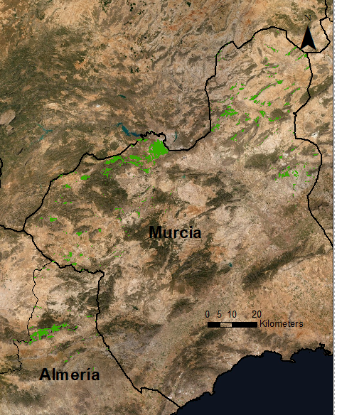
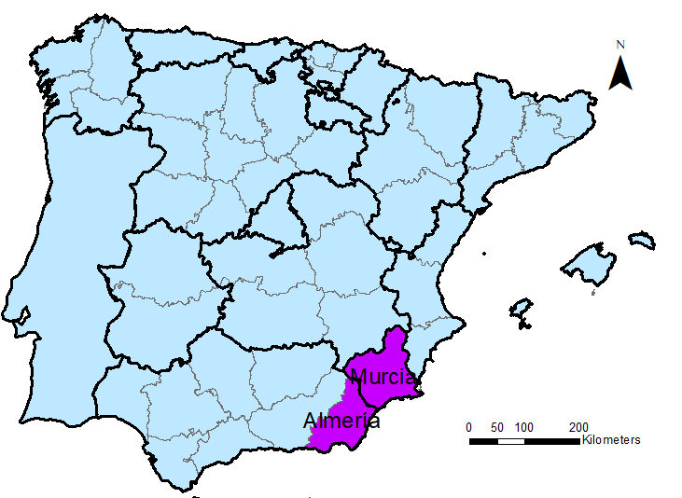
Area of study
Arid Rangelands, provided by ENESA*
Temp_{ave}: 12,8 -15,9ºC
Temp_{min}: -4,8 - -6,3ºC
Temp_{max}: 30 - 32,8 ºC
Yearly accum precip: 298-394 mm
Composed of:
Grasslands
Shrublands
Open woodlands
ES
PT
* Entidad Nacional de Seguros Agrarios/State Agrarian Insurance Agency

Slide 3
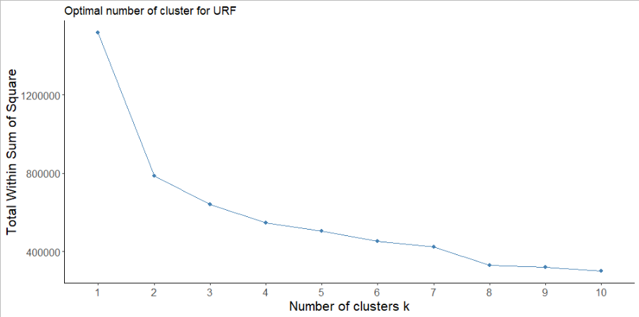


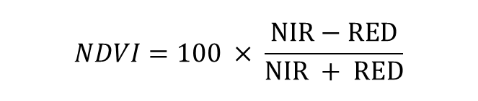

Hurst exponent and unsupervised random forest
Summary statistics of NDVI
Variances
Quartiles
MODIS MOD09Q1
Temporal resolution:8 -days
Spatial resolution: 250 m
Time series: 2000-2019
Unsupervised Random Forest
Rescaled Range (R/S)
$$\frac{\left.R(τ\right)}{\left.S(τ\right)} ={\left(cτ\right)}^{H}$$
Normalized Differenciated
Vegetation Index
Hurst exponent
Detrended fluctuation analysis (DFA)
$F_{2}(s) ∝$ $s^{H(2)}$
$$NDVI=100 × \frac{NIR−RED}{NIR + RED}$$
Flaticon.com

Slide 4
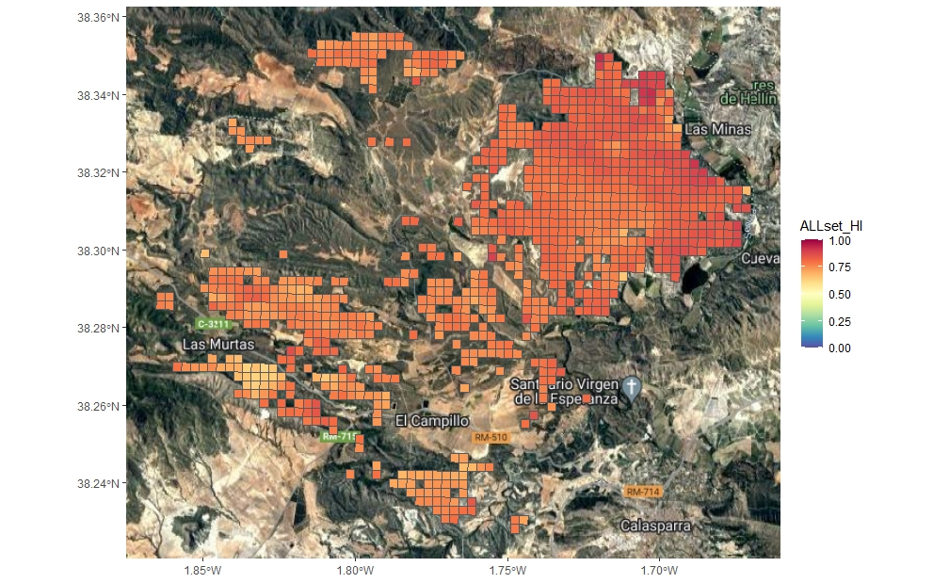
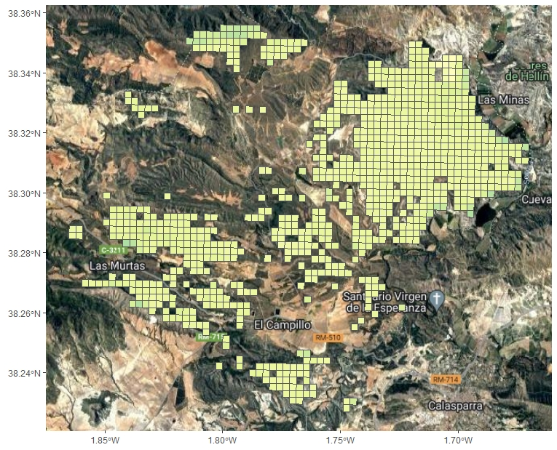
Comparison of Hurst Exponents
R/S Hurst Exponent
DFA Hurst Exponent
Hurst exponent
Persistent character: 0.6-0.9
Antipersistent character: 0.4-0.5

Slide 5
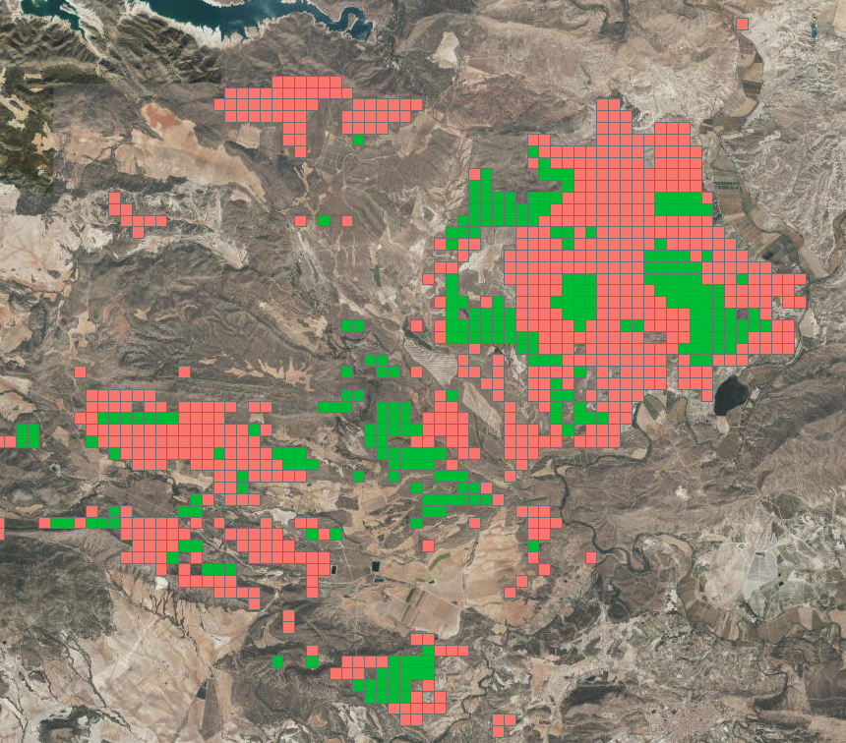
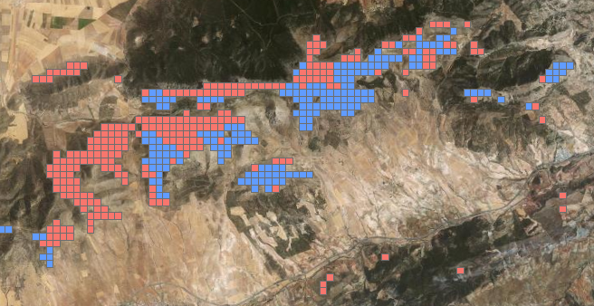
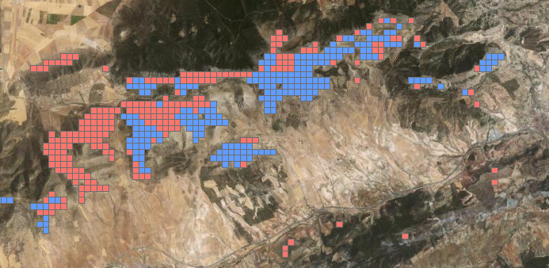
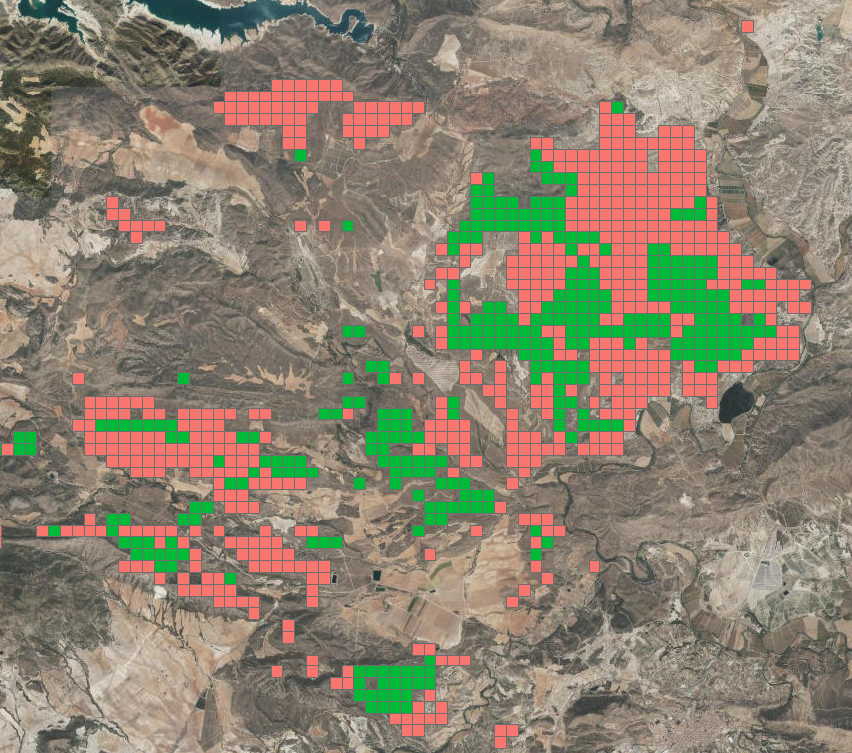
Differences between Hurst exponent
Almería
Murcia
R/S Hurst exponent
URF with R/S
URF with DFA
R/S Hurst exponent
DFA Hurst exponent
DFA Hurst exponent
Analysis | Silhouette Index
URF with R/S | 0.50
URF with DFA | 0.62

Slide 6
Conclusions
Detrending before calculating Hurst Exponent is key to understand the dynamics in vegetation time series.
Using the persistence or antipersistence of the vegetation time series and their trend, calculated with Mann-Kendall, can be used by farmers or managers to prioritize areas to study and improve management strategies.
Future research
Include more types of rangeland, as well as other types of land uses.
Compare differently managed rangeland

Slide 7
References
Sanz, E., Saa-Requejo, A., Díaz-Ambrona, C.H., Ruiz-Ramos, M., Rodríguez, A., Iglesias, E., Esteve, P., Soriano, B., Tarquis, A.M., 2021a. Generalized Structure Functions and Multifractal Detrended Fluctuation Analysis Applied to Vegetation Index Time Series: An Arid Rangeland Study. Entropy 23, 576.
Sanz, E., Saa-Requejo, A., Díaz-Ambrona, C.H., Ruiz-Ramos, M., Rodríguez, A., Iglesias, E., Esteve, P., Soriano, B., Tarquis, A.M., 2021b. Normalized Difference Vegetation Index Temporal Responses to Temperature and Precipitation in Arid Rangelands. Remote Sensing 13, 840.
Rivas-Tabares, D., Saa-Requejo, A., Martín-Sotoca, J.J., Tarquis, A.M., 2021. Multiscaling NDVI Series Analysis of Rainfed Cereal in Central Spain. Remote Sensing 13, 568.
Almeida-Ñauñay, A.F., Benito, R.M., Quemada, M., Losada, J.C., Tarquis, A.M., 2021. The Vegetation–Climate System Complexity through Recurrence Analysis. Entropy 23, 559.
Kantelhardt, J.W., Zschiegner, S.A., Koscielny-Bunde, E., Havlin, S., Bunde, A., Stanley, H.E., 2002. Multifractal detrended fluctuation analysis of nonstationary time series. Physica A: Statistical Mechanics and its Applications 316, 87–114.
Kendall, M.G., 1975. Rank Correlation Methods. London: Charles Griffin & Co.
Hurst, H.E., 1951. Long-term Storage Capacity of Reservoirs. Transactions of the American Society of Civil Engineers 116, 770–799

Slide 8
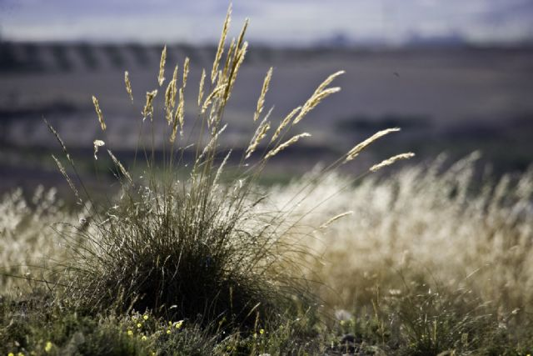

Thank you very much for your attention! Happy to answer any questions

