Slide 1



Capturing the Influence of Large Wood on Fluvial Bedload Transport with RFID Tracers and Linear Mixed Modelling
Miles Clark¹, Georgina Bennett², Sandra E Ryan³, David Sear⁴, Aldina Franco¹
University of East Anglia, Norwich, United Kingdom of Great Britain¹
University of Exeter, Exeter, United Kingdom of Great Britain²
U.S. Forest Service, Fort Collins, United States³
University of Southampton, Southampton, United Kingdom of Great Britain⁴
https://doi.org/10.1002/esp.5376

Slide 2
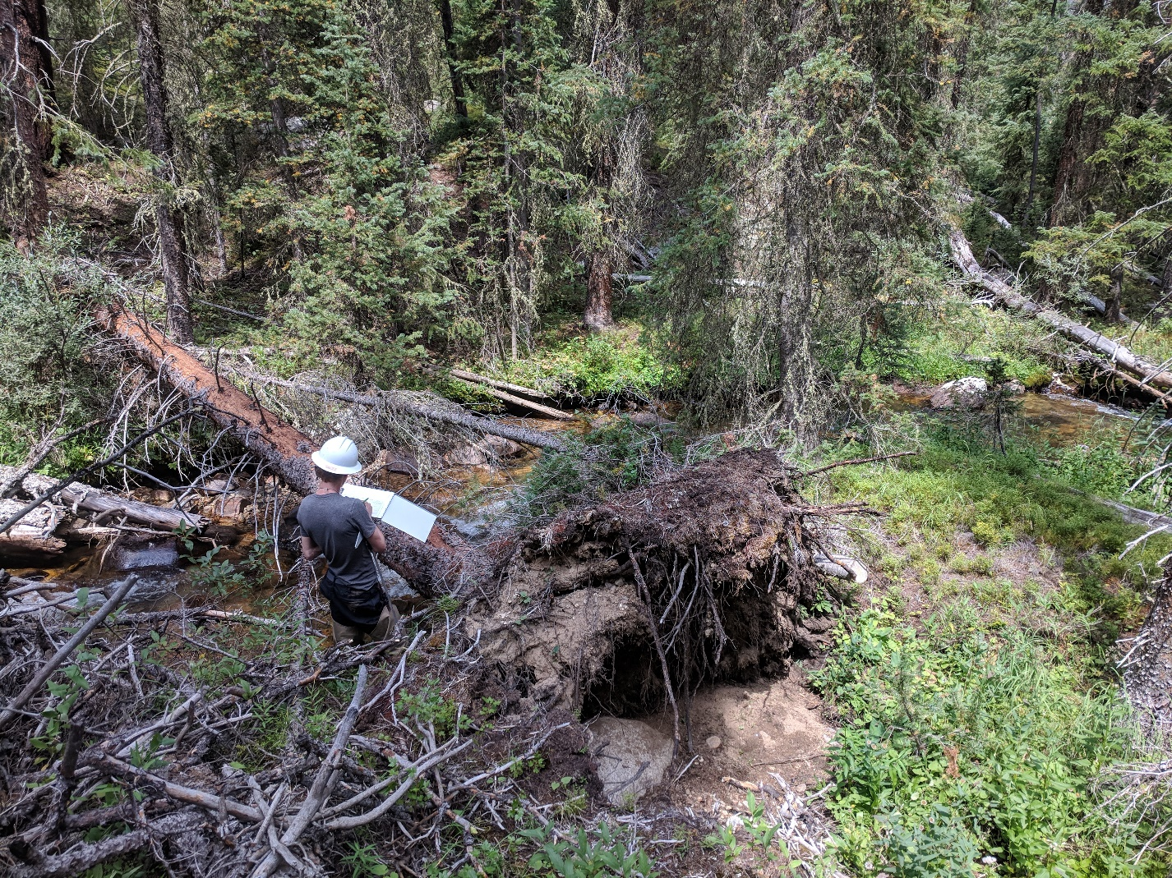
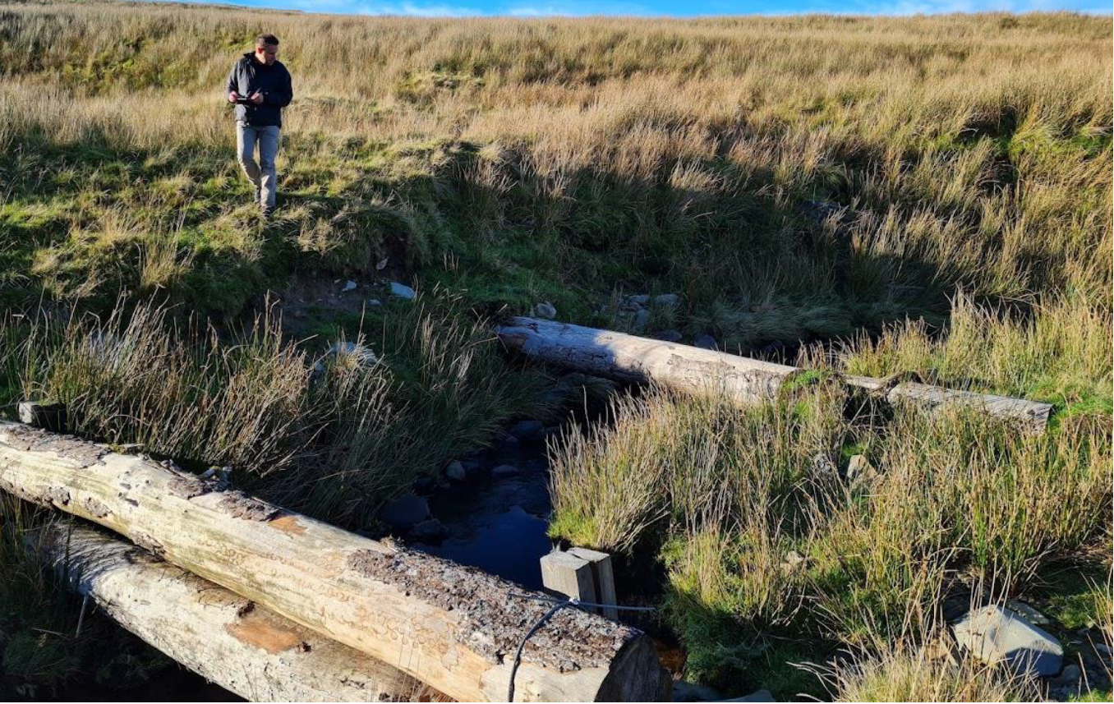
Why Investigate Sediment –
Wood Interaction?
Sediment transport tracer studies have previously omitted the influence of biological factors such as the presence of large wood
Additional data is required to evaluate the impact of wood on grain-scale transport dynamics and movement behaviour in a range of environments
Woody debris is being used more as a natural flood management tool, however, there is still a limited understanding of its consequences
Natural wood loading into stream
Anthropogenic addition of woody debris dams for flood management
Notes:
What's the context?
Previous studies miss out
Understand transport dynamics in these environments
Anthropogenic wood in natural flood management

Slide 3
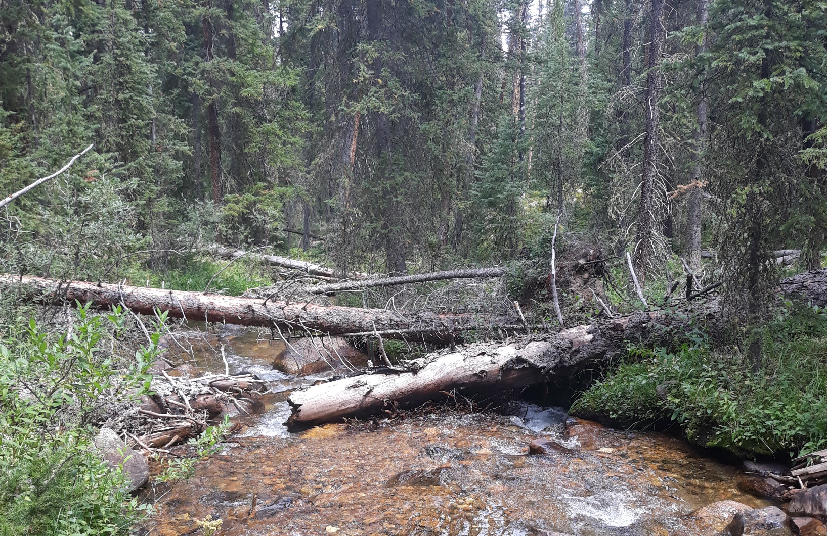
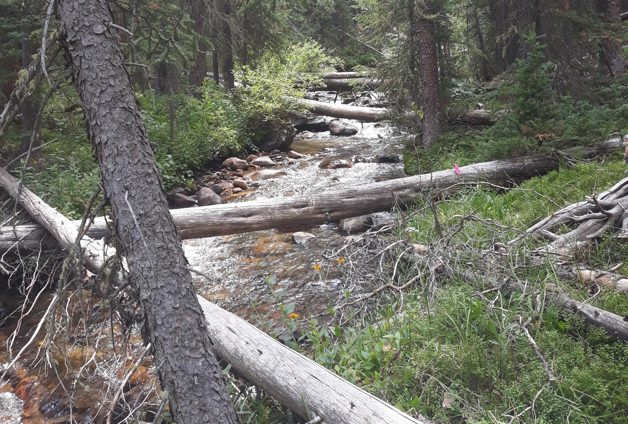
St. Louis Creek
Study area is a subalpine stream located within the Fraser Experimental Forest, Colorado
Flow regime characterised by snowmelt run off, with peak conditions throughout the summer months
High wood loading into environment due to mountain pine beetle infestation
Ideal case study for investigating sediment - wood interaction in a ‘natural laboratory’
Significant addition of large wood into St. Louis Creek
Notes:
Study site was St. Louis
Ideal location due to beetle infestation
Site acts as a Natural lab

Slide 4
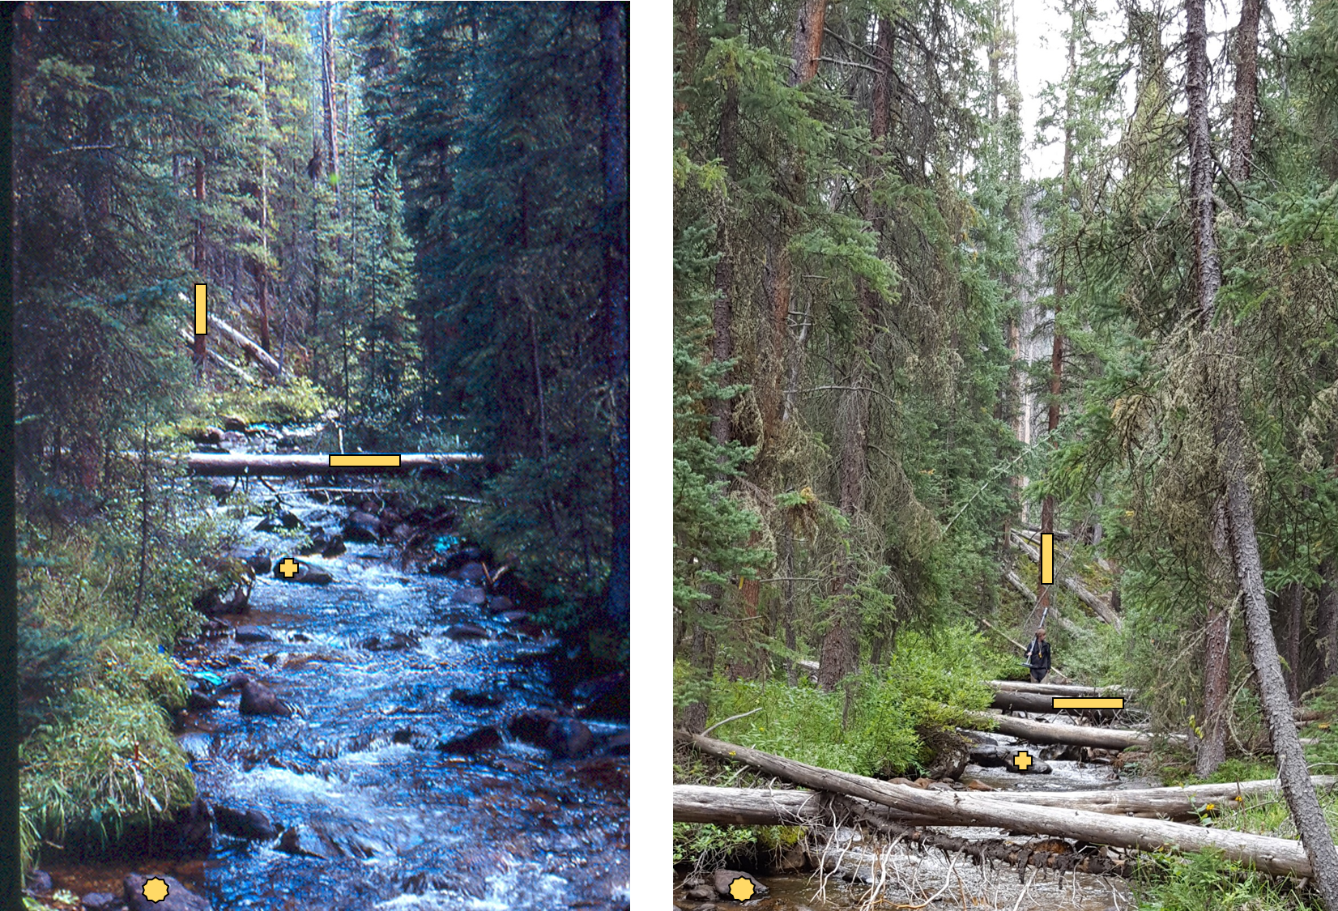
Extent of wood loading before and after beetle kill (Ryan, S. 2018).
Notes:
2000 V 2018

Slide 5
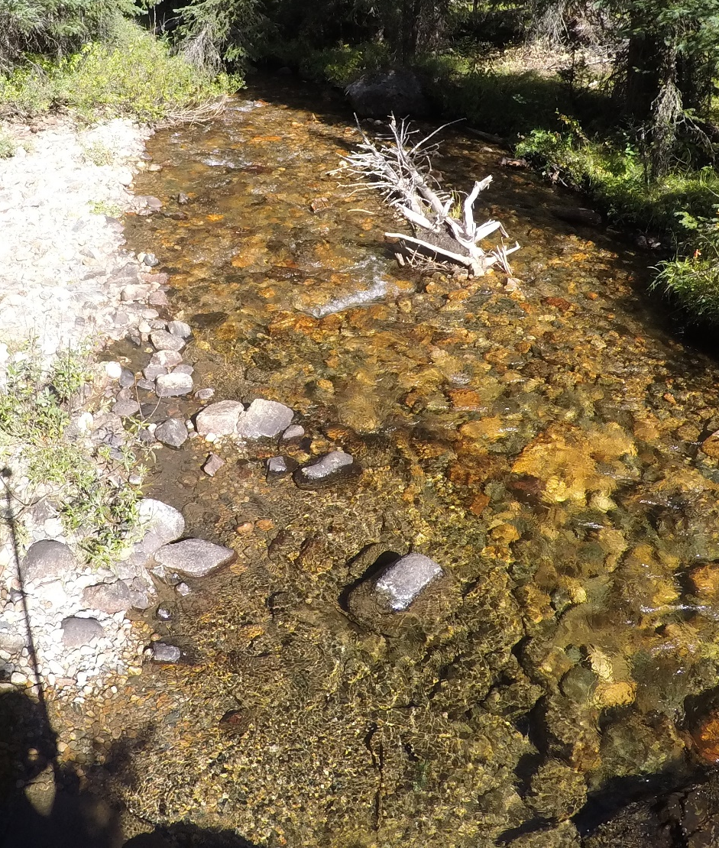
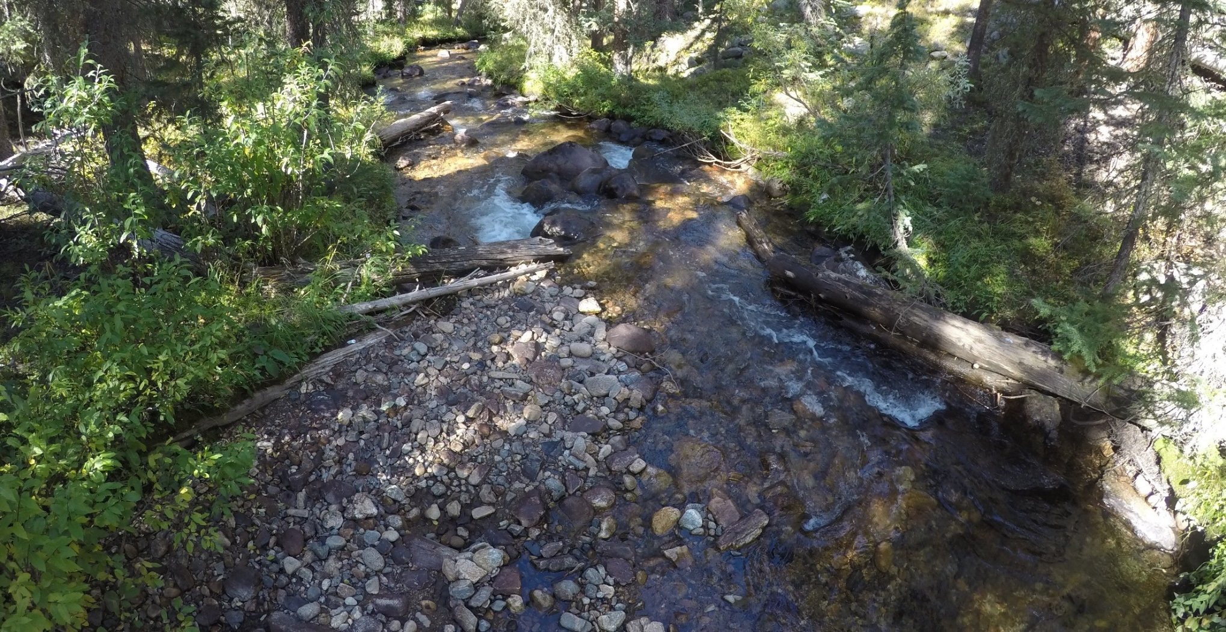
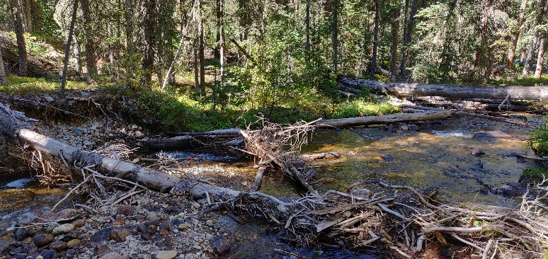
Notes:
Key wood pieces with significant sediment build up surrounding them.

Slide 6
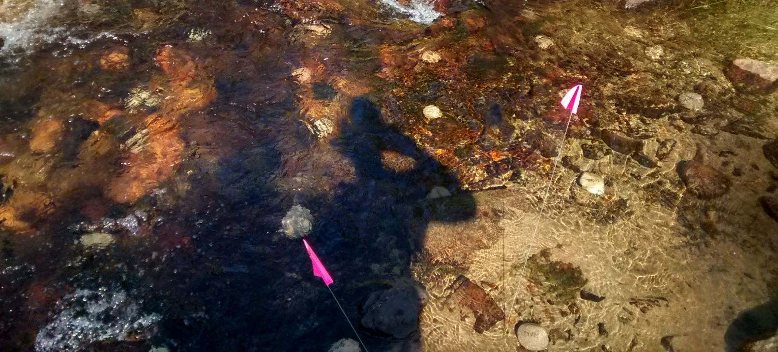
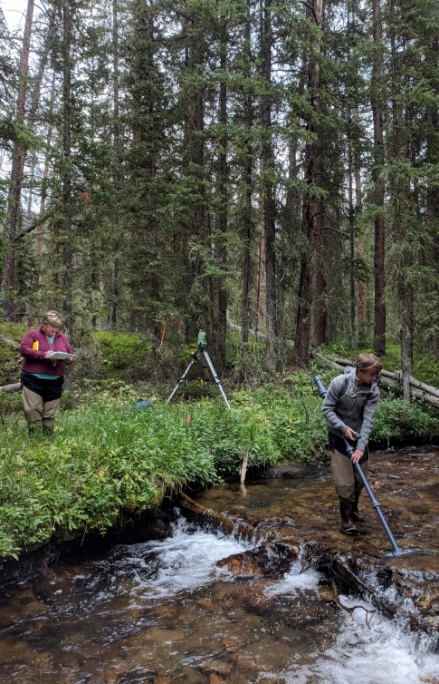
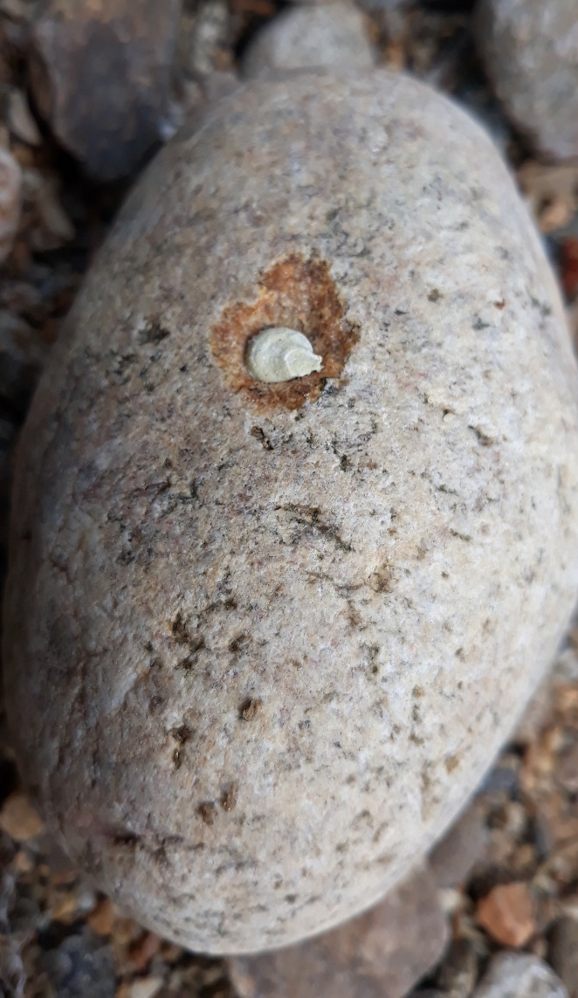
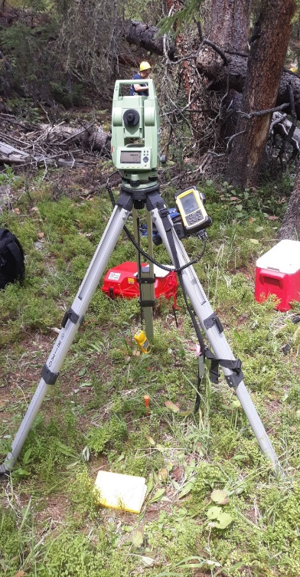
RFID Tracer Survey
957 tracer cobbles were deployed with embedded RFID tags from 2016 - 2019
Key geomorphological features of site surveyed and updated annually
Annual resurveys built an inventory of tracer movement
49% of cobbles moved, with a 80% retrieval rate
Tagged sediments in deployment position
RFID embedded cobble, surveying tracers, and total station
Notes:
Tagged over 950 cobbles
Location captured with GPS and a total station
Annual resurvey give transport of sediments over time
Involves manually scanning for tracers

Slide 7
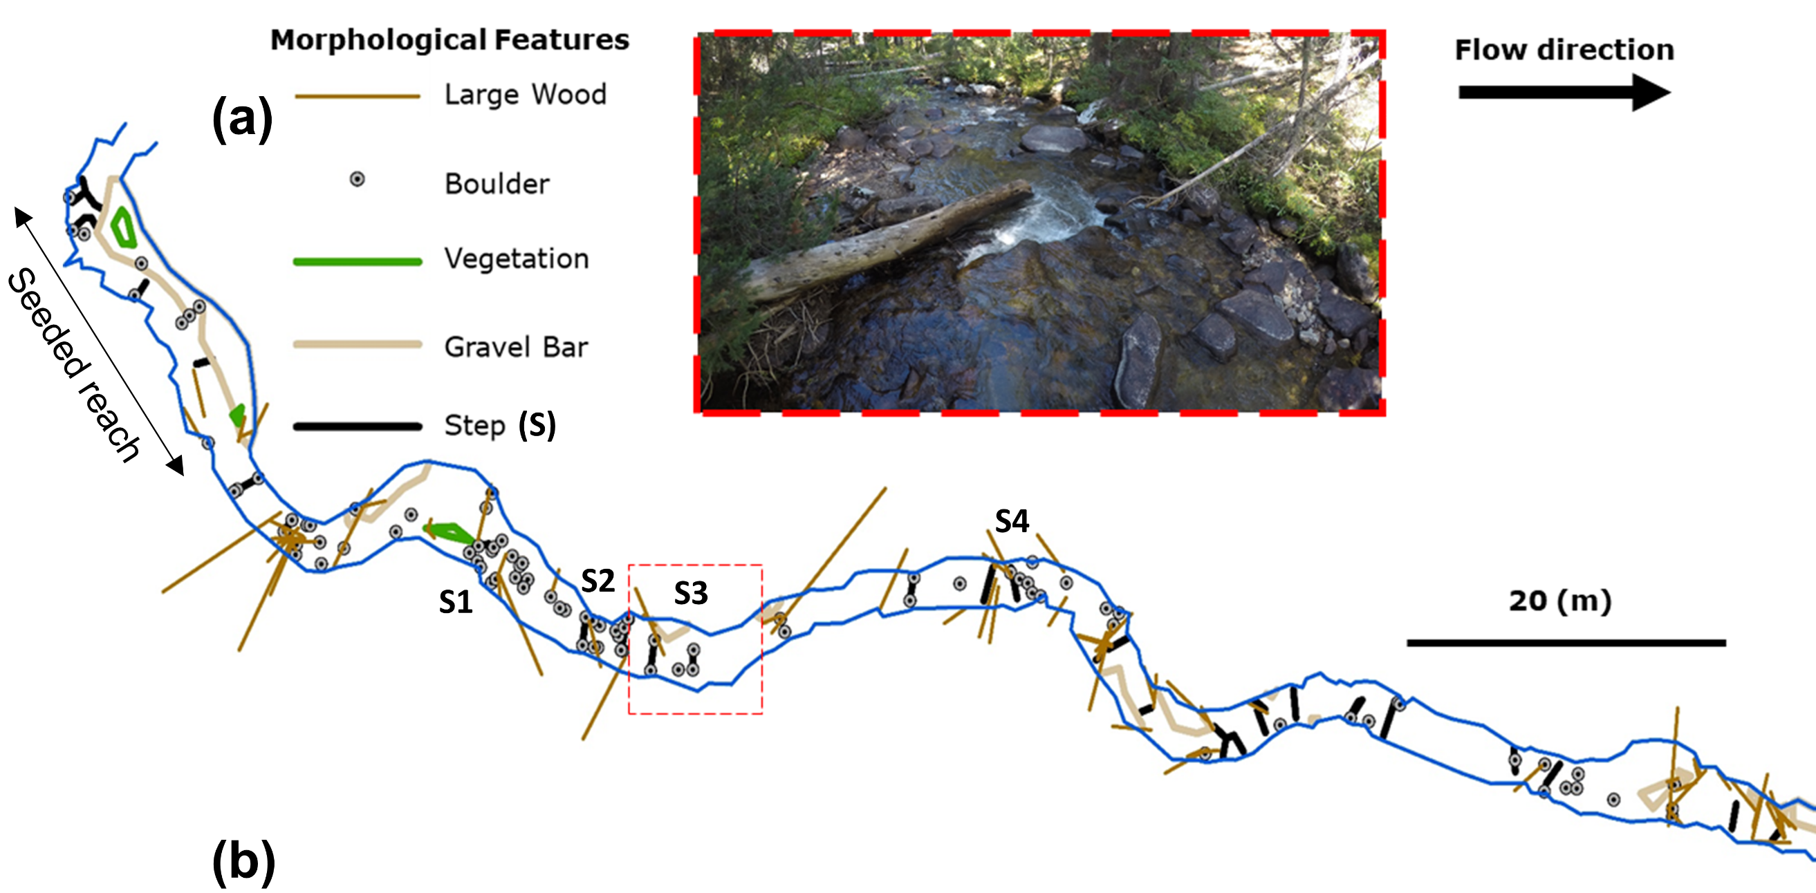
Morphological features surveyed at St. Louis Creek including large wood, boulders, vegetation, gravel bars, and locations of steps. Area highlighted displays a typical section of the study area
Notes:
Also surveyed other morphological features
Tagged large wood pieces with RFIDs to track movement

Slide 8
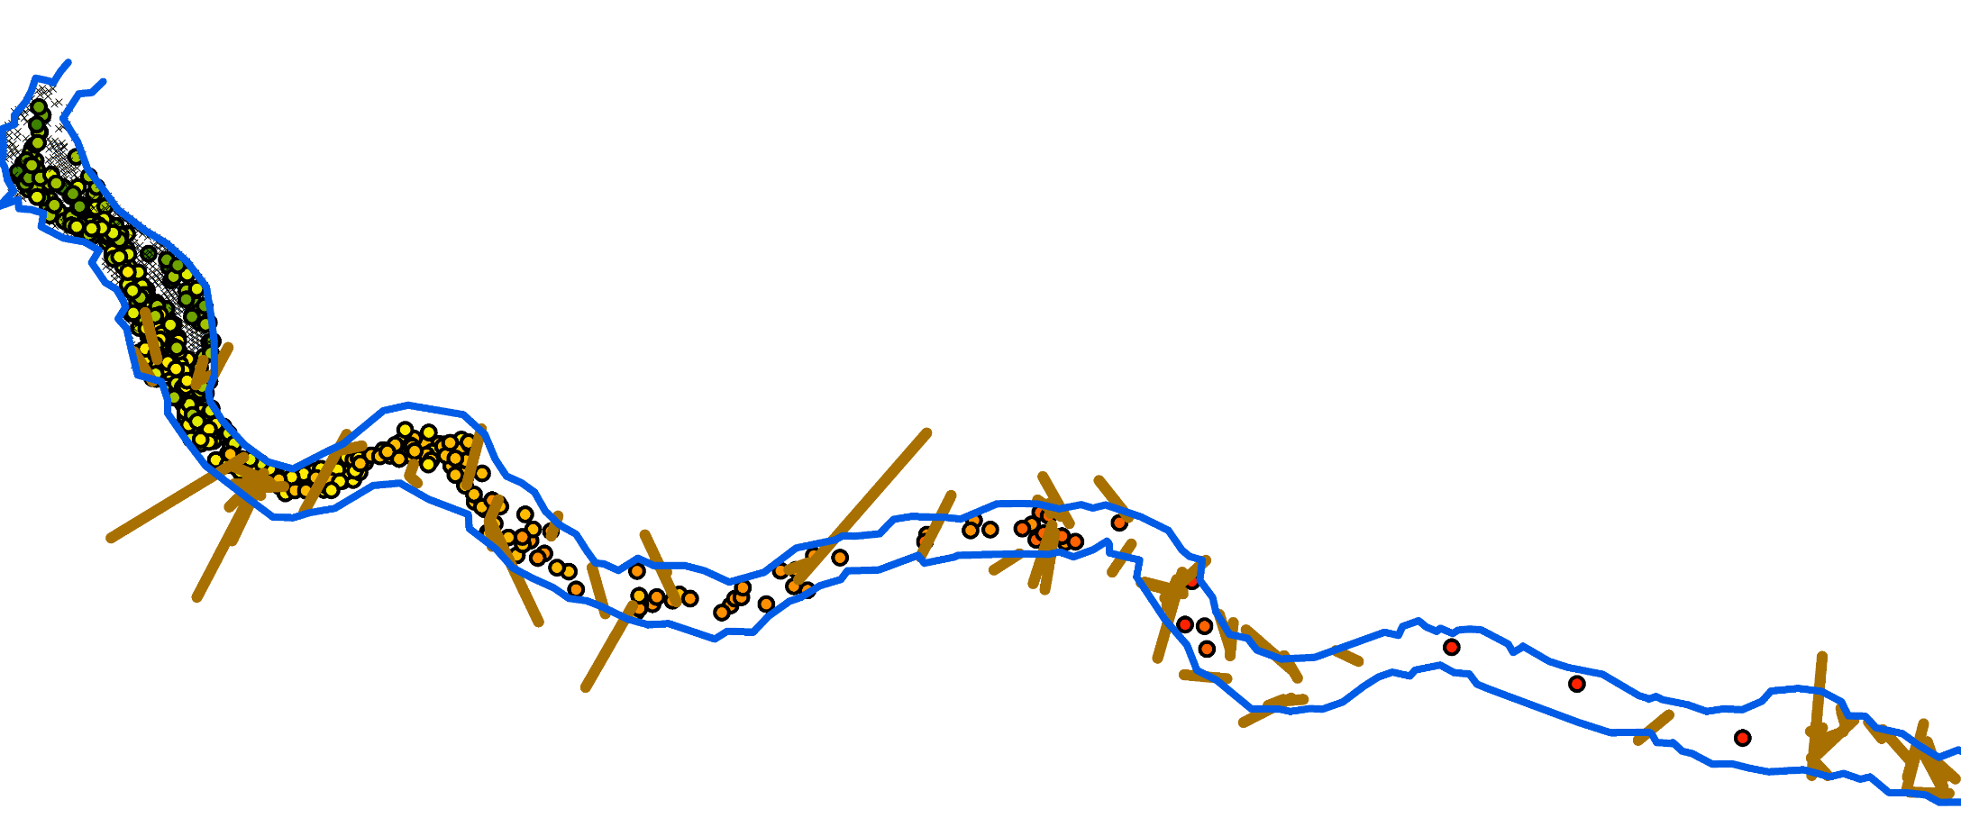
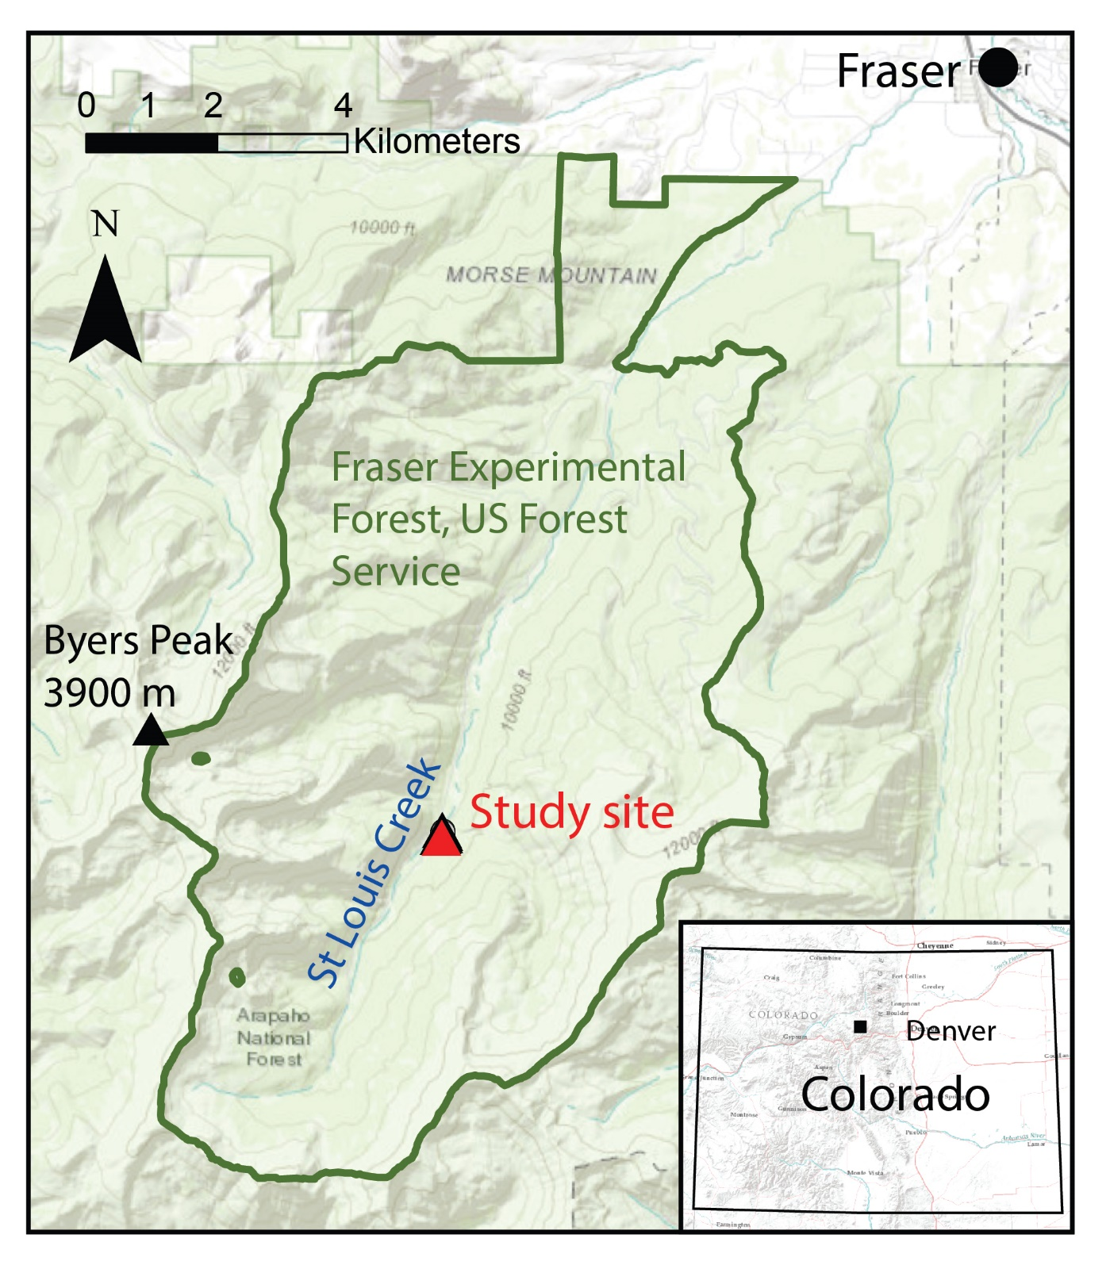
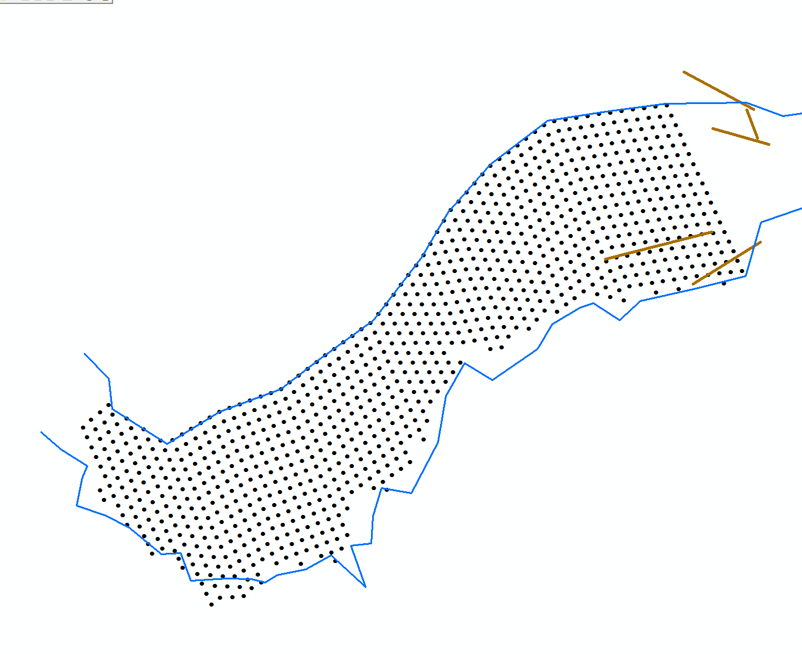
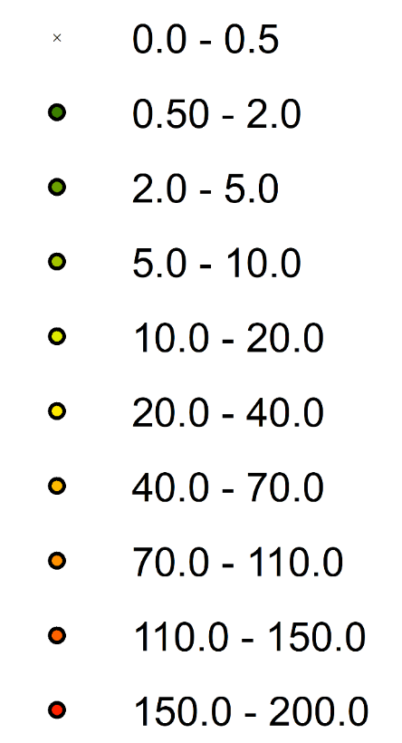
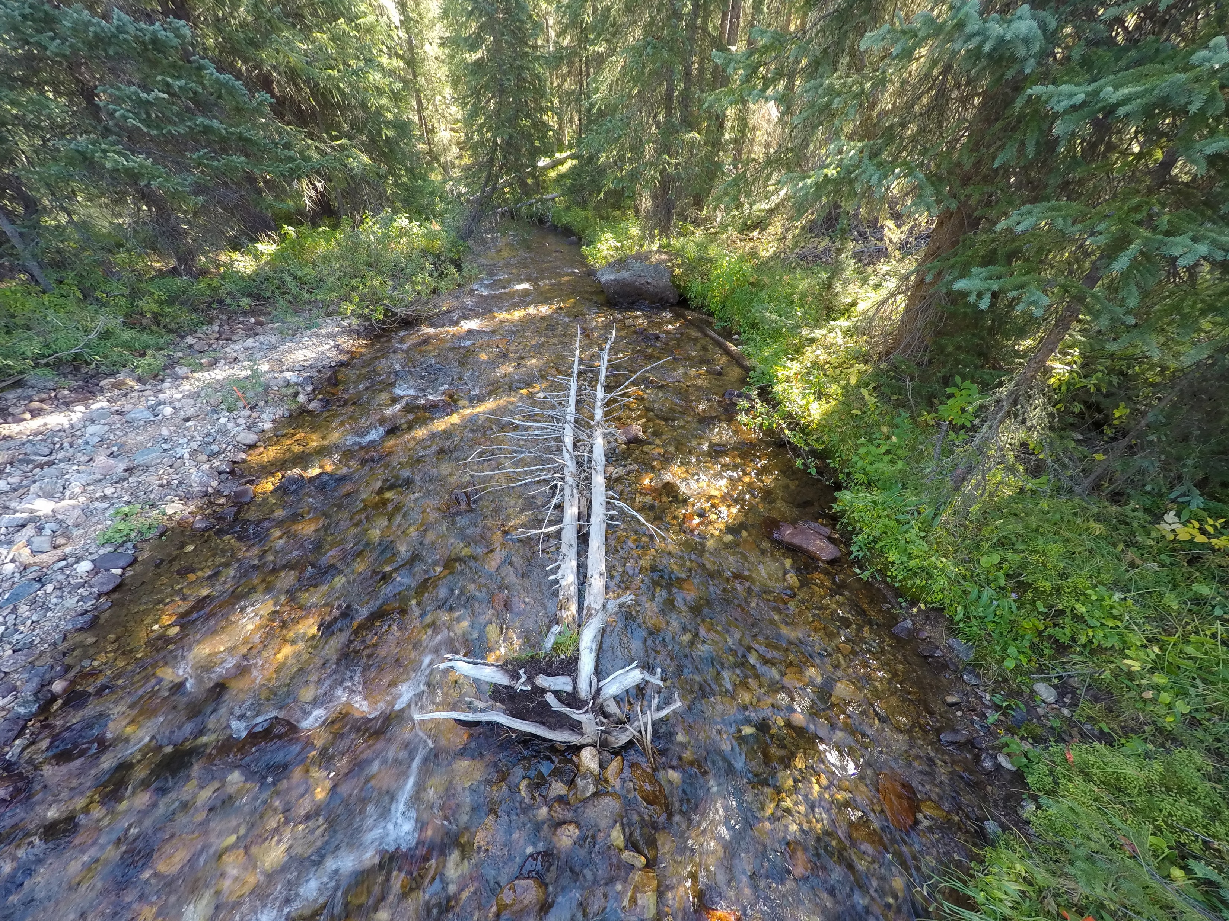
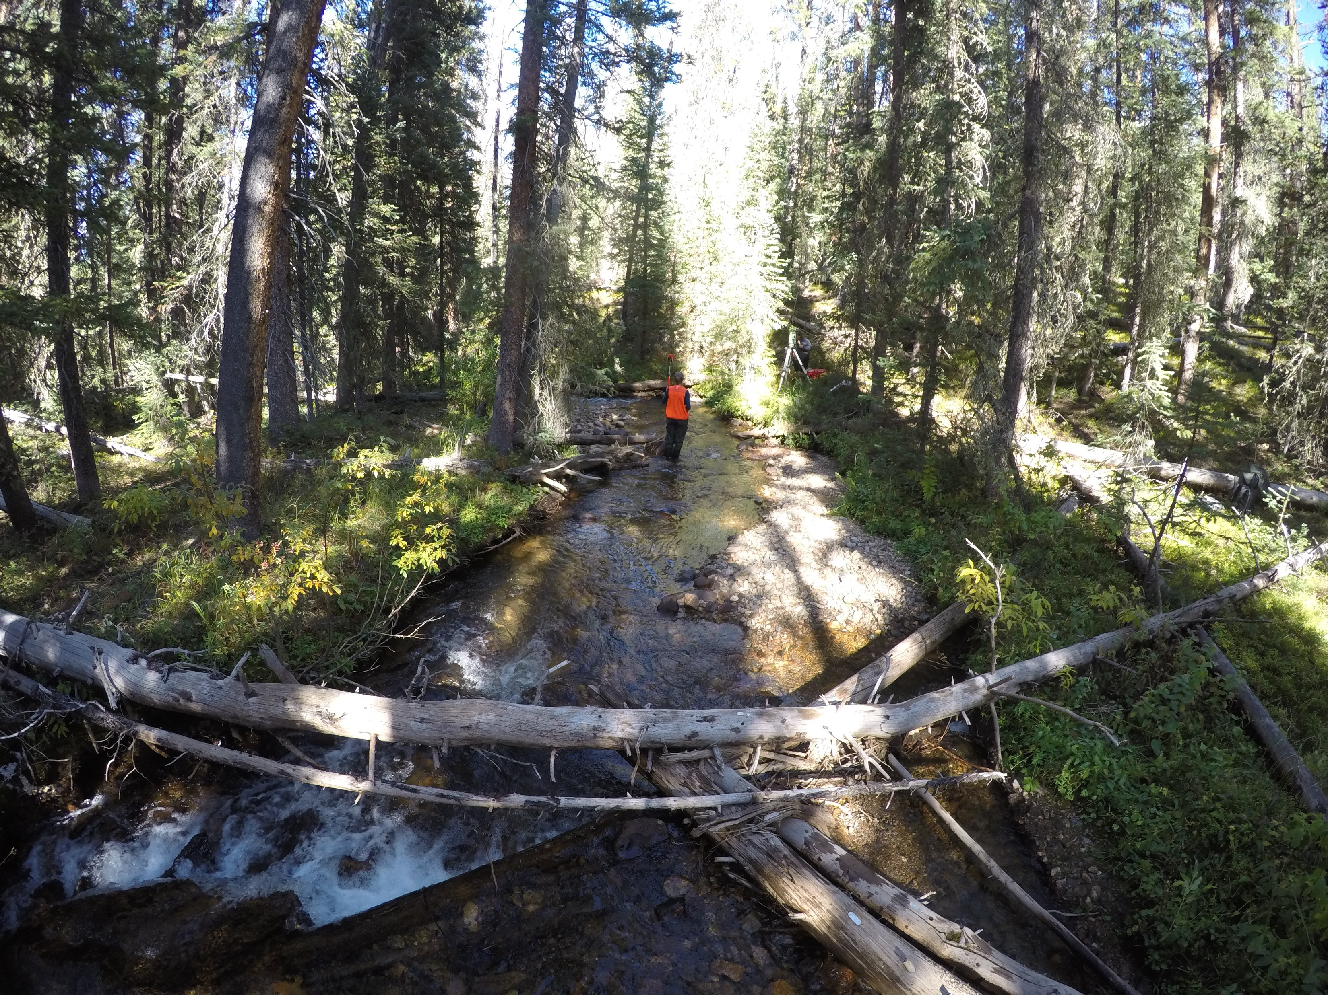
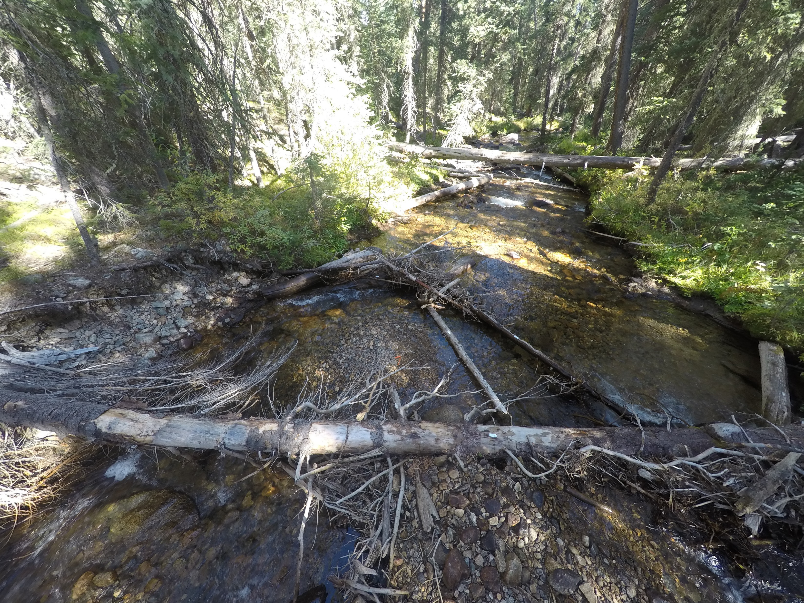
Total Tracer Distance (m)
(a)
(b)
(c)
20 (m)
Flow direction
(a) locations of tracer sediments, transport distances, and large wood pieces; (b) original locations of tracer sediments (c) location of St. Louis Creek
Notes:
Cumulative tracer transport data
Original deployment locations
Avg 23 m , max 193 m

Slide 9
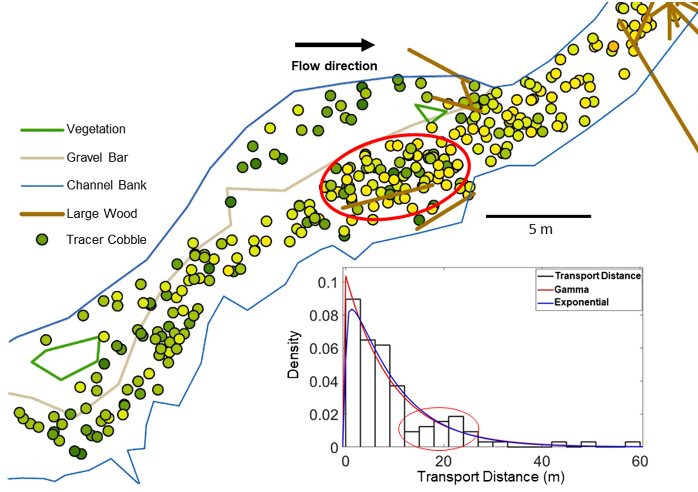
Initial Analysis
(a)
Qualitative observations and initial analysis suggested a clustering of tracers around wood pieces
Clustering corresponded to a reversal of the expected transport distributions
Quantitative data needed to asses if wood is causing this disruption
(b)
(a) observed clustering of tracer sediments surrounding wood piece, (b) reversal of expected transport distance distribution
Notes:
Qualitatively we could observe clustering
Piece fell in 2017 progressively accumulated sediment
Disruption of expected trend
Wanted quantitative data

Slide 10
Linear Mixed Modelling
Relative significance of variables on the likelihood of tracer entrainment, including distance to wood, distance to thalweg, and sediment size
Linear mixed modelling was used to determine the relative significance of variables related to sediment transport
Tracers proximity to wood at entrainment and deposition sites was used to represent woods influence on transport
Other variables, such as tracers distance from channel centreline, sediment size, and proximity to geomorphic features were also investigated
Notes:
LMM to compare different variables influencing tracers
Wood is determined by proximity to tracers
Also compare, size, weight and proximity to other morphological features

Slide 11
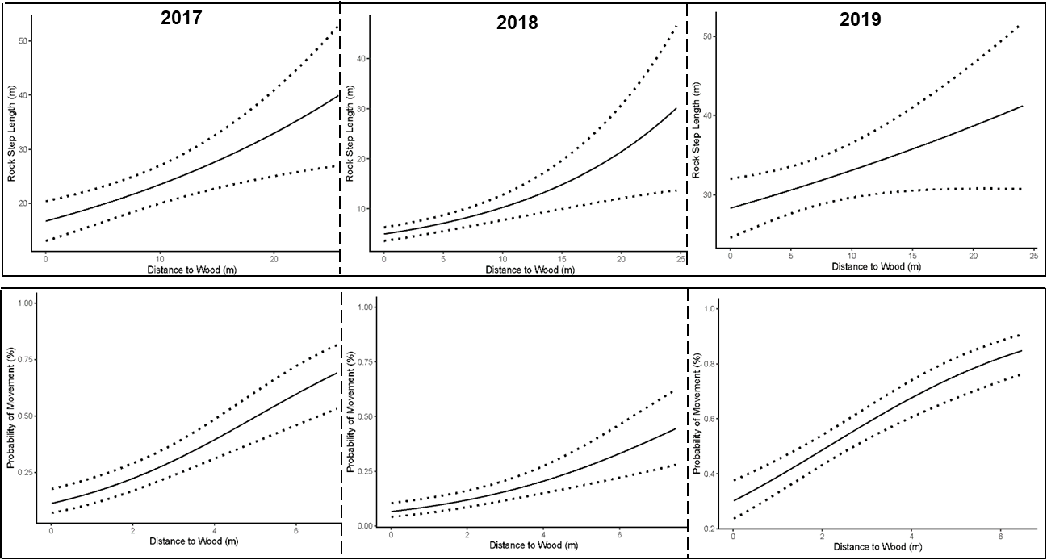
Relative influence of tracer proximity to wood on transport distance, and probability of tracer entrainment. All years were determined to be significant with at least a 95% level of confidence.
Notes:
Found that proximity to wood is significant
Tracer entrainment likelihood
Tracer transport distance
Premature deposition
Large wood major role in transport dynamics
Annual data problematic for determining precise changes in behaviour

Slide 12
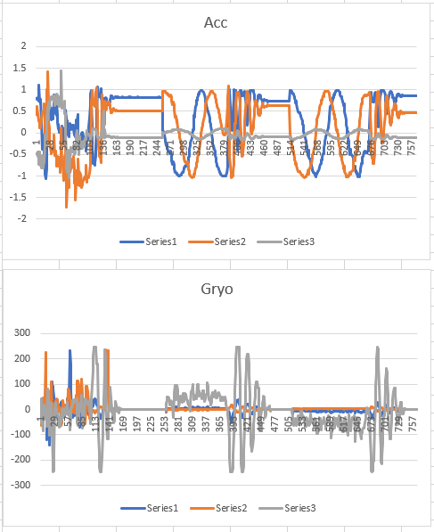
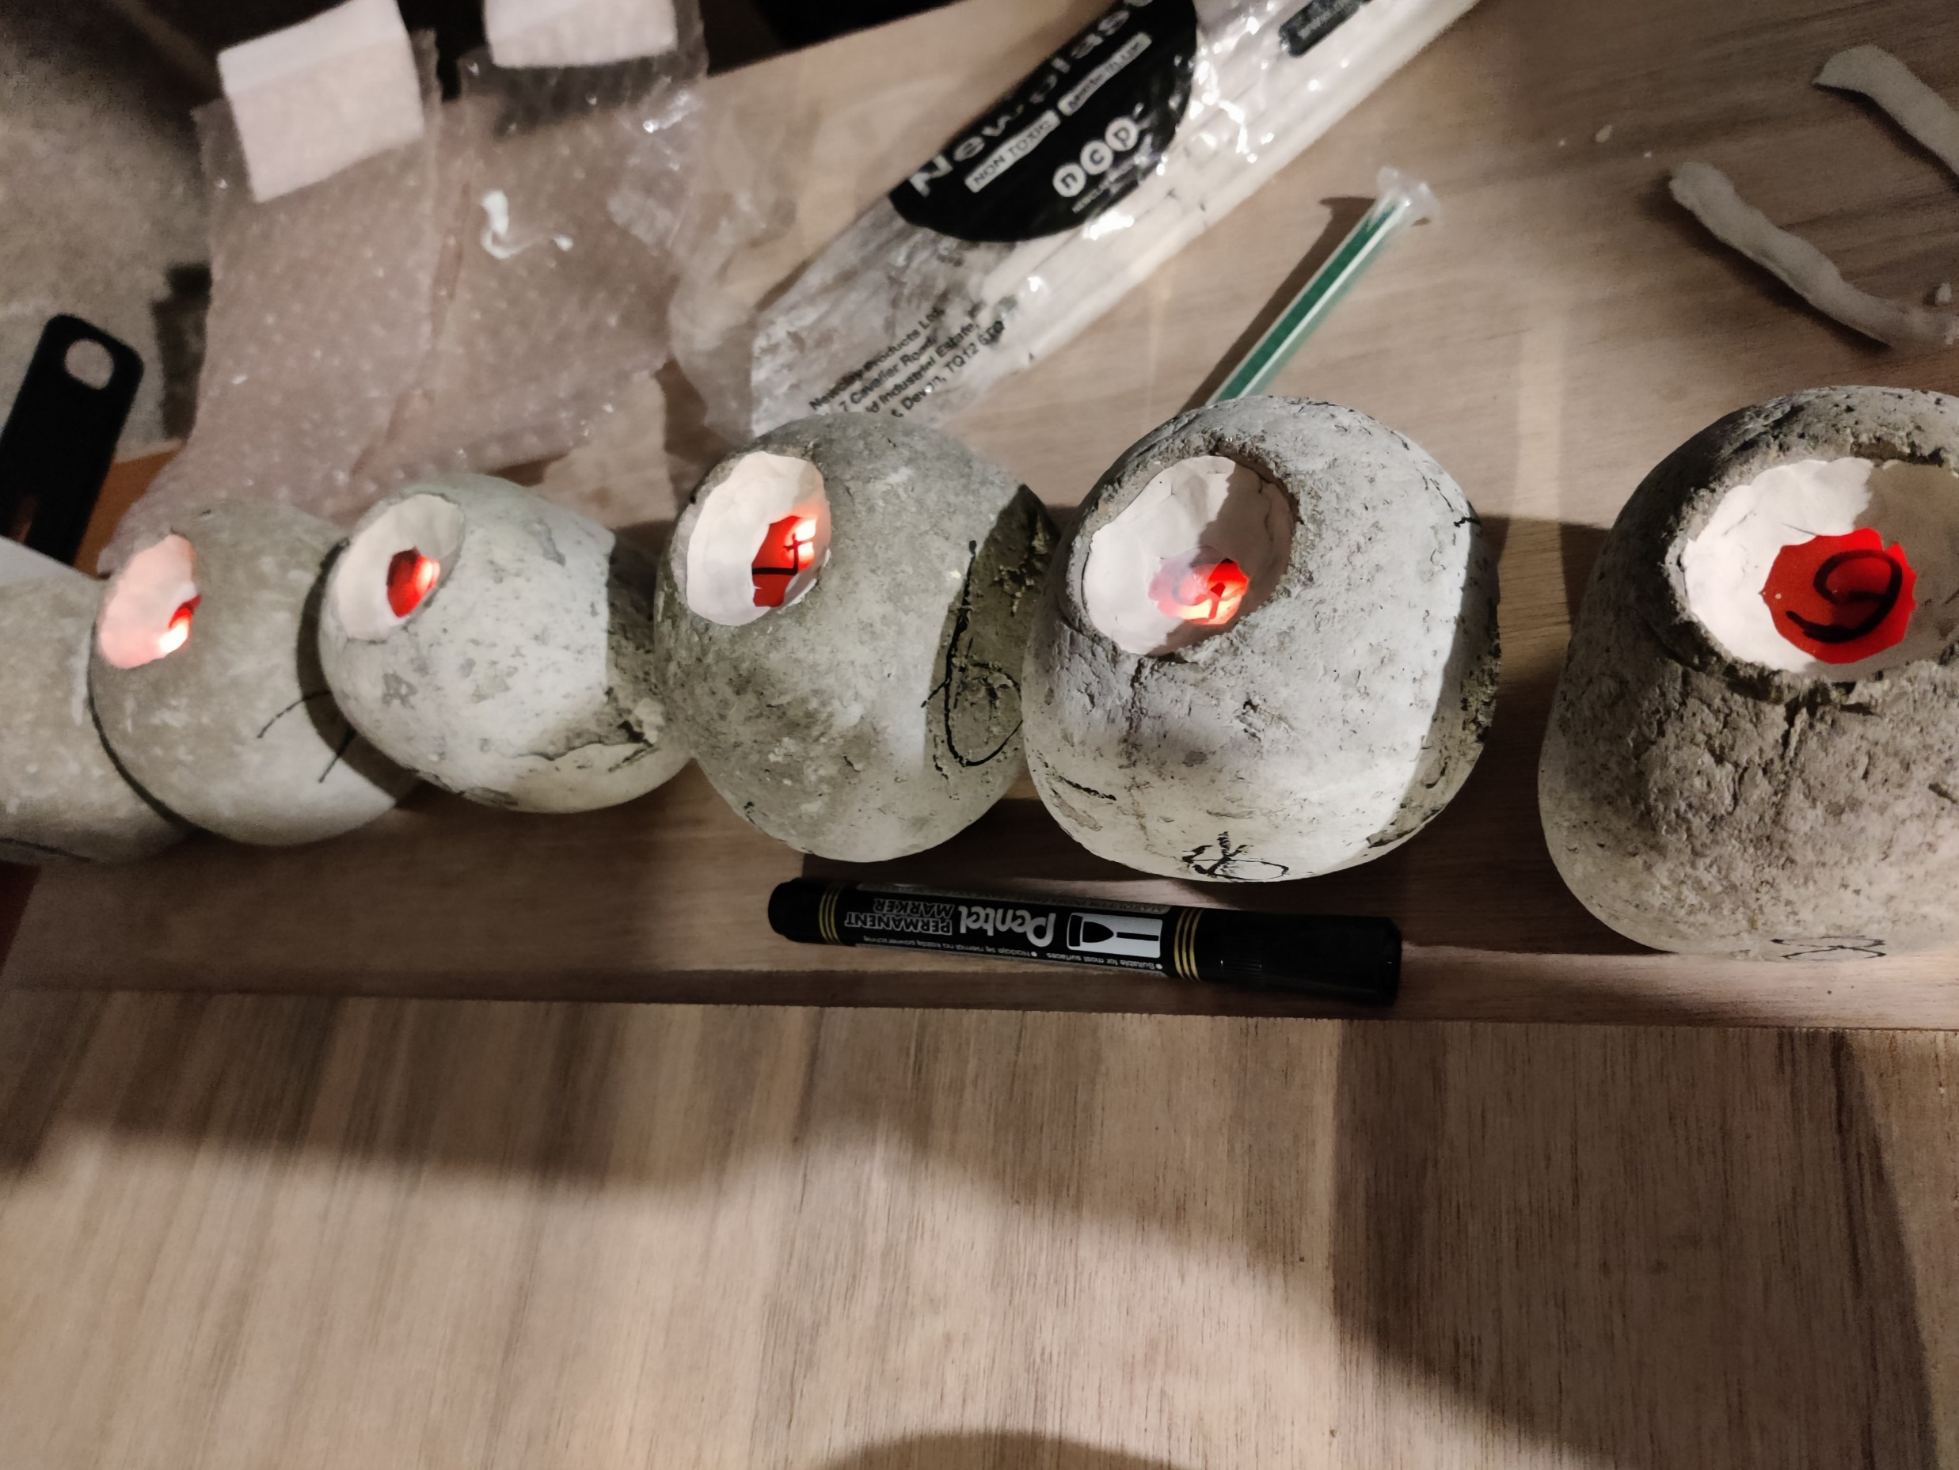
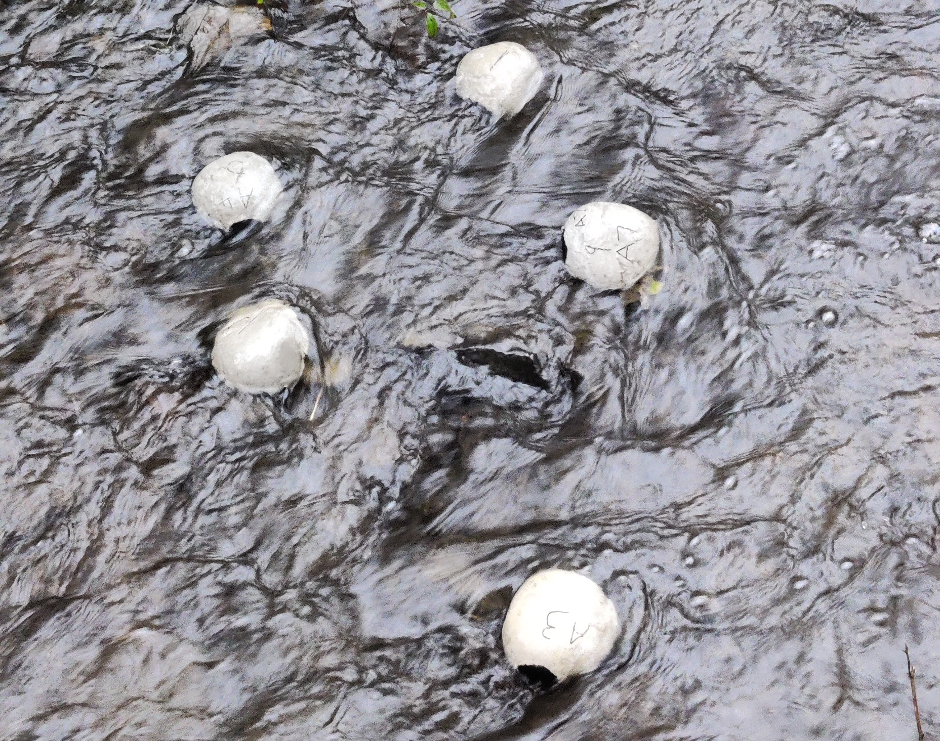
Ongoing Work - SENSUM
Accelerometer
g
Sediment transport can be captured in real time with ‘Smart’ tracer cobbles
Deployed at various SENSUM project sites around
the UK
Further investigate the change in movement behavior between wooded and wood free environments
X
Y
Z
Gyroscope
°/s
X
Y
Z
Provisional gyroscope and accelerometer output during lab tests
Notes:
Ongoing work developing tracers with built in accelerometers, Gyroscope and magnetometers
Characterise precise movement patterns
Compare between sites with different quantities of woody debris

Slide 13


Clark, M.J., Bennett, G.L., Ryan-Burkett, S.E., Sear, D.A. & Franco, A.M.A. (2022) Untangling the controls on bedload transport in a wood-loaded river with RFID tracers and linear mixed modelling. Earth Surface Processes and Landforms, 1– 16. Available from: https://doi.org/10.1002/esp.5376
Contact: m.clark@uea.ac.uk

