Slide 1
w
A new approach to transfer drainage behavior from gauged to ungauged catchments during low flow conditions
EGU 2022
M. Margreth, M. Zappa, Ch. Wanner, D. Hug, F. Lustenberger, F. Schlunegger
27.05.2022
Notes:
In my PHD project I investigate which factors are relevant for storage and drainage behavior of catchments in the Plateau and in the Alps of Switzerland. The main topic is to find a new physically based approach to transfer the drainage behavior from gauged to ungauged catchments at low flow conditions.

Slide 2
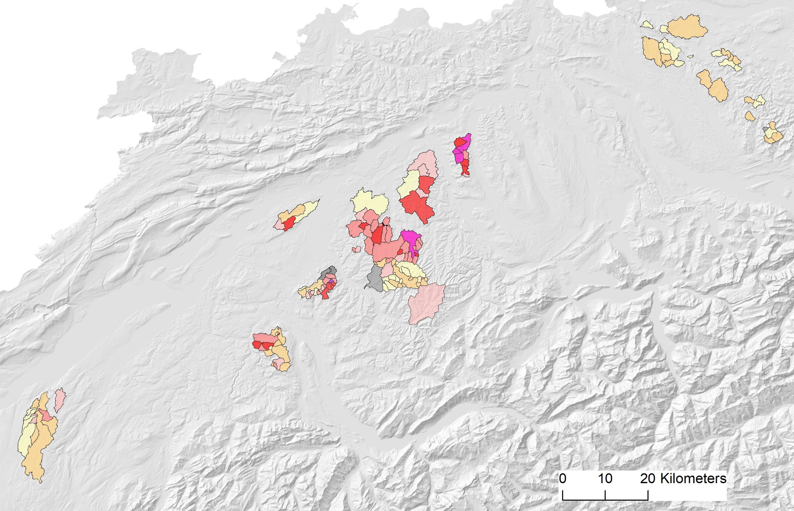
Discharge measurements during low flow periods between 2015 and 2020 normalized on q₉₅ [l s⁻¹ km⁻²]
Zurich
Solothurn
Zug
Luzern
Bern
Thun
Yverdon
Margreth & Naef (2017)
Margreth et al. (2021)
Notes:
In different field campaigns during low flow periods I executed between 2015 to 2020 singular discharge measurements in over 100 catchemnts to better understand the influence of lithology on low flow. Plotted here is the resulting discharge values normalized on q95 and divided by chatchment area. The most important criteria were:
Lithological composition
no water loss by infiltration
no influence by water removal or supply by human.

Slide 3
q₉₅ [l s⁻¹ km⁻²] for different stratigraphical units
Catchments in the Upper Marine Molasse (UMM):
Middle to high q₉₅ in central Swiss Plateau: 6 – 14 l s⁻¹ km⁻²
High variantion of q₉₅ in western Swiss Plateau: 1 – 12 l s⁻¹ km⁻²
Catchments in the Lower Freshwater Molasse (LFM):
Low to middle q₉₅: 1 – 6 l s⁻¹ km⁻²
Catchments in the Upper Freshwater Molasse (UFM):
Similar to LFM- catchments, seperate exceptions with higher q₉₅
Notes:
Summarized we could observe, that the q95 in the UMM-dominated catchments in the central Swiss Plateau range between 6 and 14 l s-1 km-2. With 1 to 12 l s-1 km-2 the variation of q95 in the western Swiss Plateau is higher.
In the LFM-dominated catchments q95 are with 1 to 6 l s-1 km-2 lower.
In the UFM-catchments q95 are comparable to LFM-catchments.

Slide 4
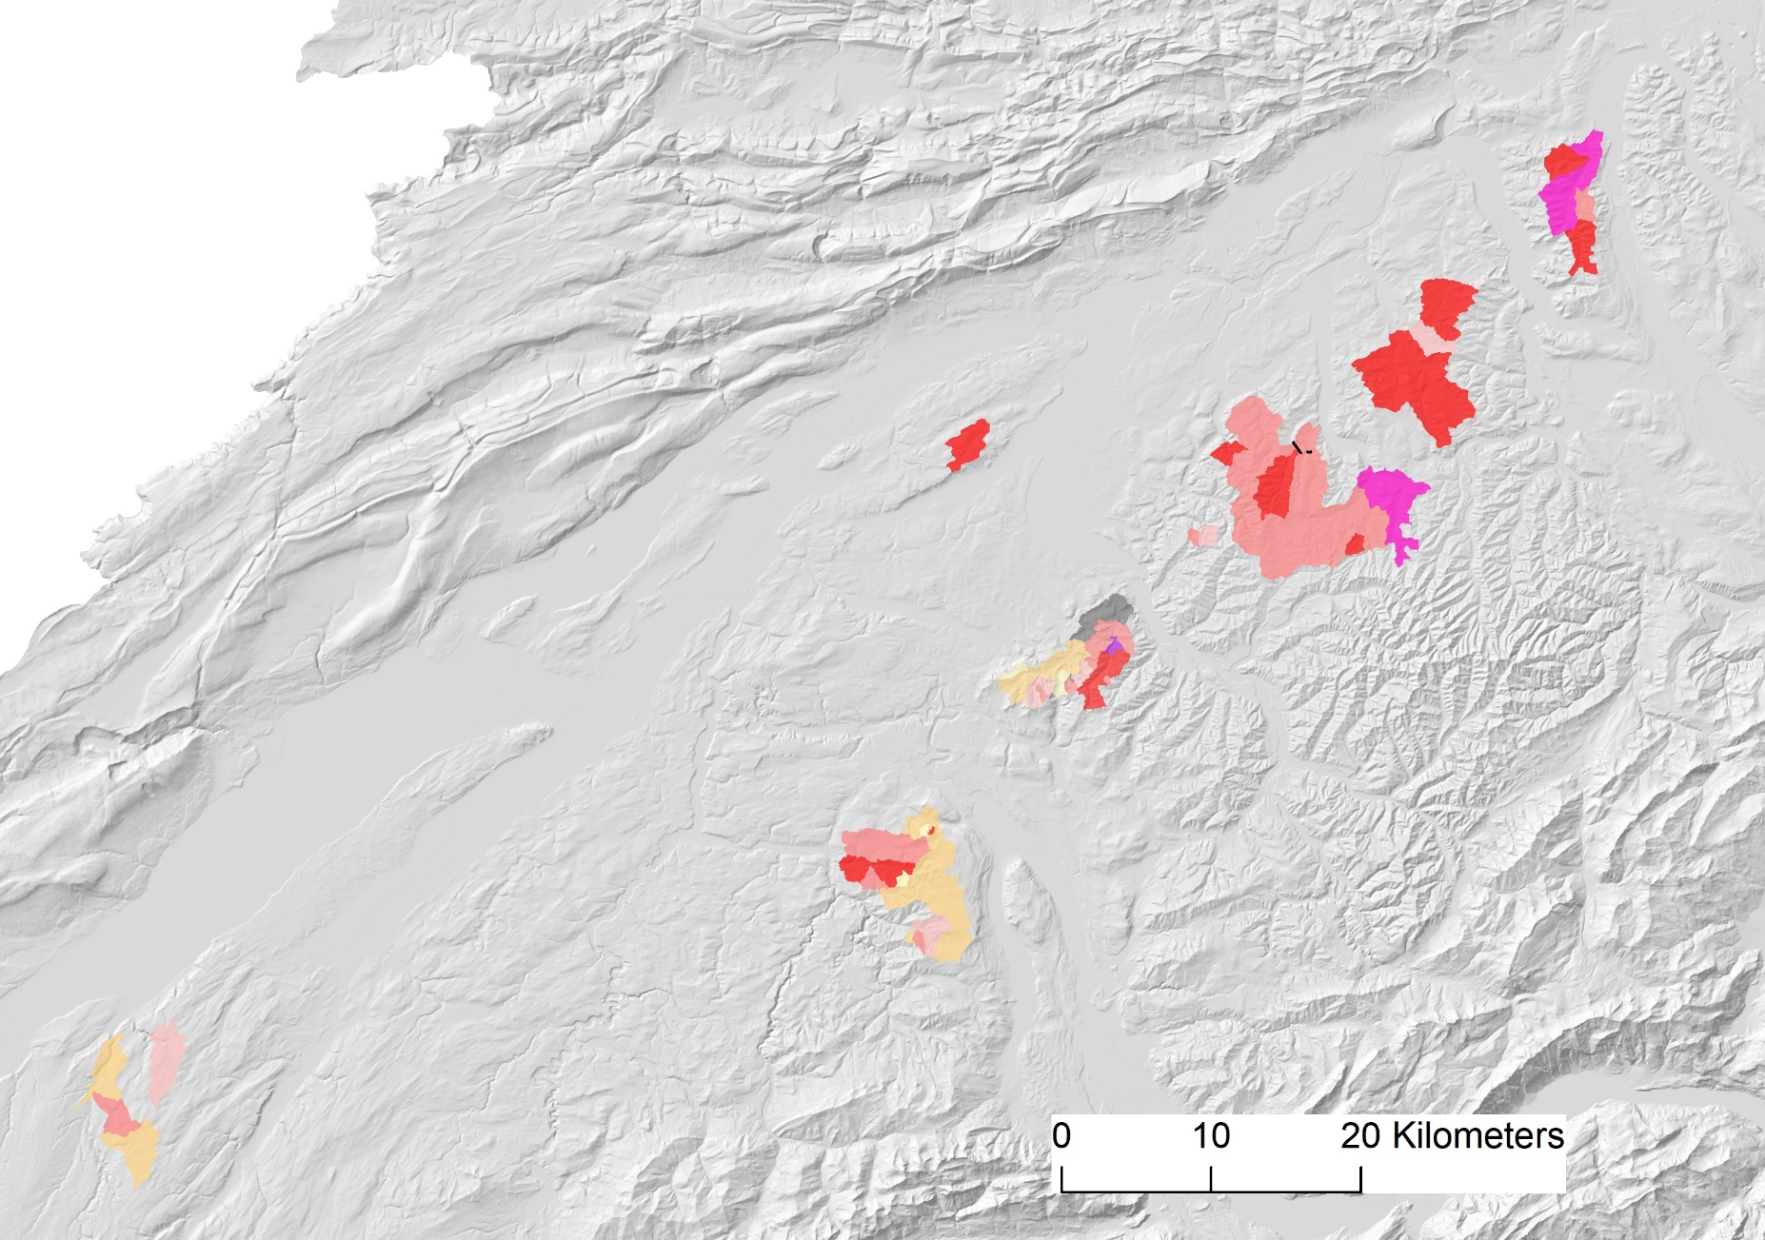
q₉₅ [l s⁻¹ km⁻²] of catchments dominated by UMM
Langenthal
Important factor: Architecture of Molasse, as a consequence of the sedimentation environment during Tertiary
Solothurn
Tides-dominated sedimentation:
Alternating sequences of coarse grained Sandstones, silty Sandstones, conglomerates, marles
Burgdorf
l s⁻¹ km⁻²
Bern
Wave-dominated sedimentation:
homogeneous Sandstone layers
Schwarzenburg
Increasing thickness of UMM
Yverdon
Notes:
Experts in Molasse lithology from the University of Bern helped me to interprete the spatial pattern of q95 geologically:
Plotted on this map are only q95 of UMM-dominated catchments. In the central part dominate mittle to high q95. The UMM is dominated here by thick and homogeneous sandstone packages, built under a wave dominated sedimentation milieu. In the more western part, around Bern, the variation of q95 is higher. The obviously higher variation in storage capacity coincide with a high variability in grainsize composition of the bedrock. The UMM in this region was built by tides-dominated sedimentation milieus. There silent and more turbulent sedimentation alter in high spatial resolution.
The thickness of UMM increases from west towards east. In the most western part no high q95 could be observed.

Slide 5
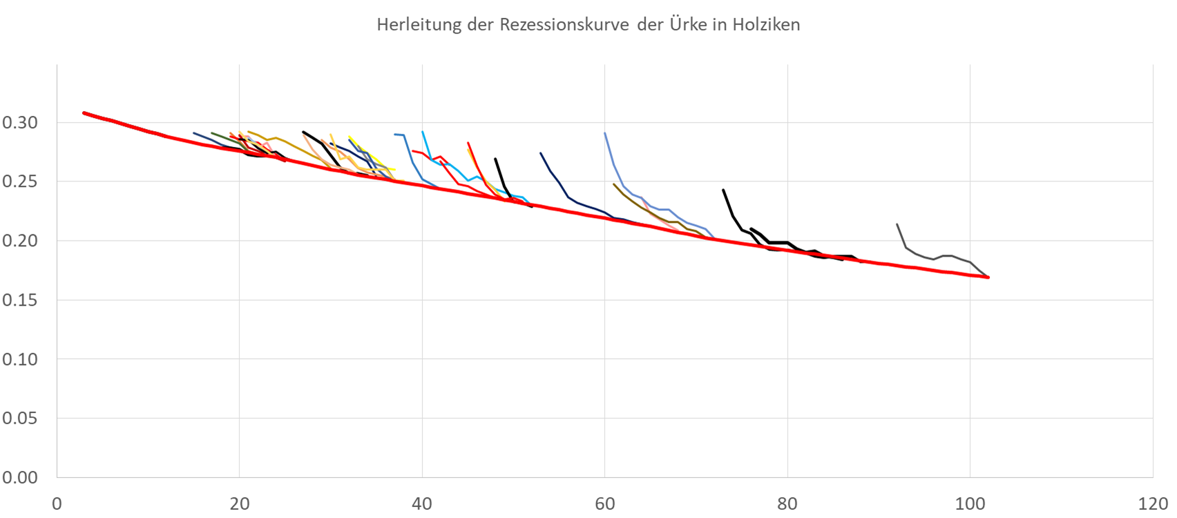
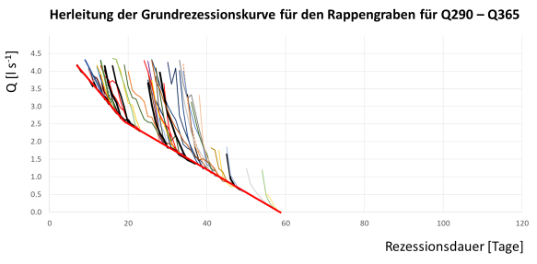
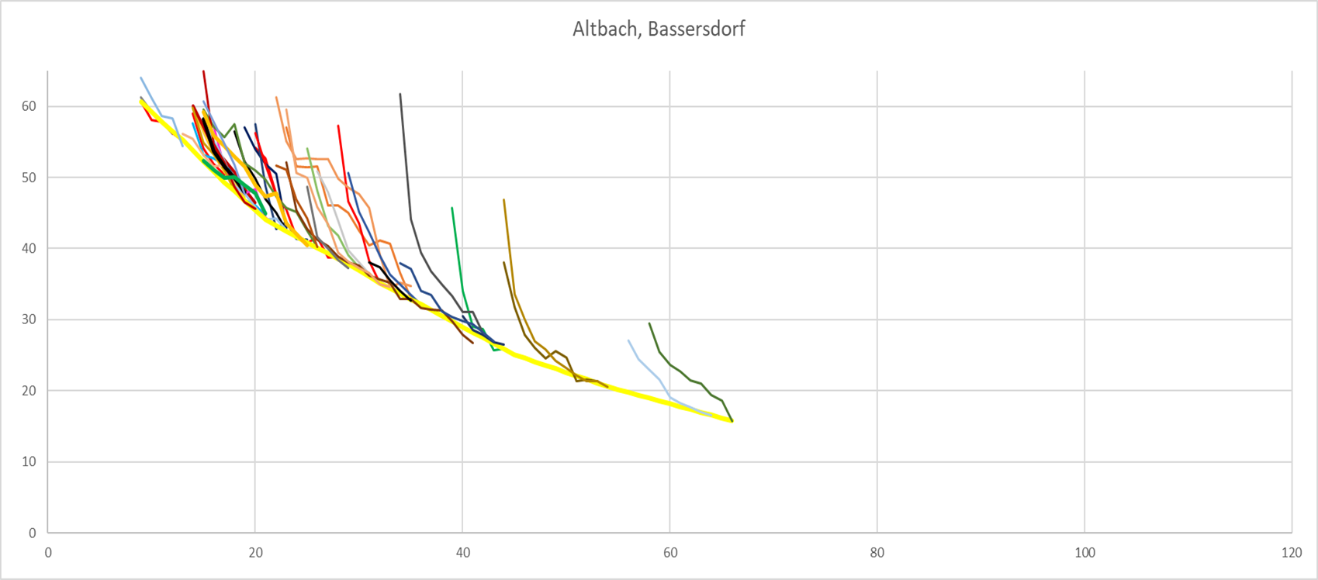
Master recession curves for three catchments of different lithological composition from Q₈₀ to Q₁₀₀
Notes:
To understand not only the storage, but also the drainage behavior, I head for a better understanding how the lithological differences influence the recession behavior. At the moment, master recession curves of catchments with different lithology are analysed.

Slide 6
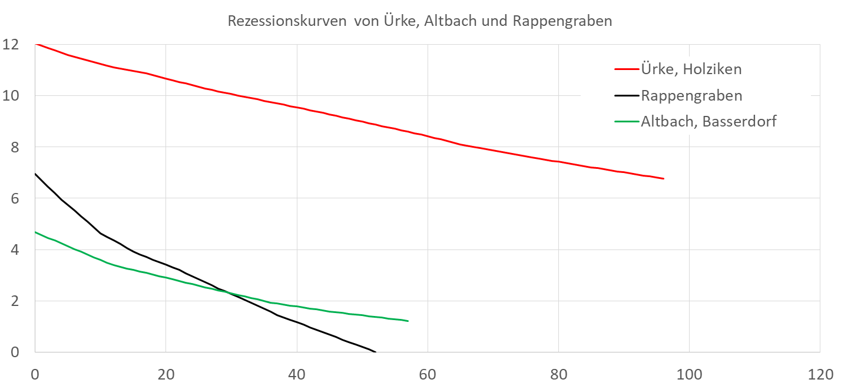
Master recession curves for three catchments of different lithological composition from q₈₀ to q₁₀₀
Lithological architecture:
homogeneous sandstone
Q [l s⁻¹ km⁻²]
alternating sandstones-marles
alternating conglomerates-marles
77mm
12.7mm
13.2mm
[days]
Notes:
Catchments composed of thick sandstone layers drain slowly. They provide high water reserves during low flow periods. The drainage behavior of catchments with alternating sandstone-marles-layers also drain slowly during low flow periods. But they provide less water reserves. In this type of catchments much more water drains at discharges greater q80 than in sandstone catchments. Out of conglomerate and marles constructed catchments drain faster. These ones also have small water reserves.

Slide 7
Conclusions
Storage and drainage behavior in Swiss Plateau catchments are mainly controlled by lithological construction of catchments. A rough regionalization seem to be possible. With at least one discharge measurement during a low flow period the determination of drainage behavior of an ungauged catchment is much more reliable than without any measurements.
Infiltration and exfiltration in and from river bed can be relevant (excluded in the measurement design)
Effects of mean annual precipitation, vegetation cover or soil properties seem to be subsidiary
Sandstone composed catchments have slowest drainage and highest water reserves in low flow periods. Catchments with many interlayers of marles have fewer water reserves in dry periods. Catchments with conglomerates drain fast.

