Slide 1
Additional information is just slides from presentation, contact i.h.smith@pgr.reading.ac.uk for more.

Slide 2




Using high-resolution climate models to predict increases in atmospheric turbulence
QR-code for Abstract
PhD student: Isabel H. Smith
Supervisors: Paul Williams and Reinhard Schiemann
Scenario DTP, NERC
Meteorology Department
University of Reading, UK
i.h.smith@pgr.reading.ac.uk
Notes:
Name, University, Title , supervisors

Slide 3

Abstract QR:
What:
Using global climate models (GCM) to investigate Clear Air Turbulence (CAT) over North Atlantic Ocean at 200hpa (~12 km).
Why:
Atmospheric turbulence has a damaging and costly impact on the aviation sector, annually around $100 million US¹.
CAT occurs in a cloud-free environment, hard to detect and is dangerous.
How:
Using range of CMIP6* HighResMIP* GMC’s to quantify percentage change.
1950-1959 CAT values used as a basis/threshold decade to quantify change.
An ensemble of indices are used to represent CAT.
*Coupled Model Inter-comparison Project 6
*High-resolution inter-comparison project
1 Golding, W.L.,2002: Turbulence and its impact on commercial aviation

Slide 4
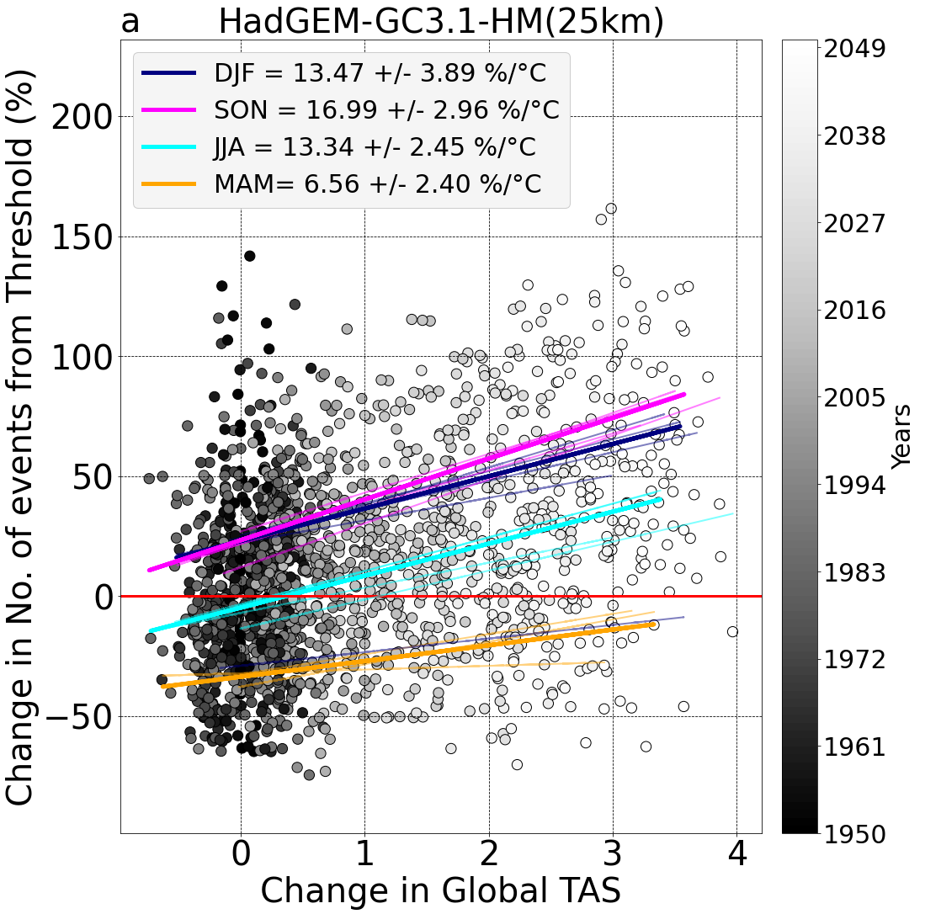
Abstract QR:
Moderate CAT (for all seasons) vs global TAS change
PRIMAVERA CMIP6 HighResMIP Global Climate Models | Horizontal atmospheric mesh spacing (above 50°N)
HadGEM3-GC3.1 (from the UK Met. Office) | 25km (HH,HM) 60km (MM) 135km (LM,LL)
EC-Earth (from a collection of European institutions) | 36km (3P-HR), 71km (3P)
MPI-ESMI-2 (from the the Max-Planck Institute) | 34km (XR), 67km (HR)
*
*TAS is near surface temperature

Slide 5
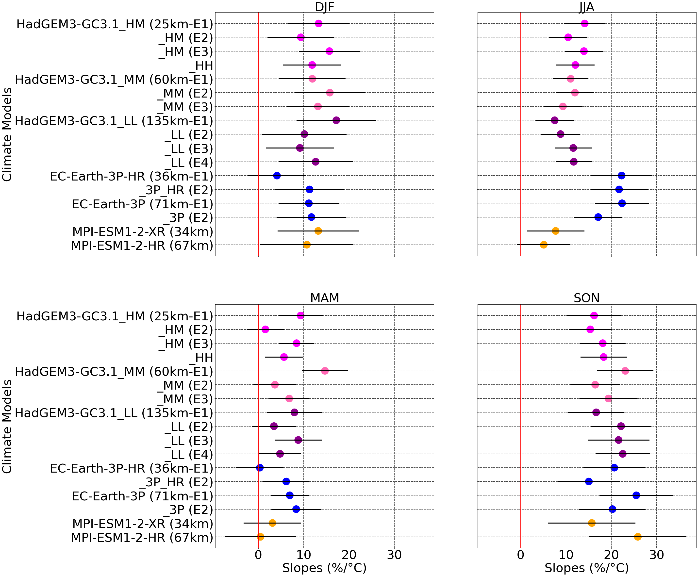
Abstract QR:
Scatter plot line of regression slope values
PRIMAVERA CMIP6 HighResMIP Global Climate Models | Horizontal atmospheric mesh spacing (above 50°N)
HadGEM3-GC3.1 (from the UK Met. Office) | 25km (HH,HM) 60km (MM) 135km (LM,LL)
EC-Earth (from a collection of European institutions) | 36km (3P-HR), 71km (3P)
MPI-ESMI-2 (from the the Max-Planck Institute) | 34km (XR), 67km (HR)
Notes:
So lets quickly break this down with the other global climate models, all models also have several ensemble runs. This has also been included.

Slide 6
Abstract QR:
Scatter plot line of regression slope values
Concluding points
All GMC’s suggest a positive slope for all seasons
SON has the steepest slope, with median of +19.37 %/°C.
JJA has large model variability. EC-Earth median of +21.99 %/°C.
DJF has less variability. Median of +11.88 %/°C (similar to JJA average).
MAM, EC-Earth and HadGEM-GC3.1 similar, MPI-ESM1-2 median +1.81 +/- 5.02 %/°C.
Notes:
MAM Medians
EC-Earth-3P= +6.55 +/- 2.51 %/°C.
HadGEM-GC3.1 = +6.82 +/- 1.43 %/°C.
MPI-ESM1 = +1.81 +/- 5.02 %/°C.

Slide 7

Abstract QR:
Future work
Comparisons with other variables
Increase in CAT events, but what does that mean?
Will there be more patches of turbulence over NA?
Will each patch of CAT increase in magnitude/size?
LinkedIn QR Code
Thank you for listening.
Contact details: i.h.smith@pgr.reading.ac.uk

Slide 8
Additional information – CAT Diagnostics
Negative Richardson Number.*
Magnitude of vertical shear of horizontal wind.
Colson-Panofsky Index.*
Frontogenesis function.
Brown Index.
Brown Energy Dissipation Rate.
Variant 1 of Ellrods Turbulence Index.*
Variant 2 of Ellrods Turbulence Index.*
Flow Deformation.
Flow Deformation x Wind Speed.
Vertical Relative Vorticity Squared.
Horizontal Temperature Gradient.*
Wind Speed.
Wind Speed times Directional Shear.
Flow deformation x Vertical Temp Gradient.
Magnitude of Residual of non-linear balance equation*
Magnitude of Horizontal Divergence
Negative Absolute Vorticity Advection
Magnitude of Relative Vorticity Advection
Version 1 of North Carolina State University Index*
Potential Vorticity
*Used within the operational CAT forecast GTG system
Notes:
We want to know about the kinetic energy but it is sub grid scale, so we use 21 indexes as estimates, all equally good estimates. ROC curve is a performance measurement for the classification problems at various threshold settings. ROC is a probability curve and AUC represents the degree or measure of separability. It tells how much the model is capable of distinguishing between classes
7 of these diagnostics are used for operational CAT forecasts such as the Graphical Turbulence Guidance which majority of piolets uses to avoid regions of turbulence

Slide 9
Turbulence Strength | Energy Dissipation Rate (m^{2/3}s⁻¹) | Percentile range (%)
Light | 0.1-0.2 | 97.0-99.1
Light to Moderate | 0.2-0.3 | 99.1-99.6
Moderate | 0.3-0.4 | 99.6-99.8
Moderate to Severe | 0.4-0.5 | 99.8-99.9
Severe | >0.5 | 99.9-100
Table 1: Turbulence severities, their rate of energy dissipation and the associated percentile range in each CAT index. (Williams, 2016)

Slide 10
