Slide 1
Microbial survival through high metabolic rates in a deep and hot subseafloor environment
F. Beulig¹, F. Schubert², R.R. Adhikari³, C. Glombitza⁴, V.B. Heuer³, K.-U. Hinrichs³, K.L. Homola⁵, F. Inagaki^{6,7}, B.B. Jørgensen¹, J. Kallmeyer², S.J.E. Krause⁸, Y. Morono⁶, J. Sauvage^{5,9}, A.J. Spivack⁵, T. Treude^{8,10}
¹ Center for Geomicrobiology, Department of Bioscience, Aarhus University, Ny Munkegade 114, 8000 Aarhus C, Denmark
² GFZ German Research Center for Geosciences, Section 3.7 Geomicrobiology, Telegrafenberg, 14473 Potsdam, Germany
³ MARUM-Center for Marine Environmental Sciences, University of Bremen, Leobener Strasse 8, 28359 Bremen, Germany
⁴ Department of Environmental Systems Science, ETH Zürich, Universitätstrasse 16, 8092 Zürich, Switzerland
⁵ Graduate School of Oceanography, University of Rhode Island, Narragansett Bay Campus, 215 South Ferry Road, RI 02882, USA
⁶ Kochi Institute for Core Sample Research, Japan Agency for Marine-Earth Science and Technology (JAMSTEC), Nankoku, Kochi 783-8502, Japan
⁷ Mantle Drilling Promotion Office, Institute for Marine-Earth Exploration and Engineering, JAMSTEC, Yokosuka 237-0061, Japan
⁸ Department of Earth, Planetary and Space Sciences, University of California Los Angeles, Los Angeles, CA 90095, USA
⁹ Current address: Department of Marine Sciences, University of Gothenburg, Carl Skottsbergs gata 22B, 413 19 Göteborg, Sweden
¹⁰ Department of Atmospheric and Oceanic Sciences, University of California Los Angeles, Los Angeles, CA 90095, USA

Slide 2
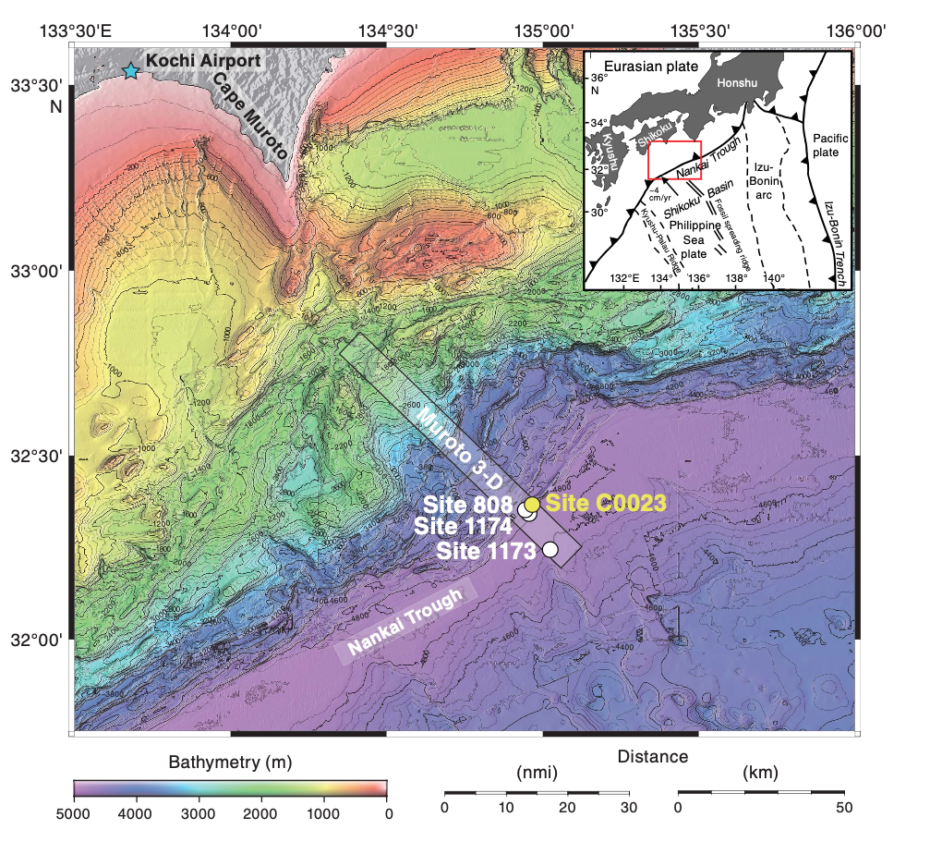
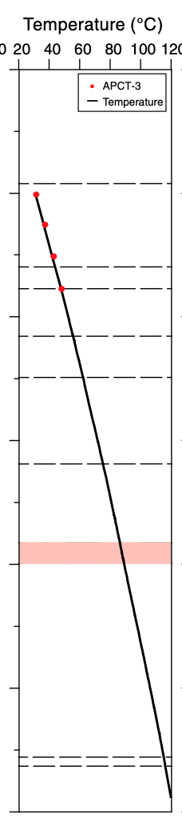
Location
IODP Expedition 370, JP
T_{grad} ≈ 100°C km⁻¹
Heuer et al. 2017

Slide 3
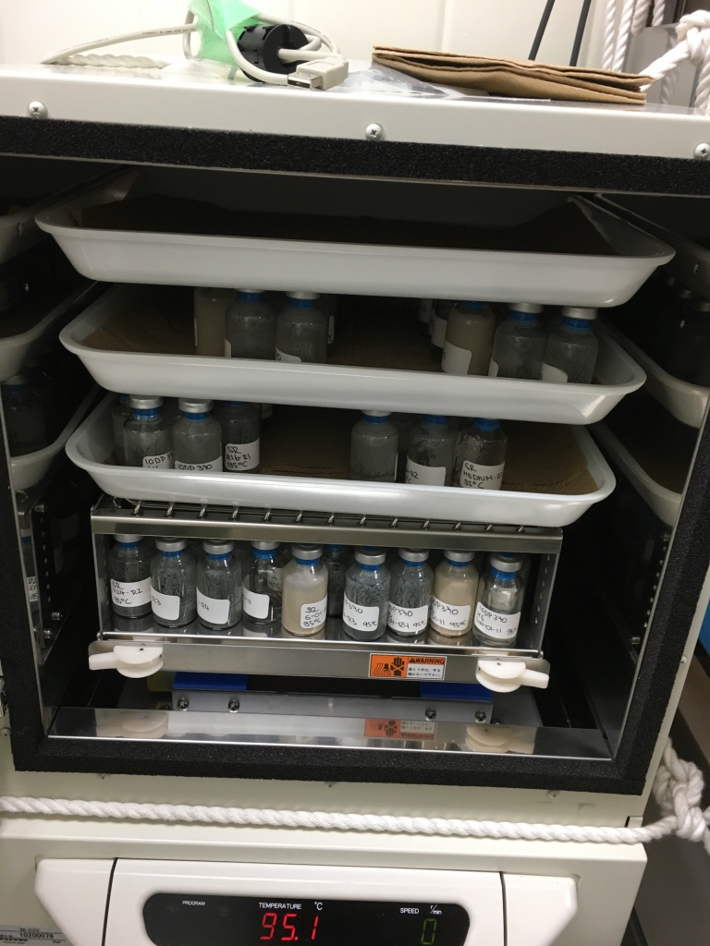

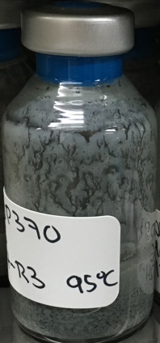
Method
Radiotracer Incubation
Sediment Slurry
Sediment + Sterile Artificial Seawater
2. Radiotracer Injection
Sulfate Reduction:
2 CH₂O + ³⁵SO₄^{2–} → 2 HCO₃– + H₂³⁵S
Methanogenesis:
¹⁴C-Bicarbonate → ¹⁴C-Methane
Batch Incubation at 95°C

Slide 4
Results
Incubation at approximate in-situ temperature in four batches
40, 60, 80 and 95°C
Beulig et al. 2022

Slide 5
Results
Inverse SMTZ : Methane-rich zone above and sulfate-rich zone below
Below SMTZ increased acetate values due to low turnover
Decrease in acetate at >1000 mbsf
Beulig et al. 2022

Slide 6
Results
Sharp drop in cell concentration within the first 400 mbsf Increase in cell counts towards basement (>1000 mbsf)
Beulig et al. 2022

Slide 7
Results
Detectable turnover rates over entire sampling depth
Beulig et al. 2022

Slide 8
Results
Detectable turnover rates over entire sampling depth
Positive response of SRR to methane and acetate in top 400 mbsf
Beulig et al. 2022

Slide 9
Results
Detectable turnover rates over entire sampling depth
Potential increase in turnover rates towards the basement
Beulig et al. 2022

Slide 10
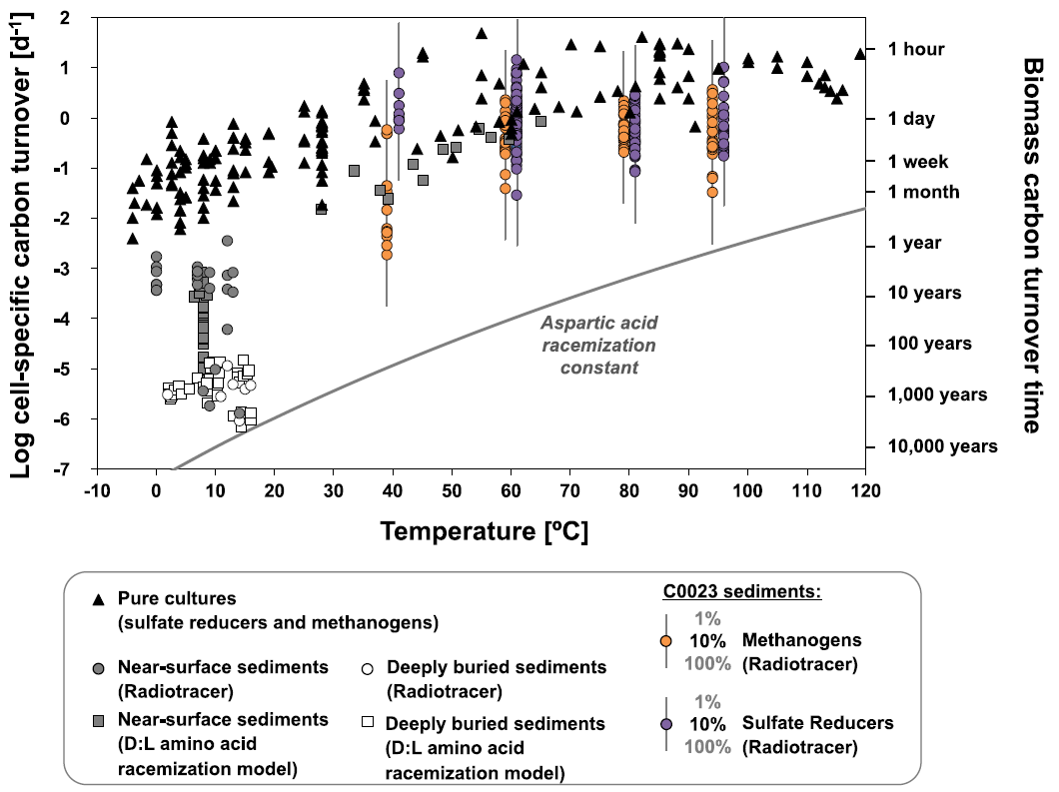
Potential cell-specific C turnover
High cell-specific C turnover in the hot deep biosphere
Beulig et al. 2022

Slide 11
Summary
High in-situ temperature (up to 120°C)
Small community in acetate-rich environment
Detectable turnover rates over entire sampling depth
Active methanogens and sulfate reducers at extreme temperatures
Minute but highly active population in deep, hot sediment
High cell-specific catabolic rates to combat thermal damage

Slide 12
Summary
High in-situ temperature (up to 120°C)
Small community in acetate-rich environment
Detectable turnover rates over entire sampling depth
Active methanogens and sulfate reducers at extreme temperatures
Minute but highly active population in deep, hot sediment
High cell-specific catabolic rates to combat thermal damage

Slide 13
Conclusion
High in-situ temperature (up to 120°C)
Small community in acetate-rich environment
Detectable turnover rates over entire sampling depth
Active methanogens and sulfate reducers at extreme temperatures
Minute but highly active population in deep, hot sediment
High cell-specific catabolic rates to combat thermal damage
Delicate balance between subsistence near the potential upper temperature limit of life and surplus of energy and bioavailable organic carbon
Beulig et al. “Rapid metabolism fosters microbial survival in the deep, hot subseafloor biosphere.”
Nature Communications 13, 312 (2022).

Slide 14
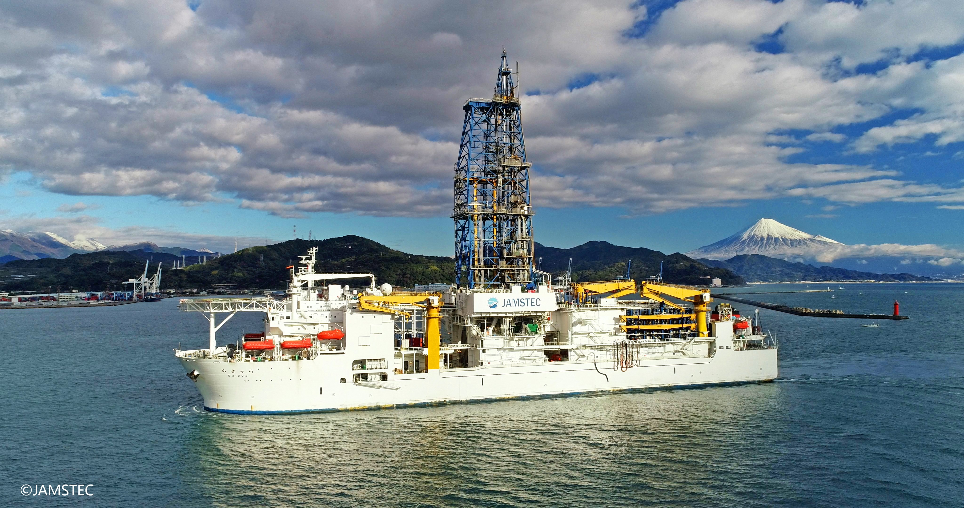
Thank you!
Drilling Vessel Chikyū
Beulig et al. “Rapid metabolism fosters microbial survival in the deep, hot subseafloor biosphere.”
Nature Communications 13, 312 (2022).

Slide 16
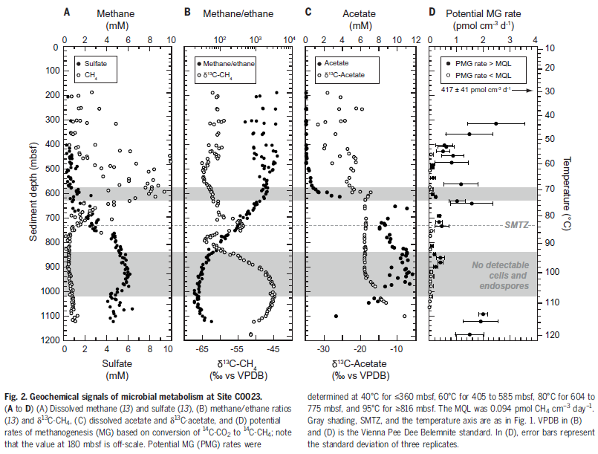
Heuer et al. 2020, d¹³C-CH₄ indicates biogenic methanogenesis up to at least 85°C (SMTZ)
Reversal of the trend indicate biogenic methane source at >100°C

Slide 17
Biomass turnover
22 fg biomass-C per cell
Estimated growth yield (efficiency of carbon assimilation) ranges from 0.08 to 0.2 (C-mol biomass/C-mol substrate)
Direct measurements of ocean water revealed growth yield as low as 0.01
Conservative calculations: biomass turnover days to few years
Consevative = growth yield of 0.01; all cells are sulfate reducers and/or methanogens
Actual biomass turnover likely much faster
10x faster if 10% of cells are sulfate reducers and methanogens, growth yield of 0.02
Biomass turnover in deep, hot sediment at C0023 many orders of magnitude faster than in colder deep sediment
consistent with amino acid racemization-based models of fast microbial turnover (days to months) in hydrothermal surface sediment

Slide 18
Potential cell-specific C turnover
Data were compiled and recalculated as mol C_{assimilated} per mol C_{cell} per day. For the pure cultures, this turnover corresponds to generation times. Bars indicate the range of potential C0023 biomass turnover estimates for a prokaryotic population with 1–100% sulfate reducers and/or methanogens. As acetate and methane additions resulted in a stimulation of sulfate reduction in <350 mbsf sediments, estimates of potential biomass turnover time in these depths are solely based on activity measurements from incubations with trace H₂. D:L = ratio between the D and L isomeric forms of aspartic acid. Symbols referring to data sets from different marine sediments, cultures, and incubations are defined in the legend.
Beulig et al. 2022

