Slide 1

www.upct.es

Slide 2




Assessment of a low-cost Handheld Vector Network Analyzer to Measure the Broadband Complex Permittivity of Soils
Juan D. González-Teruel^{1,2}, Scott B. Jones², David A. Robinson^{2,3}, Jaime Giménez-Gallego¹, Raúl Zornoza⁴ and Roque Torres-Sánchez¹
¹ Dept. of Automatics, Electrical Engineering and Electronic Technology, Technical University of Cartagena, Spain
² Dept. of Plants, Soils and Climate, Utah State University, Logan, UT, USA
³ UK Centre for Ecology and Hydrology, ECW, Bangor, UK
⁴ Dept. of Agricultural Engineering, Technical University of Cartagena, Spain
juando.gonzalez@upct.es
Vienna, Austria, 23rd May 2022

Slide 3
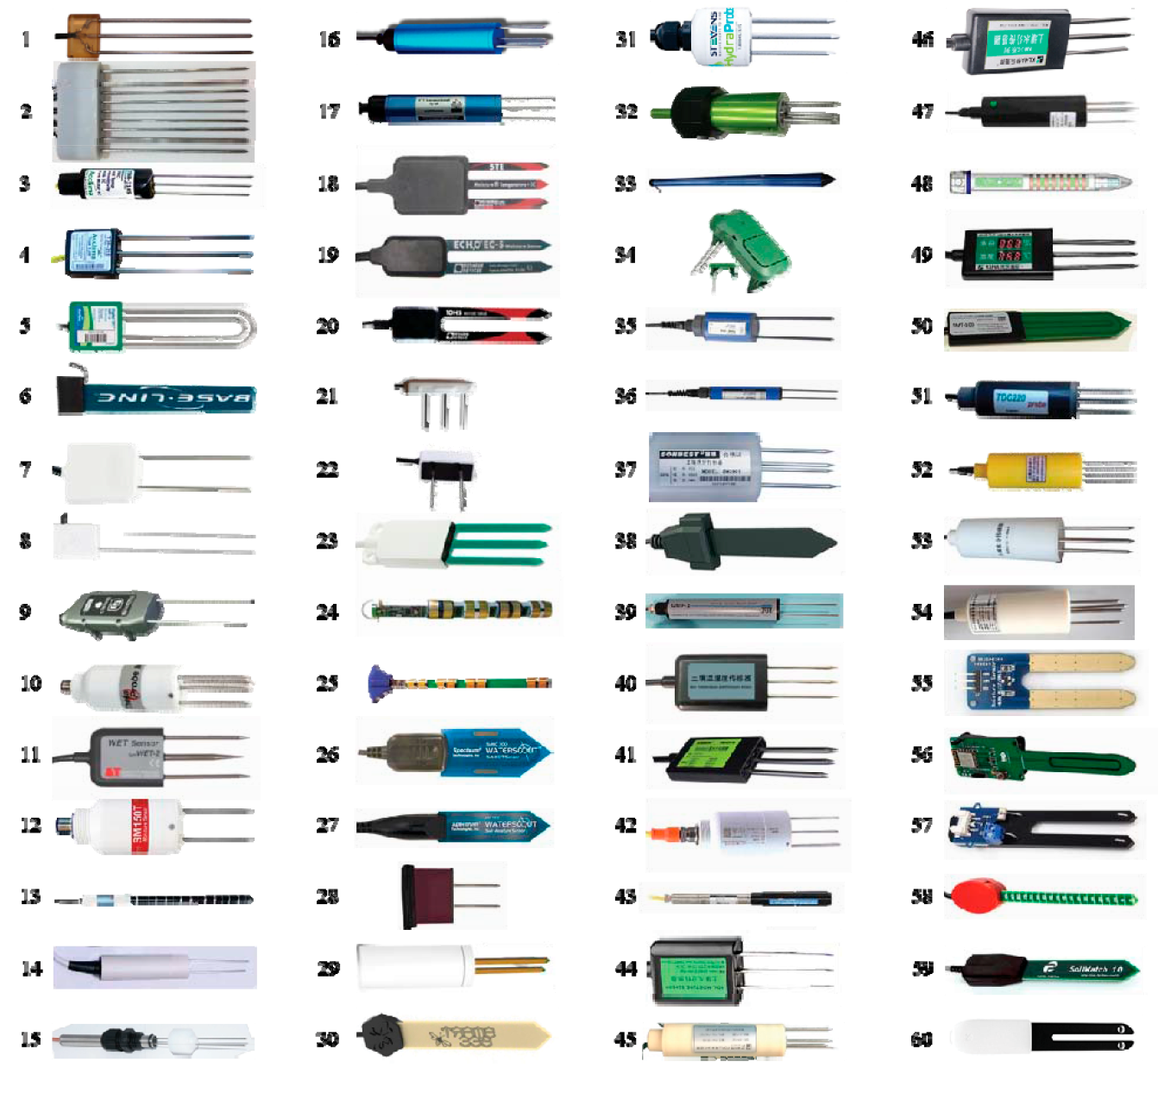
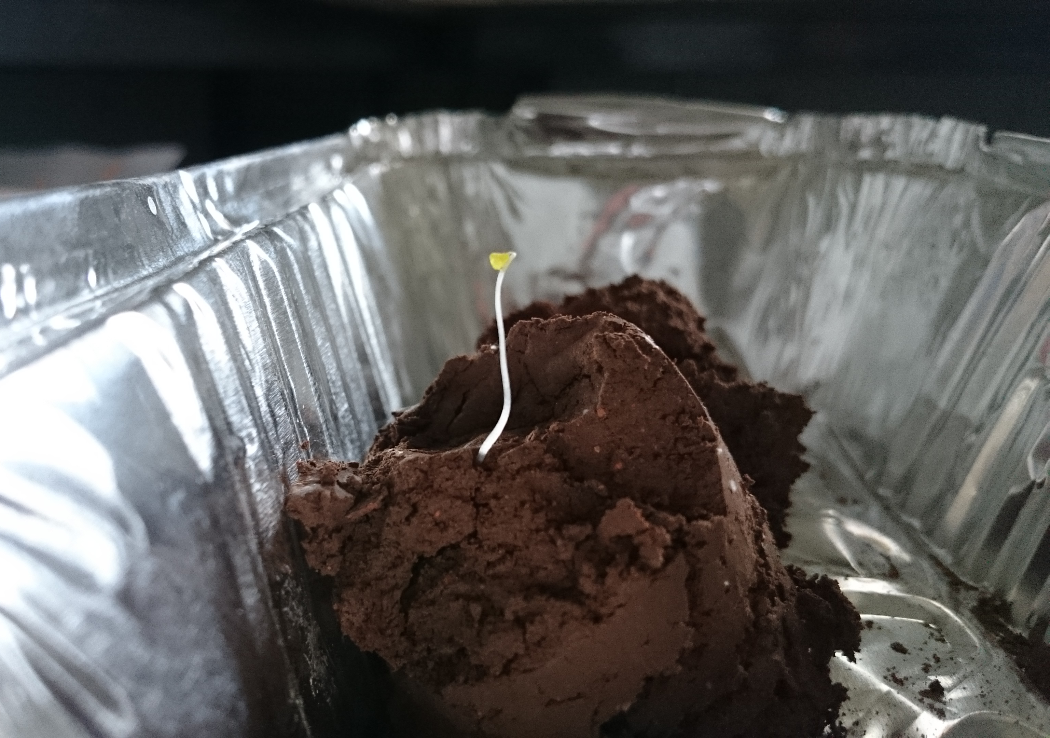
1. Motivation
1
Motivation
Importance of water content in porous media: soil, rocks, foodstuffs…
AIR GAPS
SOLID PARTICLES
LIQUID PHASE
ε_{air} ≃ 1 | ε_{solids} ≃ 4 - 7 | ε_{water} ≃ 80
Source: S. B. Jones, W. Sheng, J. Xu, and D. A. Robinson,12th International Conference on Electromagnetic Wave Interaction with Water and Moist Substances, ISEMA 2018, 2018.

Slide 4
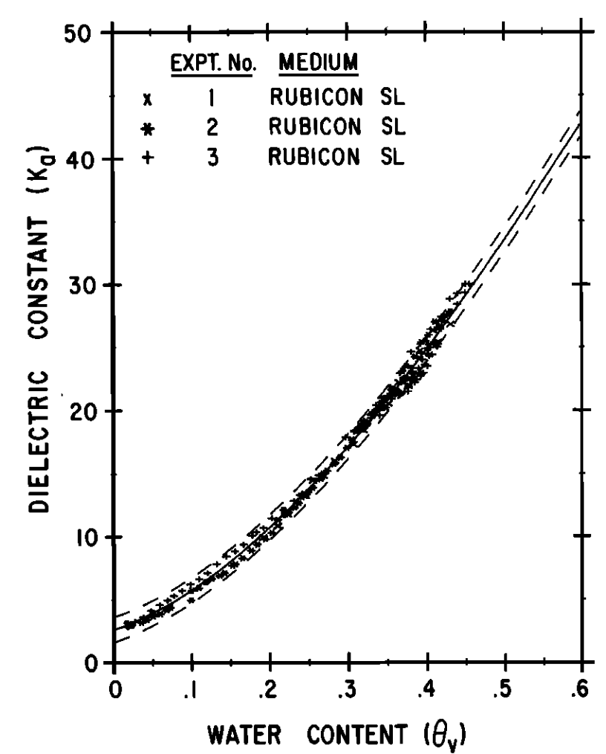
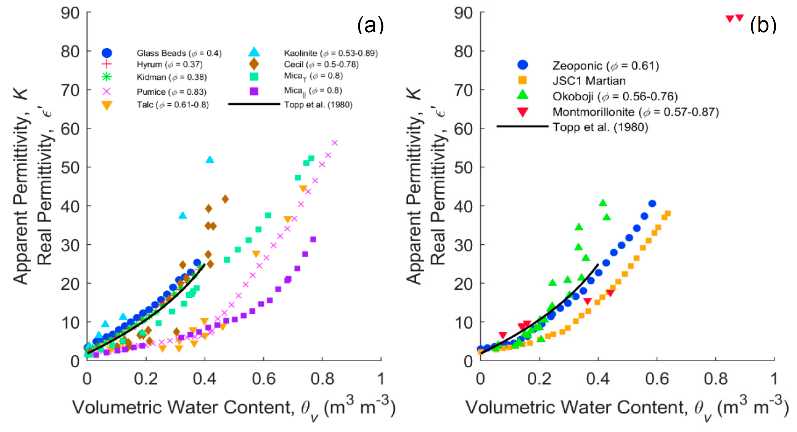
1. Motivation
ε* = f
EM Frequency
Water Content
Bulk density
Electrical Conductivity
Temperature
Solid particles composition
Solid particles shape
Phase configuration
.
.
.
Source: G. C. Topp, J. L. Davis, and A. P. Annan, Water Resour. Res., 1980

Slide 5
1. Motivation

Slide 6
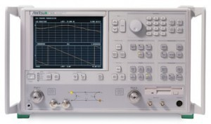
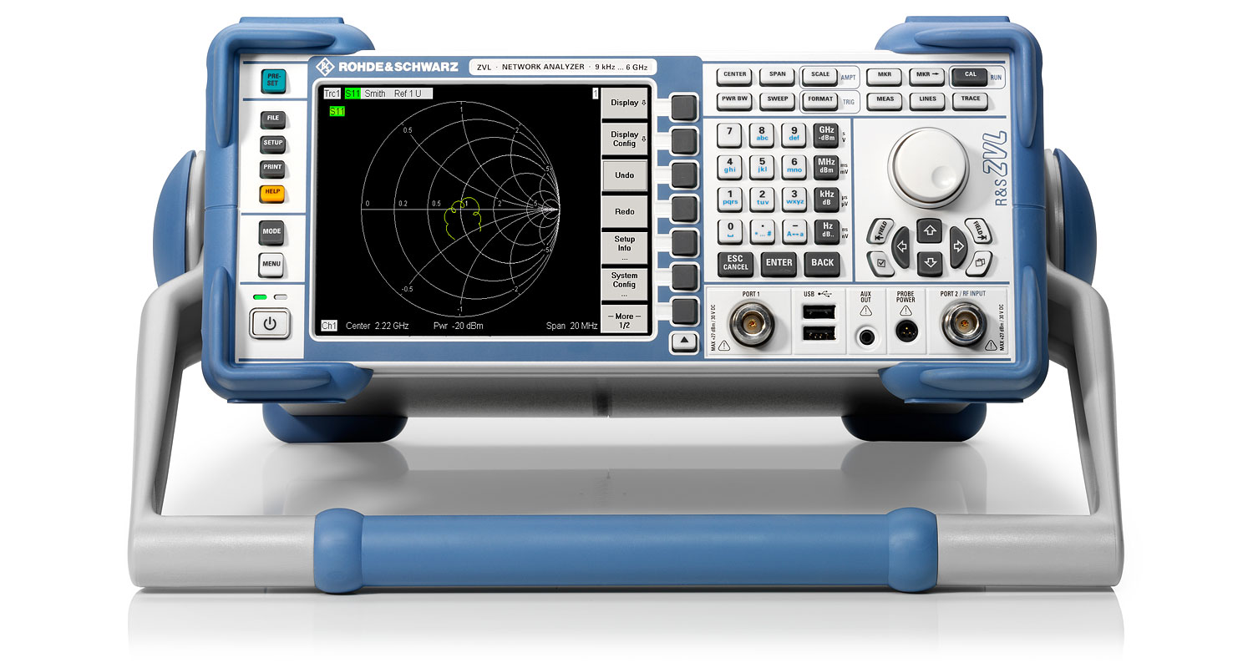
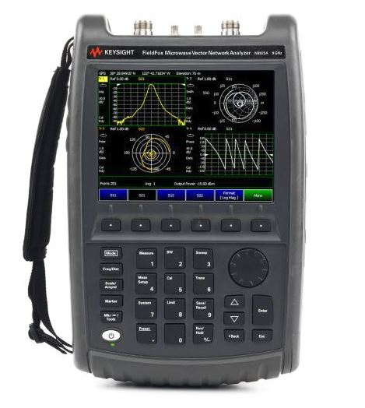
1. Motivation
We use Vector Network Analyzers (VNA) to measure the Dielectric Spectra.
Bulky
Expensive (3000€ - 50000€)
Limited for low budgets, extensive experiments and in-situ applications.

Slide 7
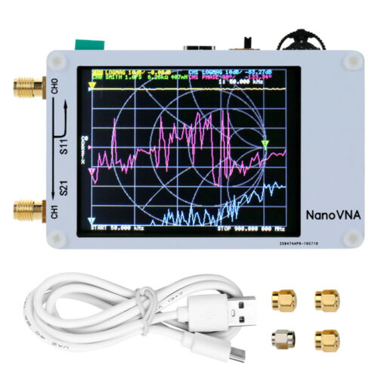
1. Motivation
nanoVNA
Low-cost (~ 50€)
Handheld
Open-source
2-ports
50 kHz – 900 MHz

Slide 8
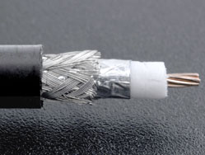
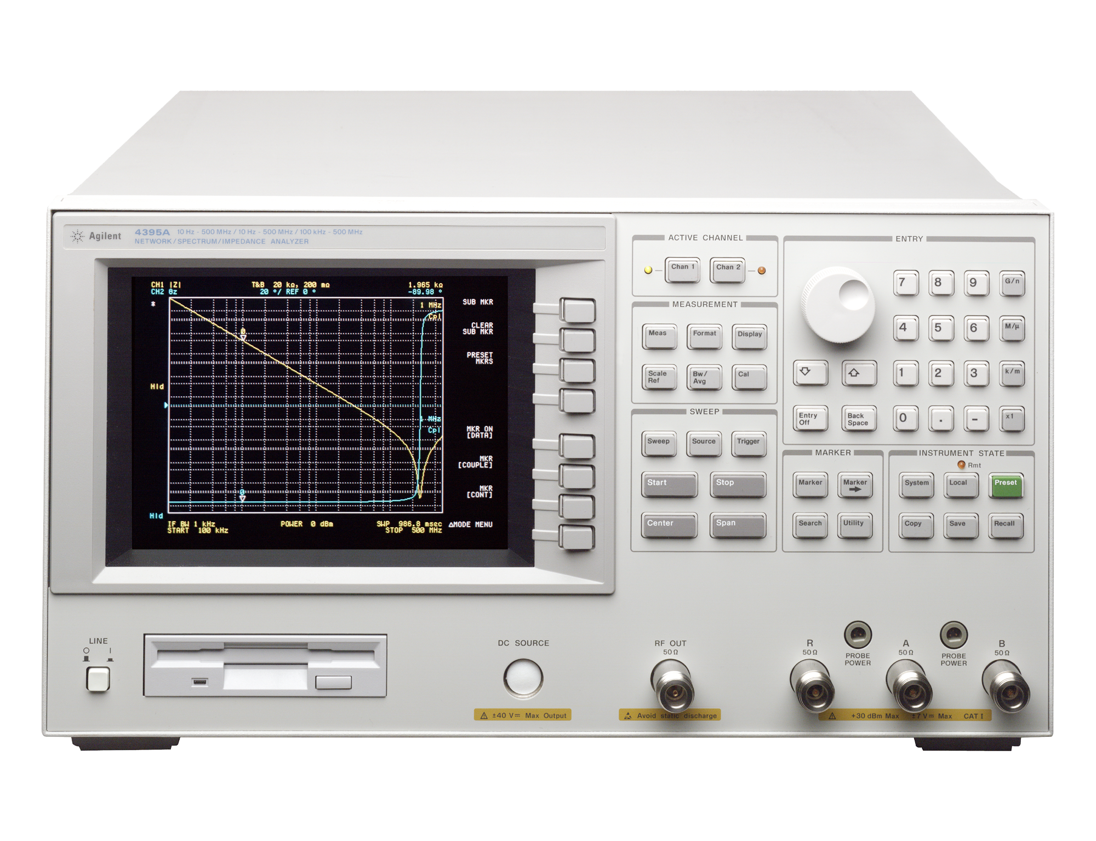
2. Materials
2
Materials
nanoVNA-H (10 – 700 MHz)
Set A:
0.75 m LMR-240 UF coaxial cable
Open-ended coaxial probe
Agilent 4395A (10 – 500 MHz)
Set B:
Notes:
Once we had our self-manufactured probe, how did we test it? Well, we used 2 experimental sets to make several comparisons: on the one hand, Set A consisted of an Agilent 4395A Vector Network Analyzer paired with its corresponding Radio Frequency Impedance Test Kit, a LMR-240 UF coaxial cable and the experimental probe.
On the other hand, Set B consisted of a Rohde and Schwarz ZVA 67 with the same coaxial cable and either the experimental probe or a comercial Speag DAK-12 probe, just for comparison.
The testing frequency range was set from 10 to 500 MHz due to the limitations of the Set A VNA.
We evaluated both experimental sets in liquid and granular media.

Slide 9
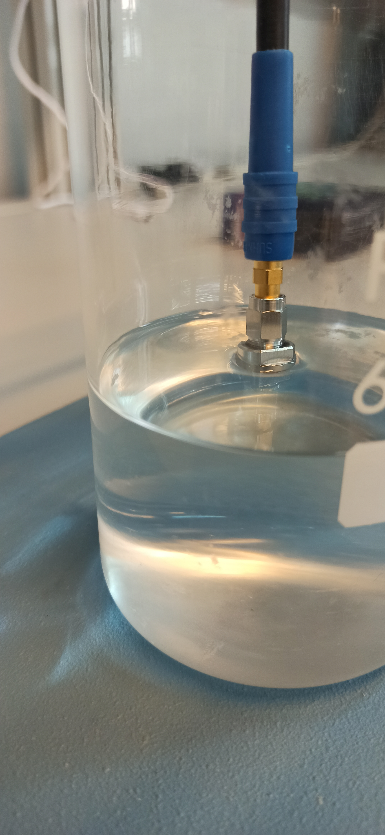

3. Methods and Experiments
3
OWL Calibration
Open
Water
Liquid
Methods and Experiments
S₁₁*(f) → ε*(f)
Calibration
Acetone
Isopropanol
Methanol
Ethylene-glycol
Bilinear equation: $ε^{∗}\left(f\right)=\frac{c_{1}^{∗}\left(f\right)S_{11}^{∗}\left(f\right)−c_{2}^{∗}(f)}{c_{3}^{∗}\left(f\right)−S_{11}^{∗}(f)}$
$$S_{11, O}^{∗}\left(f\right)c_{1}^{∗}\left(f\right)−c_{2}^{∗}\left(f\right)−ε_{O}^{∗}\left(f\right)c_{3}^{∗}\left(f\right)=−ε_{O}^{∗}\left(f\right)S_{11, O}^{∗}\left(f\right)$$
$$S_{11, W}^{∗}\left(f\right)c_{1}^{∗}\left(f\right)−c_{2}^{∗}\left(f\right)−ε_{W}^{∗}\left(f\right)c_{3}^{∗}\left(f\right)=−ε_{W}^{∗}\left(f\right)S_{11,W}^{∗}\left(f\right)$$
$$S_{11, L}^{∗}\left(f\right)c_{1}^{∗}\left(f\right)−c_{2}^{∗}\left(f\right)−ε_{L}^{∗}\left(f\right)c_{3}^{∗}\left(f\right)=−ε_{L}^{∗}\left(f\right)S_{11, L}^{∗}\left(f\right)$$
Notes:
To perform the complex permittivity measurements, we applied a 2-step calibration procedure.
In the first step, we made the Open Short Load calibration at the end of the coaxial cable, just at the inteface between the coaxial cable and the coaxial probe.
And then, the second step to estimate the complex permittivity from the complex S11 parameter consisted of the Open Water Liquid method, which has been described by many authors, but indeed, I have followed two works to applied it.
.
.
.
So, when applying the OWL method, we used Air for the open standard, Distilled Water for the Water standard and for the liquid standard we rotated the liquid used among Acetone, Isopropanol, Methanol and Ethylene-Glycol and using the rest of liquids not used as standard for validation and probe evaluation.

Slide 10
3. Methods and Experiments
RMSE
VNA model | ε* component | Organic liquid standard
 |  | Acetone | Isopropanol | Methanol | Ethylene-glycol
Agilent 4395A | ε’ | 3.3878 | 2.6476 | 2.4297 | 2.8792
 | ε’’ | 5.2261 | 2.2081 | 2.6840 | 3.3410
nanoVNA | ε’ | 0.5723 | 0.7392 | 0.6029 | 0.5924
 | ε’’ | 0.5632 | 0.9760 | 0.5482 | 0.5609
Notes:
To perform the complex permittivity measurements, we applied a 2-step calibration procedure.
In the first step, we made the Open Short Load calibration at the end of the coaxial cable, just at the inteface between the coaxial cable and the coaxial probe.
And then, the second step to estimate the complex permittivity from the complex S11 parameter consisted of the Open Water Liquid method, which has been described by many authors, but indeed, I have followed two works to applied it.
.
.
.
So, when applying the OWL method, we used Air for the open standard, Distilled Water for the Water standard and for the liquid standard we rotated the liquid used among Acetone, Isopropanol, Methanol and Ethylene-Glycol and using the rest of liquids not used as standard for validation and probe evaluation.

Slide 11
3. Methods and Experiments
Measurements in mineral soils (Haplic Calcisols)
Silt
Notes:
To perform the complex permittivity measurements, we applied a 2-step calibration procedure.
In the first step, we made the Open Short Load calibration at the end of the coaxial cable, just at the inteface between the coaxial cable and the coaxial probe.
And then, the second step to estimate the complex permittivity from the complex S11 parameter consisted of the Open Water Liquid method, which has been described by many authors, but indeed, I have followed two works to applied it.
.
.
.
So, when applying the OWL method, we used Air for the open standard, Distilled Water for the Water standard and for the liquid standard we rotated the liquid used among Acetone, Isopropanol, Methanol and Ethylene-Glycol and using the rest of liquids not used as standard for validation and probe evaluation.

Slide 12
4. Conclusions
4
Conclusions
The nanoVNA performance on the measurement of the complex permittivity of reference materials from 1 port parameters was comparable to that of a commercial model.
The nanoVNA can be a key tool to perform extensive experimentation needed to build a large dataset of dielectric measurements in soils.
EM frequency is critical in the measurement of the dielectric permittivity of soils.
Future research:
Enlarging the dataset by testing other soil textures under different temperature and EC conditions.
Modelling the dielectric spectra to inversely obtain soil physical parameters.
Notes:
To sum up, here some of the conclusions we can get from the study.
We have manufactured a open-ended coaxial probe from a coaxial adapter and has been successfully validated to measure the complex permittivity of non-conducting liquids between 10 and 500 MHz.
The accuracy on the estimation of the complex permittivity is limited below 50 MHz. Wagner et al. reported similar findings, but when trying to measure the complex permittivity of conducting soils with the manifestation of the Maxwell-Wagner effect. This is not the same case, since non-conducting media are tested.
The effective permittivity of granular media with less than 1 mm particle size can be determined with the experimental probe, although a minimum number of particles is needed to assure a relevant determination.
The experimental probe EM field penetration depth should be somewhere between 1 and 2 mm. Future research should focus on this to have a more precise determination. Additionally, the probe can be tested on measuring the complex permittivity of fine grained soils.

Slide 13



juando.gonzalez@upct.es
Thanks for your attention
Acknowledgements
The authors wish to thank the funding sources: Spanish Research State Agency, project numbers: AGL2016-77282-C3-3-R and PID2019-106226-C22 AEI/https://doi.org//10.13039/501100011033 | Spanish Education and Vocational Training Ministry, grant numbers: FPU17/05155 and FPU19/00020 and Polish National Agency for Academic Exchange, grant number: PPI/APM/2018/1/00048/U/001

