Slide 1


Agro-hydrological modeling of soil water retention measures to increase crop system resilience to extreme events
Maria Eliza Turek^{a,b}, Volker Prasuhnª, Annelie Holzkämper^{a,b}
ªAgroscope, Group of Climate and Agriculture, Division of Agroecology and Environment, Zürich, Switzerland
^{b}University of Bern, Oschger Centre for Climate Change Research, Bern, Switzerland
Monday, 23 May, 2022

Slide 2
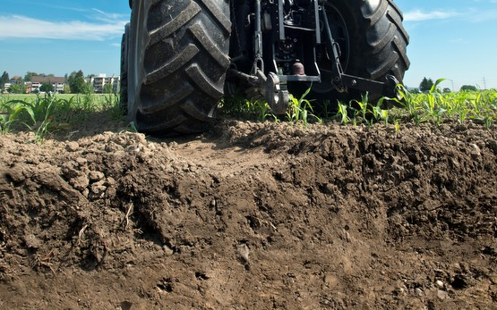
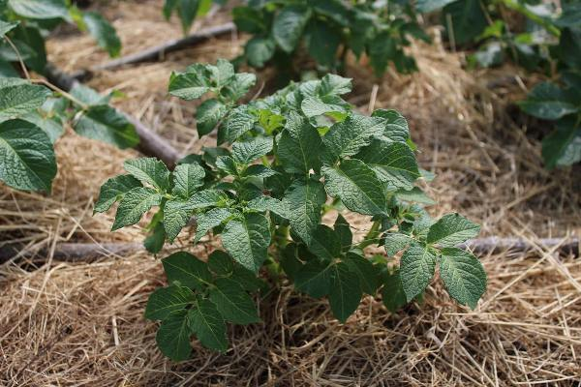

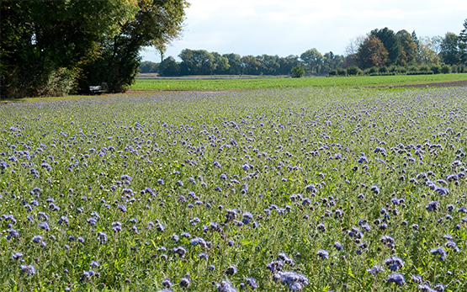
OPTAIN
Mechanical disturbance
Field scale measures
Climate change increases the occurrence of drought events and potentially aggravate conflicts between agricultural water use and other human and ecological demands for water resources
Research question:
To what extent can natural small water retention measures (NSWRM) buffer the effects of climate extremes in agricultural systems?
Ultimate goal:
Recommendations for regions with increasing drought limitations
Mulching
Ever heavier agricultural machinery puts soils under pressure (admin.ch)
Organic carbon amendment
Types Of Mulching, Advantages of Mulching In Farming | Agri Farming
Cover Crops
UNFCCC COP 23 : Soil organic carbon sequestration and food security (sciencepolicycircle.org)
Cover crops (admin.ch)

Slide 3

Nyon (CH)
Reckenholz (CH)
Wynau (CH)
Soil
Climate
Grafenried
Reckenholz
Schafisheim
MeteoSwiss Reference period (1981-2021)
Climate projections CH2018 (RCP26, RCP45, RCP85)
EUPTF2.0
Organic carbon increase (0 to 4%)
Bulk density changes (-30 to 30%)
Changes over depth or only at topsoil
Agro
hydrological
modelling
Soil hydraulic parameters
Lysimeter data + observed yield/phenology + literature
Calibration
Crop
Transpiration reduction due to dryness (Tred_{dry})
Grain yield
Soil water content
Phenology yield
Maize
Winter wheat
Potato
Rapeseed
Sugar beat

Slide 4
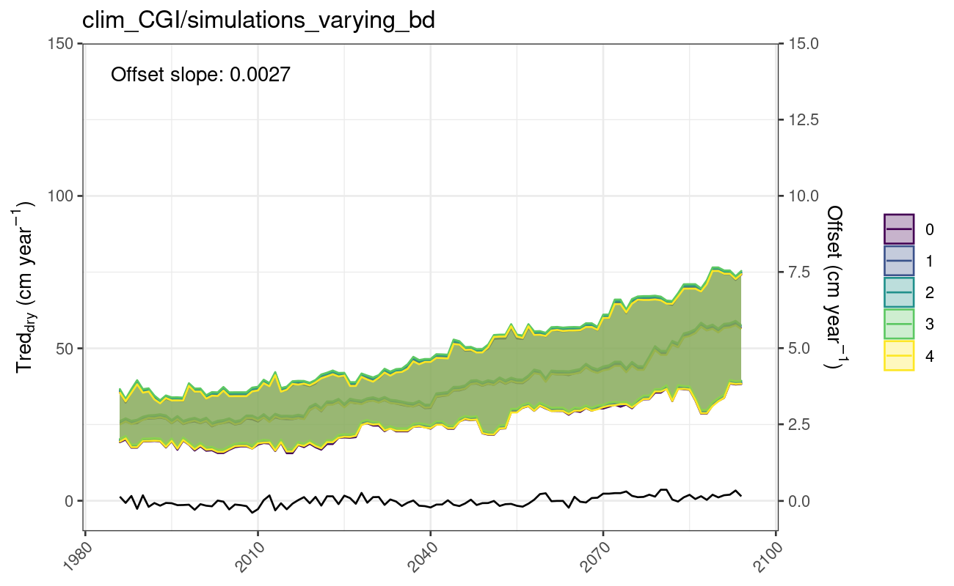
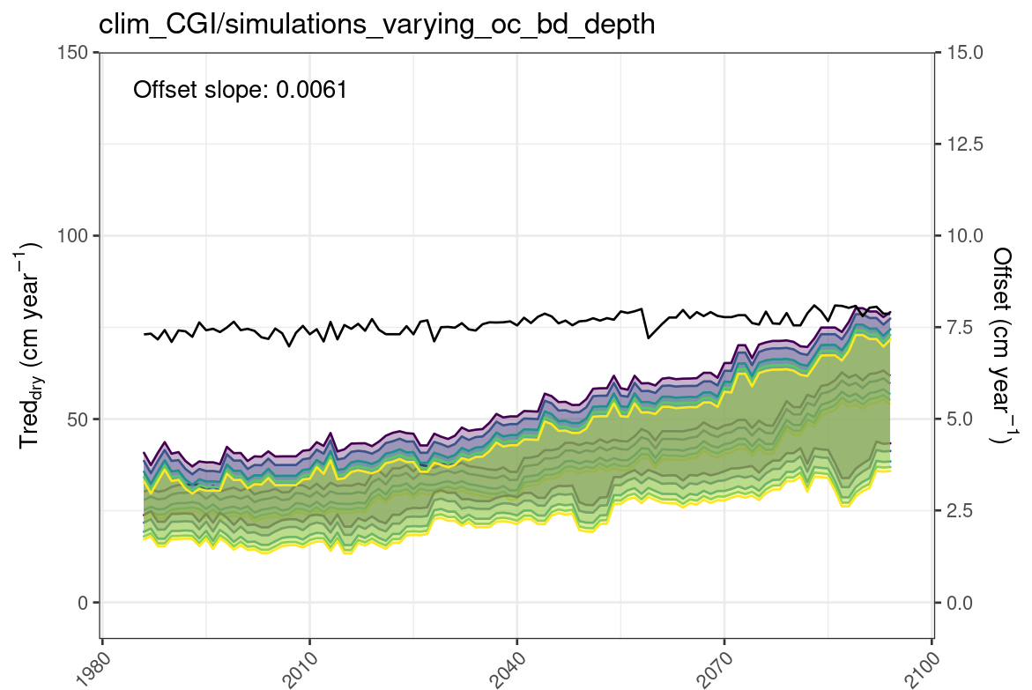
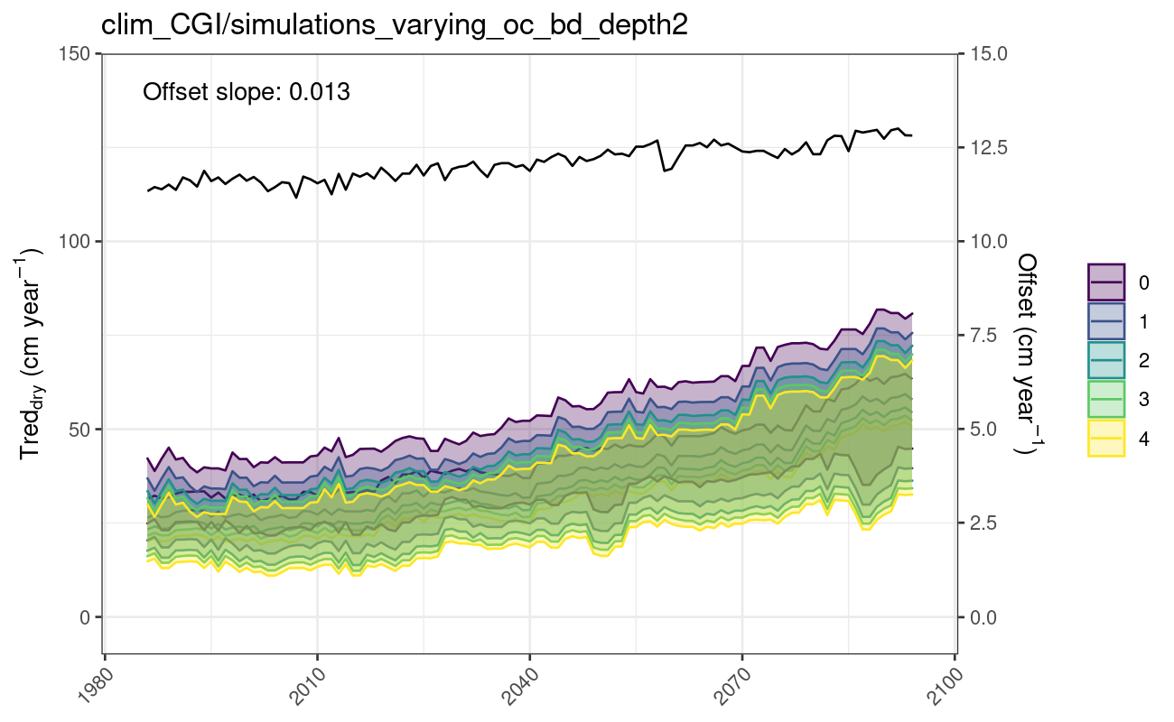
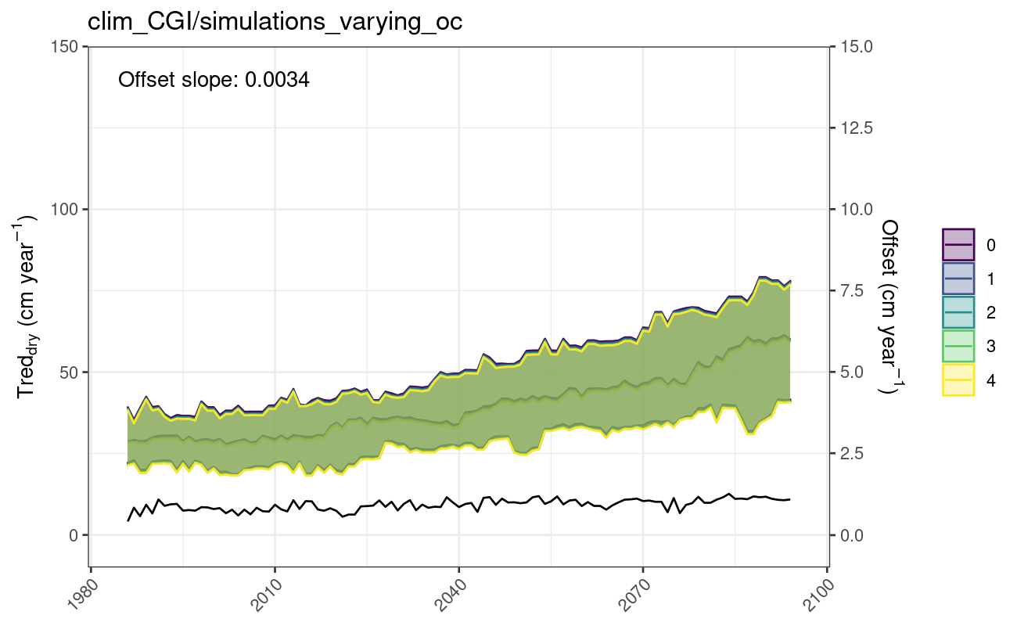
    Transpiration reduction due to dryness (Tred_{dry}): Nyon, Grafenried soil, maize, RCP85
BD altered from -30 to 30 %, only at topsoil
OC and BD altered, 100% at topsoil, decreasing to 0% at bottom
Levels of variation in Bulk Density (BD), Organic Carbon (OC), BD&OC, respectively
OC increased from 0 to 4 %, only at topsoil
OC and BD altered, homogeneously over depth
Notes:
By how much can the irrigation water requirements be reduced by NSWRM?
Under current and future climate conditions?
In different regions of Switzerland?

Slide 5
Preliminary conclusions
Transpiration reduction due to dry stress (Tred_{dry}) in maize will increase in the future according to evaluated climatic projections
Improvements on soil organic carbon and bulk density over deeper soil layers lead to reduction of Tred_{dry}, and therefore have the potential to contribute in buffering negative effects of drought in the evaluated scenarios

Slide 6
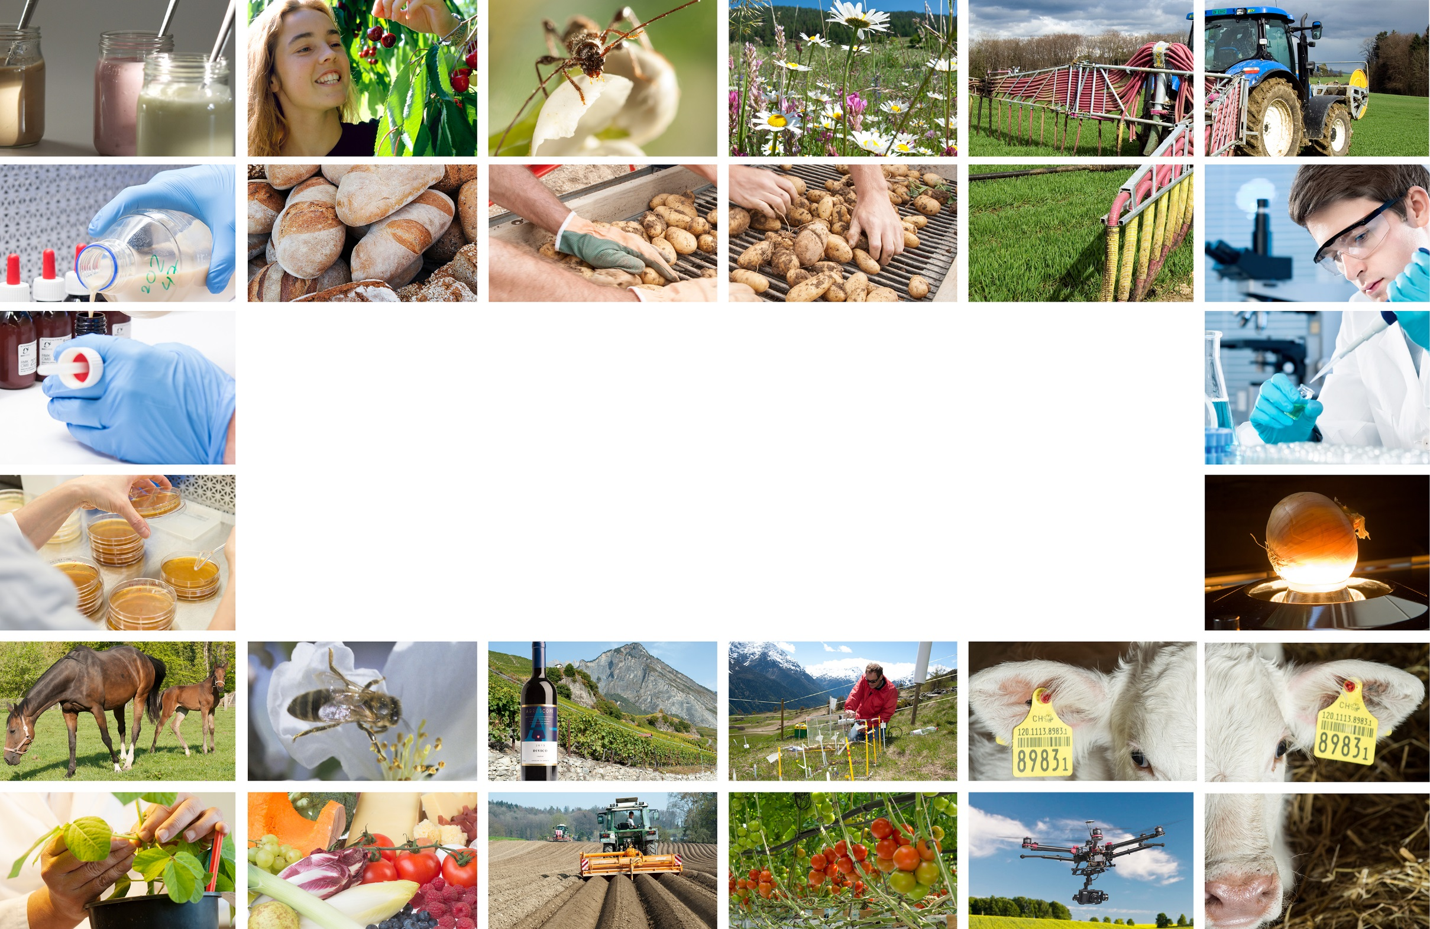
Thank you for your attention!
Maria Eliza Turek
mariaeliza.turek@agroscope.admin.ch
Agroscope good food, healthy environment
www.agroscope.admin.ch

