Slide 1







Potential of remote sensing data to analyze the effect of drought on wheat yields in the Mediterranean region: study area Kairouan Tunisia and Lleida Spain
Manel Khlif ¹, Aicha Chahbi Bellakanji ¹, Maria José Escorihuela ², Vivien-Georgiana Stefan ² and Zohra Lili Chabaane ¹
¹ University of Carthage, National Agronomic Institute of Tunisia, LR GREEN-TEAM. 43 Avenue Charles Nicolle, Tunis 1082,Tunisia
² IsardSAT, Technological Park, Marie Curie, 8-14, 08042, Barcelona, Catalonia
Date: May 23, 2022

Slide 2
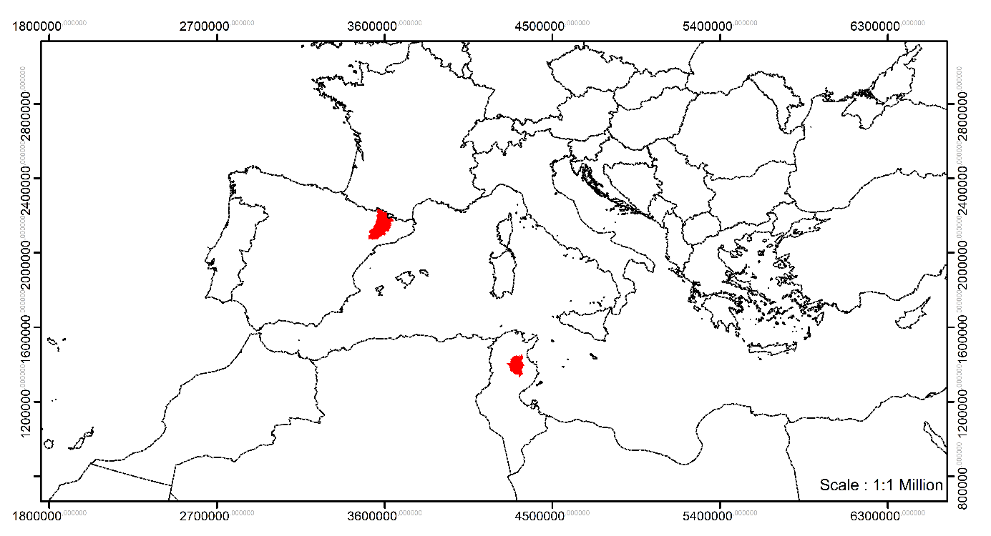
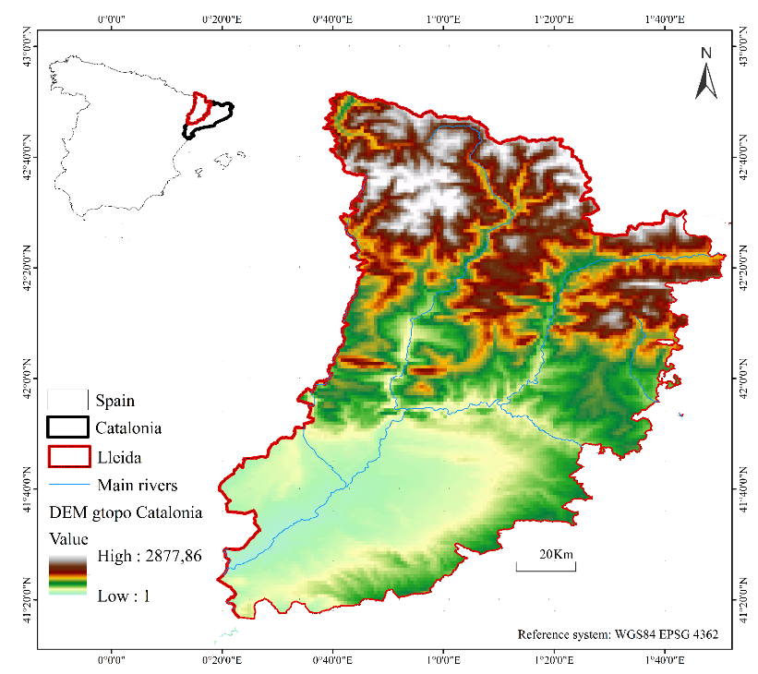
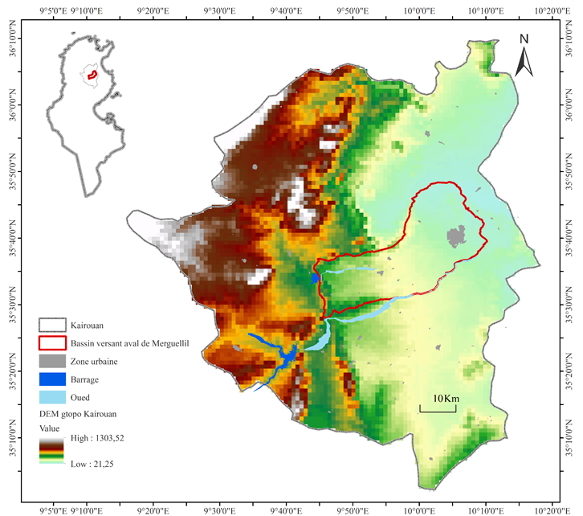
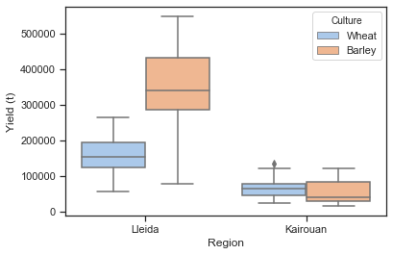
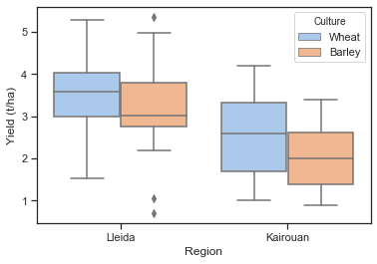
Study Area

Slide 3
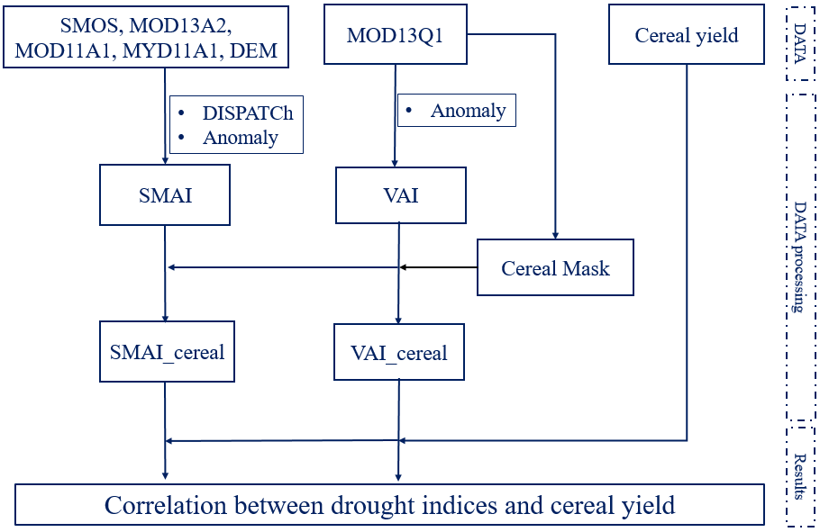
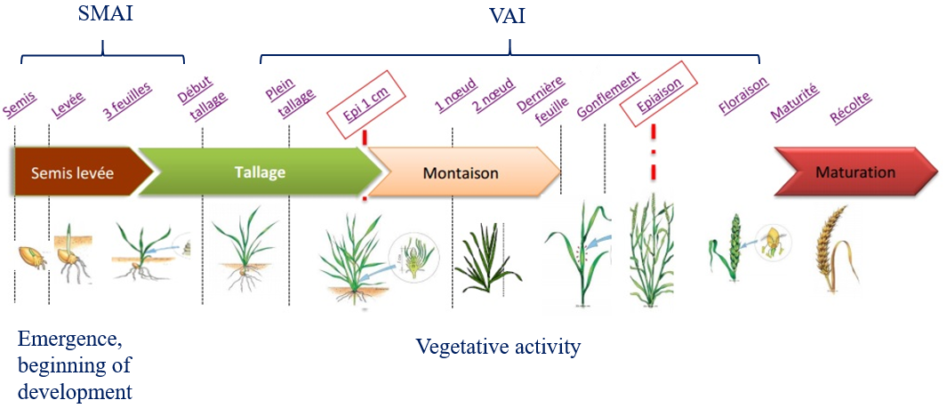
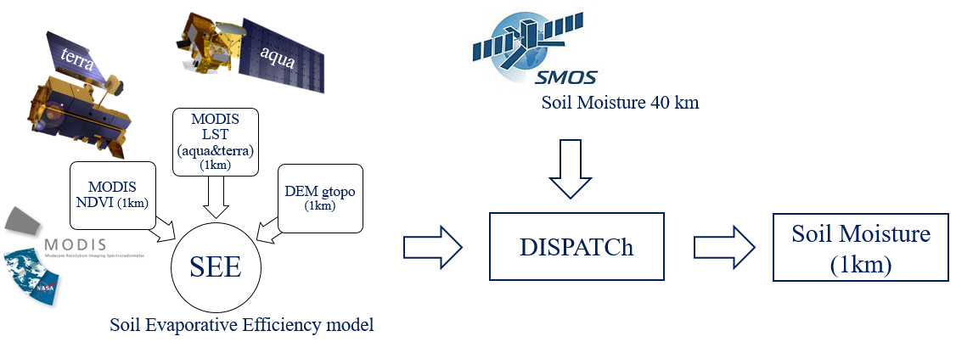
Methodology
Choice of drought indices
SMOS + DISPATCh algorithm
DISPATCh: DISaggregation based on Physical And Theoretical scale Change
SMAI: Soil Moisture Anomaly Index
VAI: Vegetation Anomaly Index

Slide 4
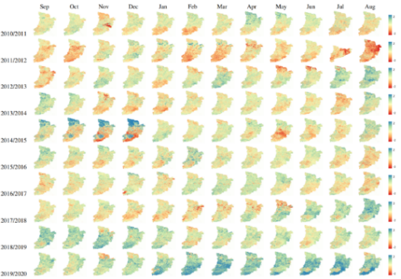
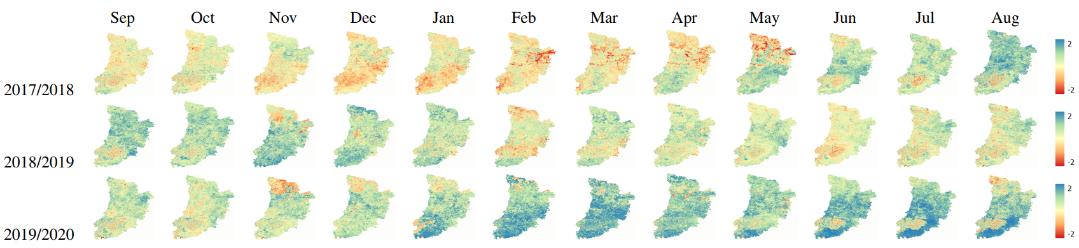

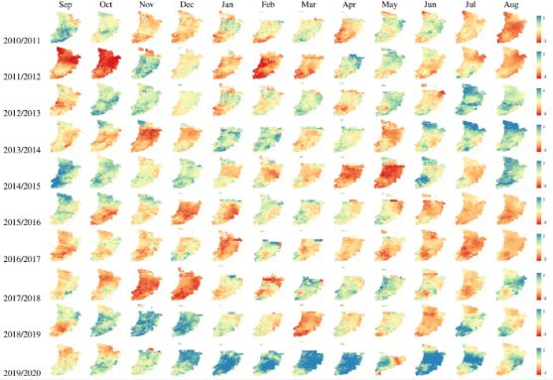
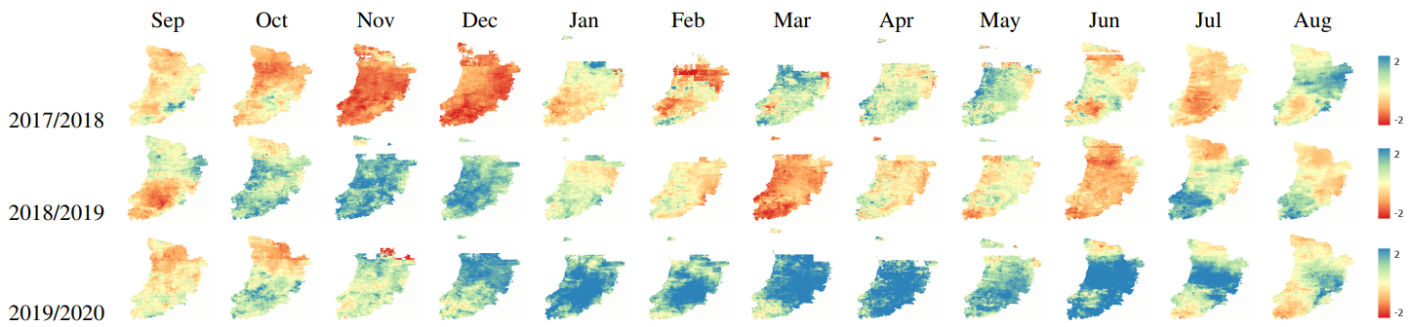
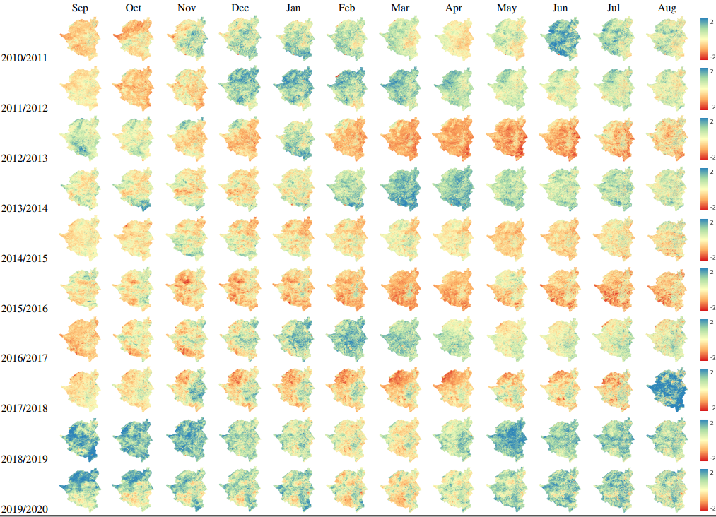
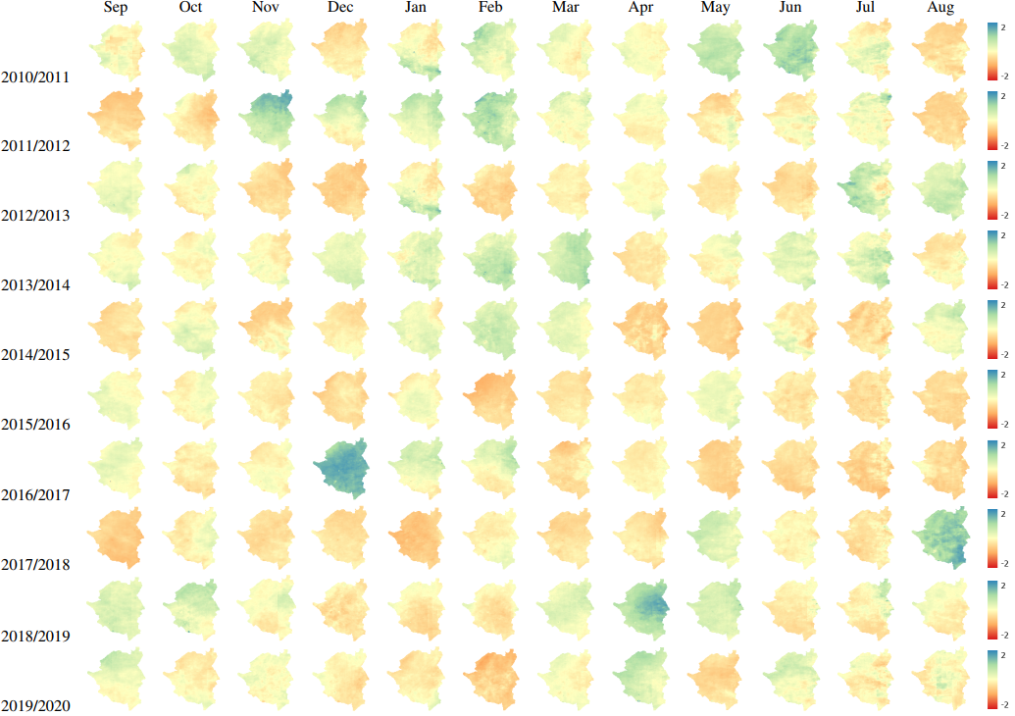
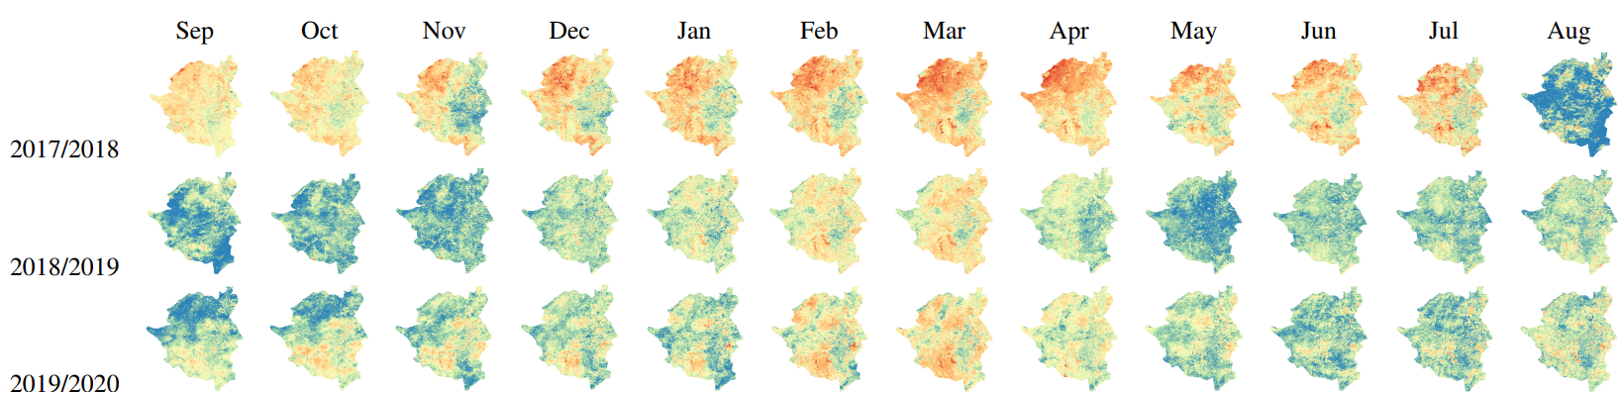
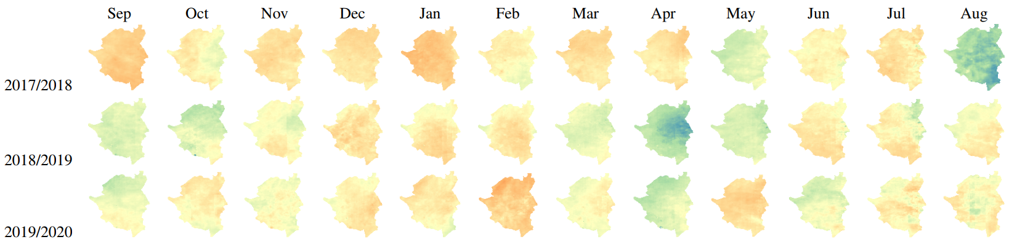
Results
Spatiotemporal series of drought indices
VAI, 250m
SMAI, 1km
Wet
Lleida
Dry
VAI, 250m
SMAI, 1km
Kairouan

Slide 5
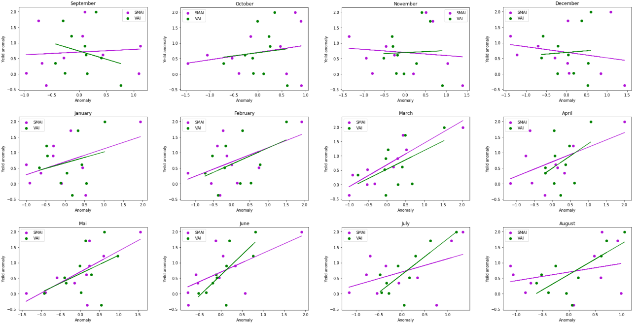
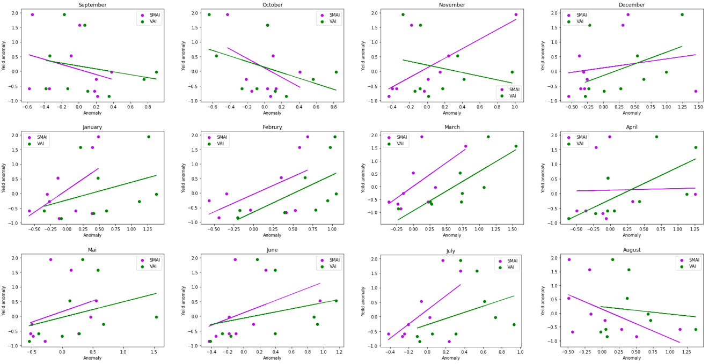
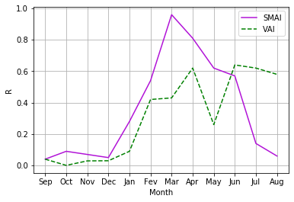
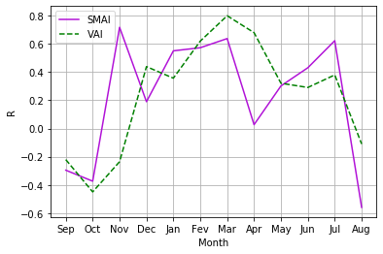
Results
Results
Correlation variation between wheat yields anomalies and drought indices of Lleida province
Correlation variation between cereal yields anomalies and drought indices for the governorate of Kairouan

Slide 6


Distinction between soil moisture drought and vegetative drought
SMAI shows higher correlation with yield 3 months ahead of harvest in an dryland area. VAI shows higher correlation in an irrigated area.
Advantage of improving the spatial resolution of soil moisture to better study drought and especially its effects on yield
Food Security
Water Security
Conclusion

Slide 7
Thank you for your attention!

