Slide 1




Constraints on Fracture Distribution in Geothermal Fields Using Seismic Noise Beamforming
EGU22-2940 Session: TS3.1 | Seismic imaging and Characterisation of crustal faults
25 May 2022: 15:45 – 15:50
Heather Kennedy^{1,2}, Katrin Löer¹ and Amy Gilligan¹
h.kennedy.21@abdn.ac.uk (correspondence)
¹ University of Aberdeen, School of Geosciences, University of Aberdeen, Aberdeen, AB24 3FX, Scotland.
² GeoNetZero, Centre for Doctoral Training
Abstract QR Code:

Slide 2
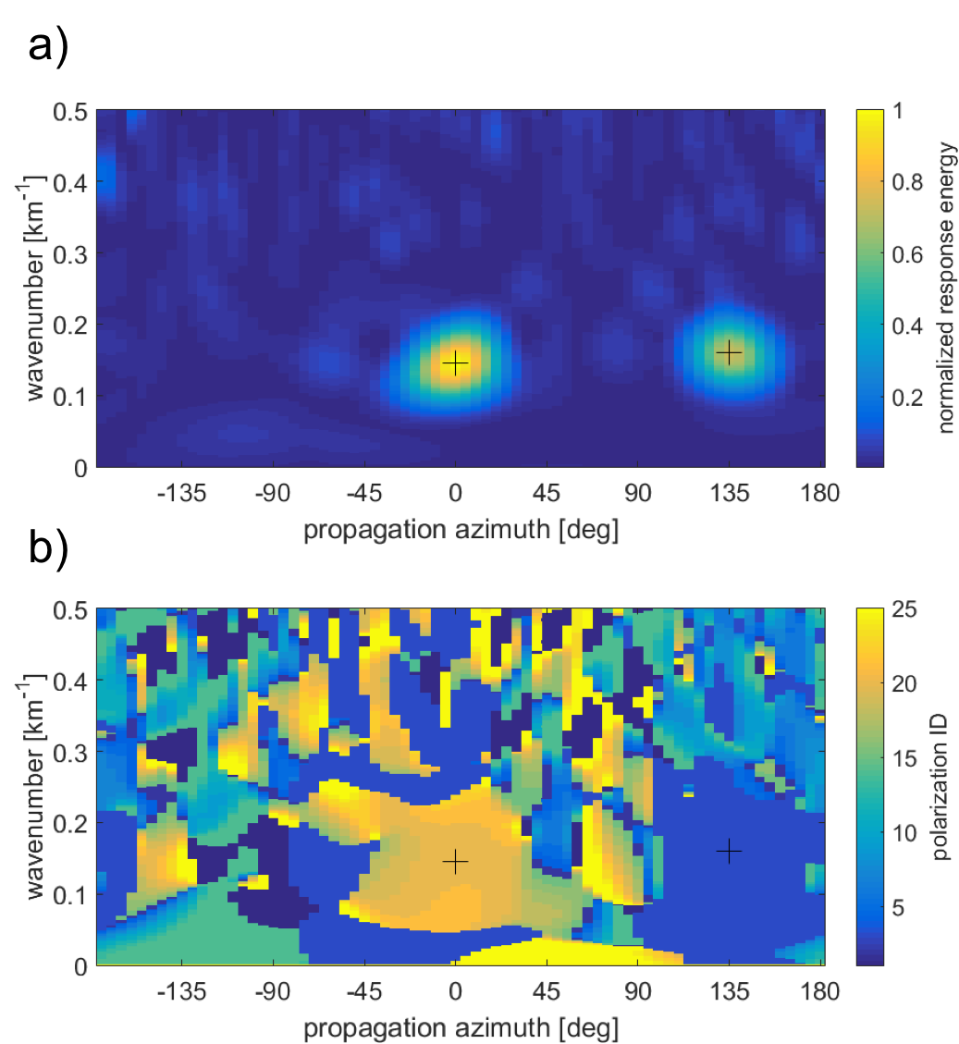
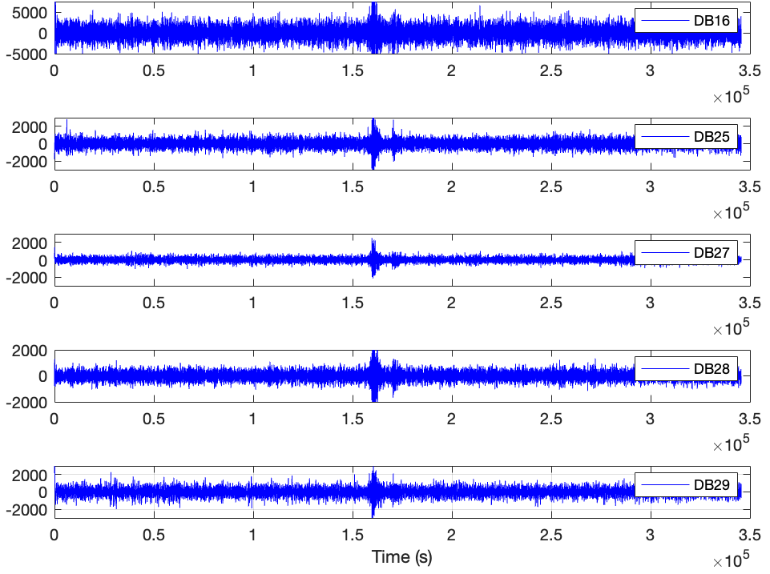
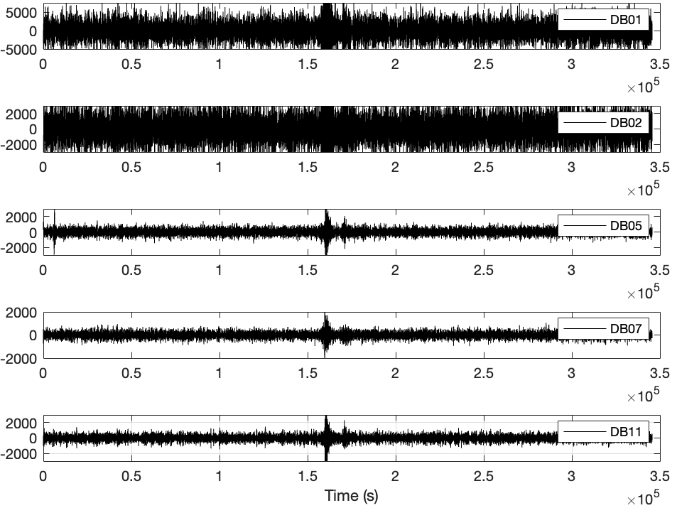
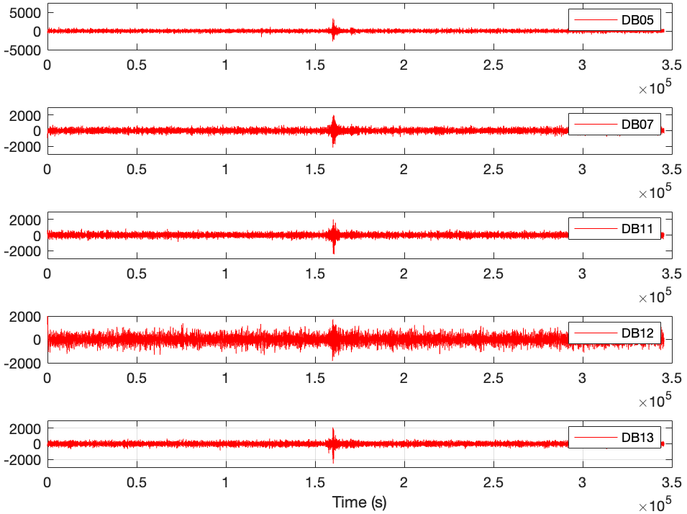


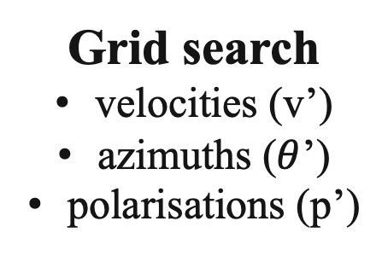
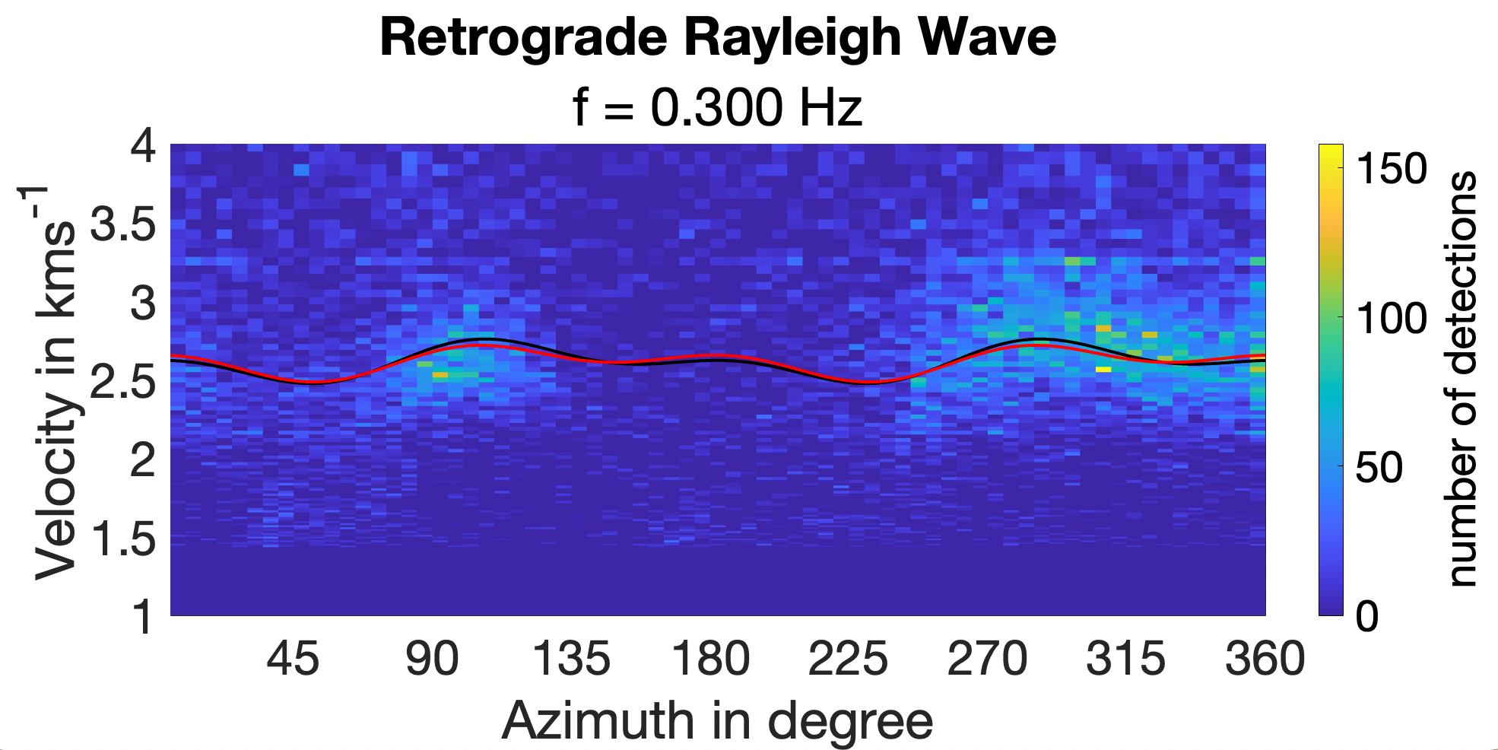
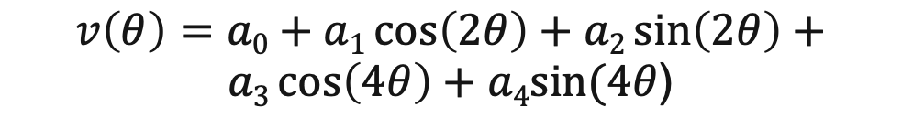
Methodology
Match between data and model
Three-component array noise data
N
amplitude
Channels
E
model
wavenumber in km⁻¹
Z
+
+
data
azimuth in degree
polarisation
wavenumber in km⁻¹
+
+
azimuth in degree
Löer et al. (2018)
One time window
Rayleigh
Love
Anisotropy Curve
Dispersion curves
Anisotropy
Wavefield composition
EGU22 25.5.22

Slide 3
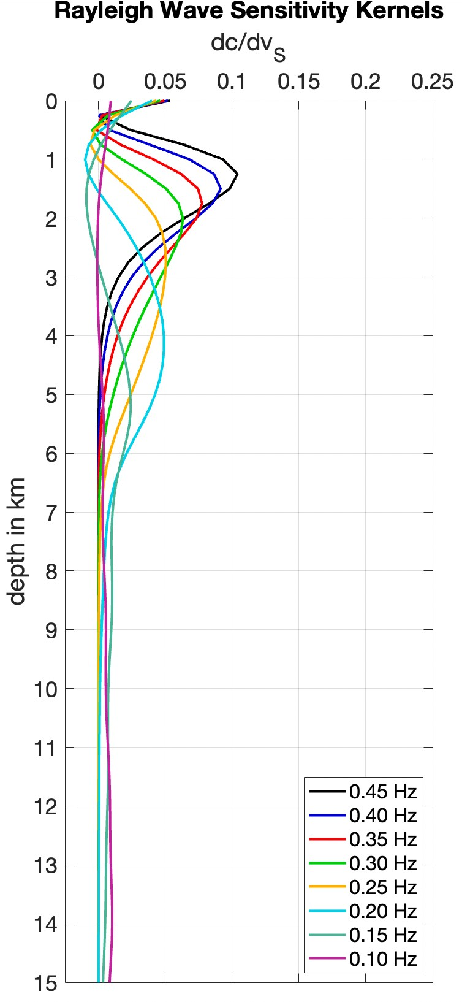
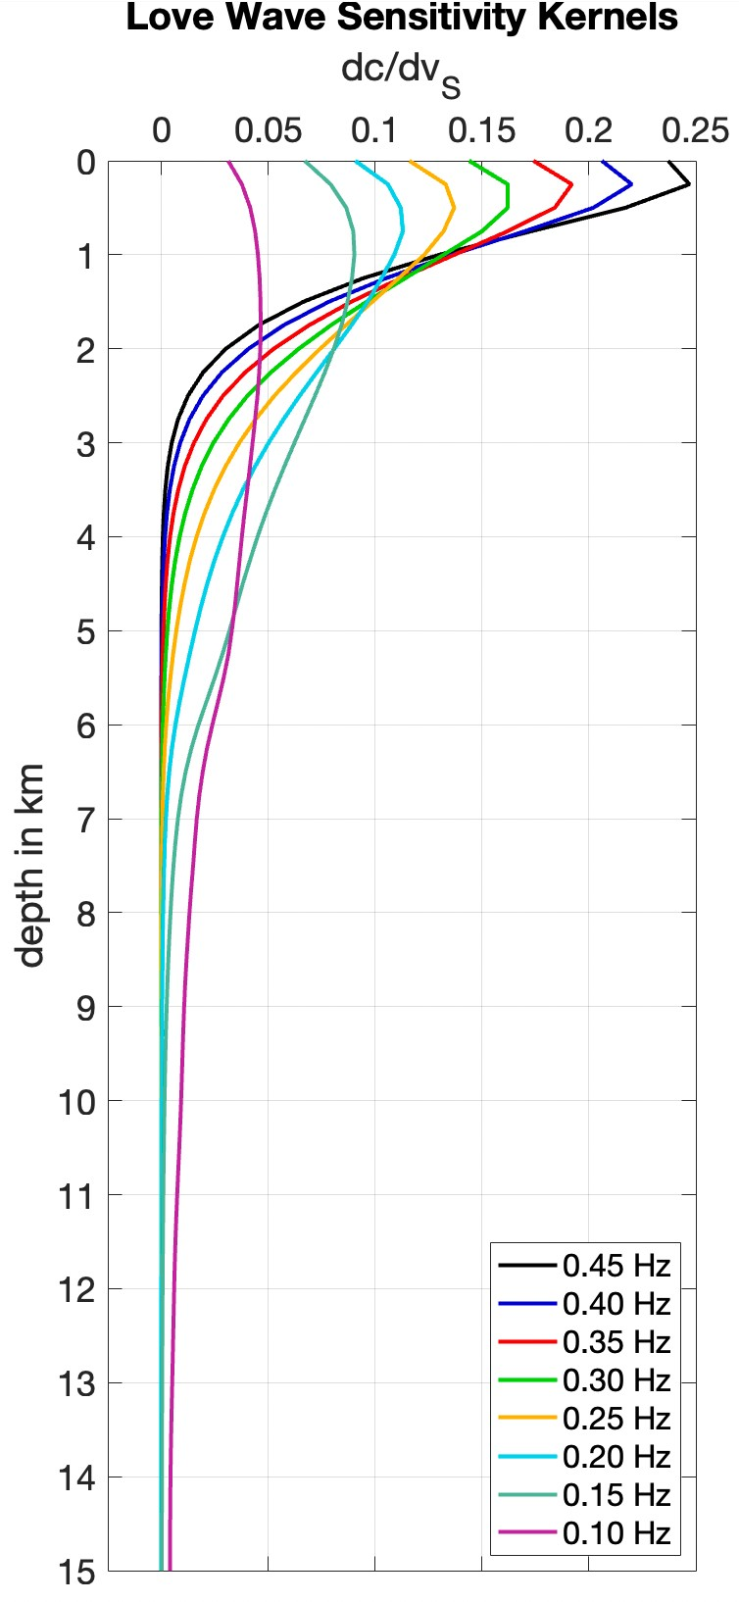
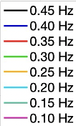
(a)
(b)
Depth Sensitivity
EGU22 25.5.22

Slide 4
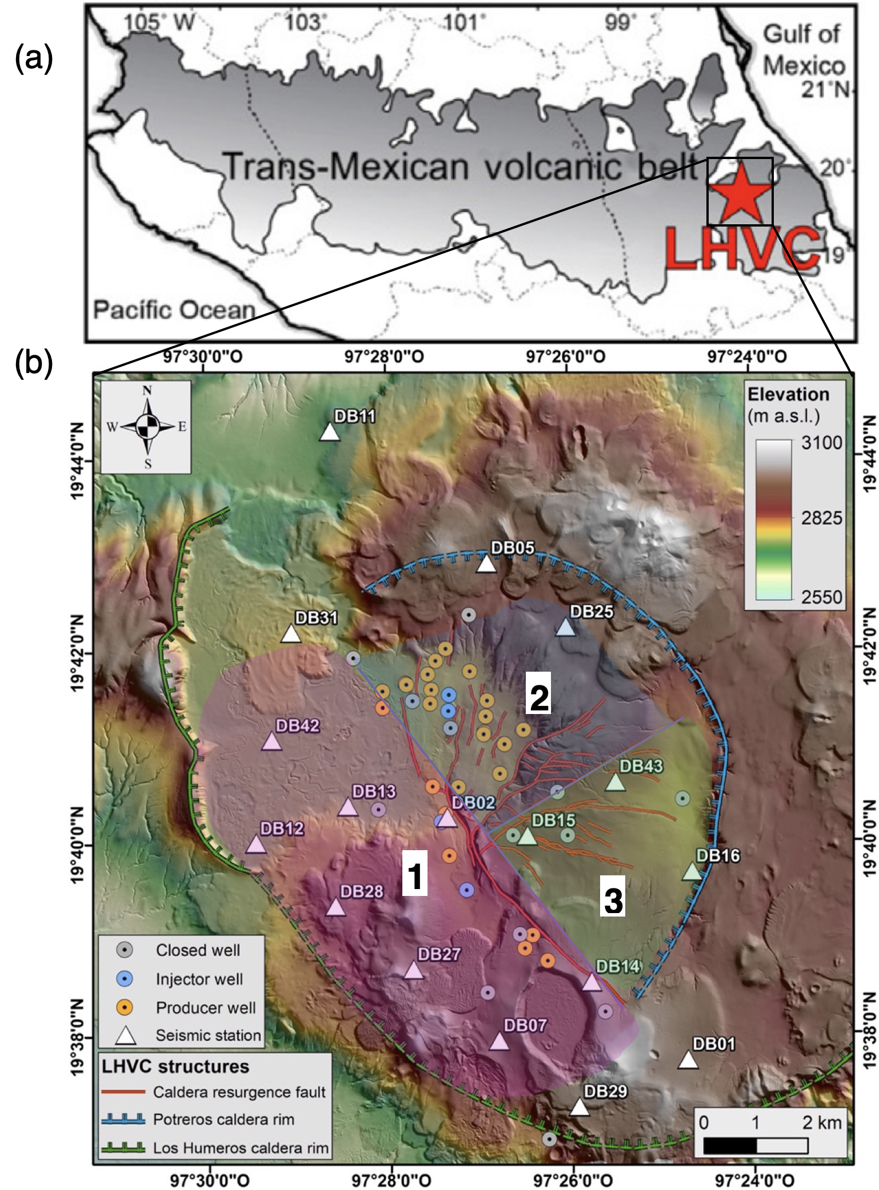
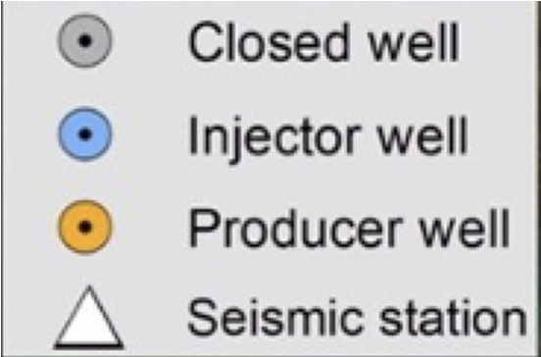
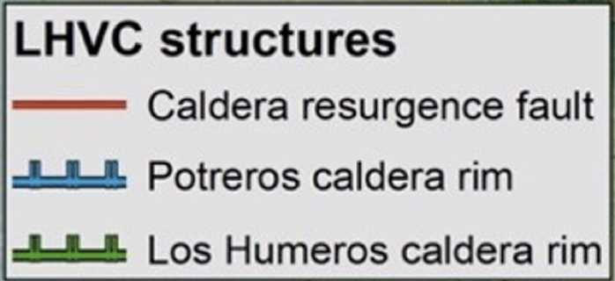
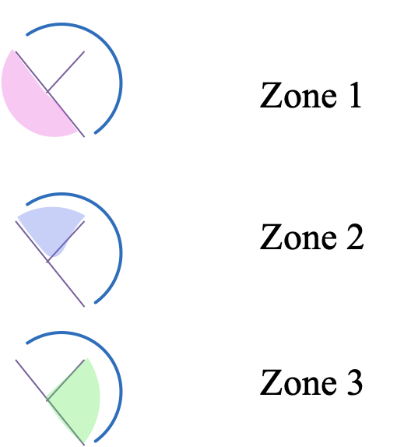
Los Humeros Geothermal Field
EGU22 25.5.22

Slide 5
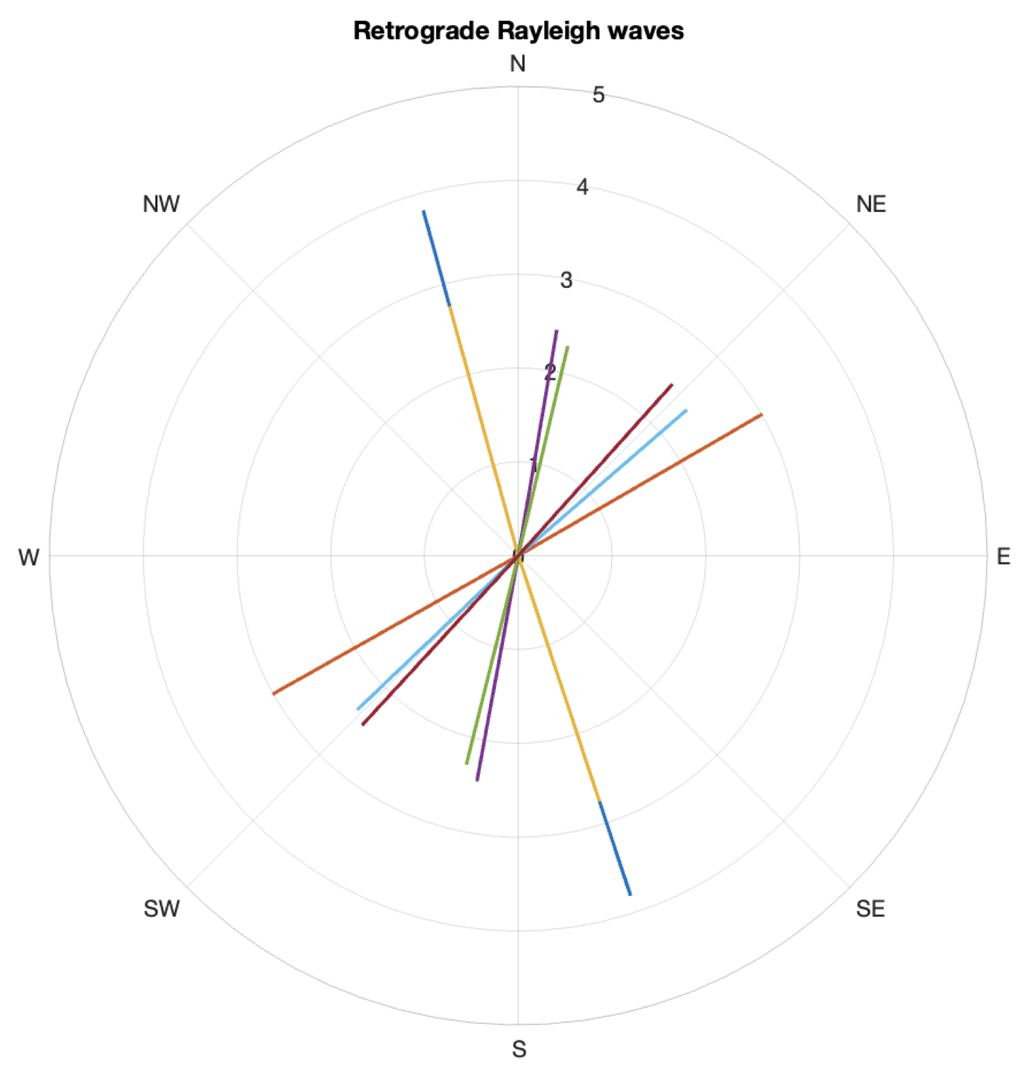
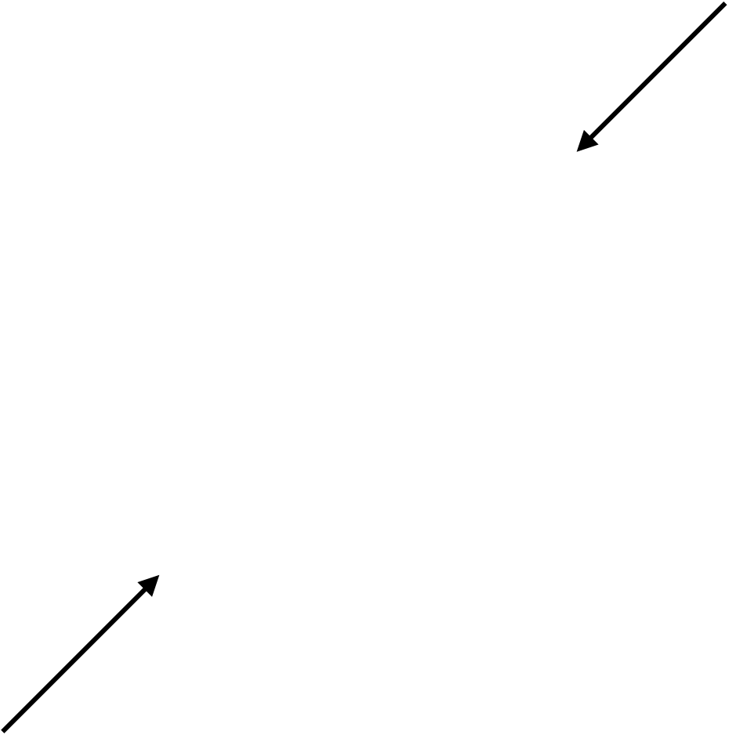
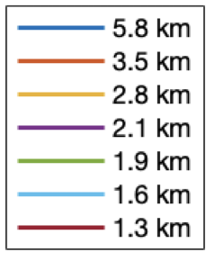
Fast Directions
Regional Stress Direction
EGU22 25.5.22

Slide 6
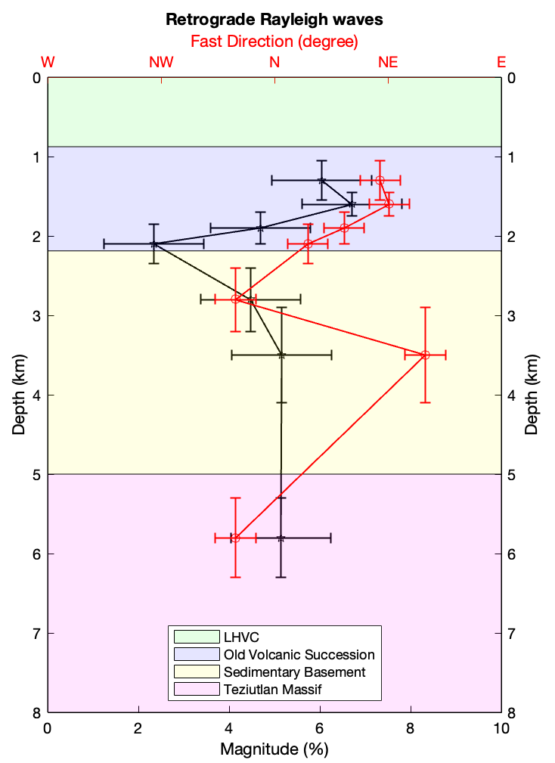
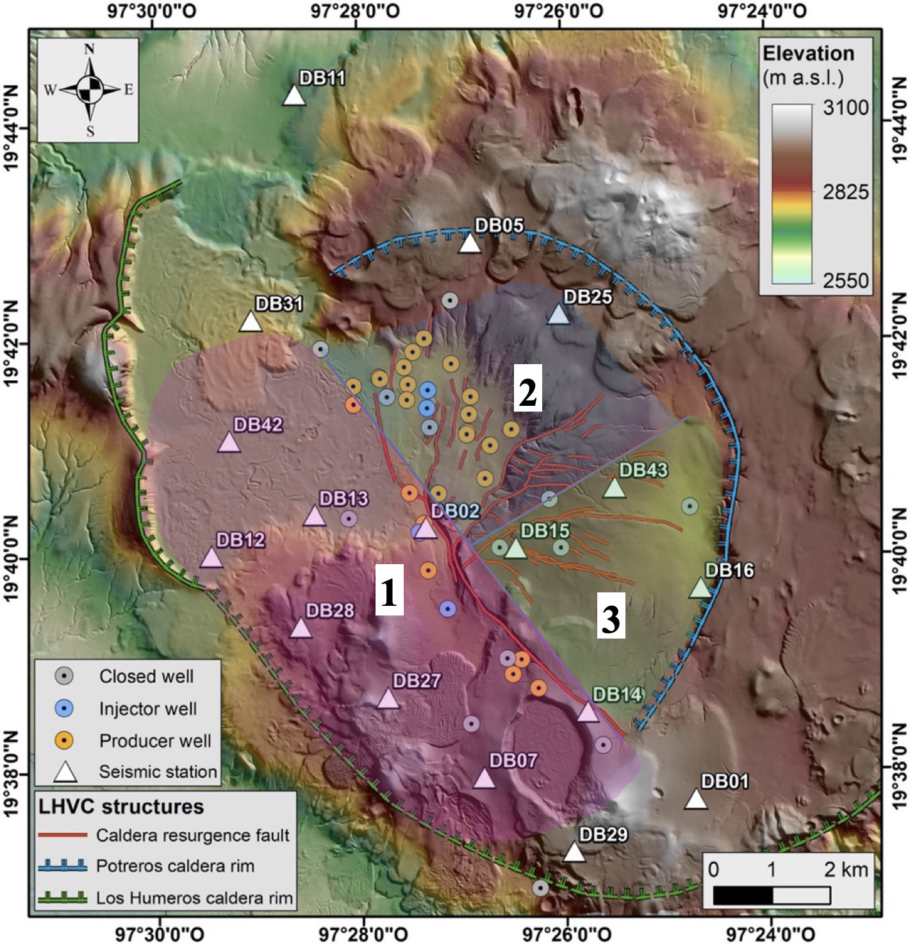
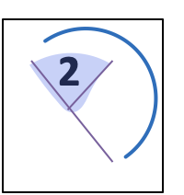
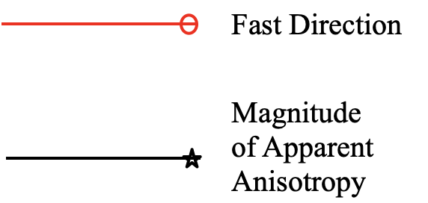
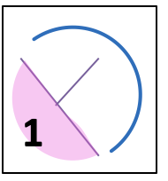
Fast Direction varying with Depth
Maxtaloya-Los Humeros Fault Swarm
Arroyo-Grande Fault and Parallel Faults
Las Papas Fault Swarm
EGU22 25.5.22

Slide 7
To Summarise
3C beamforming can estimate seismic anisotropy.
Clear fast directions from seismic anisotropy indicate subsurface structures.
Zone 1 and 2 dominant anisotropy match fast directions.
Maxtaloya-Los Humeros fault swarm (zone 1) and Arroyo Grande fault/parallel faults (zone 2) are, therefore, seen at depths > 2 km.
NE-SW trending Mafic dykes may also have caused an anisotropy response (such as 3.5 km in Fig.6a).
Implications for the Geothermal Field:
Continuation of faults at depth
Anisotropy might be sensitive to hydrothermal productivity
No evidence for brittle-ductile transition zone at depths < 6 km.
EGU22 25.5.22

Slide 8
Acknowledgements
The work contained in this presentation contains work conducted during a PhD study undertaken as part of the Centre for Doctoral Training (CDT) in Geoscience and the Low Carbon Energy Transition and it is sponsored by University of Aberdeen via their NERC GeoNetZero CDT Scheme whose support is gratefully acknowledged.
The interpretations and analyses were undertaken in the research facility at the University of Aberdeen, the underpinning financial and computer support for which is gratefully acknowledged. We acknowledge the GEMex project for access to and permission to publish examples from their proprietary data on which these interpretations and analyses were made and are grateful to MathWorks for providing academic licenses for their MATLAB software which was used to visualise and interrogate the seismic data.
A special thanks to Gianluca Norini, Institute of Environmental Geology and Geoengineering IGAG, for advising us with his expertise on the Los Humeros Geothermal Field and for contributing Fig.1b.
EGU22 25.5.22

Slide 9


Further Information
Kennedy et al. (2022), Solid Earth (submitted).
  EGUSPHERE-2022-389 | Research article: Constraints on Fracture Distribution in the Los Humeros Geothermal Field From Beamforming of Ambient Seismic Noise
  Preprint QR code:
Löer et al. (2022), EGU22-3956 Session SM3.1 | Ambient Seismic Noise & Seismic
  0900-0905 (online) : Interferometry. Mitigating array-induced bias in ambient noise beamforming.
  Abstract QR code:
EGU22 25.5.22

