Slide 1



Interactions of dissolved soil organic matter and manganese oxides
Lena Brüggenwirth
Oliver Lechtenfeld, Ricarda Behrens, Klaus Kaiser, Robert Mikutta, Christian Mikutta
Funded by DFG (No. 60423276)

Slide 2
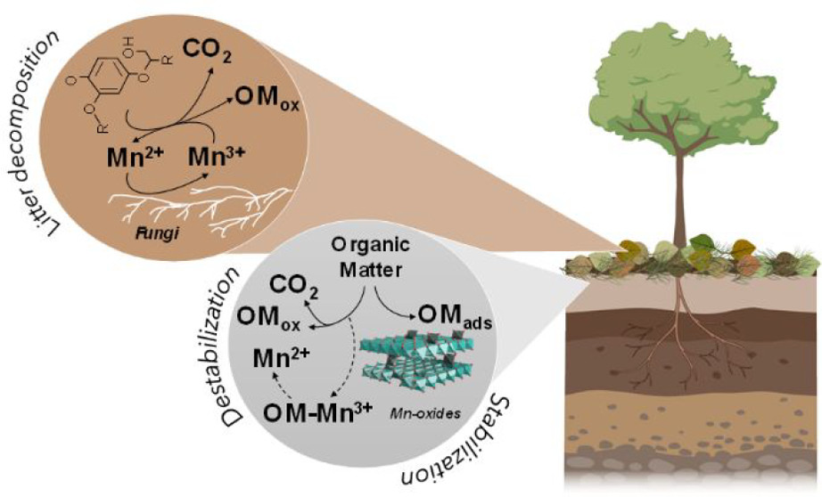
Introduction
Motivation
What is the role of Mn oxides in soil carbon dynamics?
DOM stabilization
vs.
oxidative degradation
Li et al. (2021)
Batch adsorption experiments
(varying Mn oxide, pH, background electrolyte, DOM type)

Slide 3
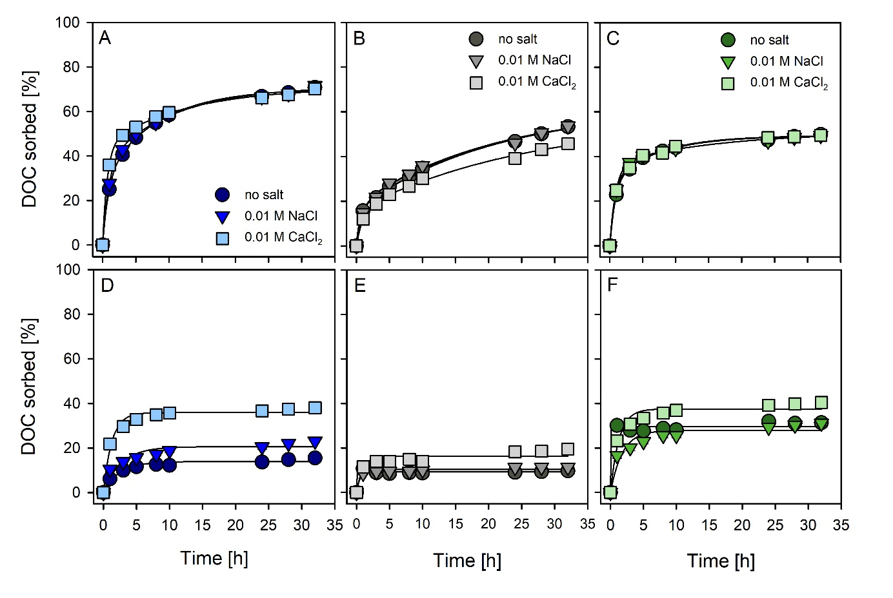
Results - DOC sorption
δ-MnO₂
Birnessite
Cryptomelane
DOC sorption at pH 4 > pH 7
Up to 70 % DOC is sorbed
(start concentration = 100 mg C L⁻¹)
δ-MnO₂ > cryptomelane ≥ birnessite at pH 4
Effect of polyvalent cations (Ca²⁺) at pH 7
pH 4
pH 7
→
Mn oxides can effectively sorb DOC,
.
BUT…

Slide 4
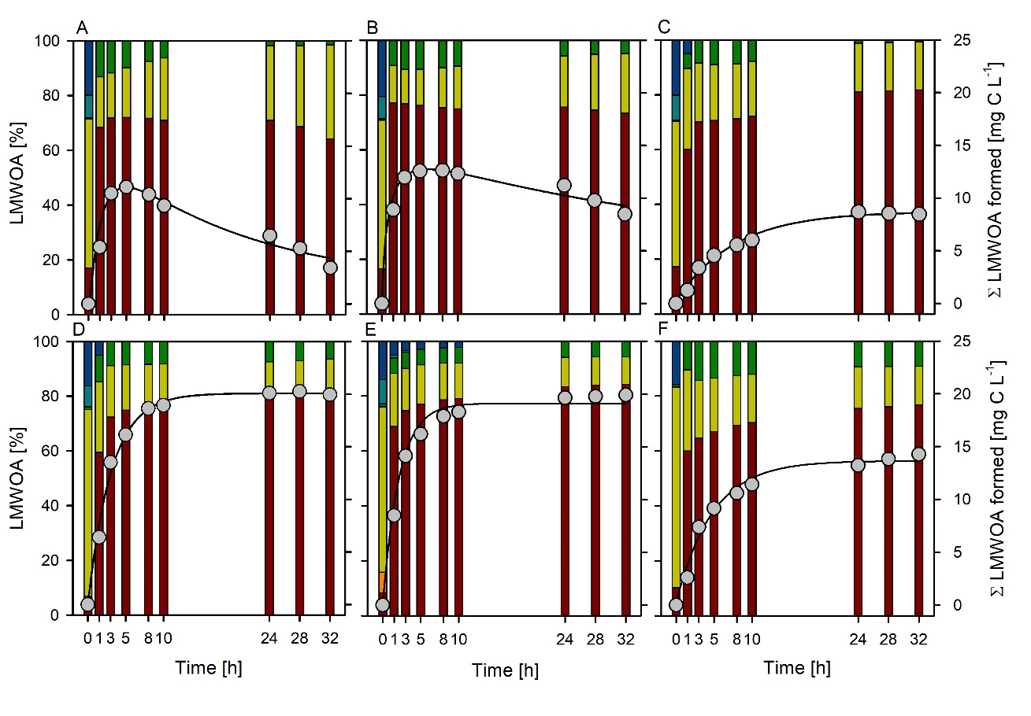
Results - Oxidative DOC transformation
δ-MnO₂
Birnessite
Cryptomelane
Low-molecular-weight organic acid (LMWOA) formation
(measured by ion chromatography)
Formate >> acetate > oxalate > citrate > propionate
Re-adsorption and/or complete oxidation at pH 4
pH 4
pH 7
→
… 9 to 21 % of added
DOC is oxidatively transformed to LMWOA
(shown only treatment without salt addition)

Slide 5
Summary and Conclusions
Short term stabilization of DOM
- Sorption
Fast DOM oxidation into LMWOA
- Degradation
- Easily available to microorganisms
Processes are driven by:
- pH
- Background electrolyte composition
- Mineral type
- DOM type (data not shown)
What is the role of Mn oxides in soil carbon dynamics?
DOM stabilization
vs.
oxidative degradation
Thank you for listening!
→ High potential to degrade and at least temporarily stabilize DOM

Slide 6
References
Li, Hui; Santos, Fernanda; Butler, Kristen; Herndon, Elizabeth (2021): A Critical Review on the Multiple Roles of Manganese in Stabilizing and Destabilizing Soil Organic Matter. In Environ. Sci. Technol. 55 (18), pp. 12136–12152. DOI: 10.1021/acs.est.1c00299.
Allard, Sébastien; Gutierrez, Leonardo; Fontaine, Claude; Croué, Jean-Philippe; Gallard, Hervé (2017): Organic matter interactions with natural manganese oxide and synthetic birnessite. In The Science of the total environment 583, pp. 487–495. DOI: 10.1016/j.scitotenv.2017.01.120.
Chorover, Jon; Amistadi, Mary Kay (2001): Reaction of forest floor organic matter at goethite, birnessite and smectite surfaces. In Geochimica et Cosmochimica Acta 65 (1), pp. 95–109. DOI: 10.1016/S0016-7037(00)00511-1.

