Slide 1
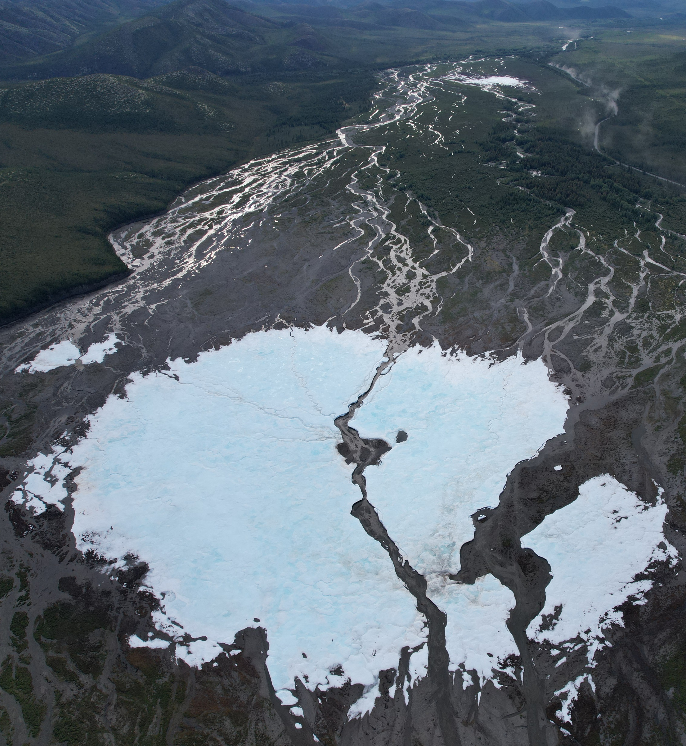


EGU22-300 ECS
Temporal dynamics of giant Anmangynda aufeis characteristics in changing climate, 1962-2021
(North-Eastern Eurasia)
Anastasiia Zemlianskova^{1,2}
Vladimir Alexeev¹
Olga Makarieva^{1,2}
Nataliia Nesterova^{1,2}
Andrey Shikhov³
Andrey Ostashov¹
¹St. Petersburg State University, St. Petersburg, Russia
²Melnikov Permafrost Institute, Yakutsk, Russia
³Perm State University, Perm, Russia
anastasiazemlanskova@gmail.com

Slide 2
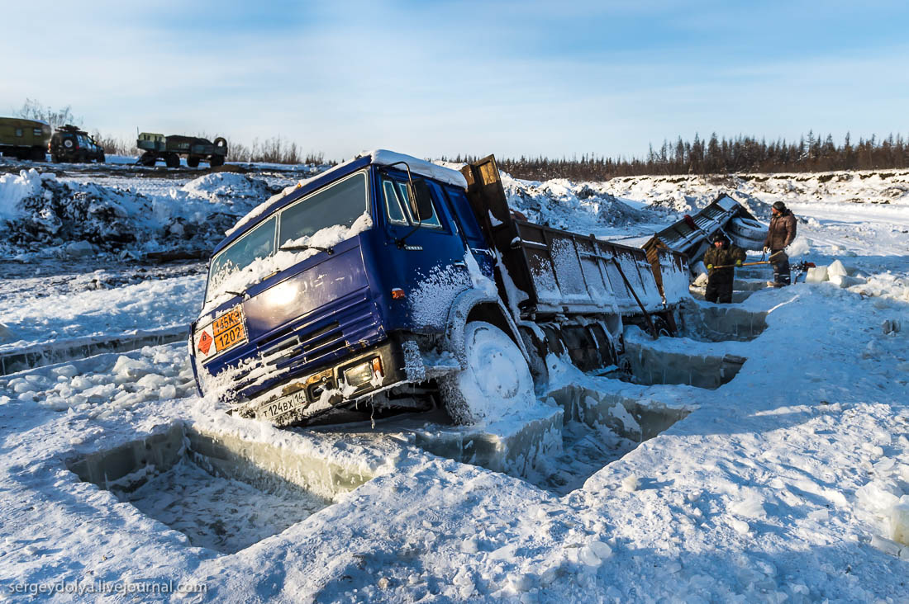
Relevance
Aufeis (icings, naled) are the ice fields produced annually due to layer-by-layer freezing of ground water on the surface.
Anadyr
Yana
Indigirka
Important water resource
Hazard
Easily identified at remote sensing images
Indicate water exchange processes in remote permafrost environment
Kolyma
Penzhina
>
Aufeis resources of North-East in current climate are about 11 km³ or 10 mm of runoff depth

Slide 3
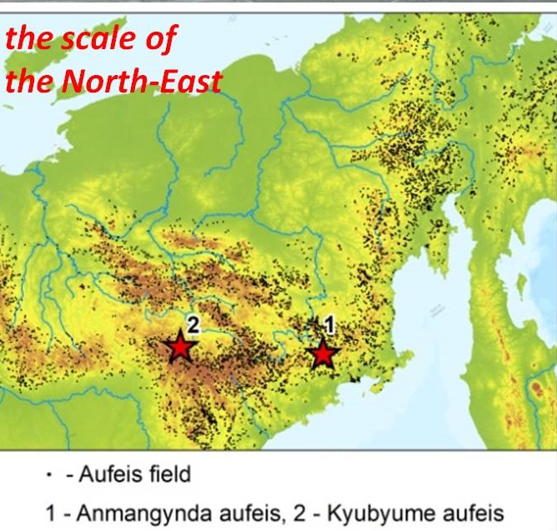
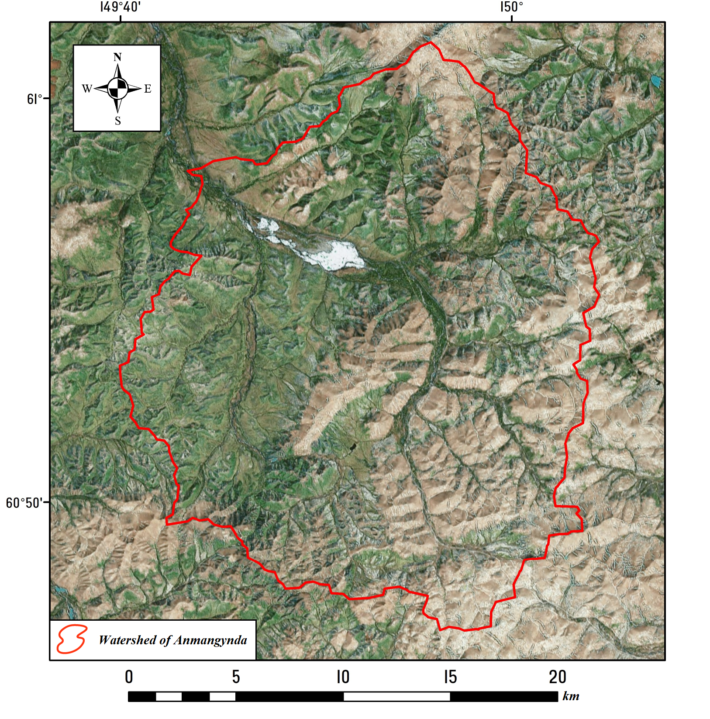
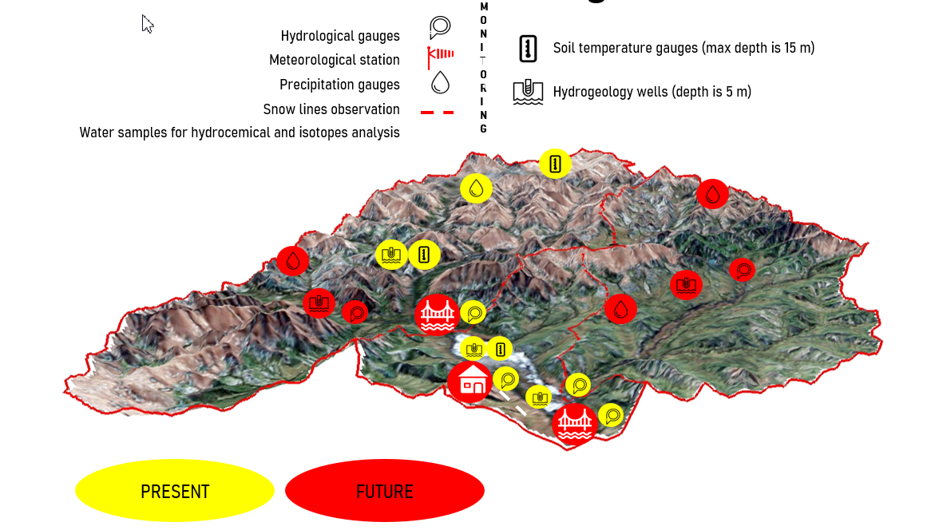
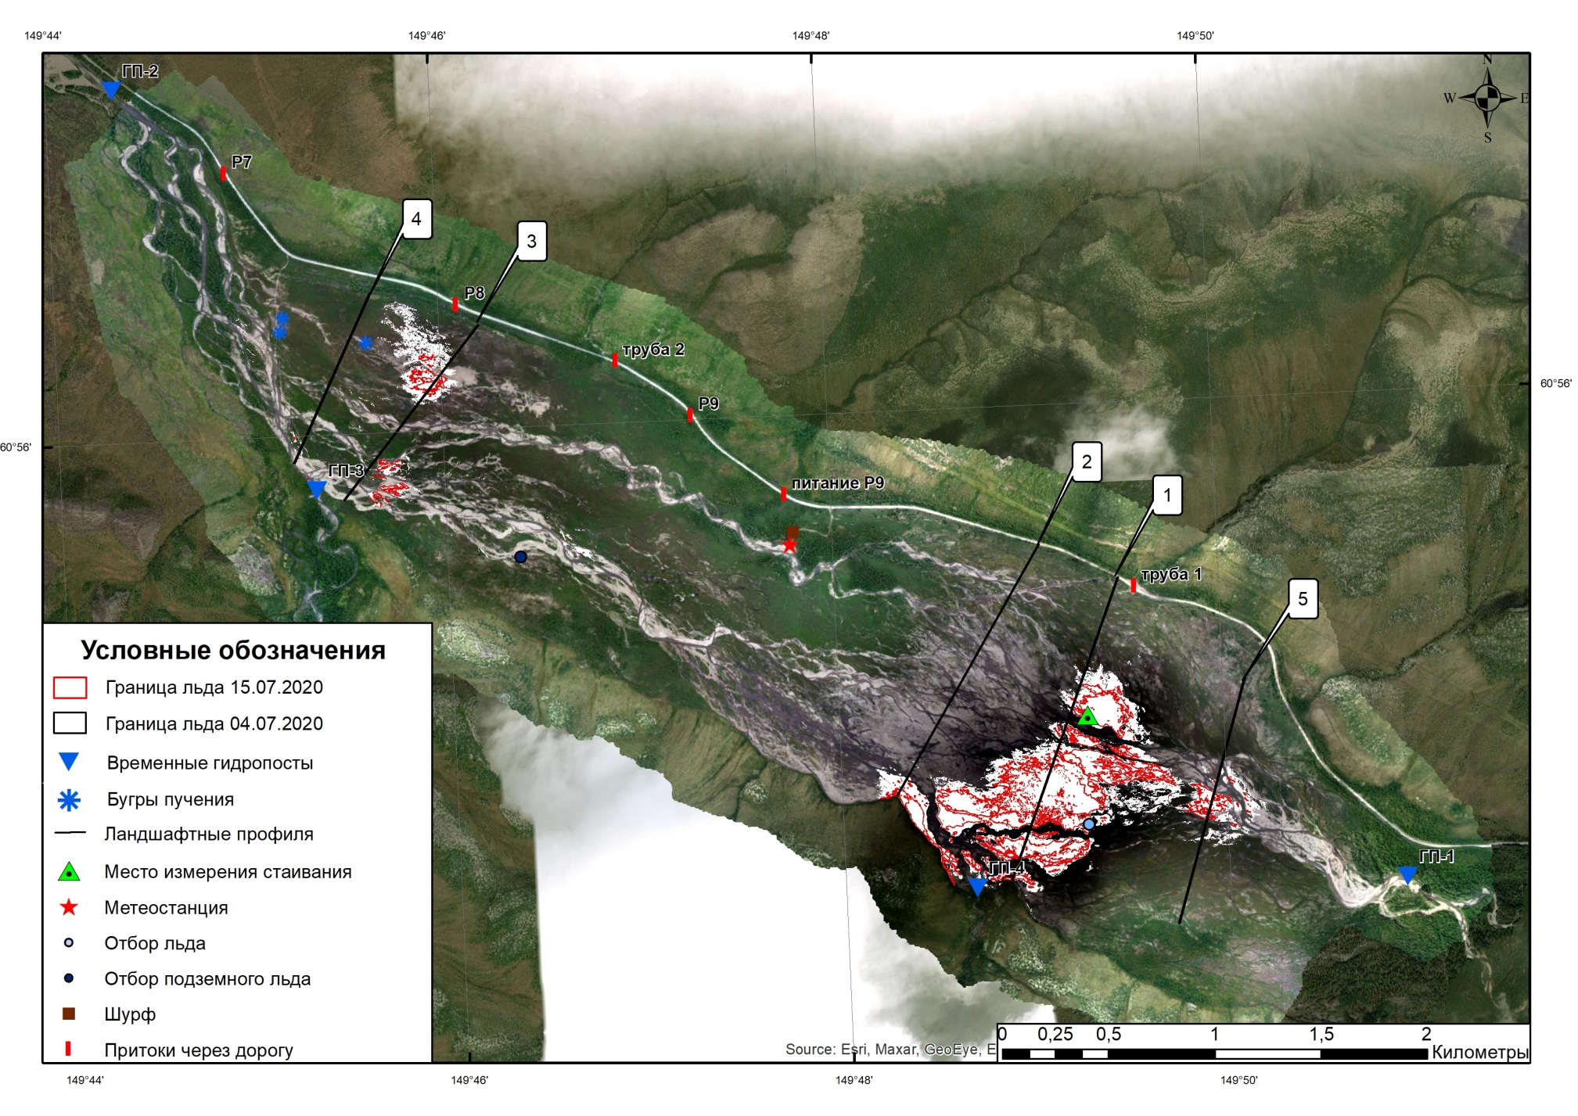

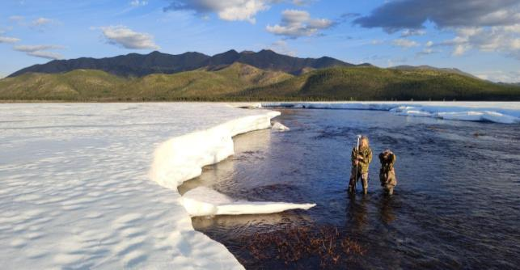
Anmangynda aufeis (Magadan region, North-East of Russia)
Basin area 400 km²
Aufeis area up to 6,8 km²
Annual air temperature -9,8℃
Annual precipitation 345 mm
Absolute altitude 700-1850 m
Permafrost and talik zones in river valleys
Ground observations of area and volume in 1962-1991
The studies have been continued since 2020

Slide 4
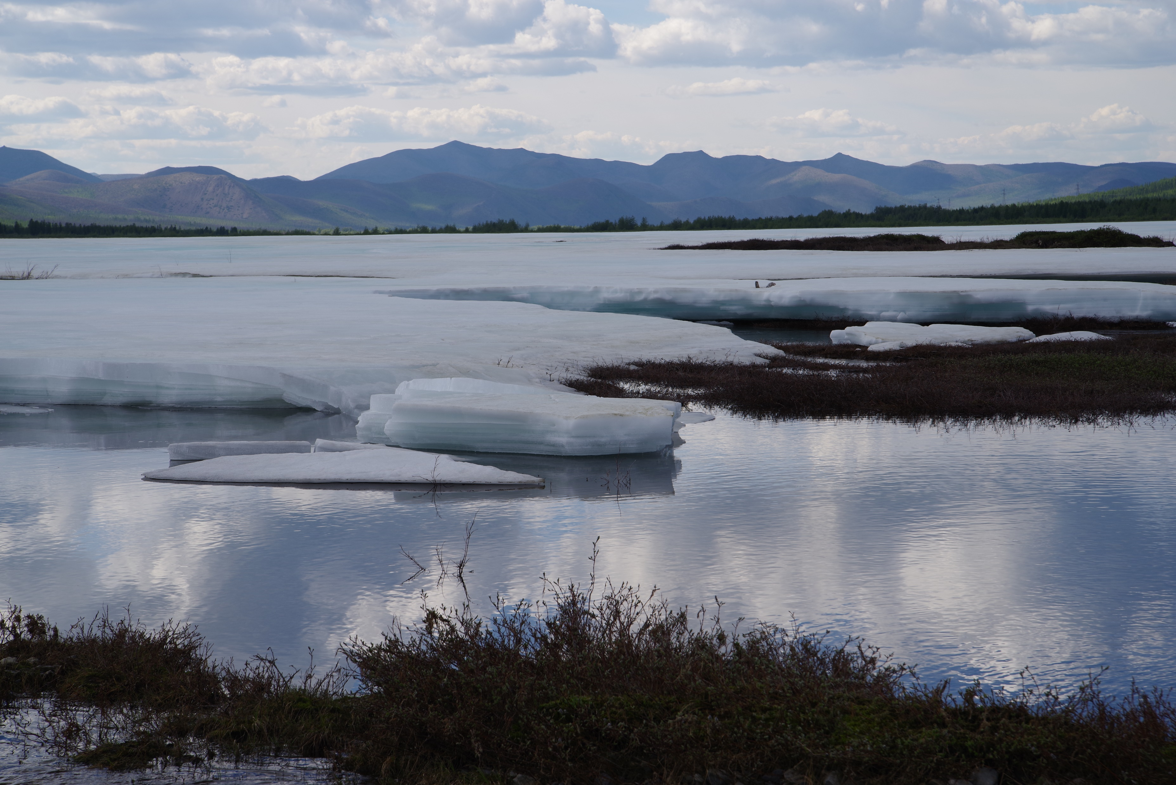
Aim and tasks of the study
The aim is to estimate the changes of area and volume of giant Anmangynda aufeis based on historical and modern observational data.
Tasks included:
1) Collection and analysis of historical data (1962-1991)
2) Application of remote sensing methods to determine the aufeis area for the current period (2000-2021)
3) Conduct ground-based observations of aufeis dynamics throughout the year

Slide 5
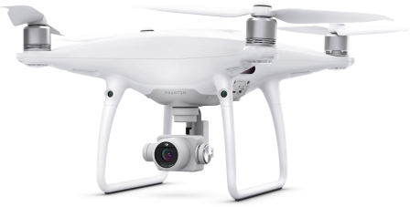
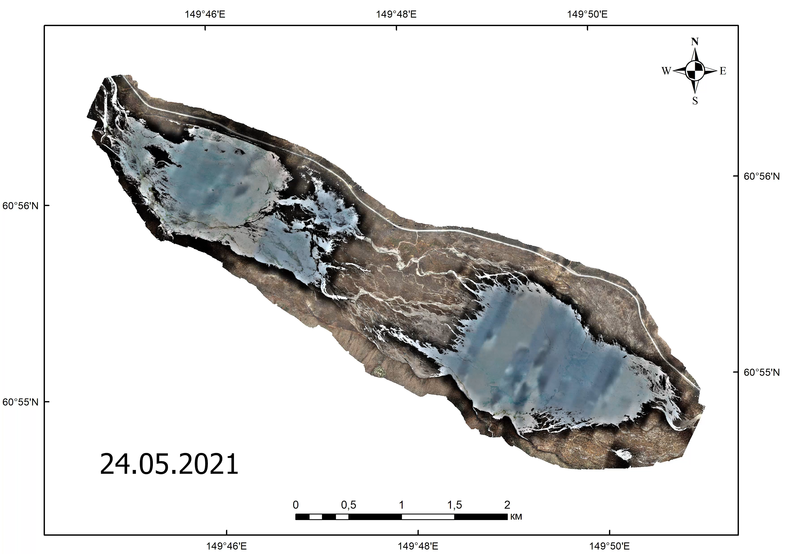
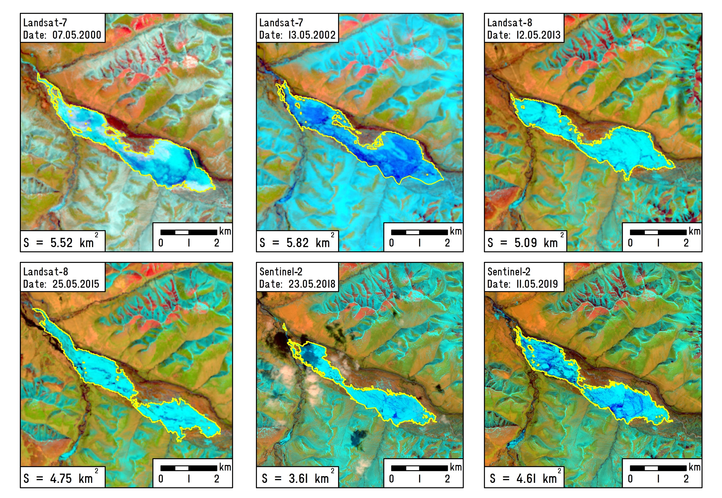
Remote sensing data (Landsat, Sentinel and UAV)
We used 84 images of Landsat (1973, 2000-2017)
52 images of Sentinel (2018-2021)
6 images of UAV (from May, 24 to September, 7)
Assessment of seasonal changes of area and volume
Estimation of area

Slide 6
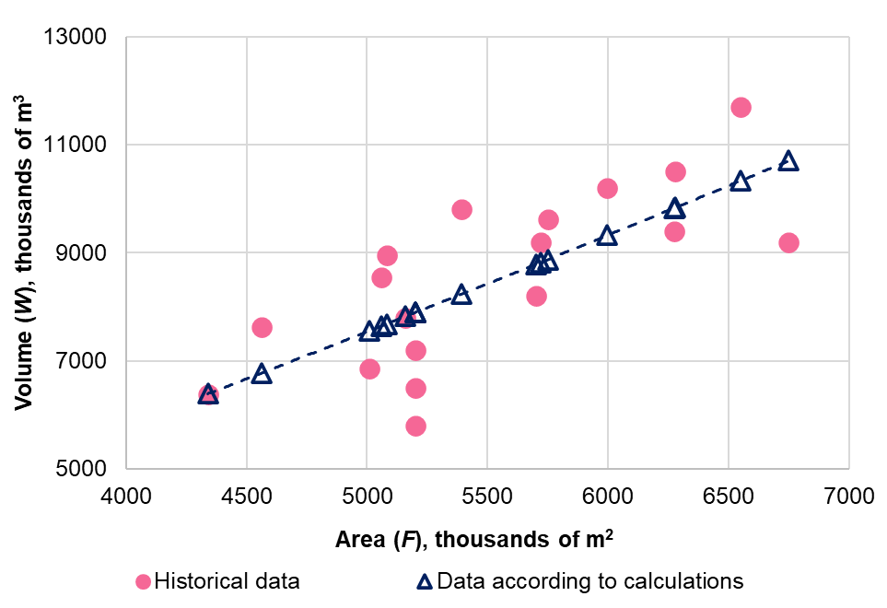
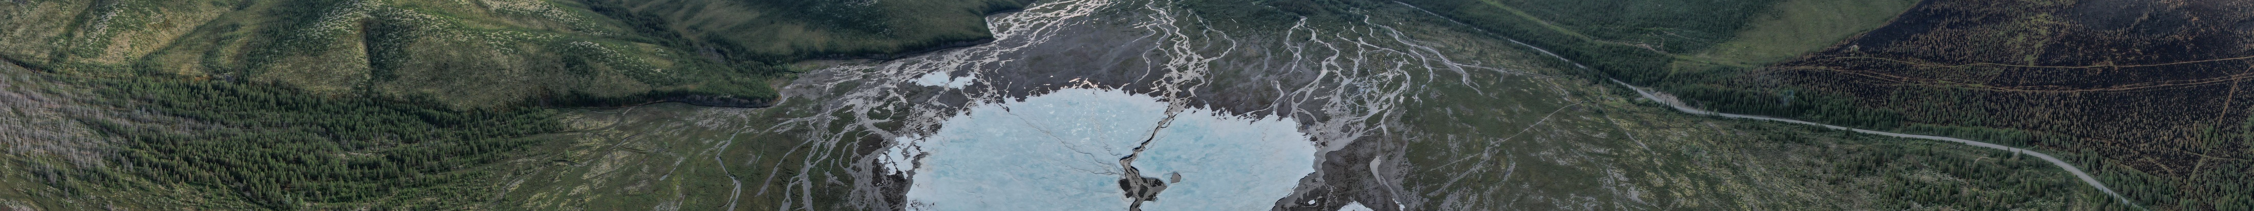
Estimation of aufeis volume
W = αF^{n}
α = 0,364
n = 1,167
W (thousands of m³) – maximum volume,
F (thousands of m²) maximum area

Slide 7
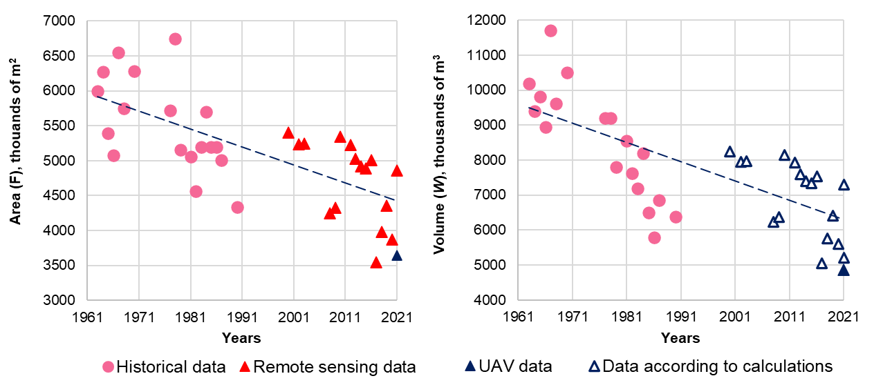
Changes of aufeis area and volume, 1962-2021
The maximum area and volume of the aufeis decreased

Slide 8
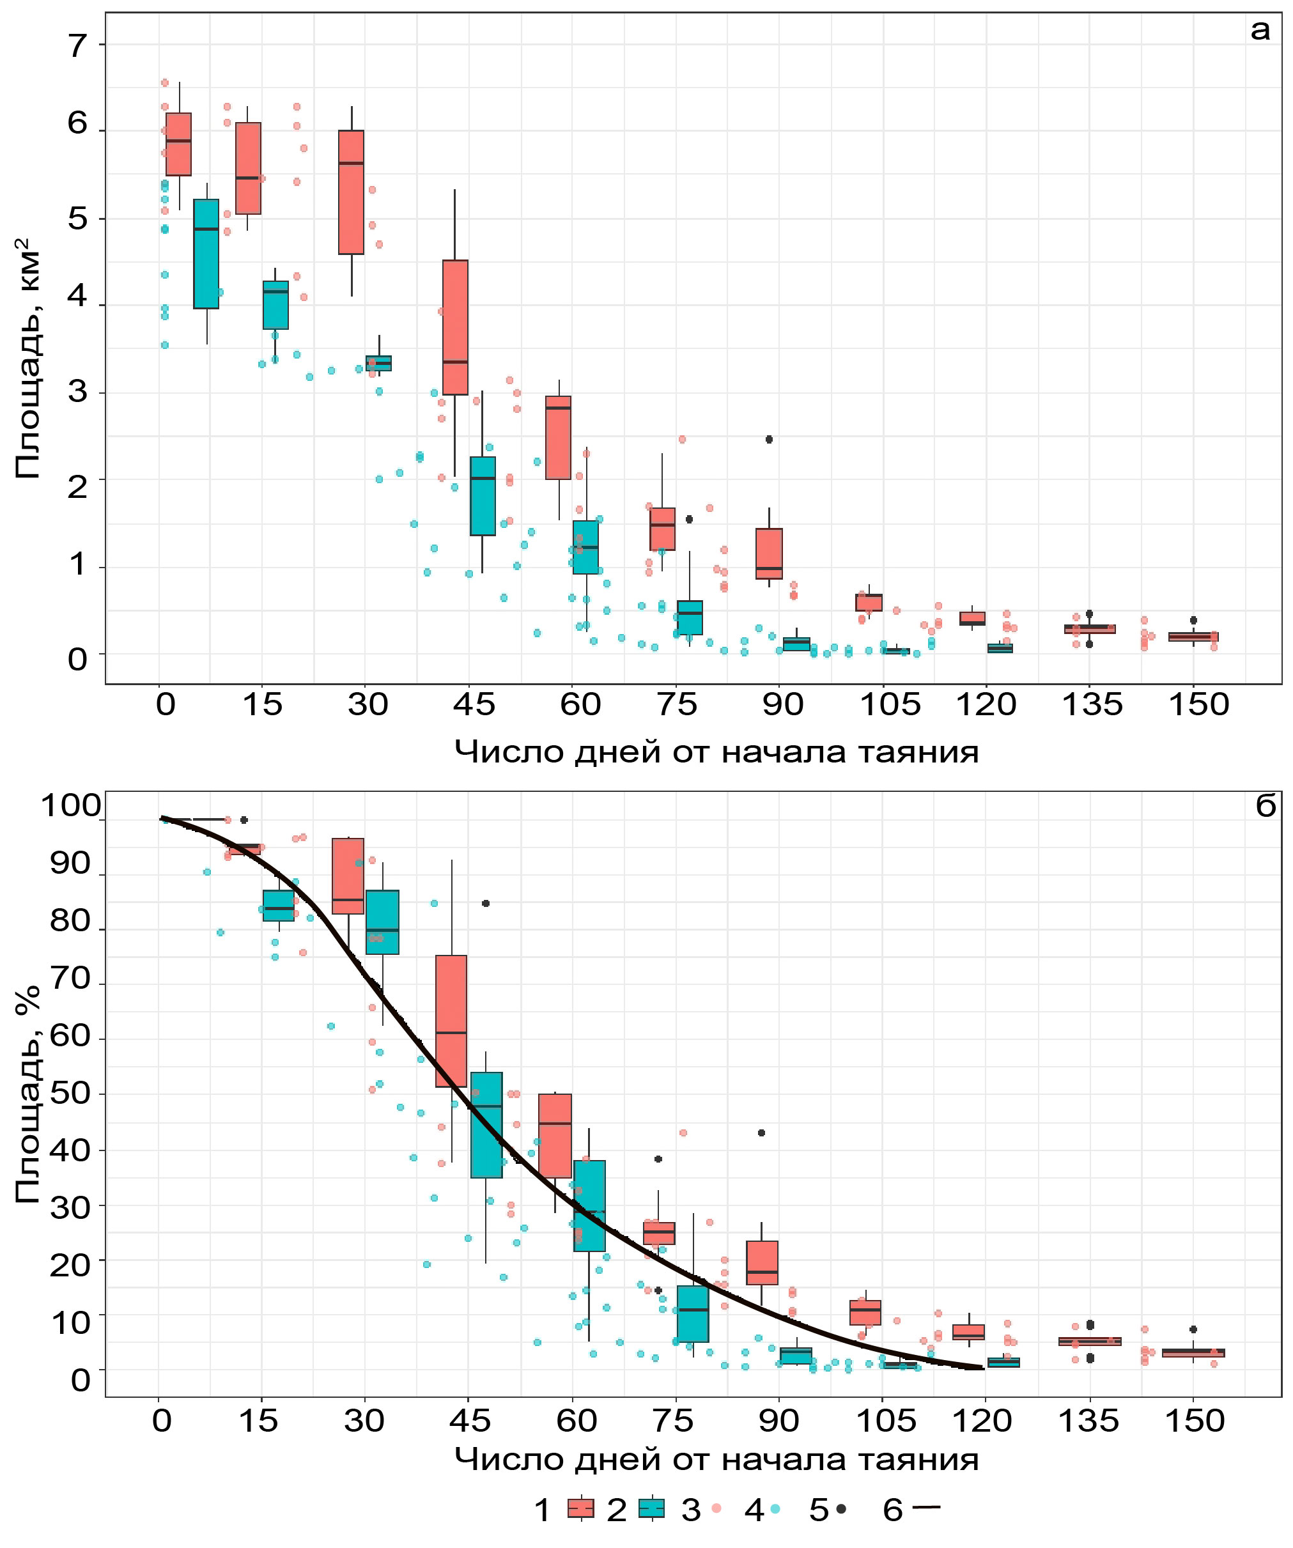
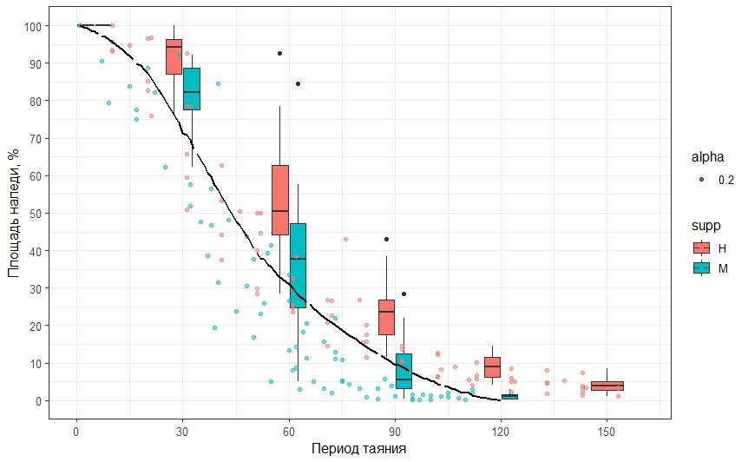
Aufeis seasonal dynamic
Aufeis area, sq. km
Aufeis area, %
The number of days from the beginning of ablation
Historical data Modern data
Empirical dependence of area depletion for aufeis with area 0,6-23 km² (Sokolov, 1975)

Slide 9
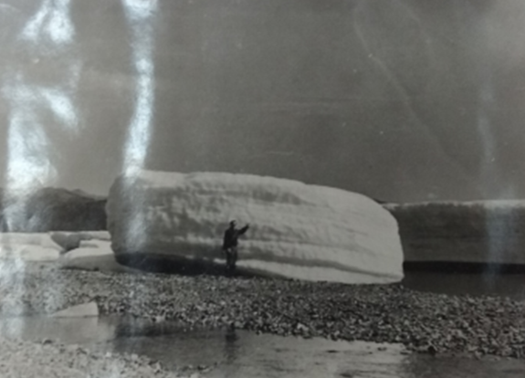
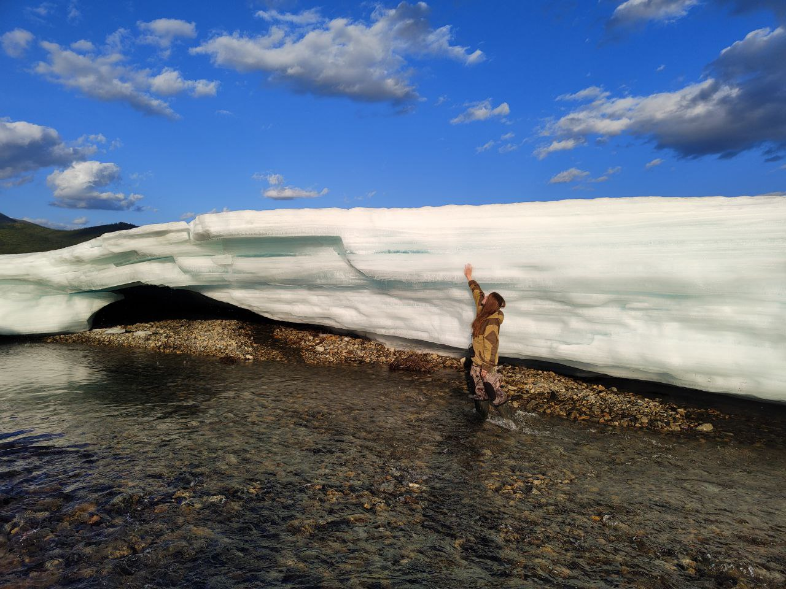
Conclusions
 | Historical data (1962-1991) | Modern data (2000-2021)
Maximum area, km³ | 4,3 – 6,8 | 3,5 – 5,4
Average area, km³ | 5,5 | 4,7
Maximum volume, million m³ | 5,3 – 11,7 | 5,0 – 8,2
Average volume, million of m³ | 8,5 | 7,1
Maximum length of ablation, days | 153 | 112
The area of perennial ice (% from maximum area) | 1 – 10 | zero
July, 1963 and 2021
Average maximum area and volume of the Anmangynda aufeis decreased by 15%.
Maximum values of area and volume decreased by 20 and 30%, respectively.
Perennial aufeis -> seasonal aufeis
Trend is supported by the data from the whole region.

Slide 10
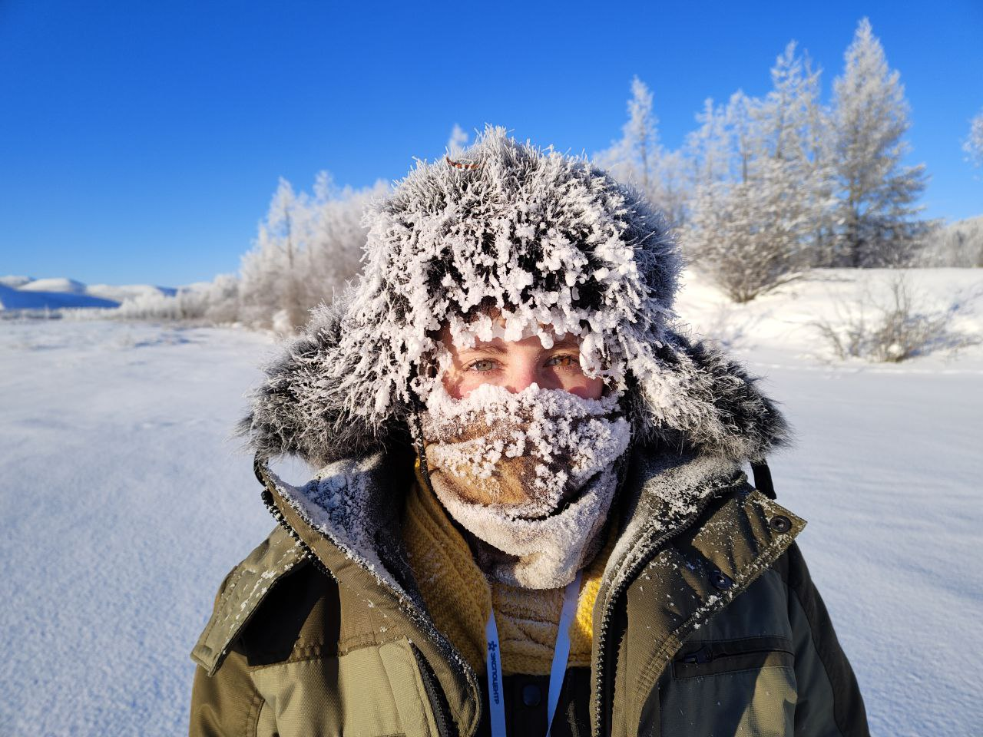
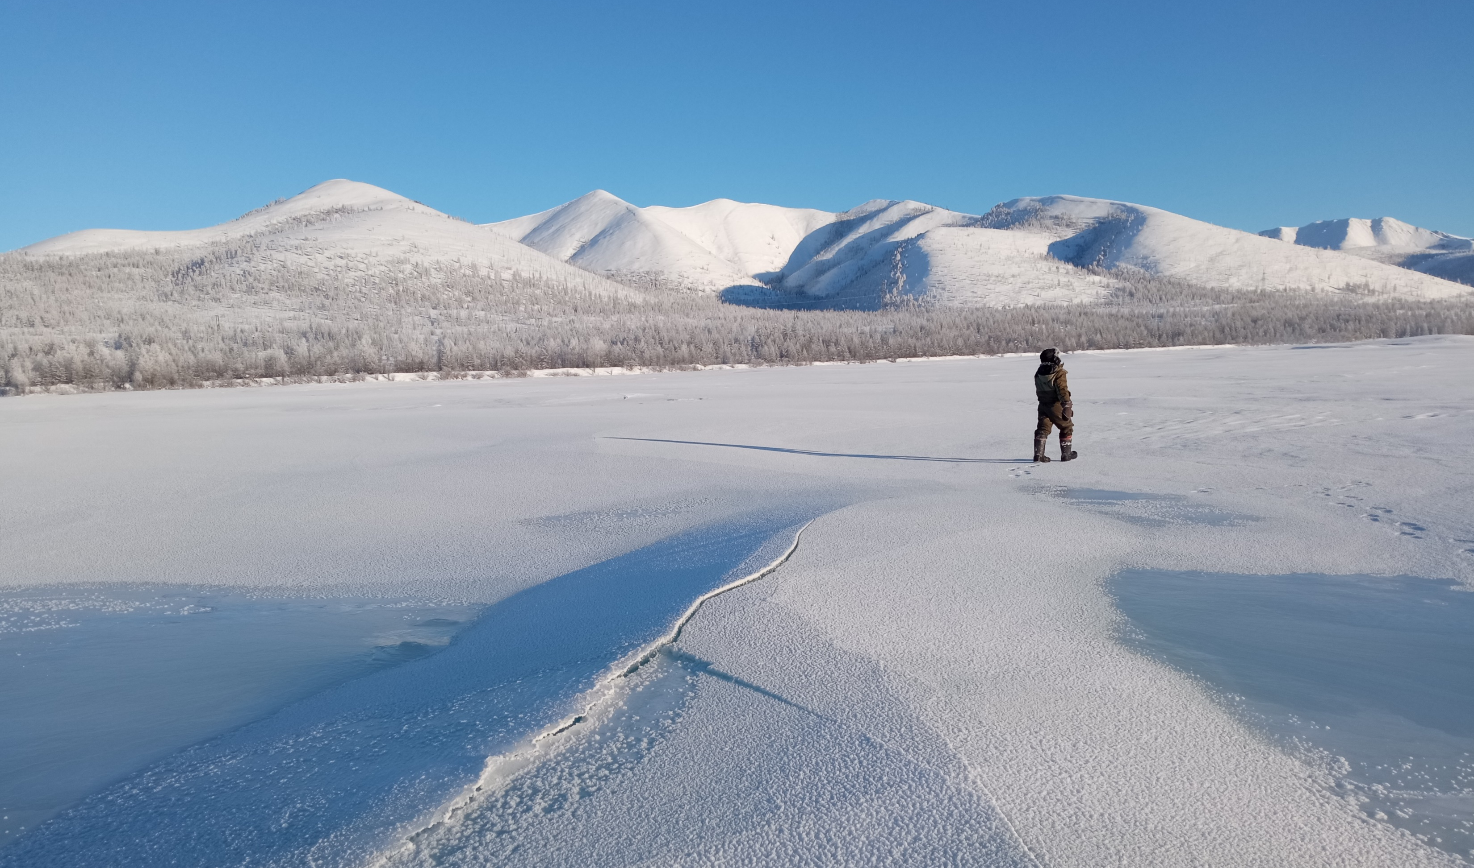
anastasiazemlanskova@gmail.com
https://www.youtube.com/watch?v=MAUa6aKRxyQ
https://www.youtube.com/watch?v=mehBEb2JFcA&t=2s
The study was carried out with the support of Russian Foundation for Basic Research (19-55-80028, 20-05-00666) and St. Petersburg State University (project 75295776)
Thank you for attention!
Visit us in the Kolyma!

