Slide 1
The RiskChanges tool for multi-hazard risk-informed planning at local government level
Cees van Westen: c.j.vanwesten@utwente.nl
Manzul Hazarika, Ashok Dahal, Tek Kshetri, Anish Shakya, and Syams Nashrrullah

Slide 2

Current tools for risk assessment
Examples:
Non-availability of multi-hazard risk assessment tools at local level
Often too complex
Too data intensive
Some are country or region specific
Some of them require to link with specific software and data
Required software are not available or maintained
No multi-hazard interactions and don’t provide loss and risk information
Do not include risk reduction alternatives
Do not include future scenarios

Slide 3

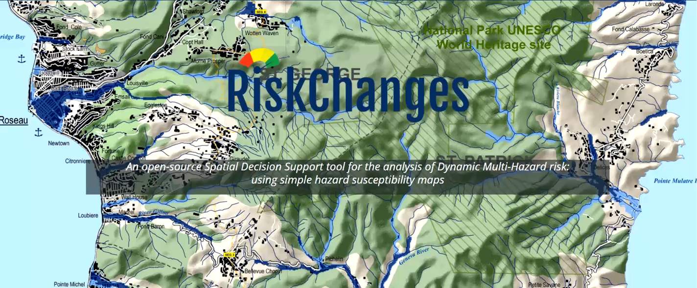
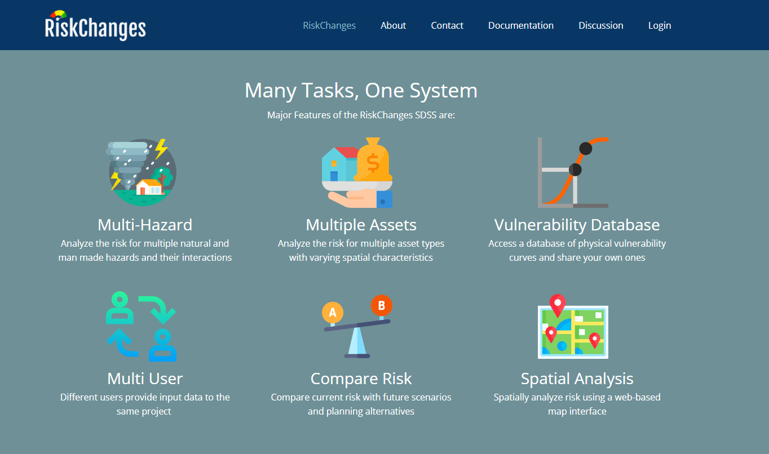
www.RiskChanges.org

Slide 4
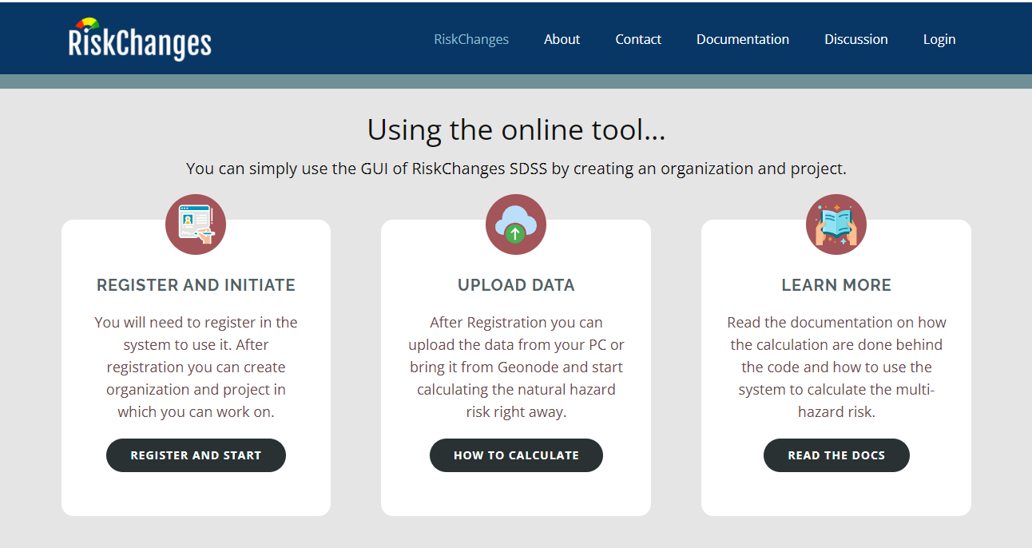

Slide 5
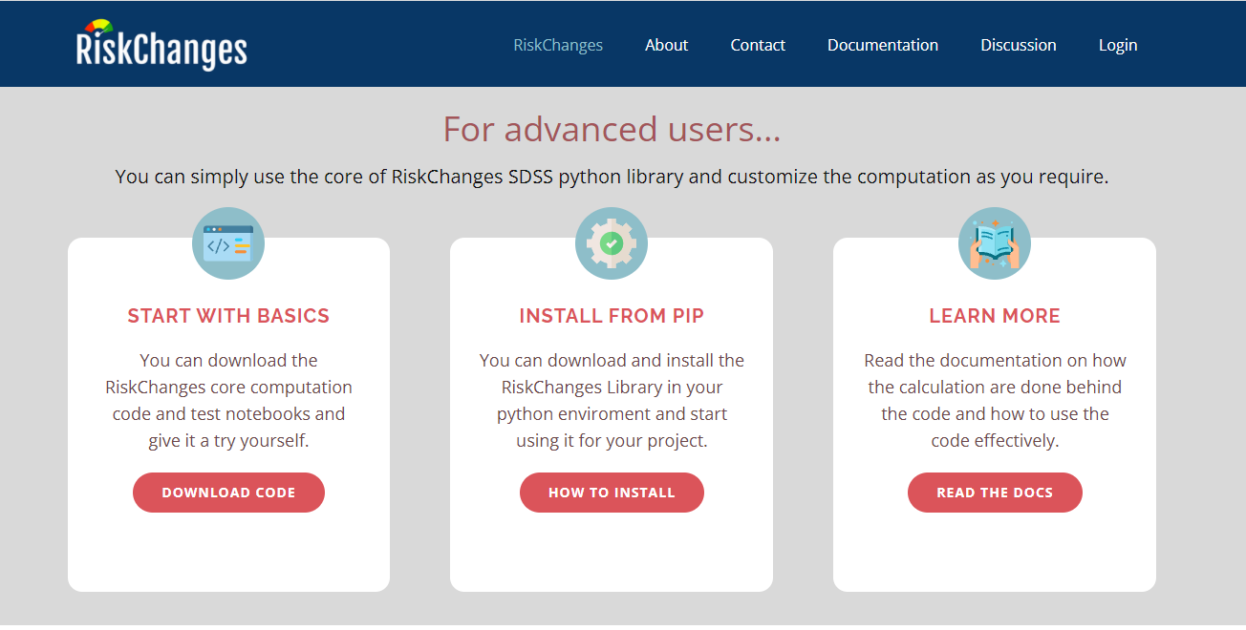

Slide 6
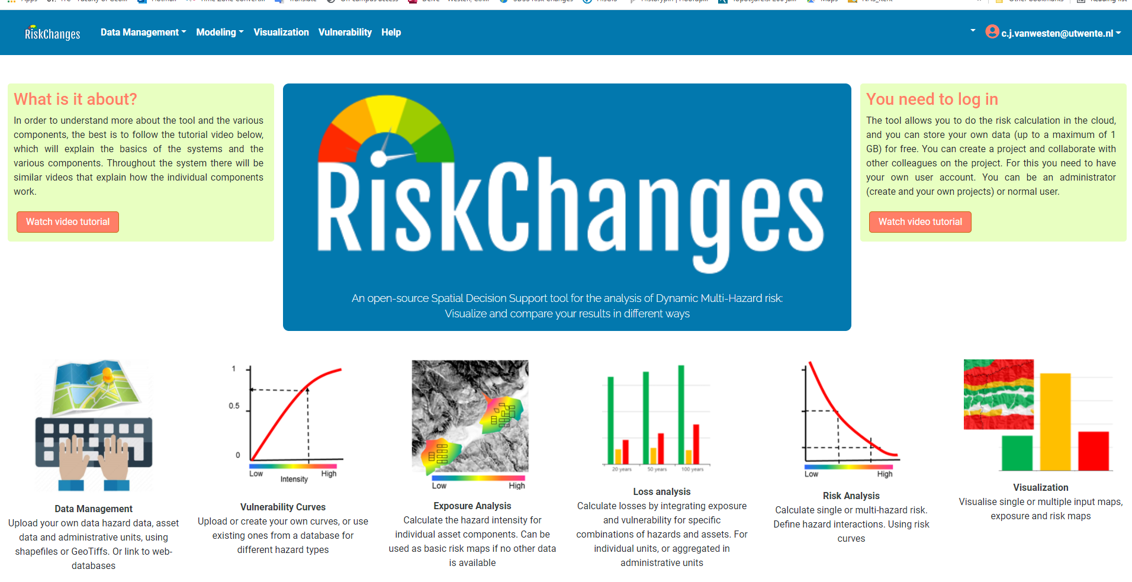

Slide 7
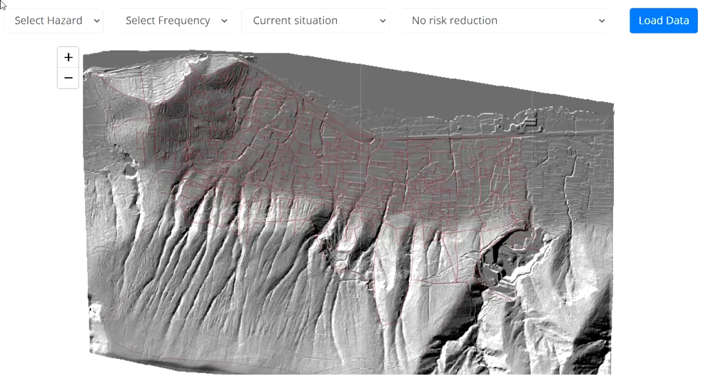
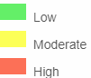
Risk Information

Slide 8
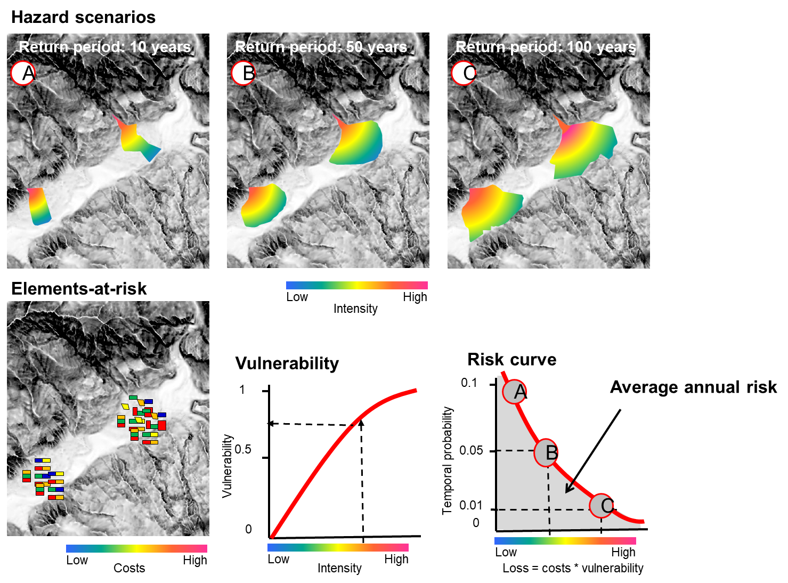
Risk and Decision Making
Current situation
Evaluation of current risk
Evaluation of risk after a disaster event
Planning alternatives:
Risk mitigation planning
Early Warning
Recovery
Future scenarios:
Short term: recovery / rapid changes
Climate change
Land use change
Future proof Planning Alternatives
Elements-at-risk
Hazard analysis
Buildings
Susceptibility
People
Intensity
Stakeholders
Infrastructure
Frequency
Legal framework
Vulnerability
& Capacity
Risk governance
Risk communication
Physical
Social
Risk Analysis
Economic
Population
(in)direct)
Risk evaluation
Perception
Acceptability

Slide 9
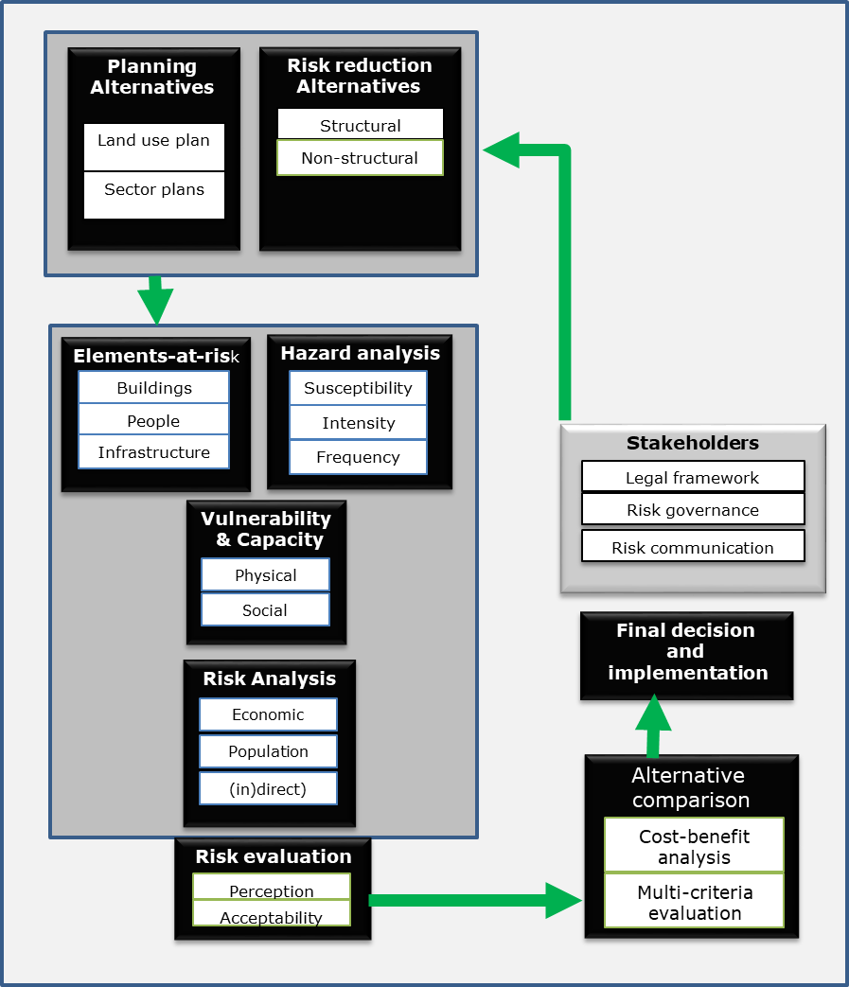
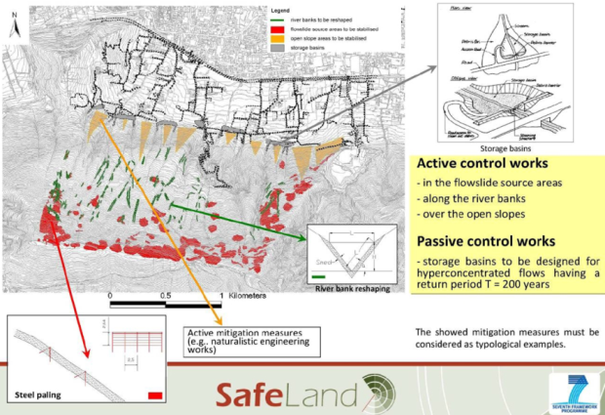
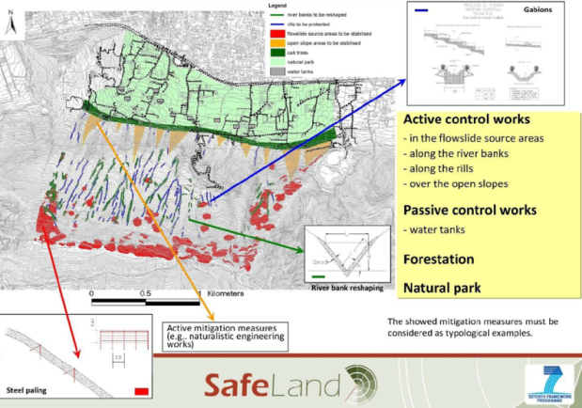
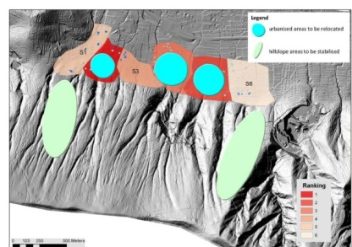
Risk Reduction Alternatives
 | Items related to construction cost | Hazard changes | Elements-at-risk changes
Alternative 1: Engineering solutions |  | Yes | No
Alternative 2: Ecological solutions |  | Yes | Partly
Alternative 3: relocation |  | No | Yes

Slide 10
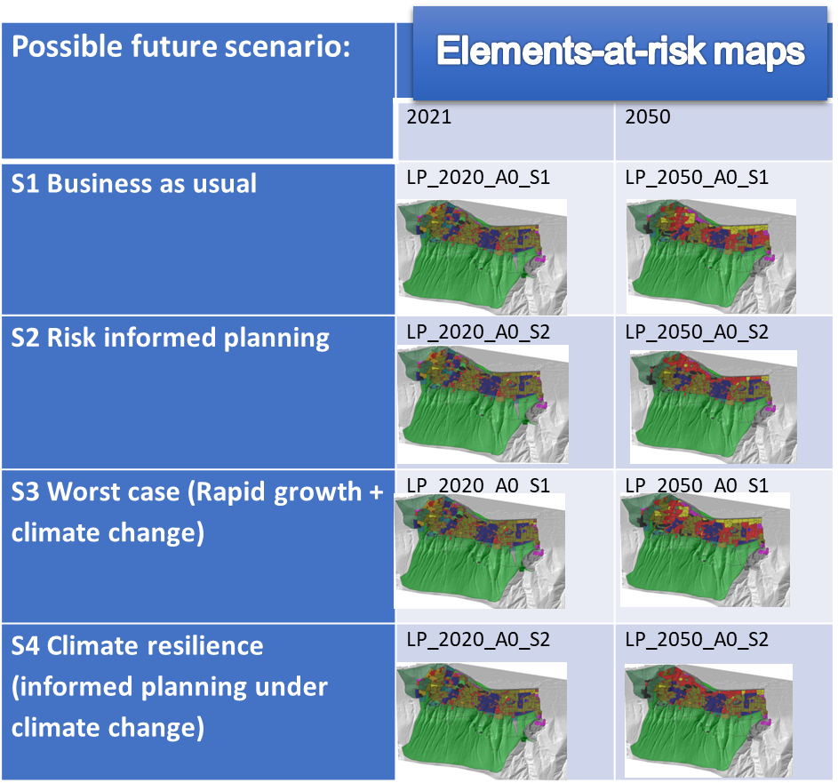
Future scenarios
Possible future
scenarios
Future scenarios:
Short term: recovery / rapid changes
Climate change
Land use change
Future proof Planning Alternatives
Climate change
Land use change
Population
Economy
Elements-at-risk
Hazard analysis
Buildings
Susceptibility
People
Intensity
Stakeholders
Infrastructure
Frequency
Legal framework
Vulnerability
& Capacity
Risk governance
Risk communication
Physical
Social
Risk Analysis
Economic
Population
(in)direct)
Risk evaluation
Perception
Acceptability

Slide 11
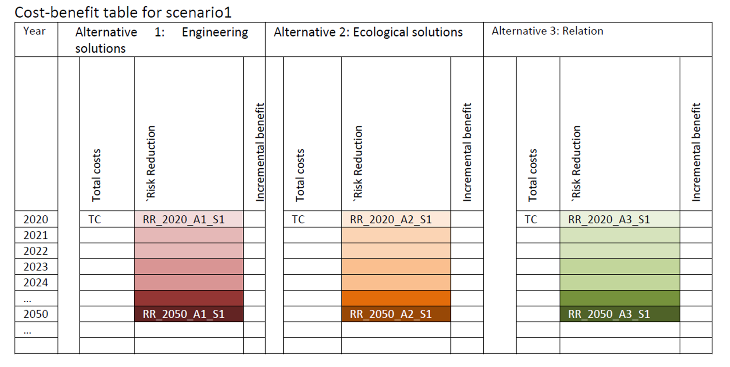
Risk and Decision Making
Planning
Alternatives
Risk reduction
Alternatives
Possible future
scenarios
Land use plan
Structural
Climate change
Non-structural
Land use change
Sector plans
Population
Economy
Current situation
Evaluation of current risk
Evaluation of risk after a disaster event
Planning alternatives:
Risk mitigation planning
Early Warning
Recovery
Future scenarios:
Short term: recovery / rapid changes
Climate change
Land use change
Future proof Planning Alternatives
Elements-at-risk
Hazard analysis
Buildings
Susceptibility
People
Intensity
Stakeholders
Infrastructure
Frequency
Legal framework
Vulnerability
& Capacity
Risk governance
Risk communication
Physical
Social
Final decision
and
implementation
Risk Analysis
Economic
Population
Alternative
comparison
(in)direct)
Risk evaluation
Cost-benefit analysis
Perception
Multi-criteria evaluation
Acceptability

Slide 12
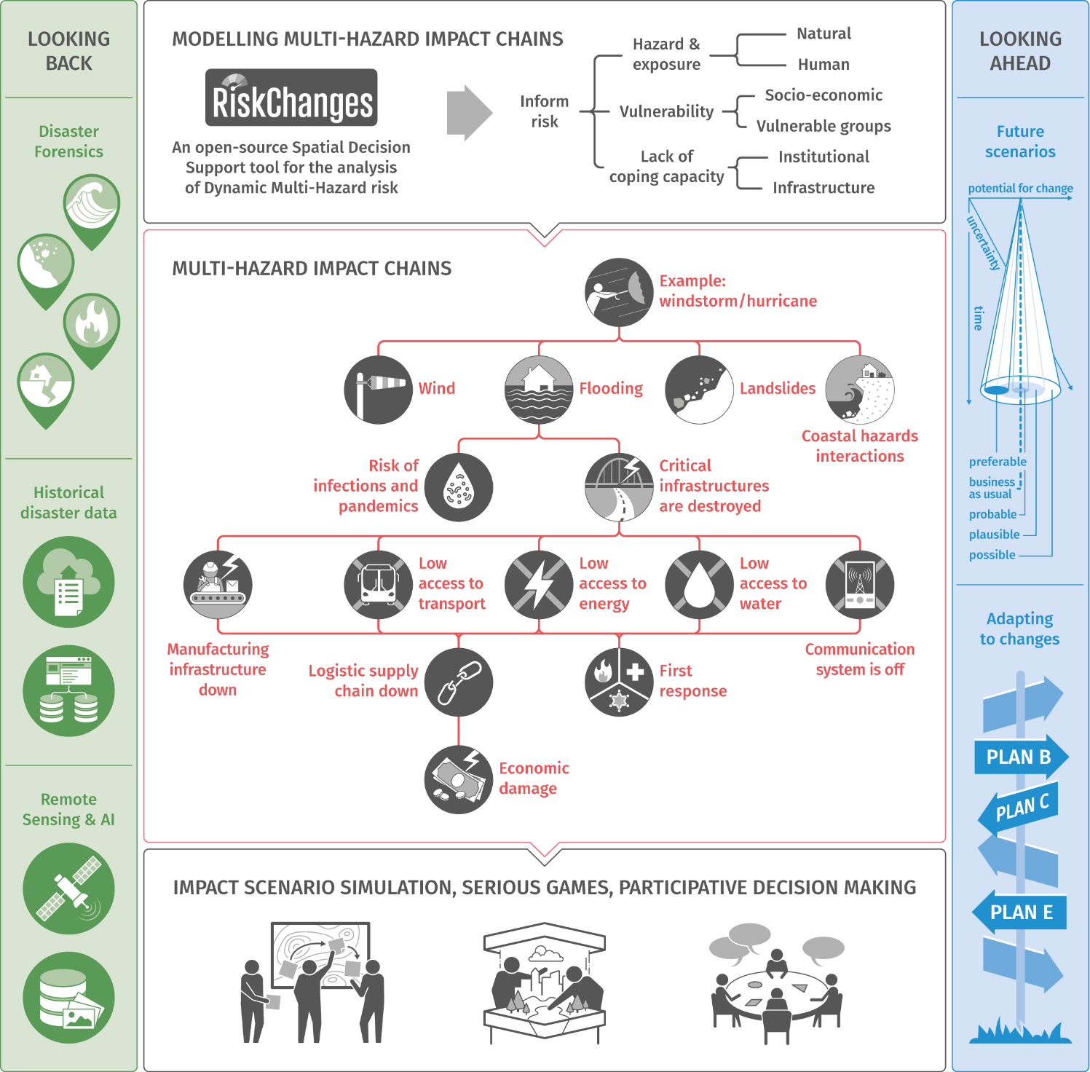

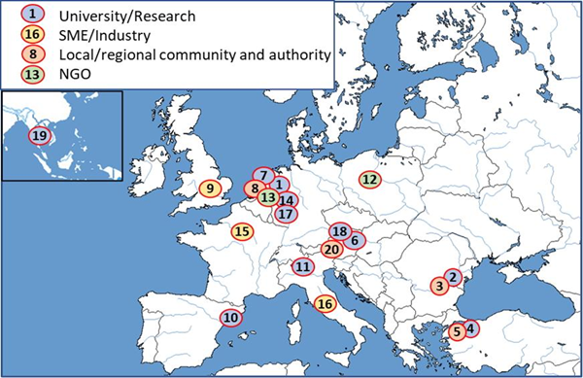
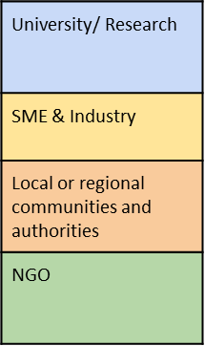
EU Horizon Europe DRS-01-03 project:
PARATUS
Increasing Preparedness And Resilience Of European Communities By Co-Developing Services Using Dynamic Systemic Risk Assessment

