Slide 1



Diverse models, diverse interglacial results? Sea ice physics versus model forcing
The Arctic during the Last Interglacial
Louise Sime, Rachel Diamond, David Schroeder, Maria Vittoria Guarino, and Rahul Sivankutty
Wed, 25 May, 15:55–16:00 Room 0.49/50
EGU22-12679 | Presentations | CL1.1.3

Slide 2
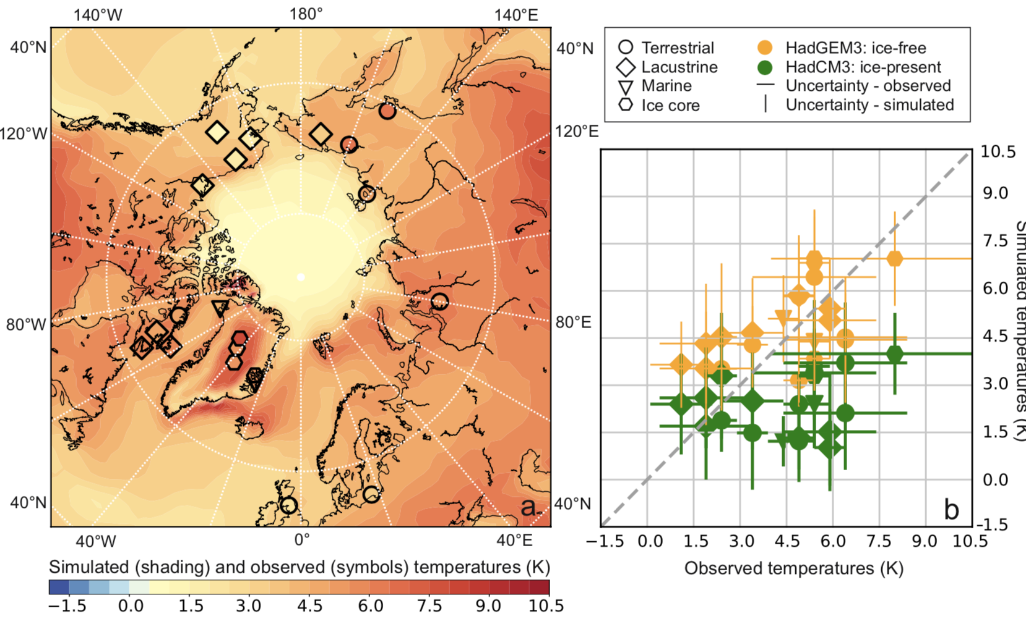
What caused summer temperature in the Arctic to rise 4.5K during the Last Interglacial (127 ka)?
Future Arctic climate change relevance – warming and sea ice declines.
Importance for mechanistic understanding and future projections.
(Guarino and Sime et al. 2020)

Slide 3
What have we learned in the last few years about the Arctic during the LIG?
In around 2013 the lack of LIG Arctic warmth in models was postulated to be due to a lack of dynamic vegetation feedbacks (Lunt et al. 2013; Otto-Bliesner et al. 2013; and IPCC AR5, 2013).
In 2018 we found that an sea ice-free summer in the Arctic might be partly responsible for signals of warming in Greenland ice cores (Malmierca and Sime et al. 2018).
In 2020 the UK CMIP6 model accurately captured the warming for the first time (Guarino and Sime et al. 2020). This was due to sea ice, rather than vegetation, physics.

Slide 4
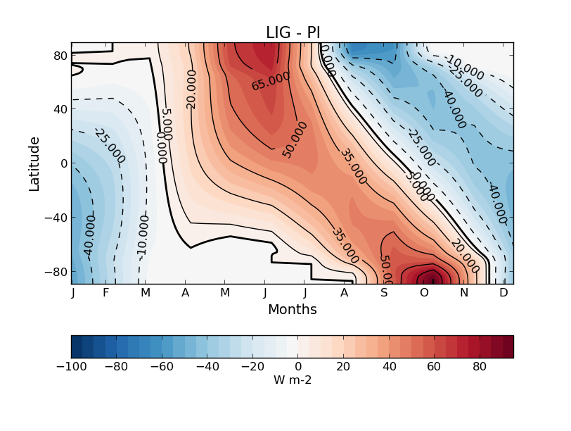
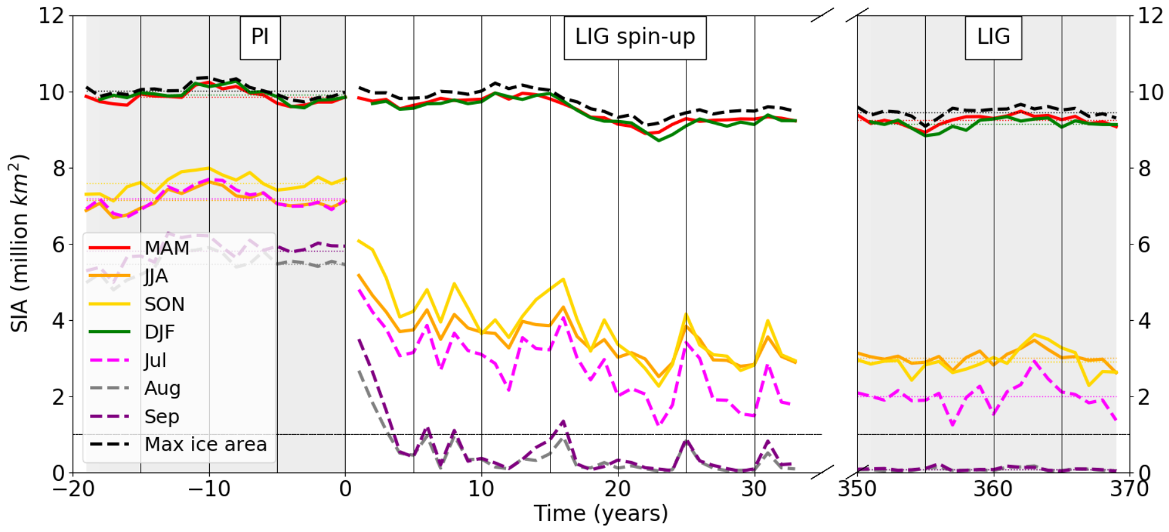
Seasonal sea-ice area (70°N - 90°N)
Strong spring-time insolation forcing can quickly melt Arctic sea ice:
PI
LIG spin-up
LIG
(Diamond and Sime et al. 2021)

Slide 5
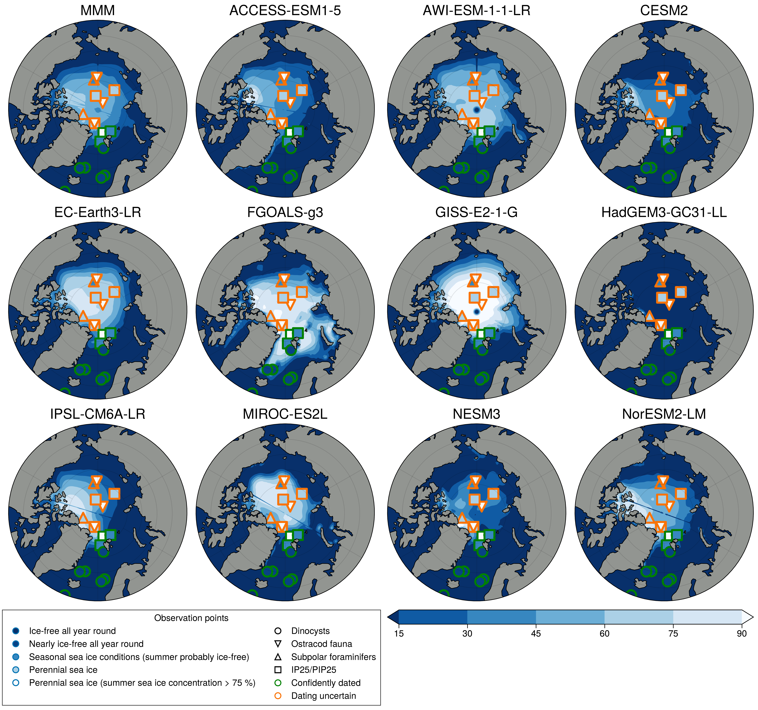
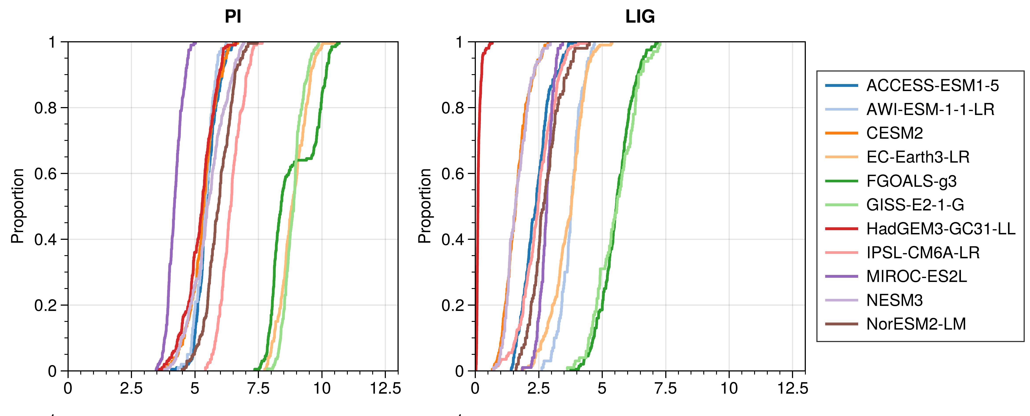
Not all models simulate a sea ice free Arctic in summer
Cumulative distribution of sea ice area
Sea ice area
The UK model HADGEM3 is ice-free through out the simulation. Two other PMIP4 models are also occasionally ice-free.
(Sime and Sivankutty et al. in prep)

Slide 6
Not all models simulate a sea ice free Arctic in summer
Cumulative distribution of sea ice area
4
Sea ice area
The UK model HADGEM3 is ice-free through out the simulation. Two other PMIP4 models are also occasionally ice-free.
(Sime and Sivankutty et al. in prep)

Slide 7
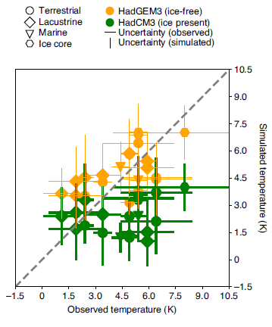
Melting all the Arctic sea ice can give a good (95%) model-data match:
Complete LIG summer sea-ice loss gives a close match between simulated and observed temperatures in the Arctic.
HadGEM3 and HadCM3 temperature: model data v. observations
(Guarino and Sime et al. 2020; Sime and Sivankutty et al. in prep)

Slide 8
What have we learned in the last few years about the Arctic during the LIG?
In around 2013 the lack of LIG Arctic warmth in models was postulated to be due to a lack of dynamic vegetation feedbacks (Lunt et al. 2013; Otto-Bliesner et al. 2013; and IPCC AR5, 2013).
In 2018 we found that an ice-free summer in the Arctic might be partly responsible for signals of warming in Greenland ice cores (Malmierca and Sime et al. 2018).
In 2020 the UK CMIP6 model accurately captured the warming for the first time (Guarino and Sime et al. 2020). This was due to sea ice, rather than vegetation, physics.
In 2021 we firstly showed that current marine data are not adequate for assessing the accuracy of Arctic sea ice changes during the Last Interglacial (Kagayama and Sime et al. 2021).
And secondly, that melt pond physics (albedo feedbacks) are sufficient to melt LIG sea ice and raise the Arctic temperature (Diamond and Sime et al. 2021). Models with explicit melt pond schemes tend to do better.

Slide 9
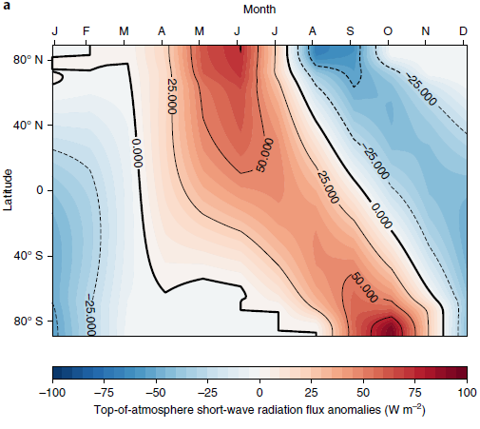
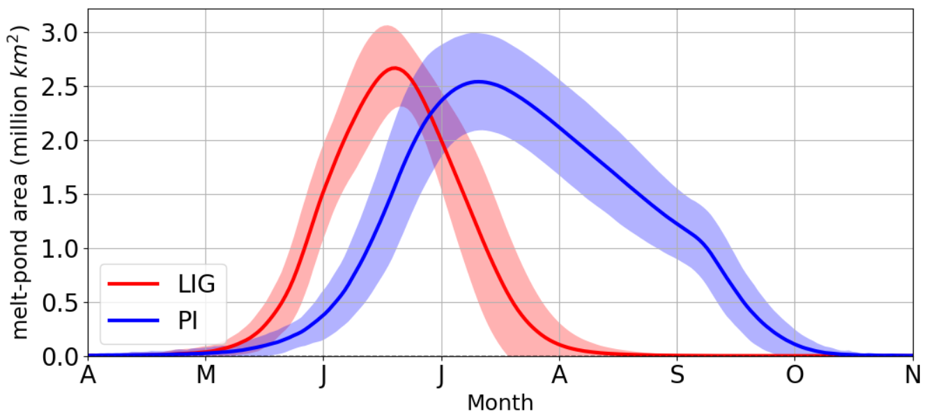
The importance of sea ice physics:
Radiative forcing → LIG earlier melt onset → albedo feedback → LIG rate of summer sea-ice melt greater → LIG complete summer sea-ice loss
Peak fraction of sea-ice pond-covered:
  LIG: ~45% (early July)
  PI: ~35% (late July)
Guarino and Sime et al., Nature Climate Change (2020)
(Guarino and Sime et al. 2020; Diamond and Sime et al. 2021; Diamond et al. in prep)

Slide 10
What do we want to know next?
More about melt pond physics, and how important they are for the future projections. Particularly whether can we use LIG modelling to better parameterise our models (Diamond et al. in prep)?
What the wider family of CMIP6-PMIP4 LIG simulations can tell us about Arctic changes in temperature and sea ice (Sime et al. in prep) AND 16:20–16:25 Sivankutty and Sime et al. THIS SESSION.

Slide 11
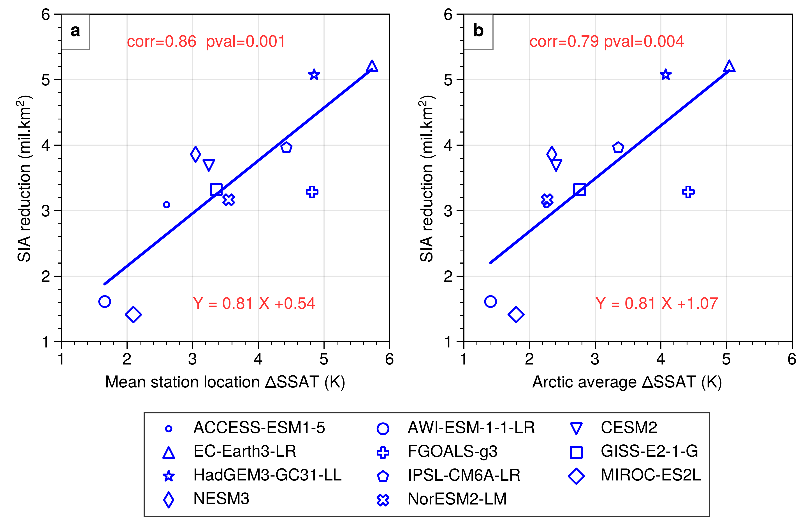
Sneak preview..
(4.5m km² loss).
Conclusions:
Sea ice is crucial in understanding Arctic LIG changes.
Interglacial data can be used to evaluate and parameterise climate models
More LIG temperature and sea ice data would be very useful
See also 16:20–16:25 Sivankutty and Sime et al. THIS SESSION (EGU22-9044).
And/or contact:
Louise Sime lsim@bas.ac.uk

