Slide 1


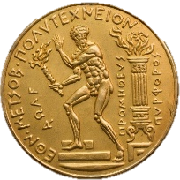
Determining optimal scale of water infrastructure considering economical aspects with stochastic evaluation Case study: Municipality of Western Mani
National Technical University of Athens
School of Civil Engineering
David Markantonis, Aimilia Siganou, Konstantina Moraiti, Maria Nikolinakou, G.-Fivos Sargentis, Panagiotis Dimitriadis, Michalis Chiotinis, Theano Iliopoulou, Nikolaos Mamassis, Demetris Koutsoyiannis

Slide 2
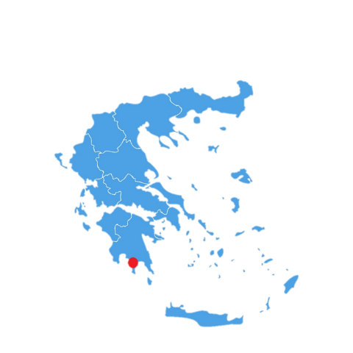
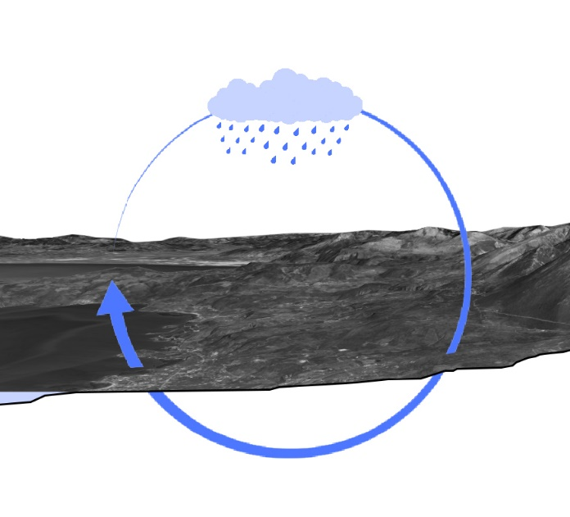
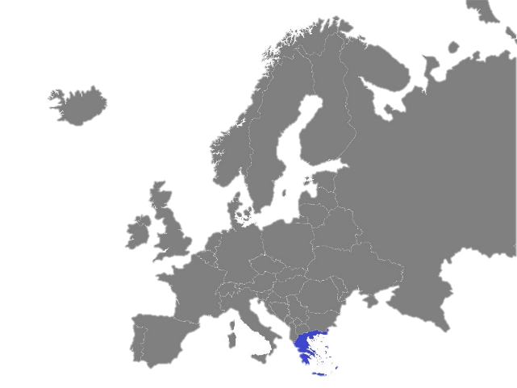
Introduction
The Municipality of Western Mani (WM) is located in the southern part of Greece in Peloponnese. The region has a high rate of rainfalls mainly in the mountainous areas.
Rainfall is mainly observed during the autumn and winter months, from October to March, while there is a significant decrease in the summer[1].
The problems that arise mainly focus on the quantitative aspect [2-5]. The geological background is extremely permeable as it consists mainly of karstic limestone. Therefore, there are limited surfaces water resources with limited water supply.
Source : https://vemaps.com/europe-continent/eu-c-04#google_vignette
Source: https://www.vecteezy.com/vector-art/2292777-greece-detailed-map-with-states
The water cycle

Slide 3
Population / Tourism
According to demographical data [6] , West Mani’s population decreased from the year 2001 to the year 2011. However, it is estimated that an increase will take place in the next decades.
Taking that into consideration, in order to hypothesize the future number of inhabitants in 20 years, we design our infrastructures to accommodate a 20% population increase.
In the past few years, the meteoric rise of the activity of tourism has also been observed during the summer months.

Slide 4
Water consumption
Lack of data throughout the past few years. In particular, the only data that have been found refer to the year 2019.
Most of the data are available only on an annual basis → impossible to use them reliably
Estimated aggregate water consumption in our study area is about 300 L / d / inhabitant.

Slide 5
Methodology
3 different solutions have been studied.
The costs of each individual solution have been determined.
The cost was determined with the assumption of 6% capital recovery rate.
For Greece, as well as for other randomly selected countries, a stochastic process has been used to examine the average price of water considering variable interest rates.

Slide 6
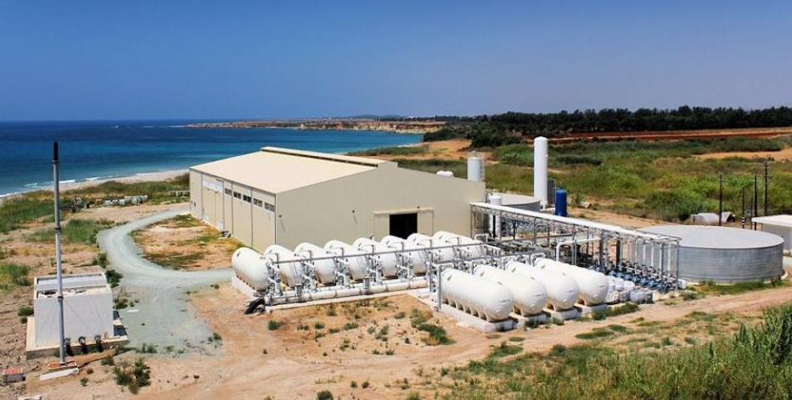
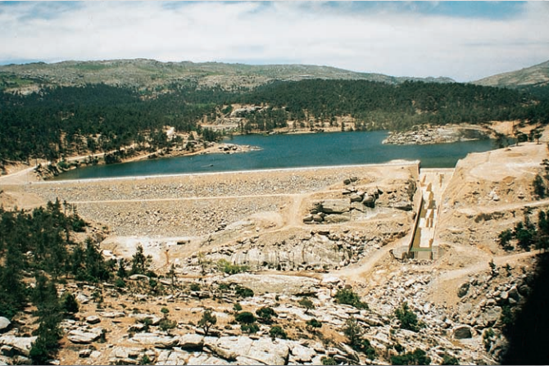
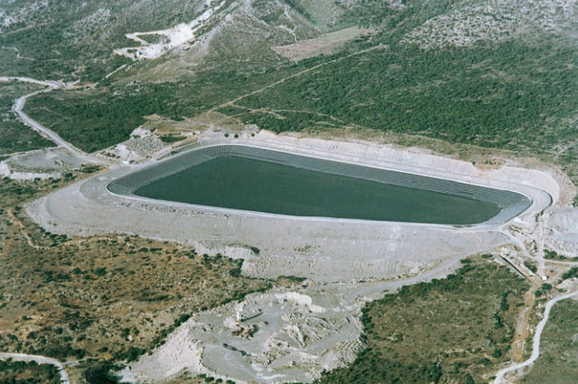
Solutions
Dam
Water ponds
Desalination
Desalination Plant, Pafos, Cyprus [7]
Dam, Ikaria, Greece [8]
Water pond, Chania, Greece [8]

Slide 7
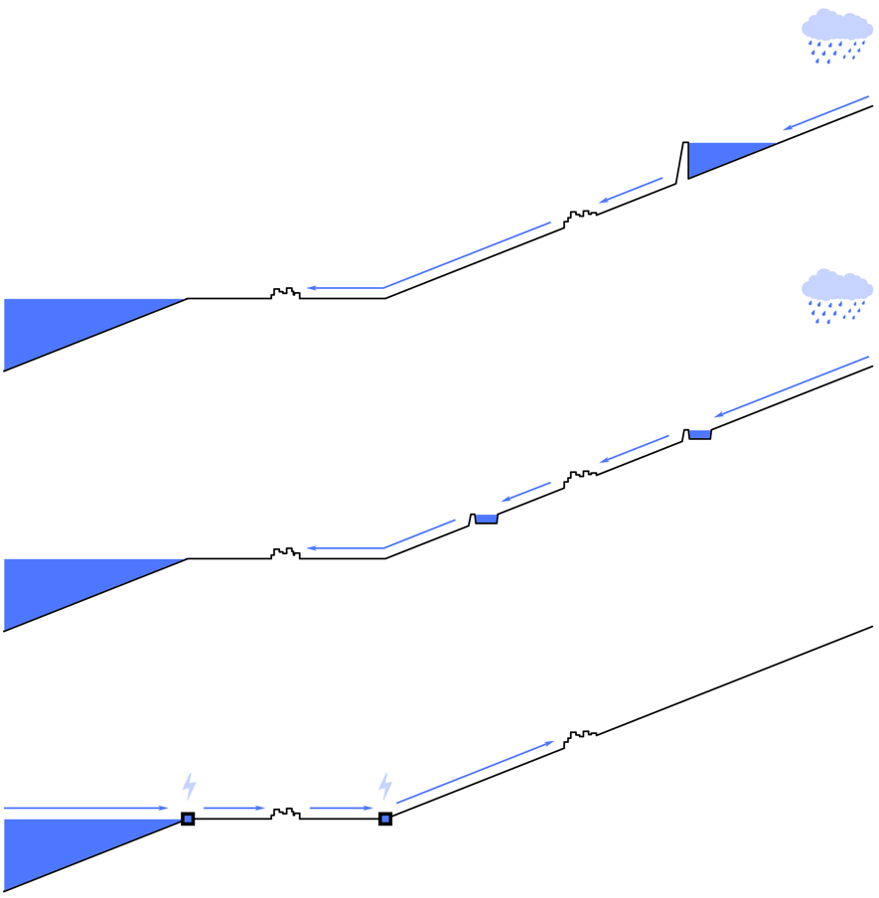
Solutions – Cross Section
Dam: Nedontas river
An appropriate position for a dam has been chosen, such that the catchment area is adequate to service the needs of our area.
The water is stored for up to a few years and then transported via pipe when needed to our area. The whole system is gravity operated.
Water ponds: local streams
Water is captured at appropriate positions from local streams.
It is then transported via pipe to a number o water ponds where it is stored for up to a few months until its use. The whole system is gravity operated.
Desalination: sea
Sea water is desalinated via reverse osmosis in several coastal desalination plants.
Afterwards it is pumped uphill to the settlements where it is stored for up to a few hours before its consumption.

Slide 8
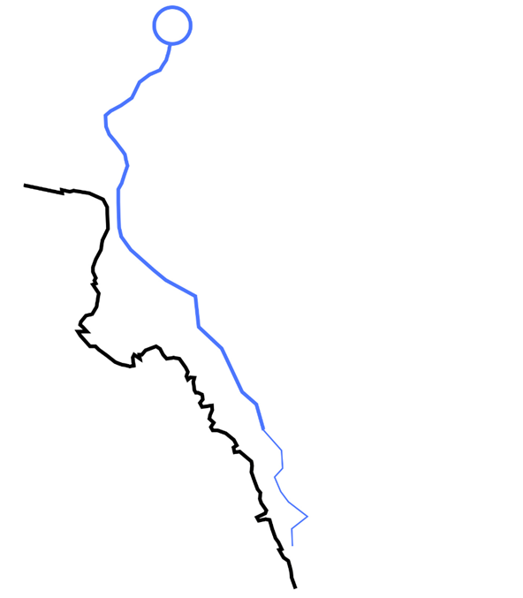
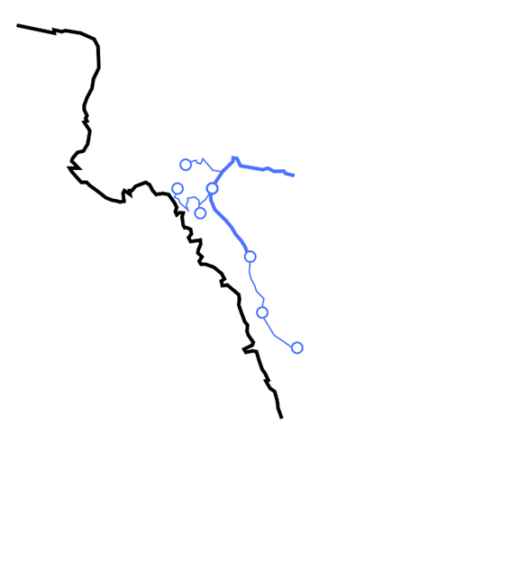
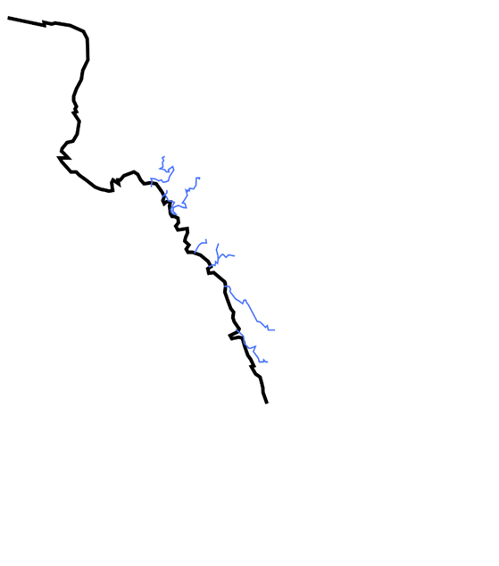
Solutions - Top view
Nedontas Dam
Water ponds
Desalination
Small diameter pipes: 12.6 km
Large diameter pipes: 42.0 km
Small diameter pipes: 21.7 km
Large diameter pipes: 17.1 km
Small diameter pipes: 43.7 km
Large diameter pipes: 00.0 km

Slide 9
Components of economic calculations
Dam (construction period: 4 years)
Dam construction [8] (lifespan 50 years)
Pipe network construction (lifespan 50 years)
Dam maintenance [9]
Water ponds (construction period: 2 years)
Ponds construction [10] (lifespan 50 years)
Pipe network construction (lifespan 50 years)
Desalination (construction period: 1 year)
Desalination plant construction and equipment [11] (lifespan 25 years)
Desalination plant maintenance [12]
Pipe network (lifespan 50 years)
Pumping equipment (lifespan 25 years)
Electricity for desalination [13] (electricity cost: 0.15 €/kwh)
Electricity for pumping (electricity cost: 0.15 €/kwh)

Slide 10
Calculaltion of cost with fixed interest rate
Assumption: 6% capital recovery rate
The cost of water is calculated [14] for the 3 different solutions
Observation:
The Water Ponds are clearly the preferred solution in terms of cost
In addition, when considering other factors such as their environmental impact, water ponds remain the preferred solution [15]

Slide 11
Stochastic modeling methodology
Data: Real interest rates [14] of selected countries
The AR(1) Markov process is used [15].
Multiple unique timeseries of interest rates are generated (50 years each ).
The cost of water for each individual timeseries is calculated.
The results are presented as a distribution of probability.

Slide 12
Stochastic simulation: 3 different solutions
The 1st series of simulations are conducted to determine the cost of water for each of the 3 solutions.
Data : Real interest rates of Greece [18]
Observations
The water ponds remain the preferred solution even in the most extreme cases.
The costs of the Dam presents comparatively high variance. This can be explained by the fact that this solution is very capital heavy, therefore is the one most exposed to the variability of the interest rate timeseries.

Slide 13
Stochastic simulation: 4 different countries
The 2nd series of simulations are conducted to determine the cost of water in the case of the Water ponds. However, the simulations use data from 4 different countries.
Data : Real interest rates of United Kingdom [19], Greece [18], Thailand [20], Madagascar [21]
Observations
The results differ from country to country.
Madagascar in particular stands as an outlier. When conducting such simulations, It is appropriate to use data from countries in similar stages of economic development.

Slide 14
References (1/2)
Nikolinakou M., Moraiti K., Siganou A. ,Markantonis D., Sargentis G.-F. , Iliopoulou T., Dimitriadis P., Meletopoulos I.-T., Mamassis N. and Koutsoyiannis D. ,Investigating the water supply potential of traditional rainwater harvesting techniques used – A case study for the Municipality of Western Mani
Sargentis, G.-F.; Defteraios, P.; Lagaros, N.D.; Mamassis, N. Values and Costs in History: A Case Study on Estimating the Cost of Hadrianic Aqueduct’s Construction. World 2022, 3, 260-286. https://doi.org/10.3390/world3020014
Sargentis, G.-F.; Siamparina, P.; Sakki, G.-K.; Efstratiadis, A.;Chiotinis, M.; Koutsoyiannis, D. Agricultural Land or Photovoltaic Parks? The Water–Energy–Food Nexus and Land Development Perspectives in the Thessaly Plain, Greece. Sustainability 2021, 13, 8935. https://doi.org/10.3390/su13168935
Sargentis, G.-F.; Dimitriadis, P.; Ioannidis, R.; Iliopoulou, T.; Frangedaki, E.; Koutsoyiannis, D. Optimal utilization of water resources for local communities in mainland Greece (case study of Karyes, Peloponnese), Procedia Manufacturing, Volume 44, 2020, Pages 253-260, ISSN 2351-9789, https://doi.org/10.1016/j.promfg.2020.02.229.
Sargentis, G.-F.; Iliopoulou, T.; Dimitriadis, P.; Mamassis, N.; Koutsoyiannis, D. Stratification: An Entropic View of Society’s Structure. World 2021, 2, 153-174. https://doi.org/10.3390/world2020011
Hellenic Statistical Authority, Demographic characteristics / 2011, https://www.statistics.gr/el/2011-census-pop-hous (accessed on 02 May 2022)
Cyclades: Desalination plants are coming to Mykonos, Paros, Available online: https://www.naxospress.gr/arthro/tehnologia/kyklades-erhontai-monades-afalatosis-se-mykono-paro (accessed on 19 May 2022)
Dams and ponds of the ministry of agricultural development and food. ΤΑ ΦΡΑΓΜΑΤΑ ΤΟΥ ΥΠΟΥΡΓΕΙΟΥ ΑΝΑΠΤΥΞΗΣ ΚΑΙ ΤΡΟΦΙΜΩΝ ,Β’ ΕΚΔΟΣΗ-ΝΕΑ ΕΡΓΑ , Available online: https://www.ekke.gr/projects/estia/gr_pages/F_synerg/mikra%20fragmata_yp.georgias/mikra%20fragmata.pdf (accessed on 20 May 2022)
C. Petheram, T.A. McMahon,Dams, Dam costs and damnable cost overruns, Journal of Hydrology X, Volume 3, 2019,100026, ISSN 2589-9155, https://doi.org/10.1016/j.hydroa.2019.100026.
Sargentis, G.-F.; Ioannidis, R.; Karakatsanis, G.; Sigourou, S.; Lagaros, N.D.; Koutsoyiannis, D. The Development of the Athens Water Supply System and Inferences for Optimizing the Scale of Water Infrastructures. Sustainability 2019, 11, 2657. https://doi.org/10.3390/su11092657
Zotalis, Konstantinos P.Ενεργειακή και οικονομική αποτίμηση των συστημάτων αφαλάτωσης. Εφαρμογή στον Ελλαδικό χώρο. 2012 http://dx.doi.org/10.26240/heal.ntua.2463
Κoykoytsakis P., Xatziargiriou N. ,Impact of desalation loading to island energy system, Επίδραση Φορτίου Αφαλάτωσης Σε Νησιωτικό Σύστημα Ενέργειας, 2007, http://artemis.cslab.ece.ntua.gr:8080/jspui/bitstream/123456789/14889/1/DT2007-0131.pdf

Slide 15

References (2/2)
Zotalis, Konstantinos & Dialynas, Emmanuel & Mamassis, N. & Angelakis, A.. (2014). Desalination Technologies: Hellenic Experience. Water. 6. 1134-1150. 10.3390/w6051134.
D. Koutsoyiannis, and A. Efstratiadis, Lecture notes on Hydraulics and Hydraulic Works: Aqueducts, 68 pages, Department of Water Resources and Environmental Engineering – National Technical University of Athens, Athens, 2017. Available online: http://www.itia.ntua.gr/en/getfile/1744/3/documents/YYE_Pumps.pdf (accessed on 20 May 2022)
Moraiti K., Markantonis D., Nikolinakou M., Siganou A., Sargentis G.-F. , Iliopoulou T., Dimitriadis P., Meletopoulos I.-T., Mamassis N. and Koutsoyiannis D., Optimizing water infrastructure solutions for small-scale distributed settlements – A case study for the Municipality of Western Mani
European Central Bank Available online: https://www.ecb.europa.eu/home/html/index.en.html (accessed on 20 May 2022)
D. Koutsoyiannis, Stochastics of Hydroclimatic Extremes - A Cool Look at Risk, ISBN: 978-618-85370-0-2, 333 pages, Kallipos Open Academic Editions, Athens, 2021. Available at: http://www.itia.ntua.gr/en/docinfo/2000/ (accessed on 20 May 2022)
https://datahub.io/world-bank/fr.inr.rinr (accessed on 20 May 2022)
https://www.indexmundi.com/facts/united-kingdom/real-interest-rate (accessed on 20 May 2022)
https://www.indexmundi.com/facts/thailand/indicator/FR.INR.RINR (accessed on 20 May 2022)
https://www.indexmundi.com/facts/madagascar/indicator/FR.INR.RINR (accessed on 20 May 2022)
Siganou A., Nikolinakou M., Markantonis D., Moraiti K., Sargentis G.-F. , Iliopoulou T., Dimitriadis P., Chiotinis M., Mamassis N. and Koutsoyiannis D. Stochastic simulation of hydrological timeseries for data scarce regions - Case study at the Municipality of Western Mani
Nikolinakou M., Moraiti K., Siganou A. ,Markantonis D., Sargentis G.-F. , Iliopoulou T., Dimitriadis P., Meletopoulos I.-T., Mamassis N. and Koutsoyiannis D. ,Investigating the water supply potential of traditional rainwater harvesting techniques used – A case study for the Municipality of Western Mani
Acknowledgment:
This research was supported by the Municipality of Western Mani.

Slide 16
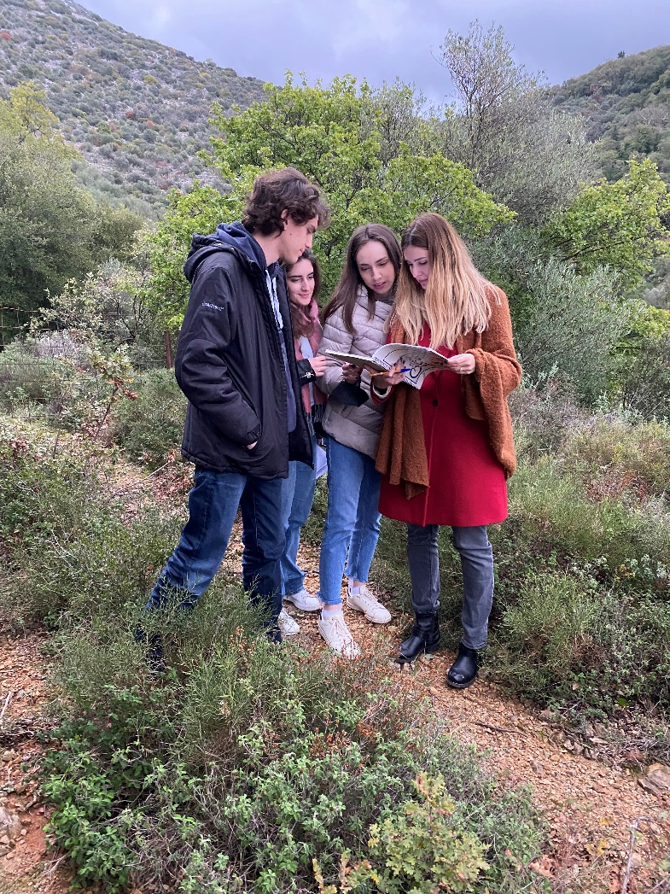
The research team in Western Mani
(left to right):
Markantonis David,
Moraiti Konstantina,
Nikolinakou Maria,
Siganou Aimilia

