Slide 1


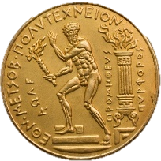
Investigating the water supply potential of traditional rainwater harvesting techniques used
Case study: Municipality of Western Mani
National Technical University of Athens
School of Civil Engineering
Maria Nikolinakou, Konstantina Moraiti, David Markantonis, Aimilia Siganou, G.-Fivos Sargentis, Theano Iliopoulou, Panayiotis Dimitriadis, Ilias Taygetos Meletopoulos, Nikos Mamassis, Demetris Koutsoyiannis

Slide 2
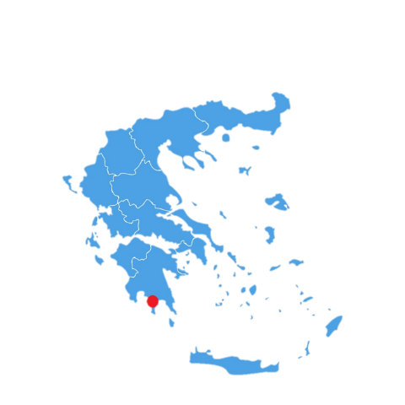
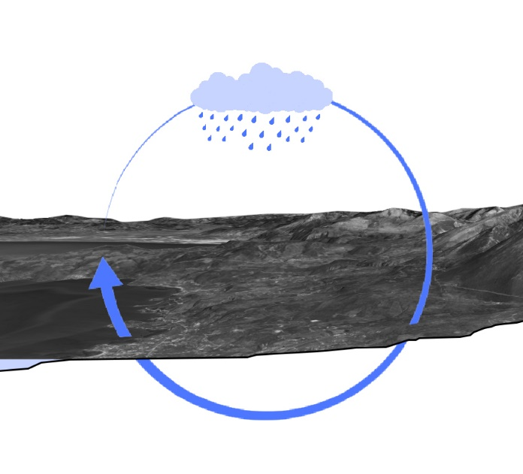
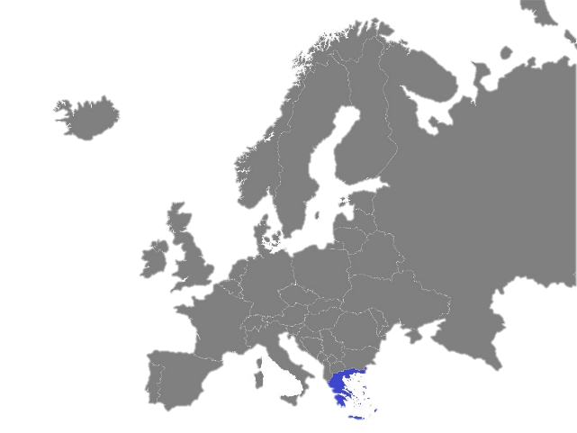
Introduction
The Municipality of Western Mani (WM) is located in the southern part of Greece in Peloponnese. The region has a high rate of rainfalls mainly in the mountainous areas.
Rainfall is mainly observed during the autumn and winter months, from October to March, while there is a significant decrease in the summer[1].
The problems that arise mainly focus on the quantitative aspect [2-5]. The geological background is extremely permeable as it consists mainly of karstic limestone. Therefore, there are limited surfaces water resources with limited water supply[6].
Source : https://vemaps.com/europe-continent/eu-c-04#google_vignette
Source: https://www.vecteezy.com/vector-art/2292777-greece-detailed-map-with-states
The water cycle

Slide 3
General Elements of Cisterns
Constitute an integral part of local tradition
Enrich the cultural heritage
Attract great architectural interest
Water Quality:
▪ Past → suitable for drinking
▪ Present → suitable for water supply
The cistern volume depends on:
Water demand of the residents
Potential rainwater yield
Amount of possible concentration of water from rainfall
Types of cisterns:
External : flat, waterlight from cement mortar
Internal : the mouthpiece protrudes in order to save space in the house
Constructions details:
Average capacity: 15-20 m³
Depth: 5-7 m
Diameter of circular orifice: 0.7-1 m
Materials of construction: reinforced concrete, cement block, stone with mortar

Slide 4
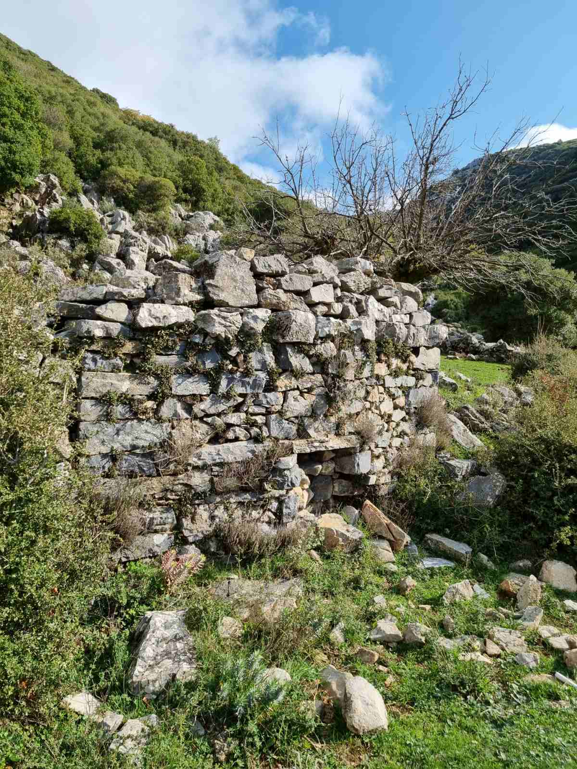
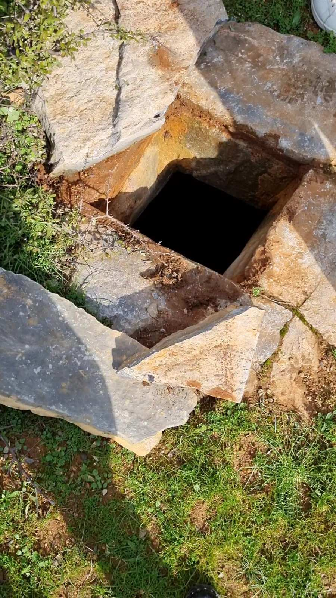
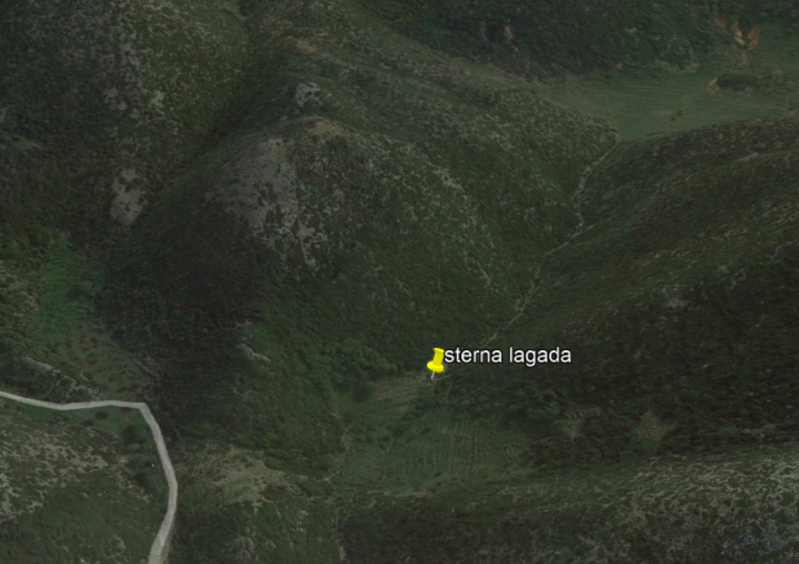
Cistern in Western Mani
Cistern on the plateau in Lagada
Source: Google Earth
These pictures show a cistern on plateau in Lagada where the water is collected and different settlements are fed.

Slide 5
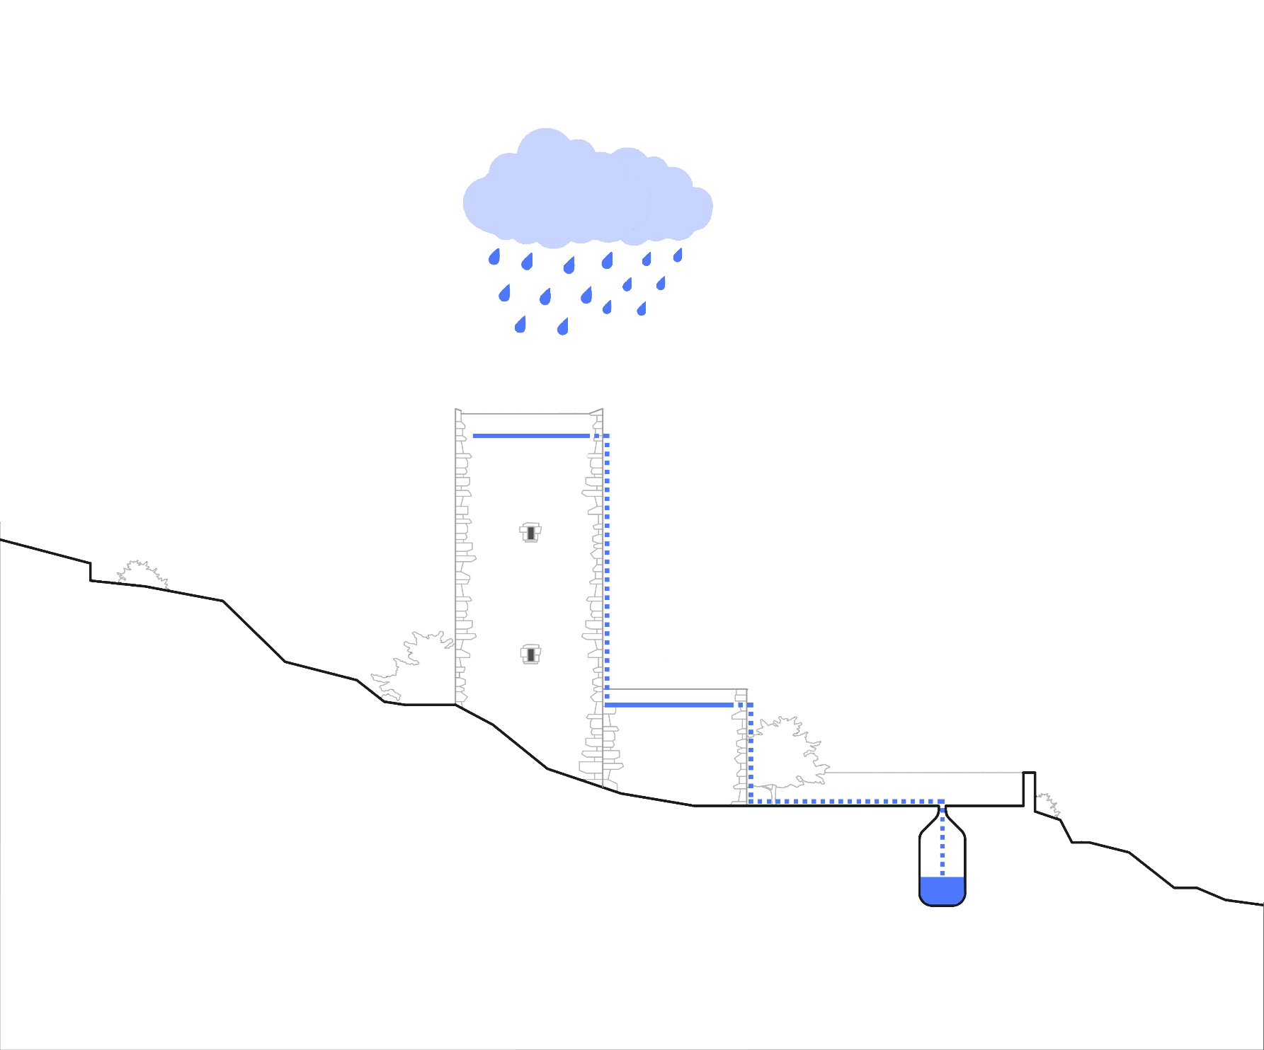
Traditional construction with cistern
▪ This section depicts a traditional tower, in which resides a traditional family of
10 people, with an external cistern which fills with water and is used for storage so
as to ensure the survival of the family.
▪ The blue line shows the water cycle of the rainwater.

Slide 6
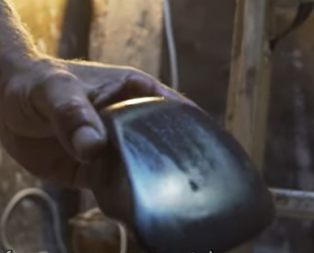
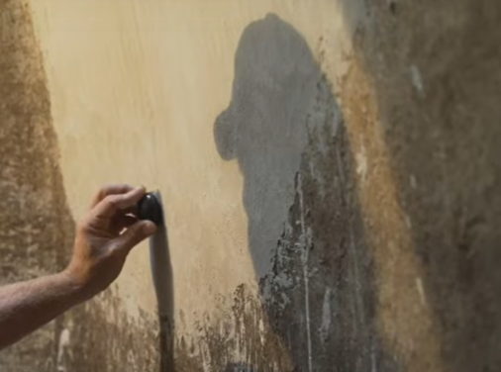
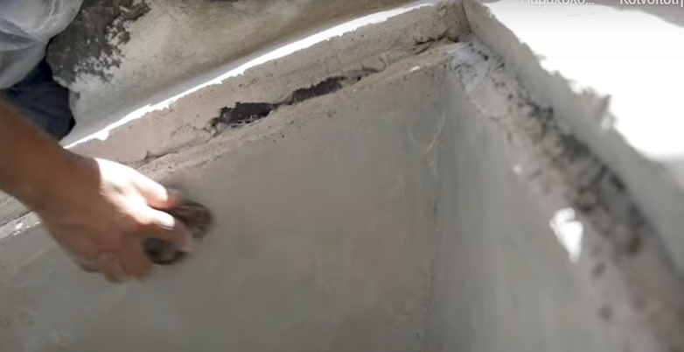
Waterproofing of cisterns
Process of waterproofing of cisterns:
Cleaning of inner surfaces of the underground water of cisterns with limewater
Removal of the friable parts of mortars
Stabilization of surfaces by applying a lime emulsion (galaktisma)
Application three different layers of mortars with theran earth and aged lime putty
Layers:
▪ Petachto: very watery mortar with small ratio lime / theran earth
▪ Aspa and aged lime: mortars which are essentially the basic substrate with 1-2 layers
▪ Alima: the last mortar of lime and theran earth which is stirred for seven days prior the final application (the use of “kochlidi” is necessary) [7].
Materials of Waterproofing:
▪ Sifted theran earth
▪ Lime
Special tool, Kochlidi, available in: https://www.youtube.com/watch?v=hSp40FHf8Hw&t=3s
Application of last layer with Kochlidi, available in: https://www.youtube.com/watch?v=hSp40FHf8Hw&t=3s

Slide 7
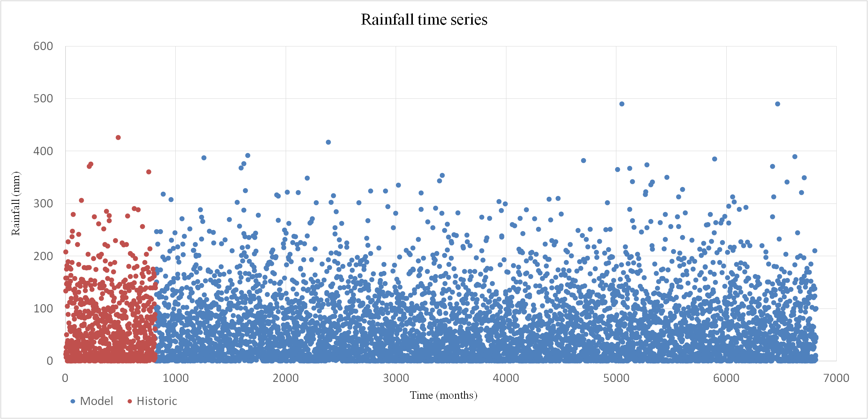
Modeling the cisterns
Data:
Very small time series, 68 years
A stochastic synthetic time series of 500 years
The Symmetric-Moving-Average (SMA) scheme was applied [8-9].
Diagram Rainfall – Time for historical and synthetic time series [10]
▪ Red depicts the historical time series and blue the synthetic time series

Slide 8
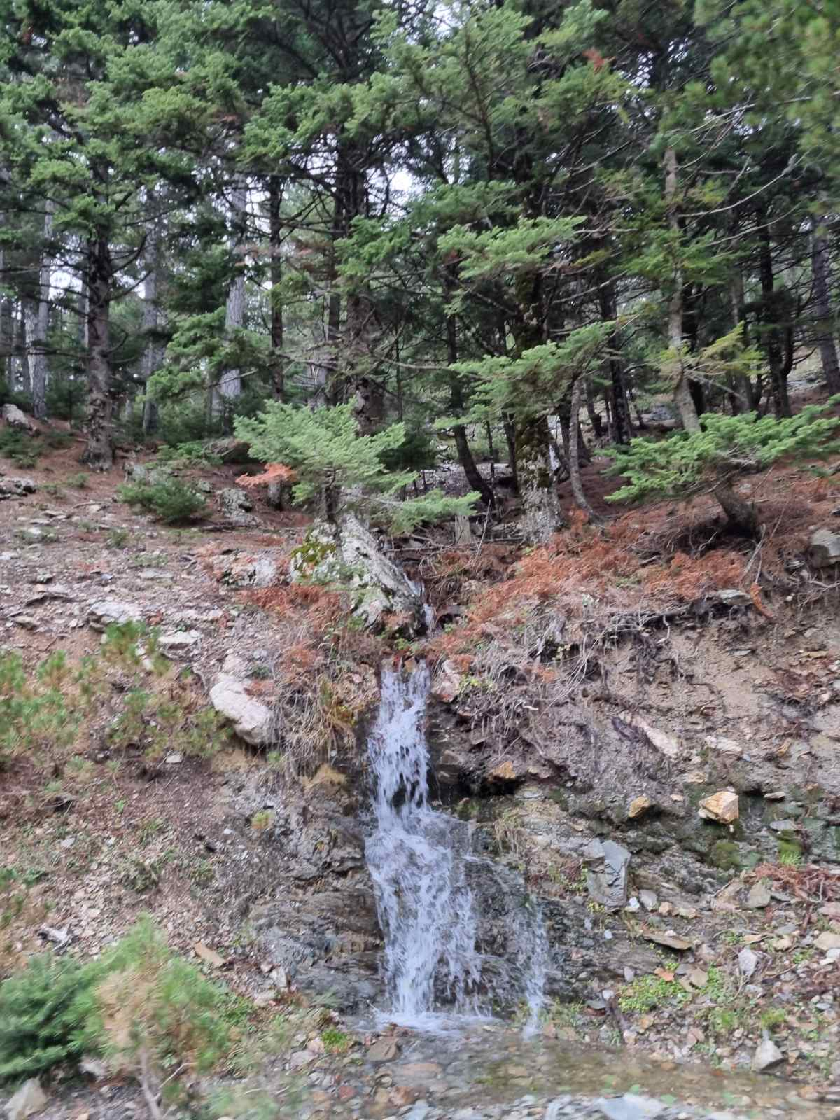


Equations of model
In our model:
▪ Water withdrawals depend on the availability of the resources
▪ The inflows are considered to be 90% of the rainfall in 100 m².
▪ The consumption is lower in the winter and higher (double consumption) in summer.
The process can be modeled by the following equations:
Where:
T : time
S_{T} : stock in the reservoir
X_{T} : inflow
R_{T} : considered consumption
R : standard consumption depended by a
α : a coefficient determining the withdrawal for each month
K : storage capacity
Small stream in the Taygetos mountain

Slide 9
Function of the cistern
Coefficient for the consumption of each month
The function of the cistern according the average inflows
▪ The coefficient for the consumption is at a peak in July and it is equal to 1.
▪ The minimum limits for survival are 5L/ inhabitant /day.

Slide 10
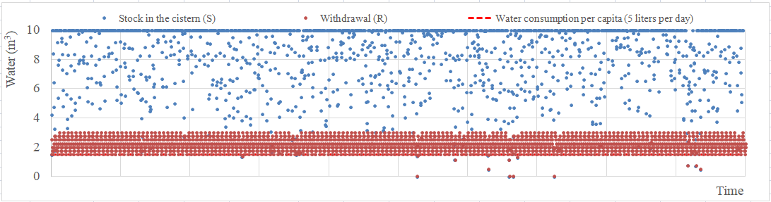
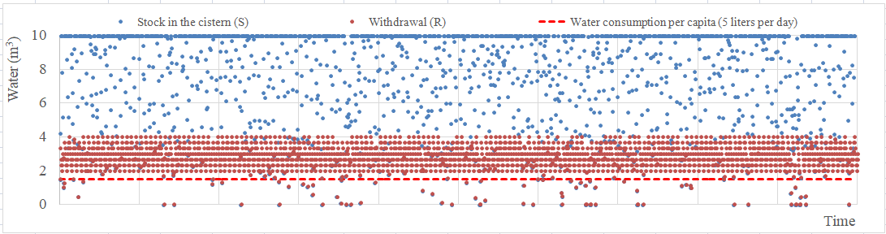
Simulation of function of cistern
In each diagram the withdrawal (R) changes and the following arise:
▪ Considering R=3 m³ the average consumption is 2.2m³ per month and the system failure is about 1.2%.
Diagram water-time for R=3 m³
▪ Considering R=4 m³ the average consumption is 2.8m³ per month and the system failure is about 8%.
Diagram water-time for R=4 m³

Slide 11
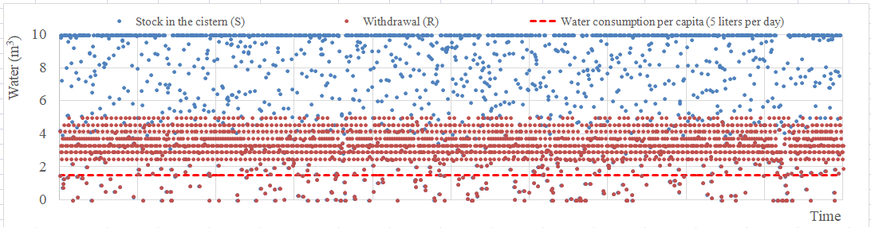
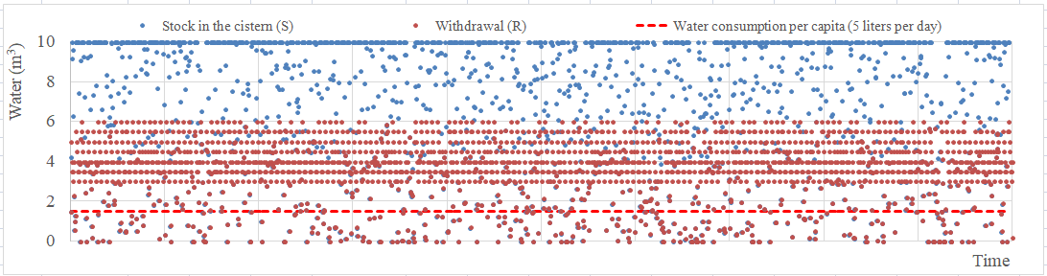
Simulation of function of cistern
In each diagram the withdrawal (R) changes and the following arise:
▪ Considering R=5 m³ the average consumption is 3.2m³ per month and the system failure is about 17.8%.
Diagram water-time for R=5 m³
▪ Considering R=6 m³ the average consumption is 3.6m³ per month and the system failure is about 28%.
Diagram water-time for R=6 m³

Slide 12
Conclusions
Water constitutes the most valuable resource
To each diagram we conclude that there are many systematic failures which are due to small changes of numbers of consumptions and water withdrawals. So the inhabitants deal with many difficulties and cannot survive.
The water supply system failure is acceptable at 1% but as resources are limited, one could assume that the system could have a systematic failure.
The availability of water resources is extremely limited. As a result, the local wars for water begin.
However, this fact forced inhabitants to adopt a ‘fighting’ culture and they were the first population to enter to the Greek Revolution of 1821 [11-12].
With the restoration of cisterns, there is drinking water.
According to the model, after its restoration, a cistern can provide 50 L of drinking water per day minimum for a family of 10 people. In this way, each family that earns about 4000€ every year avoids having to buy bottled water.

Slide 13

References
Meteo,Climatic Data https://www.meteo.gr/ClimaticData.cfm
Sargentis, G.-F.; Defteraios, P.; Lagaros, N.D.; Mamassis, N. Values and Costs in History: A Case Study on Estimating the Cost of Hadrianic Aqueduct’s Construction. World 2022, 3, 260-286. https://doi.org/10.3390/world3020014
Sargentis, G.-F.; Siamparina, P.; Sakki, G.-K.; Efstratiadis, A.;Chiotinis, M.; Koutsoyiannis, D. Agricultural Land or Photovoltaic Parks? The Water–Energy–Food Nexus and Land Development Perspectives in the Thessaly Plain, Greece. Sustainability 2021, 13, 8935. https://doi.org/10.3390/su13168935
Sargentis, G.-F.; Dimitriadis, P.; Ioannidis, R.; Iliopoulou, T.; Frangedaki, E.; Koutsoyiannis, D. Optimal utilization of water resources for local communities in mainland Greece (case study of Karyes, Peloponnese), Procedia Manufacturing, Volume 44, 2020, Pages 253-260, ISSN 2351-9789, https://doi.org/10.1016/j.promfg.2020.02.229.
Sargentis, G.-F.; Iliopoulou, T.; Dimitriadis, P.; Mamassis, N.; Koutsoyiannis, D. Stratification: An Entropic View of Society’s Structure. World 2021, 2, 153-174. https://doi.org/10.3390/world2020011
Antonakos A. Specialist Hydrogeologist, Poly Potami Study, 19/10/2017
Participatory project Under the Landscape, Boulouki 2021, available in: https://www.youtube.com/watch?v=hSp40FHf8Hw&t=3s
Koutsoyiannis, D. A generalized mathematical framework for stochastic simulation and forecast of hydrologic time series, Water Resour. Res., 36( 6), 1519– 1533, 2000. doi:10.1029/2000WR900044.
Koutsoyiannis, D.; Dimitriadis, P. Towards Generic Simulation for Demanding Stochastic Processes. Sci 2021, 3, 34. https://doi.org/10.3390/sci3030034
Siganou A., Nikolinakou M., Markantonis D., Moraiti K., Sargentis G.-F. , Iliopoulou T., Dimitriadis P., Chiotinis M., Mamassis N. and Koutsoyiannis D. Stochastic simulation of hydrological timeseries for data scarce regions - Case study at the Municipality of Western Mani
Basilatos G. N, The towers of Mani, date of release: November 2001.
Koutsilieri A., The history of Mani, published by Papadimas 1996
Markantonis D., Siganou A., Moraiti K., Nikolinakou M., Sargentis G.-F. , Dimitriadis P., Chiotinis M., Iliopoulou T., Mamassis N. and Koutsoyiannis D. ,Determining optimal scale of water infrastructure considering economical aspects with stochastic evaluation – Case study at the Municipality of Western Mani
Moraiti K., Markantonis D., Nikolinakou M., Siganou A., Sargentis G.-F. , Iliopoulou T., Dimitriadis P., Meletopoulos I.-T., Mamassis N. and Koutsoyiannis D., Optimizing water infrastructure solutions for small-scale distributed settlements – A case study for the Municipality of Western Mani
Sargentis, G.-F.; Iliopoulou, T.; Sigourou, S.; Dimitriadis, P.;​ Koutsoyiannis, D. Evolution of Clustering Quantified by a Stochastic​ Method—Case Studies on Natural and Human Social Structures.​ Sustainability 2020, 12, 7972. https://doi.org/10.3390/su12197972
Acknowledgments
▪ We thank P.hD. Candidate Nikiforos Meimaroglou for his notable comments about the construction and
the restoration of cisterns.
▪ This research was supported by the Municipality of Western Mani.

Slide 14
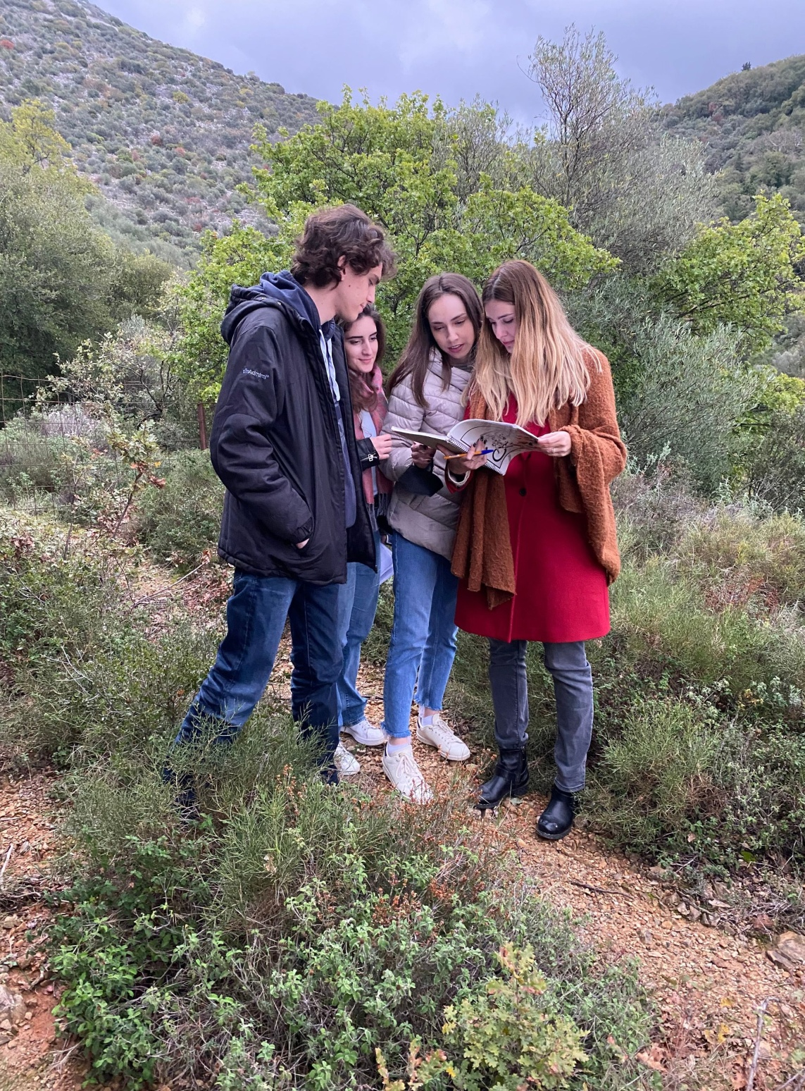
The research team in Western Mani (left to right):
David Markantonis, Konstantina Moraiti, Maria Nikolinakou, Aimilia Siganou

