Slide 1


Assessing the CO2 fertilization effect on cereal yield in Morocco using the CARAIB dynamic vegetation model driven by Med-CORDEX projections
I. Loudiyi ¹, I. Jacquemin ², B. Tychon ², L. Francois ², M. Lahlou ³, and R. Balaghi ⁴
¹Institute of Astrophysics and Geophysics, University of Liège, Belgium
²Research Unit : SPHERES, University of Liège, Belgium
³The Agronomic and Veterinary Institute Hassan 2, Morocco
⁴National Institute of Agronomic Research, Morocco
Iliass.loudiyi@uliege.be

Slide 2
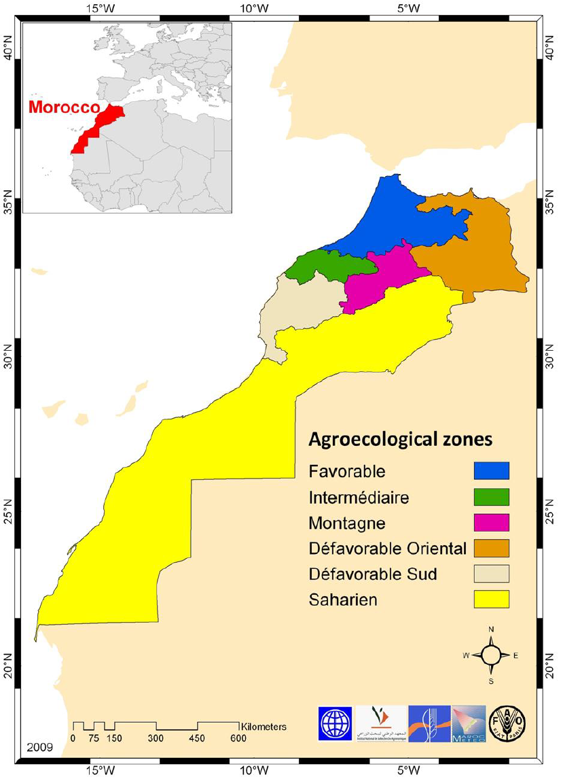
Overview : Cereal production:

Slide 3
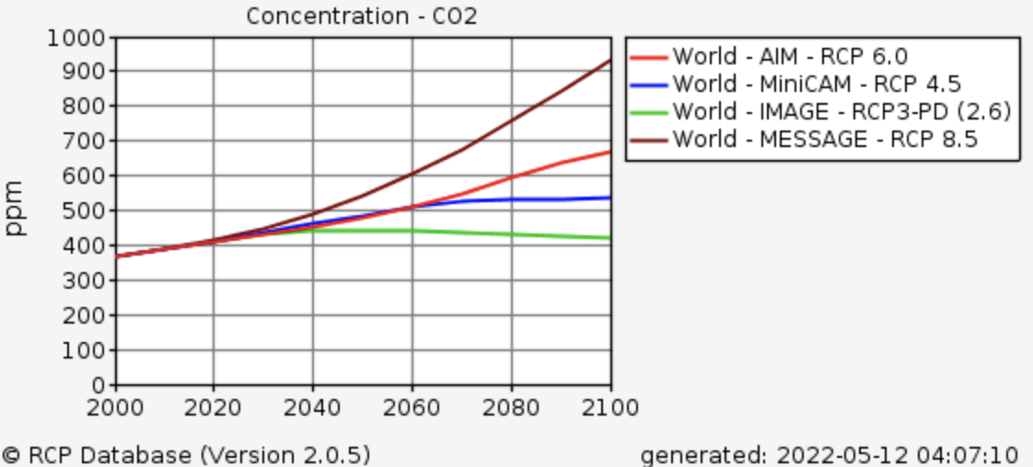
Overview :
Higher rates of photosynthesis and an improved response to stress related to a reduced stomatal closure at higher atmospheric CO2 concentrations
Higher atmospheric CO2 can negatively affect grain quality by reducing the concentrations of plant nutrients.
Time series of CO2 concentration (ppm) under RCP8.5, RCP6, RCP4.5, and RCP2.6 provided by CMIP5:

Slide 4
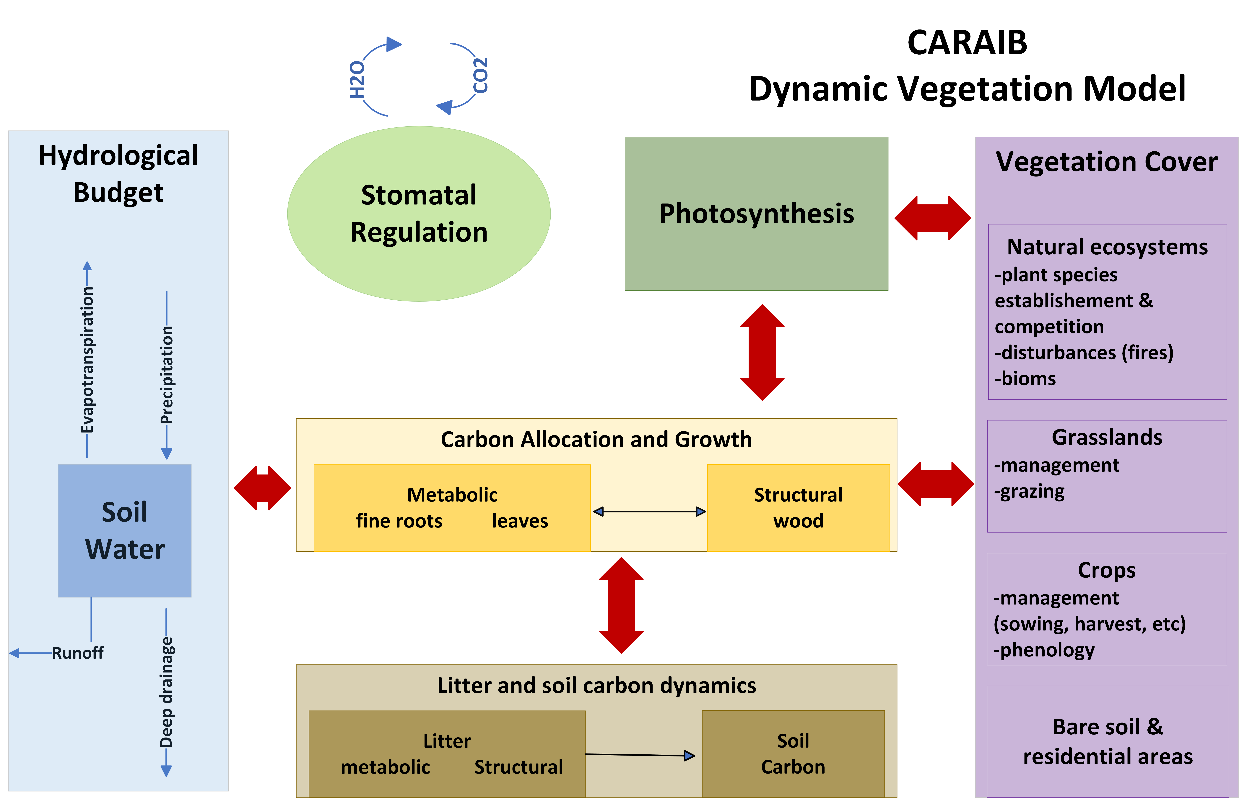

Slide 5
Simulation protocol :
CNRM ALADIN52
MERRA-2 dataset
RCP4.5 and RCP8.5
1970
1997
2006
2017
2100
Input
Climate data
Soil data
Land cover
Morpho-physiological parameters
Basic crops management (sowing, harvest, rotation)
MERRA-2 dataset from 1997 to 2017
CNRM ALADIN52 from 2006 to 2100
ISRIC data hub soil grids at 250m resolution
Copernicus Global Land Service at 100m resolution
literature
INRA guides

Slide 6
Preliminary results : Past period from 1997 to 2017 using climate data from Merra 2 database : Spatial and temporal validation:

Slide 7
Preliminary results : Past period from 1997 to 2017 using climate data from Merra 2 database : Spatial and temporal validation:

Slide 8
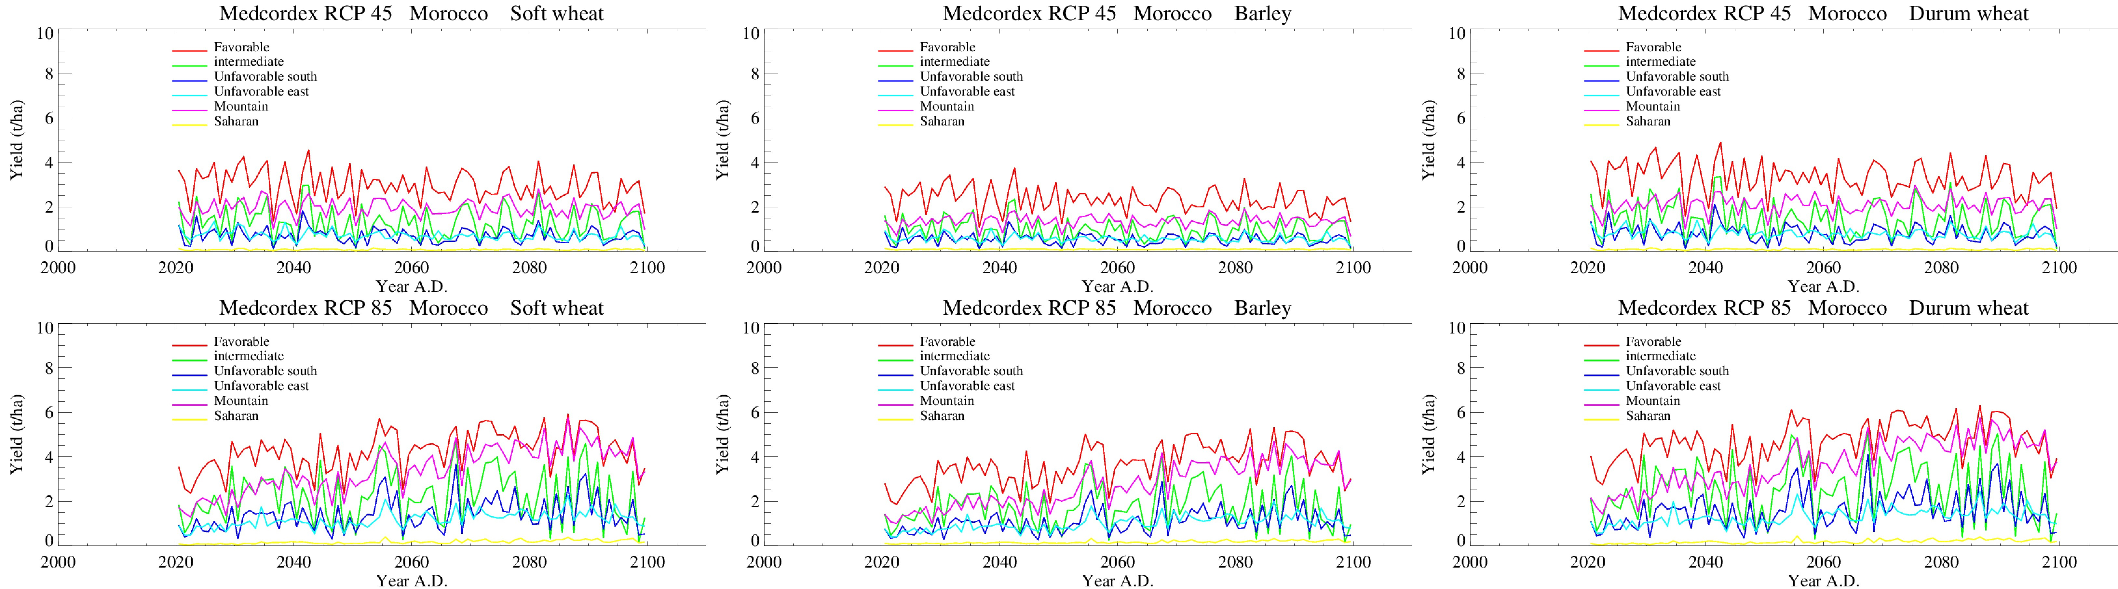
Future results (RCM: CNRM ALADIN52) : Period from 2006 to 2100 (RCP 4.5 and RCP 8.5) with an annually adapted CO2 concentration according to the RCPs

Slide 9
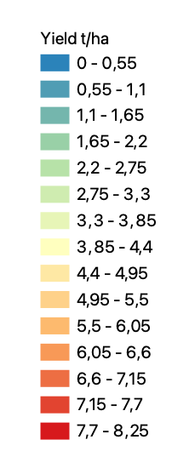
Future results (RCM: CNRM ALADIN52) : Period from 2006 to 2100 (RCP 4.5 and RCP 8.5) with an annually adapted CO2 concentration according to the RCPs :
Spatial yield Variation ‘Winter wheat (soft and durum wheat)’
Mean Yield 2020-2040
Mean Yield 2041-2060
Mean Yield 2080-2100
RCP 4.5
RCP 8.5

Slide 10
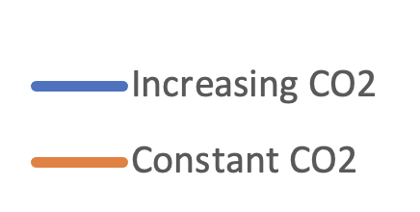
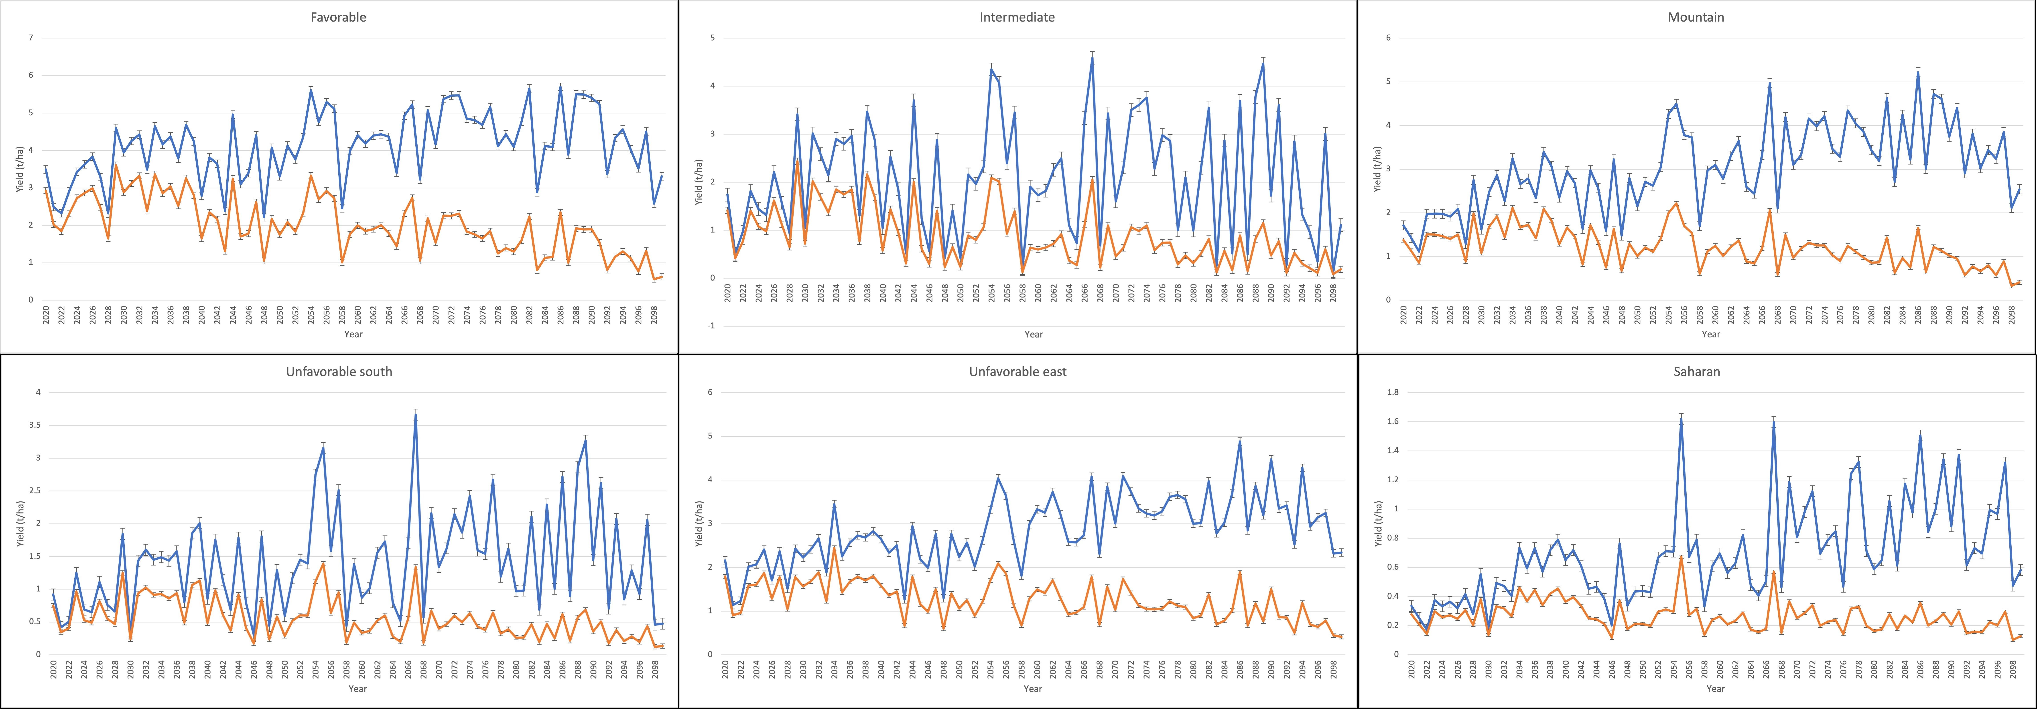
Future results (RCM: CNRM ALADIN52) : Period from 2006 to 2100: Atmospheric CO2 fertilization effect on yield (t/ha) at the agro-ecological zone level.
Yield simulation with constant and changing CO2: Modeling is conducted twice, one with an annually adapted concentration according to the RCP 8.5, and another one with fixed concentration (380 ppm) to separate the influence of CO2 from that of the other input variables

Slide 11
Synthesis:
Yield difference between constant and changing CO2. A value of +40% would indicate that yields are 40% higher when modeled using increasing CO2 instead of fixed 380 ppm.

Slide 12
Thank you for your attention

