Slide 1


Distributed Modeling: from REA to hillslope-resolving Christa Peters-Lidard Deputy Director, Sciences and Exploration NASA Goddard Space Flight Center Greenbelt, Maryland, USA
EGU22-3084
23 May 2022

Slide 2
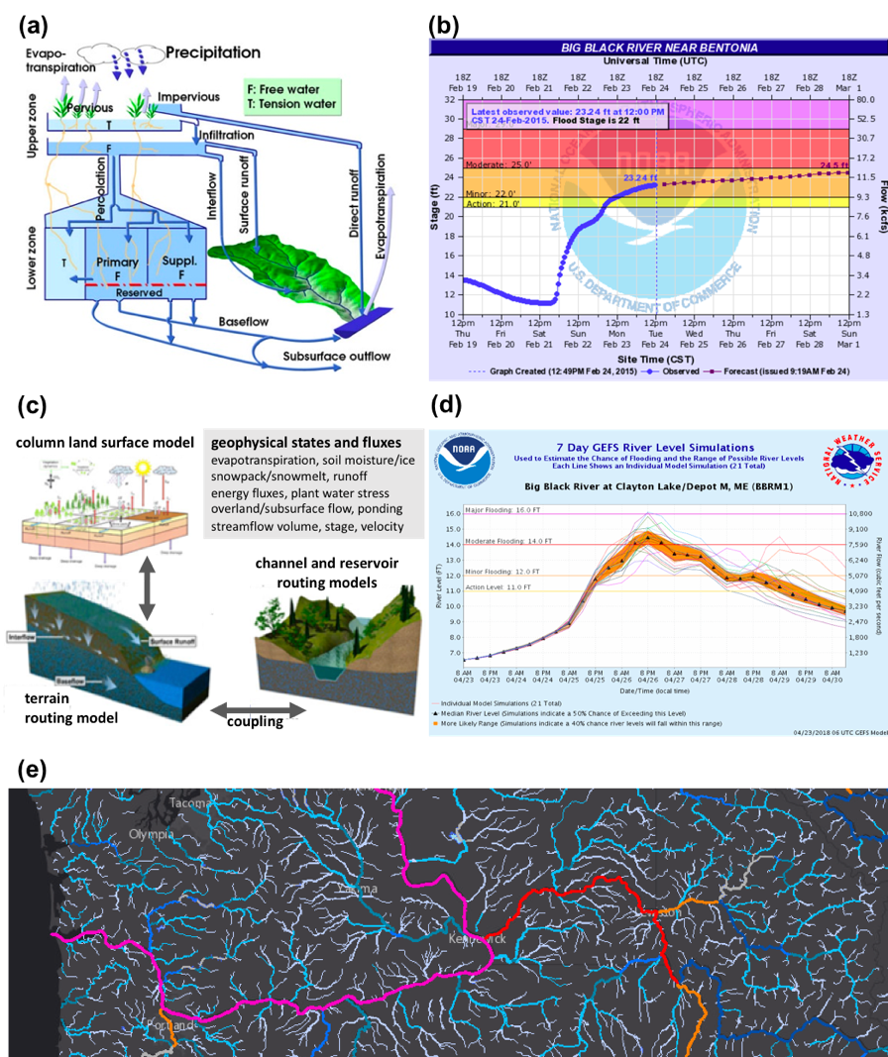
Hydrologic Prediction Across Scales
Catchments Lumped/ Conceptual / Deterministic
River Basins & Continental Distributed/ Physically-based/ Probabilistic
Peters-Lidard, C. D., Hossain, F., Leung, L. R., McDowell, N., Rodell, M., Tapiador, F. J., Turk, F. J., & Wood, A. (2019). 100 Years of Progress in Hydrology, Meteorological Monographs, 59, 25.1-25.51.

Slide 3
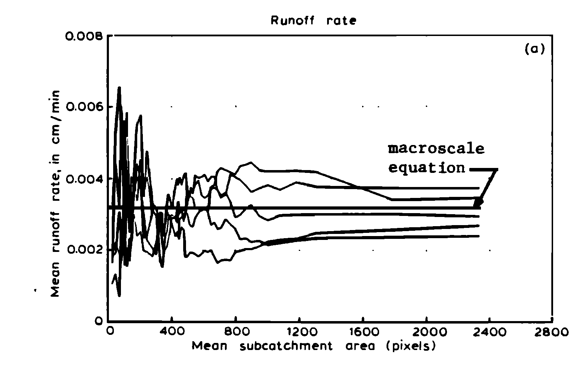
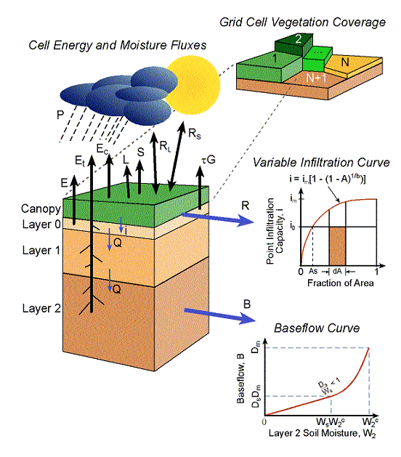
ErIC Wood’s Modeling “family Tree”
REA
Wood et al., 1988
TOPMODEL
Sivapalan et al., 1988
TOPLATS
Famigleitti, Peters-Lidard, Pauwels, Crow, Goteti
VIC
Liang et al., 1994
VIC-3L
Liang, Pan, Lettenmaier, A Wood, Nijssen
HydroBlocks
Chaney, Vergopolan

Slide 4
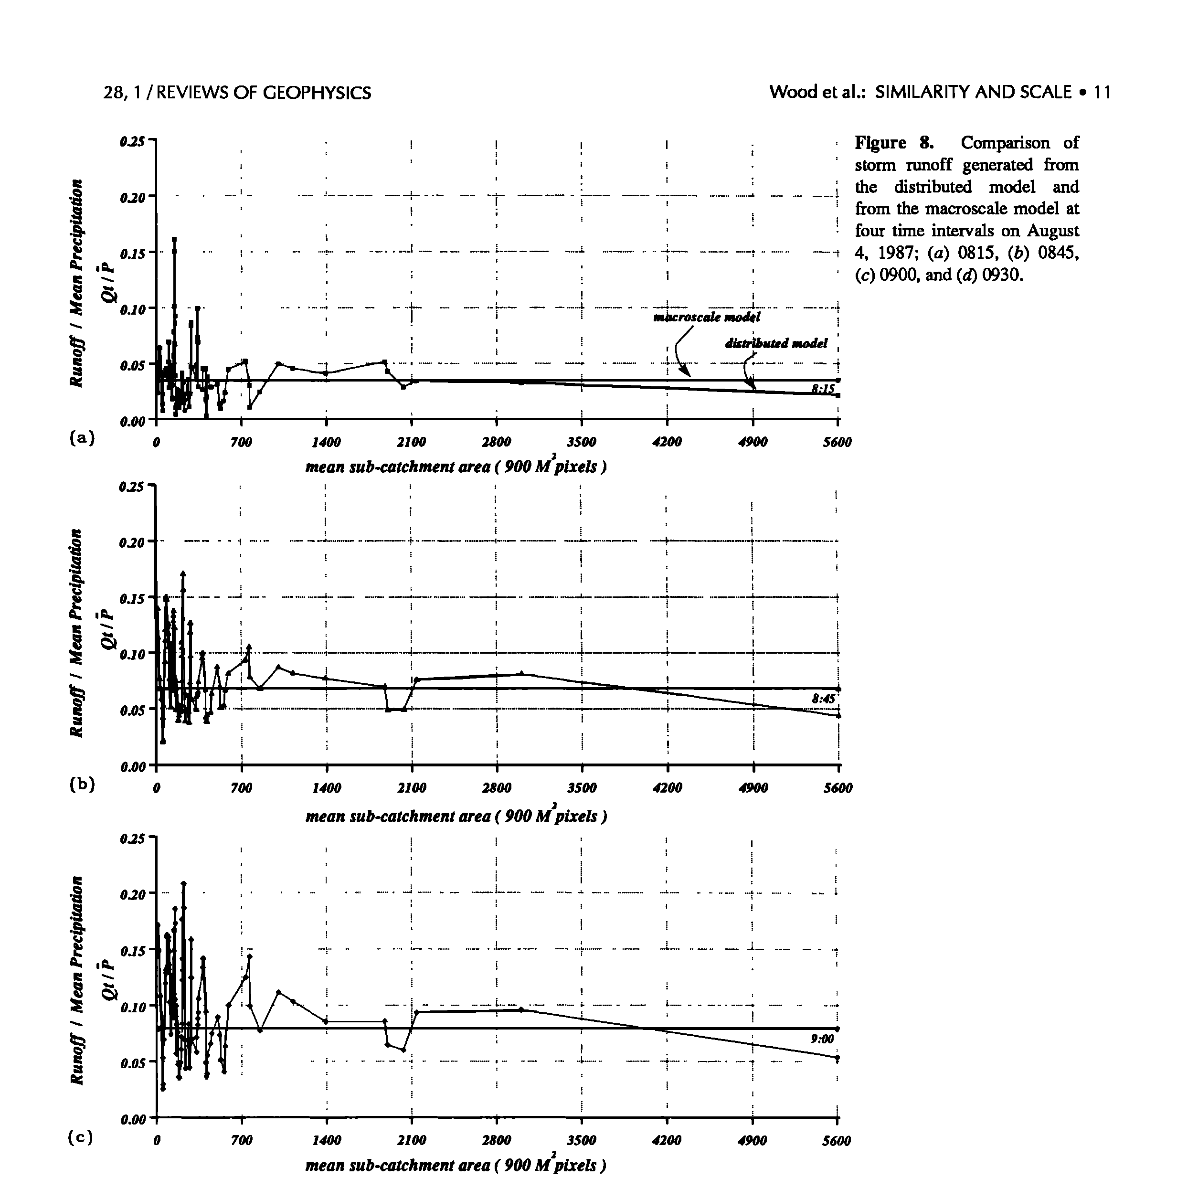
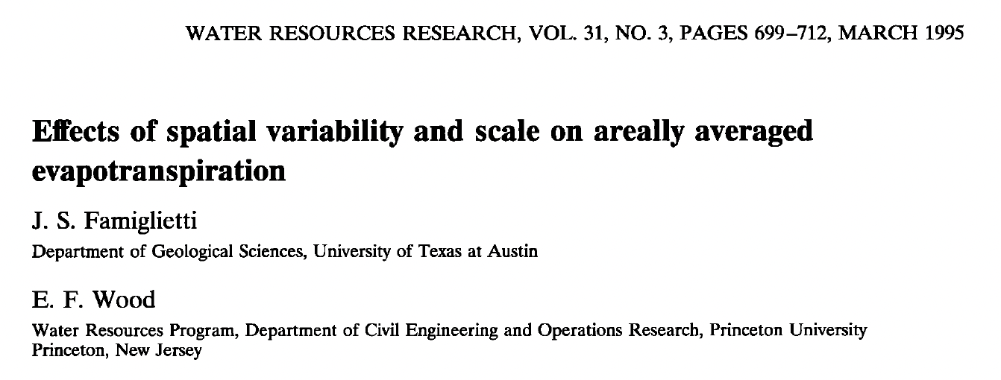
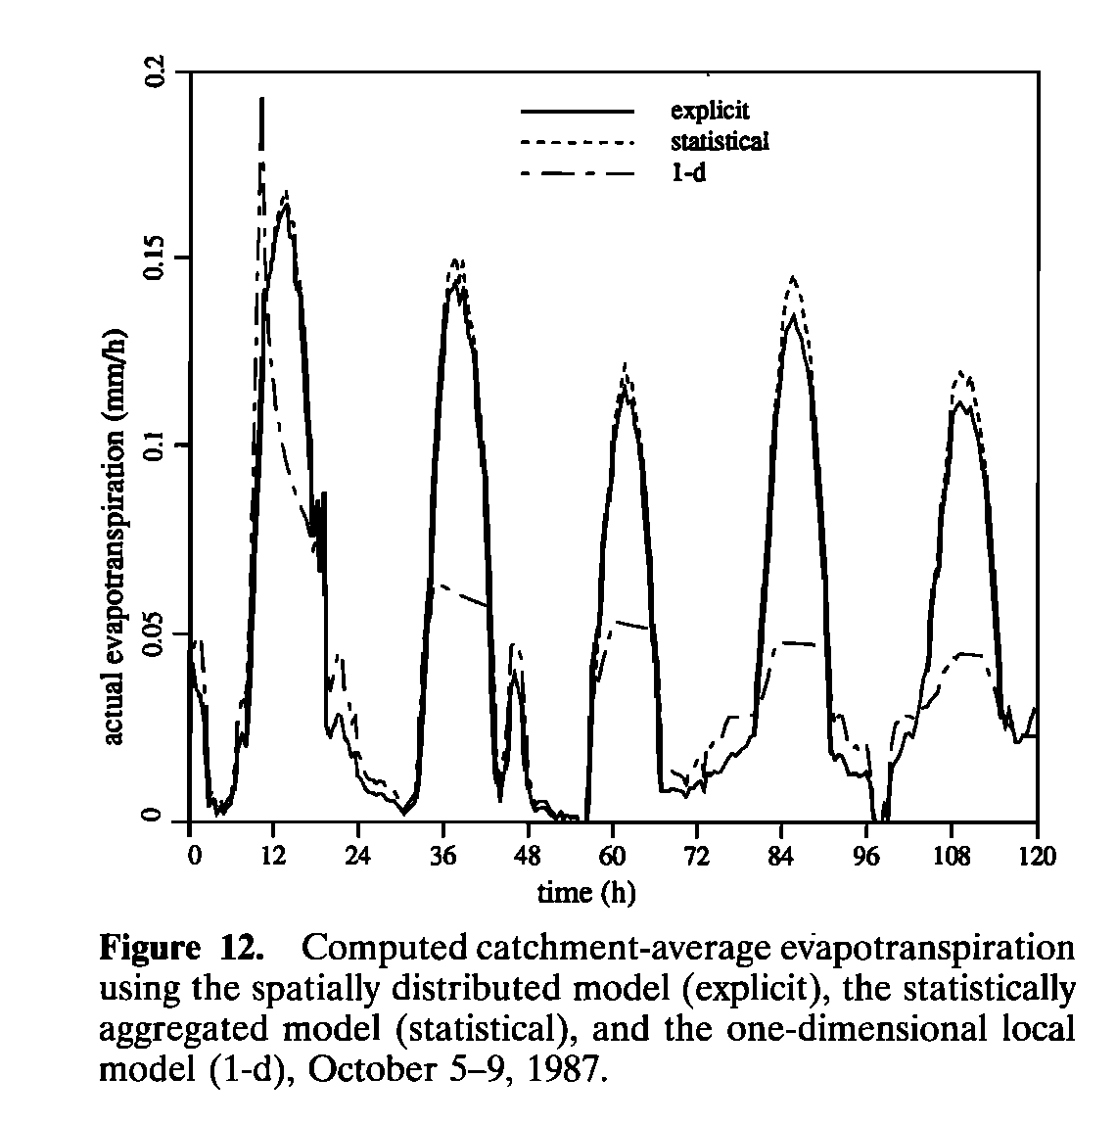
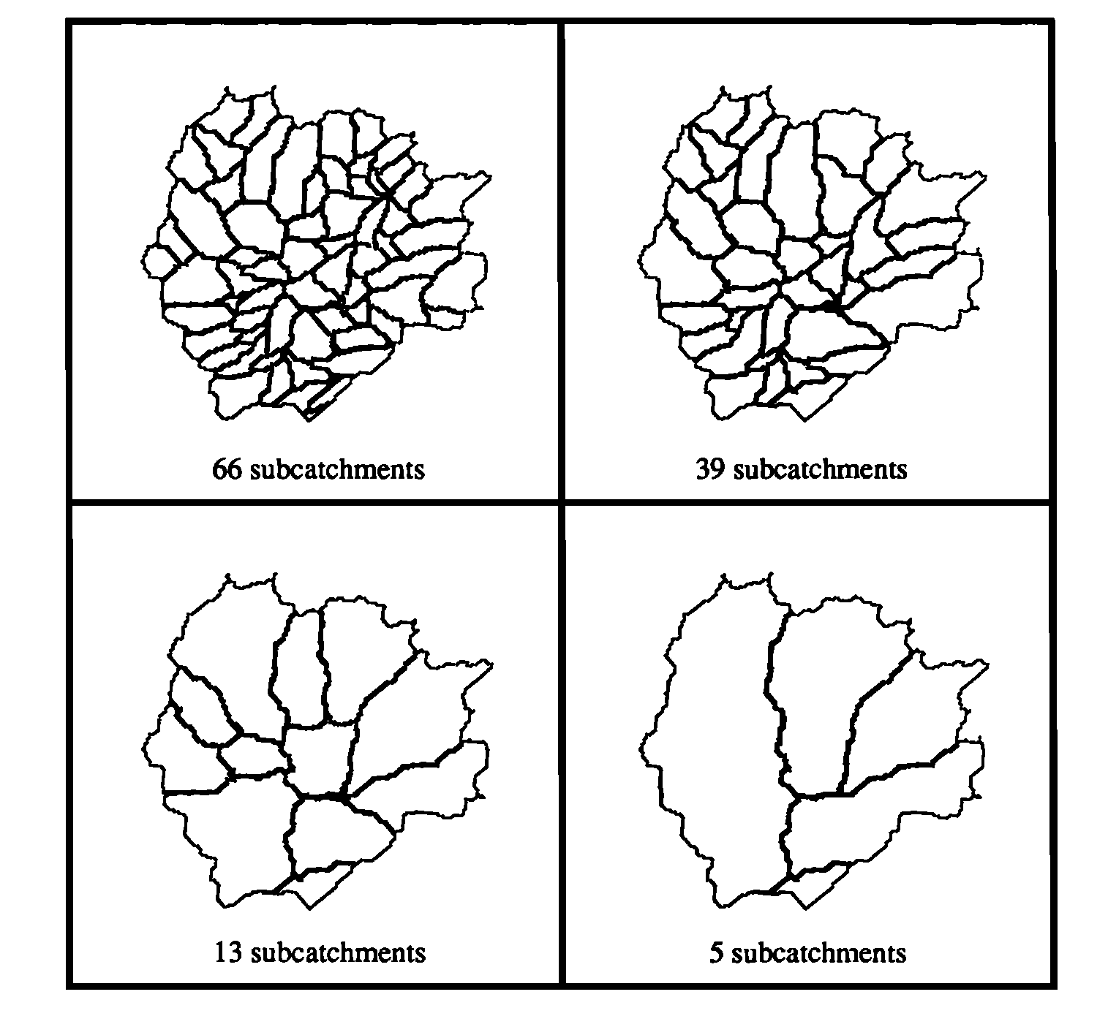
TOPLATS : REA-based Runoff and ET Kings Creek, Kansas, USA

Slide 5
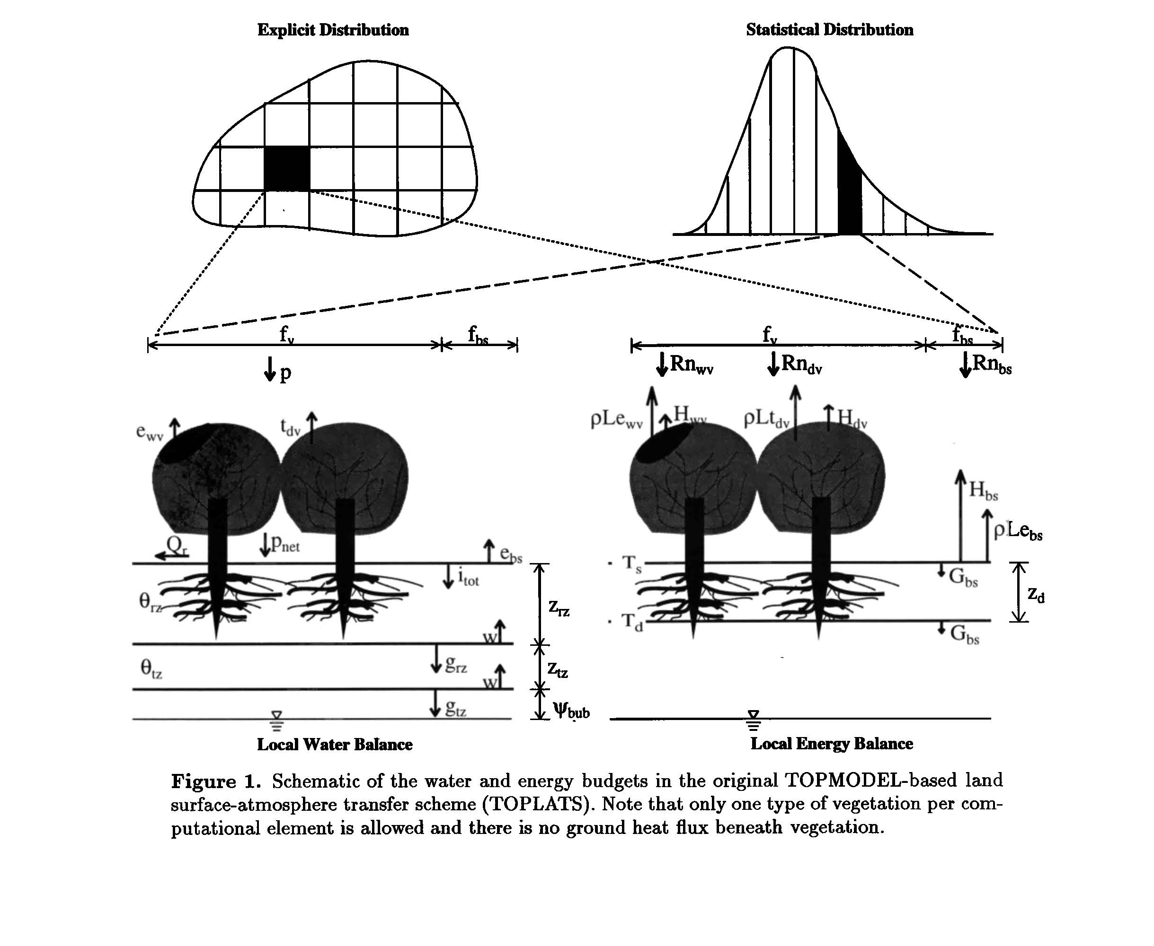
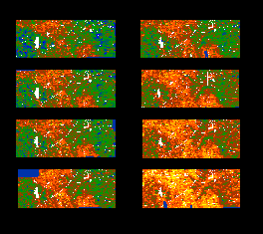
TOPLATS : Distributed vs. Statistical
Washita ‘92 ESTAR Soil Moisture, June 10-18
Peters-Lidard, C. D., Zion, M. S., and Wood, E. F. (1997), A soil-vegetation-atmosphere transfer scheme for modeling spatially variable water and energy balance processes, J. Geophys. Res., 102( D4), 4303– 4324, doi:10.1029/96JD02948.

Slide 6
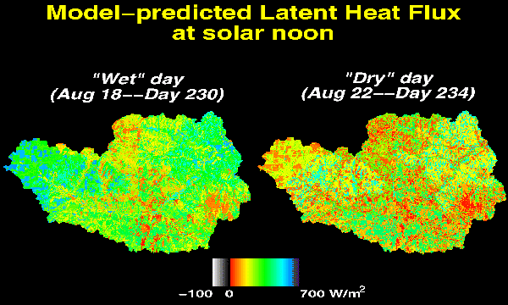
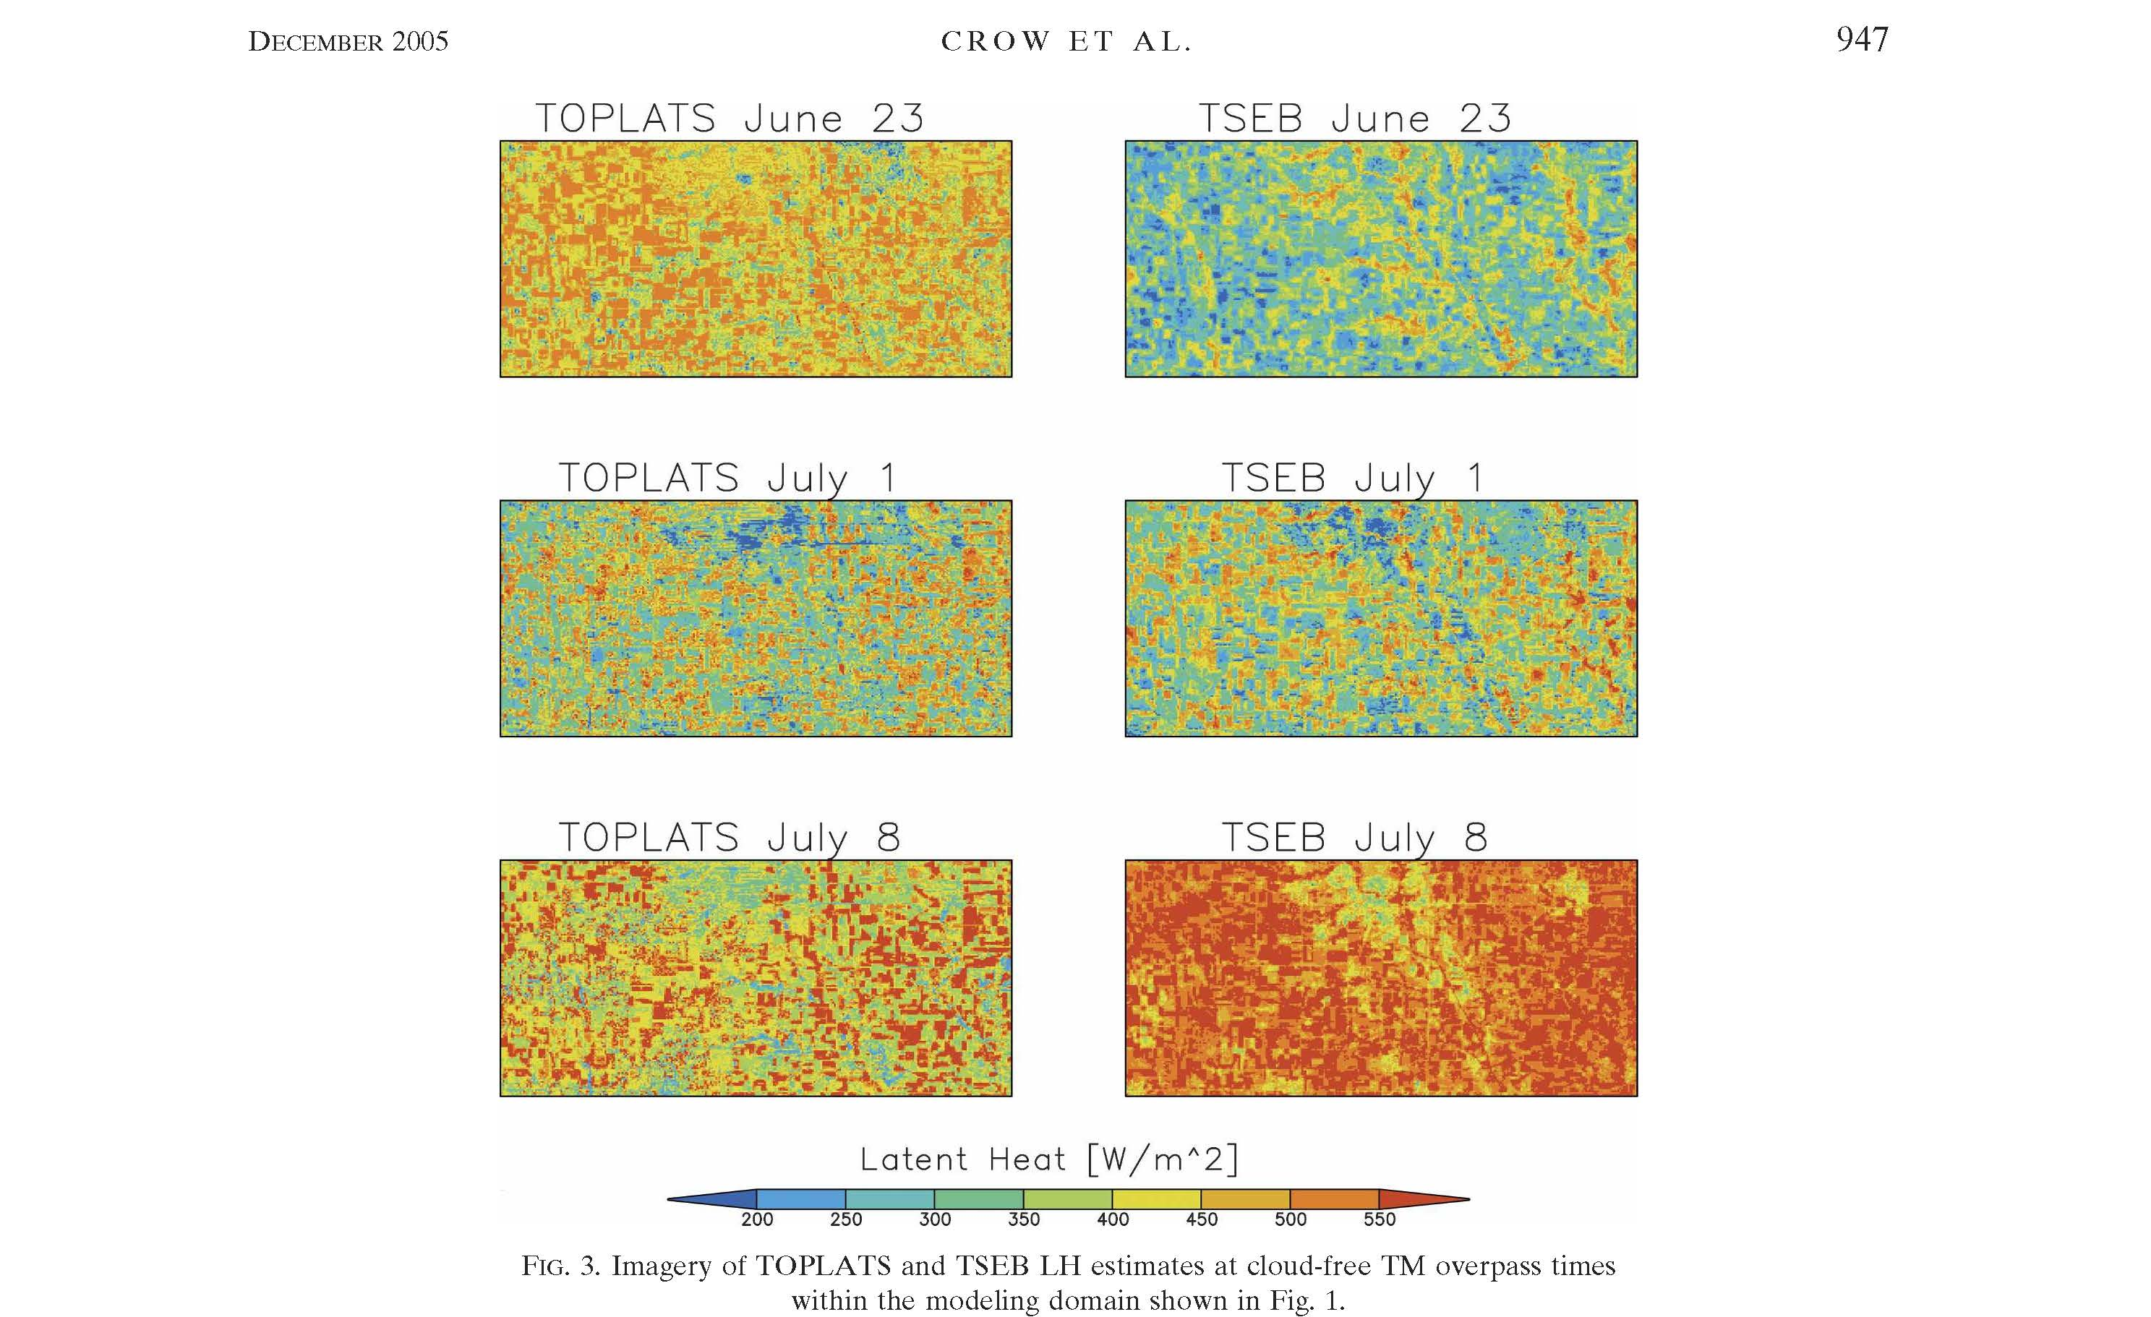
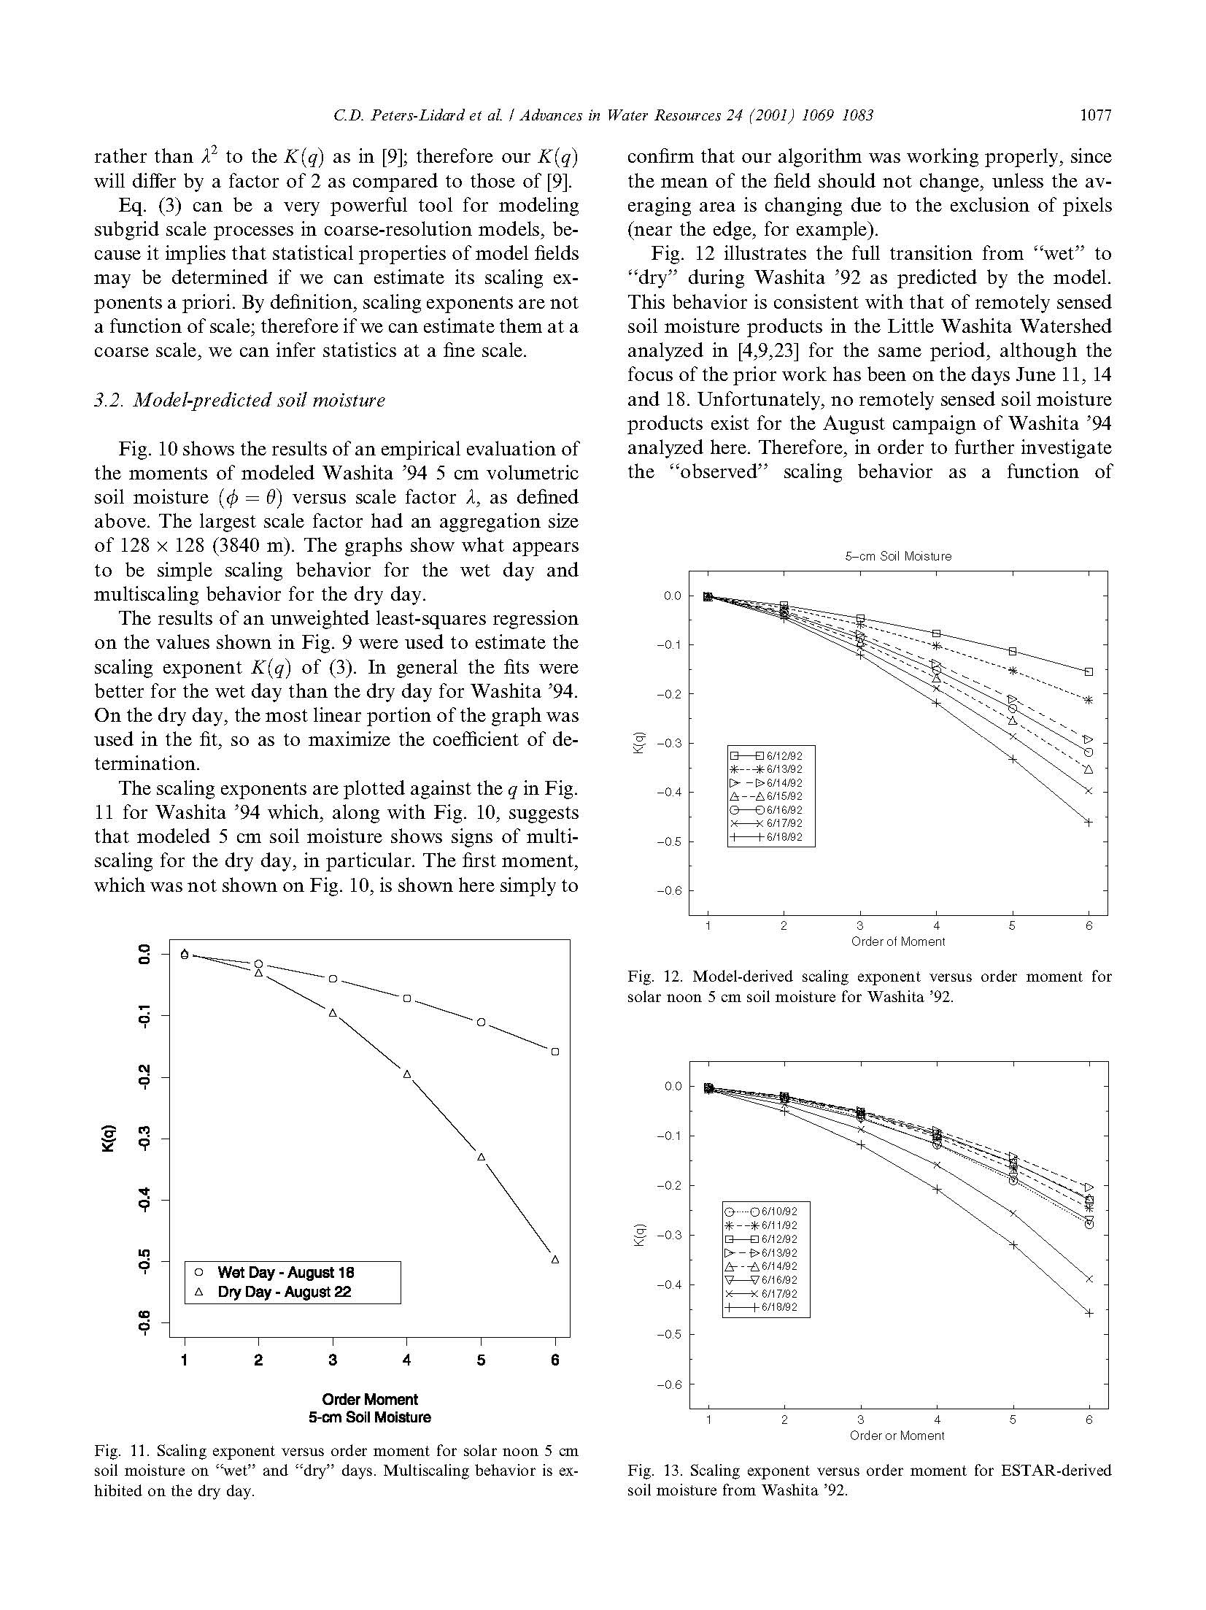
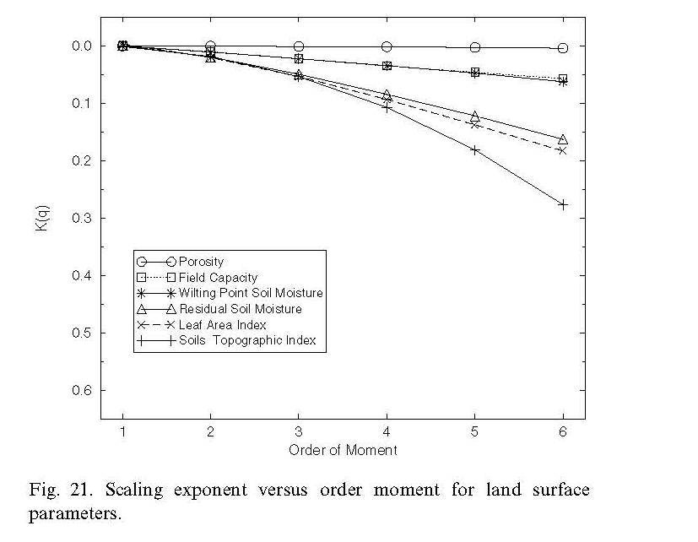
TOPLATS : Hillslope-Resolving Model Confronted with Remotely Sensed data
Hyper-resolution modeling builds on the knowledge of topographic, soil, vegetation controls on multiscaling behavior

Slide 7
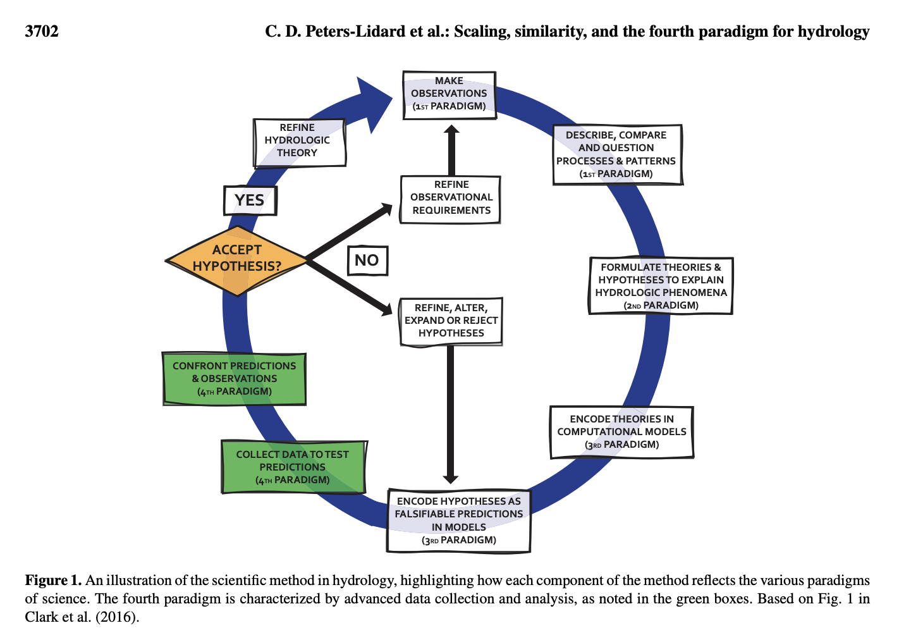
Distributed Modeling: the 4th Paradigm

Slide 8
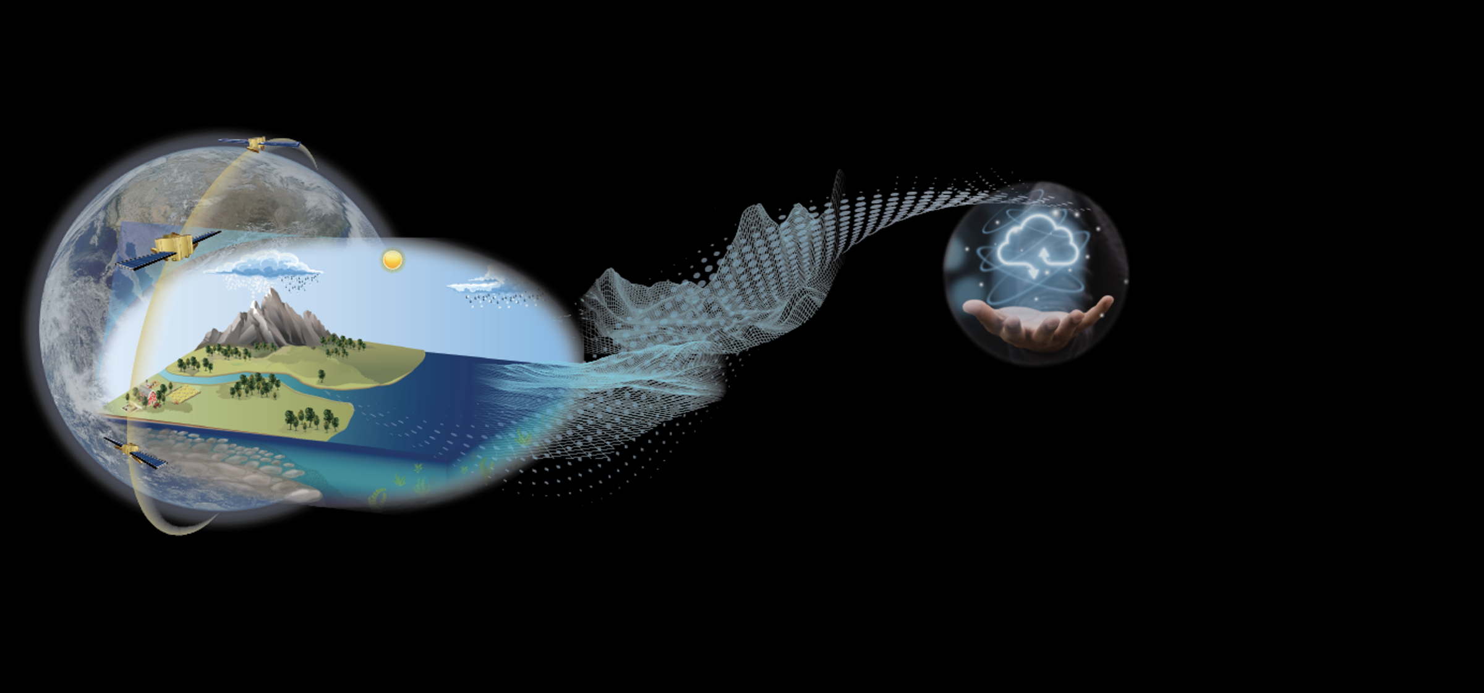
models like TopLats, Vic, and hydroblocks have enabled…
Land Data assimilation systems
NLDAS, GLDAS, FLDAS (LDAS.GSFC.nasa.gov)
Land Information System (Lis.gsfc.nasa.gov)
Coupled land-atmosphere modeling
NUWRF.gsfc.nasa.gov
GEWEX Local Land-Atmosphere Coupling (LoCo) Project (gewex.org/loco)
Earth Information Systems (https://freshwater.eis.smce.nasa.gov/)

