Slide 1



Stochastic simulation of hydrological timeseries for data scarce regions using Hurst-Kolmogorov dynamics Case study: Municipality of Western Mani
National Technical University of Athens
School of Civil Engineering
Aimilia Siganou, Konstantina Moraiti, David Markantonis, Maria Nikolinakou, G.-Fivos Sargentis, Theano Iliopoulou, Panayiotis Dimitriadis, Michalis Chiotinis, Nikos Mamassis, Demetris Koutsoyiannis

Slide 2
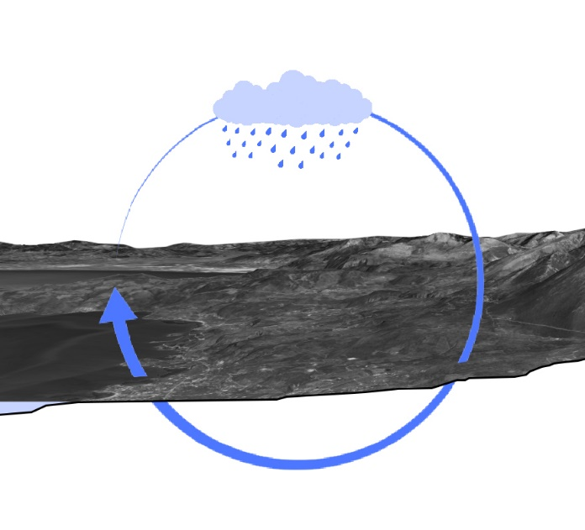
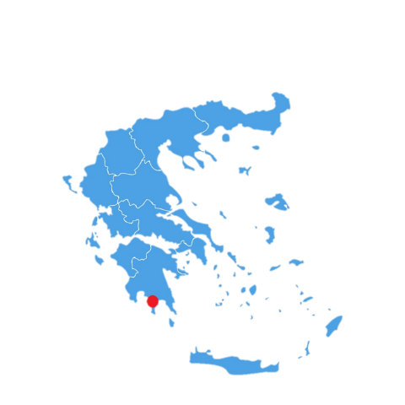
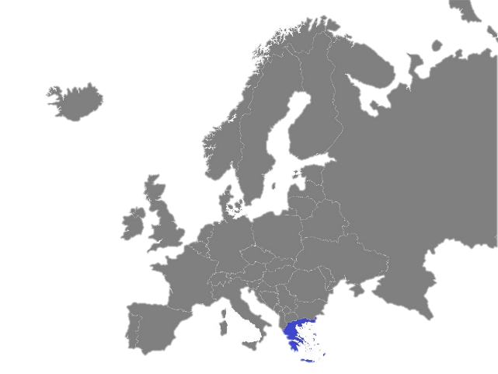
Introduction
The Municipality of Western Mani (WM) is located in the southern part of Greece in Peloponnese. The region has a high rate of rainfalls mainly in the mountainous areas.
Rainfall is mainly observed during the autumn and winter months, from October to March, while there is a significant decrease in the summer.[1]
The problem that arises, is mainly the quantitative aspect of water.[2-5] The geological background, is extremely permeable, as it consists notably of karstic limestone. Therefore, there are limited surface water resources with limited supply[6].
European map which depicts Greece
Source : https://vemaps.com/europe-continent/eu-c-04#google_vignette
Greekm map which depicts Western Mani
Source: https://www.vecteezy.com/vector-art/2292777-greece-detailed-map-with-states
The water cycle

Slide 3
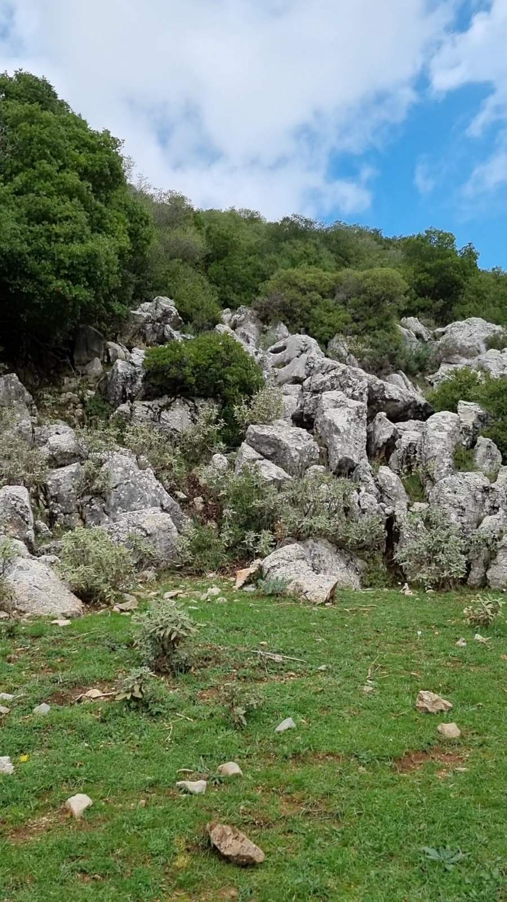
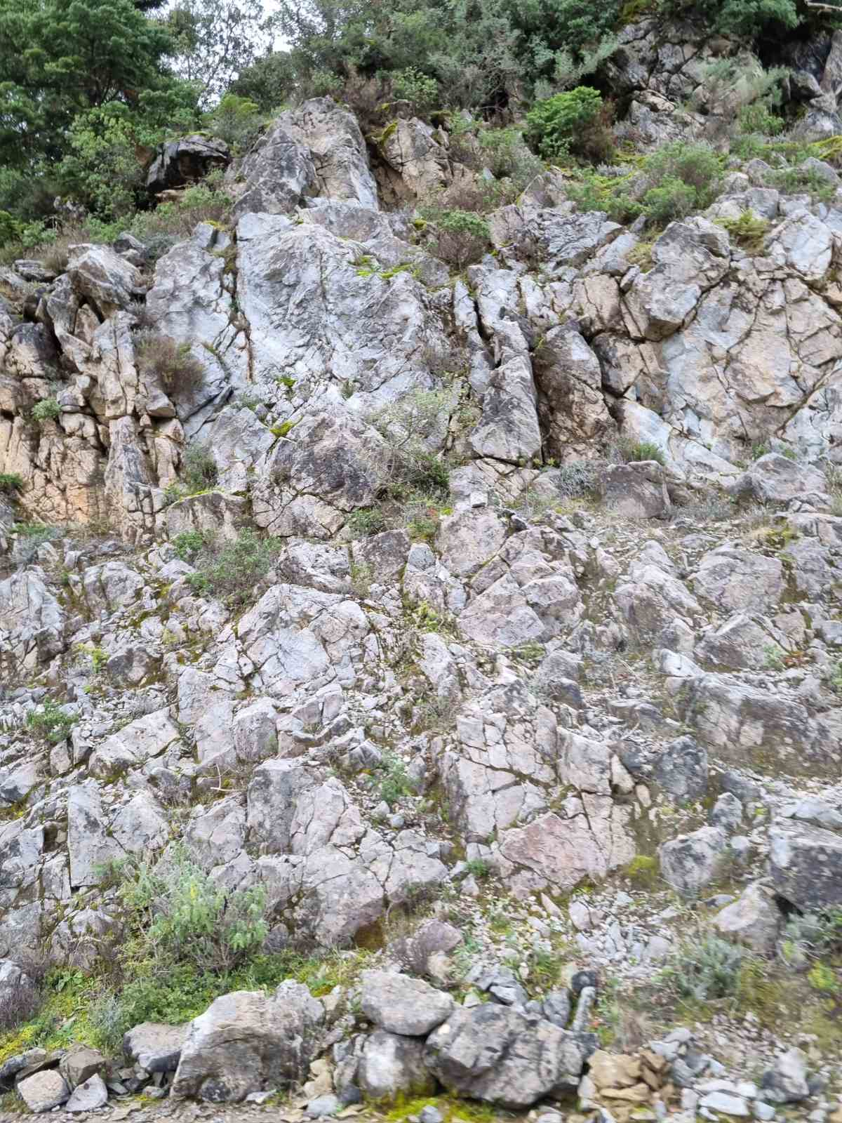
Aim of the study
The problem
Water quantity
Challenges
Data scarce region
Aim of the study
Estimate the surface water availability
The method
Stochastic simulation
Generation of synthetic rainfall time series using data from an adjacent basin , reproducing seasonality and persistence.
Karstified limestone at Lagada’s region

Slide 4
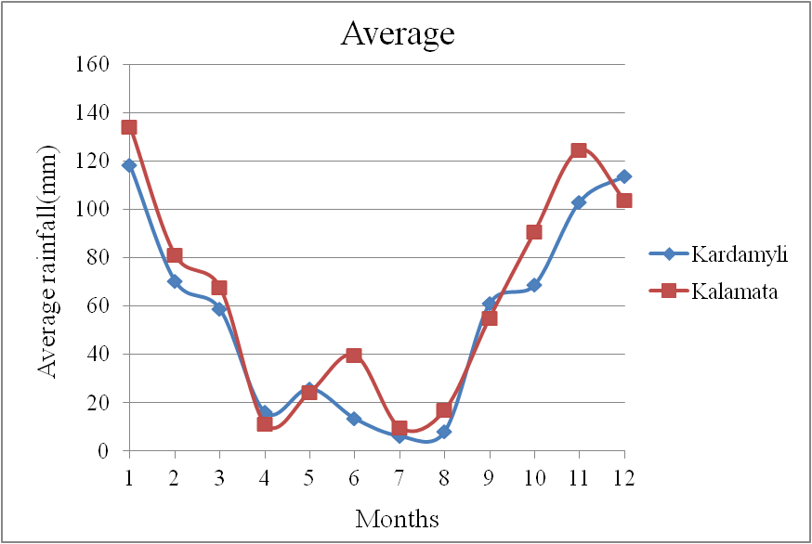
Precipitation Data
Μeteorological station
Kalamata’s station [7] (18 km from WM),
1951-2018 (68 yrs)
Sufficient length
Kadamylis’ station [8] (in WM),
2014-2021 (8 yrs)
The length of the timeseries is insufficient for the estimation of stochastic properties.
Both stations are in the same altitude (13 m).
We use Kalamatas’ rain data as:
Kalamatas’ is the closest meteorological station to the case study with long time series.
The rainfall regime in the two stations is similar.

Slide 5

The Hurst-Kolmogorov (HK) behavior
The Hurst-Kolmogorov (HK) behavior, is also known as Long Term Persistence (LTP).
It seems that in natural systems, randomness and predictability are intrinsic and can be deterministic and random at the same time, depending on the prediction horizon and the time scale[9]. Particularly, all these processes are characterized by high unpredictability due to clustering of events.
Although, in HK dynamics the marginal distribution of the process maybe arbitary, the most commonly used distribution is the Gaussian one, which results in the well-known fractional-Gaussian-noise, described by Mandelbrot and van Ness [10], i.e. the power-law decay of variance as a function of scale γ(k), is defined for a process [11]. The HK behavior is quantified by the Hurst parameter(0<H<1). In the simplest case, the variance γ(k) of the process at timescale k, known as climacogram, is given by:
Where Δ, is a characteristic timescale and λ is the variance at this time scale. For 0<H<0.5, the HK process exhibits an anti-persistent behavior, H=0.5 corresponds to the white noise process, and for 0.5<H<1 the process exhibits LTP(clustering).
Therefore, to account for the effect of the non-white-noise behavior of the spring outflow in our toy model, we simulate the spring outflow based on the HK model (with, for example, H = 0.8), and by following a Gaussian distribution (described earlier), through a stochastic synthesis algorithm, and particularly, through the Symmetric-Moving-Average (SMA) scheme [12, 13].

Slide 6
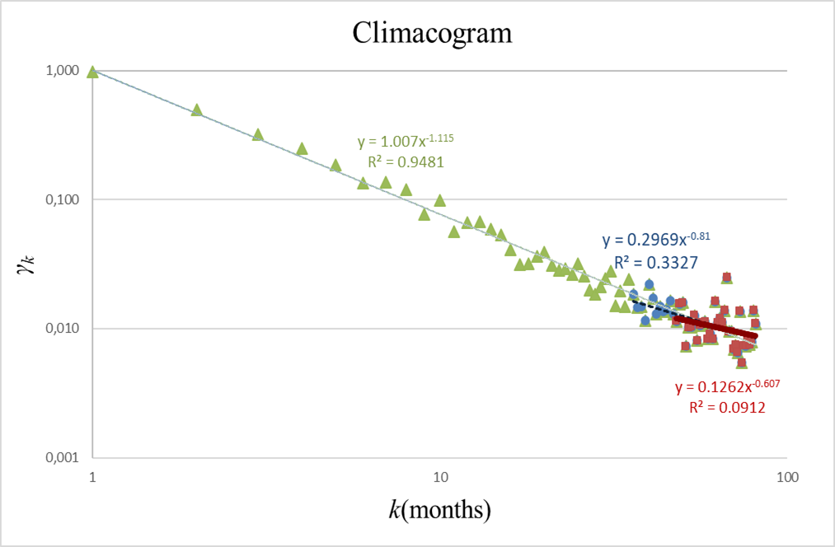
Estimation of Hurst-Kolmogorov behavior - Historic time series
We estimate the H parameter through the climacogram.
Hurst Kolmogorov behavior is apparent at the largest scales.
From 3 years until the last scales (k=36-81) , H=0.6
From 4 years until the last scales (k=48-81), H=0.7
We estimate H=0.65
H=0.65 is a value in accordance with global analylis[14]

Slide 7



Moving Average(SMA) method
SMA scheme[15] was introduced by Koutsoyiannis(2000) and transforms a stochastic process of white noise vi into a realization of stochastic process xi, according with the equation:
Where αj are weight coefficients and their number J is theoretically infinite but in practice, it takes a finite value. The method is suitable for any random autocorrelation. Function. In case of simple assimilation model, it is proved that weight coefficients are given by :
And the necessary number of weights is:
Where m is the number of autocorrelations that have to be maintained and β the accuracy coefficient(β=0.001). The method can maintain the asymmetry coefficient too Cs(x) of xi process, if the white noise has asymmetry coefficient Cs(v) is given by:

Slide 8
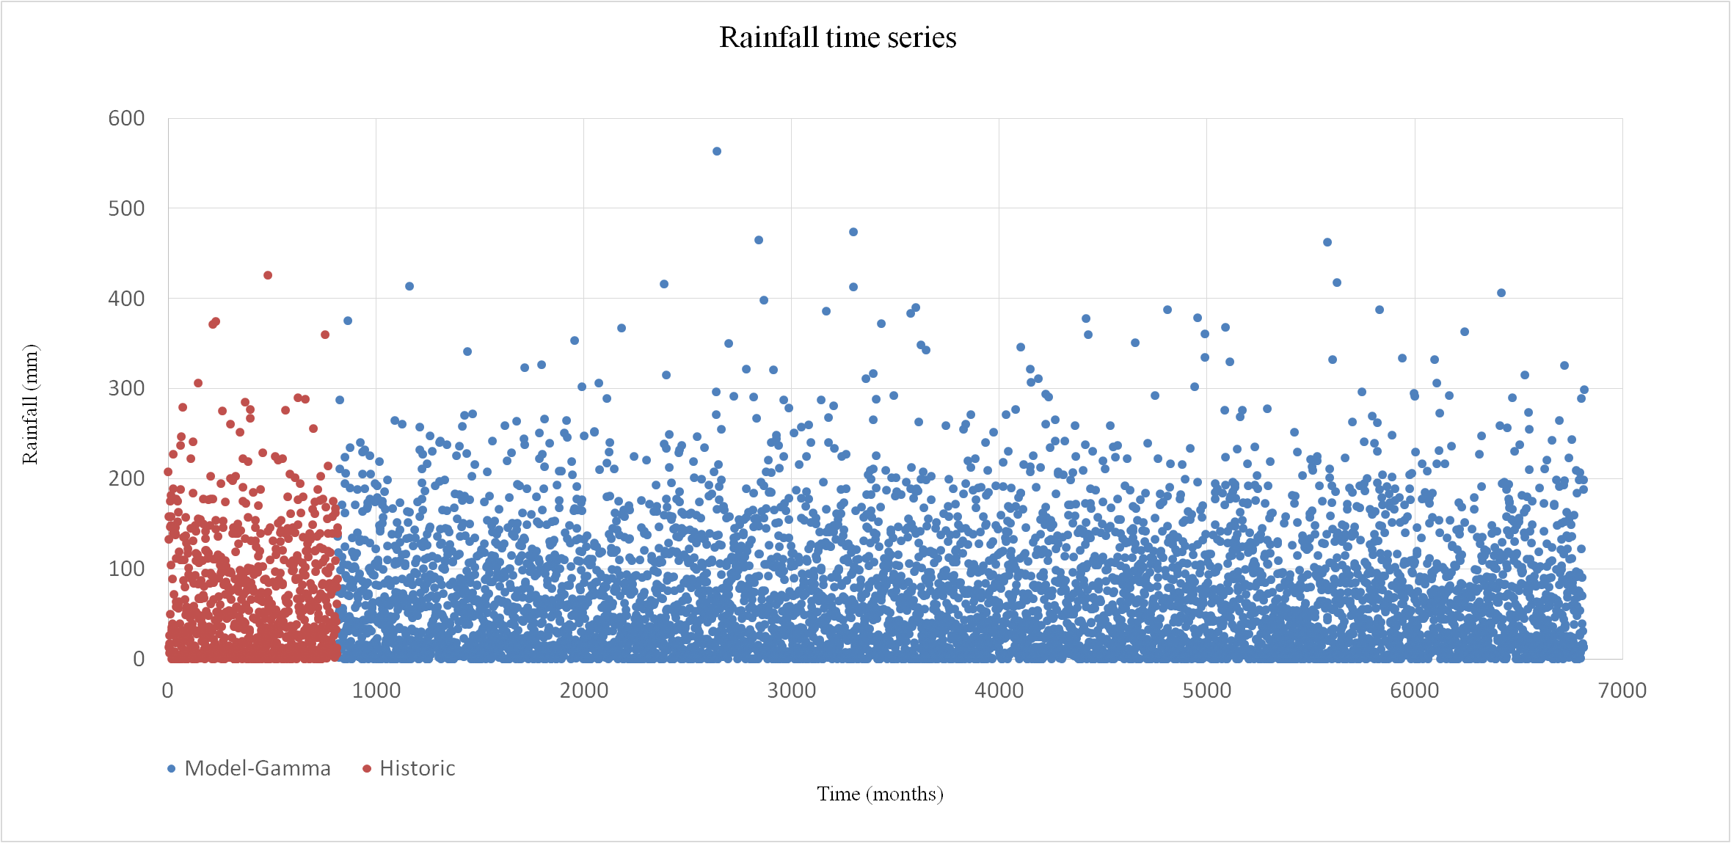
SMA method-Gamma distribution for one realization
We use standardization to maintain:
The average of each month
The standard deviation of each month
We use Gamma distribution to reproduce the skewness of the monthly rainfall series the synthetic time series. The asymmetry of total monthly time series.
We use the SMA algorithm to reproduce the Hurst-Kolmogorov (HK) behavior

Slide 9
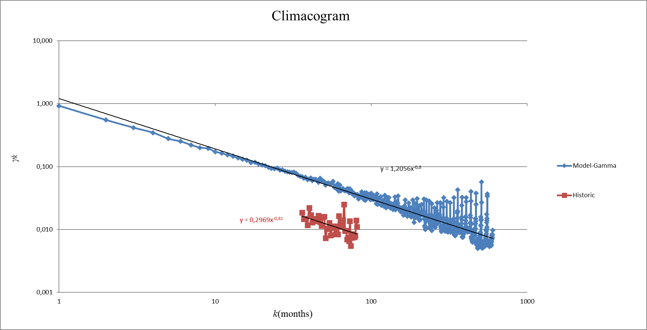
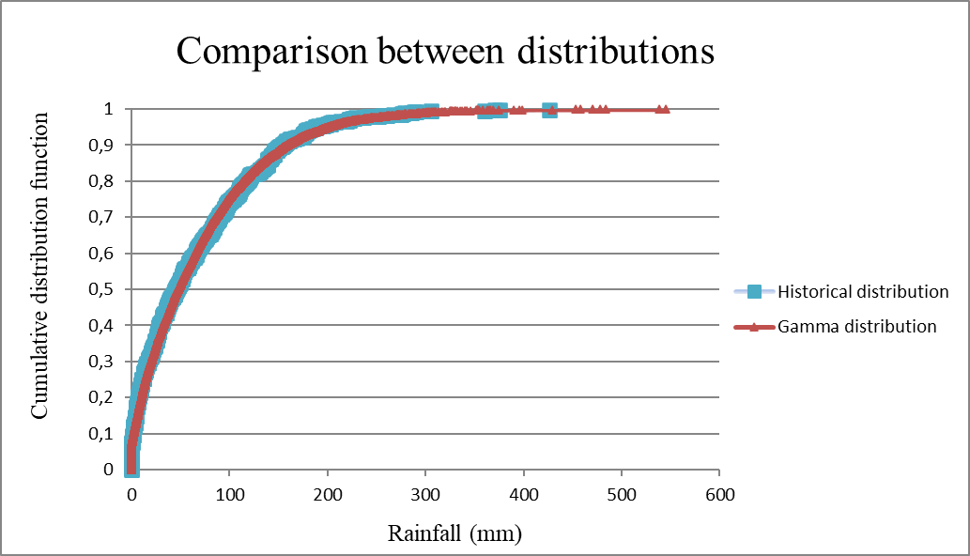
Validation of synthetic time series
From the historical climagogram we received a value of H=0.65, the same as the synthetic one.
Also, the inclination of historical and modelled climacogram , at big scales is the same.
It is proved that SMA model maintain HK behavior.
Gamma distribution fits very well at historical distribution.

Slide 10
Conclusions
Synthetic time series inspect the variability of the rainfall.
Stochastic simulation of hydrological time series with the SMA method which includes HK dynamics is an excellent tool to simulate natural processes as rainfall.
The synthetic time series which we have created (500 years) could be used as the rainfall input to the design of the hydraulic infrastructures of Western Mani, and to address the increasing water needs of the region with proper infrastructures.
This project highlights the power and the flexibility of the stochastic calculus to study and unify the study of issues which are not easy to approach and characterize in an objective and interpretable manner, such as the rainfall.
However, as the case study of Wastern Mani is a multi parametric problem, further studies will analyze this issue in the same section[1, 16,17]

Slide 11
References
Nikolinakou M., Moraiti K., Siganou A. ,Markantonis D., Sargentis G.-F. , Iliopoulou T., Dimitriadis P., Meletopoulos I.-T., Mamassis N. and Koutsoyiannis D. ,Investigating the water supply potential of traditional rainwater harvesting techniques used – A case study for the Municipality of Western Mani
Sargentis, G.-F.; Defteraios, P.; Lagaros, N.D.; Mamassis, N. Values and Costs in History: A Case Study on Estimating the Cost of Hadrianic Aqueduct’s Construction. World 2022, 3, 260-286. https://doi.org/10.3390/world3020014
Sargentis, G.-F.; Siamparina, P.; Sakki, G.-K.; Efstratiadis, A.;Chiotinis, M.; Koutsoyiannis, D. Agricultural Land or Photovoltaic Parks? The Water–Energy–Food Nexus and Land Development Perspectives in the Thessaly Plain, Greece. Sustainability 2021, 13, 8935. https://doi.org/10.3390/su13168935
Sargentis, G.-F.; Dimitriadis, P.; Ioannidis, R.; Iliopoulou, T.; Frangedaki, E.; Koutsoyiannis, D. Optimal utilization of water resources for local communities in mainland Greece (case study of Karyes, Peloponnese), Procedia Manufacturing, Volume 44, 2020, Pages 253-260, ISSN 2351-9789, https://doi.org/10.1016/j.promfg.2020.02.229.
Sargentis, G.-F.; Iliopoulou, T.; Dimitriadis, P.; Mamassis, N.; Koutsoyiannis, D. Stratification: An Entropic View of Society’s Structure. World 2021, 2, 153-174. https://doi.org/10.3390/world2020011
Antonakos A. Specialist Hydrogeologist, Poly Potami Study, 19/10/2017
ΚΝΜΙ precipitation data, https://climexp.knmi.nl/selectstation.cgi?id=someone%40somewhere&fbclid=IwAR3TPNvvXLa9EtWYs1ctfFZgqc3s0p7ezzbMoK7kX5lHDkkMImMibpX1qo0
Meteo precipitation Data, https://meteosearch.meteo.gr/
Dimitriadis, P.; Koutsoyiannis, D.; Tzouka, K., Predictability in dice motion: how does it differ from hydro-meteorological processes? Hydrol. Sci. J. 61, 1611–1622 2016.
Mandelbrot, B.B.; van Ness, J.W. Fractional Brownian Motions, Fractional Noises and Applications. SIAM Rev. 1968, 10, 422–437.
Dimitriadis, P.; Koutsoyiannis, D. Stochastic synthesis approximating any process dependence and distribution. Stoch Environ Res Risk Assess 32, 1493–1515 2018. https://doi.org/10.1007/s00477-018-1540-2
Koutsoyiannis, D. A generalized mathematical framework for stochastic simulation and forecast of hydrologic time series, Water Resour. Res., 36( 6), 1519– 1533, 2000. doi:10.1029/2000WR900044.
Koutsoyiannis, D.; Dimitriadis, P. Towards Generic Simulation for Demanding Stochastic Processes. Sci 2021, 3, 34. https://doi.org/10.3390/sci3030034
Dimitriadis, P.; Koutsoyiannis, D.; Iliopoulou, T.; Papanicolaou, P. A global-Scale Investigation of Stochastic Similarities in Marginal Distribution and Dependence Structure of Key Hydrological-Cycle Processes
Koutsoyiannis, D. The Hurst phenomenon and fractional Gaussian noise made easy, Hydrological Sciences Journal, (2002) 47:4, 573-595, DOI: 10.1080/02626660209492961
Markantonis D., Siganou A., Moraiti K., Nikolinakou M., Sargentis G.-F. , Dimitriadis P., Chiotinis M., Iliopoulou T., Mamassis N. and Koutsoyiannis D. ,Determining optimal scale of water infrastructure considering economical aspects with stochastic evaluation – Case study at the Municipality of Western Mani
Moraiti K., Markantonis D., Nikolinakou M., Siganou A., Sargentis G.-F. , Iliopoulou T., Dimitriadis P., Meletopoulos I.-T., Mamassis N. and Koutsoyiannis D., Optimizing water infrastructure solutions for small-scale distributed settlements – A case study for the Municipality of Western Mani
Acknowledgment
This research was supported by the Municipality of Western Mani.

Slide 12
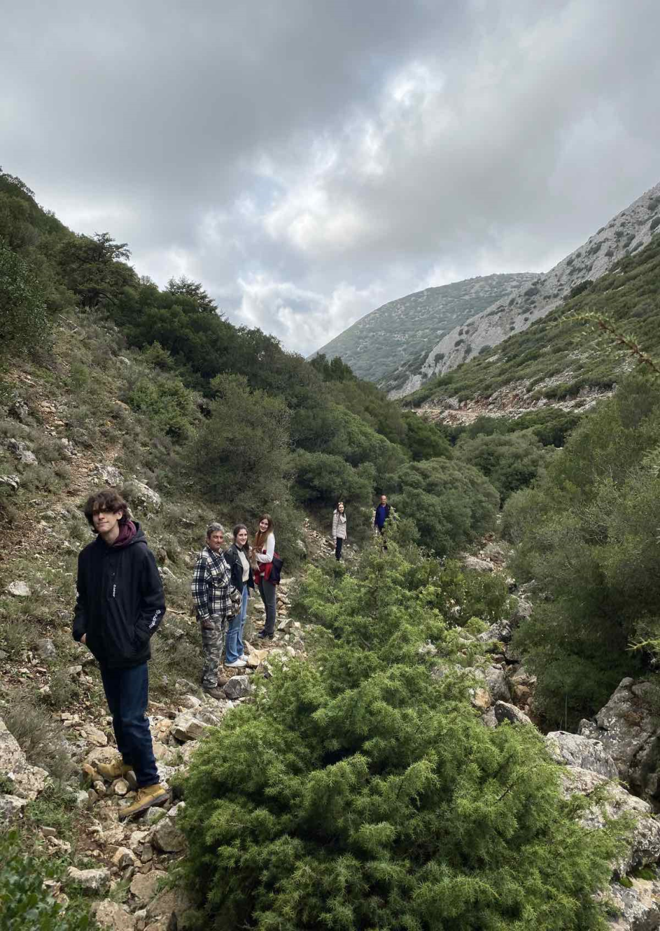
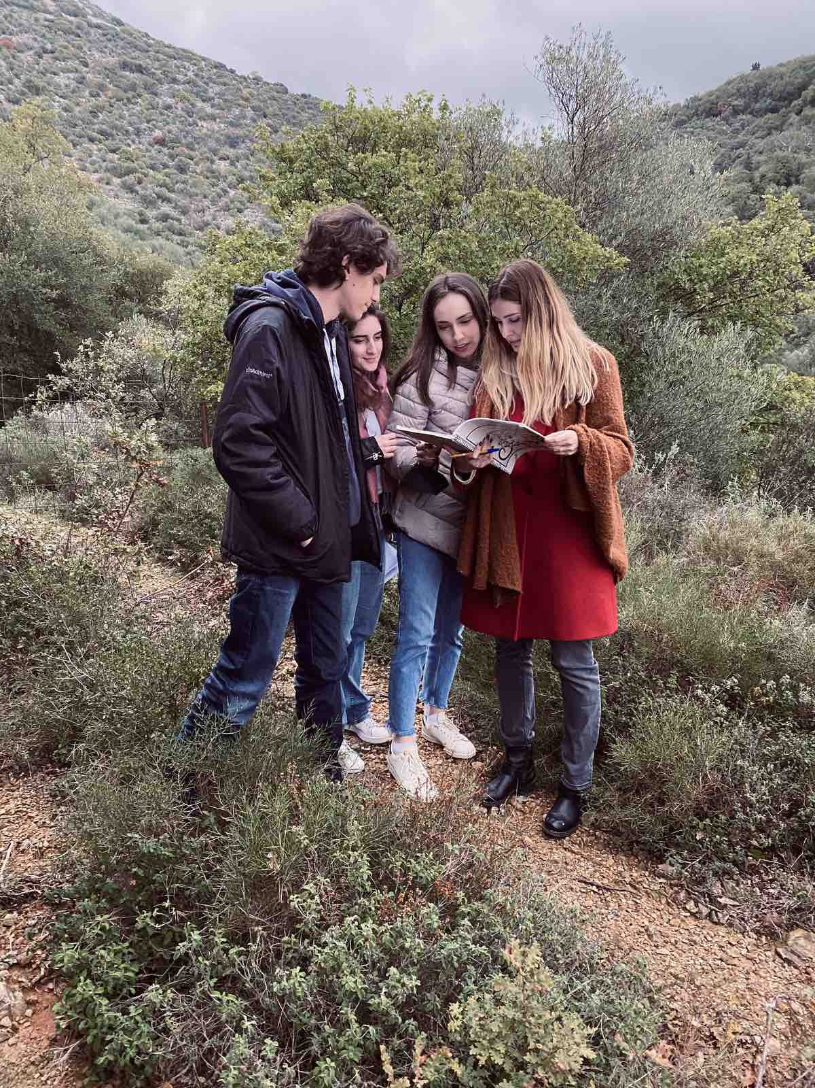
Thank you for your attention!

